Slide 1
Annual General Meeting
28 January 2020
Chair Martin Currie
please read the three handouts while you wait (see bottom of GoToWebinar Control Panel)
Notes:
Hello & welcome to the third annual general meeting of IChemE’s consultancy special interest group
Australia
Ireland
Italy
Korea (South)
Mauritius
Netherlands
New Zealand
Nigeria
Qatar
Spain
United Kingdom
You have hopefully found and had time to look through the two handouts available in the control panel. The first of these is the minutes of last years AGM, I believe we sent these out around 1 year ago, if you have any comments on them please do post them in the questions box now. The second is the value proposition. You can probably read through that as I go through the Report from the Chair, as my report again this year is the value proposition.

Slide 2
Voting System
Check the handouts
Raise any objection via questions box
Vote (if you are a Water SIG member and paid up AMIChemE, MIChemE, FIChemE, Professional Process Safety Engineer)
Notes:
----- Meeting Notes (24/6/2015 03:55) -----
We'll be voting to accept the two handouts
We'll also be voting to re-elect the committee appointed at last years AGM with the exception of the Secretary and Newsletter Editors who had to stand down for personal reasons and have been replaced by Anishta & Florence respectively (April's Newsletter)

Slide 3
Agenda
Introduction
Apologies
Minutes of last AGM (19 December 2018)
Activities report
Webinars
Wet News
Book Reviews
Website
Social Media
Awards & Bursaries
Charities
Physical Events – UK, Australia, SE Asia, New Zealand
Universities
Schools
Chair’s report
Treasurer’s report
Election of committee members
Election of Chair
Election of Treasurer
Election of Secretary
AOB accepted by Chair
Closing remarks and announcements

Slide 4
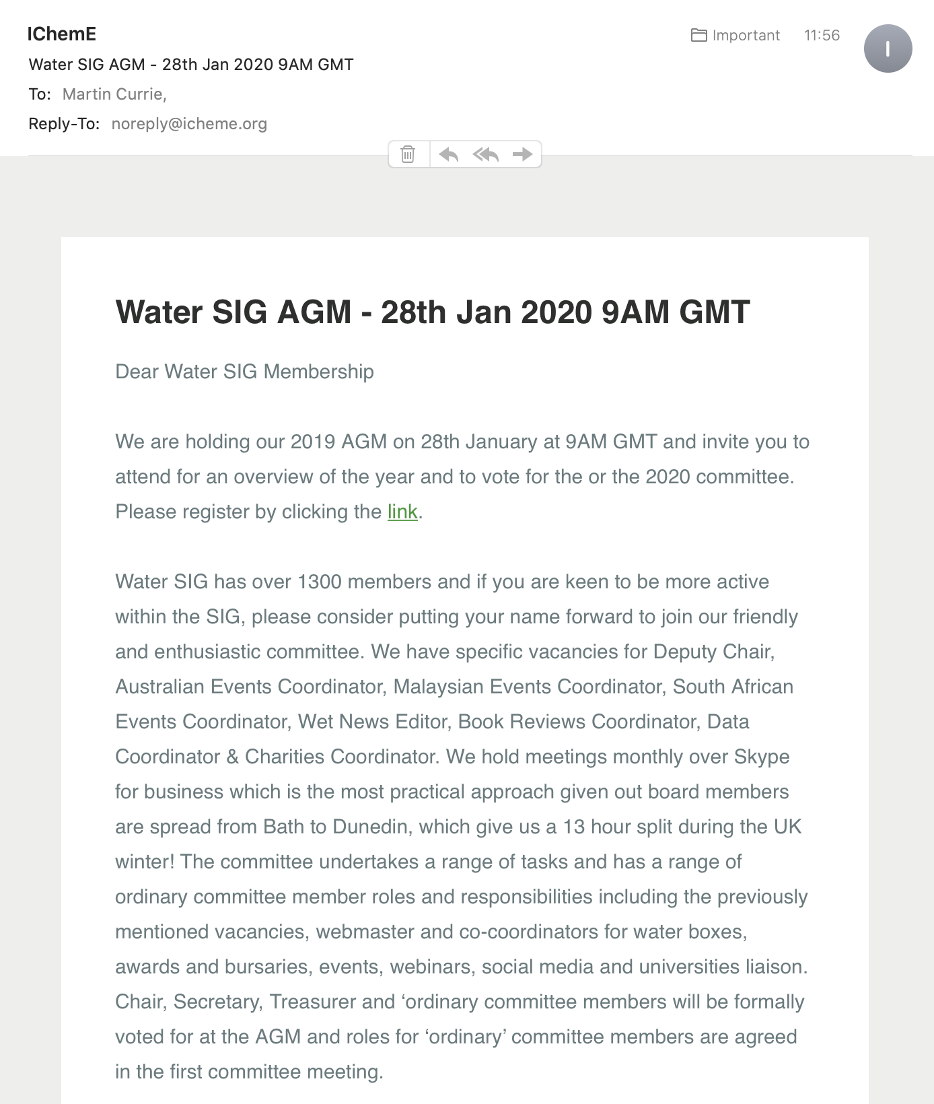
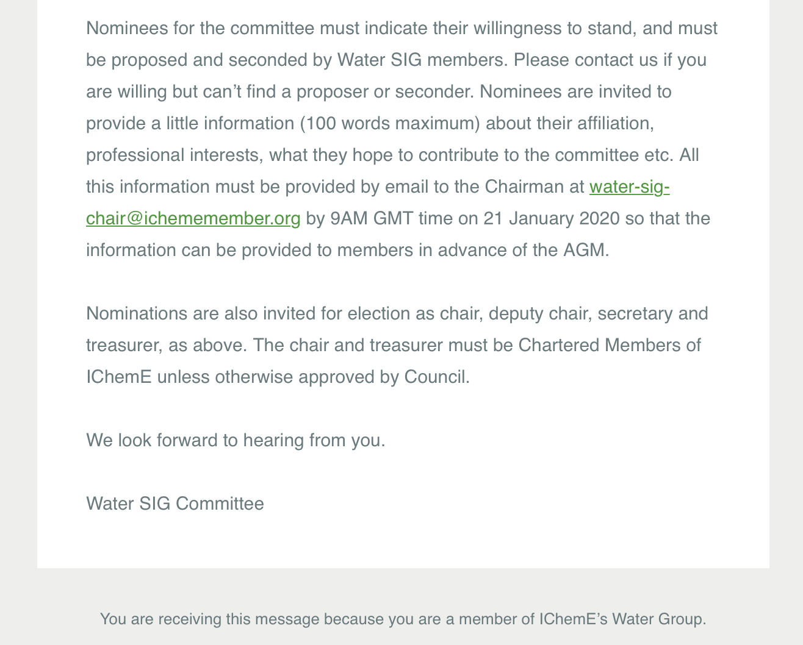
Introduction
1)
Notes:
----- Meeting Notes (24/6/2015 03:55) -----
We'll be voting to accept the two handouts
We'll also be voting to re-elect the committee appointed at last years AGM with the exception of the Secretary and Newsletter Editors who had to stand down for personal reasons and have been replaced by Anishta & Florence respectively (April's Newsletter)

Slide 5
Apologies
2)
Notes:
----- Meeting Notes (24/6/2015 03:55) -----
We'll be voting to accept the two handouts
We'll also be voting to re-elect the committee appointed at last years AGM with the exception of the Secretary and Newsletter Editors who had to stand down for personal reasons and have been replaced by Anishta & Florence respectively (April's Newsletter)

Slide 6
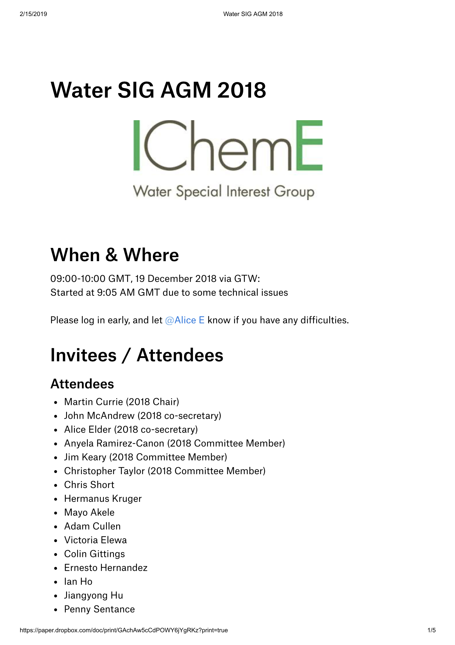
2018 Minutes
3)
https://www.icheme.org/media/9078/agm-2018-minutes_final.pdf
Notes:
***POLL***

Slide 7
Activities Report
4)
Webinars
Since December 2018 AGM
April 2019 – Balancing resilience and drinking water quality
May 2019 – 30th anniversary prize winner runners up
June 2019 – Water in NZ
August 2019 – facing a torque wrench at 80 km/h
September 2019 – Low cost options for safe water in Guanjanito – 19th Sept far east / ANZ timing
September 2019 – Low cost options for safe water in Guanjanito – 24th Sept UK timing
November 2019 – Mixing in water Seminar – Potable Water (live conference broadcast - 3 presentations)
November 2019 – Mixing in water Seminar – Wastewater (live conference broadcast - 3 presentations)
December 2019 – Charity: water
December 2019 – Mixing in Wastewater
January 2020 – Water Treatment Mixing – Where, Why & How
January 2020 – Mixing in Potable Water Treatment
Cumulative attendance >400
Recordings are available to Water SIG members on the website

Slide 8
Activities Report
4)
Webinars
Looking forward
February 2020 – mixing in sludge
March 2020 – Reuse series – webinar 1
April 2020 – Reuse series – webinar 2
Aim for 6-12 webinars in 2020

Slide 9
Activities Report
4)
Wet News
Since December 2018 AGM
Paul & Anyela to complete
Looking forward
Paul & Anyela to complete

Slide 10
Activities Report
4)
Book Reviews
Since December 2018 AGM
Hermanus to complete
Looking forward
Hermanus to complete

Slide 11
Activities Report
4)
Website
Since December 2018 AGM
6 site visits, 6 conferences, 11 webinars including a charity webinar
3 publications of WET News
Selection of recorded webinars
Over 20 emails advertising international events and webinars to over 1000 recipients
Looking forward
Many more webinars to be advertised in the near future
International events to be finalised and advertised
Updates in committee memberships
Uploads of Newsletters

Slide 12
Activities Report
4)
Social Media
Since December 2018 AGM
Chris to complete
Looking forward
Chris to complete

Slide 13
Activities Report
4)
Awards & Bursaries
Since December 2018 AGM
Chris to complete
Looking forward
Chris to complete

Slide 14
Activities Report
4)
Charities
1994 - £328 donation to WaterAid (£1 per member)
2017 - £2,162 raised for charity: water (inc Gift Aid)
2018 - £2,066 raised for charity: water (inc Gift Aid)
2019/20 - £182 raised to date for charity: water

Slide 15
Activities Report
4)
Physical Events – UK
Since December 2018 AGM
Site Visit to Thames Gateway Water Treatment Works, 14th March 2019
Ground Water Quality Conference, 15th March 2019
Nutrem pilot plant facility site visit, 22nd May 2019
European wastewater management conference, 16th-17th July 2019
Drax power station, 13th September 2019
British Sugar site visit, 31st October 2019
Mixing in the water industry, 12th November 2019 (+FMP)
Antibiotics in the water environment, 15th November 2019
European Biosolids & Organic Resources Conference & Exhibition, 19th-20th November 2019
7th UK Wastewater Network Conference, 28th November 2019
Plans for 2020: Hold 6 water SIG physical events
External Collaborations
IChemE Collaborations
Water SIG

Slide 16
Activities Report
4)
Physical Events – Australia
Since December 2018 AGM
Rhys to complete
Looking forward
Rhys to complete
External Collaborations
IChemE Collaborations
Water SIG

Slide 17
Activities Report
4)
Physical Events – SE Asia
Since December 2018 AGM
Oct 16, 2019 – Membrane application in the modern water resource management by Prof Neal Chung, National University of Singapore, Singapore
Looking forward
Addition of local Events coordinators or teams in more countries – prioritised by membership
Invitation of industrial talks on wastewater treatment by electro-chemical technologies, etc
Organization of water professionals from Singapore/Malaysia to meet and talks
to explore collaboration with water professionals in Hong Kong and China, Thailand, and others in Asia
External Collaborations
IChemE Collaborations
Water SIG

Slide 18
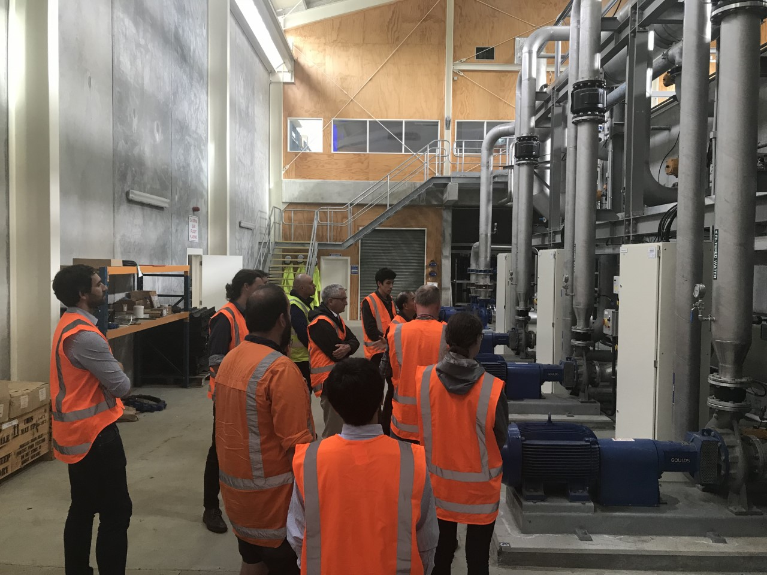
Activities Report
4)
Physical Events – New Zealand
Since December 2018 AGM
November 2019 Tour of Southern Water Treatment Plant, Dunedin arranged jointly with IChemE NZ & Engineering NZ
Waterbox presentation at Tahuna school
Looking forward
Aim for at least one event in NZ in 2020
Potential tour in South Taranaki
Likely a further tour in Dunedin in Q3/Q4 2020
External Collaborations
IChemE Collaborations
Water SIG

Slide 19
Activities Report
4)
Universities Liaison
Since December 2018 AGM
Water SIG committee have pooled their contacts in Academia
Promoting events through these simplified lines of communication

Slide 20
Universities Liaison
For 2020...
Open invitation to SIG members to add to the list of University contacts shown here...
Promotion of events in both directions
Water SIG sponsored awards and bursaries can be nominated through the committee
Ideas for events always welcomed...
​

Slide 21
Activities Report
4)
Schools Liaison
Since December 2018 AGM
Water Boxes given to:
Oxpring Primary School Sheffield (WET News #78)
Tahuna Intermediate School, New Zealand (WET News #78)
Park Road School Warrington
Greenhill Primary School, Leeds
5 Boxes sold to Cranfield University for a special outreach project
Looking Forward -
4 more enquiries in the pipeline.
Need to resolve supply issues early in 2020 so further requests can be met. Discussions ongoing with Veolia Water in Paris.

Slide 22
Chair’s Report
5)
2020 Committee
Defined roles & responsibilities
Global Reach
All committee meetings are held online-only
Committee meeting times and dates are determined by Doodle Poll, and are either 9am or 9pm London Time
Agendas, Minutes and Actions shared by Dropbox Paper currently, although we are looking to get a SharePoint site up for greater accessibility

Slide 23
Chair’s Report
5)
Dec 2018
Dual
Belgium
Brunei Darussalam
France
Greece
Lebanon
Mauritius
Oman
Pakistan
Philippines
Saudi Arabia
Sweden
Switzerland
Single
Austria
Bahrain
Germany
Israel
Italy
Jamaica
Japan
Jersey
Kenya
Kuwait
Malta
Namibia
Nigeria
Norway
Poland
Qatar
Sri Lanka
Water SIG 60% UK
IChemE Average 60% UK
Water SIG Com 75% UK

Slide 24
Chair’s Report
5)
Martin to update
Dual
Austria
Belgium
Brunei Darussalem
Greece
Japan
Kuwait
Lebanon
Mauritius
Oman
Pakistan
Phillipines
Qatar
Sri Lanka
Switzerland
Single
Bosnia & Herezegovina
Italy
Jersey
Kenya
Malta
Nambia
Nigeria
Norway
Peru
Poland
Russia
Sweden
Tanzania
Water SIG 60% UK
IChemE Average 60% UK
Water SIG Com 75% UK
Water SIG 61% UK
IChemE Average 63% UK
Water SIG Com 70-80% UK

Slide 25
Chair’s Report
5)
WaterSIG 2018 73% M
WaterSIG now 70% M
IChemE Average 76% M
WaterSIG Com 2018 69% M
WaterSIG Com now 60% M

Slide 26
Chair’s Report
5)

Slide 27
Chair’s Report
5)
Collaboration
Strengthened collaboration with RSC, new collaborations with the Institute of Water, the International Water Association (IWA) & British Water + CIWEM
Semi collaborative conference - Mixing in the Water Industry
Planning fully collaborative conference in 2021/22
More collaboration internationally

Slide 28
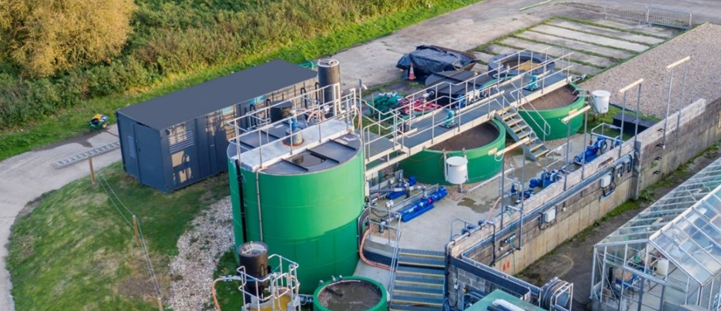
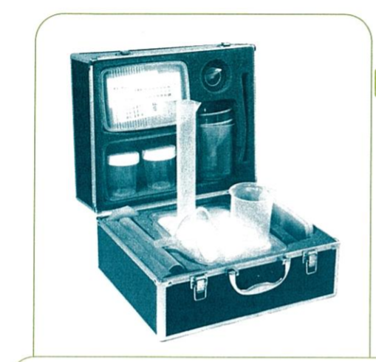
Treasurers’ report
6)
Income £3,875
Water SIG income was generated from 3 very successful events
Thames Gateway Water treatment site visit
Nutrem pilot plant site visit
Mixing in the Water Industry Conference
Expenditure £2,839
The main areas of expenditure were:
Venue Hire for Mixing Conference £1,305
George Solt Prize and Bursaries £900
Wet News publications £382
Surplus generated of £1,036
Plans for 2020:
Replenish stock of Water Boxes for schools
Deliver larger programme of UK and International events
Technical and networking events
Notes:
Difficult to read
- if you are concerned that this is difficult to read & want to see the numbers, then you are probably exactly the person we need as Treasurer, please let us know.

Slide 29
Elections
7-10)
Candidates commitment statements
KPI Matrix

Slide 30
Ordinary roles
7)
Position | Applicant (1) | Applicant (2)
WET news editor | Paul Curtis
Deputy WET news editor | Mayo Akele
Book reviews coordinator | Kirsty McCall
Webmaster & email coordinator | Mufeed Hassan
Webmaster & email coordinator | Harry Mouquet
Water Boxes & Schools liaison | Jim Keary
Awards & Bursaries | Yadira Bajón Fernández
University liaison | Hugh Thomas
Data coordinator | Penny Sentance

Slide 31
Position | Applicant (1) | Applicant (2)
Webinar coordinator | John McAndrew
Deputy Webinar coordinator | Tolulope Elemo
UK events coordinator | Alex Cronin
Global events coordinator | Amanda Lake
Australia events coordinator | Rhys Anderson
New Zealand events coordinator | John McAndrew
Singapore events coordinator | J. Paul Chen
South African events coordinator
Malaysian events coordinator | Tawana Muchatuta
Social Media | Christopher Taylor
Charities coordinator | Mayo Akele

Slide 32
Chair
8)

Slide 33
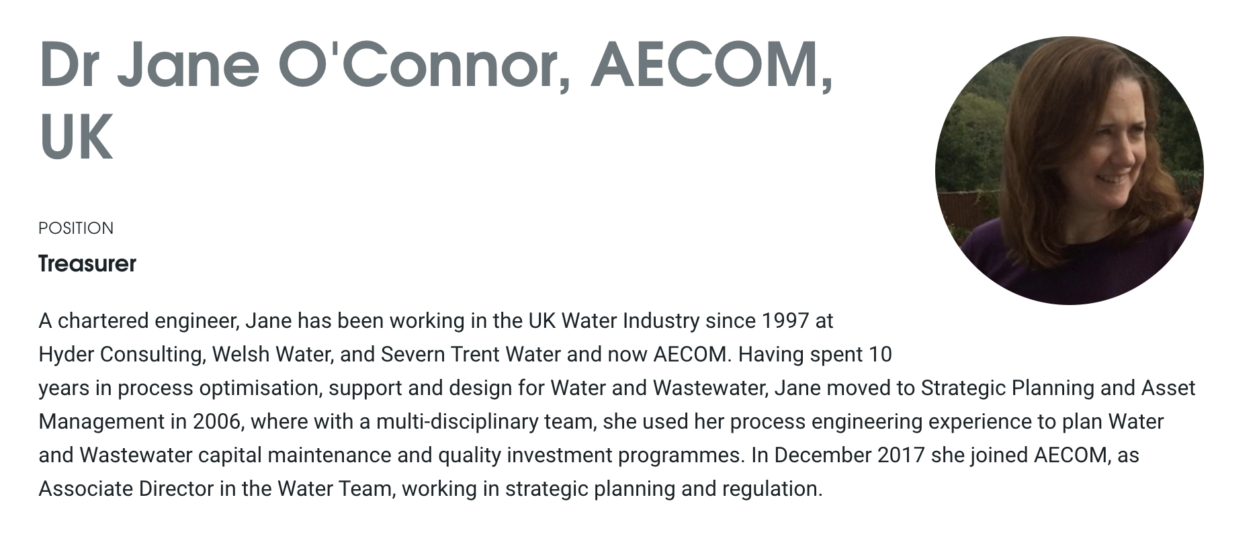
Treasurer
9)

Slide 34
Secretary
10)

Slide 35
Any Other Business
11)

Slide 36
Closing Remarks
12)
What should we be doing more of?
Please help us
Or contact someone who can help us
Charity: water campaign
http://bit.ly/WaterSIGcharity19

Slide 37
Thank you

