Slide 1
Everything you need to know about chemical, process and biochemical engineering

Slide 2
What is chemical engineering?
Combines the most exciting elements of science with the real world application of engineering.
Creates everything from bio-fuels to beauty products, food to fashion and everything in between.

Slide 3
What do chemical engineers do?
All engineers use maths and physics to solve technical problems, but only chemical engineers use chemistry to improve industrial processes in areas including:
energy
health & wellbeing
food & drink
water

Slide 4
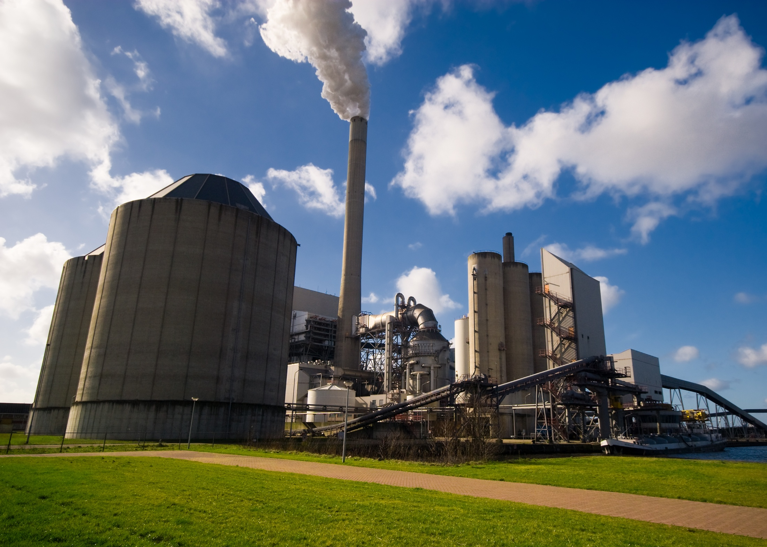

Slide 5
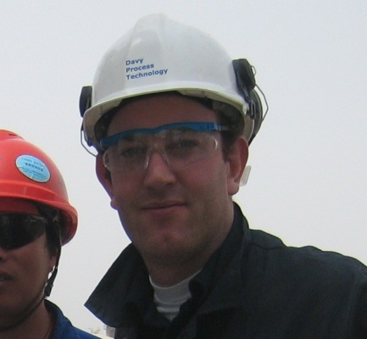
Alan Ingham studied chemical engineering at the University of Nottingham to maintain lots of career choice upon graduation.
Alan now works for Johnson Matthey as a Senior Process Engineer working on multiple projects in places such as China and Brazil.

Slide 6
Everything you need to know about chemical, process and biochemical engineering

Slide 7
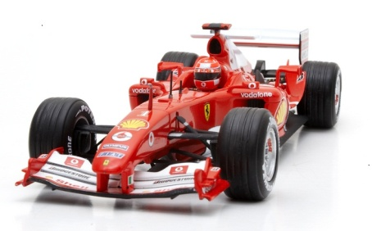
Did you know?
All of these products were developed with the help of a chemical or biochemical engineer

Slide 8
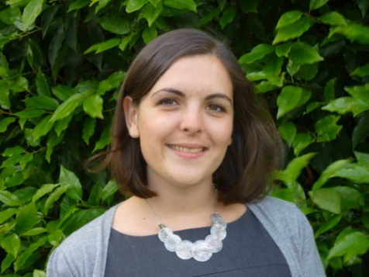
Laura McArthur moved down south after graduating from the University of Strathclyde.
Laura now works as a Senior Process Engineer at WorleyParsons and recommends that students consider a work placement as part of their degree course.

Slide 9
Did you know?
Chemical engineering is the highest paying engineering profession.
Average starting salary
for graduates: £30,000*
* From IChemE Salary Survey, members under the age of 25.

Slide 11
Everything you need to know about chemical, process and biochemical engineering

Slide 12
Graduate job sectors
The sectors employing recently graduated IChemE members.

Slide 13
Marie Taylor works in the nuclear sector and believes that her year in industry was key to her success.
Marie works for Sellafield Ltd as part of the Engineering Design Capability team and has a PhD from the University of Sheffield.

Slide 14
Did you know?
Subjects needed for entry to university:
maths
chemistry
usually another science ie physics or biology
Check specific requirements with the relevant university or UCAS.

Slide 15
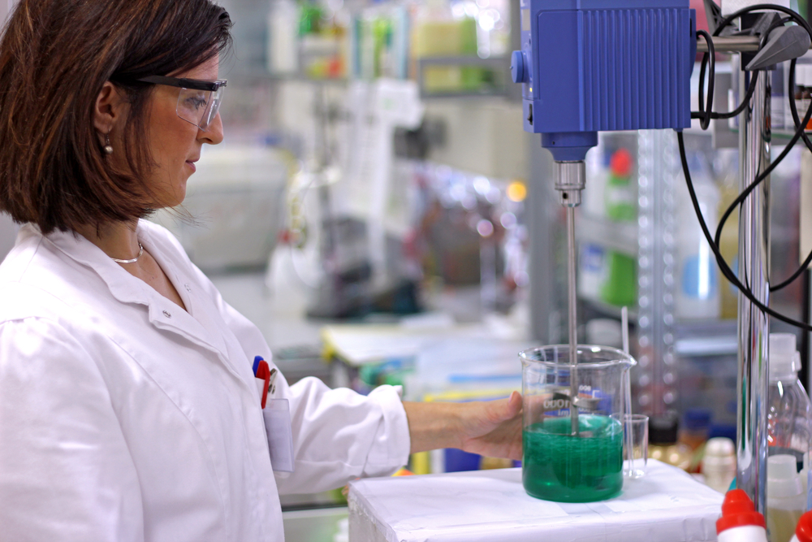

Slide 16
Everything you need to know about chemical, process and biochemical engineering

Slide 17
Types of work
The percentage of IChemE members working in different roles
The types of work undertaken by IChemE members.

Slide 18
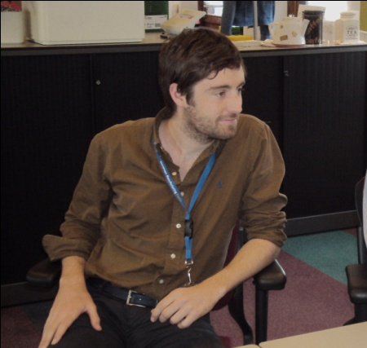
Steven Chandler says that chemical engineering is “Willy Wonka style creativity with a dose of common sense”!
Steven works as a Process Optimiser for Shell in Germany.

Slide 19
Benefits
excellent job prospects
global profession - opportunities for travel
high earning potential
variety and challenge
make a real contribution to
a sustainable future

