Slide 1
Digitalisation & Emergency Planning
18th February 2021

Slide 2
Running Order
Our interest in Emergency Services Dave Richards
About Lampada DS Dave Richards
Our Partner HFR Solutions Shaun Lyons
Large Incident Multiple Agency – LIMA Shaun Lyons
Close Dave Richards

Slide 3

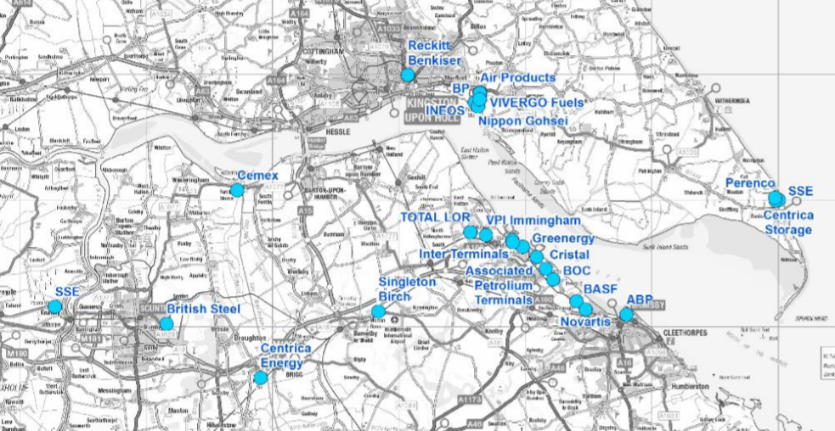
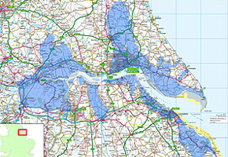
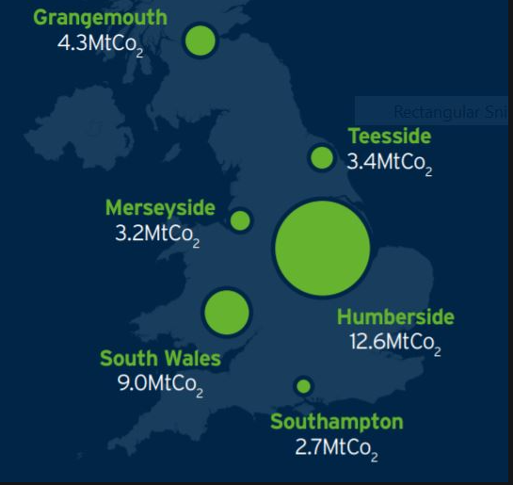


The region

Slide 4
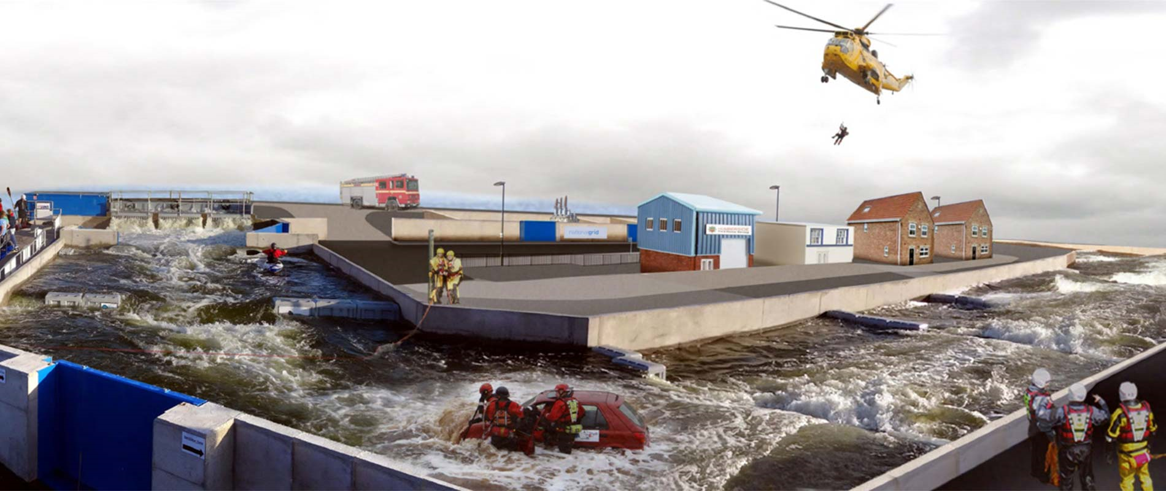
Emergency Services & Digital Solutions
University with a broad offering:
  Sciences, Engineering, Heath, Medical, Business, Humanities, Arts, Education, etc
Strong links to Emergency Services
  education – Nurses, Doctors, Paramedics, Policing, etc
  Training – management /leadership/ specialist courses
  Research programs
  Joint Developments e.g. ARK
Computer Science
  Undergraduate, postgraduate, research, enterprise activities
  Gaming, VR, AR, MR, AI, etc.
  SEED – Mission Critical Software – 14 Fire Services - Established in 2007

Slide 5
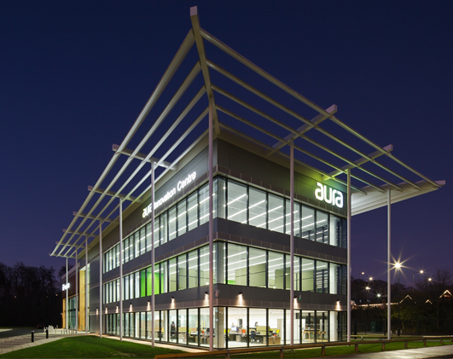
Lampada
Owned by the University of Hull to turn world leading research into a real world applications
A rapidly growing technology business that specialises in the commercialisation of products & IP.
We offer a wholly unique partnership model that blends expertise within your organisation with world leading academic research, highly trained technology consultants with emerging talent from within the University.
Based in the new Aura Innovation Centre – low carbon and digital innovation
NOT just a Software development company

Slide 6
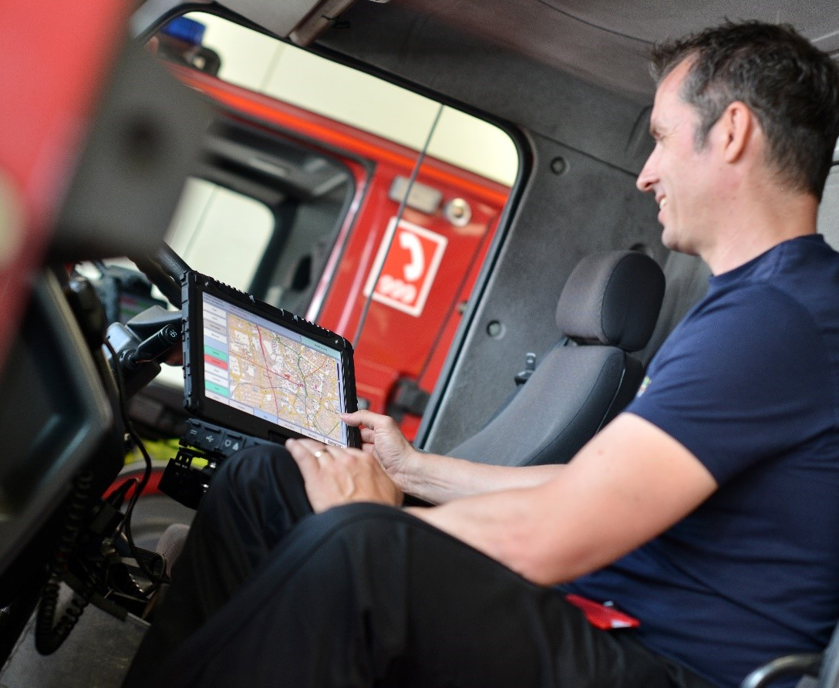
Lampada DS
Emergency Services
  Providing Intelligent Response services
Education & Training
  Providing Learning & immersive experiences
Traditional Mid to Large Enterprises
  Offering full stack digital service solutions

Slide 7

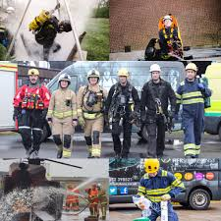
HFR Solutions
Established in 2012
To take the skills of Humberside Fire and Rescue Service to the commercial sector
Our operational response staff and instructors include serving fire officers, with vast rescue and response expertise in their respective disciplines
Quality Management Systems – ISO 9001, 14001 and 45001
Recognised accredited courses
Supports HFRS strategic objective of creating safer communities
Community interest company

Slide 8
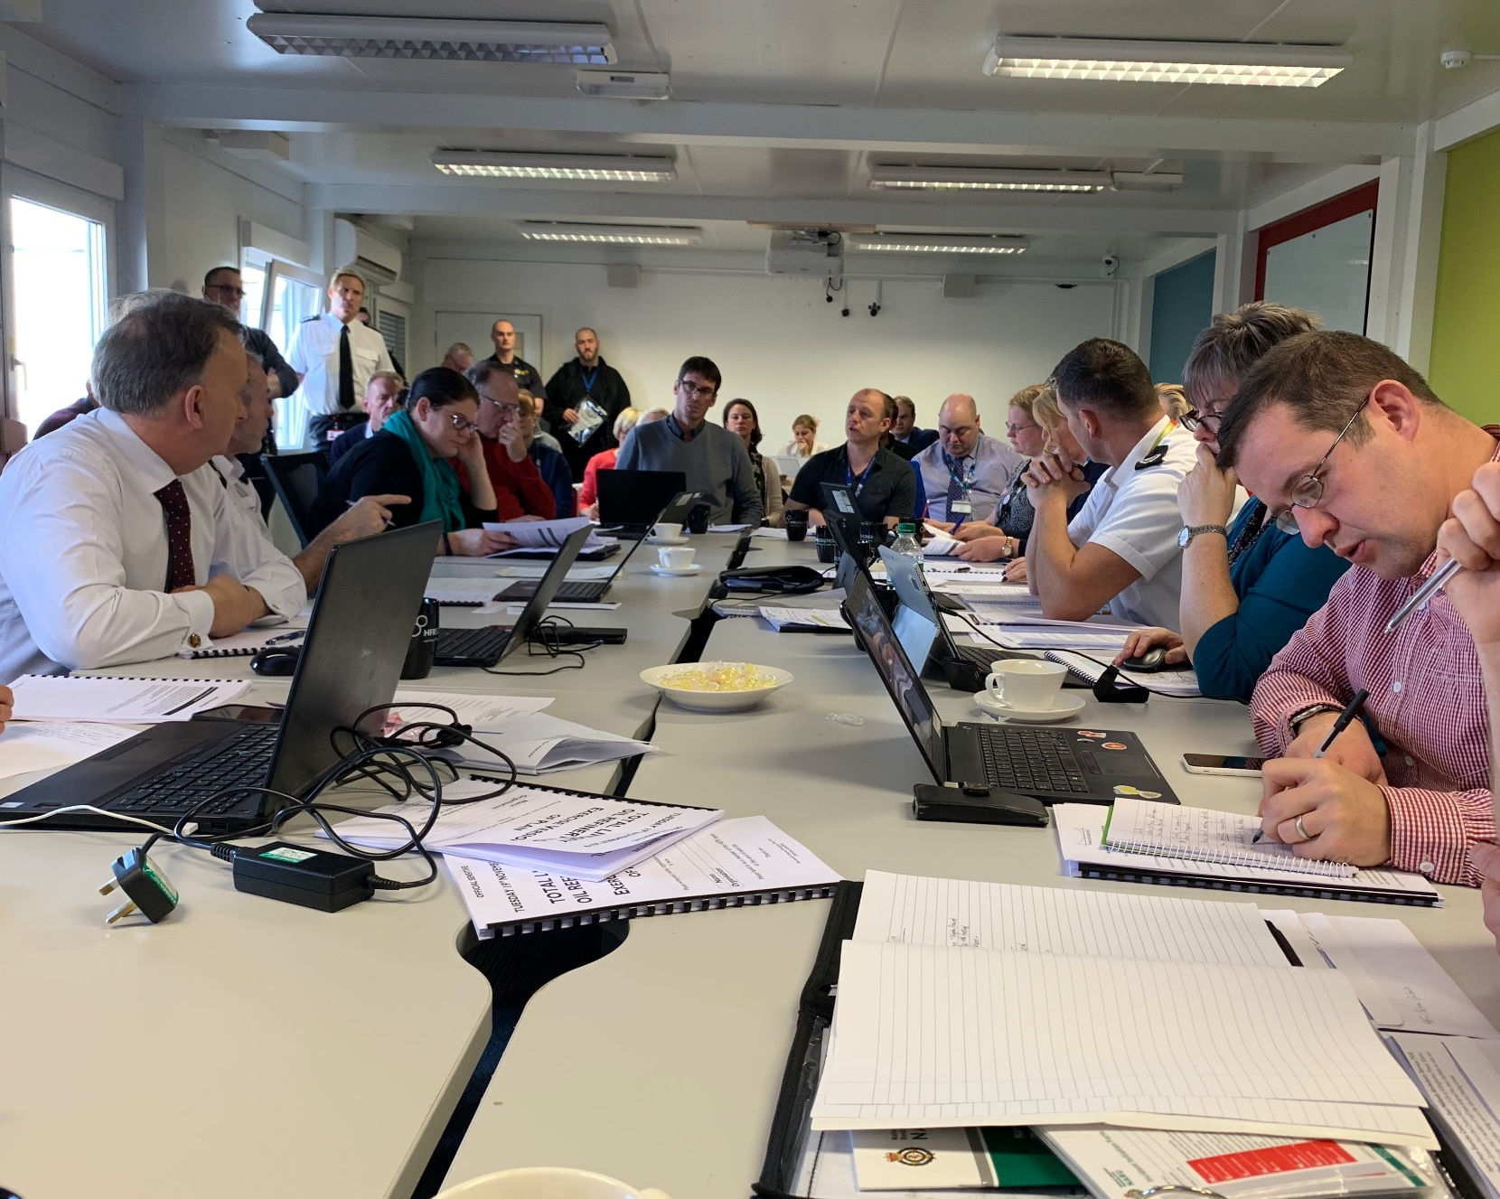
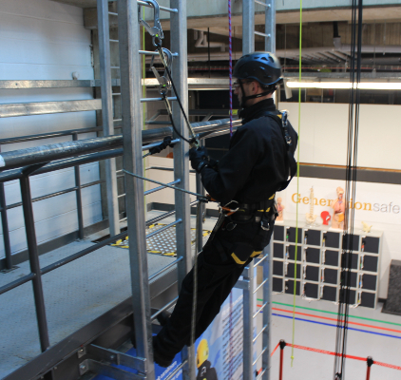
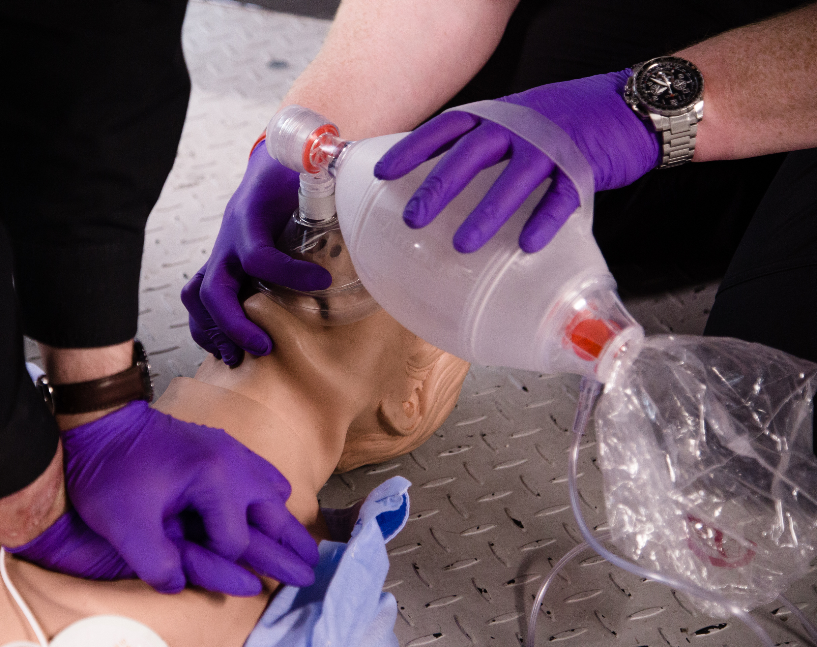
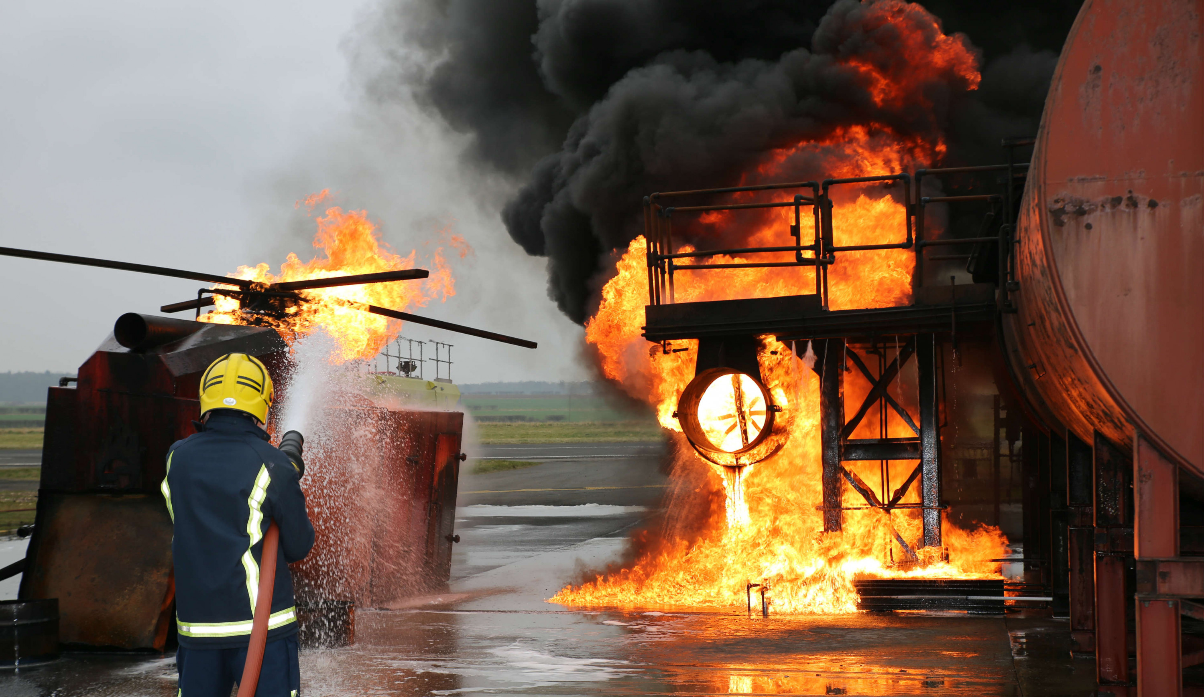
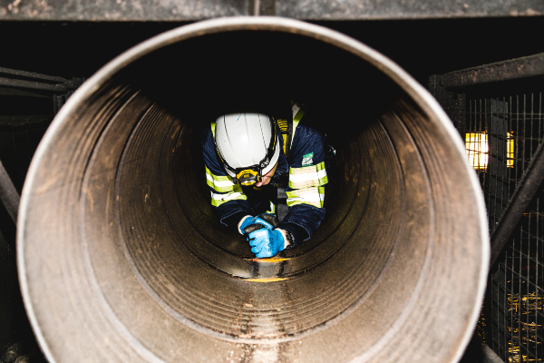
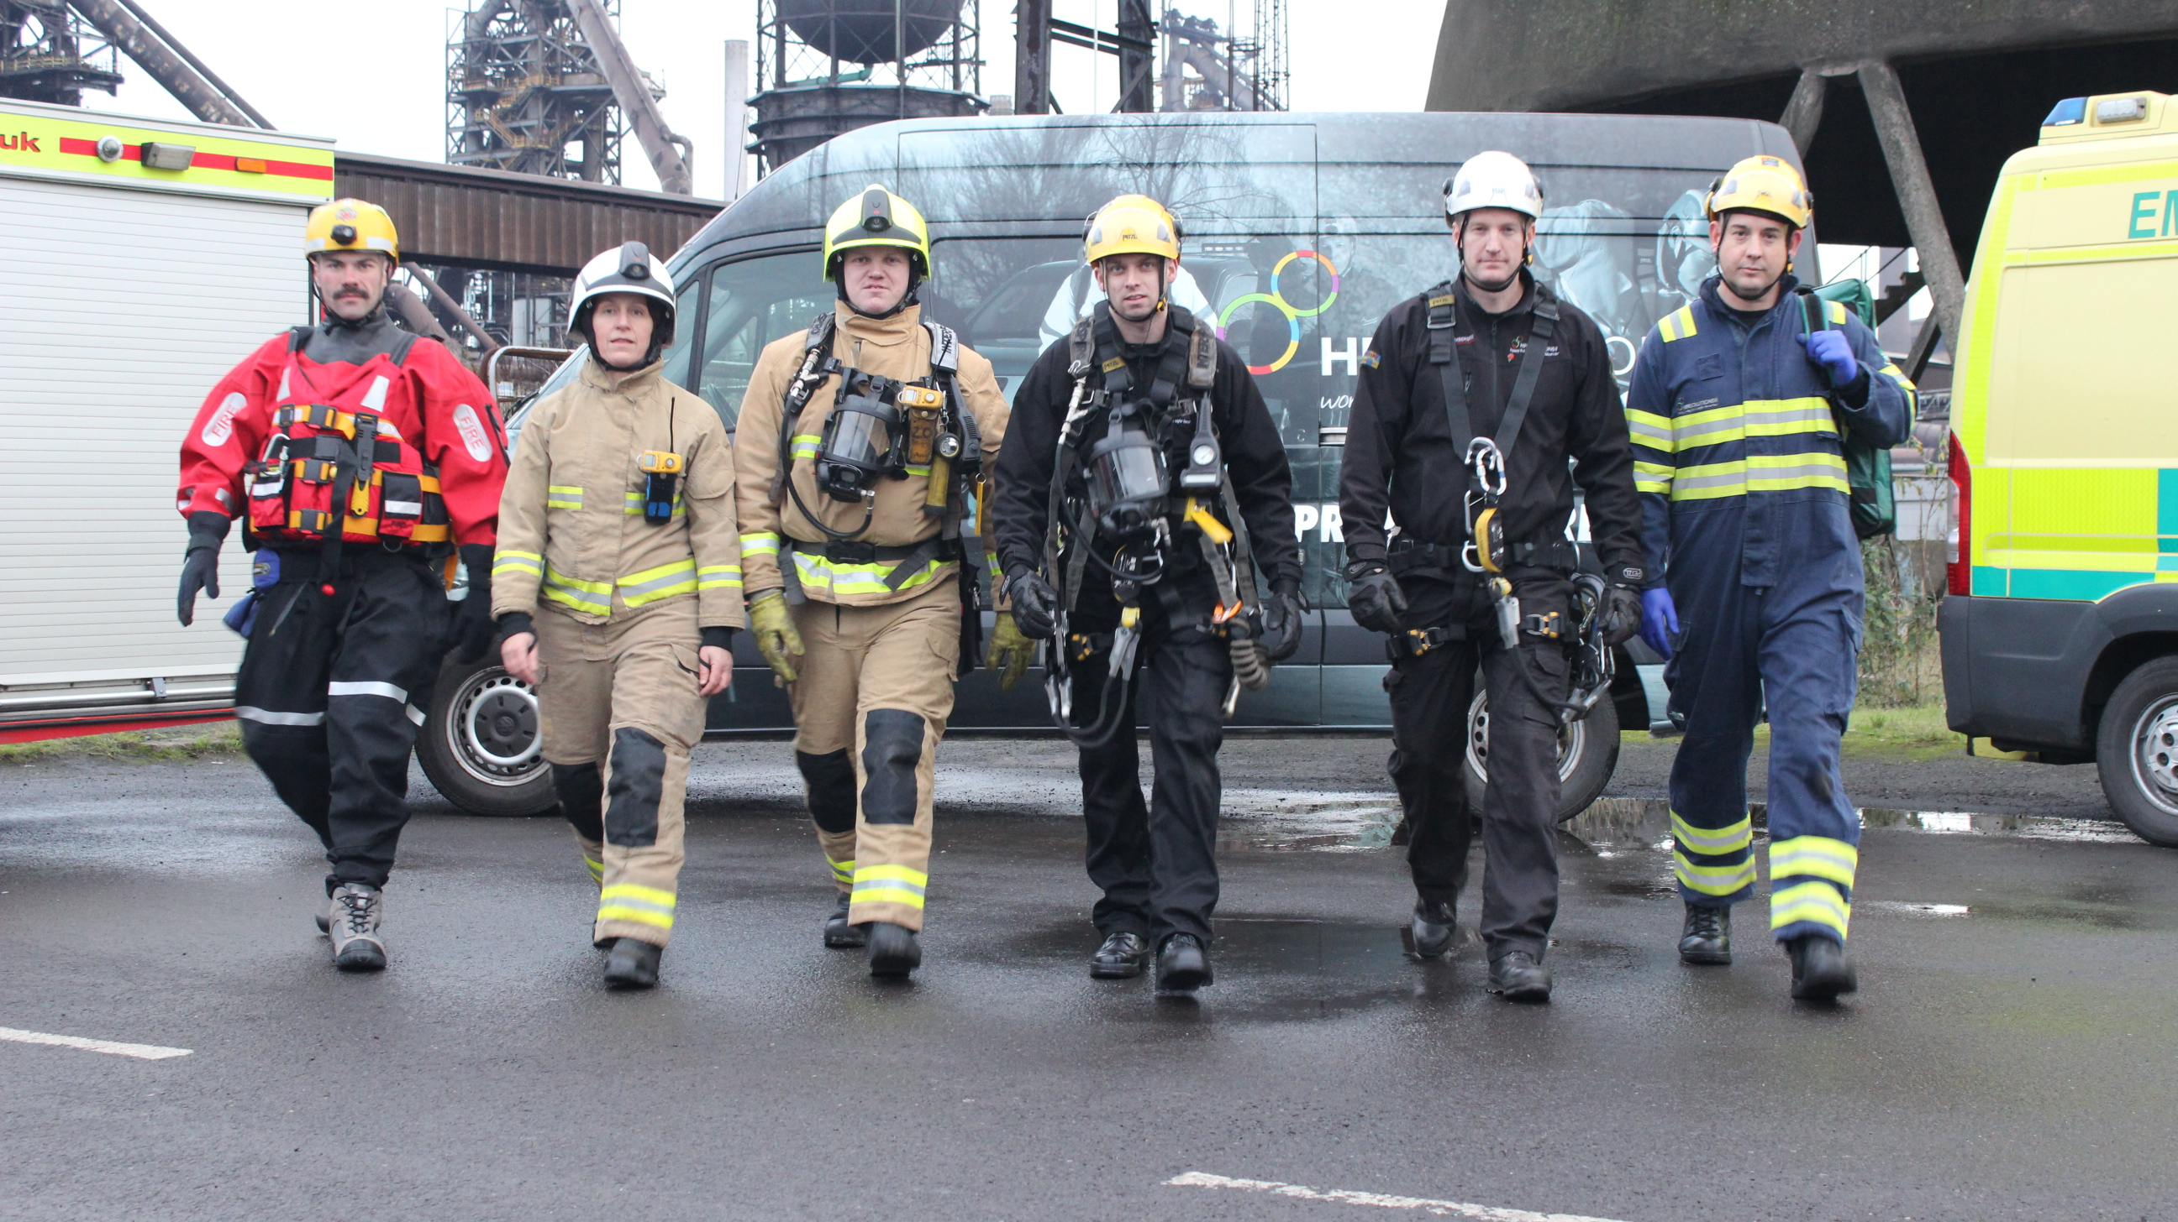
Emergency Response Services and Rescue Teams
Emergency Planning
Consultancy
Workplace safety training specialists
Notes:
Products and Services we provide;
Emergency Response Planning
Rescue Teams and Training
Fire Response Teams and Training
Fire Risk Assessments
Working at Height Consultancy and Training
Confined Space Consultancy and Training
Range of Medical Courses from Basic Life Support to Advanced Trauma
Rescue Equipment and PPE

Slide 9
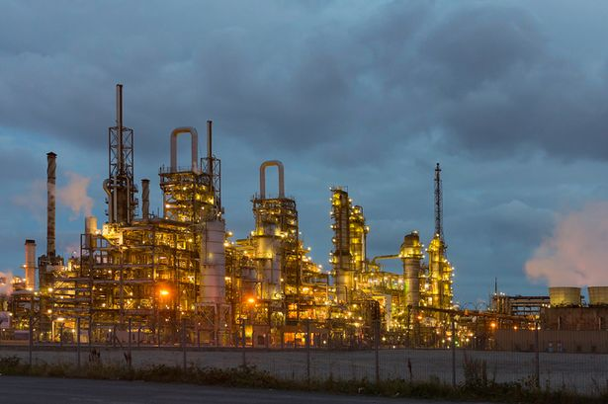
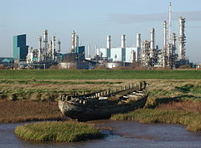
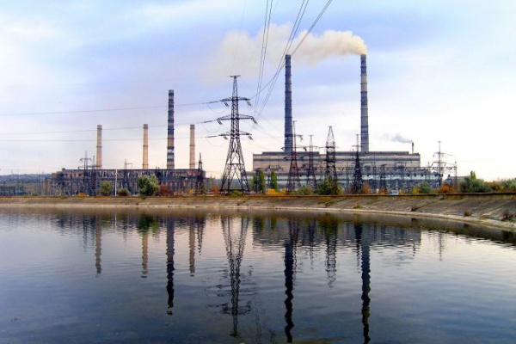


Digital Tech for Emergency Planning
The Problem – Emergency Planning Training needs to be as realistic as possible. Currently there is no digital tool which enables a visual and immersive experience.
The Challenge – The software needed to be flexible, simple to use and incorporate all areas of an Emergency Plan at all levels – Operational, Tactical and Strategic.
The Solution – Large Incident Multiple Agency (LIMA) software allows for effective testing of a sites Emergency planning and preparedness. LIMA offers Incident Management Teams a professional platform to replicate realistic site incidents with a clear visual perspective.

Slide 10
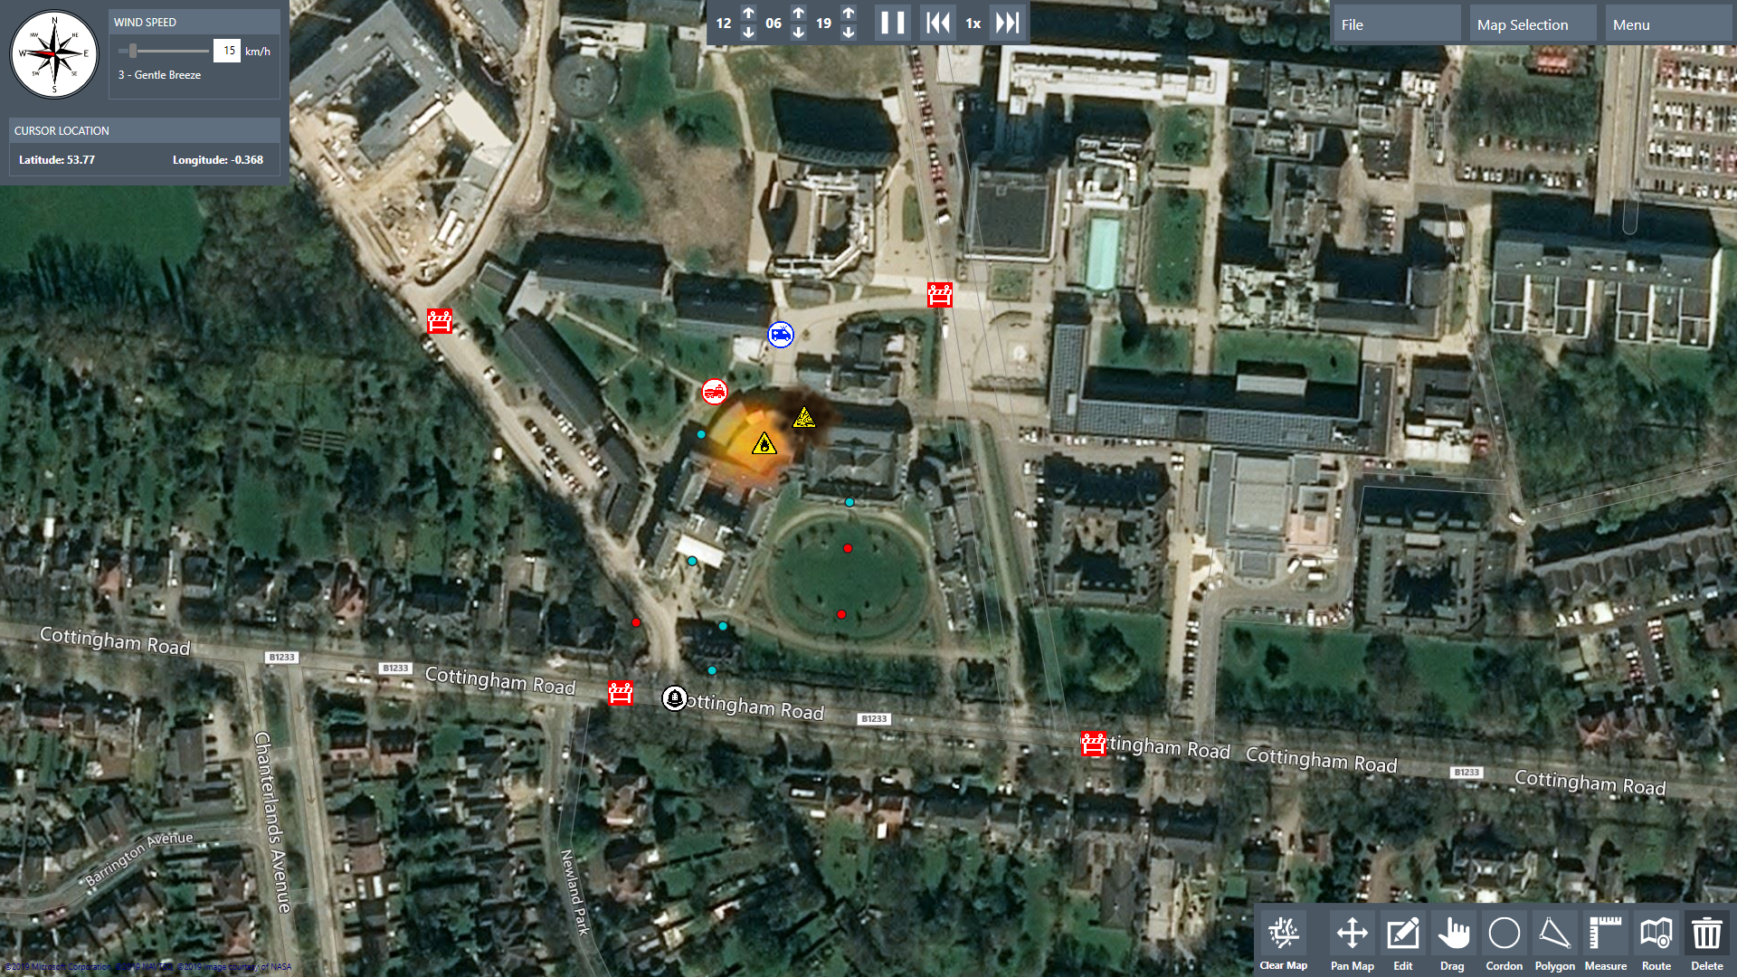
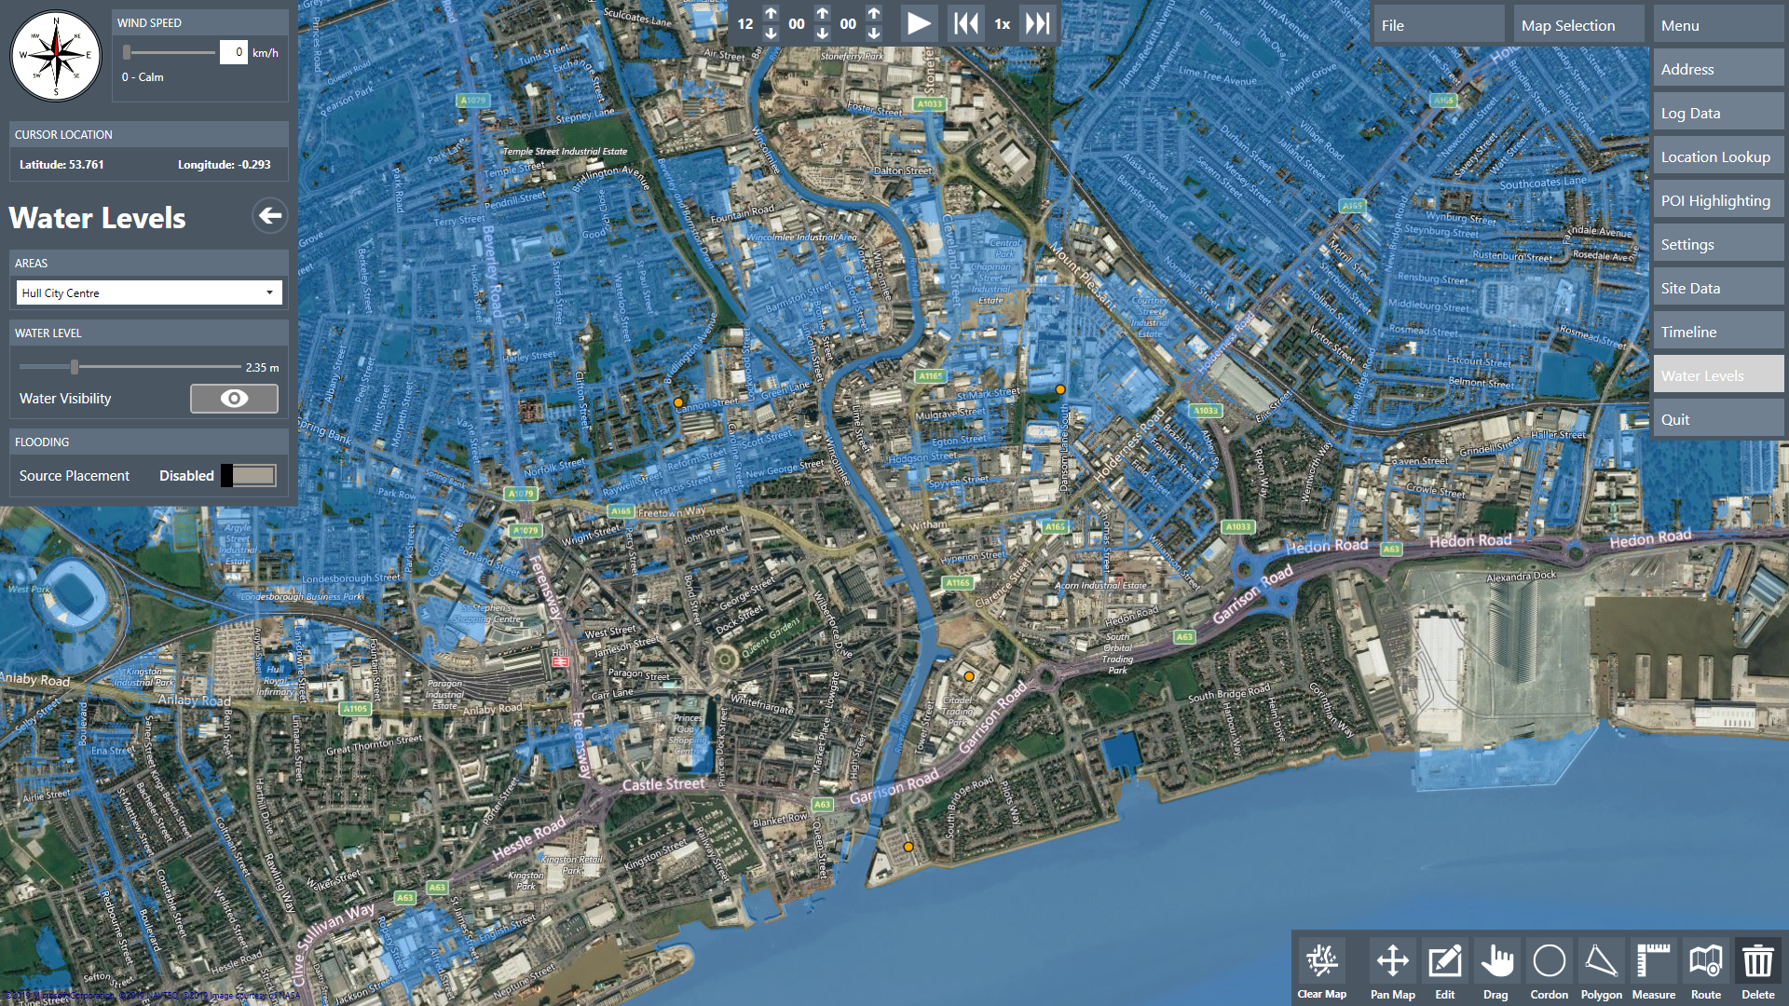
LIMA – Large Incident Multiple Agency
LIMA provides a fully immersive mapping tool designed for emergency planning and training for COMAH and other high-risk industries
Currently built for users within the UK
Engaging and immersive visualisation tool offering paperless training
Developed in conjunction with emergency planning specialists
Experience the implications of decision making in real-time
Replicate live weather variations (wind speed, direction etc)
Plot dynamic data such as hazard cordons, blast radius and site perimeters
Flood modelling
Record training exercise, play back, fast forward to see how the event unfolds

Slide 11
LIMA Pre Built Scenario – Video

Slide 12


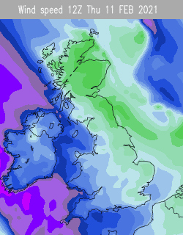
LIMA - Future Potential
Ability for multiple users to access the software at the same time from multiple sites globally
Software used during real-time events (not just for training)
Visualisation of live data such as weather feeds
Integration with Smart Devices i.e. flood sensors
Forecast events using AI Predictive modelling

Slide 13
Contact details:
Lampada Digital Solutions
www.lampada.co
Joanne.Redburn@lampada.co
+ 44 1482 935 350
The University of Hull
www.hull.ac.uk
David.Richards@hull.ac.uk
+ 44 1482 346 311
HFR Solutions
www.hfrsolutions.co.uk
Shaun.Lyons@hfrsolutions.co.uk
+ 44 1482 398 521

