Slide 1

A Reflection of How the Downstream Oil Sector Responded to the Outbreak of COVID-19, and How that Response Mapped to Process Safety Management During the Ensuing Pandemic
Simon Wood, UKPIA

Slide 2

“We prioritise our inspections based on risk and your performance, which determines relative priority for interventions at your establishment against a range of factors.
We visit higher-hazard establishments and poor performers more frequently than lower-risk and/or well-managed establishments.
We use a site prioritisation methodology to categorise and target our inspections.
Inspections will include focused national strategic inspection topics to check common features of risk control, as well as looking at site-specific issues.
We will score your performance against strategic topics and share this with you.”

Slide 3


Slide 4
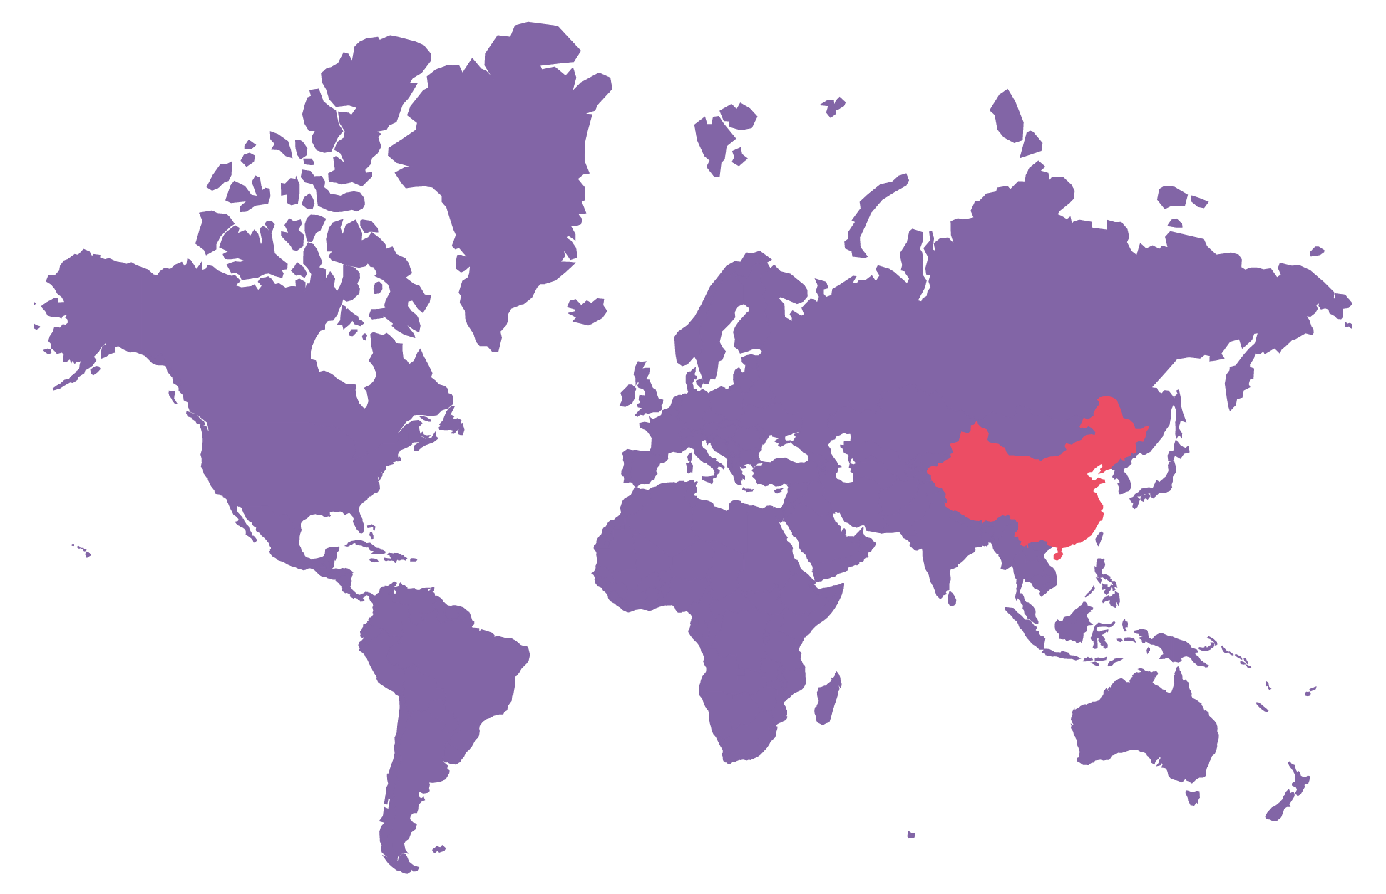
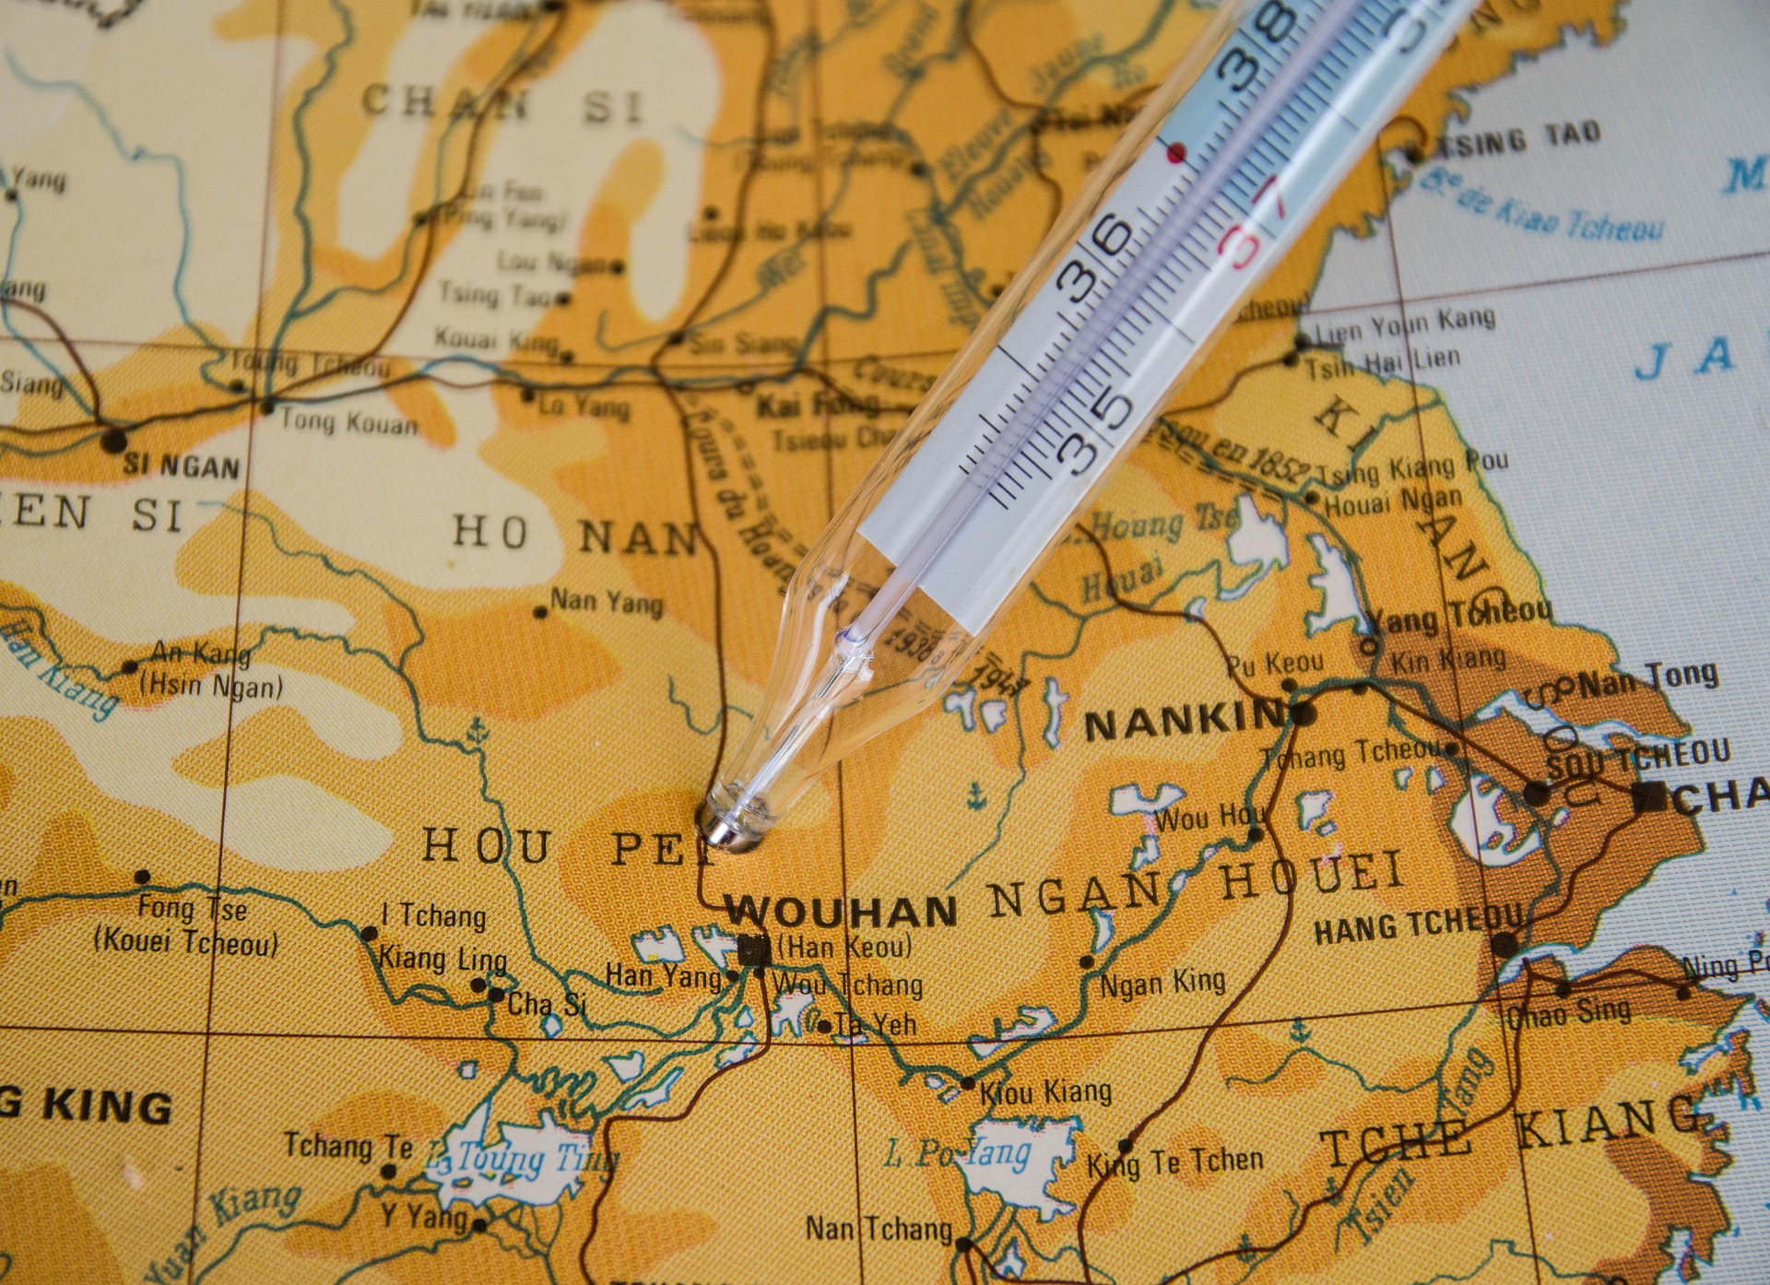
Image by Jaqueline Macou, Pixabay

Slide 5


Slide 6

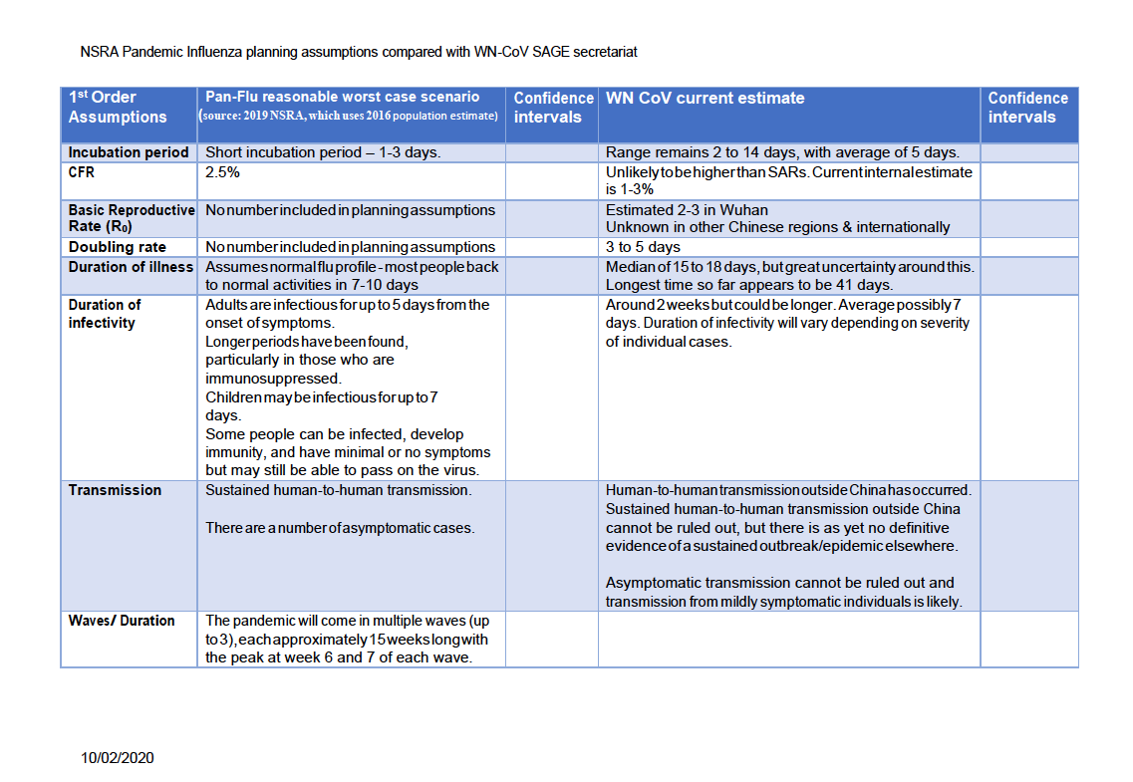
Cumulative UK COVID cases
10/2/2020 Statista
0
0
0
0
8

Slide 7
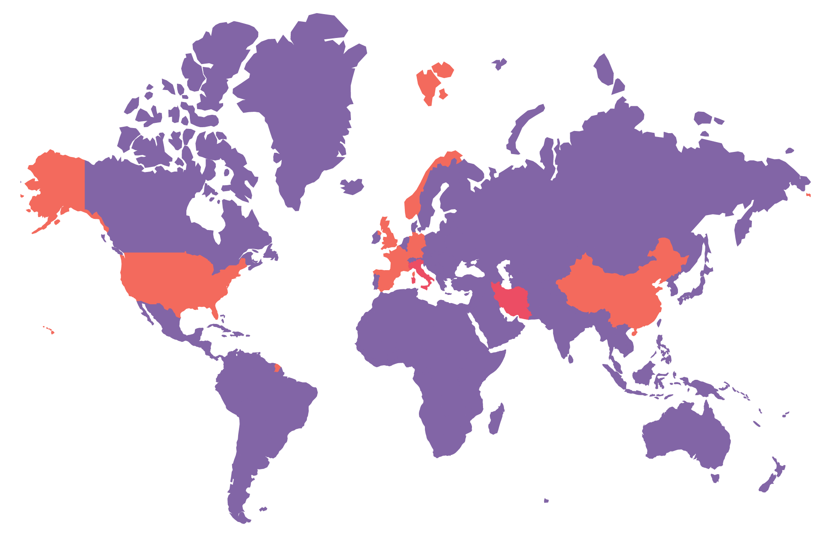
Cumulative UK COVID cases,
10/3/2020 Statista
0
0
3
7
3

Slide 8
Cumulative UK COVID cases,
10/3/2020 Statista
0
0
3
7
3

Slide 9
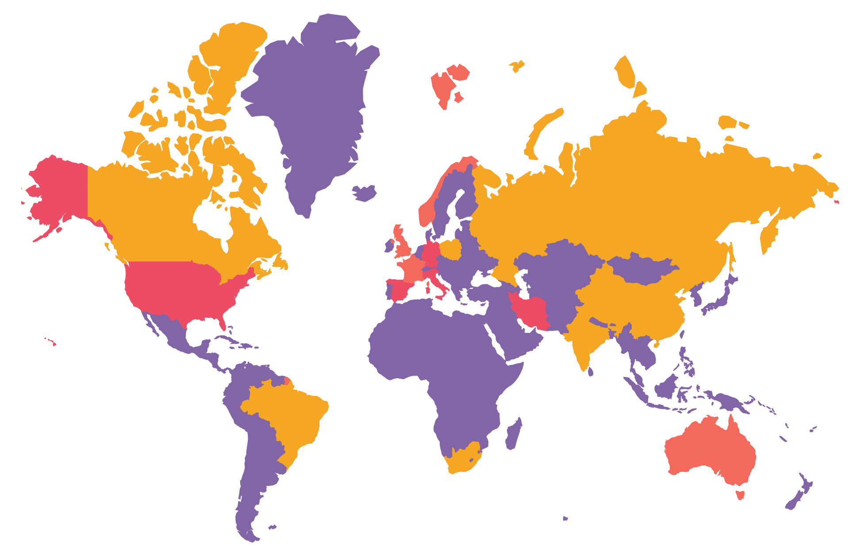
Cumulative UK COVID cases,
23/2/2020 Statista
0
6
6
5
0

Slide 10

Cumulative UK COVID cases,
23/2/2020 Statista
0
6
6
5
0

Slide 11
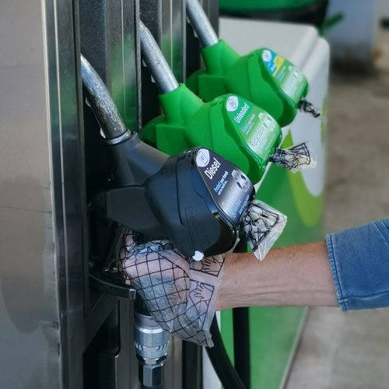

Cumulative UK COVID cases,
23/2/2020 Statista
0
6
6
5
0
bp has installed on-the-nozzle hand protection on fuel pumps at all 330 company-owned retail stations across the UK.
Source: BEIS
Source: bp

Slide 12
23/3lockdown

Slide 13
Cumulative UK COVID cases,
23/2/2020 Statista
0
6
6
5
0
Working from home
Reducing shift numbers
Quarantining shifts from one another
Essential personnel only on sites
Protection of Control Rooms

Slide 14
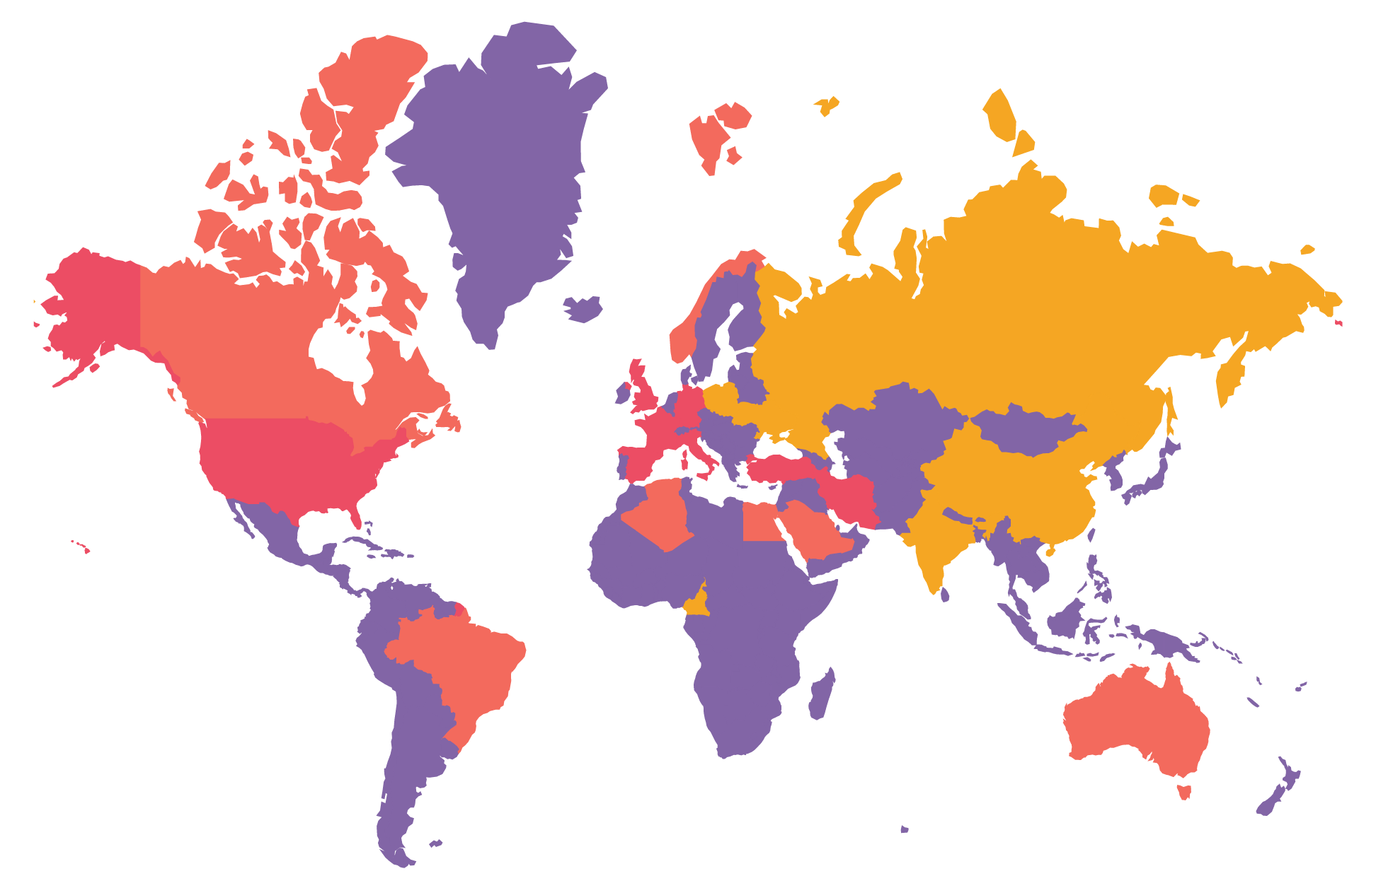
Cumulative UK COVID cases,
1/4/2020 Statista
2
9
4
7
4

Slide 15
Cumulative UK COVID cases,
1/4/2020 Statista
2
9
4
7
4
60-70%
Road Fuel demand
90%+
Aviation kerosene demand

Slide 16
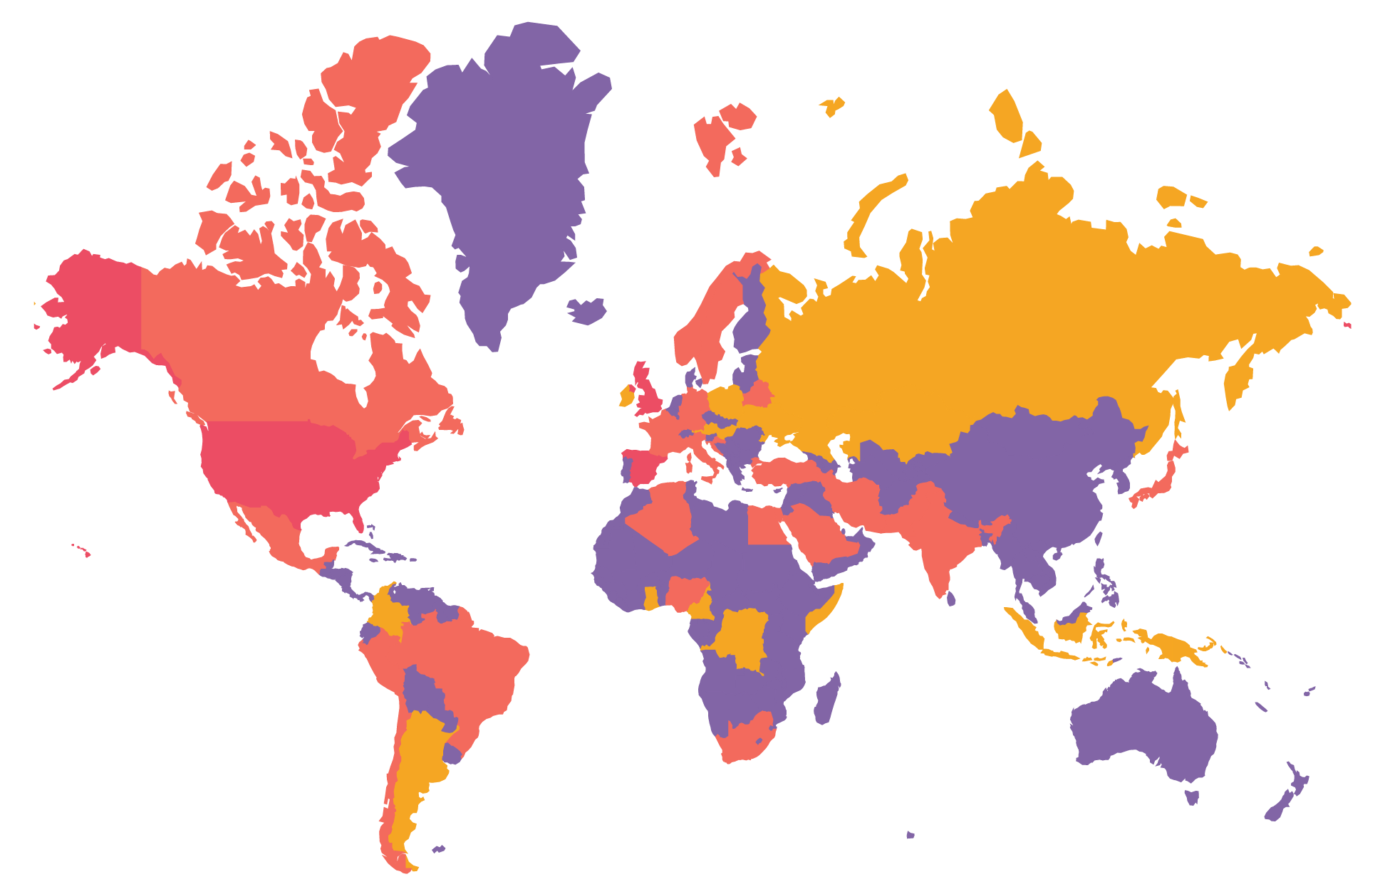
Cumulative UK COVID cases,
1/5/2020 Statista
1
7
7
4
5
4

Slide 17


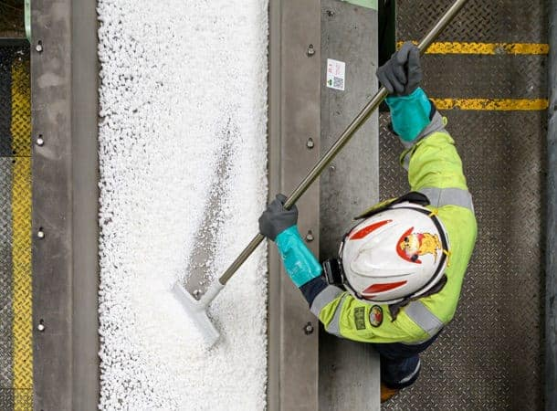
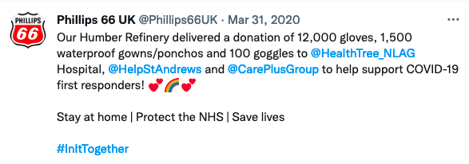
Cumulative UK COVID cases,
1/5/2020 Statista
1
7
7
4
5
4
Source: Ineos
ExxonMobil Fawley says about half of all the rubber being turned into vial stoppers originates from the site
Source: ExxonMobil
Source: P66 / Twitter

Slide 18

Why is a whole shift being pinged?
Identify if there are real situations where workforce may have been in close proximity
Train your workforce to understand mitigations
Liaise closely and clearly with public health

Slide 19
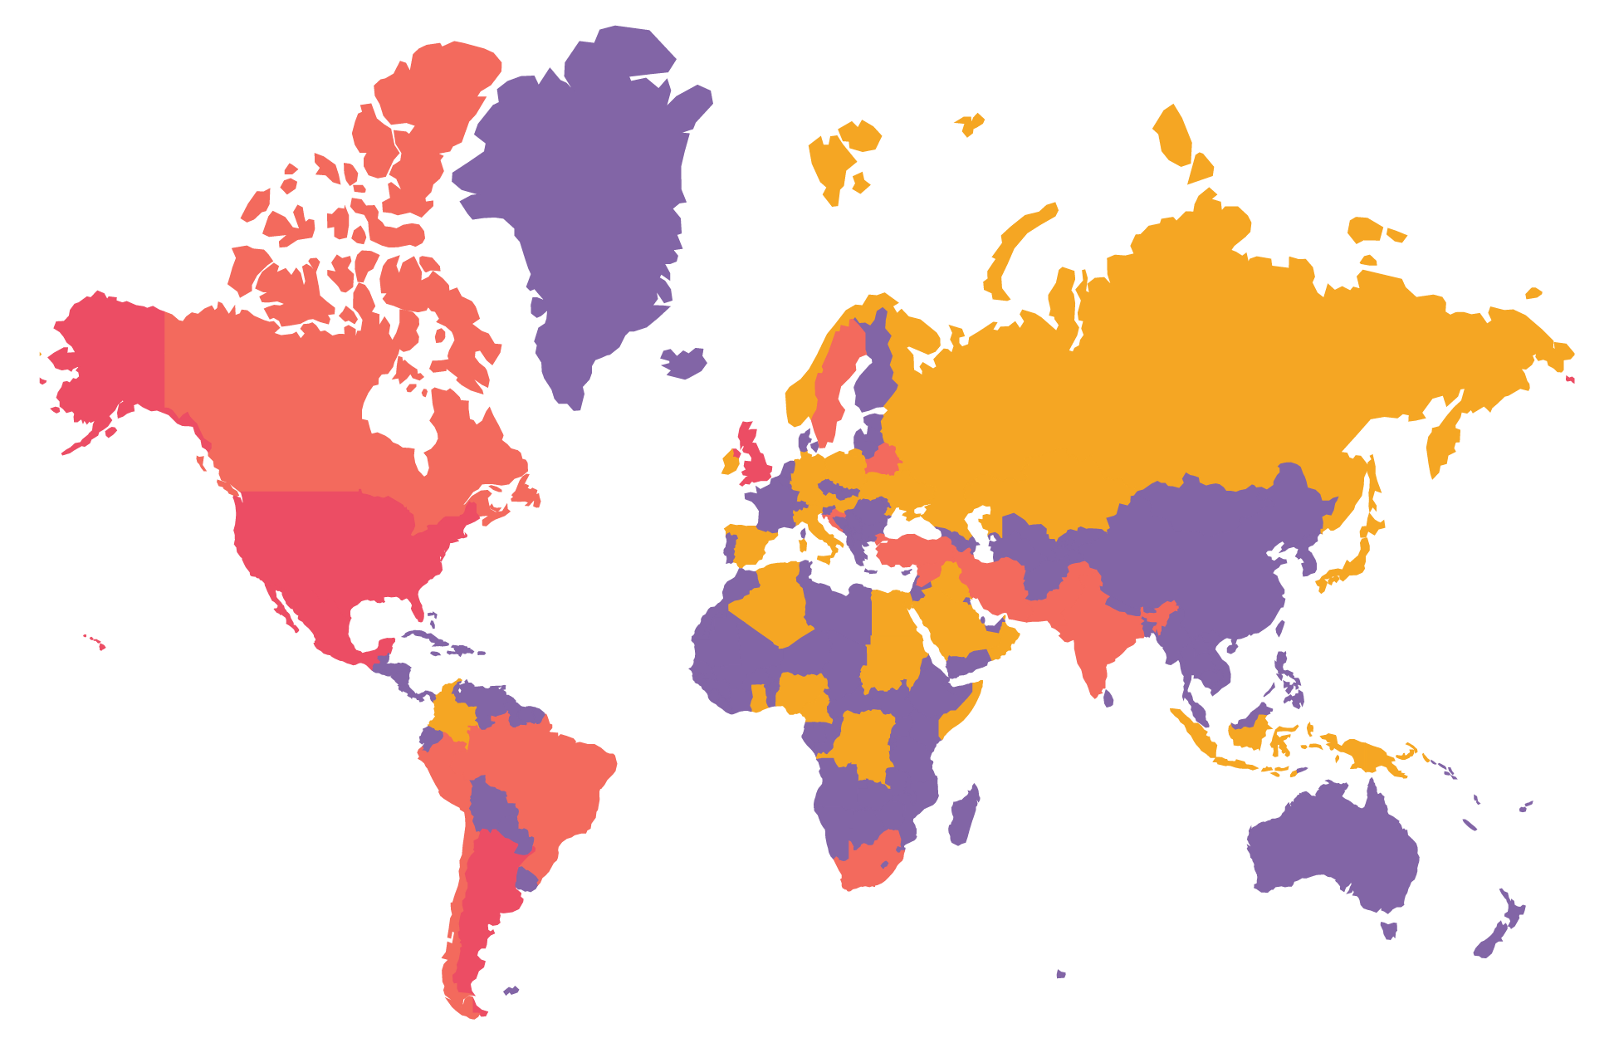
Cumulative UK COVID cases,
1/6/2020 Statista
7
0
6
0
3
0
3
8
2
0
2

Slide 20
Physical
Importance to process of control rooms
Importance of shift handover
Limiting on-site personnel
Regulatory
Risk based and proportionate regulation
Flexibility and prioritisation
Speed of response
People
Protection of the workforce #1
Do we really have to be on-site?
New ways of working and problem solving will come from the workforce

Slide 21
Thank you
Simon.wood@ukpia.com
www.ukpia.com
Twitter: @uk_pia

