Slide 1
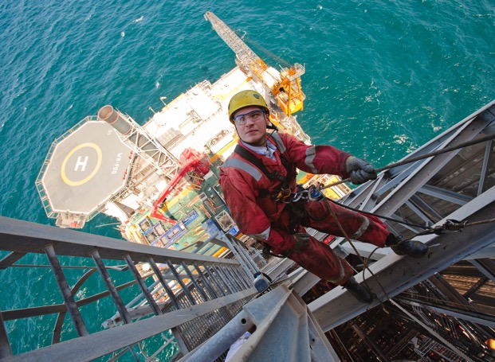
Learning from Global Upstream Process Safety Event Data
David Fargie, bp; Kirsty Walker, Schlumberger; Wendy Poore, IOGP, Olav Skar, IOGP
IChemE Hazards32
18-20 October 2022

Slide 2
Content
PSE data
PSE analysis processes and results
  By keyword
  By point of release
  By causal factors and barriers
Development of Process Safety Fundamentals
Conclusions

Slide 3
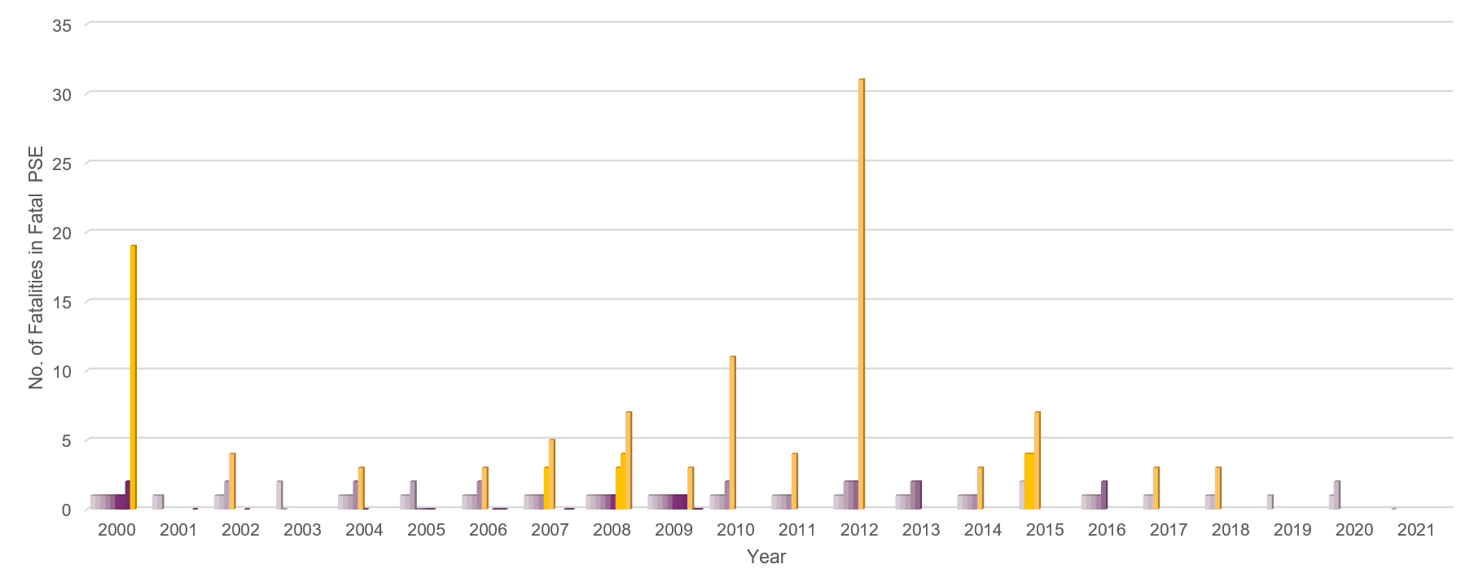
IOGP Reported Fatal Process Safety Events (2000-2021 inclusive)
Fatal PSE occurred annually from 2000 to 2020, 2021 was the first year with no reported fatal PSE
PSE involving 3+ fatalities occur, on average, every 14 months

Slide 4
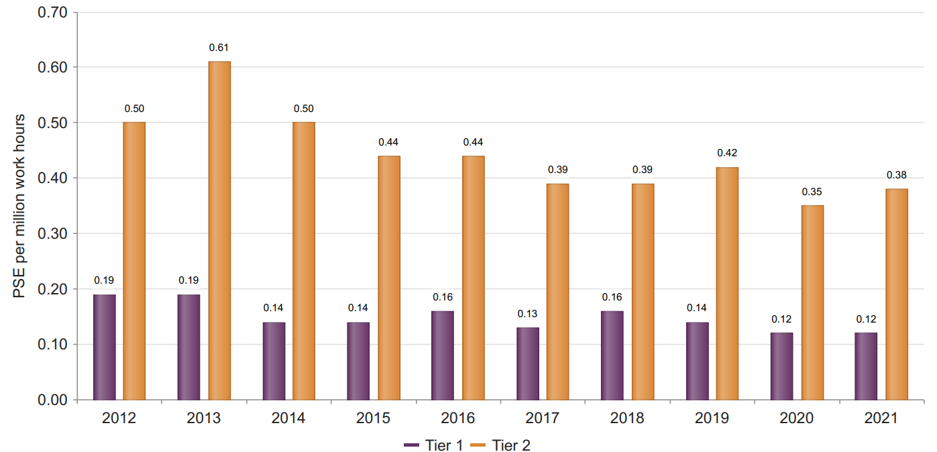
IOGP Member Company reported Tier 1 and 2 PSE Rates (2011-2021 inclusive)
Note: 2011-2012 total incidents and rates reflect the introduction of PSE reporting, data collected since 2013 carry greater confidence.

Slide 5
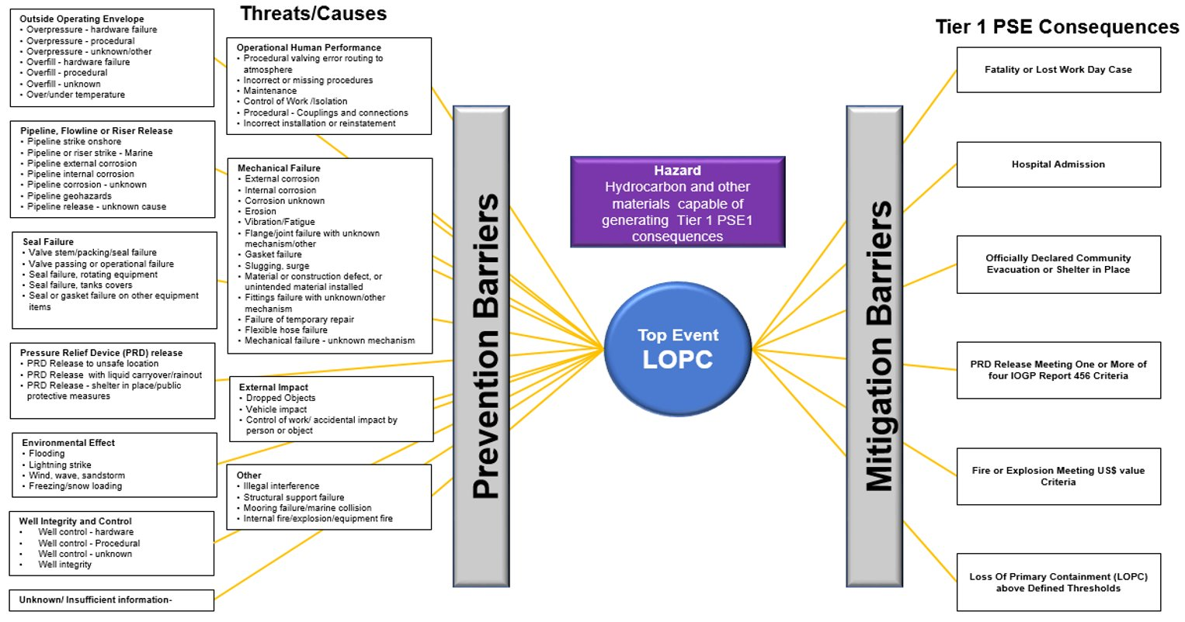
PSE generic Bow and associated 'Key Words'

Slide 6
Point of release for PSE Tier 1 categorization
Piping Systems | Equipment | Tanks and Sumps/Pits
Piping joint Piping material/tubing Valve (body, stem, plugs) Choke Instrumentation and small bore tubing Sight glass Platform/well pad flowline Flexible hose/piping | Pressure vessel Pig launcher/receiver Pump Compressor/blower/fan Meter Filter Fired heater/Boiler/Furnace Power generation unit Reactor Heat exchanger | Atmospheric tank Atmospheric tank overflow Pressurized storage vessel Sump/pit overflow
Relief, Vent and Discharge Systems | Breaking Containment Locations | Wells, Drilling and Intervention
Relief valve (body, plugs) Flare and atmospheric vent systems (intended discharge location) Flare and atmospheric vent systems (not at intended discharge location) Drain Discharge to sea | Breaking containment location Loading/unloading coupling Sample system Piping/valve (inadvertently left) open to atmosphere | Well Subsea well Well intervention equipment Mud circuit/tanks
Subsea | Onshore Pipelines/Flowlines | Unknown/Insufficient Information
Subsea Pipeline/Flowline Subsea equipment | Onshore pipeline Onshore flowline Unknown/ insufficient information | Unknown/Insufficient Information

Slide 7
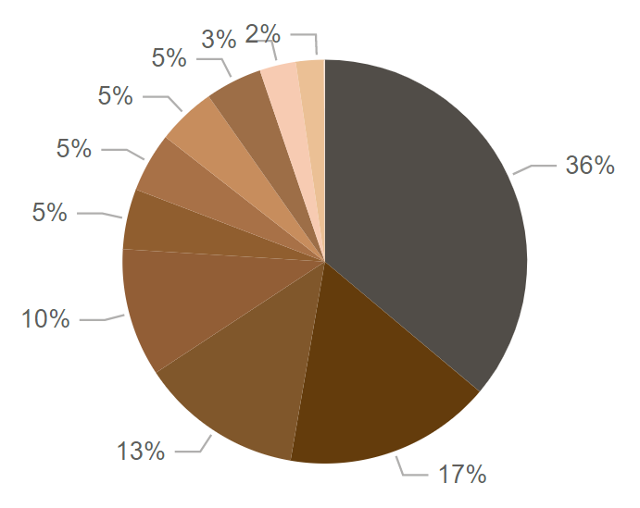
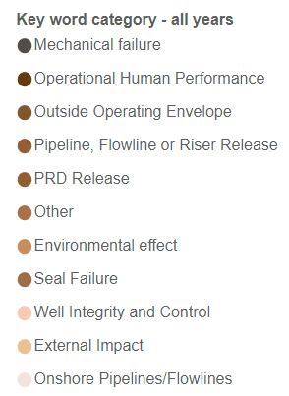
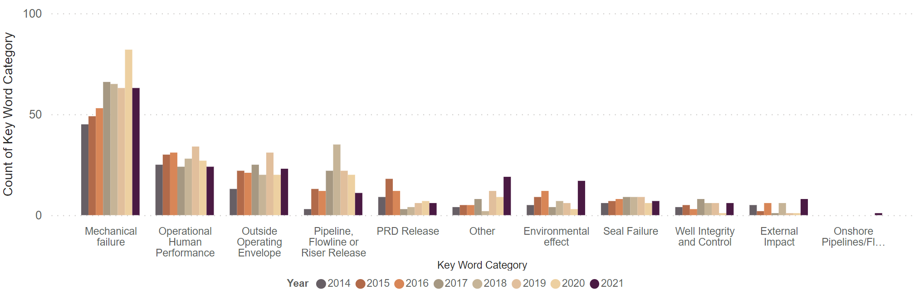
Results - Keyword Analysis
PSE Tier 1 keyword category analysis 2014-2021, excluding PSE with ‘Unknown/insufficient information’
Number in keyword category, 2014-2021 by year

Slide 8
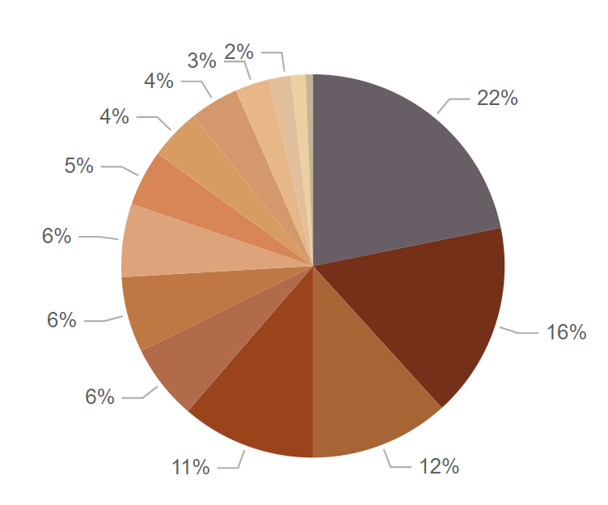
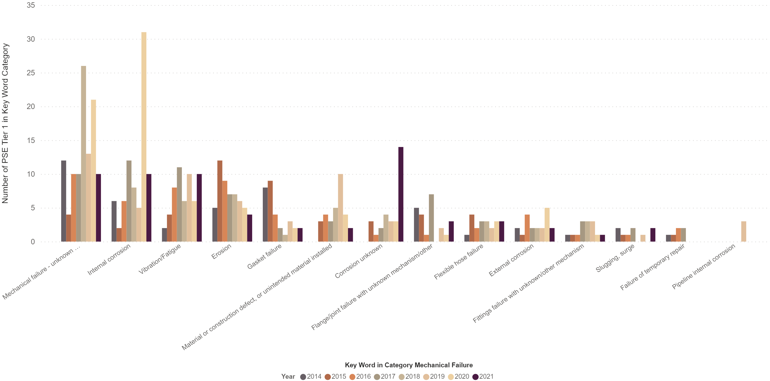
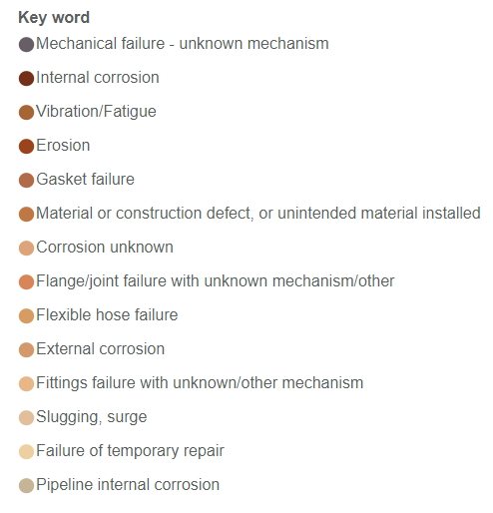
Keyword Analysis – Mechanical Failure
Tier 1 PSE mechanical failure key word assignments, 2014-2021 combined
Number of Tier 1 PSE mechanical failure key word assignments, 2014-2021 by year

Slide 9
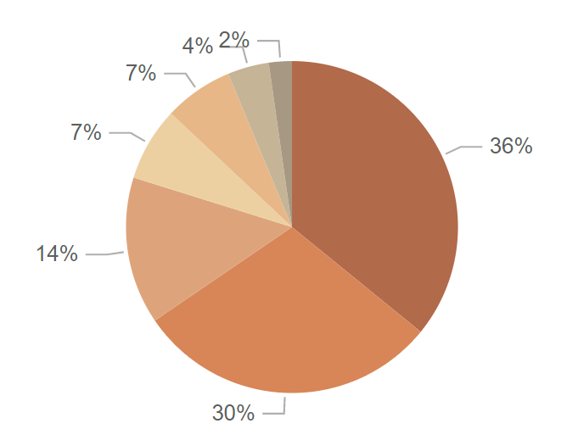
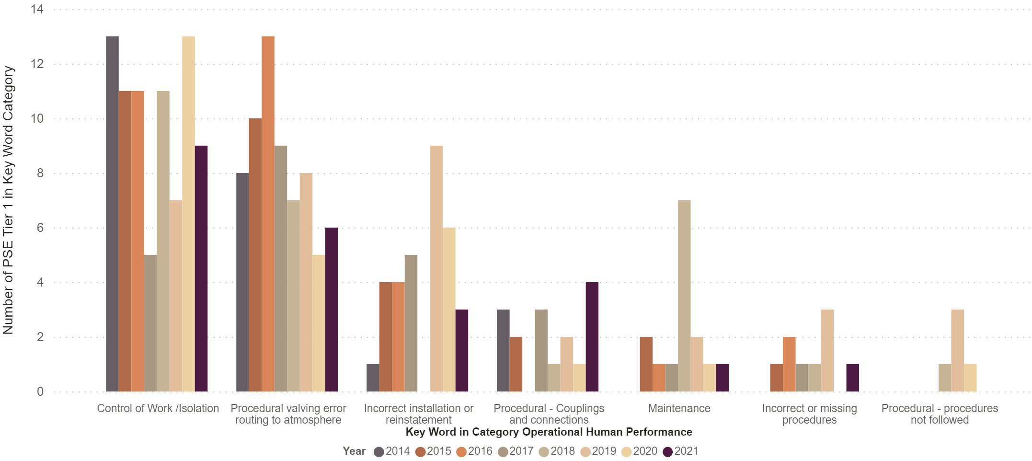
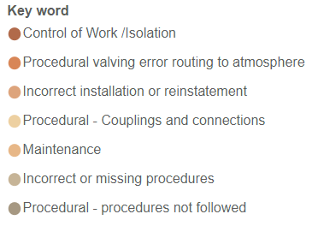
Keyword Analysis – Operational Human Performance
Tier 1 PSE operational human performance key word assignments, 2014-2021 combined
Number of Tier 1 PSE operational human performance key word assignments, 2014-2021 by year

Slide 10
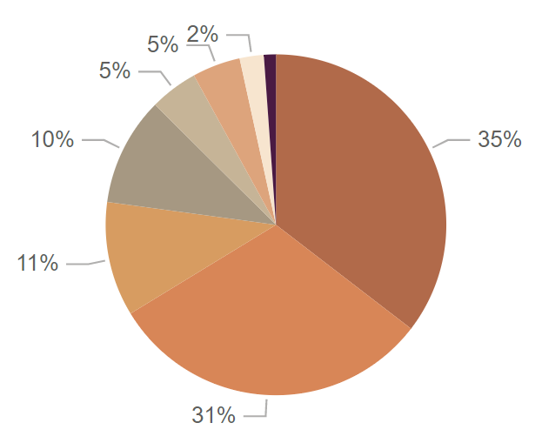
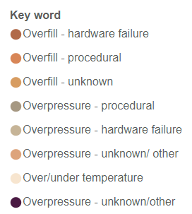
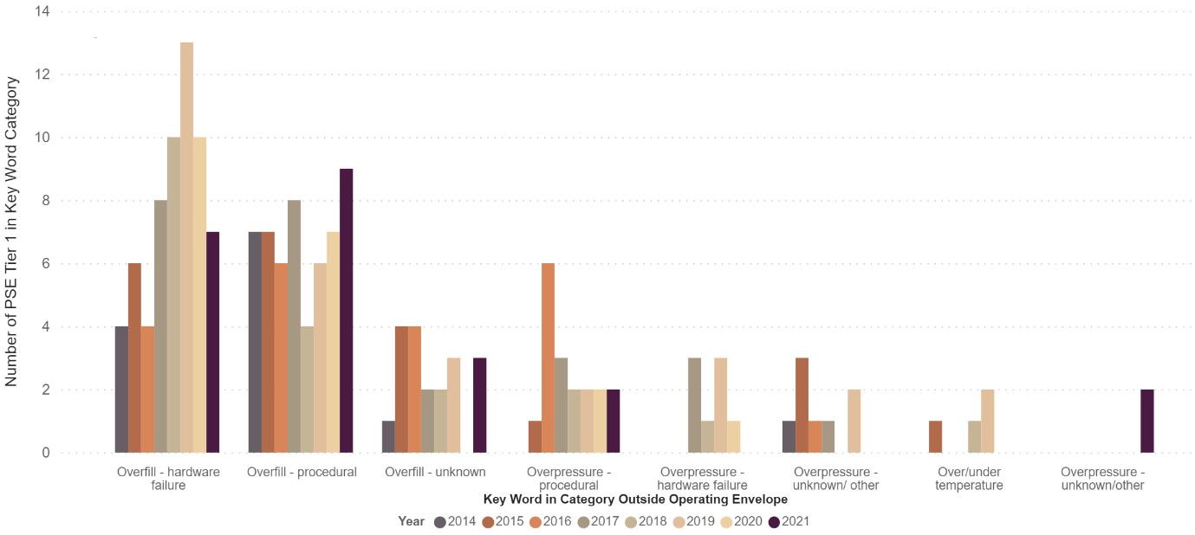
Keyword Analysis – Outside Operating Envelope
Tier 1 PSE outside operating envelope key word assignments, 2014-2021 combined
Number of Tier 1 PSE outside operating envelope key word assignments, 2014-2021 by year

Slide 11
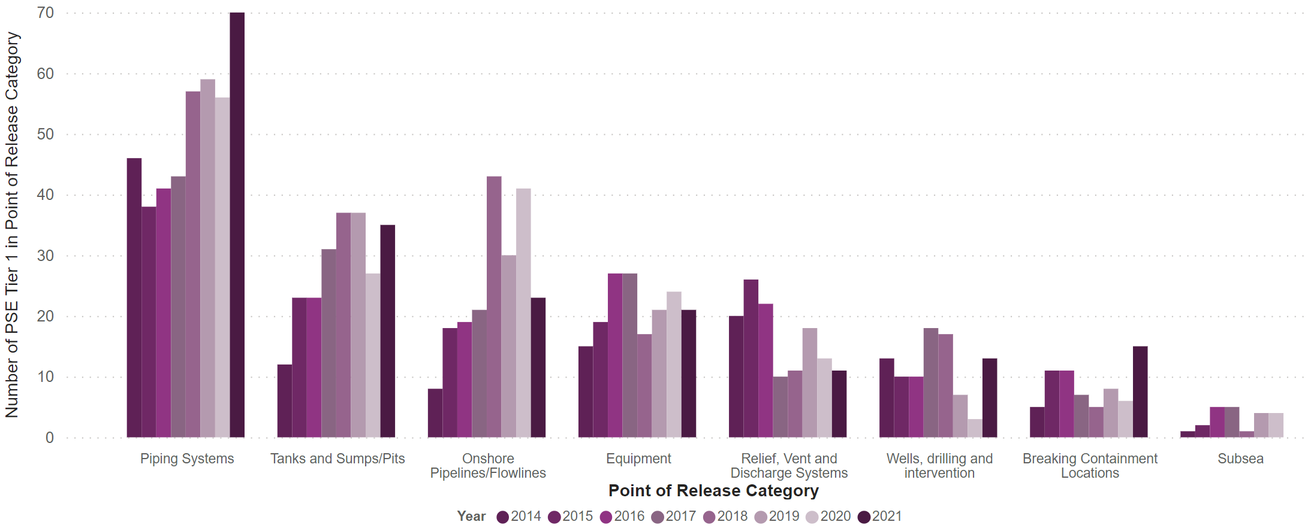
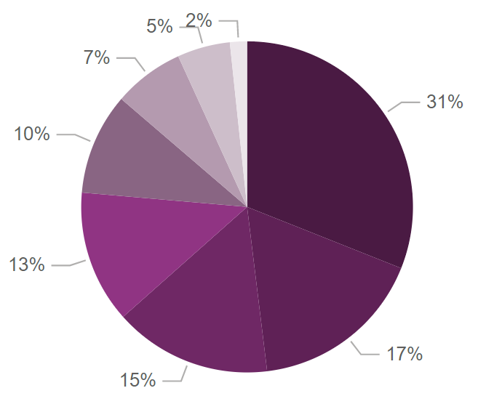
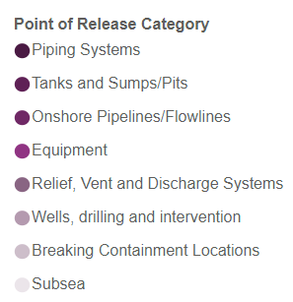
Results – Point of Release Analysis
Tier 1 PSE point of release assignments, 2014-2021 combined
Number of Tier 1 PSE by point of release category, 2014- 2021 by year

Slide 12
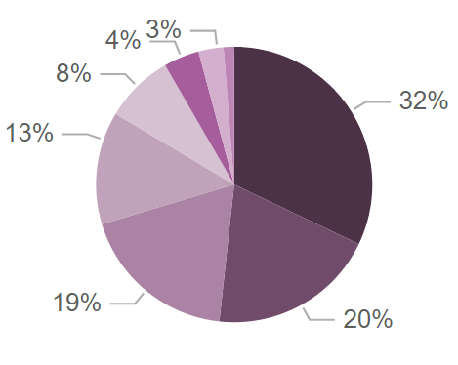
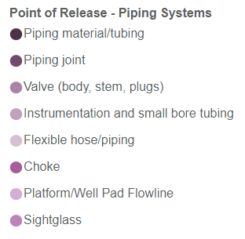
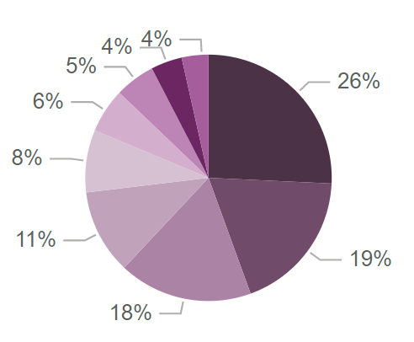
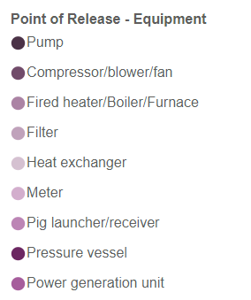
Point of Release – Further Analysis
Tier 1 PSE point of release assignments – piping systems, 2014-2021 combined
Tier 1 PSE point of release assignments – equipment,
2014-2021 combined

Slide 13
PSE Tier 1 Causal Factor and Barrier Analysis 2014-2021
Causal Factors reported in the Top 10 every year
Inadequate/defective tools/equipment/materials/products
Inadequate maintenance/inspection/testing
Inadequate design/specification/management of change
Inadequate hazard identification or risk assessment
Inadequate work standards/procedures
Inadequate training/competence
Barrier failures reported in the Top 10 every year
Process Containment
Asset design and integrity
Operating in accordance with procedures – PTW, Isolation of equipment, Overrides and inhibits of safety systems, Shift handover, etc.
Risk assessment and control
Structural Integrity
Surveillance, operator rounds and routine inspection
Plans and procedures
Execution of activities
3,038 causal factors assigned to 1,264 of 1446 Tier 1 PSE reported
79% of these were in the process (conditions) categories and 21% in the people (acts) categories
Reference IOGP Report No. 544 for full list of Barriers

Slide 14
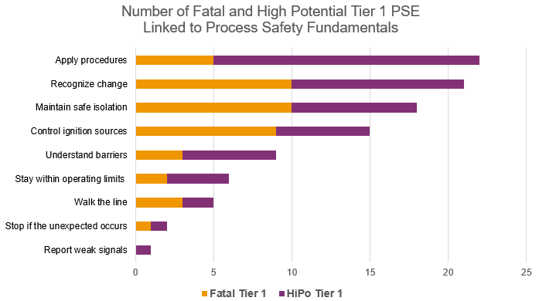
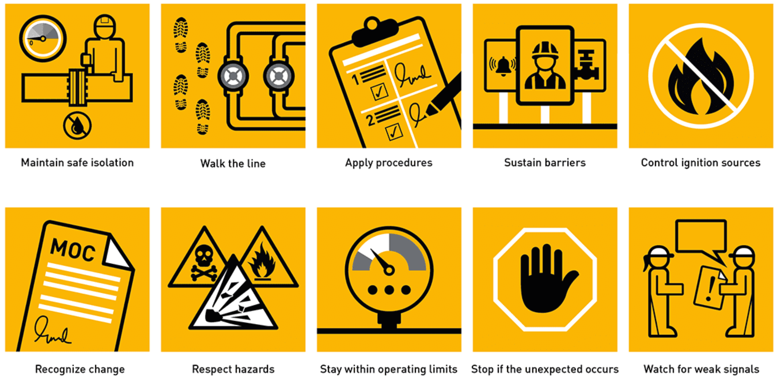
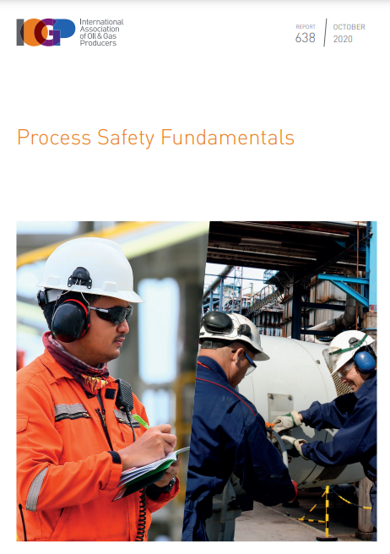
Development of Process Safety Fundamentals
Reference IOGP Report No. 638 for further information

Slide 15
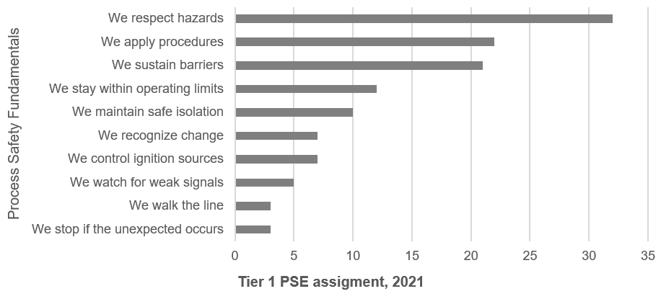
Analysis – Process Safety Fundamentals
PSF were applicable for 68% of the reported Tier 1 PSE (122 of the 190 Tier 1 reports)

Slide 16
Conclusions
Aligned PSE reporting with standardized metrics and taxonomies enables
benchmarking and learning:
  Keywords
  Point of release
  Causal factors
  Barrier failures
Actively use data to identify opportunities to reduce PSEs and eliminate
fatalities – moving from data to action

Slide 17
Wendy Poore wp@iogp.org

