Slide 1
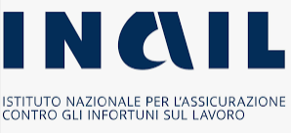
Management and Technical Factors Emerging from the Inspection Activity After a Major Accident in Italy
Hazards32, IChemE
18-20 October 2022, Harrogate, UK
Process Safety Conference – Lessons Learned I – 18/10/2022
Romualdo Marrazzo ISPRA - Italian National Institute for Environmental Protection and Research. Roma, Italia
Paolo Bragatto DIT, INAIL. Monteporzio Catone (RM) Italia
Armando De Rosa DCPST, CNVVF. Roma, Italia

Slide 2
Program and themes
Introduction
Background
Accident Reporting Method
Lessons Learned and Conclusions

Slide 3
Introduction

Slide 4
The role of ISPRA for industrial control
ISPRA has a national role as a technical body supporting the Ministry of Environment in the national implementing of the Seveso Directives for the prevention of major accidents
Definition of technical contents of laws and decrees to control Major Accidents
Set-up of the National Inventory of major accident hazards establishments and other related data-bases
Inspections of upper-tier establishments SMS-PMA on regular basis or after an accident
Support for international activities (EU, OECD, bilateral cooperation)
Technical coordination and addressing of Regional Agencies for the Protection of Environment (ARPA)
Collaboration with other Authorities competent for industrial risk (Ministry of home affairs – National Fire Brigades; Department of civil protection; Ministry of infrastructures)

Slide 5
The Seveso directive: Scope and principles
The Italian implementation of the Seveso III directive (2012/18/EU) is the D.Lgs. 105/2015, aiming at the prevention of major accidents involving dangerous substances
Depending on the amount of dangerous substances present, establishments are categorized in Lower Tier (LT) and Upper Tier (UT) (increasing safety measures according to the quantities)
“Presence of dangerous substances”: the actual or anticipated presence of dangerous substances in the establishment, or of dangerous substances which it is reasonable to foresee may be generated during loss of control of the processes, including storage activities

Slide 6
The national situation
In Italy, about 1.000 sites fall under Seveso directive (50% of UT and LT)

Slide 7
Major accident in the D.Lgs. 105/2015
Following a major accident, the operator shall be required to:
Inform the competent authority
Provide information: the circumstances of the accident; the substances involved; the effects on human health, environment and property; the emergency measures taken
Inform of the steps to: mitigate medium and long-term effects; prevent recurrence
Update the information provided if further investigation reveals additional facts
Following a major accident, the competent authority shall be required to:
Ensure that any urgent, medium-term and long-term measures are taken
Full analysis, by inspection, of the technical, organisational and managerial aspects
Action to ensure that the operator takes any necessary remedial measures
Make recommendations on future preventive measures
Inform the persons likely to be affected

Slide 8
Background

Slide 9
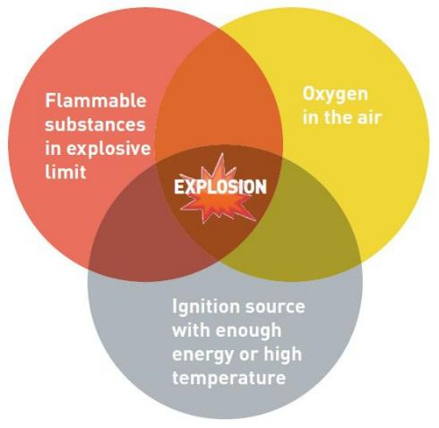
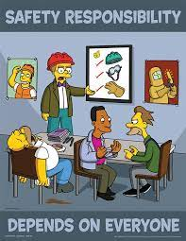
Hot works and Flammable Vapors
FLAMMABLE VAPORS IGNITION: A VERY WELL KNOWN PHOENOMENON!
GOOD PRACTICES AND GUIDELINES, INCLUDE
AICHE CCPS (2012), Guidelines for Engineering Design for Process Safety, 2nd Ed.
API, RP 2009:2002 Safe Welding, Cutting, and Hot Work Practices in the Petroleum and Petrochemical Industries 7th Ed.
NFPA 51B:2009 Standard for Fire Prevention During Welding, Cutting and Other Hot Work
In EU process industries, major accidents related to vapor ignited by sparks are now less frequent, because ATEX and SEVESO directives require a system of “Permits To Work” PTW …..including special rules for hot works

Slide 10
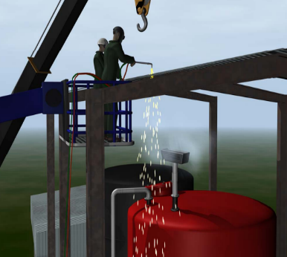
Wastewater and hot-work
WASTEWATER from chemical processes containing mixture of different materials, including flammables, is a major threat, because during cutting or welding intervention vapors may be ignited by sparks
In the US, the CSB investigated 13 hot work-related major accidents occurred in 2001-2016 including municipal and industrial sites
At European SEVESO sites these accidents are less frequent, but they continue to occur, despite regulations, guidelines and inspections
We discusses in the detail the very last event, happened in Italy, May 2020

Slide 11
Accident Reporting Method

Slide 12
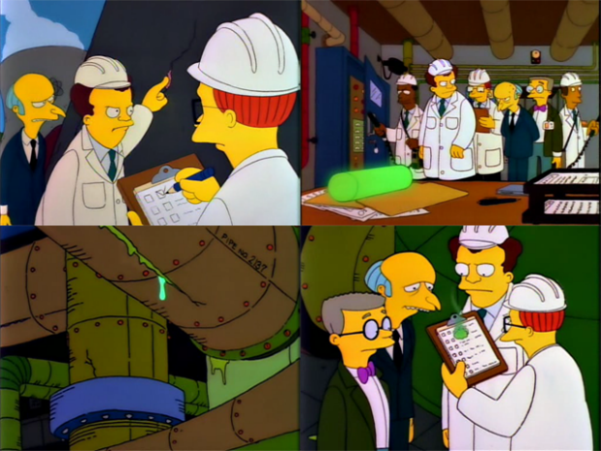
Post-accident inspection
Post accident inspection commission is charged by Ministry of Environment and it is made up by
ISPRA - National Institute for Environmental Protection and Research
CNVVF - National Fire Brigades
INAIL - Workers’ compensation Authority
The inspection duties:
collect documents and evidences
on-site inspection of plants and equipment
interviews with workers representatives, internal staff and subcontractors
The goal of the inspection is to learn lessons for preventing future accidents and mitigating their consequences
Reports shared through the eMARS (European Major Accident Reporting System) database

Slide 13
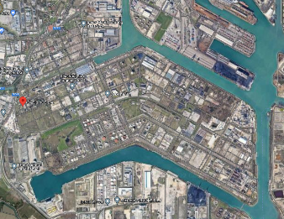
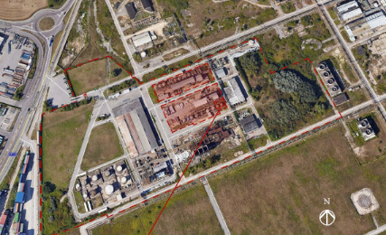
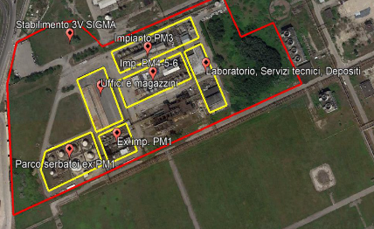
The site of the industrial establishment
The area within a two-kilometers include industries and populated buildings, airport, port, lagoon
The UT establishment used to produce highly reputated specialties for personal and home care, paper, plastics, textiles, cosmetics, and other industries

Slide 14
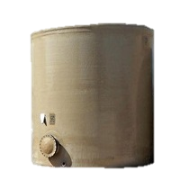
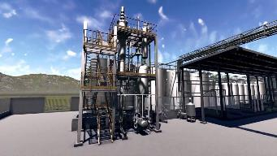
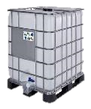
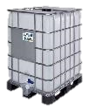
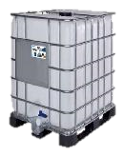
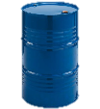
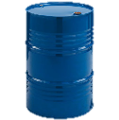
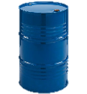
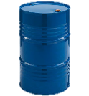
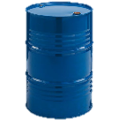
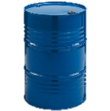
Involved substances
Tank TK 2.2 was likely to have been holding
WASTEWATER CONTAINING METHYL ALCOHOL, ETHYL ACRYLATE, WHITE SPIRIT, XYLENE (H226 - Flammable liquid and vapor; H411 - Toxic to aquatic life with long-lasting effects)
The amount directly involved in the event was 130 tonnes
Other substances present at the establishment in the units affected (plants, units and storage on the forecourts)
2-ethylhexyl-4-aminobenzoate | bis-Aminopropyl ethylenediamine
Xylene | tert-Butyl hydroperoxide
Acetone | tert-Butylamine
Methanol | Ammonia
Ethyl acrylate | Diisopropylamine
White spirit | Xylenic mixture
Morpholine

Slide 15
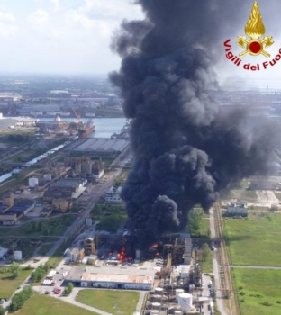
Accident dynamic
The accident occurred in the morning during modification works, by an external firm, which was connecting tank TK 2.2 to the wastewater network
One hour before the event, these workers had cut the pipe that was being worked on
The event occurred when the cut pipe was being sealed, while an electric arc welder was in use
The trigger gave rise to the explosion and catastrophic rupture of the atmospheric tank
An internal domino effect was generated, in a succession of fires and explosions

Slide 16
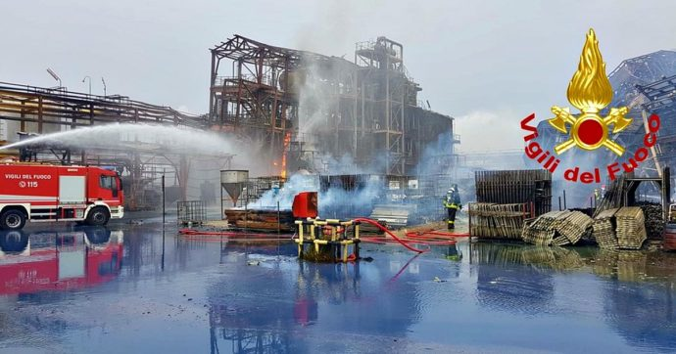
Emergency response
The External Emergency Plan (EEP) was activated by the Prefect’s Office, following first notification from the fire brigade
People living in the industrial district within 1 km radius of the establishment were asked to stay at home with the windows closed until the emergency was over
Following intervention by the off-site external emergency services, the fire was brought under control at 14:00, and the emergency was declared over at 17:00
Approximately 30 fire brigade vehicles attended with 90 firefighters, including from neighbouring stations

Slide 17
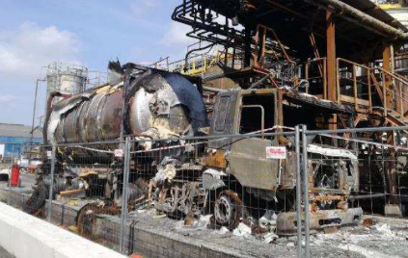
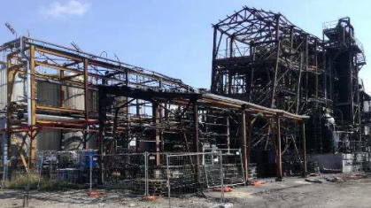
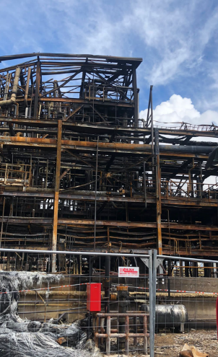
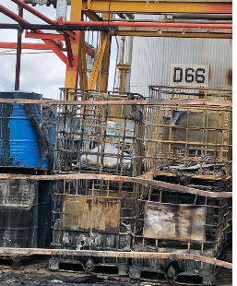
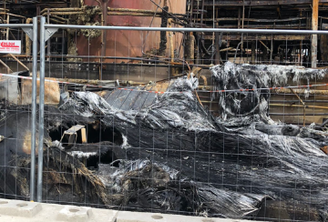
Consequences on equipment and structure
Tanker Truck >>
<< Plant Unit #3
IBC and DRUMS
>>>>
<<<< Plant Unit #6
Collapsed Fiberglass tank

Slide 18
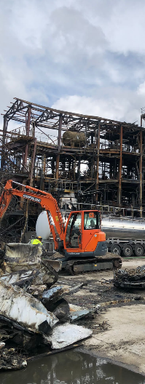
Damage to human health, environment and property
2 employees sustained burns to 30-40% of their bodies, hospitalised for 2 months, but at the end they recovered well
3 employees first degree burns to the face and neck; inhalation of toxic fumes; multiple bruises: they recovered in a couple of weeks
EUR 35,000,000 (material losses)
EUR 14,000,000 (response, clean-up, restoration costs)
No pollutants were found in the waters of the Lagoon, traces were found in the industrial canals

Slide 19
Lessons Learned and Conclusions

Slide 20
Lessons learned
A risk analysis on all changes (preliminary risks, risks during implementation and risks during operation), resulting in the identification of preventive and protective measures to be implemented, as well as the related training activities for the staff
Always keep systems subject to modification works under isolated and inert conditions to prevent the environmental conditions from changing, which could lead to the formation of potentially flammable and/or explosive atmospheres

Slide 21
Lessons learned
The work permit process must always pay attention to: checks prior to and/or during the performance of the activities; supervision by the persons responsible; formalization
Follow the procedures for the correct positioning of stores of hazardous substances and mixtures on the forecourt (e.g. tanks, drums, IBCs, etc.), including related fire protection systems and equipment, as a result of an appropriate risk analysis

Slide 22
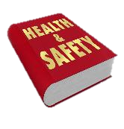
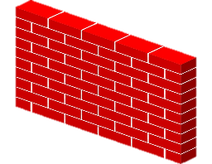
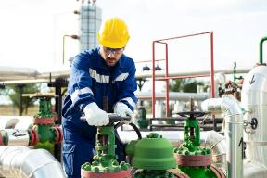
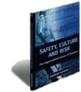
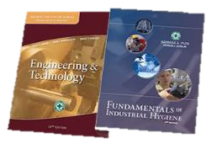
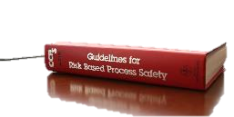
Discussion
In chemical specialties industry there are many SMEs with a poorer safety culture. As competition is higher, technical interventions are done under hurry, and recognized practices are possibly disregarded. Experience and knowledge are forgotten, risks are ignored or misunderstood at all
The lack/impoverishment of safety culture makes internal organization impervious to external knowledge
The industrial associations should supply the weakness of single enterprise, with a capillary action to disseminate knowledge through their network

Slide 23
Conclusions
Regulatory authorities have a huge responsibility. In particular, the mandatory inspections, required by the Seveso Directive, should verify actual safety culture
In the chemical specialties sector, inspectors should pay attention to the management of changes, where recognized good practices may be forgotten, preferring informal procedures, which may cause accidents with flammable substances
Sample interviews with personnel of all levels can be useful for inspectors to understand the level of awareness and knowledge of the personnel
Inspectors should prescribe specific interventions for the promotion of the safety culture

Slide 24
Thanks for the attention!
Questions…???...
romualdo.marrazzo@isprambiente.it

