Slide 1
It’s the people, dammit!
Assessing process safety competence; one company’s approach.
Gillian Wigham (Synthomer plc)
Tham Chee Kar (Synthomer plc)
Dr Ken Patterson (retired)
Paul Bruffell (retired)

Slide 2




Gillian Wigham
Gillian is a chemist who has over 30 years experience in the chemical industry having worked as a Research Chemist, Plant Support Chemist, Development Chemist, Occupational Health Manager, SHE auditor, Training Manager and Quality Manager.
Gillian joined Synthomer in 2005 and now works for the corporate team, across the Group’s global sites, as Group SHE auditor and Occupational Health advisor.
Tham Chee Kar
Tham is a Chemical Engineer having graduated from the National University of Malaysia in 1996. He has 26 years’ of work experience in various chemical process operation, engineering, projects and safety roles. He gained his MBA in 2011.
Currently the Senior Process Safety Manager for Synthomer Asia and is an Industrial Advisor for Faculty of Science and Engineering at University of Nottingham, Malaysia.
Paul Bruffell
Paul is a Chartered Chemical Engineer with 35 years experience in the chemical industry.
Paul has been working in the South East Asia region for over 10 years and specialises in HAZOP Studies, Hazard Identification and risk reduction, auditing and incident investigation / root cause analysis.
Paul retired from Synthomer plc in 2017 where he was the Asia Regional SHE manager.
Dr Ken Patterson
After 10 years in Industry, Ken joined HSE as a specialist inspector, dealing with process safety. After 11 years with Hickson & Welch as their SHE manager and retired in 2015 after 10 years with Synthomer plc as the Global SHE manager.
Ken was a member of the working group which wrote IChemE’s “Fundamentals of Process Safety” course, and chaired the working group which produced the third edition on CIA’s Occupied Buildings guidance
In 2011 he was awarded the Franklin Medal by IChemE for his work in process safety.

Slide 3


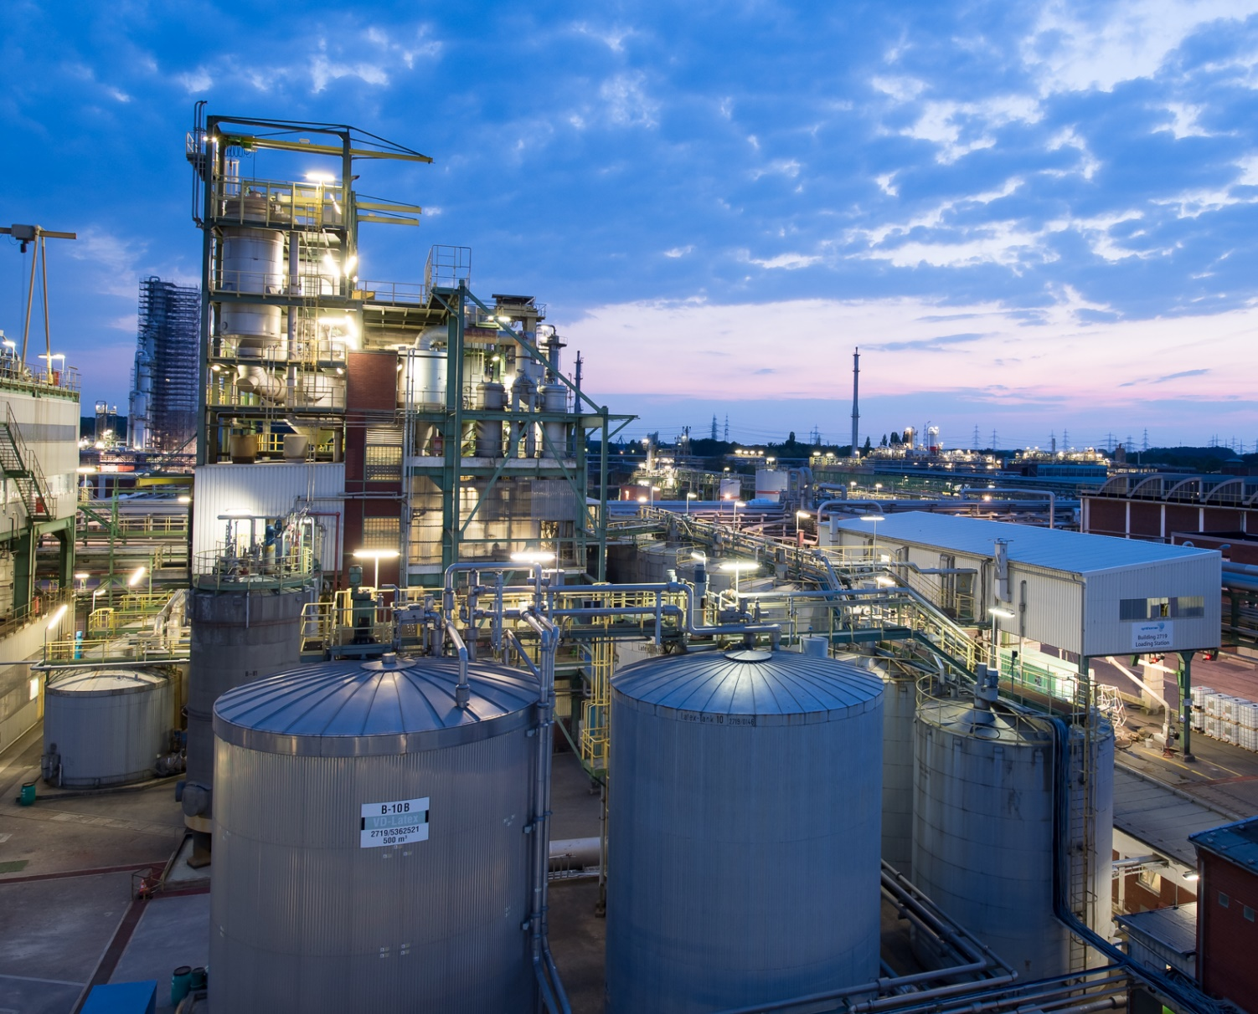



A leading global supplier of water-based and differentiated polymers with 2020 revenues of £1.65bn; Headquartered in London (UK)
An international footprint across 18 countries, with 43 manufacturing sites and 4 Innovation Centres located in Europe, North America and Asia
A strong track record of organic growth and M&A
ca. 4750 employees around the world
FTSE 250
Listed on London Stock Exchange since 1971; Market Capitalisation ~£2bn
Notes:
Showcasing some good practice from Synthomer

Slide 4

Assessing Process Safety Competence
Over the years, the process industries have developed systems for process safety management (PSM) and training courses to go alongside those systems to reduce risk.
However, all this knowledge is of no use unless it actually affects the way the process industries are managed and operated – Companies must make changes in their culture and the way they manage major accident hazards.
Given we all make mistakes, and that the best safety culture and the best safety management systems are still designed and operated by fallible people – how do we improve?
At an individual level, the answer is largely "competence". Individuals can only be usefully competent if they work in a system which is itself fit for purpose: giving them the appropriate tools, authority and time to use their competence effectively.

Slide 5
Defining Competence
Competence for an individual comes by recognising their own incompetences: recognising the boundaries of their own knowledge, experience and skills
Competence is also organisationally located - to be a person who can competently manage a plant in organisation X, does not make them automatically competent to manage even a quite similar operation in organisation Y. The new organisation and the individuals within it will be different; with different hazards to deal with.
An individual’s competence will also change with time, as they learn and the organisation's technology changes

Slide 6
Defining Competence
HSE’s CoMAH guidance describes competence as - “the ability to undertake responsibilities and perform activities to a recognised standard on a regular basis. It is a combination of skills, experience and knowledge.”
HSE’s assessment guidance - competency of the leaders of high hazard manufacturing sites – should be an essential part of any Process Safety Management System (PSMS).
The problem is –
  for Process Safety there is not a formally “recognised standard” on Competence Assurance.
  So how do we develop an assurance system?

Slide 7

Competence Assurance
A competence assurance system should cover the individual with overall operational responsibility for a manufacturing site, the individual with responsibility for the integrity of the physical assets on the site and the individual with responsibility for the implementation and performance of the process safety management system on site.
It is important to differentiate between personal competence and institutional competence. A good PSMS requires both. Dedicated, competent people cannot make up for an incompetent system and a good quality management system is rapidly undermined if it is run by incompetent people.
Good PS management systems identify what is important to different levels in the company - something which can change with time
In a competent PS system, appropriate PS KPIs should be seen by staff at every level.

Slide 8
A Competence Assessment Scheme
Step 1 - A competence assessment scheme should be assurance that the leadership of the company and of individual sites have appropriate PS competence.
Step 2 - The second step would be to develop each site's PS awareness and culture; particularly focusing on the front-line production, maintenance and engineering staff who operate or maintain the integrity of the process equipment.
Step 3 - The third step would be developing and sustaining the PS competence of personnel in the "front line": principally operators, shift team leaders and maintenance technicians.
The overall programme should be allied to an individual's training and development
Embedding a programme of development, assurance and maintenance of PS competence is essential if the organisational culture is to reach what the "Bradley Curve" defines as the state of “Interdependent Team Culture”

Slide 9

Competence Assessment
For front-line employees training and competence assessment is site based with PS comprising one - essential - part of the wider personnel development programme. For these employees, evidence of PS Competency is likely to include:
  training on PS essentials and local risk assessment;
  question and answer evaluation from supervisors; and
  documented observation of work being carried out.

Slide 10
Competence Assessment
A good deal of the above is essentially a description of UK and EU approaches to competence development and assessment. However, with the Industry and the Institution's reach stretching outside Europe, it is important to consider the situation elsewhere.
Our experience is in SE Asia, where standards and understanding are not the same as in the EU.
Across the whole SE Asia region, the international oil & gas industry leads the way in the use of publicly available PS leading indicators, which are used to measure PS performance and indirectly PS competence.
Most international oil & gas majors are committed to the use of API RP 754 "Process Safety Performance Indicators" and the Recommended Practice (RP) specifies one of its leading indicators as ‘the percentage of employees trained in process hazard awareness and risk assessment’

Slide 11

PS Competence Assurance – A Case Study
The Company first initiated background training and development
The company board and senior management team received process safety awareness training, based on OECD's document "Corporate governance for process safety: Guidance for senior leaders in high hazard industries" .
Many (~10%) company staff attended in-house week long sessions of IChemE’s Fundamentals of Process Safety course.
Having initiated the training, competence would be assured on a cascade basis:
  Key players on each site would be centrally assessed; and
  Their assessment would include consideration of the competence of site staff.

Slide 12
PS Competence Assurance – A Case Study
The key players were those in positions where they could significantly affect the PS performance of a site - and hence affect the performance and reputation of the whole company
They were expected to pass the assessment at the end of the FOPS course. Those failing were expected to undertake additional study and then re-take the assessment.
  Those attending included the site managers, the site engineers, and safety staff both group and site based, the chemists and process technologists.
  Other staff such as plant managers, warehouse managers, engineering staff of all disciplines, and other operations staff attended the course on a second round. They too took the assessment, though without the expectations that they should necessarily pass.

Slide 13

Case Study - Competence Assurance Programme
The best competency assurance systems are a balance of challenge and support.
In this case, the Company decided that the system should focus on challenging the individuals' understanding of the MAH on their site, the potential consequences of those accidents, and the barriers (prevention and mitigation) in place to prevent those MAH becoming real incidents.
It was decided that the assessors would be a senior member of the Corporate Safety team and one of the Operations Directors, normally the one with line management for the site.

Slide 14
Case Study - Competence Assurance Programme
The individuals should be able to demonstrate that they:
  understand the MAH of their site;
  have appropriate experience, attitude and ability to fulfil the leadership role required to give good PS performance;
  have suitable management systems and competent people in place to manage the PS performance of the site; and have thereby reduced the risk of major accidents to an acceptably low level.
The competence assurance process developed involves presentation, discussion, evaluation, feedback and appointment
The individual makes a presentation to the assessment team about the potential MAH on the site for which they are responsible. The presentation should cover the management controls and systems to prevent the MAH occurring, including an assessment of the people responsible for day to day operations and maintenance on the site.

Slide 15
Case Study - Competence Assurance Programme
Alongside the competence assurance process, and available to all individuals in the process, are a set of global PS expectations, a description of the responsibilities of site leaders and a criteria assessment sheet
The assessment team judge the individual based on their ability to demonstrate their knowledge of the MAH and how they are managed; and how well they have demonstrated their understanding of their personal role in the PSMS
Immediate verbal feedback, including any conditions or requirements, is given to the person being assessed and this is confirmed by a formal letter of appointment, with or without any endorsements. The letter only deals with matters of their personal competence.
Any gaps in the staff competencies required to manage the MAH on site are dealt with outside the individual's competence assurance process.

Slide 16
Case Study - Competence Assurance Programme
Where competence has not been adequately demonstrated, the Company's approach is to –
  Provide additional training or familiarisation with particular systems, to enable the individual to reach the required standard.
  Time and support will always be offered to enable staff to achieve the competency required to fulfil their role in the company.
  However, competency assessment must always have as a possible outcome that an individual has not effectively demonstrated the required competence for the role they are in and is judged not to be likely to be able to do so. A corresponding action should be set in the programme to allow for this outcome.

Slide 17

Case Study - Competence Assurance Programme
Note - that the assessment is for the individual in the specific role. If an individual judged competent in their current site engineer role (for example), moves to take up the role of site engineer on a different site they must re-demonstrate their competence in their new role with the changed MAHs on the new site

Slide 18
Developing the System
The Company has now included the generation of a new PS training package focusing on the company's own particular risks and PS management system. This has had the advantage that the package can be given to a wider range of staff, notably to process supervisors, process managers and some operators.
On specific sites, where the PS competence system is being developed, the company chose to assess the plant shift supervisors before the production managers. This was seen as appropriate as out of hours shift supervisors are the highest level of management available on site and hold ultimate management responsibility on behalf of the company, for roundly 75% of the time.
Recently, the Company has extended PS competency assurance to operators and maintenance technicians.
  In preparation for the assessment, operators and technicians will attend a 1.5-day company PS awareness training session which focuses on principles of major accidents, basis of safety, layers of protection and the safe working envelope for their process operations

Slide 19
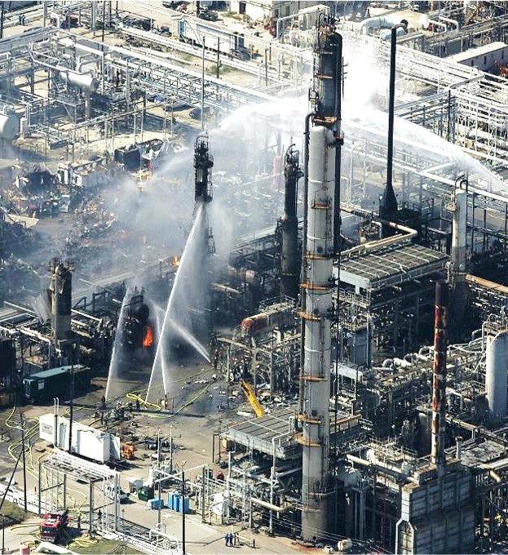
Developing the System
Plus - a 1-day site specific training session which focuses on site MAHs and the barriers in place to prevent major accidents.
This training is run as an interactive workshop, delivered using the site's local language.
  The training includes videos of major accidents, pictures, diagrams, and dialog sessions to explain the working principle of each barrier
  At the end of the training operators will be assessed, in their local language on their understanding of the company's PS principles, with the same options available as those for other staff members.

Slide 20
Conclusions
Process Safety (PS) competence assessment really is a "must do" not a "nice to have“.
This applies not just to “Major Hazard” sites but to all chemical processing sites where the hazard assessment shows they have the ability to have a serious safety or environmental accident
The Case Study describes an approach which has so far been sustainable and possible (but not easy) to fulfil within reasonable resource limits
  It is a continuous process, requiring new managers to be assessed as they take up new appointments.
  The approach is tailored to the different responsibilities of individual managers; and asks them to consider the Major Accident Hazards (MAH) on their sites and how the MAH are controlled
  It requires site managers to demonstrate their understanding of their site and its MAH, and to consider the competence of their staff, both individually and collectively across the site.

Slide 21
Thank you
Any comments or questions?

