Slide 1
October 18-20, 2022 | Hazards 32
Elevating Competency Frameworks through eLearning Solutions: Lessons Learned from COVID & Beyond
Kristin Robbins, Senior Director, PSL BU
robbins.k.tx@ioMosaic.com
Lisa Ruth, CPSM, Vice President
ruth.l.tx@ioMosaic.com

Slide 2

Kristin Robbins – Senior Director, PSL Business Unit
M.S., Corporate and Organizational Communication, Northeastern University
M.A., Media Studies, Brock University
10+ years’ experience in
  Strategic planning
  Marketing
  Communications
  Organizational development

Slide 3
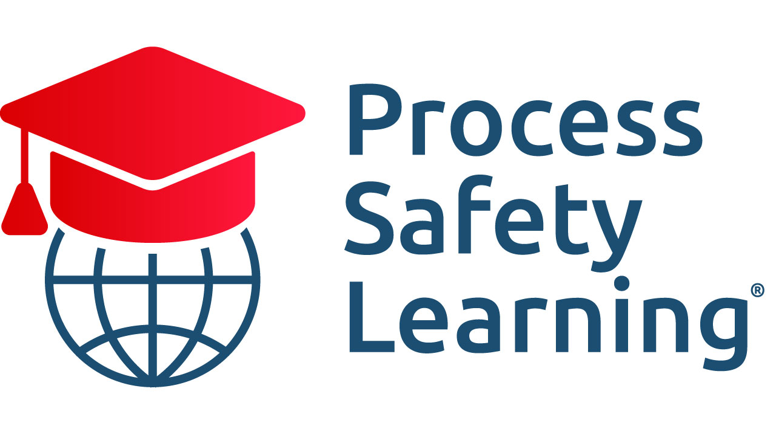
Agenda
Background
ISC roadmap & LMS benefits
Case study: Before/after of Lessons Learned highlights
Source: Process Safety Learning®, ioMosaic Corporation

Slide 4
Background
Notable roadmap plan: Process Safety Competency Guidance by IChemE ISC
Six practical steps for competency framework implementation
Paper examines:
LMS champions competency-based training to strengthen competency development and overall safety performance
Enhancing competency frameworks via Learning Management System (LMS)
Formal training and competency mapping is key

Slide 5
The case for competency
Competency development and training is fundamental to proper process safety
Shifting times
Pre-COVID: Global competency crisis looming
COVID: Online Learning Environments (OLEs) skyrocketed & disruption to “preparedness”
Post-COVID: Leap in value for integrating learning technology & new definition for competency
LMS enhances competency development programs

Slide 6
What is a Learning Management System (LMS)?
Delivers and manages eLearning programs
Acronym represents:
L = Learning
Delivers training courses and programs
M = Management
Manages all courses and learners with automation features
S = System
Single, central system
Admin interface and user interface
Learning ecosystem

Slide 7
Competency development framework steps
Determination of required competency level
Alignment with competency criteria
Alignment with organization roles
Develops plans to address competency gaps
Monitor
Review and update

Slide 8
LMS supports #4: Develop plans to address competency gaps
Competencies are developed incrementally module by module (aka microlearning)
Embeds development activities into organizational culture
Personalized learning journeys
Promotes continuously learning to sustain desired competency levels

Slide 9
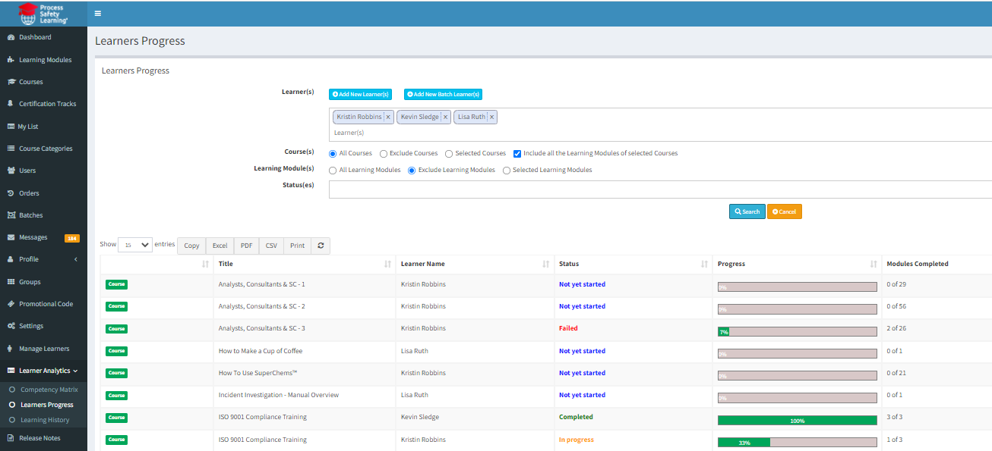
LMS supports #5: Monitoring – Learner analytics
Tracks learner progress
Source: Process Safety Learning®, ioMosaic Corporation

Slide 10
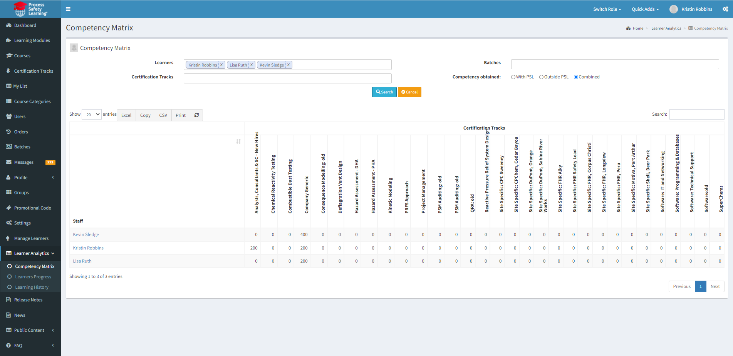
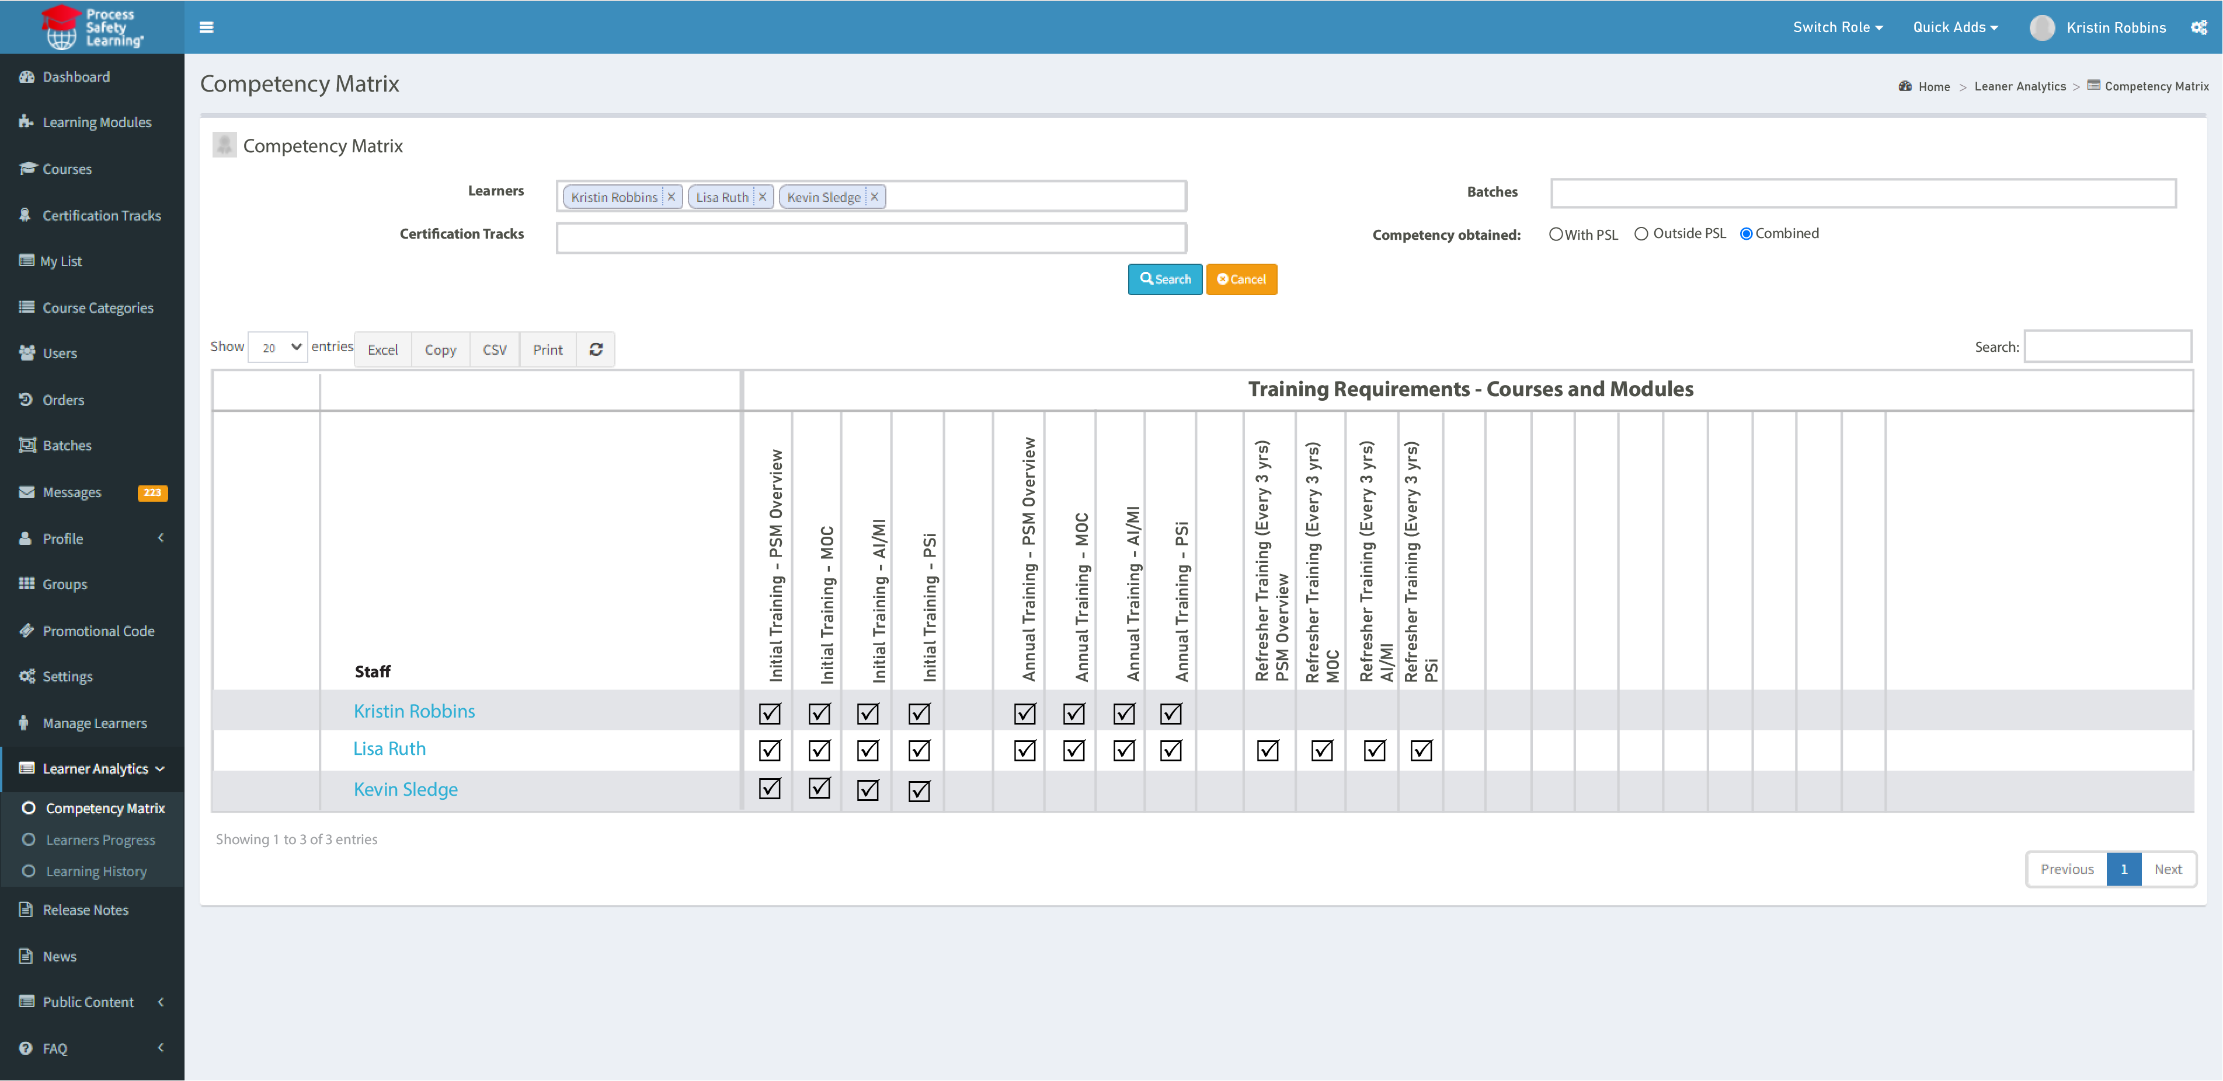
LMS supports #5: Monitoring – Organizational analytics
Quantifies competency via benchmarks
Source: Process Safety Learning®, ioMosaic Corporation

Slide 11
LMS supports #6: Reviewing and updating
Analytics highlights gaps to inform review
Simplifies and expedites new content or updates
Automates process for renewal/refresher training

Slide 12
Clicking up competency: Case study #1 – Pre-COVID
PSM training for >100 employees globally to enhance competencies & upskill
Learning became the “work” event
Pandemic prompted investment & scale up development activities/training
Results: eLearning enriched accessibility to training & empowerment to improve competencies

Slide 13
Lessons Learned highlights from case study #1
#1 – Elevated significance of a competent worker
#2 – Reversed flow between learning and work
LMS helps circumvent the unprepared Increased trend of more L&D from employees
Normalized learning events makes LMS adoption and integration easier
LMS cost-effectiveness = training investment more feasible

Slide 14
Clicking up competency: Case study #2 – Post-COVID
Flexible learning solution
Scaled and evolved with organizational needs
Easy, adaptable & integration into routines
Results: LMS became continuous learning tool to close gaps & sustain competency levels

Slide 15
Lessons Learned highlights from case study #2
#3 – Rise of personalized learning
#4 – Future is here: eLearning
Meaningful and relevant training
Training landscape has changed
50% reduction in development costs
Learner-centric
300% acceleration of learner development

Slide 16
Key takeaways
LMS supports ISC's guidance on process safety competency
LMS enhances competency frameworks
Microlearning develops competencies incrementally to resolve gaps
Tailors learning journeys; supports competency mapping and succession planning
Results: Boosted retention, more engagement, and acceleration of competencies to cultivate stronger process safety
Robust reporting efficiently monitors competency levels
Automation features streamline and simplify management of training

