Slide 1

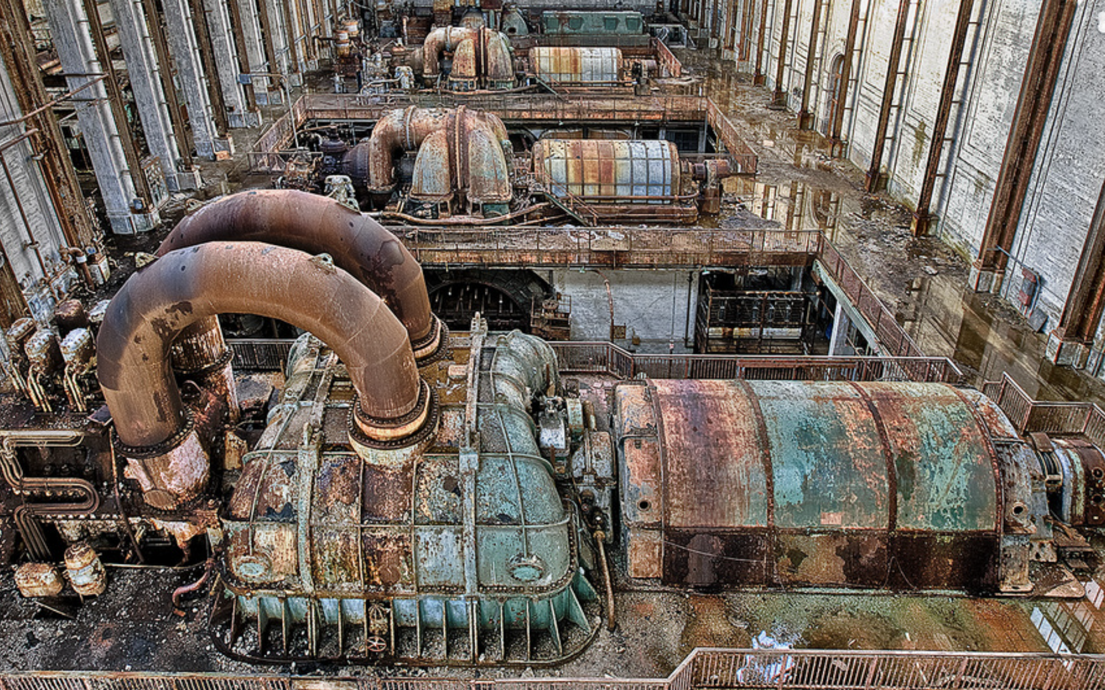
Ageing Plants – Corrosion is the Real Enemy but there are other problems
Eur. Ing. Robert Canaway B.Sc., C.Eng., F.I. Chem.E., M.I. Mar.E.
Managing Director, Suregrove Limited, 20 White Beam Way Tadworth Surrey KT20 5DL suregrove@btinternet.com
Hazards 32
Companies have had to prolong the deployment of their facilities beyond their intended life due to:
Increased growth worldwide increasing the demand for products particularly in developing countries.
Prohibitive costs for new replacement plants.
State employment requirements.
Sales (often complete plants) to buyers.
The main concerns are corrosion, erosion, wear and tear, obsoleteness.
1

Slide 2
Corrosion is the real enemy costing owners millions per annum in every country.
It is one of the most potentially damaging losses to any commercial, private, or industrial property.
An estimated one-sixth of all new worldwide steel production is used to replace corroded metal - corrosion problems are increasing in frequency and severity, not decreasing. Reasons - are declining material quality (cheaper less sustainable products are demanded for plants under design/construction) and inadequate corrosion control engineering combined.
The corrosion of steel piping/fittings/vessels/towers/drums/heat exchangers and so on is a continuous and virtually unstoppable process. The end product is commonly rust which is simply the result of an electrochemical reaction through which the higher energy-processed metal is slowly reverted back to its naturally occurring form: metal ore.
Many high-corrosion scenarios result from unaddressed problems not only in process areas but also in the secondary support systems such as utilities and offsites. They can be inherited from a previous owner or operator who was not effective at recognizing/controlling a corrosion problem.
Apart from fire, corrosion represents the most serious threat and monetary loss to any facility, causing decline in heat transfer efficiency and plugged piping to pinhole leaks and temporary shutdown for repairs. If there is a loss of containment due to component failure, there could be a fire/explosion and also the potential for a Vapour Cloud Explosion (and catastrophic loss). Corrosion also causes flood damage, loss of production, and personal injury.
This paper describes 30 types of corrosion/erosion which
can be found in ageing industrial plants and suggests the remedial
actions that are usually required to correct the problem.

Slide 3
Key Identifiers (KIs)
which lead to plant failure:
Changes in operating conditions
More aggressive feedstocks
Corrosion Under Insulation (CUI)
Inadequate inspection regimes
Material mismatches
Overdue retirements and obsoleteness
‘Mothballed’ plants which do not have oxygen or water free atmospheres
Thermal cycling caused by too many start-ups/shutdowns per annum
Plant location (coastal plants tend to suffer higher corrosion rates than in-land facilities due to the saliferous environment and humidity)
Effects of nature such as microbiological attack
Events such as seismic damage caused by earthquake, flooding, windstorms and so on
Deteriorations caused by variance in soil conditions, stray electrical currents,
biological effects (pipelines); stress (all plant),
low point water accumulation and unstable flow regimes.

Slide 4
Lifespan Technical Examinations (LTEs) are becoming common place to establish the possibility of extending the operation of a plant. These often make recommendations to the plant to improve its integrity.
Mature sites have some key advantages such as generous equipment and pipework thicknesses (overdesign) and use of high-quality reliable materials although spares availability is obviously a concern.
This paper also considers retirement criteria such as inefficient production, high maintenance costs (corrosion and erosion) and safety issues. Downgrading of system pressures have to be made when pipework shows thinning, and this can also occur in pressure vessels with costly total replacement. The use of clamps is discussed which have either been used to seal leakage or are rated for full pressure.
Four Case Studies are provided to demonstrate classic failures; the risk of mixing old obsolete equipment with newer plant leading to error in maintenance; gradual tank corrosion leading to major environmental pollution; operational limitations posed by retaining antiquated instrumentation and failure to modernize; particulate or dust explosions caused by erosion.
The effect of the current pandemic will be discussed.

Slide 5
The current COVID pandemic has created five problems: -
Unavailability of international specialists to check site equipment for problems and a backlog of tasks to be completed.
Supply chain interruption for all types of equipment, components and materials, replacement parts and spares.
Maintenance/Inspection Deferrals or scope reductions.
Some owners have had to mobilize an extra contractor workforce to cater for teams required to isolate, illness and failure to attend their sites.
Delay in modernization programme implementation.

Slide 6
2.0 Inspection Data is the Key
Rigorous inspection program for to continuously assess their physical condition. This will entail: -
Maintaining comprehensive inspection and maintenance records⁽³⁾ which can be trended to illustrate changes in corrosion, erosion, wear, and tear. Typical areas for examination are tower trays and internals, lined or clad vessels, pump impellors, compressor and turbine rotors, seals and bearings, high-temperature services such as tubes in furnaces/boilers/exchangers, all types of pipework, pipelines and trunklines. Typical NDT techniques which are suitable are: Visual Inspection, Ultrasonic Thickness Measurement, Ultrasonic Phase Array, Radiographic Testing., Measuring Vibration, Penetrant Test.
2.1 Other Criteria for Investigation
Noting the design basis of devices which generate heat (such as control systems, electrical equipment, instrumentation). Climatic changes may increase the temperature in enclosures/rooms and create a need to install more HVAC system capacity to prevent overheating.
The adequacy of cooling systems (water, air etc.) can deteriorate overtime due to corrosion, fouling, wear and tear and this needs to be evaluated.
Pump wear can reduce the performance (e.g., Firepump wear means that the design flow cannot be achieved).
Methods of pipeline inspection need to be considered where intelligent pig inspection cannot be used for buried locations such as through tunnels, submerged under water. Guided wave and ultrasonic testing systems can be deployed.
RBI (Risk Based Inspection) cannot be used for reducing maintenance unless complete certainty is known that similar systems are in identical condition.
Subsidence and collapse can occur through drying out of foundations. Regular inspection using theodolite measurements are advised to discover movement.
Damage will occur if the site is subject to earthquake, windstorm, cyclones, hurricanes, volcanic ash deposition, flooding or tsunami. Following any natural peril event, the plant should be checked for any form of damage.

Slide 7
2.2 Typical Trend Calculations
T_{A}-T_{Min} = Thickness Remaining (mm) where T_{A} is the actual measured thickness and T_{Min} is the minimum required to meet the design conditions.
R_{D} = Rate of Wear = mm/year
So (T_{A}-T_{Min})/ R_{D} = Remaining life (years)
Many plants incorporate a corrosion/erosion allowance (usually 3-6mm in pipework or vessels) which supplements the design thickness. When this has been lost there is a no safety factor, and the plant will be able to meet the design conditions providing there is no further deterioration. Can the plant cope with the Maximum Operating Working Pressure (MOWP)? If not, then replacement is required.

Slide 8
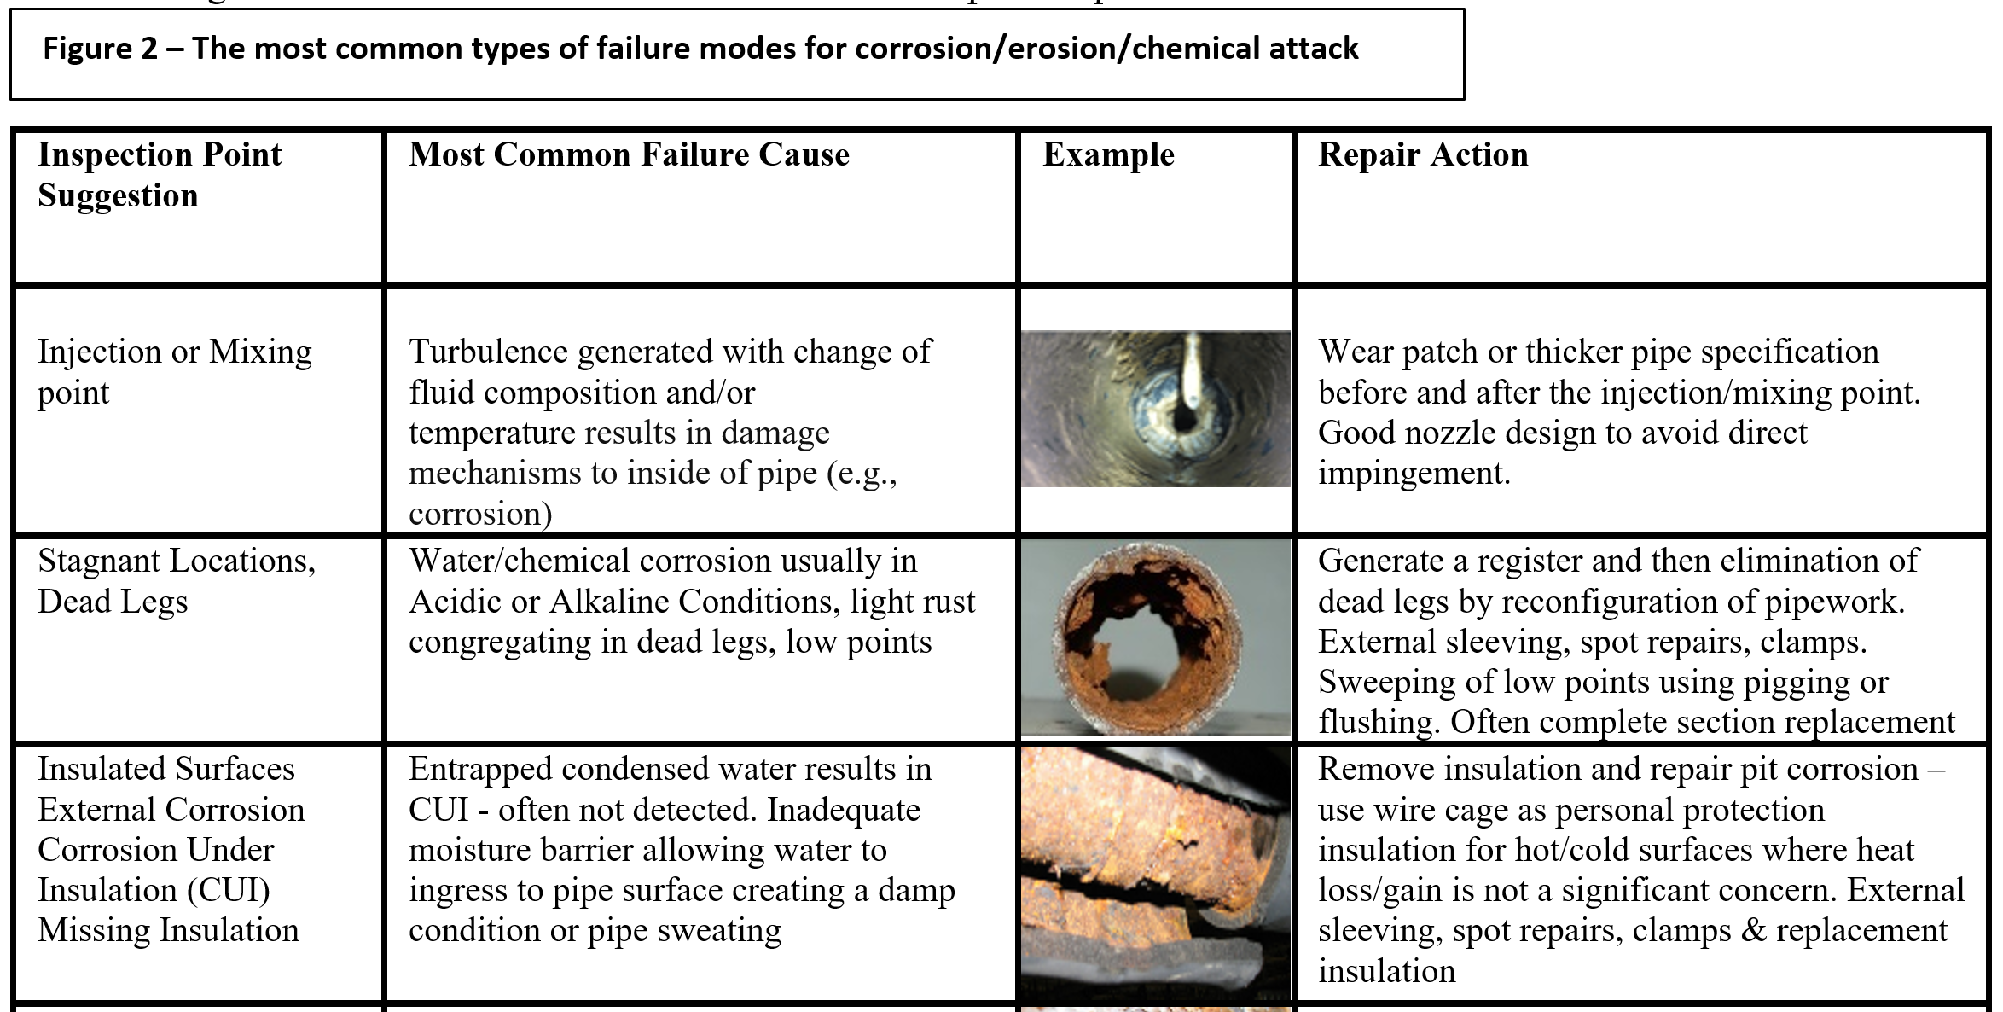

Slide 9
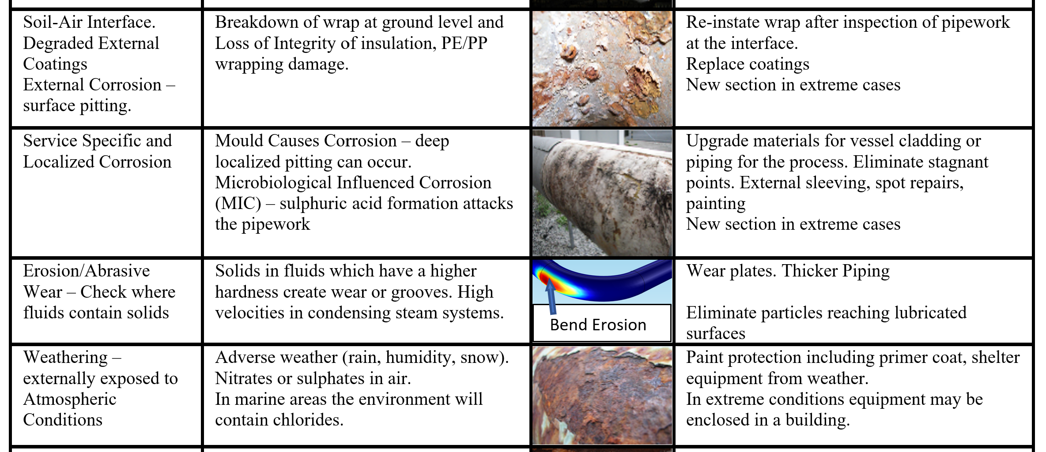

Slide 10
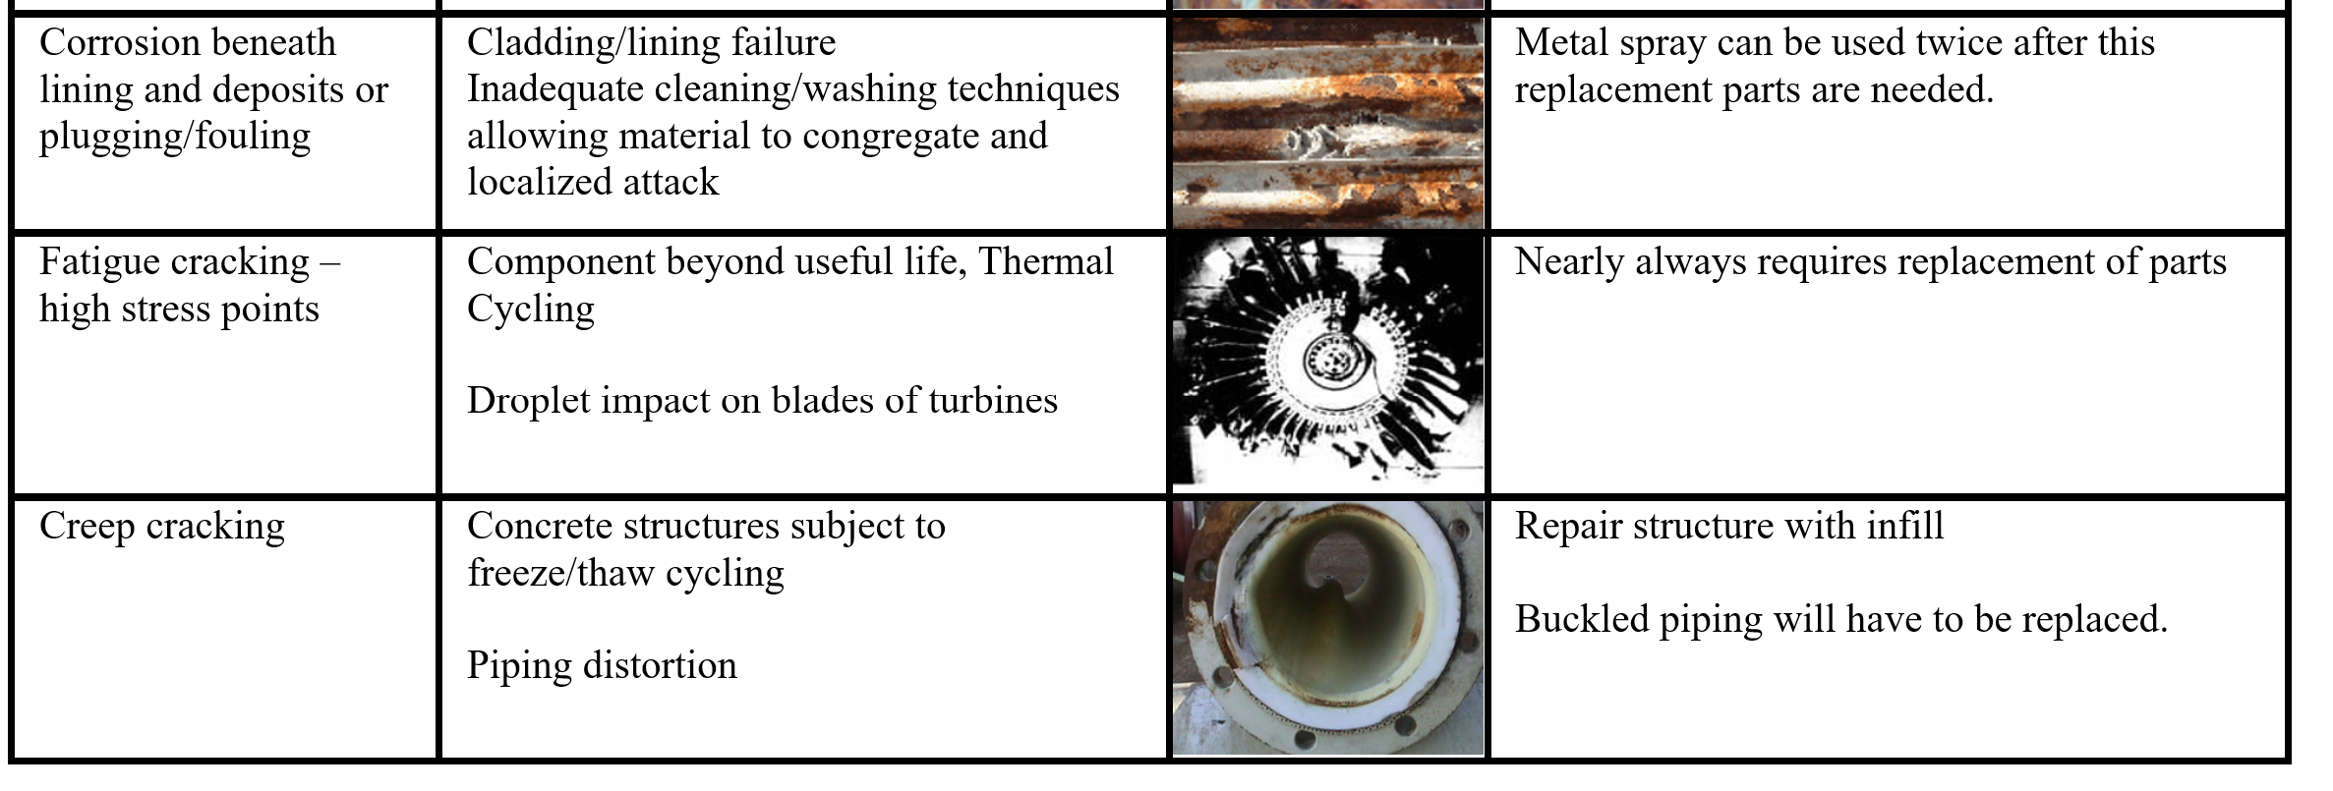

Slide 11
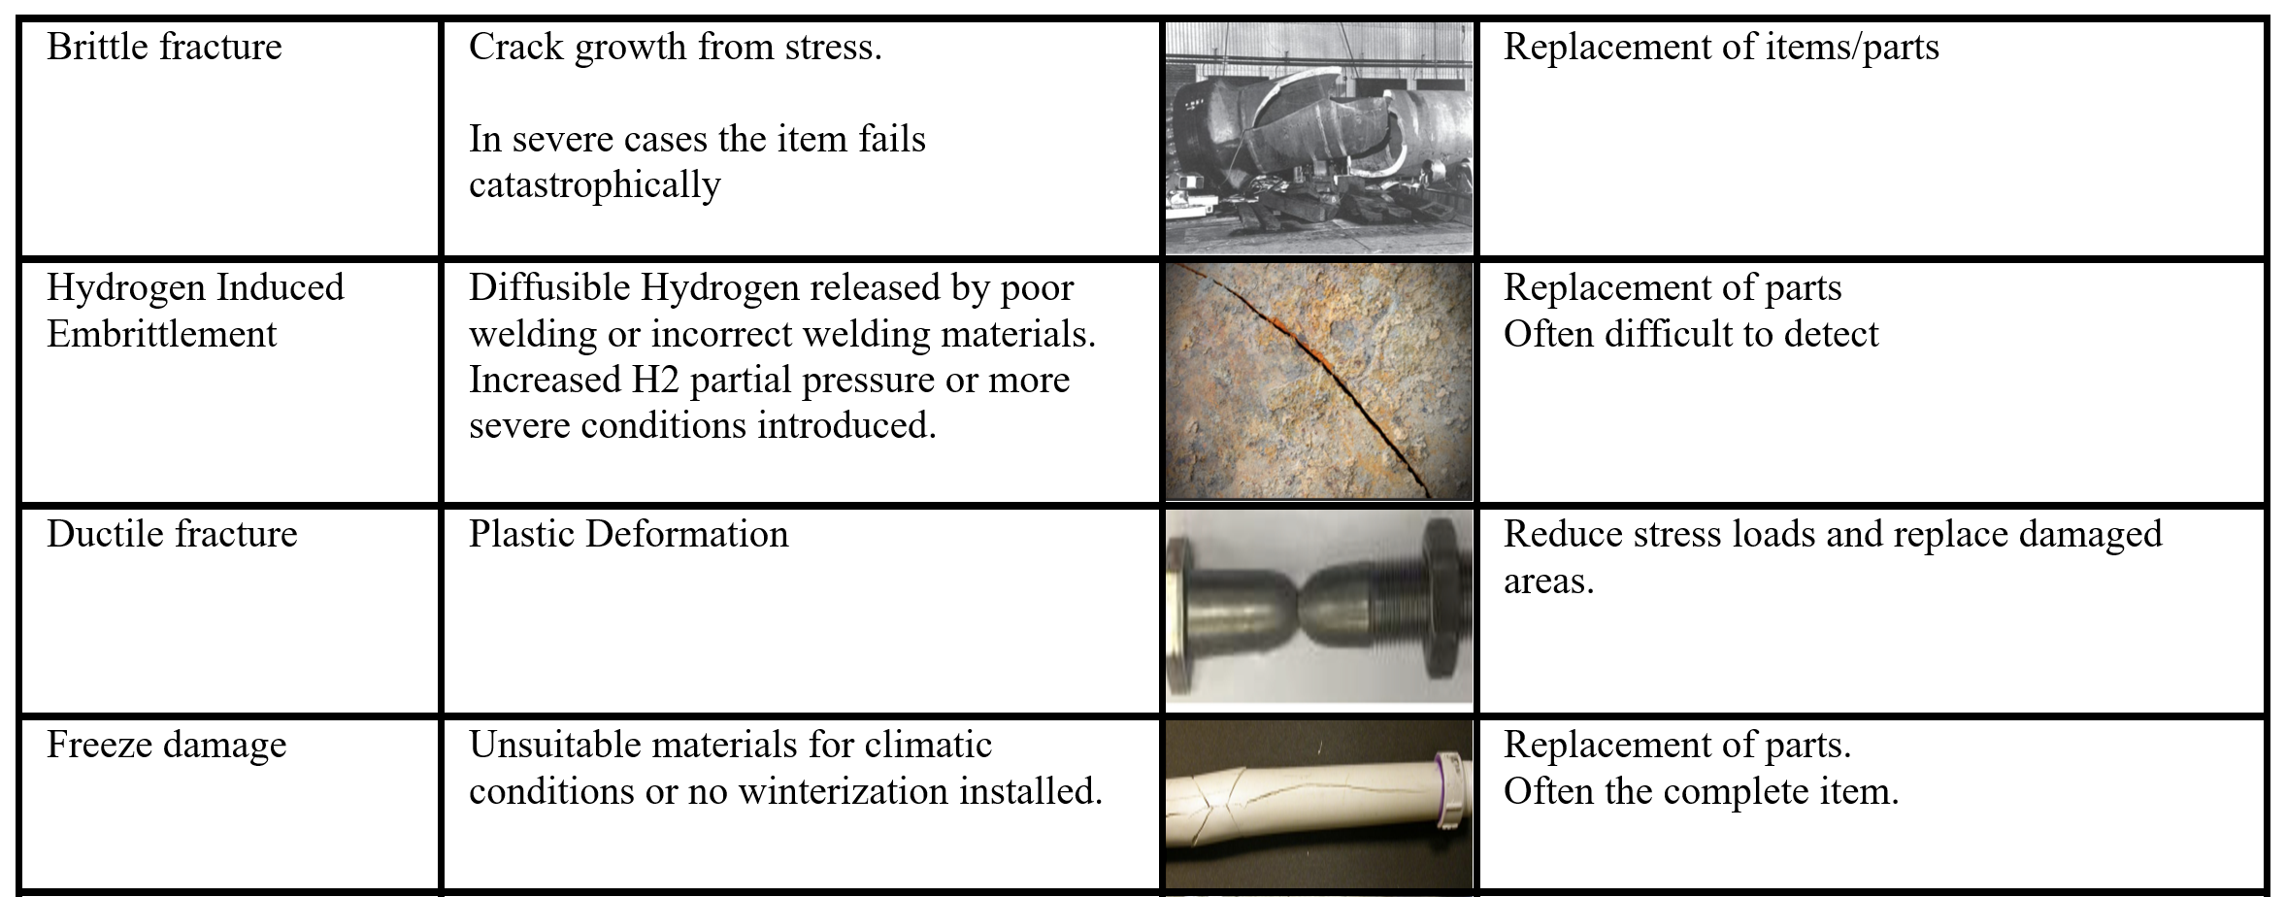

Slide 12
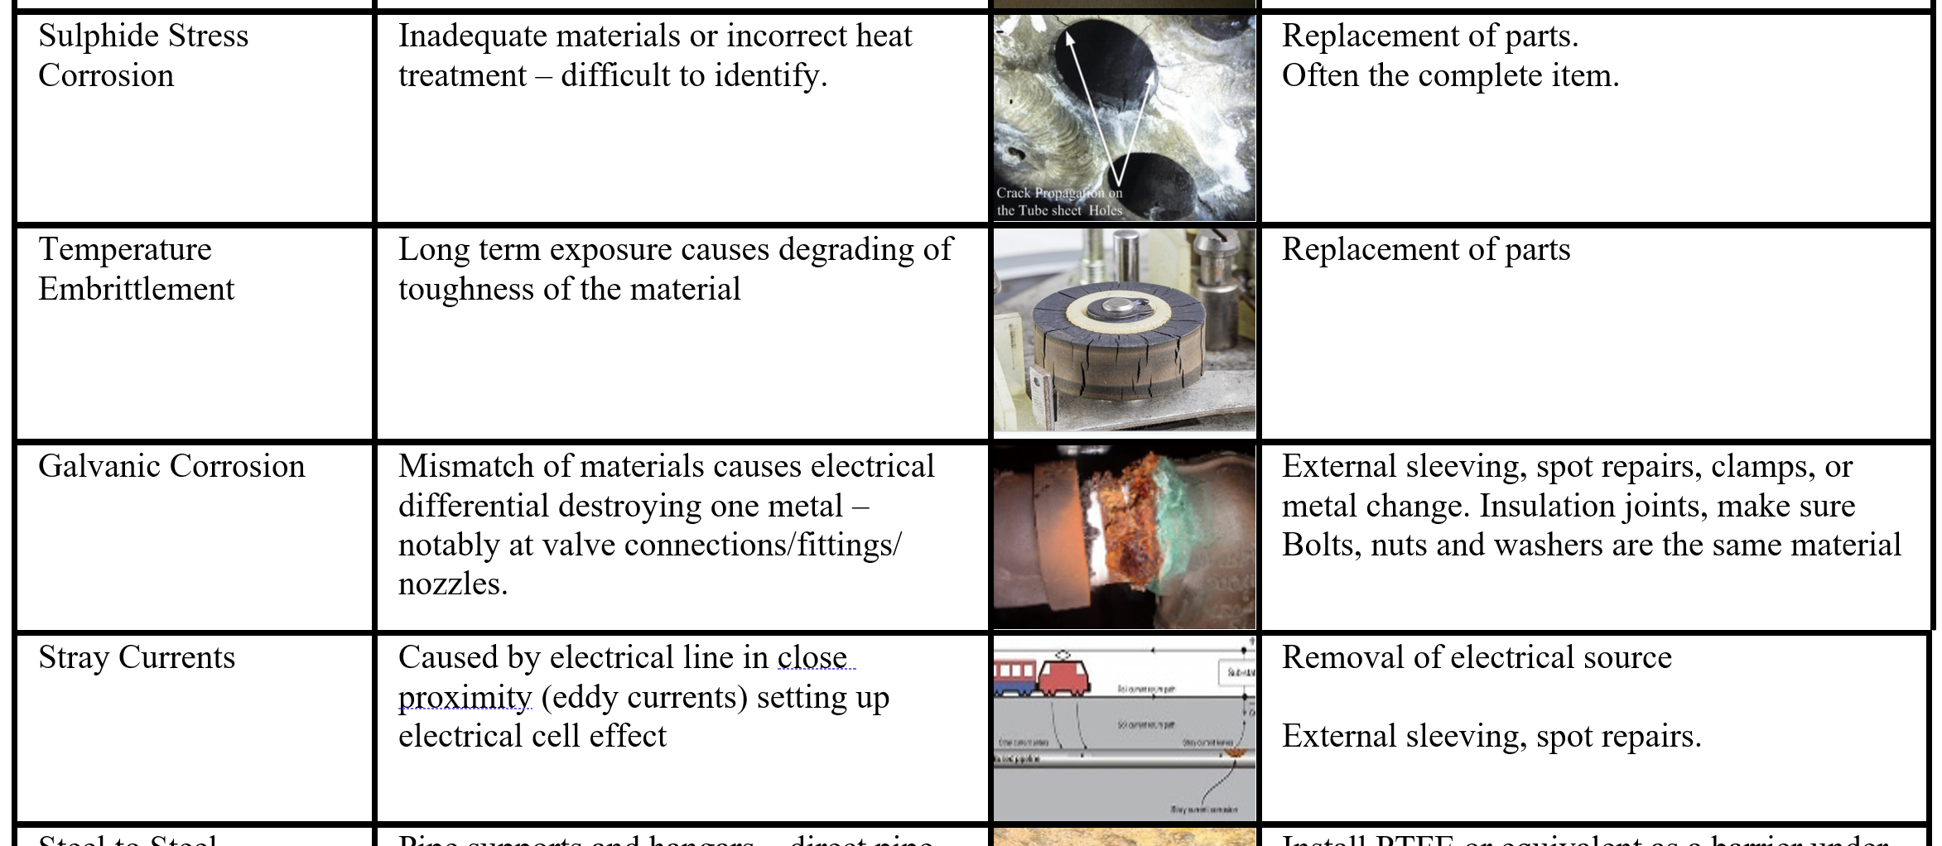

Slide 13
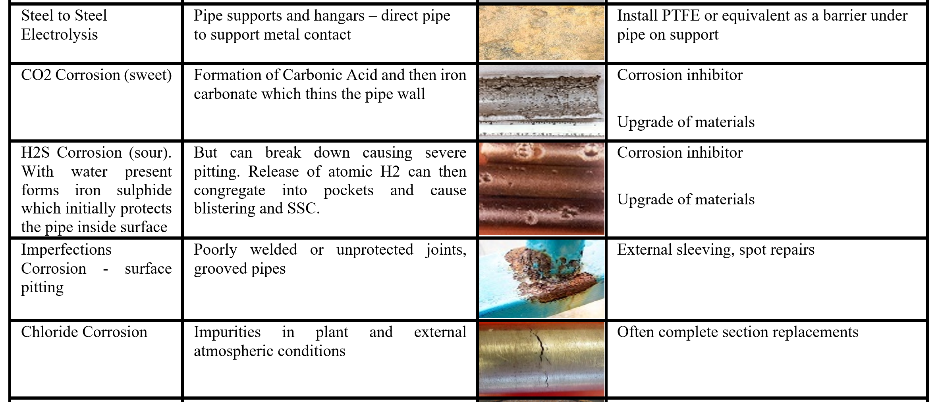

Slide 14
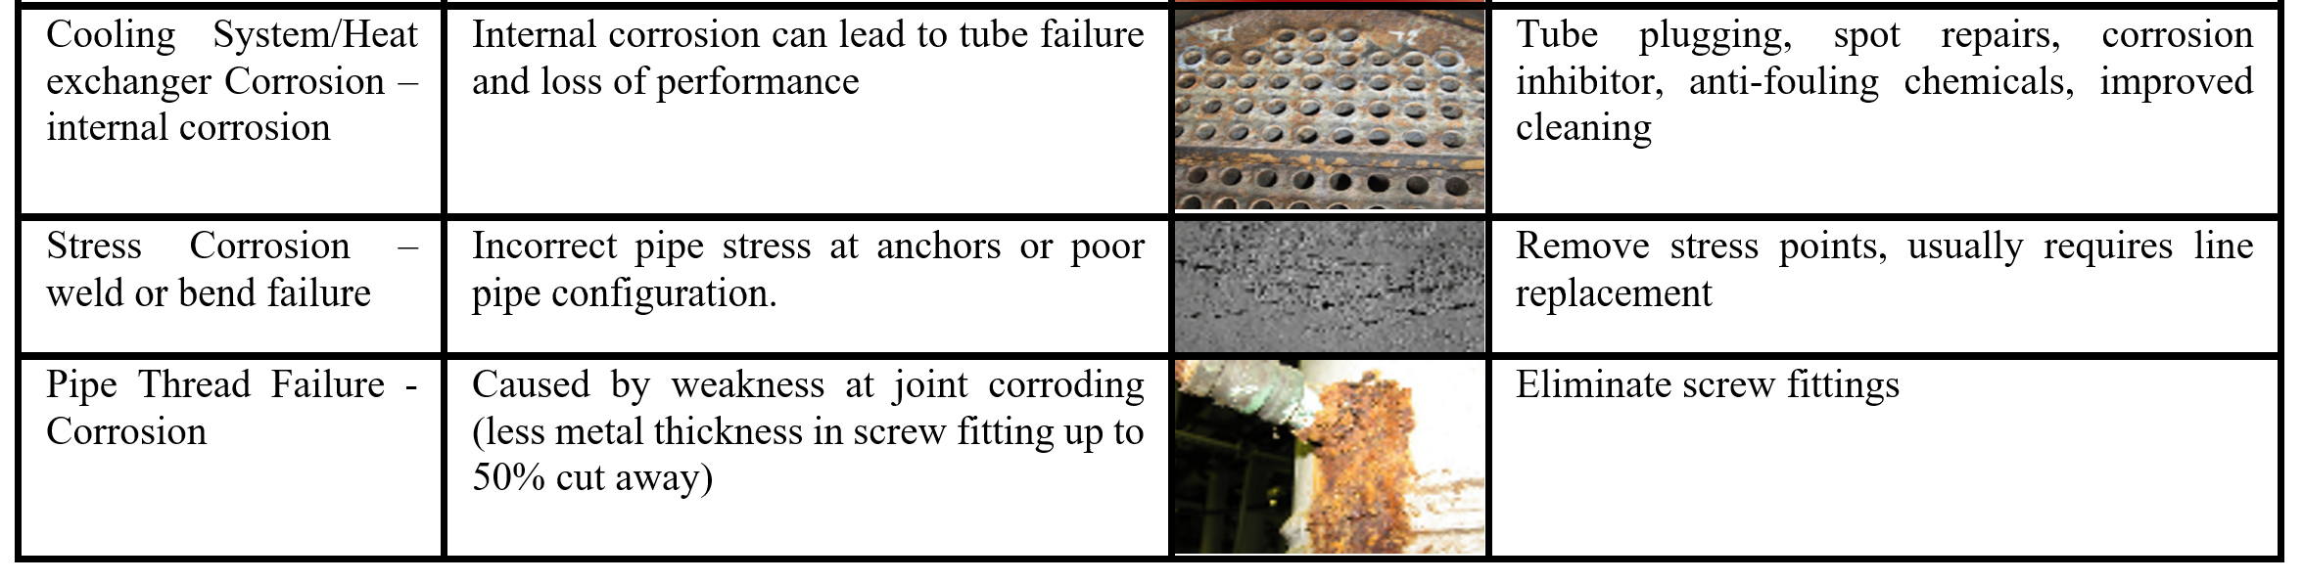

Slide 15
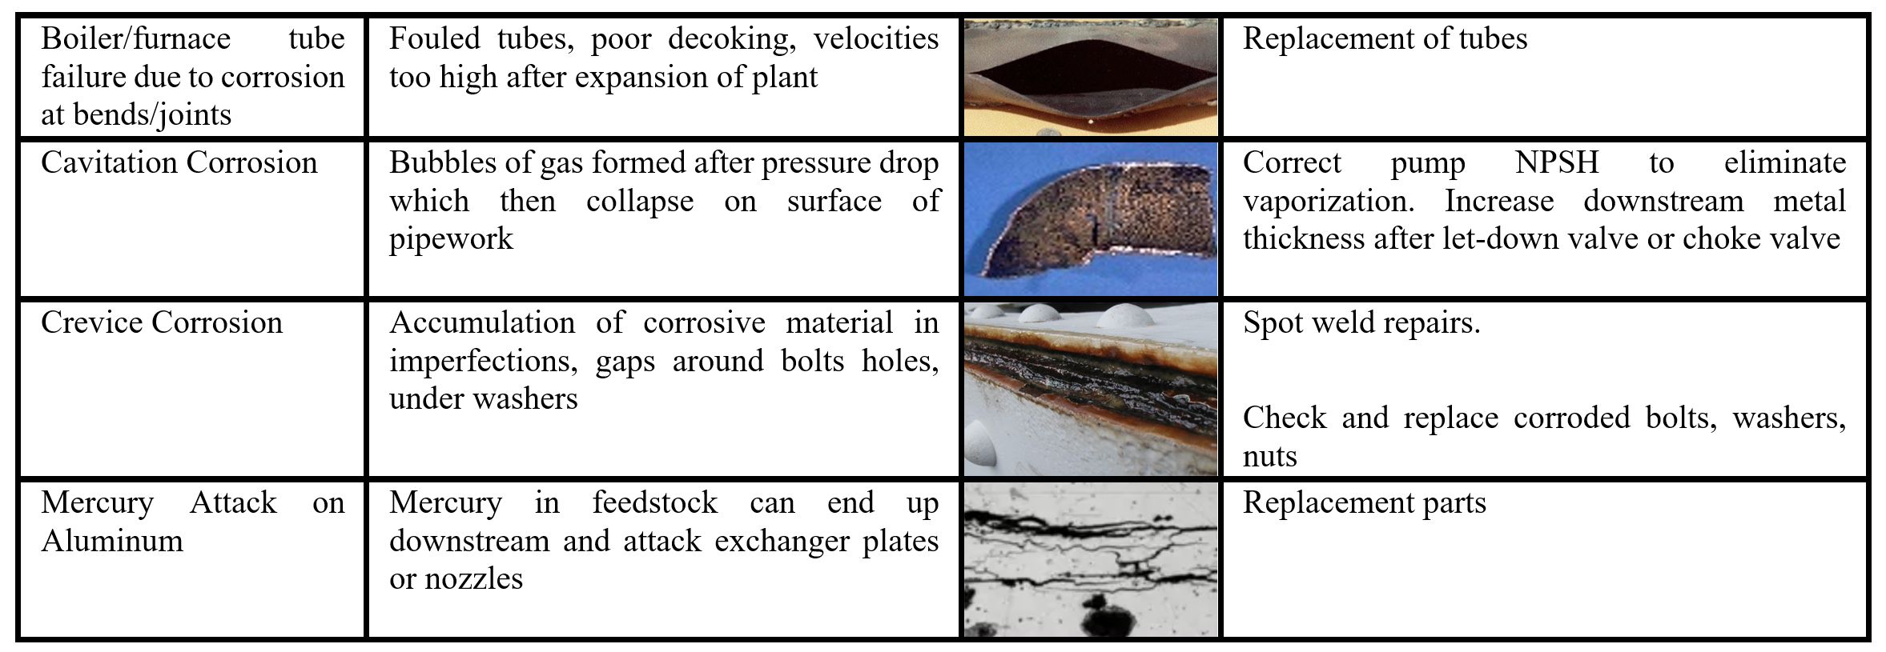

Slide 16
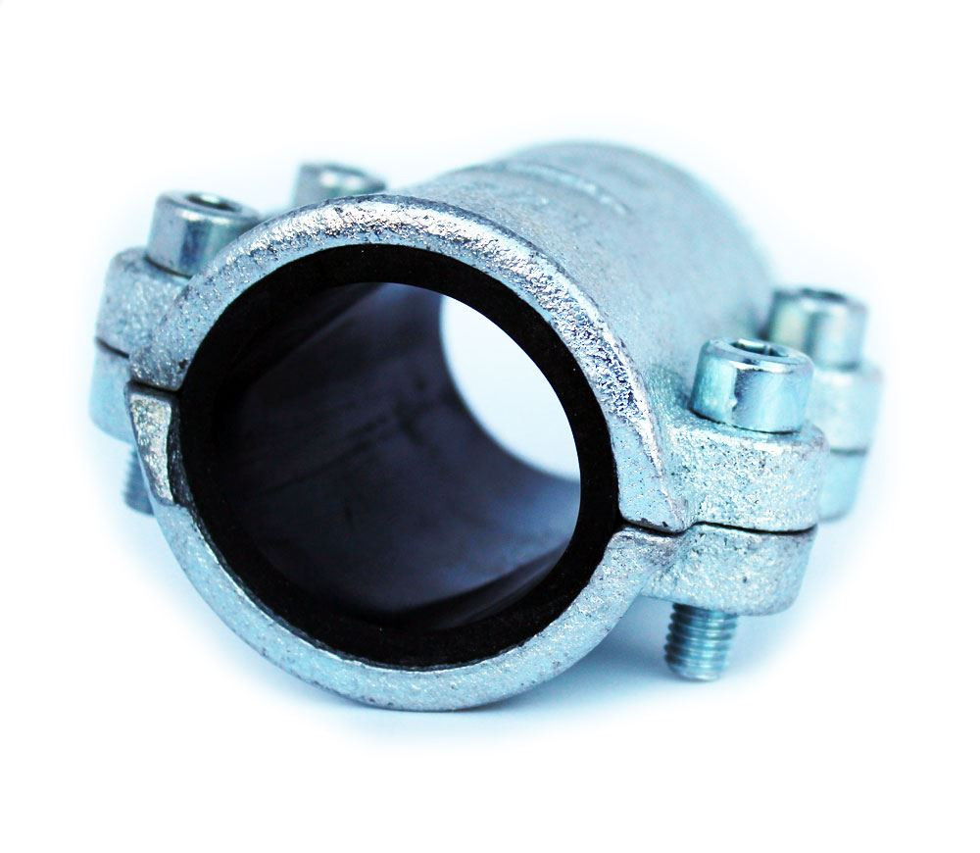
4.0 Critical Aspects Leading to Failure & Remedial Measures
4.1 Vessels/Pipework
Metallic equipment/piping - external and internal corrosion.
Externally - acidic atmospheric pollution - condenses on the pipework/vessel (often under insulation) - CUI & CUS
Internal - will occur whenever acidic or alkali conditions can occur, oxygen, water is present.
Pipe repairs – temporary clamps to the replacement of entire piping systems.
Too many clamps require regular inspection and maintenance
Cannot be removed until the next turnaround which may be 3-6 years.
Corrosion coupons have some benefit but are not completely reliable in reporting the complete picture.
Two very positive aspects of mature plants:-
Vessels often made with generous steel thicknesses & therefore long lifespans. Studies on lifetime extensions indicate that 10-15 years is often possible on some pressure vessels after 40 years service.
Steel quality was often a high priority thereby reducing the effect of corrosion.
Pipework is the main concern as these were normally calculated on the design conditions plus corrosion allowance, however, increasing flowrates in expansions or revamps and more severe process conditions can lead to faster erosion and reduced design margins. Bolting also can deteriorate over time and also the use of incorrect bolts, nuts (size or material) is a concern. Old gaskets often leak and need to be replaced (tightening up may damage the fitting).

Slide 17
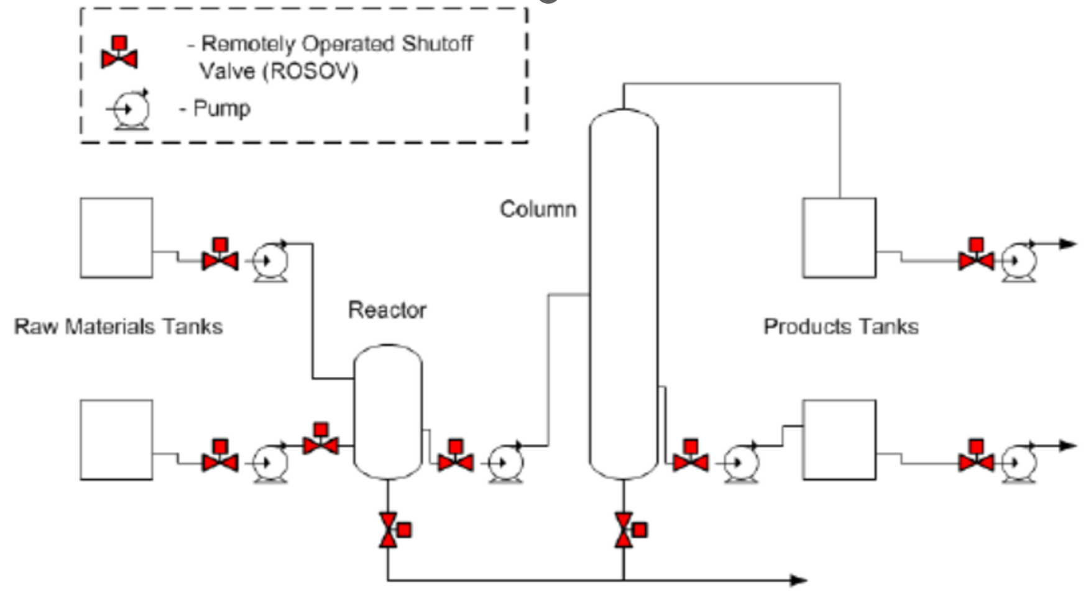
4.2 Valves
More mature plants - lower level of automation - fewer remotely operated shutdown valves to isolate major inventories.
Valves which are not regularly opened/closed (ESD/relief valves/blowdown) will ‘stick’ in some services and fail to perform. Except for full bore valve types, the valve internals will provide a restriction around which contaminants, solid particles can accumulate.
Power systems’ substations switching valves (particularly oil-filled mechanical devices) can fail without regular testing and maintenance.
Reliable valve suppliers are important to avoid early change-out or repairs. Selection of an appropriate valve trim material for a specific due is essential particularly if the service can experience erosion. Valves which cannot be locked in position (such as flare lines to PSVs) should be replaced so that a LOTO system can be enforced (Lock Out Tag Out).
These valves are often missing.
Some block or control valves can only be maintained
by removing integral bolts (exposing the internal line conditions) and this has resulted in accidents (Case Study No.1). Also, a number of stem failures have been noted,
caused by acidic material leaking past seals.

Slide 18
PROBLEM AREAS
ViBRATION – POOR MONITORING In OLDER PLANTS
EROSION – HARD PARTICLES DAMAGE LUBRICATED PARTS
SEALS – OFTEN SINGLE – EVEN FOR LIGHT HYDROCARBONS
CANNOT EASILY CONVERT TO DOUBLE SEAL
SPARES – NOT AVAILABLE
VIBRATION
EROSION
ROTATING MACHINERY
SEALS
SPARES

Slide 19
PNUEMATIC/
ANALOGUE
PROBLEM AREAS
REQUIRES TUBING CONNECTED
TO CONTROL ROOM
CABLING DECAY
OBSOLETE PARTS
ADVANTAGES OF DCS
OCCUPIES SMAlLER VOLUME
SMART TECHNOLOGY
DATA COLLECTION & PROCESSING
PAPER/OIL FILLED CABLING?
FLOAT GAUGES ?
ELECTRICAL/INSTRUMENTATION
RELAYS?
CHART INK RECORDERS?

Slide 20
BOILER /FURNACE
FIREBOX CONDITION
POOR
MATERIAL
SELECTION?
CLEANING PROBLEMS
DIFFICULT TO DETECT INTERNAL CRACKS
HEAT EXCHANGER FOULING/
CORROSION/
EROSION
PROBLEM AREAS
TUBE LIFE DETERMINATION
DETECTION OF PIN-HOLE LEAKS/CRACKS
INCORRECT MATERIALS SELECTION
INADEQUARE CLEANING
IMPORTANT ASPECTS
REPUTABLE SUPPLIER ESSENTIAL
PROPER BuRNER MANAGEMENT SYSTEM
WELDING INTEGRITY
gASKET SELECTION
FIRED EQUIPMENT & HEAT EXCHANGERS

Slide 21
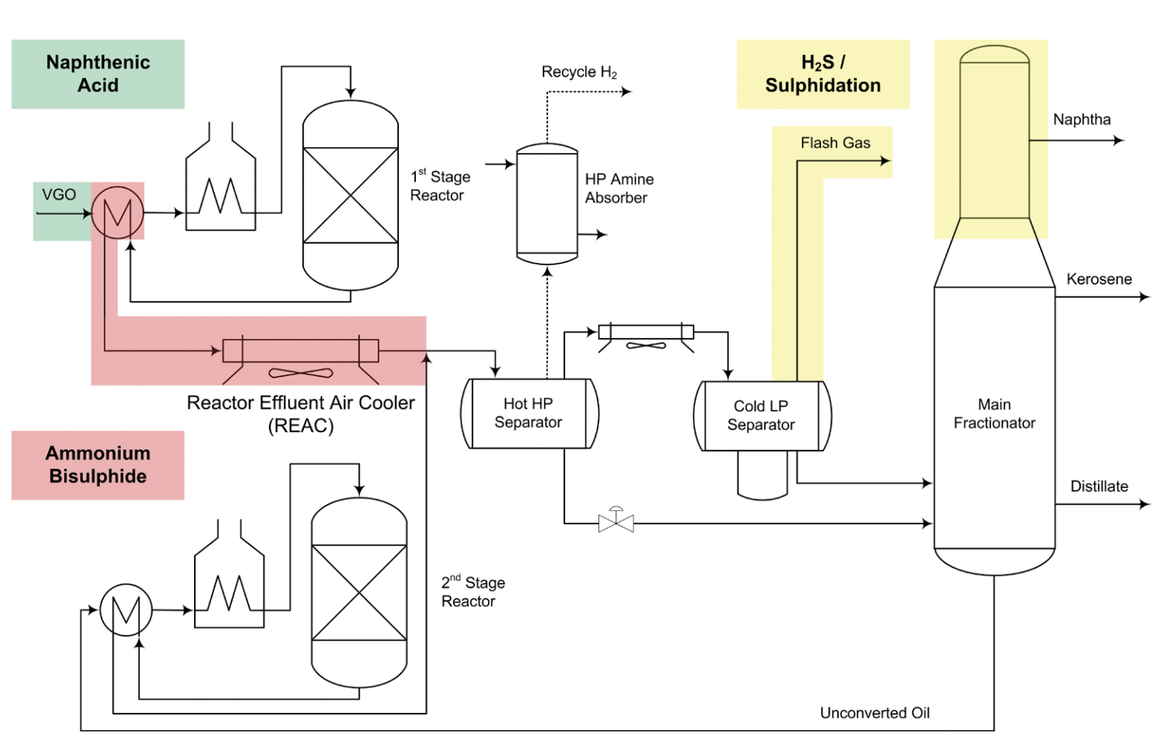
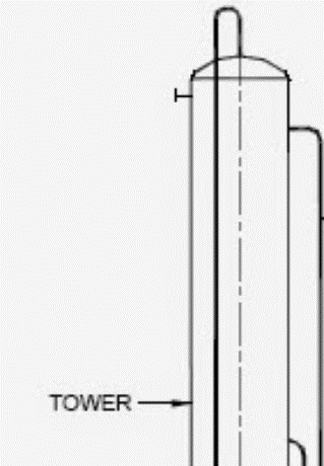
Difficult Areas to inspect – unfortunately these areas may experience the highest corrosion rates
Figure 4 – Tower Top

Slide 22
TANKAGE
PRESSURERISED
CUI (COLD TANKS)
FLOOR PLATE & ROOF CORROSION
ATMOSPHERIC PRESSURE STORAGE
PROBLEM AREAS
RIVETTED DESIGN EVENTUALLY LEAKS
FLOOR CAN LEAK INTO ENVIRONMENT
POOR WELDING SHELL TO FLOOR
ABSENCE IF ANCHOR BOLTS
INADEQUATE PILING
CUI (COLD STORAGE)
IMPORTANT ASPECTS
INPECTION INTERVALS & SCOPE
INTERNAL COATING TO RESTRICT CORROSION FROM FREE WATER
DUPLICATE LEVEL MEASUREMENT

Slide 23
FLARE/VENT/
BLOWDOWN
LEAK DETECTION
SUPPORTING STEEL?PASSIVE FIREPROOFING
HVAC
DRAINAGE/
SEWERS
PROBLEM AREAS
UNDETECTED CORROSION in SYSTEM
POOR WELDING
BLoCKED DRAINS/SEWERS
POOR LEAK DETECTION
HVAC INADEQUATE TO PREVENT OVERHEATING
SUPPORT STEEL CORROSION
CUI/CUS
IMPORTANT ASPECTS
INPECTION INTERVALS
GOOD PAINTING – PRIMER + 2 TOP COATS
OTHER AREAS

Slide 24
FIREWATER SYSTEM
FIRE/GAS DETECTION
DUST/DEBRIS
CONTROL ROOM INTEGRITY
PASSIVE FIREPROOFING
PROBLEM AREAS
FIREWATER RATE TOO LOW?
No DIESEL PUMPS
POOR PASSIVE FIREPROOFING CONDITION
POISONED DETECTORS
COMMON FAULT ALARMS
DUST/DEBRIS
IMPORTANT ASPECTS
TESTING & INPECTION INTERVALS
CONTROL ROOM POSITION & BLAST RESISTANCE
LOCATION OF FIREPUMPS (WRT THE PLANTS)
FIRE/EXPLOSION PROTECTIONS

Slide 25
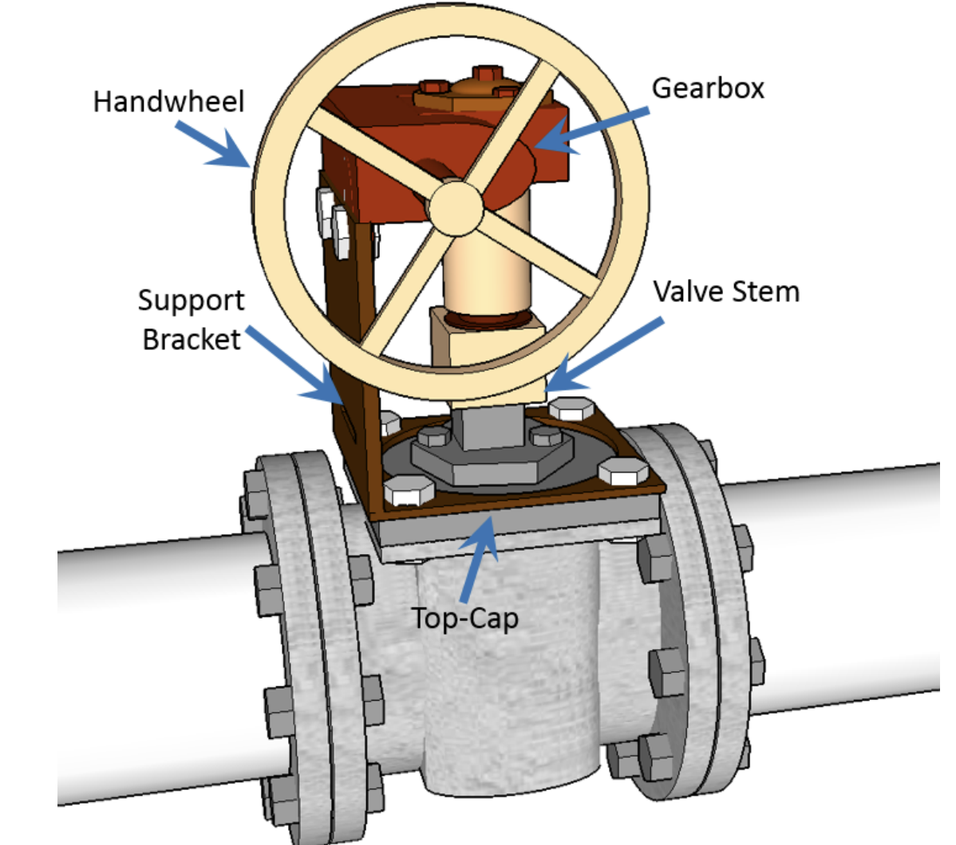
CASE STUDY 1 – November 2016 – Alkylation Unit
Isobutane release and fire seriously injured four workers at a refinery in Baton Rouge, Louisiana. During removal of an inoperable gearbox on a plug valve, the operator removed critical bolts securing the pressure-retaining component of the valve known as the top-cap. Attempted to open the plug valve with a pipe wrench, the valve came apart and released isobutane into the unit, forming a flammable vapour cloud. The isobutane reached an ignition source within 30 seconds of the release, causing a fire and severely burning four workers.
This type of valve should have been replaced or clear working instructions should have been given to the maintenance crew.
Warning Signs are useful to indicate direct connections to the internal process for this type of configuration

Slide 26
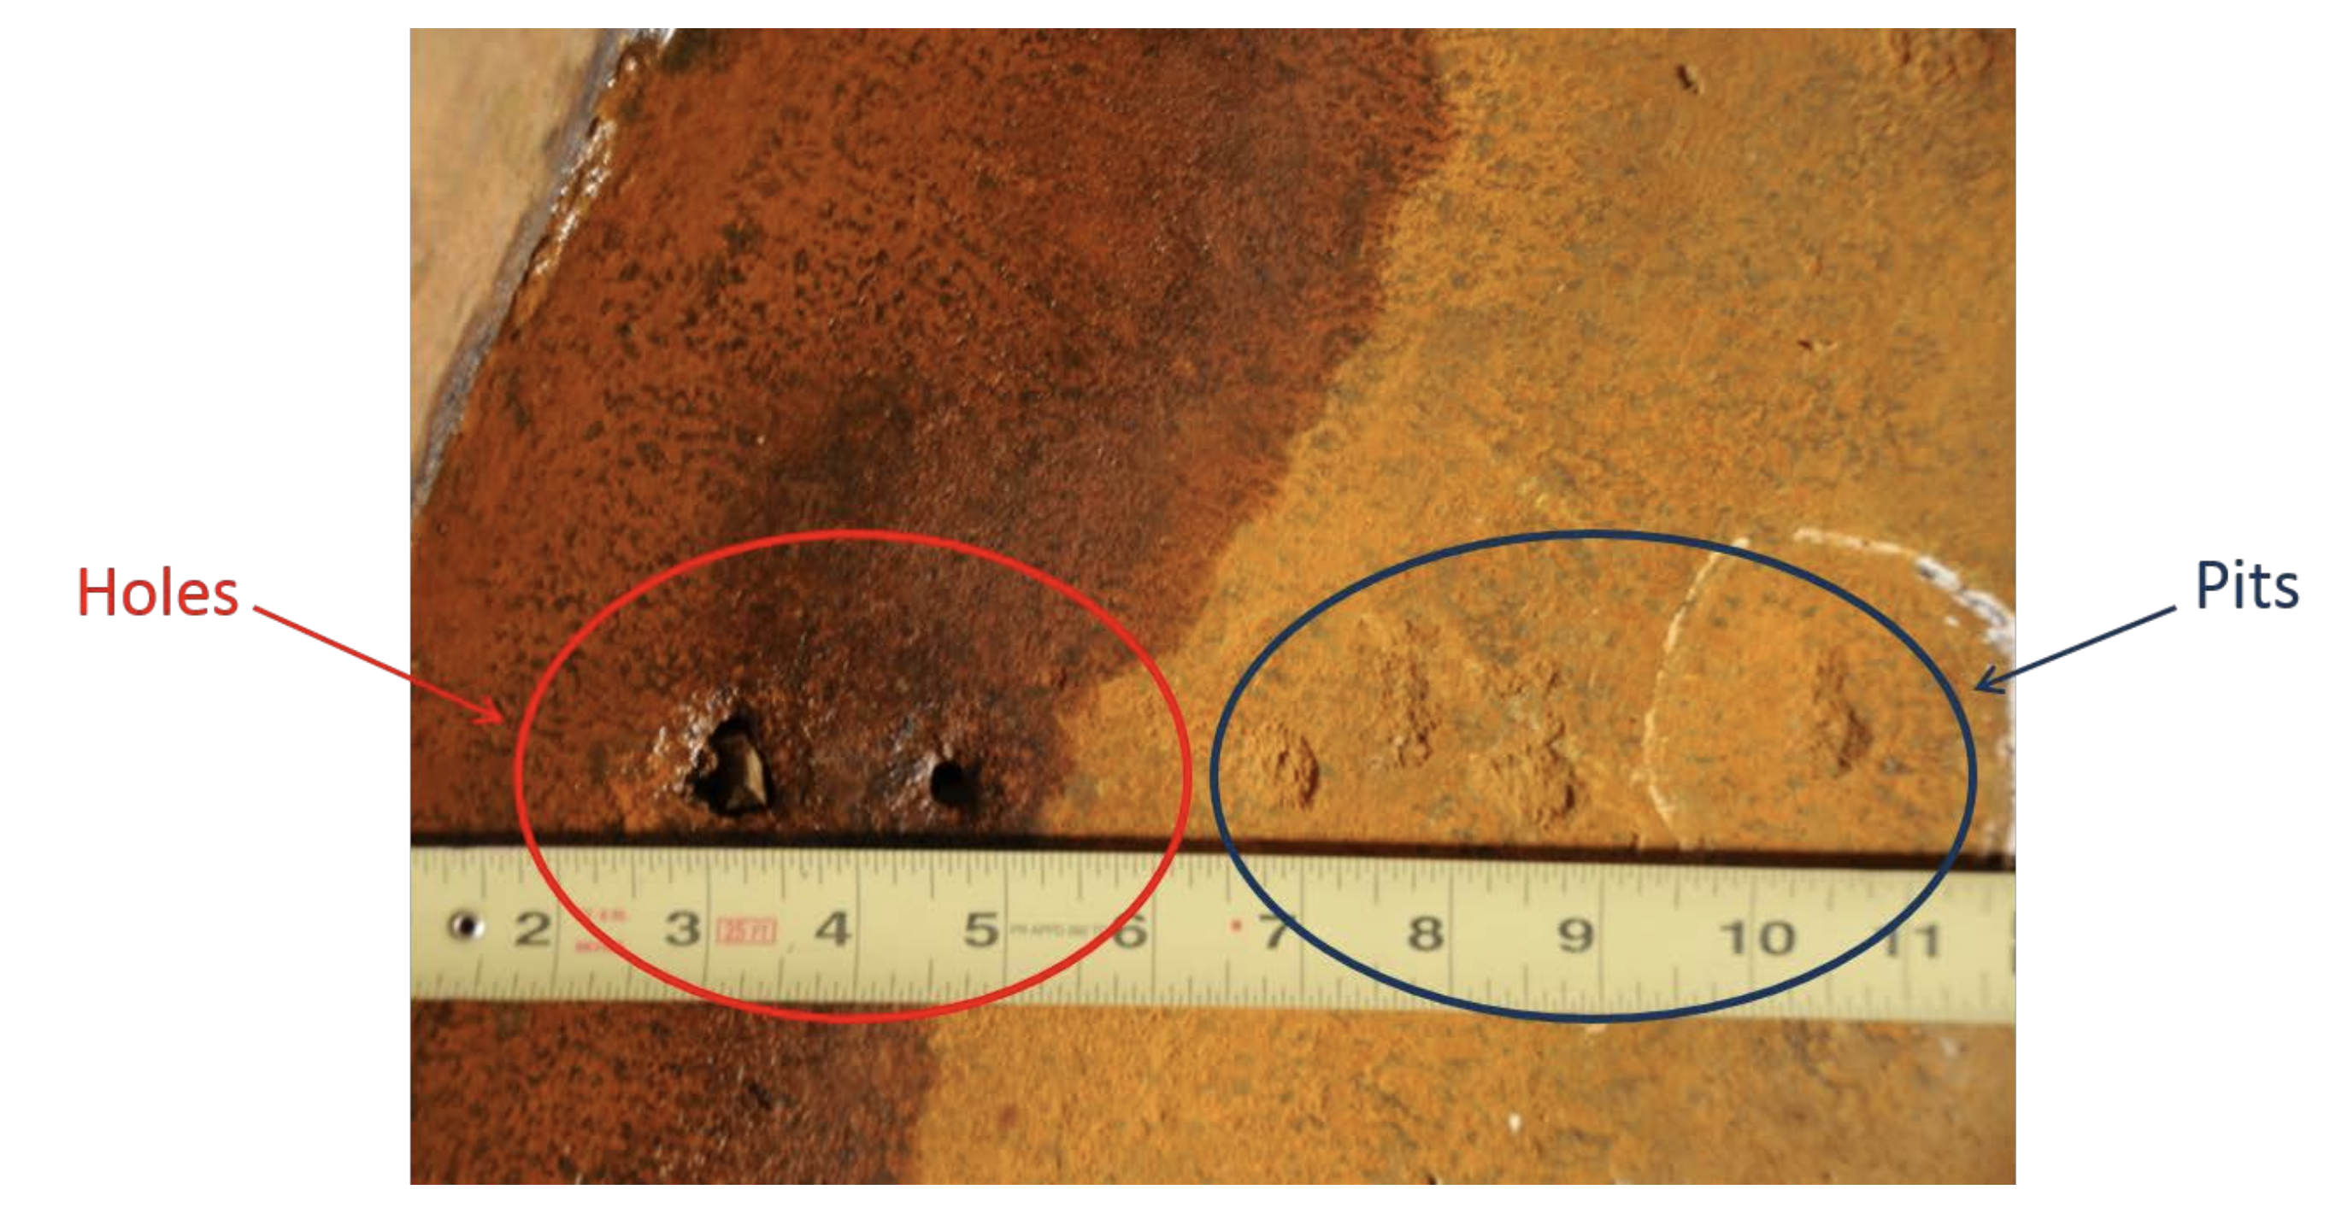
CASE STUDY 2 –November 2017 – Chemical Storage
Tank leaked in Charleston, West Virginia - contaminated the local water supply leaving thousands of residents without clean drinking water. The 20ft diam. tanks were t built in 1930s - single lap-riveted construction with tank base 0.25-inch lap-welded bottom replacement for the original lap-riveted bottom. The bottom interior of tank 396 - deep, isolated pits or crevices near the shell (side) & two holes on the tank floor, 0.75 inches and 0.4 inches in diameter, which were the source of the leak.
Tank Inspection was inadequate for ageing tanks and the advanced pit corrosion was not identified. This eventually made two holes in the bottom plate allowing a toxic chemical to be released into the environment.

Slide 27
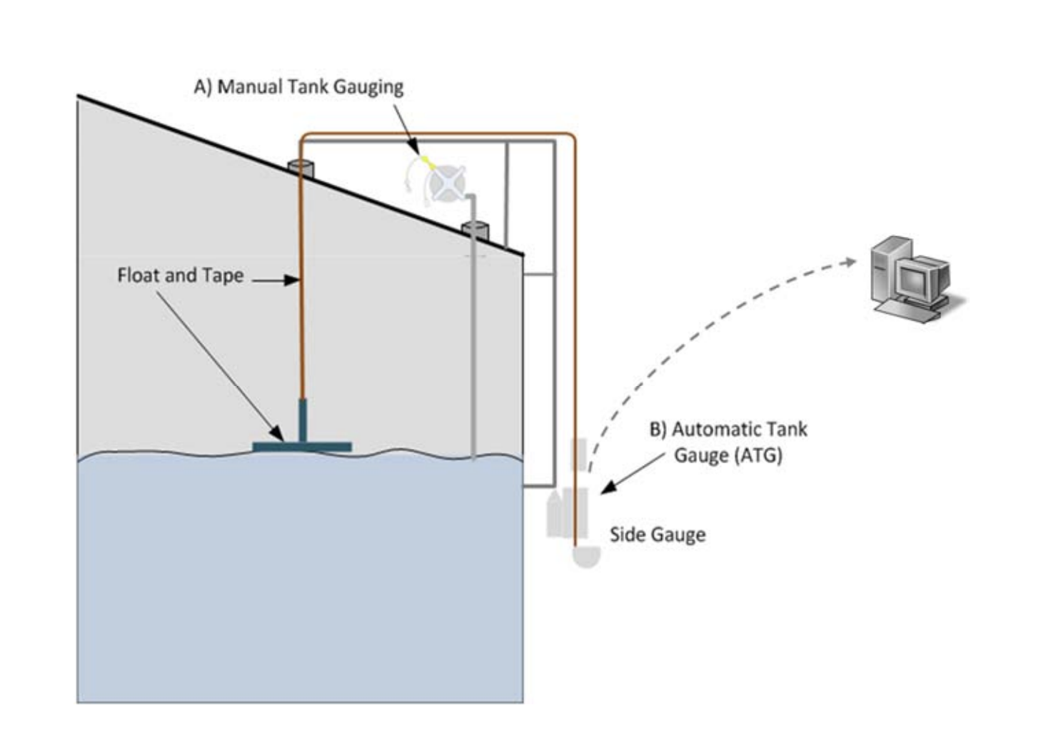
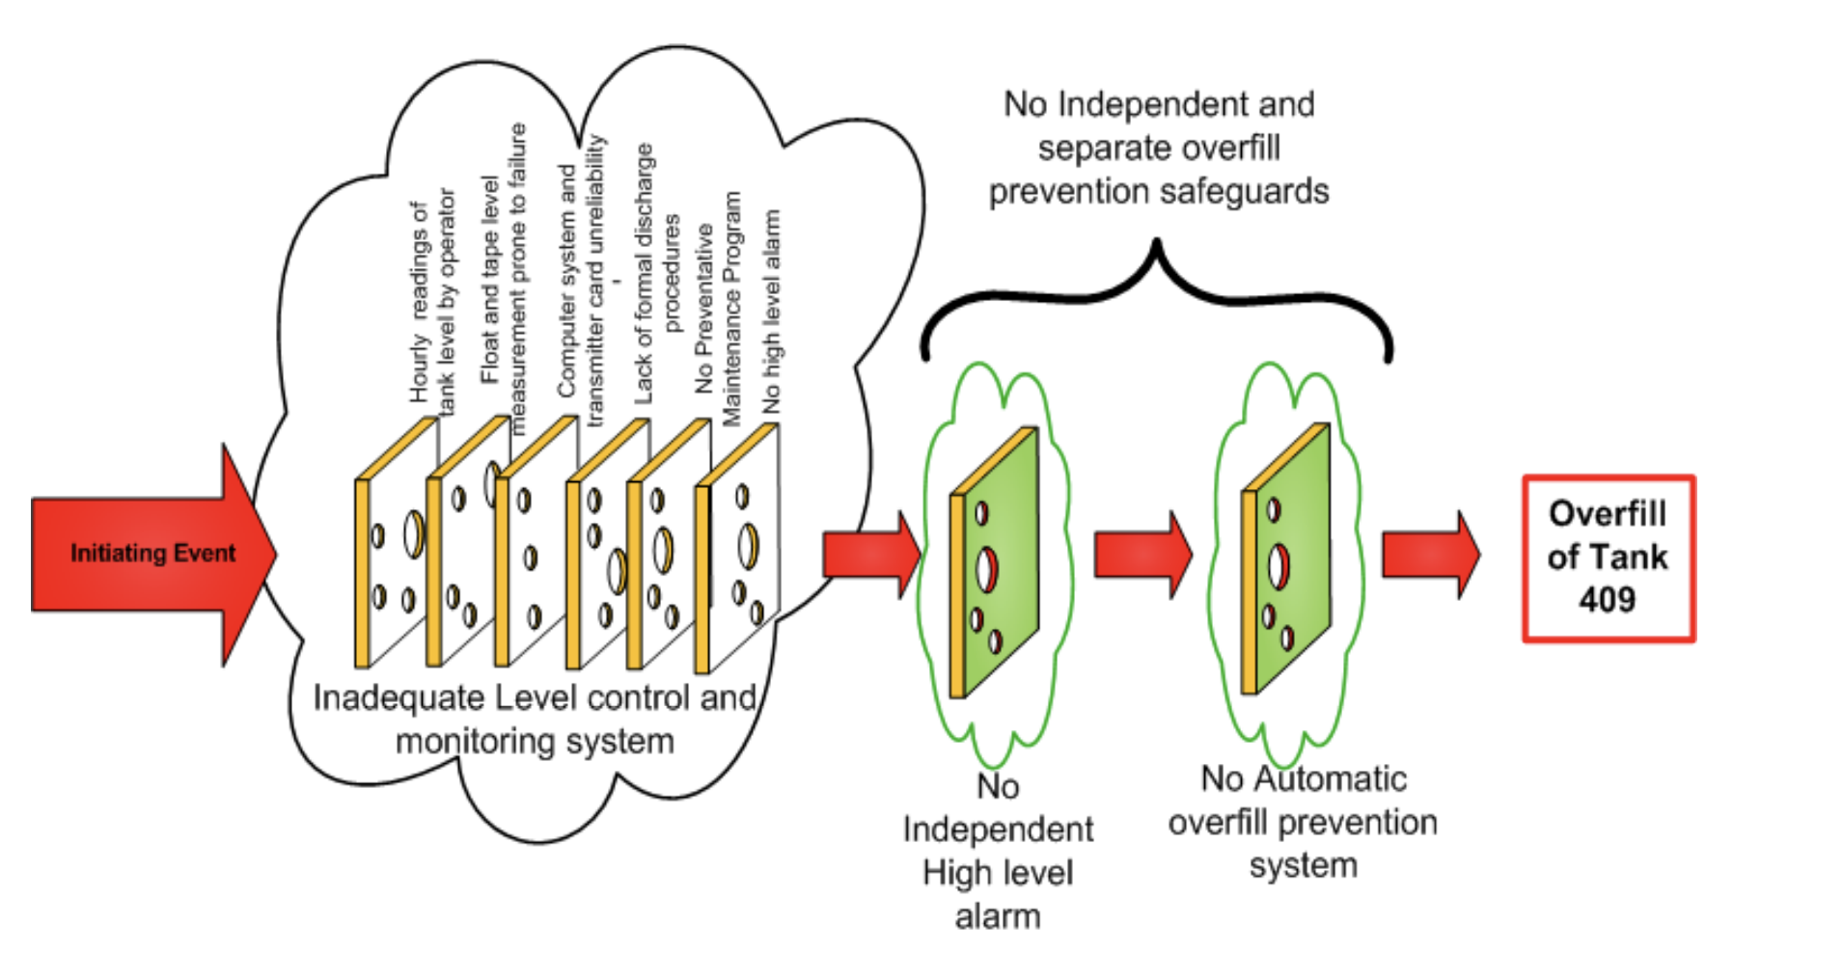
CASE STUDY 3 – October 2009 – Terminal Explosion
A large explosion occurred at a facility in Puerto Rico, during offloading of gasoline from a ship. A 5-million-gallon aboveground storage tank overflowed into a secondary containment dike. The gasoline spray aerosolized, forming a large vapour cloud, which ignited after reaching an ignition source in the wastewater treatment area of the facility. Blast and fire/explosions resulted in loss of 17 of 48 tanks and damage in neighbourhood. The fires burned for almost 60 hours.

Slide 28
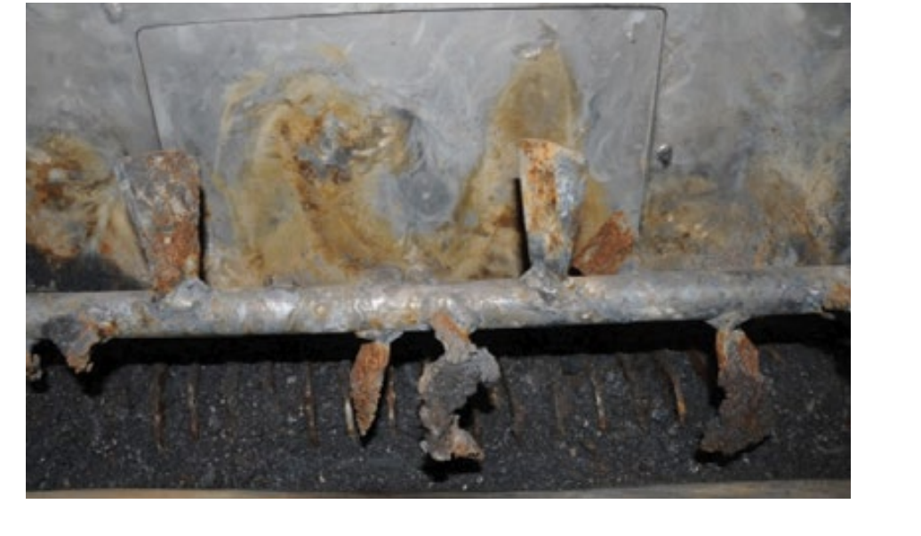
CASE STUDY 4 – September 2010 – Dust Explosion USA
An explosion in the production building was caused by combustible titanium and zirconium dusts (processed at the facility). The explosion originated in a blender containing milled zirconium particulates, ignited by frictional heating/spark ignition of the zirconium arising from defective blender equipment. Hydrogen gas produced by the reaction of molten titanium or zirconium metal and water (wash-down/water deluge system), may have also contributed. A dust collection system was not installed (refer NFPA 484 for controlling combustible metal dust hazards).
Press Blade Damage

