Slide 1
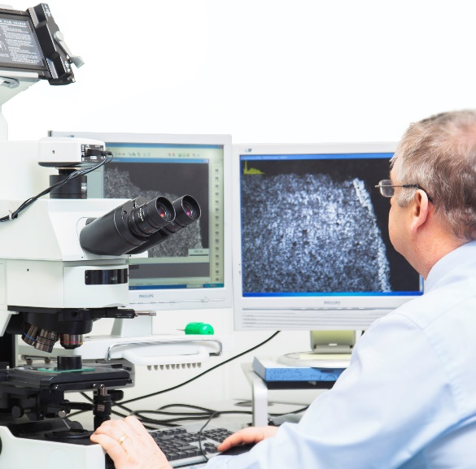
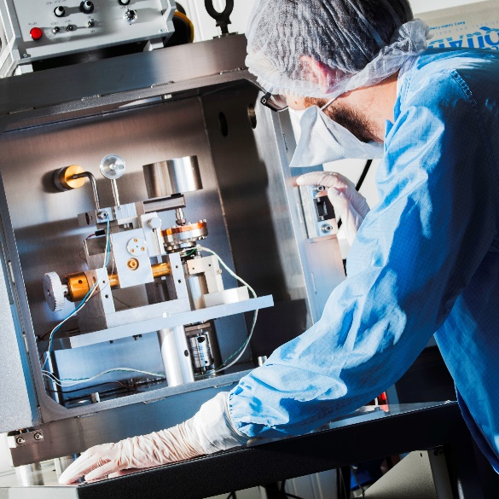
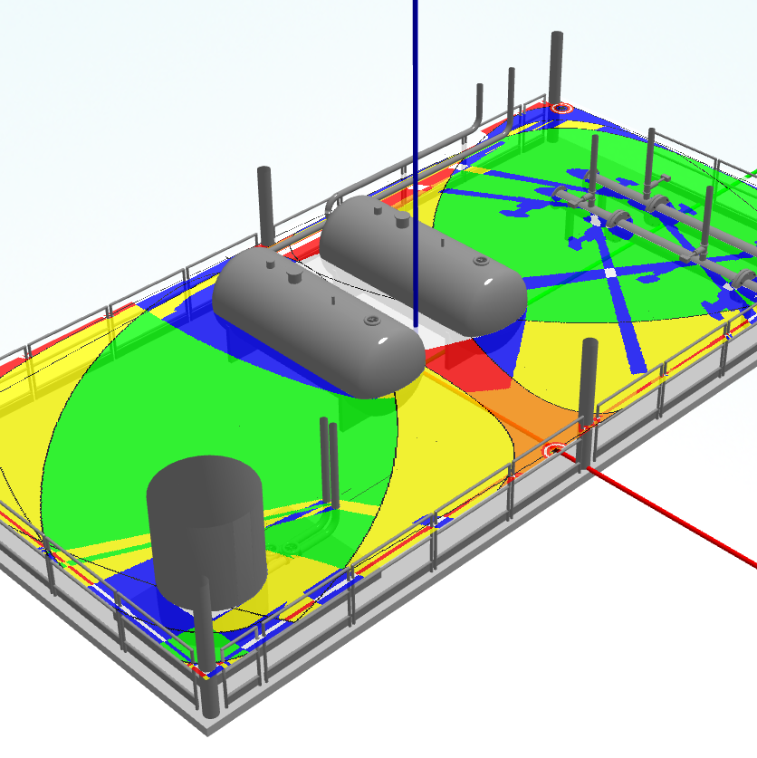
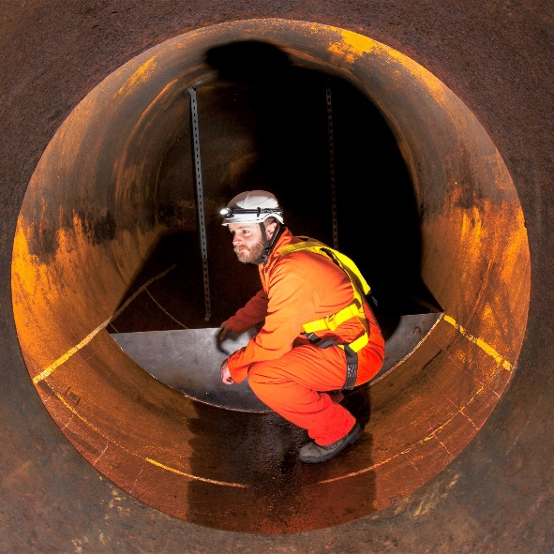
Assessment of Vent Pipework Structural Support Response to Internal Explosion
Materials Engineering
Space and Vacuum
Tribology
Industrial Tribology and
Good Practice
Safety & Risk
Hazards 32 Conference
Andrew Benton, ESR Technology
Management
Non-Destructive Testing
Notes:
Hello and welcome to this presentation on assessment of vent pipework structural support response to internal explosion. My name is Andrew Benton and I am one of the Principal Consultants within the Safety and Risk Management Group of ESR Technology.

Slide 2
Background
UK sector installation
Submission of safety case to HSE
Justification for vent system without continuous purge system
A3 pipework rated to 19.6 barg so not concerned with rupture
Noted recent case of internal explosion leading to displacement of system and potential risk to personnel
Notes:
ESR were contacted be a client who is an operator in the UK sector. They were undertaking safety case renewals process to the HSE and as part of it the status of the vent system had been highlighted. Specifically the vent system does not include a continuous purge system and so therefore there is the potential for a flammable atmosphere to be generated within it. Whilst ESR were not directly involved in the discussions with HSE we were made aware that the concerns were not in relation to an explosion rupturing the pipework, which was considered unlikely given the A3 rating to 19.6 barg, but rather to do with an explosion causing the structural supports to fail and the vent system becoming detached and creating a hazard. We were led to believe that a similar incident had occurred within the UK sector relatively recently and so HSE were particularly interested in this type of scenario. Unfortunately, the details of this previous incident were never made available to us during this assessment.

Slide 3
Objectives
Determine whether credible internal explosion event could lead to failure of a structural support enabling significant displacement
Two-phase approach:
FLACS CFD explosion modelling to determine internal pressures/forces on the pipe walls
Solidworks FEA modelling of forces on structure to determine stresses and failure potential of supports
If failure could occur, expected that recommendations would be made about structural strengthening
Notes:
The objective of the assessment was to determine whether this was a plausible scenario on the clients vent system. It involved a two stage process of firstly doing some CFD explosion modelling to see what type of forces could be generated on the internal pipe walls by an internal explosion, and then followed by FEA modelling to apply those forces to the structure and see whether the stresses would lead to failure of one or more of the structural supports. Assumed that if failure was predicted then some recommendations would be required about strengthening the structural supports.

Slide 4
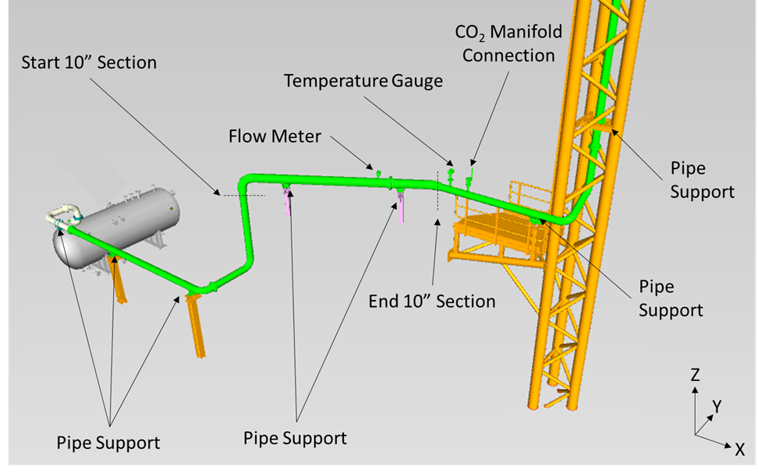
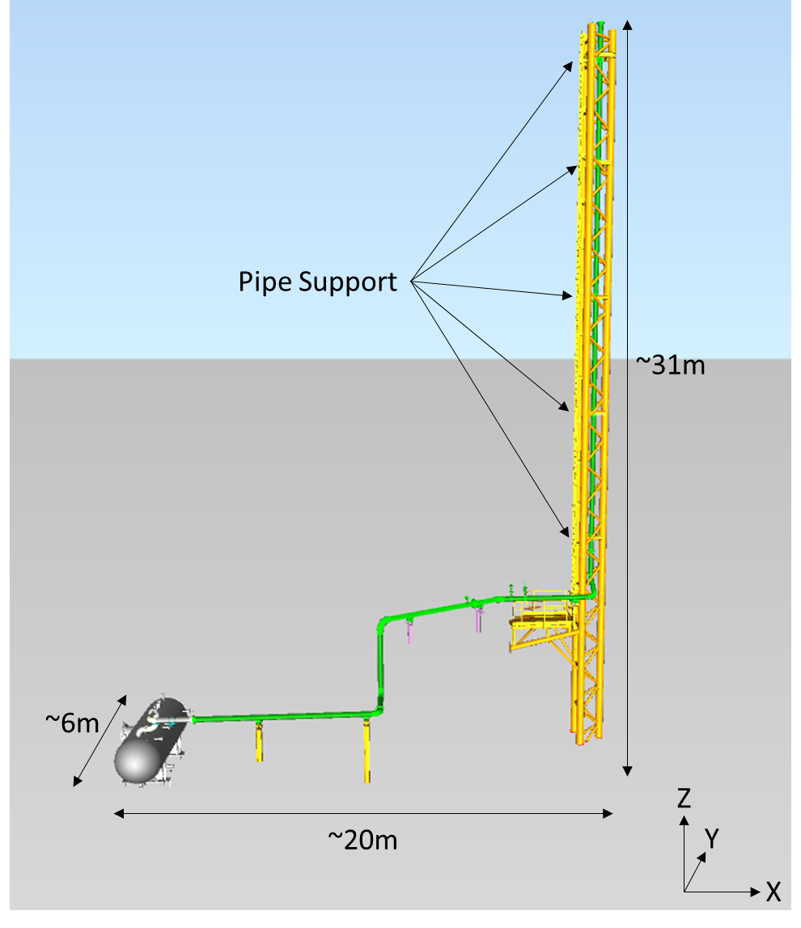
Vent System
11 sections of pipe
10 bends (8 of 90°)
8” pipework with a 10” section
11 structural supports
5 within vent stack
6 along horizontal section
Notes:
For the purposes of the assessment it was agreed to limit system to the section including the knock out vessel down to the vent tip. This system consisted of 11 lengths of pipe separated by 10 bends with all but one pipe section 8” diameter the other of 10”. The system was connected via 11 pipe supports, 5 of which were in the vent stack, with the remaining 6 spread along the horizontal pipework section.

Slide 5
Explosion Modelling – 3D Model
CFD explosion modelling using FLACS software
Limitation that all 3D space represented even when only internal vent space of interest
Minimum of 5 grid cells across flow field (i.e. 8” pipe = 4cm cells)
Full 3D arrangement (i.e. ~20m x ~ 6m x ~ 31m) impractical to model
Requires flat profile to minimise cells
Notes:
The CFD explosion modelling was undertaken using FLACS software. FLACS is the primary CFD explosion package used in oil and gas industry particularly for explosion risk analyses.
One of the challenges of using FLACS for this assessment is that the entire region in which the vent system is located will be included within the grid, most of which is external space. This becomes a significant issue because it is also desirable to have at least 5 grid cells across the flow field, which implies very small ~4cm cells to represent an 8” pipe. Based on the extents this becomes impractical to model and so it was necessary to use a representative arrangement with an almost flat profile to minimise the spatial requirement.

Slide 6
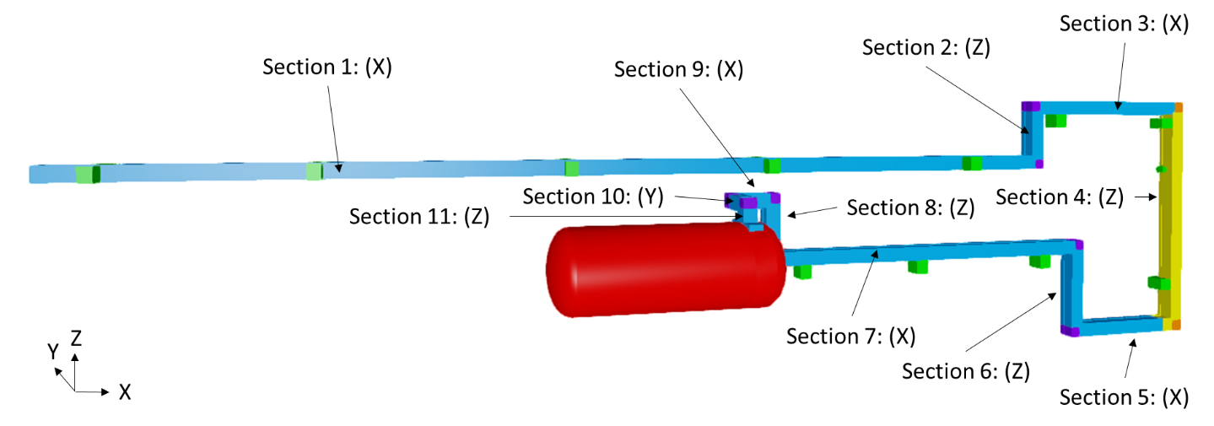
Explosion Modelling – 3D Model
All bends represented in correct positions
Gravitational forces assumed insignificant relative to pressures
Forces reorientated when applied in structural modelling
Notes:
The pipeline lengths and relative positions of the bends are unchanged. Gravitational forces will be incorrect however these are considered to be insignificant relative to the forces generated by the explosion.
Force results derived using this 3D model were reorientated to the original arrangement for use in the FEA modelling.

Slide 7
Explosion Modelling – Grid
FLACS uses cartesian grid, not ideal for circular flow field
Different arrangements tested – square duct most suitable
Grid to fit 8-inch and 10-inch sections
Minimum 5 cells required for flame speed propagation
5 to 7 cell transition used for smooth transition
3.2 cm cell size chosen for final grid
Notes:
FLACS uses a cartesian grid which is not ideal for representing a narrow circular flow field like a pipe cross-section as semi-porous cells are created at the pipe walls which can lead to artificial turbulence generation during an explosion. This necessitated the need for an alternative representation of the pipe. We tested a number of options and ultimately a square duct approach was found to be most suitable.
A further consideration is that the grid needed to be appropriate for both 8” and 10” sections of pipework and it was necessary to represent the smooth transition between these sections in a uniform manner to avoid distorting the flow. This lent itself to the use of the minimum recommended 5 cells across the 8” section and 7 cells across the 10” section. Ultimately a 3.2cm cell size was adopted for the final grid.

Slide 8
Scenarios
Feasibility of flammable environment within vent is uncertain
Size, location, and gas concentration distribution unknown
Assumed worst-case of 100% fill of system i.e. vessel and pipework with stoichiometric mixture – light methane rich gas
Ignition at vent tip most plausible case, vessel ignition alternative
Modelled from ignition until fuel consumed and system stabilised
Notes:
It is probably worth remembering that this was a hypothetical assessment of an explosion scenario that could happen but without any basis for what a real-world example would look like. Beyond the fact that air is most likely to enter via the vent tip, the size, location, and appearance of flammable gas cloud is completely unknown, including if it could happen at all. There was no dispersion analysis to inform the modelling. While all manner of scenarios could be imagined, for simplicity it was agreed to model an explosion of a worst-case 100% fill of the system with a stoichiometric mixture. An ignition point at the vent tip was considered a plausible scenario e.g. from a lightning strike, and as an alternative case ignition within the vessel was also modelled although there was no certainty about such an ignition was actually possible.
The simulations were ran from the point of ignition until the fuel had been consumed and the system appeared to stabilise.

Slide 9
Force Calculation
Internal duct surfaces covered with pressure panels
Enabled clear differentiation between the sides
Force calculated across panel area
Generated force time history per panel
Opposite panels paired together to calculate differentials (‘out of balance forces’)
Pairs normal to direction of flow (radial) found to have minimal differential force
Pairs at opposing ends of a pipe section (axial i.e. at the bends) found to have significant differential force
Analysis limited to axial pairs
Notes:
To measure the forces within the pipework during the explosion the internal surfaces of the ducts were covered with pressure monitor panels. The use of a ducting approach enabled clear differentiation between the different internal faces of the duct so that force directionality was known. A force time history was then extracted for every panel from the pressure across the panel area. What we really wanted to see was how the force varied in X/Y/Z for each section of pipe and this was done by measuring force differentials between pairs of panels on opposing faces of the ducts. As might be expected, pairs of panels normal to the direction of the flow exhibited minimal differential forces but pairs at opposing ends of the pipe sections, i.e. at the bends, exhibited significant differential forces, no doubt due to the time elapsed between the blast wave arriving at one end of the pipe before the other. Ultimately the analysis was limited to consideration of these axial pairs only.

Slide 10
Differential Force Results
Tip ignition case very slow burning through pipework until vessel then sudden acceleration
Vessel ignition case immediate explosion
Two phases with separate datasets:
‘Dynamic’ burning phase with highest/fluctuating pressures/forces
‘Static’ system depressurisation phase with stable pressures/forces
Vessel ignition forces significantly larger than tip ignition
Venting while fuel being consumed within pipework
Static phase forces generally similar as simple depressurisation of combustion products
Larger forces associated with longer pipeline sections as greater time difference between flow at either end
Notes:
For the tip ignition case the ignition was followed by a period of very slow burning through the pipework, lasting about 30s, before it suddenly accelerated on reaching the vessel. Conversely for the vessel ignition case the explosion took off immediately. Therefore both cases were dominated by the fuel burning in the vessel, however when the tip ignition case begins to depressurise it is through pipework which has already been cleared of fuel, whereas for the vessel ignition case the depressurisation is occurring alongside the consumption of fuel in the pipework and this lead to higher overpressures.
The results also suggested two phases to the force development. An initial dynamic period in which the forces oscillate, followed by a steady state phase in which the vessel depressurises and the forces are relatively constant. This lead to the development of two datasets for input into the FEA.

Slide 11
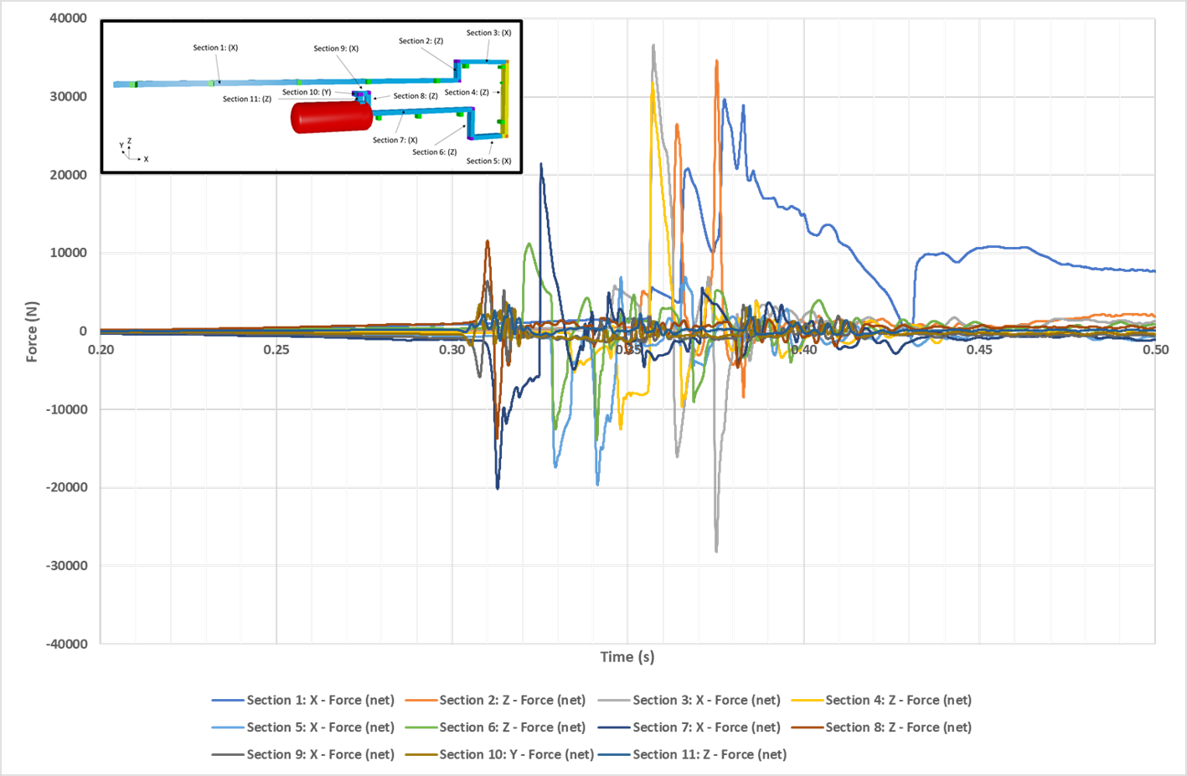
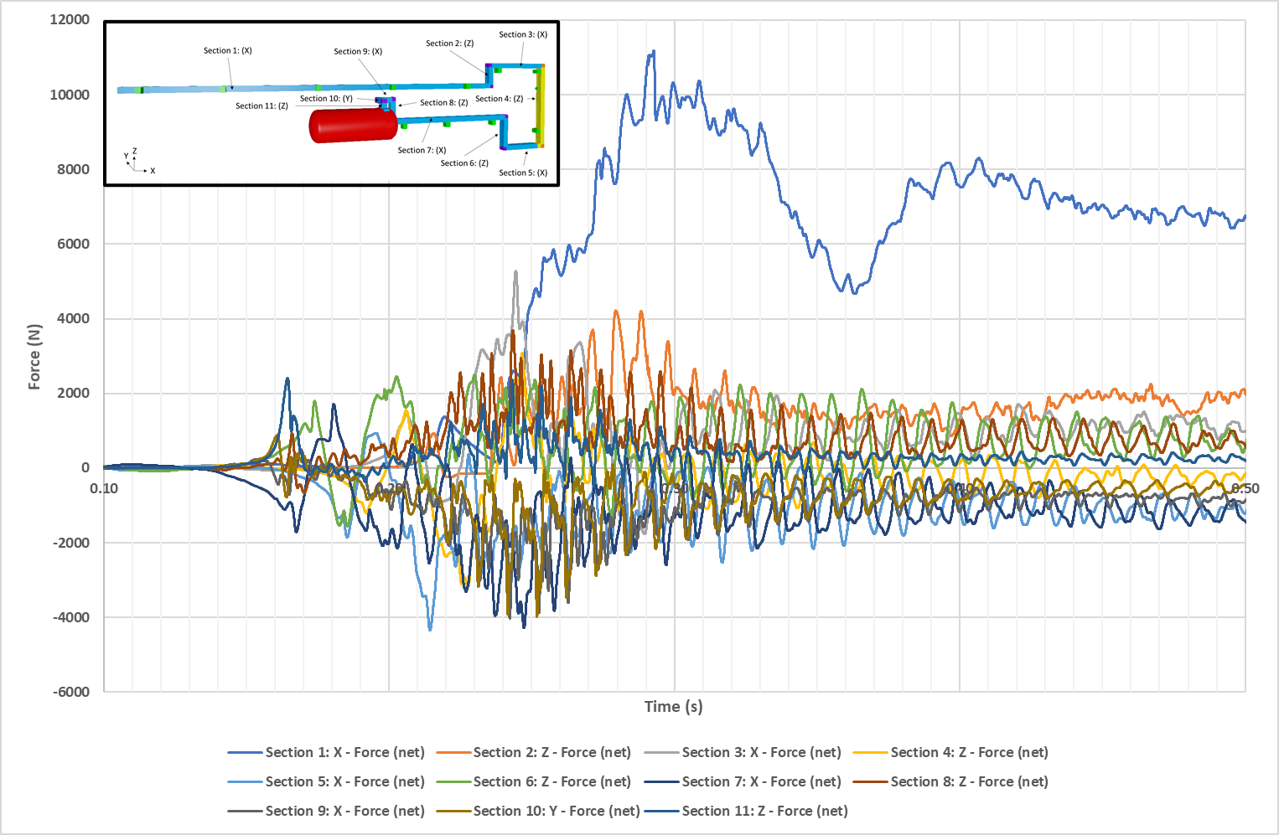
Differential Force Time History Results
Vessel Ignition Case
Tip Ignition Case (Time Adjusted)
Notes:
These two graphs demonstrate the differential force time histories on the 11 pipe sections in the vessel ignition case on the left and the tip ignition case on the right. As can be seen, the vessel ignition case yielded peak forces about 3x greater than the tip ignition case.
Once the explosion gets going there is a period of significant oscillation, particularly visible with the vessel ignition case, whereas towards the right hand side of each graph the forces average out to be fairly stable over time.
In terms of input for the FEA analysis, we provided the force time history for each pipe section during the dynamic phase, and then a single force for each pipe section to represent the steady state phase.

Slide 12
Structural Response Modelling
FEA modelling using Solidworks
3D model developed comprising vessel, pipework, structural supports, and vent stack
Each part assigned a material type with associated properties
‘Blended curvature-based’ mesh was applied to geometry
Adapts well to geometry with curves
Resizes elements automatically without need for additional mesh control
Standard mesh found to be incompatible with pipe support parts
Notes:
The purpose of the structural response modelling was to measure the stresses on the component parts of the structural support system when the pipework is subjected to the explosion blast loads shown in the previous graphs. The stresses were then compared to the material thresholds to determine whether failure would be expected. The analysis does not model the impact of the failure.
In the model each component is assigned a material and that material has a set of properties to represent its behaviour.
A ‘blended curvature based’ mesh was applied to the geometry. This is well suited to a curving geometry and resizes all elements automatically without the need for additional mesh control. We did attempt to use the standard mesh but found this to be incompatible with the pipe supports

Slide 13
FEA Simulations
Four scenarios modelled:
Tip ignition dynamic phase – fluctuating forces
Tip ignition steady state phase – single continuous force per section
Vessel ignition dynamic phase – fluctuating forces
Vessel ignition steady state phase – single continuous force per section
Von Mises Stress time-history measured averaged across each component
Enables comparison with material yield stress and therefore whether failure is expected
Notes:
Four separate simulations were run in Solidworks. These were for the two ignition cases, and the dynamic and steady state loading cases respectively.
The von Mises Stress was measured across each component and output as a time history. The von Mises is a useful parameter as it enables comparison with the material yield stress which thereby provides an indication about whether the component is expected to fail.

Slide 14
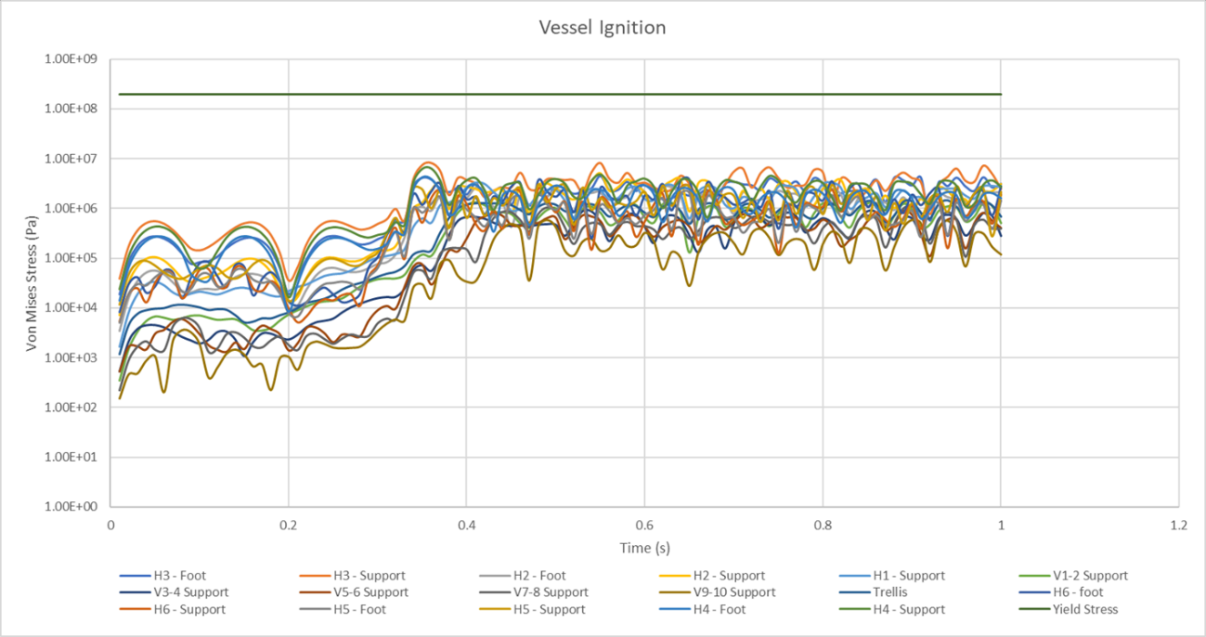
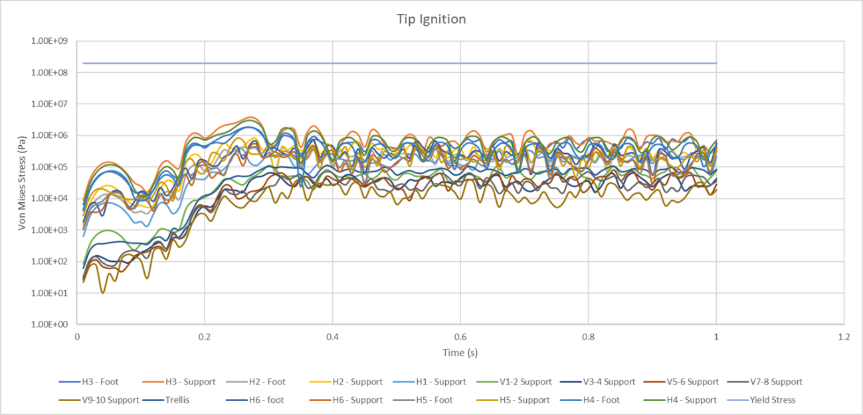
FEA Results – Dynamic Cases
Dynamic case results always below minimum yield stress of all the materials – by at least 1 order of magnitude
Highest stress on support within horizontal pipework section
Notes:
These graphs show the von Mises stress results as a function of time during the dynamic loading phase, with each component plotted individually. The vessel ignition case is on the left and tip ignition case on the right.
Also plotted is the minimum yield stress from any of the component materials.
As can be seen, in all cases the maximum stress was found to always remain at least one order of magnitude below the material yield stress which therefore suggested that the component parts were no expected to fail under the loading.
As would be expected, the vessel ignition case produces the highest stresses given that the applied loading is higher.
The highest stress, shown by the orange curve, was found to be on one of the pipe supports within the horizontal pipework section.

Slide 15
FEA Results – Static Cases
Part | Von Mises Stress (Pa)
 | Vessel Ignition | Tip Ignition
H6 -Foot | 3.87E+05 | 4.06E+05
H6 - Support | 1.50E+05 | 2.61E+05
H5 -Foot | 8.83E+04 | 7.90E+04
H5 - Support | 1.20E+05 | 1.51E+05
H4 -Foot | 5.73E+05 | 5.04E+05
H4 - Support | 1.09E+06 | 9.88E+05
H3 -Foot | 6.71E+05 | 6.53E+05
H3 - Support | 1.30E+06 | 1.17E+06
H2 -Foot | 2.89E+05 | 3.20E+05
H2 - Support | 3.06E+05 | 3.23E+05
V1-2 - Support | 3.91E+05 | 3.00E+05
V3-4 - Support | 2.23E+05 | 2.14E+05
V5-6 - Support | 2.05E+05 | 2.01E+05
V7-8 - Support | 1.81E+05 | 1.78E+05
V9-10 - Support | 1.37E+05 | 1.35E+05
Trellis | 4.52E+04 | 3.82E+04
H1 - Support | 6.37E+05 | 5.18E+05
Static case results always below minimum yield stress of all the materials – by at least 1 order of magnitude
Highest stress (1.3 MPa) on same support as dynamic result
Stresses generally lower than dynamic cases
Notes:
For the steady state loading we have just a single result output per component as summarised in this table.
Once again it was found that for all of the components the stress was at least one order of magnitude below the material yield stress and so the component parts were not expected to fail under the loading.
As with the dynamic results it is the vessel ignition case produces the highest stresses given that the applied loading is higher.
The highest stress was found to be on the same pipe support within the horizontal pipework section as the dynamic results.

Slide 16
FEA Summary
No component parts of structural supports predicted to fail
Minimal likelihood of pipe sections breaking free
Maximum displacement of any component was ~5mm
Sensitivity indicated limited value in subdividing parts looking for increasingly localised higher stresses
Notes:
So in summary none of the component parts were predicted to fail and therefore there was considered to be minimal risk of section of the vent pipework breaking free. A maximum of ~5mm displacement was observed which was also not considered to pose any significant risk.
We did examine the results of one of the components in greater detail to consider the impact of subdividing the parts into smaller pieces in case some higher stresses could be observed at a local level, however the results of this sensitivity case suggested there was limited value in doing this on a wider scale.

Slide 17
Overall Summary
Significant uncertainty about nature of explosion event
Worst-case explosion scenarios modelled in CFD and force time-histories applied to FEA model
Resulting stresses all below material yield stresses by significant margin
Structural failure not predicted
Significant confidence margin in results helps address uncertainties and/or variability e.g. in fluid type, ignition point, gas concentration distribution etc.
Notes:
Overall its fair to say that there is considerable uncertainty about the type of explosion that could occur within the vent system. However, in the interests of caution some worst-case scenarios were modelled using CFD and the force time histories applied to the FEA model.
The calculated stresses were all found to be below the material yield stresses by a significant margin, at least one order of magnitude. Therefore failure of the vent system structural supports is not predicted to occur.
Given the confidence margin this should provide a degree of assurance about the conclusions given the uncertainties and potential variability in some of the inputs such as the fluid type, ignition point, or gas concentration distribution.

Slide 18
Thank You
greg.kelly@esrtechnology.com
neil.ketchell@esrtechnology.com
andrew.benton@esrtechnology.com

