Slide 1

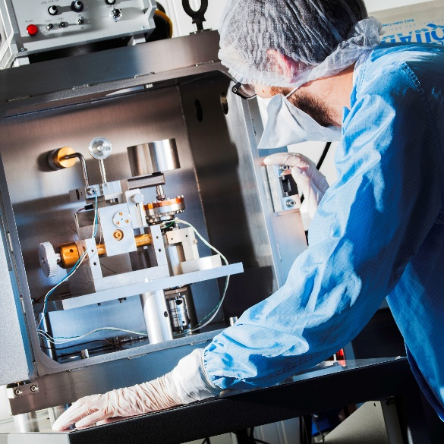
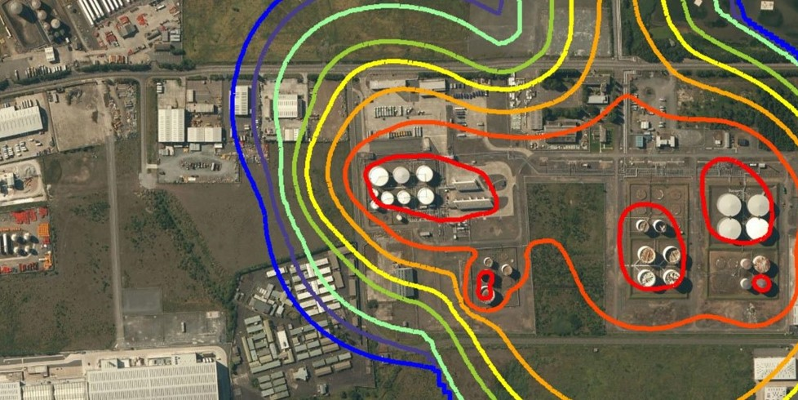
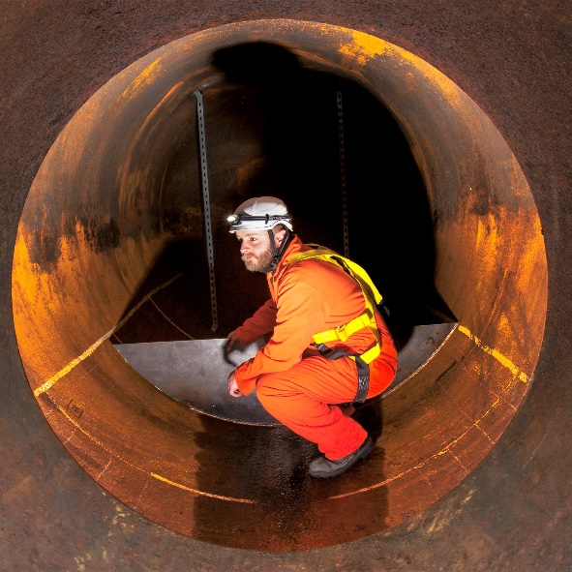

Materials Engineering
Space and Vacuum
Fire and Gas Mapping: Comparative Impact of Different Standards
Tribology
Industrial Tribology and
Shamsudeen Hassan PhD, CEng
Senior Consultant
Shamsudeen.hassan@esrtechnology.com
October 2022
Good Practice
Safety & Risk
Management
Notes:
MAX 90 seconds
Welcome to this presentation on the Comparative Impact of Different Standards for Fire and Gas Mapping:
My name is Shamsudeen Hassan and I am a Senior Consultant with ESR Technology and the product manager for ESR’s F&G Mapping Software
The accompanying paper to this presentation provide further details and references for the work being presented today

Slide 2
Agenda
F&G System Functions
Development of F&G Guides & Standards
Differences between Standards
Investigating Impact of the Differences: Case Study
Results
Conclusions
Notes:
30 seconds
The presentation would follow this format:

Slide 3
F&G System Overview
F&G System:
Performs 3 basic functions
Enable hazard mitigation
Provides objective analysis of detector layouts
F&G system does not:
stop incident from occurring
reduce the risks on its own
Detection
Hazards Detection
Alarm
Decision
Alert Operator
Control System
Action
Initiate Control Action
Shutdown
Notes:
90 seconds
Appropriately designed F&G system enables mitigation of hazardous conditions such as fire or loss of containment by:
Detecting the hazard;
Alerting personnel;
Initiating appropriate mitigating/control action(s).
F&G detector mapping studies provide an objective analysis of detector layouts to support the design process and optimise the number and placement of detectors needed to meet performance requirements

Slide 4
Development of F&G Standards & Guides
HSE, 1993
BP (2003) and Shell (1995)
ISA (2004), ISA TR (2010, 2018)
BSI (2020), EI (2020)
HSE Research on gas detector siting criterion – 1993
Operators begin to develop in-house guidance - mid 90s to early 2000s
IEC 61511 & ANSI/ISA 84.00.01 published – 2003/2004
ISA TR 84.00.07 Published – 2010
BS 60080, EI guide and ISA TR Rev2 – 2018-2020
Notes:
90 seconds
The drive for some form of quantifiable assessment of the placement and performance of F&G system for Oil and Gas installations can be traced back to the HSE sponsored research on Gas Detector Siting Criterion in 1993, where a review of the then recent works in the field have been carried out taking into account such influencing factors
gas species,
blockage characteristics and
overpressure values
to determine the optimum siting and spacing of flammable gas detectors in an installation.
Then in the mid 90s to early 2000s, major operators, such as Shell and BP, began to develop inhouse guide on assessing F&G system design and placement.
Document such as Shell DEP 32.30.20.11 was published in 1995 and BP GP 30-85 was published in 2003.
However the development of international standard that covers the performance of F&G system can be traced to IEC 61511 - Standard for Functional Safety in the Process Industry – which was released in 2003. The standard was then adopted by the ISA International Society of Automation as ISA 84.00.01.
This was deemed the first international standard to include F&G system assessment. However, this standard is performance-based and does not directly address how the F&G mapping and assessment is conducted. ISA then set up a committee to produce practical guidance on the application of the standard to F&G system assessment. The first edition of the guidance ISA-TR84.00.07 was published in 2010. its full title is Guidance on the evaluation of fire, combustible gas, and toxic gas system effectiveness. This standard was considered the first international guidance that aimed to codify best practices in F&G system analysis and mapping, even though it inclined more towards instrumentation engineering.
ISA-TR84.00.07 was the main international standard for a decade until 2020 when both British Standard BS 60080 Guidance on the placement of permanently installed flame and gas detection devices using software tools and other techniques
and the Energy Institute (EI) - Guidance on fire, combustible gas and toxic gas detection system development were released.
The three standards have a similar approach generally; however, they have differences in some areas, driven by several factors including the target audience, scope, etc.
The major driver behind these standards and guidance is to address design inconsistency in relation to F&G mapping and to allow for the appropriate application of performance-based design in conducting F&G system analysis.

Slide 5

The Need for Standards
Aims to:
Address design inconsistency
Allow appropriate performance-based design
Allow comparability to assure similar level of safety across industry
Notes:
90 seconds
The demand for F&G mapping assessments has been increasing, however, the lack of national or international standards or guides means that the outcome of these assessments can vary widely. In most cases, the assessment is either conducted with reference to company guidance where one exists or an ad-hoc agreement between the consultant and client. Assessing and comparing these mapping results is often difficult.
Additionally, the availability of computers with fast processing power and the advancement in software development makes the deployment of 3D mapping software commonplace. This software allows for performance-based F&G mapping to become the more common approach. However, this increases the inconsistencies in the design with very limited independent third-party review of the software output. It is common for a client who has engaged different F&G mapping consultants to have widely different results recommending a significantly different number of detectors for a similar plant area, all other factors being equal.
Industry players saw the need for having an international standard or guidelines that would aim to harmonise all the disparate methodologies and come up with a consistent and comparable approach that ensures similar levels of safety are provided across the industry.

Slide 6
Perceived Differences
- EI guide mostly conceptual
- BS 60080 & ISA-TR84 have similar approach
- Differences exist, e.g.,:
  Determining graded area
  Coverage factors
  Target RHO
Notes:
90 seconds
Of the three standards and guidance, the EI guidance is mostly applicable for design at the concept stage as it contains little design guidance for carrying out detailed prescriptive or performance-based F&G mapping studies. It references ISA-TR 84 where specific details can be obtained
The BS 60080 and the ISA-TR84 both offer a detailed guide on what is expected for an F&G system assessment and therefore have been considered here in detail.
Although the general approach is similar, the standards and guides have differences in some areas such as in determining graded/hazard areas and coverage factors. For example, for flame detectors, both ISA-TR84 and BS60080 use a risk assessment approach to determine the risk areas, however, ISA-TR84 uses an additional semi-quantitative hazard ranking method resulting in an adjusted risk area. Also, while BS 60080 de-emphasises the use of fixed coverage factors as a marker for the performance target, ISA-TR84 implies reliance on a coverage factor as part of the overall F&G system effectiveness determination. Other areas with potential differences include the determination of detector sensitivity and the target RHO.

Slide 7

Case Study Application
Delos Alpha Platform
Two standards compared
Delos 3D F&G Software
  Works with 3D layouts
  Different CAD models
  In-built detection logic
  Genetic algorithm - automatic optimization
Only flame detection assessed
Notes:
90 seconds
In order to investigate some of the differences in the approach and potential outcomes of the ISA TR84 and BS 60080, a case study application of the two standards has been carried out on the deck of a representative offshore installation, shown here.
The case study is limited to flame detection mapping and aims to show whether applying design guidance from the different documents could result in a similar level of detector requirement and protection, or widely different outcomes.
DELOS, a 3D F&G mapping software developed by ESR Technology has been used to carry out the assessment as it provides all features required for the analysis carried out in this paper.
The software uses the 3D model of the plant and calculates each detector’s ‘view’ and coverage in 3D. DELOS can be used to assess flammable gas detection, toxic gas detection and flame detection.
DELOS operates in full 3D, is capable of loading complex CAD models and has in-built detection logic that determines the optimum detector layouts, including the use of a genetic algorithm for the automatic optimisation process.
Results can be presented in 3D format, or 2D slices at a reference height, whichever provides the most insight.

Slide 8
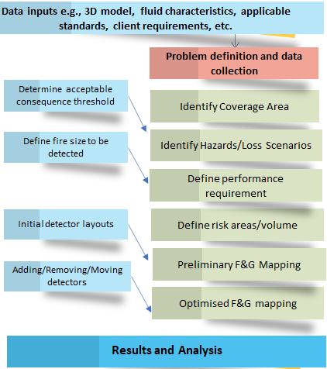
Case Study Application: Methodology
Receive and review data input
Risk & hazard assessment
Hazard/graded area
F&G detection arrangement
Optimization
Results analysis
Notes:
60 seconds
Receive and review the facility data input from the end user including 3D model, plot plans, fluid characteristics, heat and material balances (HMB), piping and instrumentation diagrams (P&ID), previous safety studies, specific client requirements, company standards and guidance and environmental conditions;
Carry out risk and hazard assessments to identify areas where protection would be required and the risk scenarios within such areas;
Determine the hazard/graded areas which delineate the protection area;
For a facility with a preliminary or outline assessment conducted, review the preliminary F&G detection systems provided;
Identify the F&G detection arrangements required for the equipment in terms of detector type, location, orientation, and elevation;
Using the 3D software, assess the proposed detector arrangements, considering the coverage requirements; and
Optimise the detector layout by changing the position of the detectors and/or including additional detectors to ensure that the detector coverage provided is in accordance with the performance requirements.

Slide 9
Cases Considered
Features Assessed | Case
 | ISA-1 | ISA-2 | ISA-3 | BS-1 | BS-2
Performance target identification and developing hazard / graded area |  |  |  |  | 
1ooN for alarm and 2ooN for control action |  |  |  |  | 
Applying minimum boundary area/volume | ☐ |  |  |  | 
Using manufacturers claimed (ideal) viewing distance |  |  | ☐ |  | ☐
Using reduced (effective) viewing distance | ☐ | ☐ |  | ☐ | 
Using the same target flame size (RHO) for alarm and control action |  |  |  | ☐ | ☐
Using different target flame sizes (RHO) for alarm and control action | ☐ | ☐ | ☐ |  | 
Notes:
90 seconds
To assess the differences in the various approaches and the potential outcomes, the two standards have been reviewed, coming up with design options as shown in the diagram.
EI guidance is excluded as it only offers high level provisions and does not provide any detailed design guidance to afford comparison.
The guidance and recommendations provided within the two Standards – BS 60080 and ISA-TR84- have a number of nuances implying different users could come up with different proposals depending on the user’s judgement, experience, and background. Whilst this offers flexibility in the design, the approach creates difficulty in achieving design consistency and makes comparative analysis difficult.
For this assessment, five cases have been developed, three from ISA-TR84 and two from BS 60080, based on the example approaches provided in the documents and some of the main suggested factors highlighted in the documents. T
The features used for the mapping in each case are shown in the Table.
Note that the combination of factors considered in developing the options are those with a likely high impact on the detection requirement.

Slide 10
Results
- Graded Areas
- 2D and 3D Coverage
- Coverage Slices
Notes:
Aim for 60 seconds
The results of the grading assessment indicate two hazard/graded areas have been assigned covering the equipment - High Hazard (HH) and Medium Hazard (MH) areas.
The two different hazard areas are assigned different target fire sizes and coverage requirements.
Diagram here shows the hazards area map for the deck level for all the cases. The HH area is assigned 90% coverage for both alarm and control action and the MH area is assigned 80% coverage.
The F&G mapping coverage achieved is presented as both coverage statistics and a snapshot of the coverage image.
The Diagram here shows the snapshot results for the cases as 3D coverage and 2D coverage at 1.2m above the deck level.
Worth nothing that all the cases achieved the performance target of detecting a set fire for different zones and ensuring coverage is achieved for 90% of the HH zone and 80% for the MH zone

Slide 11
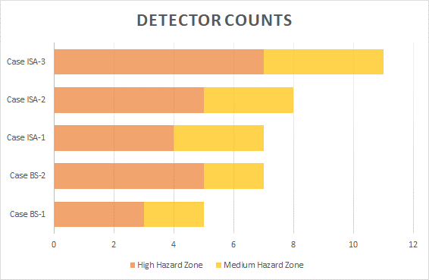
Results
Baseline is ISA-1
Detector count 5 ≤ x ≤ 11
Indicates ISA cases = more detectors
However, user choices/decisions major influence
Notes:
Aim for 90 seconds
The assessment has been carried out for the five different cases, ensuring the coverage target has been met for all the cases.
Figure here shows the total flame detector count for the cases assessed, which range from five for case BS-1 to 11 for case ISA-3.
The detector provision for the HH zone, which is the main driver for the required detector numbers is also shown.
Results would indicate ISA cases results in more detector numbers for the same area being protected.
However it is the choices and decisions made by the user that is the major influence, driven by the features selected.

Slide 12
Results
Detector Count Changes:
  Total
    BS-1 ~30% less
    ISA-3 ~60% more
Notes:
Aim for 45 seconds
ISA-1 as Baseline
Number of detectors could vary by up 100%
Total Detectors
BS-1: 5 – (-30%)
BS-2: 7 – (0%)
ISA-1: 7 – (0%)
ISA-2: 8 – (+15%)
ISA-3: 11 – (+57%)

Slide 13
Results
Detector Count Changes:
  Total
    BS-1 ~30% less
    ISA-3 ~60% more
  High Hazard Zone
    BS-2 & ISA-2 ~20% more
Notes:
Aim for 45 seconds
ISA-1 as Baseline
Number of detectors could vary by up 100%
HH Zone Detectors
BS-1: 3 – (-25%)
BS-2: 5 – (+25%)
ISA-1: 4 – (0%)
ISA-2: 5 – (+25%)
ISA-3: 9 – (+75%)

Slide 14
Results
Detector Count Changes:
  Total
    BS-1 ~30% less
    ISA-3 ~60% more
  High Hazard Zone
    BS-2 & ISA-2 ~20% more
  Medium Hazard Zone
    BS-1 & BS-2 ~30% less
    ISA-3 ~30% more
Notes:
Aim for 45 seconds
ISA-1 as Baseline
Number of detectors could vary by up 100%
MH Zone Detectors
BS-1: 3 – (-35%)
BS-2: 5 – (-35%)
ISA-1: 4 – (0%)
ISA-2: 5 – (0%)
ISA-3: 9 – (+35%)

Slide 15
Conclusion
Variations between the standards
Key is choices users make
Various design options available within each standard
BS approach tends to result in fewer detectors
Experience and judgement important
Scope clarity & performance requirement
Notes:
Aim for 120 seconds
In conclusion, the results of the comparative analysis indicate that variation in terms of the F&G mapping outcome exists between the two standards but of more importance is the variation as a result of the judgement and choices the user makes.
Within both standards, there are different design options that the user could choose, with each choice having a potential impact on the assessment outcome and the number of detectors required.
In general, this assessment indicates that the BS 60080 approach tends to result in a fewer number of detectors for the same coverage compared to the ISA-TR-84 approach.
This is because BS 60080 is more prescriptive and recommends certain features such as the use of different RHO for alarm and control action, from the typical example given.
Conversely, ISA TR-84 lists different options and expects the user to make their choices, implying if a user makes choices similar to the BS 60080 recommendations, they will get comparable results.
This assessment indicates the importance of the experience and judgement of the F&G mapping engineer, and clear agreement of the performance requirement of the F&G system with the end user, including assessing different approaches and the likely consequence in terms of the number and placement of the F&G detectors.
It is recommended that sensitivity analyses are carried out in order to better understand how the followed guidance is affecting the outcome. The suggested variables to change include prescribing different volume extensions around equipment, different ratios of RHO values for alarm and control action, different vendor flame detectors with different detection characteristics and extending the coverage representation to include late alarm and minimal coverage in addition to the traditional alarm and control action coverage

Slide 16

Any Questions?
Corresponding author: Shamsudeen Hassan shamsudeen.hassan@esrtechnology.com
Enquiries: Terry Atkinson
terry.atkinson@esrtechnology.com or www.esrtechnology.com
ESR stand, ESR Technology Exhibiting as a Silver Sponsor
Notes:
Thank you for listening to the presentation.
If you have any question or query on the presentation you can contact me via my email shown on the screen.
If you have any general query or DELOS F&G Mapping Software please contact my colleague Terry.
We are also exhibiting at the conference, you can also stop by at the stand and I will be glad have a chat on the work presented here or any other thing.

