Slide 1

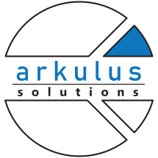

Bridging the gaps for Industrial Risk Assessment and Emergency Response Plan
Presented by: Andre Perseval CEng, MBA, PMP
Principal Process & Safety Consultant
Shamrock HSE Consultancy
Mark Baldeo BSC, MSC
Project Management Consultant
Arkulus Solutions

Slide 2
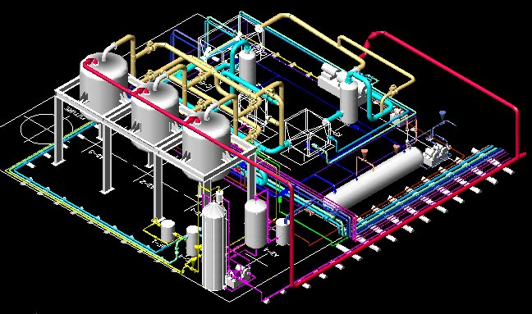
Shamrock HSE
Arkulus Solutions
    “Our Mission is to provide Customer Focused Solutions leveraging our HSE Engineering Expertise and Innovative Technology.”
    Process Hazard Analysis (PHA) Studies.
    Process Safety Engineering Services, Start-up and Commissioning support.
    Quantitative Risk Assessments, Emergency Systems Survivability Assessment, Environmental Impact Assessments.
    Process Safety Layout studies, Hazardous area classification, PSV verification, Flare sizing and assessment, Layer of Protection (LOPA), Structural Failure Analysis and Dropped Objects Studies.
    Dispersion Modelling and Fire, Blast and Explosion Analysis.
    Safety Critical Elements and Performance Standards development.
    Carbon and Air Pollution Impact Studies with Renewable Energy Integration Assessments
“Our objective is to understand the organization’s expectations, concepts, goals and limitations, and implement the best solutions to sustain, maximize and protect your resources”
Project Management Expertise
Support to Brownfield facility modification projects and Greenfield integration projects
Workflow development
Cost Estimation
Customized business management solutions

Slide 3
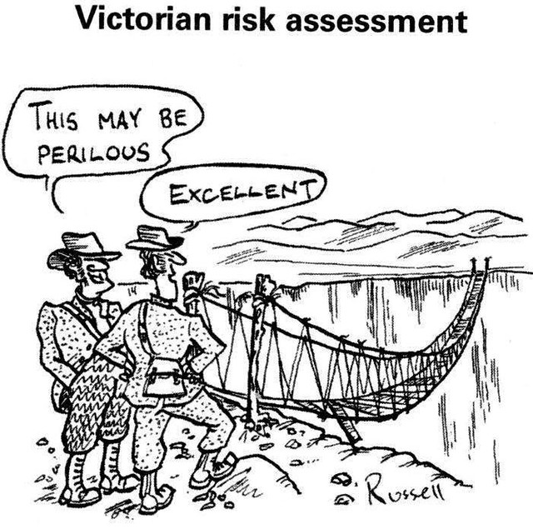
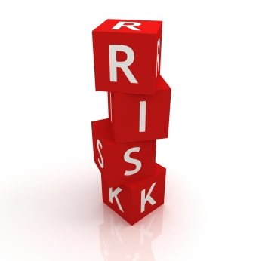
Introduction – identifying and managing risk
How do we currently manage our risk exposure across the process industry?

Slide 4


Frameworks for Risk Management
- Compliance with Standards: Applicable regulations, standards, codes, and other requirements issued by HSE Executive / National Governments, International Standards and Organization’s policies and procedures.
Examples:
ISO 31000:2018 Risk Management
IEC 31010:2019 - Risk Management - Risk assessment techniques
IEC 61882 - HAZOP Studies

Slide 5
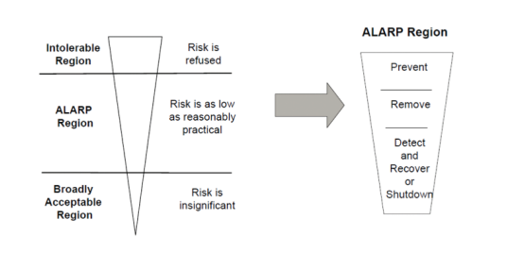
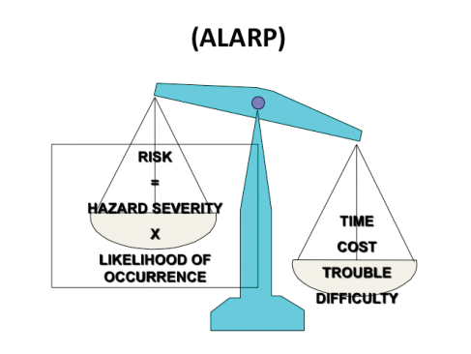
Risk Management Systems
Ensure the appropriate safeguards, mitigations and elements of contingency planning are in place to protect our workplace activities on any industrial site, generally setting risk tolerances to as low as reasonably practicable - ALARP Principle:
Notes:
It may not practical to stage all the solutions, adequate emergency plans for each scenario to stabilize the situation can be prepared and time taken to mobilize said resources must be factored in. For example, most site work usually carries a degree risk of injury depending on the work activity, if it is not practical to have an ambulance on site, instead having a trained HSE officer who can provide necessary support to stabilize the Injured Person (IP) until the professional medical response arrives is a viable alternative.

Slide 6
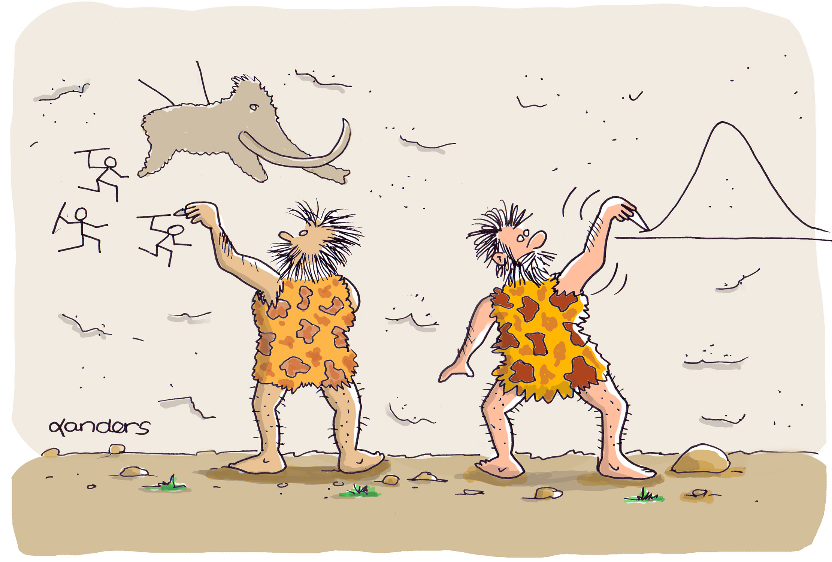
Conducting Risk Assessments
Which Type of Risk Assessment Approach should we perform?
Qualitative & Semi-Quantitative Risk Assessments:
What-if Analysis, Job Hazard Analysis (JHA)
Hazard Identification Study (HAZID)
Hazard and Operability (HAZOP) studies
Layer of Protection Analysis (LOPA)
Failure Mode and Effect Analysis (FMEA)
Fully Quantitative Risk Assessments:
Quantitative Risk Assessment (QRA)
Probability Risk Analysis (PRA),
Quantitative Scenario Analysis (QSA)
Notes:
The purpose of conducting each type of risk assessment is ultimately the same, that is identifying and reducing the risks of potential hazard events to as low as reasonably practicable, a common shortfall when conducting risk assessments is the selection of the appropriate risk assessment type or approach to be used. Essentially, the degree of detail in the risk assessment should align to the level of the intrinsic hazard

Slide 7
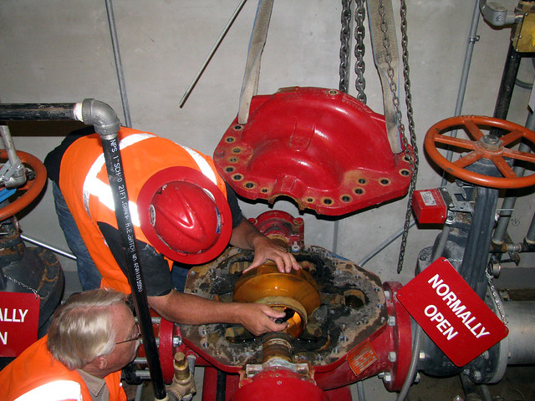
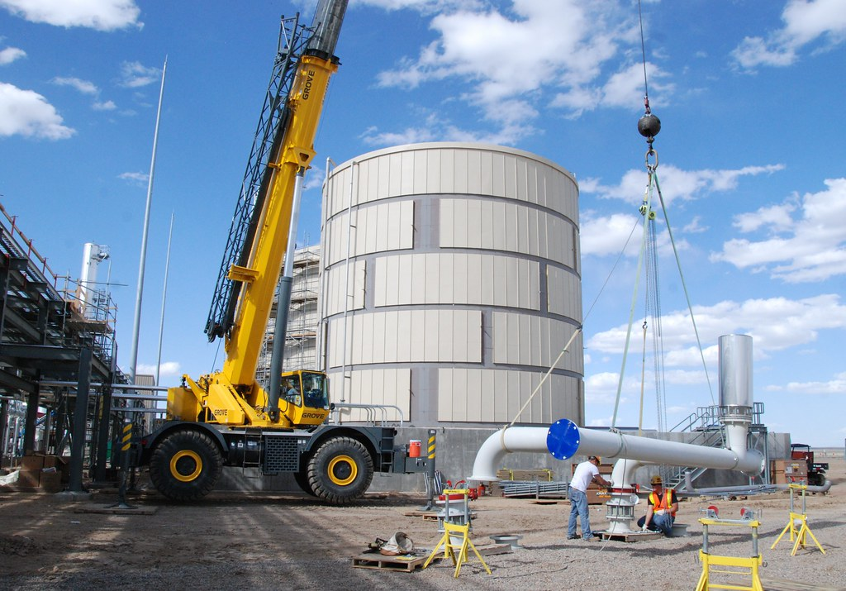
Conducting Risk Assessments
Risk Assessment Proportionality: The degree of detail in the risk assessment should be aligned to the level of the intrinsic hazard(s).
Firewater Pump Repair
VS
Installation of new process plant
Notes:
For site operations it may be desirable to quantify and rank the risks arising from human failures. Several methods exist for quantifying the contribution made by human action or inaction to the overall risk. Human Reliability Assessment (HRA) include the process of task analysis which helps with the identification of all points in a sequence of operations at which incorrect human action, or the failure to act, may lead to adverse consequences . Procedural HAZOPs may well be applicable in high risk, manual/semi manual site operations and should be implemented to capture the human factor elements and provide a more in-depth analysis

Slide 8
Shortfalls of Risk Assessments
Some Key Mistakes:
Failure to involve key team members and Subject Matter Experts (SMEs).
Team members’ attitude toward risk management.
Poor Risk Assessment facilitation and control (e.g. results in conflict between parties, missed hazards or dominant personalities taking control)
No consideration of ALARP or further measures that could be taken;
Only considering the risk from one activity; No Cascade risk linkages.
Using ‘Reverse ALARP’ arguments (i.e., using cost benefit analysis to attempt to argue that it is acceptable to reduce existing safety standards);
*Refer to White Paper for many others.
Notes:
Risk can be Safety, Environmental, Business and Reputational

Slide 9

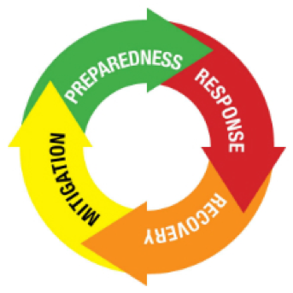
Emergency Response Planning (ERP)
ERP to include all identified emergency scenarios prior to site operations.
ERP is not the answer to all Mitigation / Preventions, during Risk Assessment we may take the ERP for granted as a ‘silver bullet’ solution!
ERP must be developed to meet financial/human resource needs and address knowledge gaps prior to the occurrence of the emergency scenario.
Notes:
Project specific ERP required

Slide 10
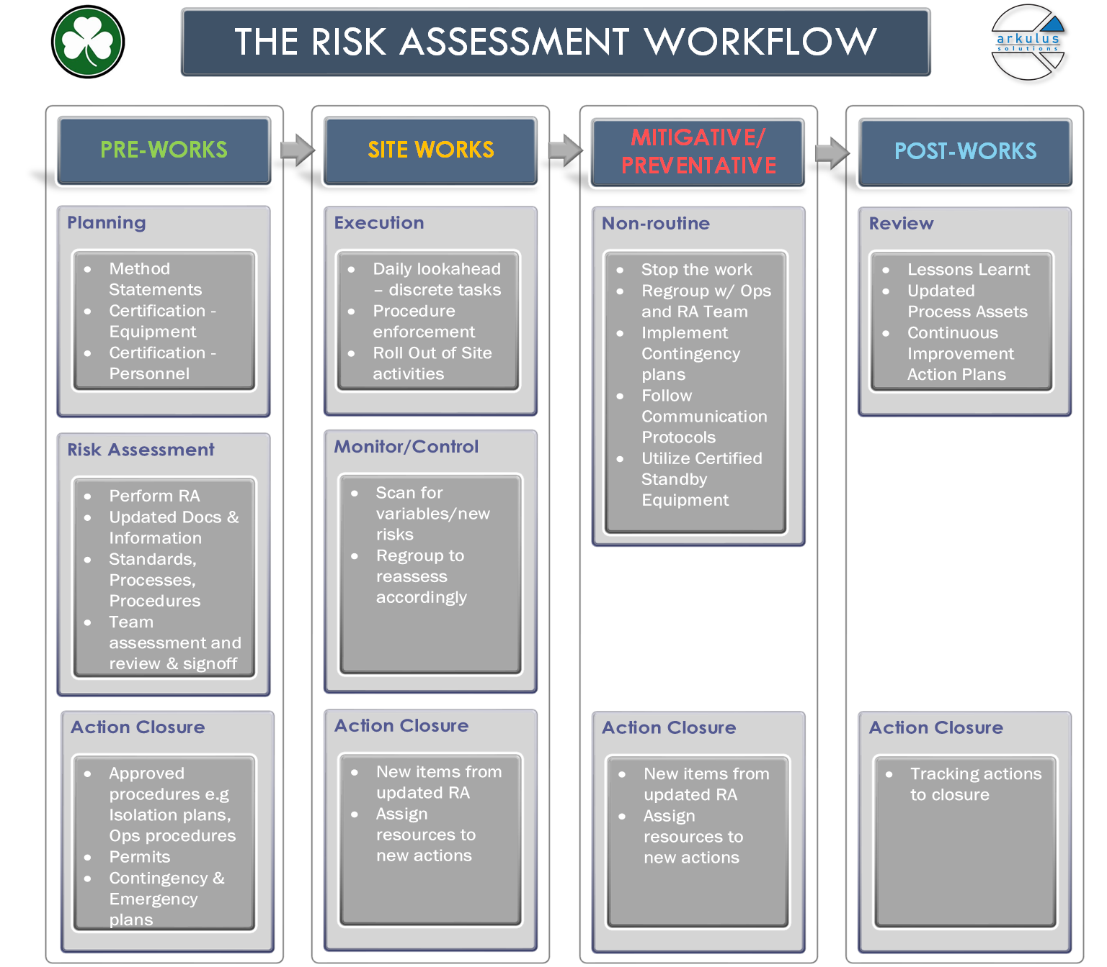
Risk Assessment Workflow
A dynamic approach should be taken to the Risk Assessment process by considering four (4) phases:
PRE-WORKS
SITE WORKS
MITIGATE/PREVENTATIVE
POST WORKS
Notes:
Job activities for stages

Slide 11
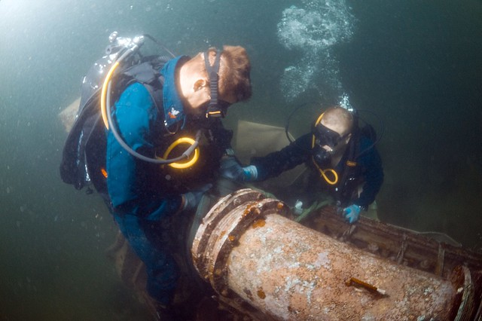
Scenario for Risk Assessment Workflow
A private contractor was conducting a maintenance exercise involving replacement of isolated subsea spool on a hydrocarbon pipeline when an incident occurred at an offshore unmanned facility.
The incident resulted in the loss of sight of three offshore workers (divers). Immediate rescue attempts for the missing personnel were initiated, with one person rescued, but further rescue attempts were affected by the time taken to assess and implement an emergency response plan.

Slide 12
Scenario for Risk Assessment Workflow
This created great controversy amongst several stakeholders involved in the incident, namely the Contractor team, who was restricted from gaining access to the location of the event. During this misalignment, valuable time was lost in assessing the hazard scenario and locating the remaining workers.
The bodies of remaining divers were discovered over the following days and an incident investigation was initiated by the Operator and Governing Safety Regulators.

Slide 13
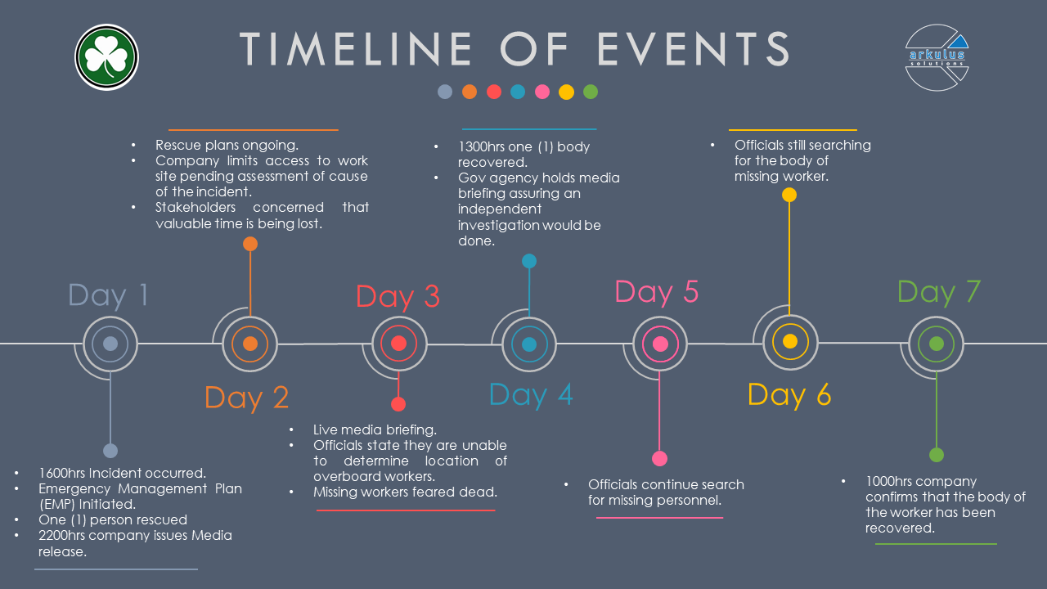
Notes:
A private contractor was conducting a maintenance exercise involving replacement of isolated subsea spool on a hydrocarbon pipeline when an incident occurred at an offshore unmanned facility.
The incident resulted in the loss of sight of three offshore workers (divers). Immediate rescue attempts for the missing personnel were initiated, with one person rescued,
but further rescue attempts were affected by the time taken to assess and implement an emergency response plan.
This created great controversy amongst several stakeholders involved in the incident, namely the Contractor team, who was restricted from gaining access to the location of the event. During this misalignment, valuable time was lost in assessing the hazard scenario and locating the remaining workers.
The bodies of remaining divers were discovered over the following days and an incident investigation was initiated by the Operator and Governing Safety Regulators.

Slide 14

Phase 1: Pre-works
Identification of the Risk Assessment Scope - like for like replacement?
Emergency Response Plans includes all scenarios, communication protocols, Responsibility Assignment Matrix ,Emergency isolation/Plugging of Pipeline procedures in case of leaks or isolation breach, SIMOPS, etc
A Procedural Risk Assessment with Subject Matter Experts (SMEs).
Accuracy of documentation verification to ensure ‘As-Built’ information is correctly shown.
Standby Equipment that is certified and capable of meeting the requirement of emergency dive rescue situations.
Notes:
Team composition

Slide 15
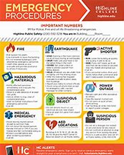
Phase 1: Preworks
Establishment of ‘not to exceed’ variance levels (upper and lower control limits) for critical process parameters.
The Control of Work process, which includes isolation of pipeline (Lock-Out/Tag-out) and physical isolations.
Importance of 'Drills' such as an unconscious dummy diver retrieval.
Integration of technology, use of tracking apps, virtual whiteboards to all stakeholders, digital waterproof watches or tracker with GPS and vital statistic monitoring in place.

Slide 16
Phase 2: Site Works
For site operations a communication plan is key to identify the responsibilities of each resource and keep all team members abreast of the progress.
Daily lookaheads review discrete tasks, keep all parties updated
Reviewing of risk assessment from Pre-Works
Monitoring for change of relevant process conditions and variables such as environmental site conditions, pressures, temperatures, flowrates, levels in pipeline,
Monitoring Physical conditions of personnel: tracking heart rate, location, body temperature, oxygen levels, oxygen pressures etc
Reassess and update RA – Ensure new actions closeout

Slide 17

Phase 3: Mitigative/Preventative
Elimination of any potential future hazardous events from recurring (e.g. cease operations in the vicinity).
Assessment on situation – Assemble all SMEs, TAs, key stakeholders
Implementation of ERP and contingency response plans in a calm and controlled manner following the Responsibility, Accountability, Consulted and Informed (RACI) matrix.
Previous Drills from the Pre-works phase should be familiar.
Use of digital tools during a ‘Live Emergency’ such as mobile updates, digital white boards, live visuals/audio tools during rescue efforts.

Slide 18
Phase 4: Post Works
Key learnings from this incident are to capture the lessons and develop solutions to ensure this can be prevented.
Reviewing the accuracy of the risk assessment includes identifying any gaps, root causes and lessons learnt.
Implementing continuous improvement action plans to ensure we learnt from this mistake.
Update of process safety assets to improve safety culture and future knowledge sharing.

Slide 19
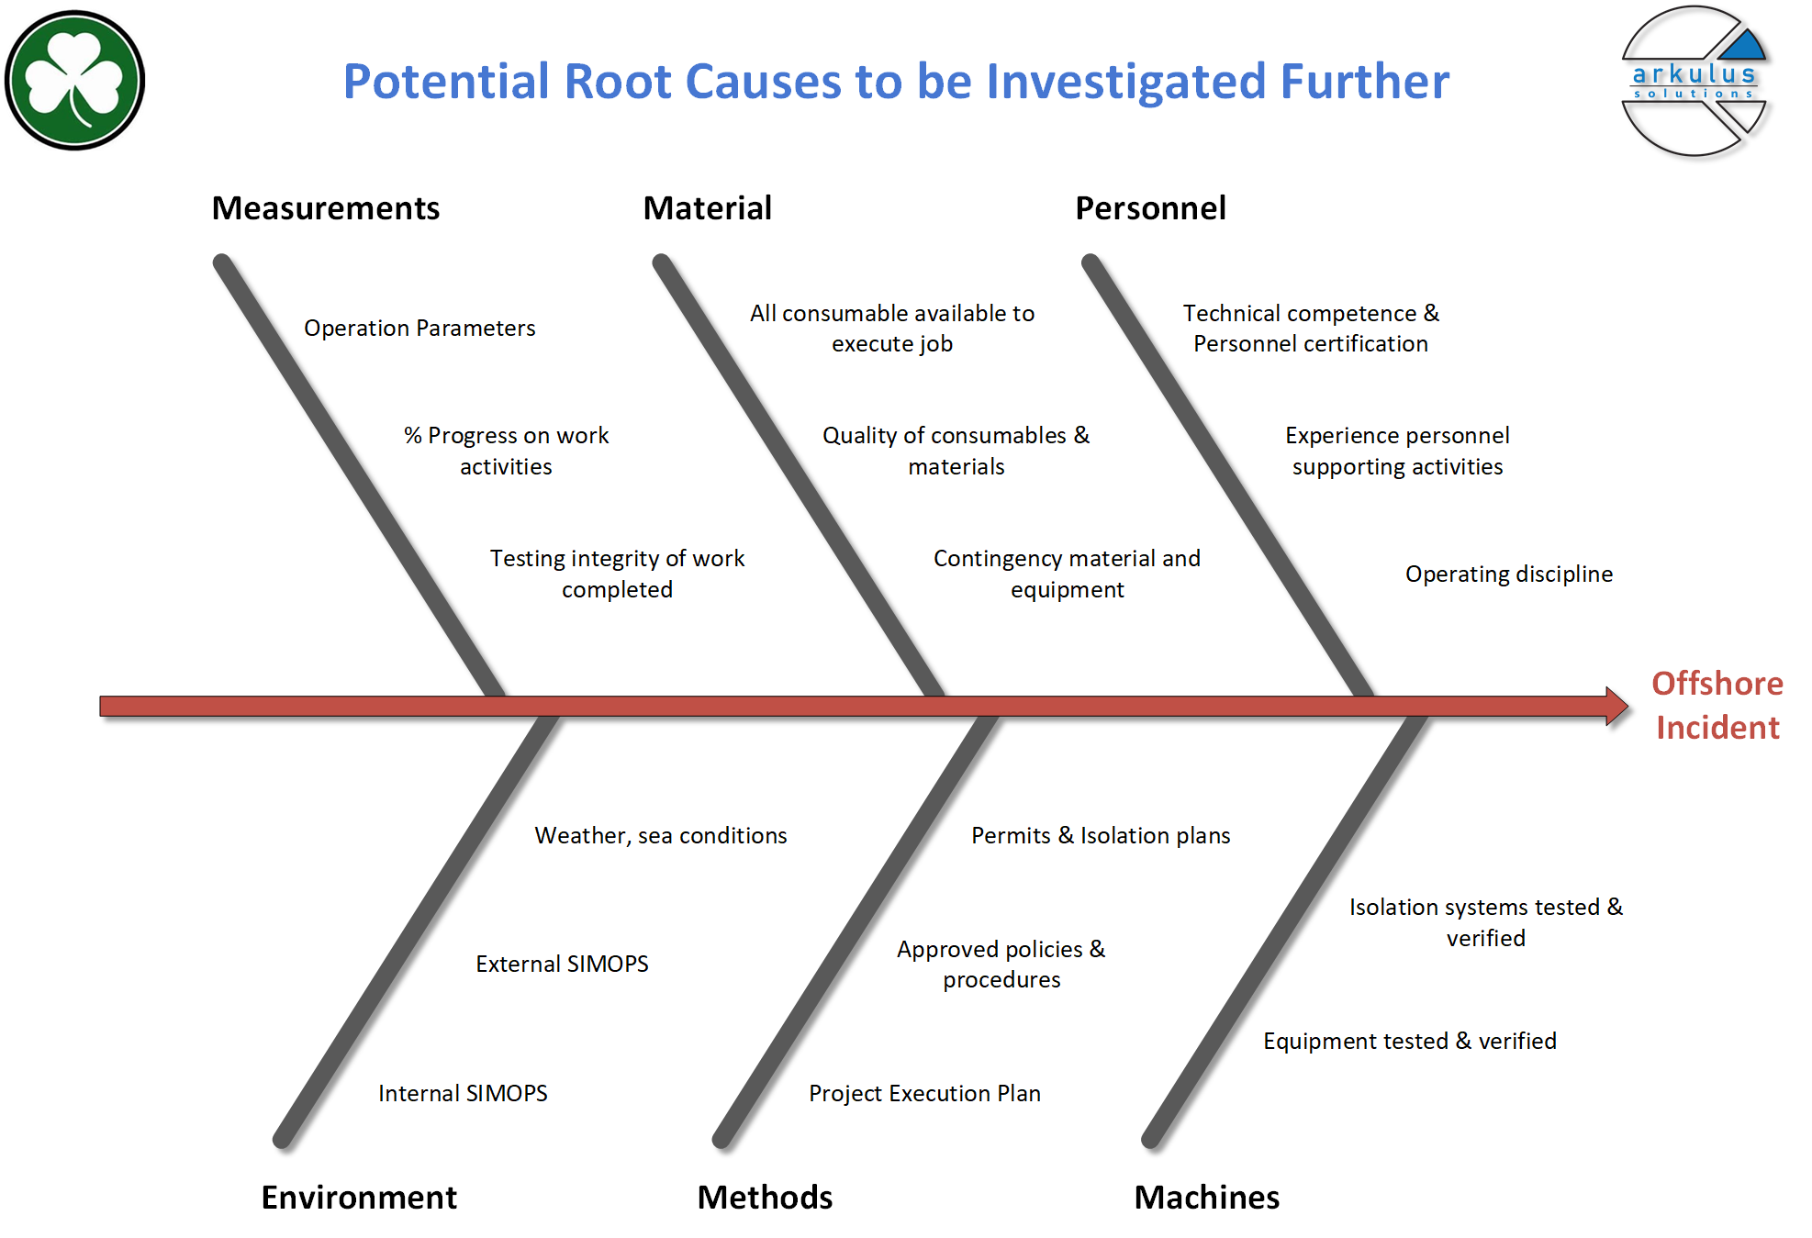
Phase 4: Post Works
Important to perform validation of the root cause of the incident before we can develop and implement solutions.
This determines which gaps exist and where collectively the emphasis should be placed.

Slide 20
Conclusions
The following tools & techniques can address the gaps in risk assessment:
Use correct Process safety management tools and processes: Safety Critical Task Analysis, Human Factors Risk Assessment, methodology for contractor capability assessment, procedure for issuing permits for emergency response, Emergency Drills, Safety Critical Equipment listings/deployment etc. to ensure risks are ALARP.
Use Technologies including spatial modelling, thermal/laser imaging inspections, unmanned vehicles and others, pressure/temperature/flow monitors to mitigate risks in day-to-day operations by facilitating comprehensive and timely analyses and diagnoses.

Slide 21

Conclusions
Embrace a robust communication plan can also help provide closer feedback and may help prevent personnel from exposure to potential hazards being created by changing variables.
Perform Regular reviews and audits by independent 3rd parties.
Utilize New technologies exploited such as Big Data, analytics, mobile applications, cloud computing, enterprise resource planning, Governance, Risk, and Compliance (GRC) systems, are very important for risk management.

Slide 22

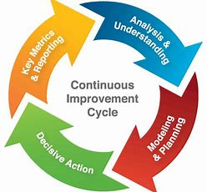
Conclusions
Purse an Enterprise-Wide Risk Management (EWRM) system will aid organizations in accessing cascade risks it covers many different aspects of strategy /operations/ projects/unforeseen risks including the interlinkages between the different risk levels and the strength of those interlinkages.
Mobilize a resource such as a ‘Risk Engineer’ to provide risk leadership, continuous improvement and reduce the gaps in industrial risk assessment

