Slide 1
Process Safety Management: Beyond the Norm
Hazards 32 Process Safety Conference ​
Mohamad Fazaly Mohamad Ali,
Principal (Process Safety), PETRONAS
19 October 2022
Open

Slide 2

Presentation Outline
Process Safety Journey
Process Safety Focused Enhancement (PSFE)
Learning from Incidents
Integrated Process Safety Management (IPSM)
Summary
Acknowledgement
Open

Slide 3
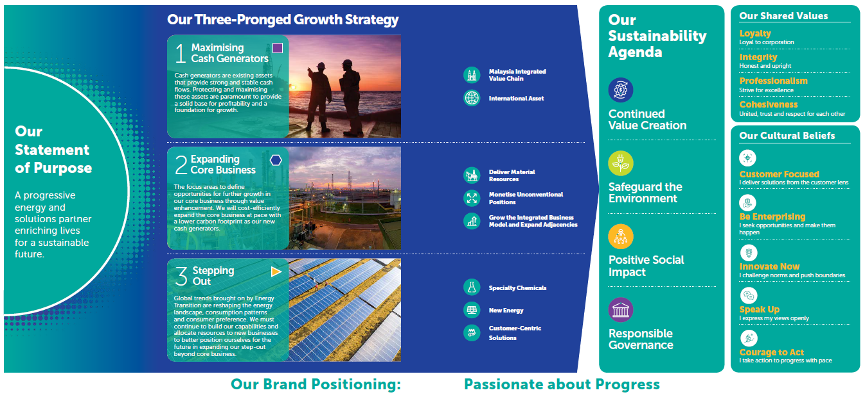
PETRONAS at a Glance Overview
Open
Notes:
Petroliam Nasional Berhad (PETRONAS) was established 47 years ago and today is a global energy and solutions company, ranked amongst the largest corporations on Fortune Global 500®. As global energy and solutions company, PETRONAS seek opportunities in energy investments both in hydrocarbon and renewables across the globe and maximise value through our integrated business model.

Slide 4
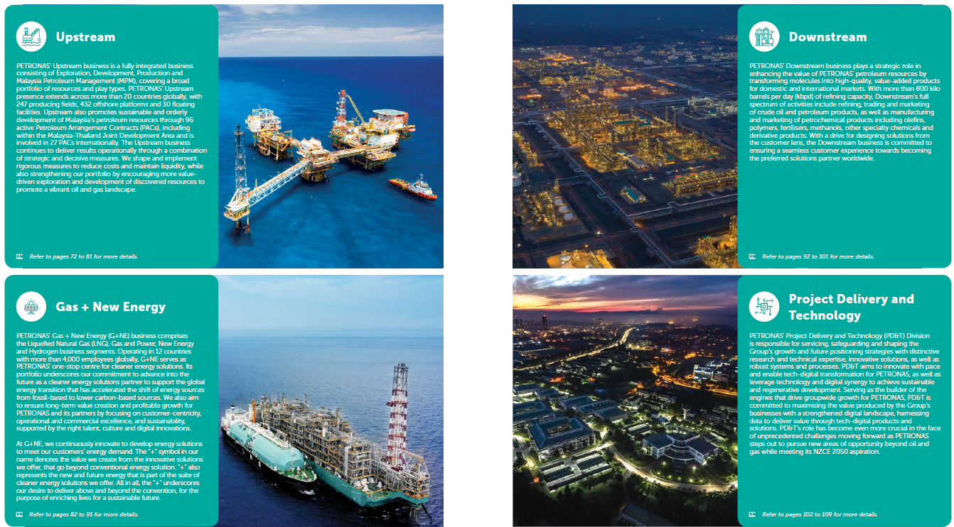
PETRONAS at a Glance Business Snapshot
PETRONAS is the custodian of Malaysia’s national oil & gas resources as well as a global energy solutions partner
We explore, produce & deliver energy to meet society’s growing needs through our core businesses
Open

Slide 5
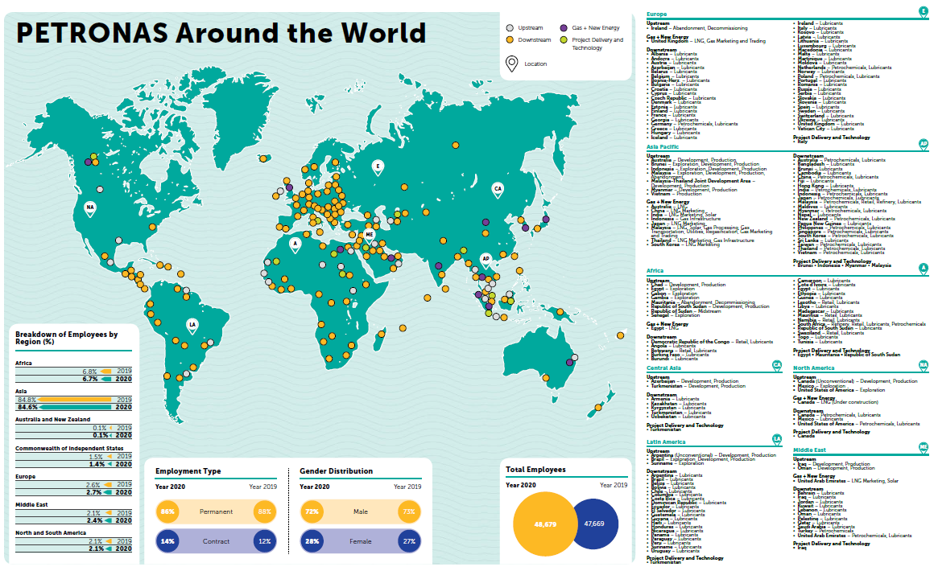
PETRONAS at a Glance Location & Workforce
Operating in over 50 countries
48,600 total workforce of various nationalities
Open

Slide 6



PETRONAS Process Safety Journey
2020 onwards
Towards ZERO Process Safety Events
Process Safety journey in PETRONAS started since year 2000, when PSM department was established at a PETRONAS Refinery.
PETRONAS has continually improved on Process Safety Management since 2006.
2015-2020
PS Framework & Programs established
2006
Establishment of PSM in PETRONAS focusing on 8 elements
2014-2015
Formations of PSM functions at Group HSE & Businesses
Open
Notes:
Add INSTEP logo (?)

Slide 7
Process Safety Focused Enhancement (PSFE)
PSM Leadership & Accountability
Inculcate right mindset and behavious through clear and pervasive tone on Process Safety priority and accountability.
PSM Risk Visibility & Timely Escalation
Enable greater visibility, continuous analytics and timely escalation of Process Safety risks for prompt decision and mitigation.
PSM System Enhancement
Holistically drive & govern Process Safety Management beyond Process Safety 8-Aspects and through interlinkages of multi-disciplinary system
In achieving Zero Process Safety Event Aspiration, Process Safety Focused Enhancement (PSFE) initiative was established in 2020.
PSFE is a 3-point strategy which is envisioned to focus on specific key areas that is anticipated to elevate Process Safety excellence throughout the organization.
Open

Slide 8
PSM System Enhancement
PSM System Enhancement
Integrated PSM and enhanced PS governance processes
Enhanced PSM related Capability Development
Holistically drive & govern Process Safety Management beyond Process Safety 8-Aspects and through interlinkages of multi-disciplinary system
Open
Notes:
In driving and governing PSM in PETRONAS, the following main elements have been in place and focused upon since the establishment of PSM requirements:
Management of Change (MOC);
Process Hazard Analysis (PHA);
Process Safety Information (PSI);
Design Integrity (DI),;
Mechanical Integrity (MI);
Operating Procedure (OP);
Pre-Activity Safety Review (PASR); and
Proprietary and Licensed Technology Assessment (PLTA).

Slide 9
Learning from Incidents
Tapping into various process safety related incidents provided valuable insights for this improvement.
PETRONAS have adopted deep dive approach on analysing previous incidents, which was found to be coherent.
Incident Investigation
Deep Dive
Open
Notes:
Initial incident investigation focuses mainly on identifying the immediate causes of the incident and does not track back far enough to understand the background stories or events. Deep dive approach analyses the interactions between the various components/ parts of the incident whether they are physical (i.e., installations, organisations, policies, procedures), or cognitive (i.e., norms, practices, organisation) within a particular system.

Slide 10

Incident #1: Major Fire at refinery resulting in major asset damage
MOC & PASRs
Deficiencies in implementing Management of Change (MOC) and or Pre-Activity Safety Reviews (PASRs) for the changes involving valves replacement.
Competency
Knowledge of personnel on high temperature sulfidation and requirement for use of special material.
Organization Change
Critical positions were left vacant for few years
Procurement Process
Understanding and compliance to procurement work process.
Open

Slide 11

Incident #2: Vent piping rupture resulting in a major asset damage (blast impact) and minor LOPC at offshore platform
PTW & SIMOPS
Deficiencies in implementing Permit to Work (PTW) system during Simultaneous Operations (SIMOPS) activities
Asset Integrity
No proper preservation of equipment for delayed projects
Competency
Interfaces
Knowledge of personnel in handling SIMOPS activities
Clarity of asset ownership (i.e., either project or operations) and work planning
Organization Change
Managing availability of critical positions during critical period of project
Open

Slide 12
Incident #3: Major Fire at refinery resulting in major asset damage
PHA & OP
Deficiencies in implementing adequate Process Hazard Analysis (PHA) and develop Operating Procedure for 3rd Party Equipment
Procurement & Contractor Management
Failure to establish a comprehensive contract between supplier and company
Safe Operation
Failure to include essential parameter to be recorded and analysed during daily monitoring
Asset Integrity
No intervention and rectification of any faulty component due to maintenance program of 3rd party equipment
Open
Notes:
Using these as examples, Integrated Process Safety Management (IPSM) was created to ensure comprehensive, robust, and sustainable system for managing process safety risk and minimizing the likelihood of a major accident

Slide 13
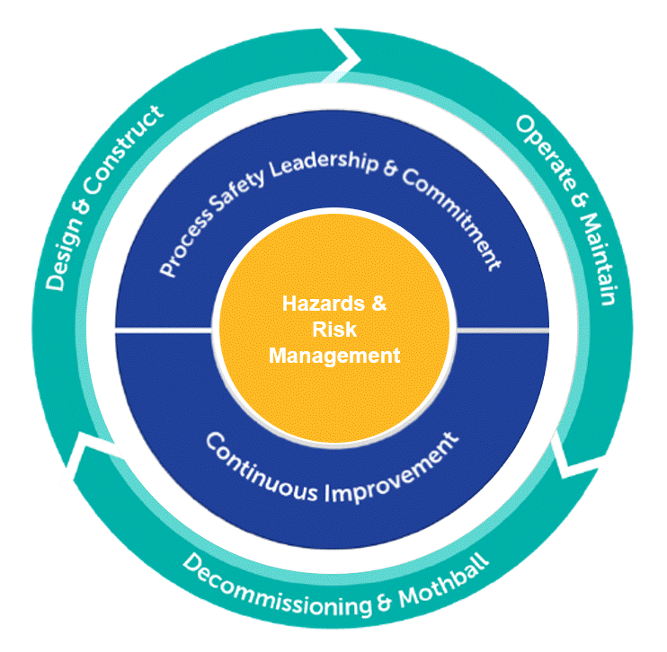
Integrated Process Safety Management (IPSM)
The key components of PETRONAS PSM requirements can be reflected as per PETRONAS Integrated PSM Model (IPSM)
Open
Notes:
The IPSM is illustrated in spinning circle to imply that Process Safety risk is dynamic, and it has to be consistently managed throughout the asset lifecycle. It covers the necessary requirements that relate to Design, Construct, Operate, Maintain, Decommissioning and Mothball of the assets. It is made up of 17 elements which are clustered into 3 cores.

Slide 14

Process Safety Leadership and Commitment
Process Safety Leadership and Commitment shall be translated as compliance to the requirements as well as building PS competency in the organization. This core to emphasize that leadership at all levels would drive Process Safety culture that enables us to achieve Process Safety excellence. The Process Safety Elements under 1st Core are:
Process Safety Culture
Standards, Codes and Regulations
Competency
Open
Notes:
The first core is Process Safety Leadership and Commitment.
Strong foundation and culture ensure consistent practice of Core 2 and Core 3.

Slide 15
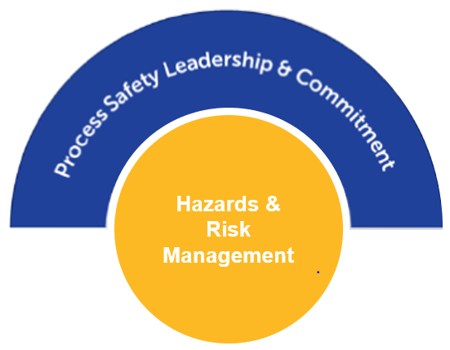
Hazards & Risk Management
The ultimate requirement for Process Safety is to identify the hazard and manage the risk accordingly. It is important to identify potential of PS hazards at different stages of assets / key activities and manage the risk to ALARP. Process Safety Elements under 2nd Core are:
Process Safety Information (PSI)
Process Hazard Identification & Risk Analysis
Operating Procedures (OP)
Asset Integrity and Reliability
Management of Change (MOC)
Pre-Activity Safety Review (PASR)
Safe System of Work (SSOW)
Safe Operation
Procurement and Contractor Management
Emergency Management
Open
Notes:
At the centre of the circle from the Integrated PSM illustration is the second core i.e., Hazards & Risk Management.

Slide 16
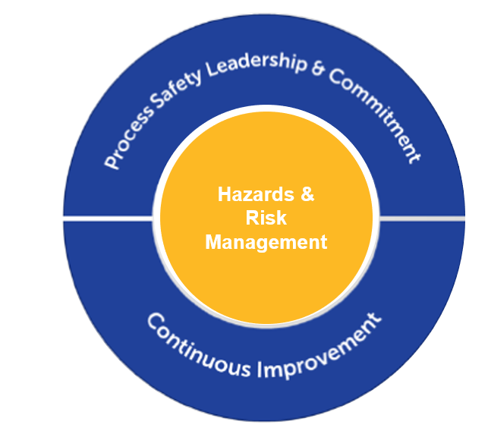
Continuous Improvement
The heart of PS Management is the drive towards Zero Process Safety Event. This can be achieved by driving site compliance, analysing current PS performance, and taking actions as part of continuous improvement which are covered by the following Process Safety Elements:
Incident Management
Performance & Monitoring
Assurance
Management Review
Open
Notes:
The third core of Integrated PSM is Continuous Improvement

Slide 17
Summary
Process Safety Leadership and Commitment
Process Safety Culture
Standards, Codes and Regulations
Competency
Hazards & Risk Management
Process Safety Information (PSI)
Process Hazard Identification & Risk Analysis
Operating Procedures (OP)
Asset Integrity and Reliability
Management of Change (MOC)
Pre-Activity Safety Review (PASR)
Safe System of Work (SSOW)
Safe Operation
Procurement and Contractor Management
Emergency Management
Continuous Improvement
Incident Management
Performance & Monitoring
Assurance
Management Review
Open
Notes:
As technology advances, the scale and complexity of the process also increase rapidly, hence it is becoming harder to control accidents in process plants. Based on past incidents, it appears that incidents are no longer controlled solely by engineering practices but a combination of technical and cultural factors which requires a holistic safety management approach.
The objective of Process Safety Management (PSM) is to ensure comprehensive, robust, and sustainable system for managing process safety risk and minimizing the likelihood of a major accident.
As Process Safety risk is dynamic and has to be consistently managed throughout the asset lifecycle, these 17 PS elements covers the necessary requirements that relate to Design, Construct, Operate, Maintain, Decommissioning and Mothball of the assets.

Slide 18

Acknowledgement
Co-Authors
Rizal Harris Wong, Custodian (Process Safety), PETRONAS.
Yogendren Sevakumaran, Principle (Process Safety), PETRONAS.
Nor Afida Sikandar Bacha, Staff (Process Safety), PETRONAS.
Open

Slide 19
PETRONAS
Passionate about Progress
Open

