Slide 1
Investigating a Complex Energetic Decomposition Incident using Kinetic Modelling to Establish Safe Manufacturing Conditions
Stephen Rowe
Keith Middle
DEKRA UK Ltd
Contents
Material and Process Information
Incident description
Incident cause determination
Defining “safe” material temperatures
Kinetic modelling and data scale-up
Recommended assessment strategy
Conclusions

Slide 2
Material & Process Information
Multi-step API manufacture. Intermediate containing 2 energetic functional groups.
Material filtered, filter dried at 55°C, discharged to FIBC’s.
Process fully HAZOP’d and in production since 2015.
Dust explosion
MIE 60-80 mJ (mechanical spark)
MIT 730°C
LIT 260°C
St 1 (low explosion severity)
Thermal stability
UN Class 4.1 (flammable solid)
Energetic decomposition (1870 J/g by DSC)
TD₂₄ = 170°C by ARC
Material
Properties
Explosive Properties
Borderline explosive
Negative impact and friction test
Negative in UN Test Series 2 tests

Slide 3
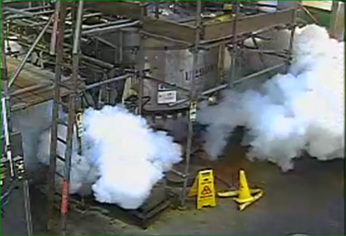
Incident Description
June 2019 – fifth batch of a five batch campaign.
Problems with powder discharge (hold-up in intermediate hopper).
Mechanical delumper used to break-up lumps but tripped twice.
After 10 – 11 minutes on hold, overpressurisation and release of white powder.
No serious injuries but reported to HSE under RIDDOR.

Slide 4


Incident Cause Determination
A root cause analysis identified three possible causes of the top event (Loss of Containment):
1. Internal deflagration
2. High pressure nitrogen supply
3. Product decomposition
event lasted minutes, not ms
discharge not consistent with combustion
ignition sources not present
Ejected powder was chemically altered.
Product decomposition could not be discounted, but initially felt unlikely.
Further studies undertaken despite the TD₂₄ of the pure compound being 170°C.

Slide 5
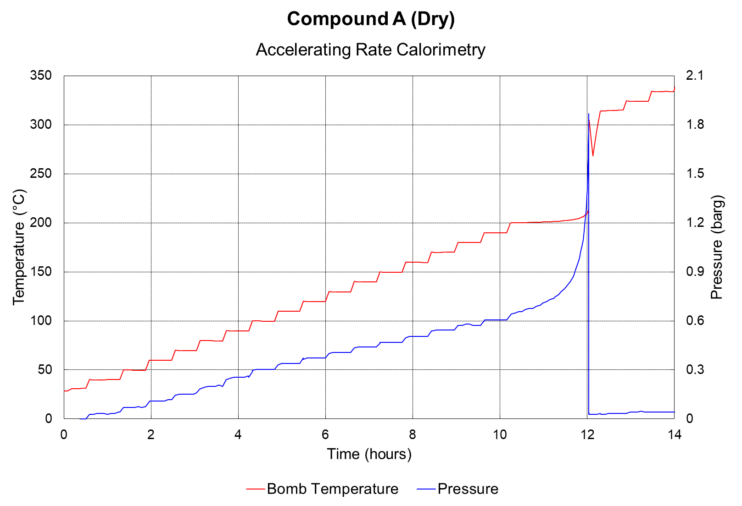
Defining “Safe” Material Temperatures
How to determine safe temperature for a solid?
Applying a blanket “safety margin”
Using simple empirical corrections.
Using the TD₂₄ value from adiabatic calorimetry.
Multiple tests to extract kinetic parameters / build full kinetic model.
Extreme sensitivity calorimetry
Not suitable for autocatalytic reactions
Notes:
Explain TD24

Slide 6
Building a Kinetic Model
Examine process compositions to identify worst case.
Multiple tests to extract kinetic parameters.
Construct kinetic model.
Validate model against range of data.

Slide 7
Building a Kinetic Model: Worst Case Process Composition

Slide 8
Building a Kinetic Model: Worst Case Process Composition
Material | Compound A Dry | Chloride Contaminated | Rust Contaminated | Wet Cake (39% solids) | Solvent Slurry (24% solids)
Measured onset temperature (°C) | 201 | 124 | 172 | 141 | 141
TD₂₄ (°C) | 170 | 93 | 158 | 110 | 124
Various compositions tested under identical conditions.
Pure compound MOST stable, not least.
Chloride contamination prevented by procedural control and IPC.
Wet cake retained as worst case (least stable)
TD₂₄ = temperature from which adiabatic decomposition (corrected for phi factor) takes 24 h to reach peak rates.
Assumes simple 1st order Arrhenius kinetics.

Slide 9
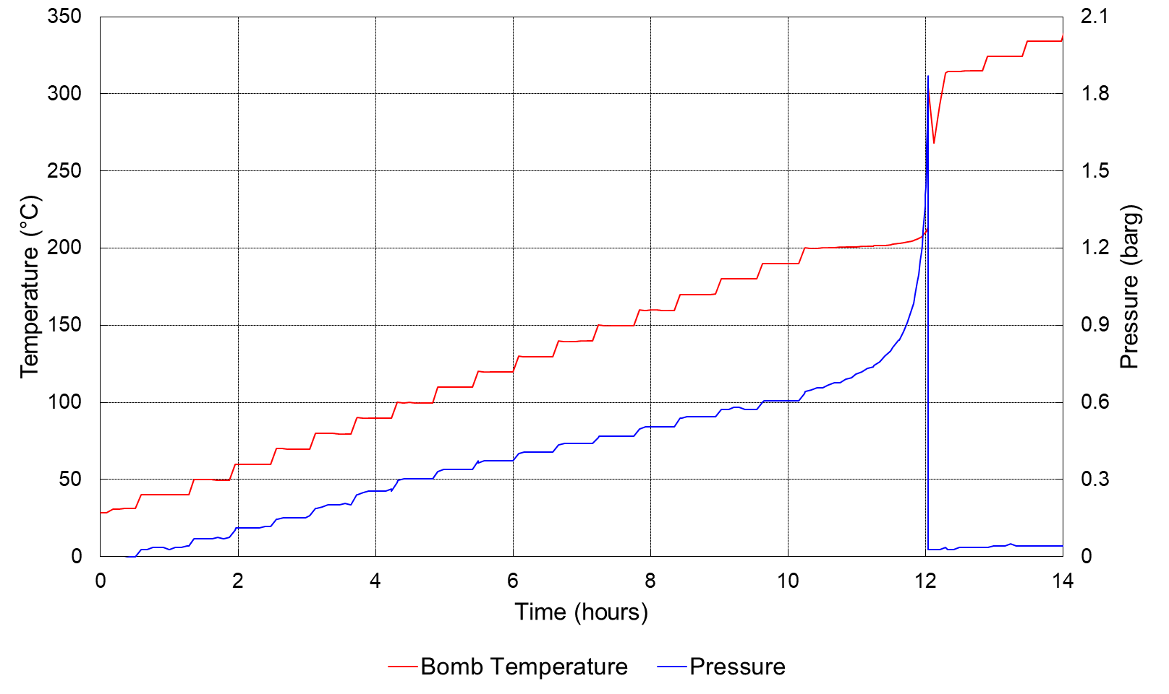
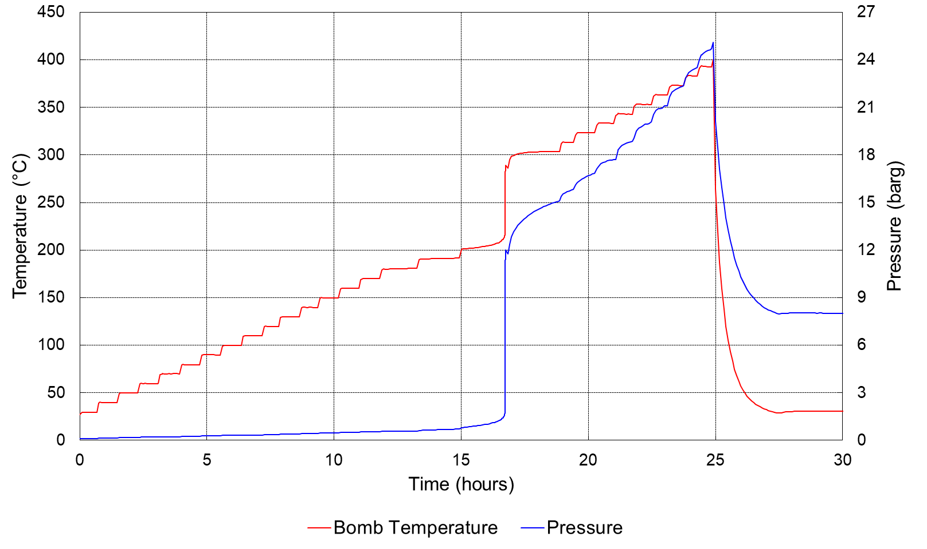
Building a Kinetic Model: Assumptions and Process
Obtain data for partially inerted mixture (wet cake) which is contained by cell but maximised range.
Measure material properties:
  powder particle density – for void space calc
  specific heat capacity – for heat release calcs
  thermal conductivity – for scale-up to plant
Construct model using commercial kinetic software platform
  E.g. ‘ARKS AC’ and ‘ARKS FK’ (Adiabatic Calorimetry analysis and Formal Conversion-Based Kinetic Modelling software), from ChemInform St. Petersburg (CISP)
Validate model against data from tests with varying conditions.
Inert with Al₂O₃
Notes:
Too energetic for apparatus at 4 g fill, at 2 g fill, etc, despite increasing phi factor (suggest you should explain this,). So need to raise phi factor to mitigate max. conditions - hence inert solid (assumed to only add phi, not influence kinetics by change in concentration).
For the wet cases, same assumptions of extra solvent acting as heat sink, but not accounting for concentration affecting kinetics.
Particle density to yield accurate void space for gas quantification.
Cp as a function of temperature to allow accurate heat release calculation
Thermal conductivity for simulations when kinetic model is applied to heat-loss behaviour in plant vessels

Slide 10
Building a Kinetic Model: Model and Validation
Best fit kinetic model for wet cake…
A → B1 → B2 → B3 → B
  A → B1 Generalized Autocatalysis
  B1 → B2 Generalized Autocatalysis
  B2 → B3 Generalized Autocatalysis
  B3 → B N-Order
Validation confirmed.

Slide 11
What is the “Safe Temperature”?
With a kinetic model and Filter Dryer plant design data, it is possible to model heat generation and heat loss and identify the CRITICAL TEMPERATURE.
  Critical temperature is temperature above which rate of heat generation exceeds the rate of heat loss and runaway reaction occurs (for a specific vessel geometry and fill).
  Frank Kamenetskii model applies for solids / Semenov model for liquid systems. Conductive only heat transfer considered for immobile wet cake.
Critical Temperature for wet cake Compound A was determined to be 80.5°C (30 K below the TD₂₄ value and 60 K below the raw measured onset temperature).
SIL-rated interlock applied to vessel heating medium at 75°C (using 5 K safety margin specified in UN SADT protocols for selecting control and alarm temperatures).
Notes:
Pure conductive model for settled powder and immobile wet cake (powder thermal conductivity dominant in former, solvent conductivity probably dominant in latter).
In slurry, convective model assumes agitation off; whereas well-stirred model when agitator functional - but as this latter is not worst-case, we've ignored this model

Slide 12
Basis of Safety for Self-reactive Substances
Yes
Adiabatic calorimetry
Is the reaction
autocatalytic?*
Calculate & use Critical Temperature
Extract kinetic model
Construct vessel model
Is protection viable / desirable?
No
No
Use TD_{24**} as safe handling temperature
(conservative)
Prevent
(with SIL-rated systems)
Yes
Containment
Protect
(without SIL-rated systems)
Venting
Quenching
Use TD_{24**} as safe handling temperature
(non-conservative)
Protect
(with SIL-rated systems)
Emergency cooling
* Plot rate curve ln(dT/dt) v 1/Temperature – straight line = not autocatalytic
** Confirm 24 h is worst case exposure duration. Use longer duration if appropriate.

Slide 13
Key Learning Points
Do not focus on pure substances alone, consider potential destabilising effect of solvents / impurities and specify safe temperature limits based on the most demanding.
  The default assumption may be that the pure substance will be most energetic and concentrated and hence will exhibit the lowest onset temperature. This study suggests that this is often not true.
Conventional rules of thumb and use of TD₂₄ extrapolated values may provide non-conservative, overstated safe handling temperatures for solid and / or autocatalytic substances.
If a material can propagate a hot spot (UN Class 4.1) then maximum temperature limits must be respected (identified, monitored and controlled) in all production areas.
For very energetic solid substances, extraction of kinetic parameters enables development of a rigorous kinetic model which can be combined with vessel geometry information to enable critical temperature to be established.
Prevention of violent decomposition initiation by temperature control requires all thermal scenarios to be identified and avoided by the use of high integrity systems (SIL rated).

Slide 14
THANK YOU!
Contact information
Stephen Rowe
 +(0)23 8076 0722
 stephen.rowe@dekra.com
MISSION
SAFETY

