Slide 1
Developing a solid-flame model for assessing consequences of large-scale rectangular pool fires and trench fires
Yongfu Xu, David Worthington and Adeyemi Oke
DNV, 30 Stamford Street, London, SE1 9LQ

Slide 2
Content
Pool fire and models for consequence and risk assessment of pool fires
Motivations and challenges for this new model
Modelling approach for the new model
Validation of the new model
Conclusions

Slide 3
Pool fire and models for consequence and risk of pool fires
Pool fires
Fire hazards from the releases of liquid and 2-phase flammable materials from storage and transportation
Solid flame models
POLF in Phast/Safeti
Poolfire6 by Rew and Hulbert (1996)
LNGFire3 by FERC (2013)
….
CFD (Computational Fluid dynamics)
KFX
FLCAS
Other CFD tools

Slide 4
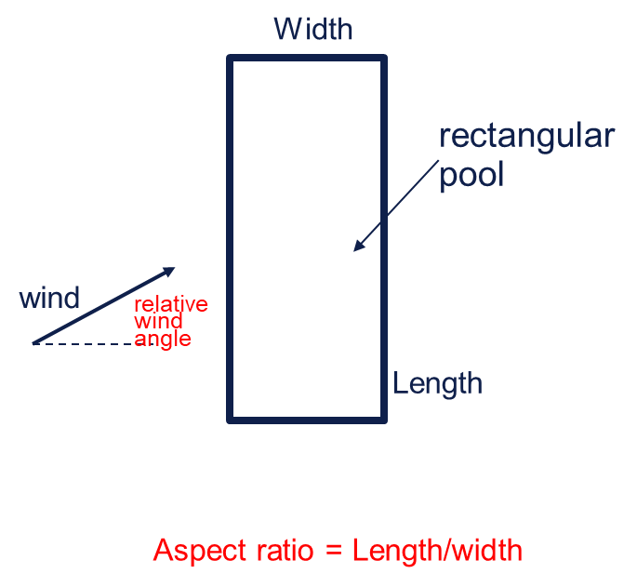
Challenges to develop solid flame model for pool fires
Challenges
Shape effect. One important factor in studying rectangular pool fires is the ratio of bund length (longer side of the bund) to the width (shorter side of the bund), normally referred to as aspect ratio. This can vary from 1 (square bund fires) to large numbers (fires in long trenches).
Directional wind effect. Rectangular pool fires are directional and depend on relative orientation between wind and the bund. When wind is in the direction of bund length, the pool fire can be very different from the fire if the same wind is in the direction of the bund width when the aspect ratio is high.

Slide 5
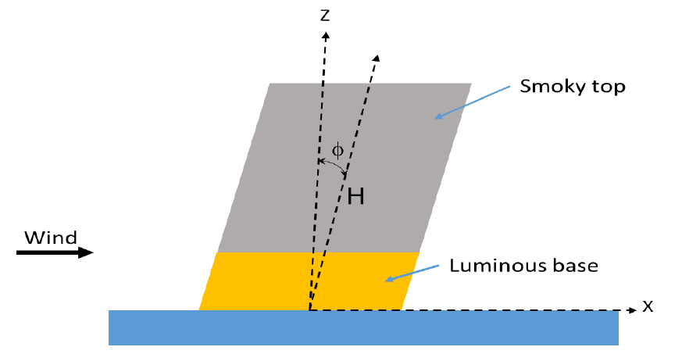
Solid flame models for circular pool fires
Solid flame shape of a tilted cylinder
Luminous & smoky zones
Correlations based on experimental results are used to estimate the shape of the flame
Suitable for pool fires of square pools or rectangular pools with small aspect ratio

Slide 6
Flame representation in this new model
Two-zone tilted elliptical cylinder for pool fires
-- Luminous flame base and smoky flame top
-- Elliptical cross-section of the flame gradually varies between flame base and top. This model would be applicable to rectangular pool fires with moderate aspect ratio.

Slide 7
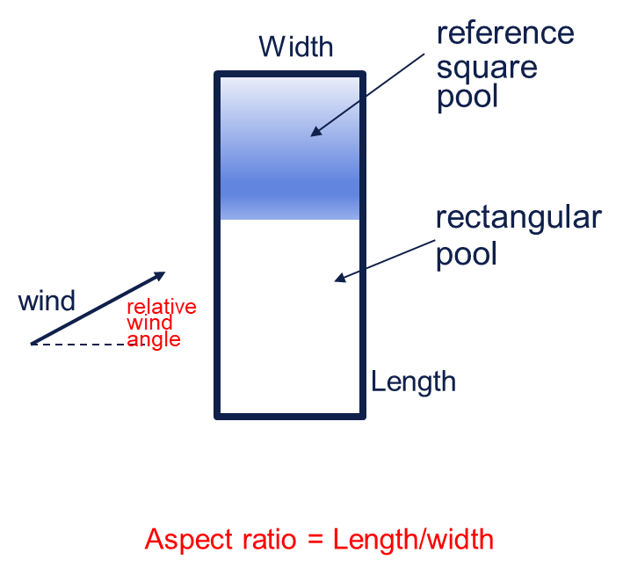
Modelling approach
Main assumption
Each of the flame variables of rectangular pool fires can be correlated to the pool fire of a reference square pool which has its side length equalling the shorter side of the rectangular pool.
Correction factors Func_P
Where P stands for flame variables, i.e. Flame length, Length of the luminous base section, flame tilting angle into the downwind direction, SEP (surface emissive power) of the luminous and smoky flames, Flame base length & width (including flame drag due to wind), Major and minor axes of the elliptical top.

Slide 8
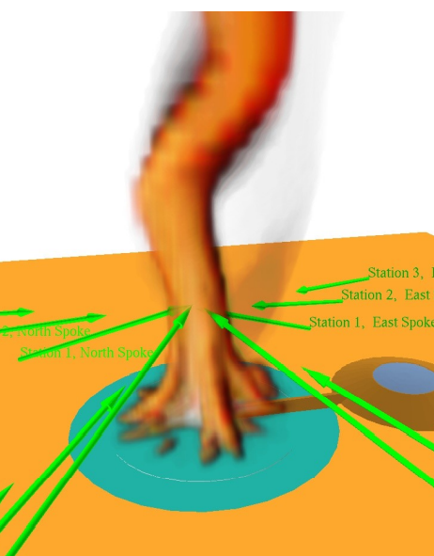
KFX
KFX™ is a three dimensional transient CFD tool for gas dispersion, gas explosion, fire development, fire mitigation and fire extinction CFD
A CFD software started in 1970 at Norwegian University of Science and Technology (NTNU)
Supported by major oil and gas companies on many JIP projects
Widely used on projects on onshore and offshore risk assessment.
It is a CFD tool for DNV
Phoenix LNG Pool Fire Test No. 2
KFX visualization of the predicted Phoenix LNG pool fire test

Slide 9
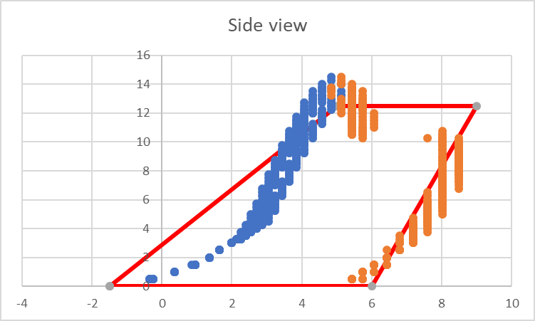
KFX simulations and flame shapes
Methane
Wind speed: 0.1m/s & 1.5m/s
Pool Width: 1m;
Pool aspect ratio: 1, 2,3,4
Wind direction: 0, 30, 60, 90 degrees
Iso-surface of 1000K predicted by KFX
Extracted flame shape for the solid flame model

Slide 10
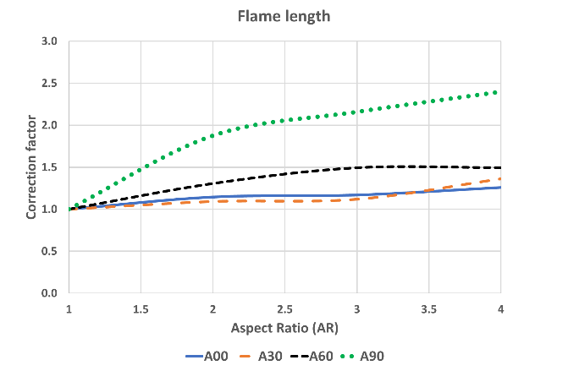
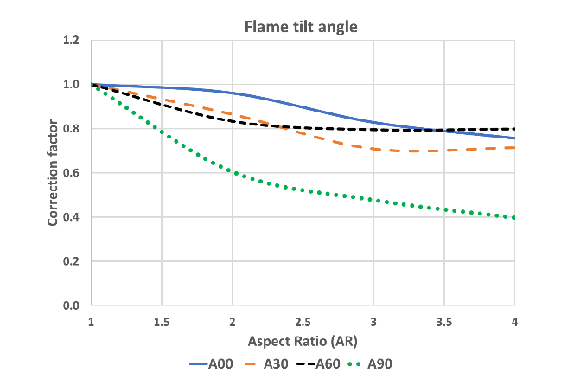
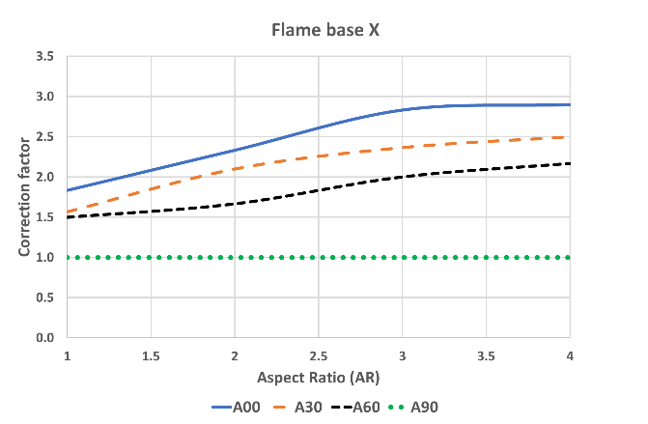
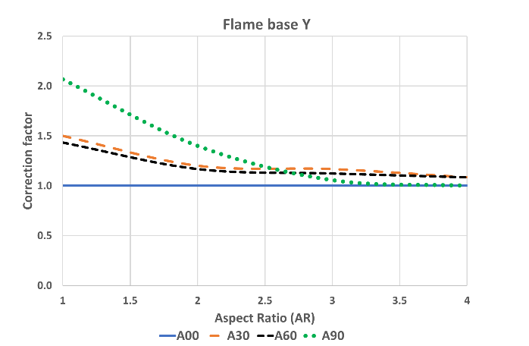
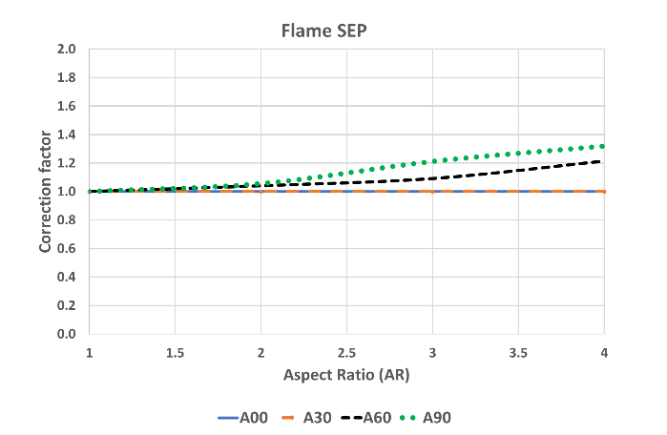
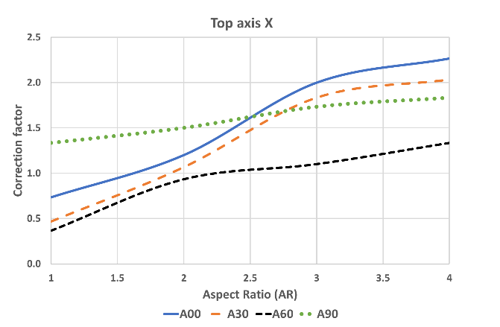
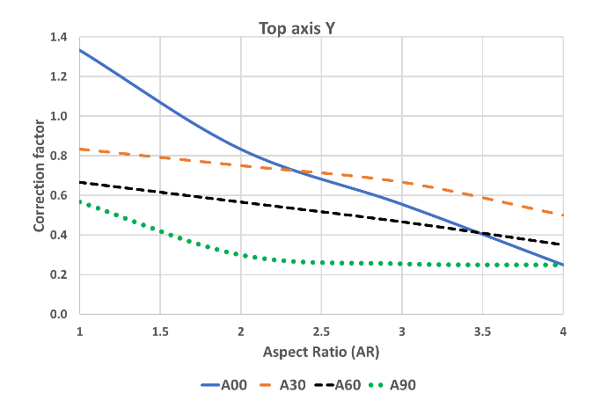
Correction factors for flame variables

Slide 11
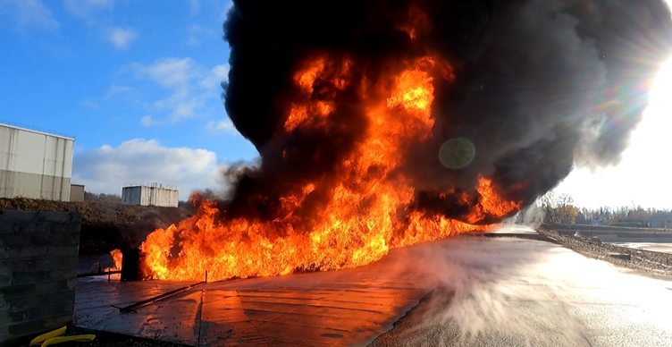
Validation 1: LASTFIRE gasoline pool fires
Plan view of the test site and locations of radiometers of a test
Pool fire of Test 6

Slide 12
LASTFIRE test cases: ambient conditions
 | Ambient temperature | Ambient humidity | Wind speed | Wind direction
Test 1 | 13 | 67 | 2 | -100
Test 2 | 20 | 68 | 4 | -100
Test 3 | 15 | 69 | 3 | -70
Test 4 | 19 | 50 | 2 | -75
Test 5 | 20 | 43 | 1 | -90
Test 6 | 15 | 91 | 1 | 70
Test 7 | 20 | 68 | 0.8 | 0
Test 8 | 17 | 86 | 0.2 | 90
Test 9 | 18 | 78 | 0.9 | -100
Test 10 | 21 | 72 | 0.9 | 145
Test 11 | 14 | 90 | 0.4 | -50
Test 1* | 5.2 | 72.5 | 3 | 72.5
Test 2* | 7.3 | 67.2 | 3 | 67.2
Test 3* | 8.4 | 66.4 | 3 | 66.4
Test 4* | 3.6 | 90 | 1.3 | 90
Test 5* | 3.8 | 90 | 3.1 | 90
Test 6* | 5.6 | 81 | 0.7 | 81
Test 7* | 2.1 | 92 | 0.4 | 92
Test 8* | 3.8 | 91 | 1.6 | 91
Test 9* | 5.9 | 92 | 1.5 | 92

Slide 13
Comparing predicted radiation against measurements: Test 1 of the June test

Slide 14
Comparing predicted radiation against measurements: All tests by LASTFIRE
Most of the predictions are within factor of 2 of the measurements, i.e. within the two dotted lines.
On average, there is an overprediction of 39.3% comparing with the measured maximum radiation of all tests.
Most of the locations with overprediction higher than 50% are for radiometers located very close to the trench

Slide 15
Validation 2: LNG trench fires by Croce, Mudan & Wiersma (1986): Test cases
Test No. | Trench Length (m) | Trench width(m) | Ambient temperature | Ambient humidity | Wind speed | Wind direction
Test 1 | 23.53 | 1.81 | 4.5 | 94 | 3.8 | -3.6
Test 2 | 15.52 | 1.81 | 2.0 | 92 | 1.5 | 12.9
Test 3 | 9.23 | 1.83 | 2.1 | 91 | 1.0 | 47.0
Test 4 | 23.50 | 1.83 | 6.6 | 90 | 8.36 | 3.0
Test 5* | 9.05 | 1.82 | -- | -- | 9.31 | --
Test 6 | 23.45 | 3.94 | 15.8 | 68 | 4.98 | -177.0
Test 7 | 23.45 | 0.82 | 21.8 | 69 | 3.80 | 1.0
Test 8 | 11.82 | 0.82 | 20.0 | 95 | 2.05 | 9.0
Test 9 | 9.10 | 0.82 | 13.0 | 83 | 5.40 | 157.7
Test 10 | 52.05 | 3.89 | 16.1 | 88 | 7.05 | 5.6
Test 11 | 4.37 | 0.81 | 17.0 | 73 | 5.90 | 173.0
Test 12 | 52.15 | 1.82 | 13.9 | 72 | 8.60 | -10.5
Test 13 | 23.10 | 0.77 | 14.5 | 85 | 3.69 | -14.5

Slide 16
Predicted radiation vs measurements: All tests of LNG trench fires
Most of the predictions are within factor of 2 of the measurements, i.e. within the two dotted lines.
On average, there is an overprediction of 5.9% comparing with the measurements of all tests.
Consistent under-predictions are observed at the crosswind locations

Slide 17
Conclusions
A new solid-flame model is developed based on empirical relationships as well as correlations derived from CFD simulations of a series of designed cases using KFX (a CFD tool) for large-scale rectangular pool fires and trench fires.
The model is validated against measurements of LNG trench fires by Croce, Mudan & Wiersma (1986) and rectangular pool fires of gasoline by LASTFIRE (2021). The predictions are generally conservative and are within factor of 2 of the measurements.
Initially this model was developed for rectangular pool and trench fires with modest aspect ratios and the CFD simulations that form the basis of the model have aspect ratios up to 4. However, a lot of the test cases have higher aspect ratios up to the highest AR of about 30. The validation results are generally reasonable as presented in this paper. This validation seems to indicate the method used to estimate correction factors in the model works adequately for pool fires up to an AR of 30.
For pool fires with AR higher than 30, we can’t recommend the model as it is outside the validation range and possibly a single flame representation of the fire may still give reasonable results.
More validation is required to test its capability for pool fires of mixtures and heavy hydrocarbons.

