Slide 1
Development of a Resilience Model for the Analysis of Process Systems at the Early Design Stage
Freya Vesey^{1,2} , Joan Cordiner¹
¹The University of Sheffield
²Cavendish Nuclear

Slide 2
Limitations of Traditional Safety Analysis
Severe hazards that can’t be completely protected against
Severe hazards, inadequately considered due to their low-frequency
Underestimated or completely unexpected hazards
Beyond Design Basis Events
Matrix employed in risk analysis ^{[4]}
[1] Azadeh, A., Salehi, V., Arvan, M. and Dolatkhah, M., 2014. Assessment of resilience engineering factors by fuzzy cognitive maps. Safety Science, [online] 68, pp.99-107.
[2] MacAskill, K., 2021. Resilience Engineered - Demystify resilience with this three-part film series. [online] The Resilience Shift
[3] Pitblado, R., Fisher, M. and Nelson, B., 2016. Dynamic Barrier Management. HAZARDS 26, [online] (161), pp.1-8.
[4] Bridges, B., 2014. More on the Use of Risk Matrices in PHAs/HAZOPs. [online] Process Improvement Institute.

Slide 3
What is Resilience?
A Resilient System can withstand variation, absorb impact and recover
Very useful for considering beyond design basis events
Resilience investments must be highly effective and low cost
Source: [2]
[1] Gilbert, S., 2010. Disaster Resilience. U.S. Department of Commerce National Institute of Standards and Technology, [online] 1117, pp.1-113.
[2] World Economic Forum. 2022. Resilience Consortium. [online]

Slide 4
A New Approach to Resilience
The presented model will differ from existing resilience models by:
Avoiding reliance on complex system modelling
Giving a single value for a systems, describing its resilience to a wide range of beyond design basis events
Giving an indication of the system properties of which resilience is a function of
[1] Yodo, N. and Wang, P., 2016. Engineering Resilience Quantification and System Design Implications. Journal of Mechanical Design, [online] 138(11), pp.1-13.

Slide 5
Model Framework
Resilient Design – how resilient the system is
Potential Impact – the severity of potential consequences to impact
Vulnerability – a systems susceptibility to severe hazards
$Ψ=\frac{Resilient Design}{Potential Impact . Vulnerability}$

Slide 6
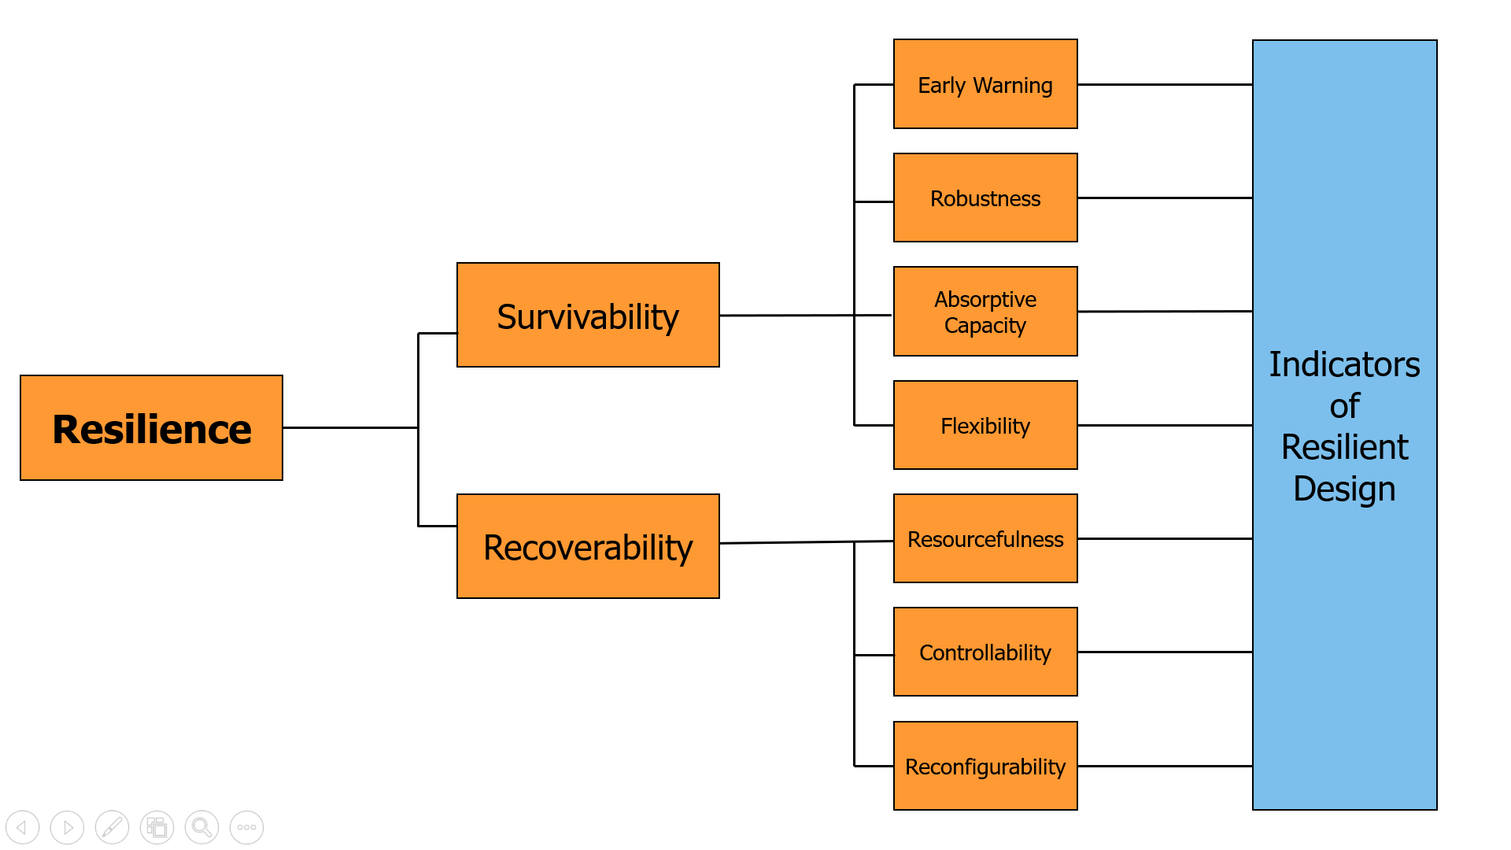
Resilient Design
Dimensions
Metrics
Indicators

Slide 7
Potential Impact
Potential for Economic Impact:
Potential for economic impact = CC + R
CC – Capital Cost
R – Yearly Revenue
Potential for Human Health and Environmental Impact:
Potential for Impact to Human Health and the Environment = CHP ( H + E )
CHP – Chemical Hazard Potential
H – Human Health Impact Rating
E – Environmental Impact Rating
Potential Impact =
(CC + R) + CHP ( H + E )

Slide 8
Vulnerability
Cascade failure → uncontrolled consequences to an initial impact
CHP is modified to describe hazards due to fire and explosion only
Vulnerability =
CHPi + CHPp
CHPi – CHP due to ignition
CHPp – CHP due to excess pressure
[1] Darbra, R., Palacios, A. and Casal, J., 2010. Domino effect in chemical accidents: Main features and accident sequences. Journal of Hazardous Materials, [online] 183(1-3), pp.565-573.

Slide 9
Resilience - Final Equation Form
$Ψ=\frac{Resilient Design}{Potential Impact . Vulnerability}$
$Ψ= \frac{Σ n_{j}i_{j}}{\left[(CC+ R)+CHP(H+E)\right] \left[CHP_{i} +CHP_{p}\right]}$

Slide 10
Contribution and Cost Benefit Analysis Results
Contribution Weightings of Indicators of Resilient Design
Average weighting: 7.6
Range: 3-10
Cost-Benefit Ratings of Indicators of Resilient Design
Average weighting: 74
Range: 25-200

Slide 11
Case Study Results
Case Studies:
1) Ammonia and Urea Facility – Houston, Texas
2) p-Aminophenol and Aniline Facility - Mumbai-Pune Industrial Area, India
Resilience Results of Case Study 1 and 2
 | Case Study 1 | Case Study 2
Indicators of Resilient Design | 2.28 × 10¹⁶ | 1.17 × 10¹⁶
Potential Impact | 7.22 × 10⁸ | 2.63 × 10⁹
Vulnerability | 2.26 × 10⁸ | 4.87 × 10⁸
Resilience, Ψ | 1.40 × 10⁻¹ | 9.12 × 10⁻³
$$Ψ= \frac{{10}^{17} Σ n_{j}i_{j}}{\left[\left(CC+ R\right)+{10}^{−8} CHP(H+E)\right] \left[{10}^{−2} CHP_{i} +{10}^{−3} CHP_{p}\right]}$$

Slide 12
Case Study Results
Conclusion after trials:
Safety analysis must be expanded to include specific resilience considerations
This model is appropriately sensitive to all factors of resilience
Resilience Results of Case Study 1 and 2
 | Case Study 1 | Case Study 2
Indicators of Resilient Design | 2.28 × 10¹⁶ | 1.17 × 10¹⁶
Potential Impact | 7.22 × 10⁸ | 2.63 × 10⁹
Vulnerability | 2.26 × 10⁸ | 4.87 × 10⁸
Resilience, Ψ | 1.40 × 10⁻¹ | 9.12 × 10⁻³

Slide 13
Improving Resilience
Design A – improvements made via indicators of resilient design
Design B – improvements made via factors of potential impact and/or vulnerability
Case Study 2, Adjusted for Improved Resilience
 | Design A | Design B
Indicators of Resilient Design | 5.83 × 10¹⁶ | 1.17 × 10¹⁶
Potential Impact | 2.63 × 10⁹ | 2.76 × 10⁸
Vulnerability | 4.87 × 10⁸ | 4.87 × 10⁸
Resilience, Ψ | 4.56 × 10⁻² | 8.69 × 10⁻²

Slide 14
Putting This Model to Use
Excellent Resilience
Develop a resilience database to contextualise model results
Good Resilience
Unsatisfactory Resilience

Slide 15
And Finally
This model:
Presents resilience clearly for easy understanding
Is developed with the philosophy of accessibility and being straightforward to complete
Has potential to become a standardised analysis used across process sectors
Thank you for watching

