Slide 1
Safe plant reinstatement following intrusive work; new Energy Institute guidance
Peter Webb
Director, Beyond Risk Limited
Peter.Webb@beyondrisk.co.uk

Slide 2
Agenda
Introduction
Reinstatement within a Process for Managing Intrusive Work
Reinstatement Process
Managing the integrity of disturbed joints
Human Factors
Safe Plant Reinstatement Process within a Management System
Leadership

Slide 3
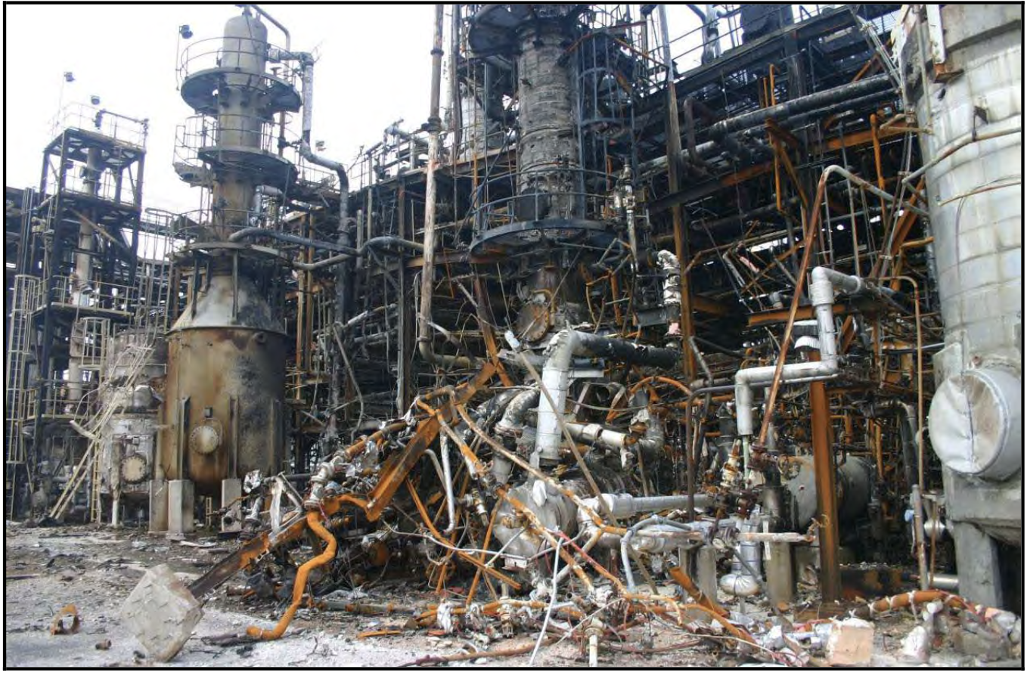
Introduction
HSE UK Offshore Hydrocarbon Release Database:
2016 to 2020 7.5% of releases were during reinstatement
Notes:
PW intro.
Serious incidents have occurred in all kinds of major hazards facilities from chemicals manufacturing to off shore oil and gas. Sometimes the consequences are fatal and sometimes facilities have got away with less serious consequences.
The guidance gives some specifics on what constitutes good practice. It also gives recommendations on how to risk assess reinstatement activities so that operating companies can establish their own risk controls.

Slide 4
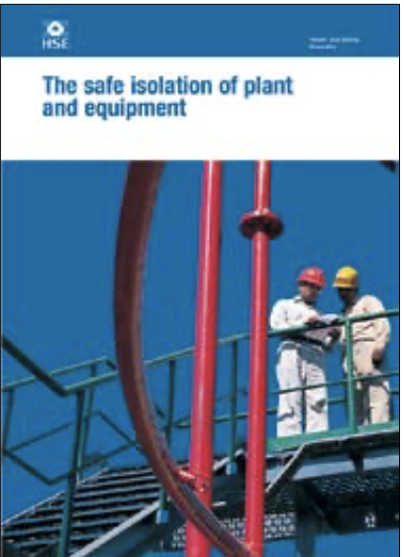
Reinstatement within a Process for Managing Intrusive Work
1. Hazard identification
2. Risk assessment and selection of isolation scheme
3. Planning and preparation of equipment
4. Installation of isolation
5. Draining, venting, purging and flushing
6. Testing and monitoring effectiveness of the isolation
7. Carrying out the intrusive activity
8. Reinstatement of the plant
Notes:
Although HSG253 is a large document, it has little to say on reinstatement. The new guidance not only provides detailed guidance on how the last step can be carried out safely, it also highlights what you need to do in the previous 7 steps to arrive at step 8 ready to do it safely.

Slide 5
Reinstatement Process
Hynds & Templeton 2020
Notes:
We could have a discussion on the definition of what is reinstatement. We settled on these 8 eight activities from Ashley Hynds and Scott Templeton’s paper at Hazards 30.
Operating companies may group or order the elements differently, taking account of company practices, reflecting grouping of the steps, recycles in the process, overlaps or different sequencing. For example, steps 1 and 2 in the diagram might be considered as part of the same activity; step 4, leak test, might be done after removing the isolations at step 5, where the removal of positive isolations has led to a requirement for additional leak testing of disturbed joints
But we also acknowledge that although these are the core activities, there are things which need to go on outside of this envelope. For example, safe plant reinstatement relies on having a system to manage broken joints during preceding mechanical work. Joints which were not leak tested during reinstatement should be subject to post start-up checks.
I don’t have time to go through all of these activities, but will just say a few words about what’s in the guidance on line walking and leak testing.

Slide 6
Reinstatement Process - Leak Testing
*
To confirm a desired level of leak tightness.
Leaks revealed should be investigated.
Five types of leak testing defined:
Gross
Reinstatement
Sensitive
Service
Reverse integrity
Don’t forget small bore tubing
*EPSC Process Safety Fundamentals
Notes:
Gross – 10% of Max OP or 10 barg, first step prior to reinstatement leak test.
Reinstatement – inert medium to 90-95% of RV set pressure. Tape the flanges and soap solution.
Sensitive – specialized technology to detect smaller leaks, nitrogen/helium
Service – during startup with service fluid. For joints which could not be leak tested during reinstatement
Reverse integrity – for specific joints which cannot be tested any other way. Special gasket with tappings which allows the joint to be put under pressure individually. Can alos be monitored individually once in service.

Slide 7
Reinstatement Process - Line walking
*
The processes for managing the intrusive work should have ensured the plant has been put back to its operational configuration ….
But just in case something got missed …. line walking is a back up.
Write a standing procedure – what you will line walk, who will do it, how etc
Have a work pack.
Adjust the complexity depending on the scope of work
How items will be followed up – what can be deferred until after start up
*EPSC Process Safety Fundamentals
Notes:
Operating companies should have in place a procedure which defines in what circumstances line walking should take place, how it should be done, the responsibilities of the people involved, the documentation required to carry out and manage the activities and how actions will be followed up.
The line walking should be managed with a work pack which includes assignment of responsibilities, marked up P&IDs, isometrics, layout drawings, list of instrument tag numbers to be checked and checklists.

Slide 8
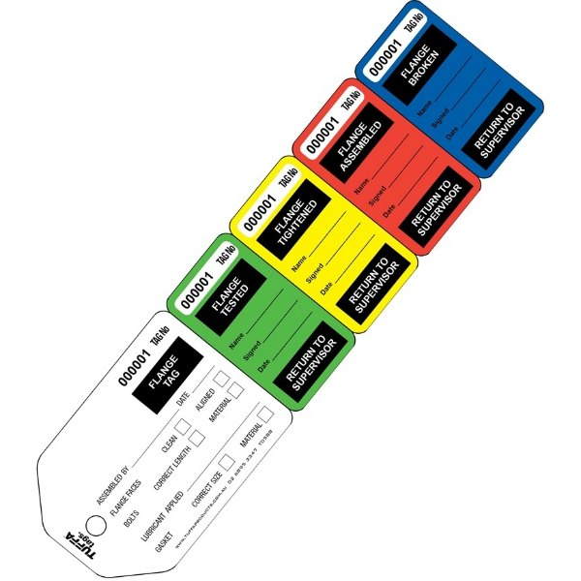
Managing the integrity of disturbed joints
Have a management system for bolted joints.
Maintain a disturbed joint register throughout the intrusive work.
Permanent tags identify the joint.
Temporary tear off tags.
“No Tag, No Touch!”
Notes:
Flange broken
Flange assembled
Flange tightened
Flange tested
Post start up check

Slide 9
Human Factors
All of the activities in the reinstatement process are vulnerable to human failure.
Shift handover.
Competence.
Checking and verification – peer checking and independent verification.
Human machine interface.
Safety Critical Task Analysis.
Notes:
It has even been suggested that these factors can result in peer checking and independent verification increasing the risk of error. This paradoxical outcome can be countered by:
• increasing the error wisdom of those carrying out the practices, by sharing examples of reinstatement incidents and awareness about the consequences of reinstatement error scenarios;
• establishing a culture where people welcome and even seek out their actions being checked or verified;
• establishing a leadership vision of the team collectively working towards safe reinstatement.

Slide 10
Safe Plant Reinstatement Process within a Management System
A systems approach can help to ensure safe plant reinstatement.
References the headings of ISO 45001, for example
Organisational Roles, Responsibilities and Authorities - assigned and communicated
Hazard Identification and Risk Assessment
ISO 45001
Notes:
Organisational Roles, Responsibilities and Authorities –
• authority to issue permits to work and to take equipment back at handover;
• appropriate authority to sign equipment off as mechanically complete;
• authority levels to progress through the stages of reinstatement, including for approval and sign off prior to the reinstatement progressing to reintroducing process fluids;
• authority to deviate from documented reinstatement procedures;
• authority to sign off management of change documentation.
Hazard Identification and Risk Assessment -
• systematically identifying which hazards should be considered;
• using risk assessment to select the isolation scheme;
• ensuring that positive isolations (as defined in HSG253) can be safely removed when the work has been completed;
• assessing the criticality of bolted joints and using the result to support decisions regarding leak testing;
• risk assessing the leak testing plan;
• using risk assessment to determine whether it is safe to reintroduce process fluids if equipment which affects the operation of the plant is not available;
• making a decision on how to deal with a passing boundary valve during leak testing
• evaluating alternative arrangements when it is necessary to deviate from the intended plan.

Slide 11
Leadership
HSE findings of systematic failures indicate the need for more than a few tweaks to management systems.
The necessary organisational and cultural changes require strong leadership.
Regulatory bodies and professional bodies have published expectations.
The guidance provides a leadership framework for reinstatement.

Slide 12
peter.webb@beyondrisk.co.uk
0776 993 6457

