Slide 1
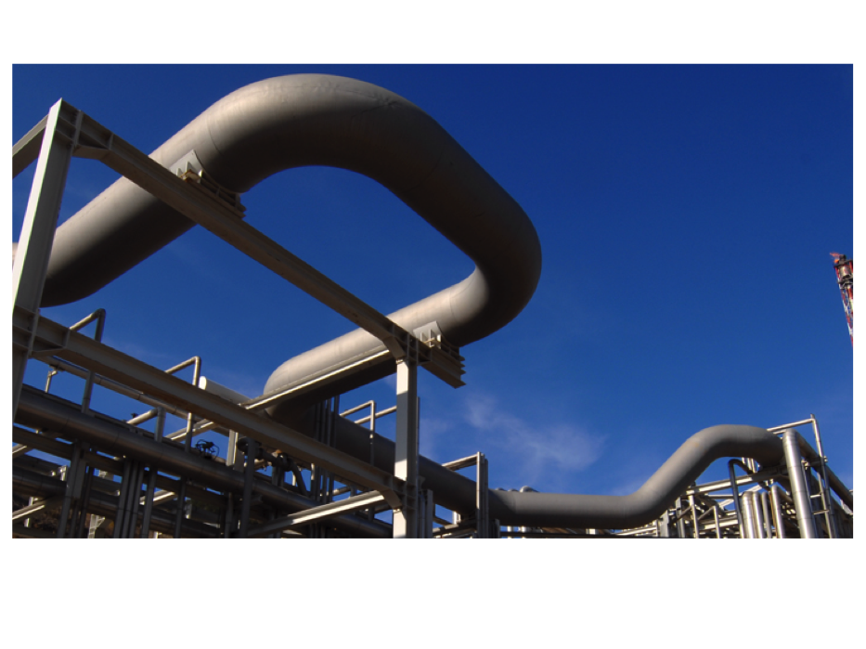
Operational Tabletop Drills to Improve Emergency Response Capabilities and Process Safety Culture
Tupras Kirikkale Refinery-KIRIKKALE/TURKEY
Notes:
Welcome to my presentation. In this presentation we will discuss how operational tabletop drills contribute to the improvement of emergency response capabilities and process safety culture in Tupras.
Tupras aims to turn the obligation of conducting emergency response drills at regular intervals into gains and contribute to a safety culture within the organization. Tupras takes the emergency planning and response management one-step further and lays the foundations of its own operational tabletop drill.

Slide 2

CONTENTS
    Participants
    Planning
    Resources of Credible Scenarios
    Application
    Follow-up & Control
    What are Key Features?
    What is Operational Tabletop Drill & Relation with Safety Culture?
    What are Benefits?
    What are Challenges?
Notes:
Let’s look at what we will be covering in this presentation.
We will examine the relation between operational tabletop drills and safety culture as an introduction.
Then, we will look at the key features of the operational tabletop drills, which are the resources of credible scenarios, participants, planning, application, follow-up & control.
And finally, we will talk about the challenges and benefits of operational tabletop drills.
So let’s get started.

Slide 3
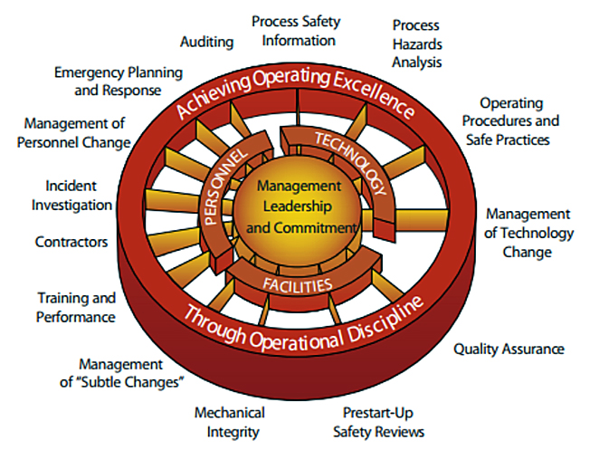

Safety Culture & Operational Tabletop Drill
Notes:
As you know, in the organizations it is important to build the common culture to affect people’s decisions and behaviours. Because the outcome of these behaviours and decisions have the biggest impact on safety and performance.
To prevent hazardous situations in refineries without delay and hesitation, an effective safety culture and operational discipline must be established.
One of the applications to develop safety culture in Tupras is operational tabletop drills.
It provides different perspectives to the emergency management element under PSM elements [1].
Focusing on the operational intervention and addressing the management of asset integrity before a loss of primary containment occurs or talking about the unit operator actions during emergency is a powerful weapon for emergency planning and response management.

Slide 4

What is Operational Tabletop Drill?
Scenario-based discussion
Ready-made scenario pool, open & interactive discussion & operator engagement
Cost effective
Simulation of an emergency without the expense of assembling the response team and staging a full-blown drill
Proactive
Review of effectiveness/adequacy of existing barriers
Opportunity for taking precautions against possible hazards
Educational & Instructive
Aim for increase in unit operators’ experience/competency and
for development in mechanism of instant and effective decision-make in a crisis
Notes:
So, let’s know what operational tabletop drill is.
Operational tabletop drill is a cost-effective, scenario-based discussion designed to simulate an emergency without the expense of assembling the response team and staging a full-blown drill.
In addition to the drill carried out by the emergency response teams, operational tabletop drills are organized to proactively deal with process safety in the refinery. It gives an opportunity for taking precautions against possible hazards and review the effectiveness/adequacy of our existing barriers.
It also gives a chance to increase unit operators’ experience/competency at the same time.
Thanks to the operational tabletop drills, discovering where and how plans fall short before anything more serious than the scenario happens can undoubtedly save lives and protect assets, the environment and reputation.

Slide 5
What are Key Features of Operational tabletop Drill?
    Resources of Credible Scenarios
1
2
Participants
3
Planning
4
Application
Follow-up & Control
5
Notes:
Now we can go deep dive in what are the key features of tabletop dril in 5 steps.

Slide 6
1) Resources of Credible Scenarios
RAYEP
Behavior-oriented scenarios in the operator training program
SEVESO
Scenarios defined for critical equipment
OSAR
Lessons-learnt from incident investigations
HAZOP
Critical scenarios from Hazop risk assessment studies
Notes:
Let’s talk about first key feature, which is resources of credible scenarios.
As the scenarios of operational tabletop drills can be produced by being inspired by real events, it has been seen that it is more beneficial to deal with possible risks if they are predicted and applied before a more dangerous event occurs. The scenarios should be jointly developed by representatives of process safety and operations. To promote the drills throughout the refinery, process safety team create a scenario pool for supporting the operations team.
Seveso scenarios defined for critical equipment, critical scenarios from Hazop risk assessment studies, experiences from incident investigations and behaviour-oriented scenarios in the operator training program are addressed as auxiliary resources for drills. You can see the abbreviations for scenario sources in the slide, as SEVESO, HAZOP, OSAR and RAYEP respectively.
It is advised that the balance between low-frequency/high-consequence and high frequency/low consequence scenarios can be sought by unit chiefs.

Slide 7
1) Resources of Credible Scenarios
Example of Scenario-Based Plan of Operational Tabletop Drills;
 | Control Room 1-2 | Control Room 3-4 | Control Room 5 | Oil Movement | Loading/Unloading
SEVESO | Leakage from outlet flange of the reactor C-1151 | Loss of containment from inlet line of the high-pressure separator due to high pressure case | F-1877 furnace blow-out | Loss of containment from LPG sphere tank outlet line due to high pressure | Overfilling of LSRN tanker due to high level)
HAZOP | G-1202 C/D vacuum pumps trip | Closure of FV-017 by the reason of FIC-017 control loop failure | HC carryover to F-1876 furnace due to wrong level of D-1753 | High level by the reason of level transmitter failure on the MTBE tank) | Accuload failure during LPG tanker loading operation
OSAR | Natural gas outage | No flow by the reason of seal blockage at the sulfur recovery unit | Boiler trip and steam outage in power plant unit | Leakage from the base T-4304 | Leave open of the kerosene discharge valve at the rail car unloading unit
RAYEP | Release of hydrogen from valve packing on the make-up hydrogen pipeline | G-1826 pump trip | Out of operation of K-1452 A/B/C compressors | Entry of chlorinated HSRN to T-4201 tank | Overfilling of fuel oil unloading drum
Notes:
To better illustrate the scenario pool, I would like to share an example of scenarios which are planned for different units.

Slide 8
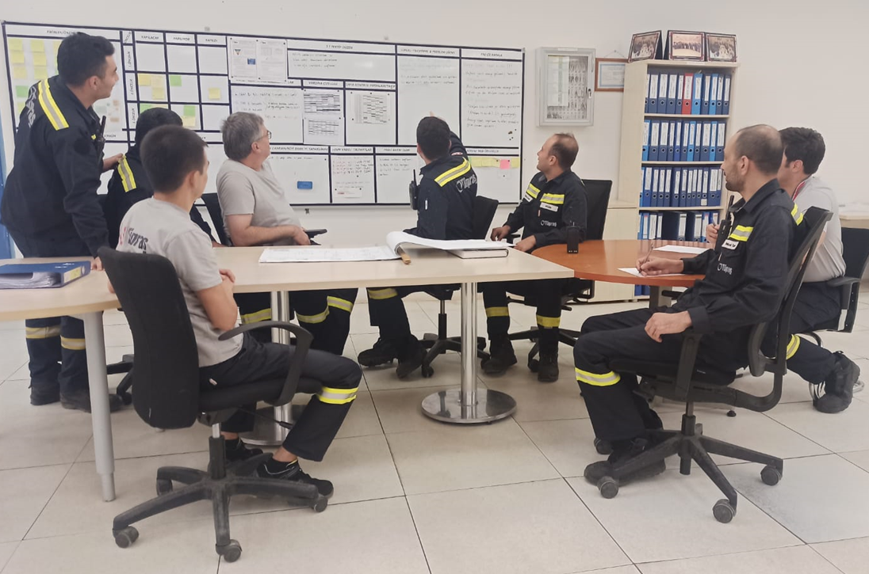


2) Participants
Head Operator
06
02
Managers
Control Operator
03
05
01
Process Safety Engineers
Field Operators
04
Operation Engineers
Notes:
Second key feature of operational tabletop drill is participants.
In general, field operators, control operators, head operators in shift, operations engineers and process safety engineers attend the operational tabletop drills. Since there is a shift system in Tupras, it is also important that the drill held during the day should reach to all shifts to ensure a conversation among themselves.
Emergency response team can be sometimes invited as relevant discipline.
To strengthen the effectiveness of these drills and support the team and to reinforce the visible leadership, the participation of the managers is also ensured.
Unit-based operational tabletop drills are aimed to be carried out in an interactive and open communication environment.
The approach to unit operators during operational tabletop drills is very crucial element.
It is advised that there should be an effective two-way communication where operators share their opinions openly and transparently, rather than a platform where the managers and engineers speak most, and operators listen to them. The operator should not hesitate to give the wrong answer in front of everyone, should not be afraid of saying something wrong. It is stated that these operational tabletop drills are not conducted for questioning purposes, and that mutual information sharing is aimed.

Slide 9
3) Planning
Example of Operational Tabletop Drills Calendar;
 | Production Units
 | Control Room 1-2 (Crude/Vacuum/ISO/LPG/NHT/HDS) | Control Room 3-4 (HCU/HMU/SRU/SWS) | Control Room 5 (DHP/CCR/Amine/SRU/SWS)
August | 23.08.2022 | 17.08.2022 | 31.08.2022
September | 27.09.2022 | 14.09.2022 | 28.09.2022
October | 18.10.2022 | 19.10.2022 | 26.10.2022
November | 22.11.2022 | 16.11.2022 | 30.11.2022
December | 20.12.2022 | 7.12.2022 | 28.12.2022
 | Utility Units
 | Oil Movement | Wastewater Treatment | Loading/Unloading | Steam Generation Unit | Power Generation Unit
August | 11.08.2022 | 17.08.2022 | 18.08.2022 | 24.08.2022 | 16.08.2022
September | 8.09.2022 | 21.09.2022 | 15.09.2022 | 20.09.2022 | 22.09.2022
October | 13.10.2022 | 19.10.2022 | 13.10.2022 | 20.10.2022 | 18.10.2022
November | 9.11.2022 | 16.11.2022 | 17.11.2022 | 23.11.2022 | 10.11.2022
December | 8.12.2022 | 14.12.2022 | 15.12.2022 | 22.12.2022 | 15.12.2022
Notes:
Now, let’s talk about third key feature, which is planning.
In Tupras standard, there is no defined frequency for these operational tabletop drills. It is recommended that the units determine their annual plans and scenarios upon their needs to make them own the drills.
In general, each unit makes its plan once a month. You can see the sample calendar in the slide. The plan can be revised according to the needs.
Calendars containing scenario information are set at the beginning of the year and shared with the relevant disciplines to provide the opportunity of planned participation. The topic of the scenario is also shared with calendar.
Although each unit assigns the necessary operator depending on its field size during the operational tabletop drills, the drill should not take a long time for the operator.
So, it is organized for an average of half an hour. It is ensured that drills do not coincide with the shift handover, the times when the field controls are conducted, and the times when the work permits are busy.

Slide 10
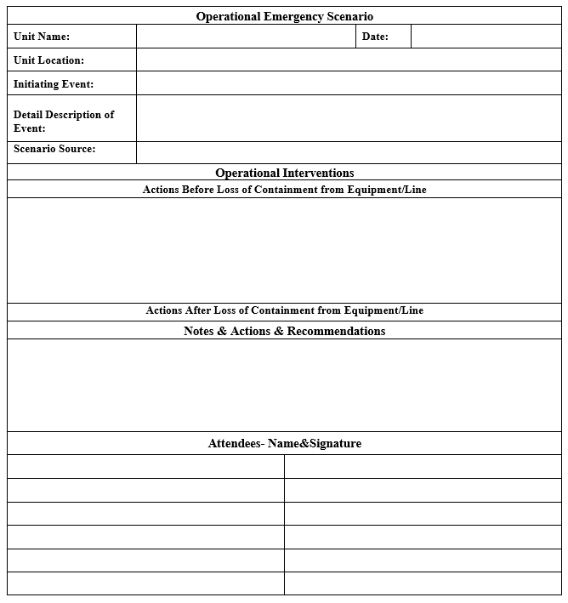
4) Application
Notes:
Another key feature is of course application step.
To visualize the moment of the drill, I would like to share a photo.
Under the guidance of a unit operations chief/engineer, the scenario is identified for the unit operators, then brainstorming is carried out about proactive interventions before the event, reactive interventions after the event, and the recommendations.
At the end of discussions, the unit chief sums up the drill and includes lessons learned and important information highlighted during the discussion on a registered form and has the form signed by the participants. Finally, necessary communication/distribution of the form is made to ensure its transfer to other shifts.
The drill report is shared with the process safety team by the unit chief.

Slide 11
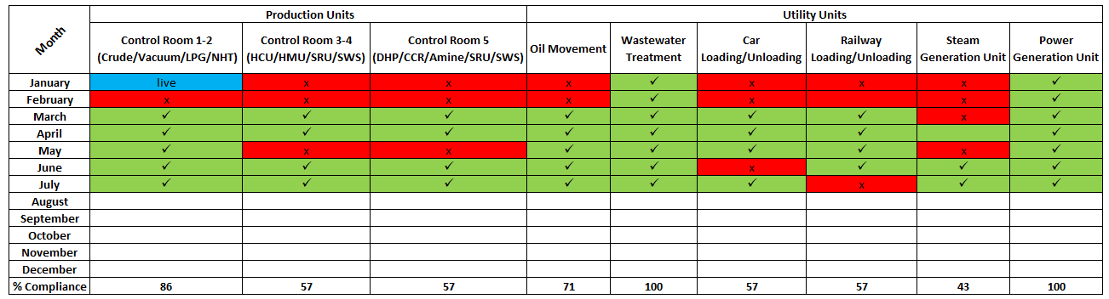
5) Follow-up and Control
Unit-based drill realization by month in 2022;
Notes:
As in every process, let's talk about the follow-up and control step as the final key feature.
For continuous improvement, operational drills are also followed through the relevant process safety key performance indicators. The compliance of the drills with the plan made at the beginning of the year is reported quarterly in process safety KPI’s report. You can see an example sheet.

Slide 12
5) Follow-up and Control
Scenario selection and balance
Planning
Tracking actions management
Invitations
Drill management
Compliance with plan & Dills Realization
Drill records
Notes:
In addition, at the end of the year, further analysis about the operational tabletop drills is carried out according to items shared below for each control room:
•Scenario selection and balance / Planning / Invitations / Drill records /Transfer to shifts / Compliance with plan & Drills Realization / Tracking actions management / Drill management
Successful and open to development issues are reported to all parties. The goal is to turn this process in a culture and to strengthen operational discipline in units.
To provide value, the observations which are documented on the drill report as findings or recommendations should be turn into actions. Of course, there should be a consensus on actions before recording into a well-established action tracking system. Review of actions such as delay time, what and how the actions are taken, is carried out and is reported to unit supervisor and manager.

Slide 13
5) Follow-up and Control
Recommendations of Operational Tabletop Drills as Unit-based;
Plant | Scenario | Recommendations
Control Room 3-4 (HCU) | Leakage from EC-1354 A/D bundles | Evaluate placing a steam station for the location of EC-1354 A/D.
Control Room 1-2 (ISO) | Loss of containment from outlet of C-1180 Reactor due to high pressure | Evaluate relocation of snuffing steam valves
 |  | Convert that C-1151 reactor manuel emergency quench valve to DCS controlled valve (HCV) and revise the nitrogen lines to the inlet of C-1180 and C-1151 reactors
Control Room 1-2 (NHT) | Trip of K-1401 Recycle compressor and the operation mode changes to "Once Through Operation" | Prepare "Once Through Operation"'s instructions
Steam Generation Unit | Opening of PV-014 B, MP pressure breaker valve by control loop failure | Transfer the motorized vale position to DCS
Control Room 1-2 (Crude) | Failure of DCS | Evaluate that the valve of HCV-368 is to be FO (fail open). Its current position is FC (fail close).
 | Abnormal amper and voltage of desalter and going to IOP | Evaluate placing a shut off valve at the inlet and outlet of the desalter
Wastewater Treatment Unit | Overflow of Balance slope oil pit | Evaluate auto-start of G-1154 A pump when LT-010 reaches 4.9 m.
Oil Movement Unit | Random leakage from HC slop lines | Develop and recommend a systematic that will ensure the periodic control of the HC slop lines between units
Notes:
The corrective and remedial actions from critiques of tabletop drill can be identified and entered to tracking system as well.
In this slide , recommendations which are specific to the unit and scenario are given as an example.

Slide 14
What are Challenges During Operational Tabletop Drill?
Compliance to annual drill plan
& participation
Unit’s ownership and willingness to take
responsibility for drills
1
2
Perception of "this has always been here,
we always do it like this"
The thought of formality and workload
3
4
Notes:
Alright, so we’ve talked about the key features of operational tabletop drills and we’ve seen the examples. Now let’s talk about firstly challenges, then benefits of operational tabletop drills.
Of course, ee must acknowledge that difficulties are encountered in the operational tabletop drills as in every process.
1) For example, the consistent compliance to annual drill plan is one of the challenges. While the units prepare their drill plan with their own business plans and needs, the workload can affect the stability of operational tabletop drills. Even if the drill schedule is determined, it is difficult to find a suitable time for all participants.
2) Another challenge is that operational tabletop drills is not just an activity of process safety but must be carried out under the responsibility of and owned by the unit personnel. This can cause disruption of review the drill, reading the registered drill report and signing the form by all shifts. For this reason, the drill cannot be spread equally to all unit shifts.
3) It is another problem that some employees who think that the operational tabletop drills remain theoretical, say that this process appears as a formality and workload.
4) Another important issue to be mentioned is, to manage the "this has always been here, we always do it like this" perception that operators take for granted. It turns into a problem that seriously affects the efficiency of the exercise and the ownership of the outputs. We can also see this as an opportunity due to expression in a conscious environment thanks to tabletop drills, without being demotivated by negative, destructive comments.

Slide 15
What are Benefits of Operational Tabletop Drill?
The importance, effectiveness, reliability and adequacy of existing preventive and mitigating barriers are evaluated. The potential safety vulnerabilities in the units can be found.
1
2
It provides to detect that the original design of preventive barriers is changed without management of change for years ago.
Recommendations that will reveal the effect of these operational tabletop drills on the preventive barrier side are determined.
3
Benefits
4
Recommendations can be shared with other units as a good practice. This allows information exchange and dissemination between units.
Reactions in real events have also improved thanks to these drills. It builds operational discipline to ensure a quick response in the event of an incident.
5
6
It contributes to the increase of the competence of the unit personnel. It also shows the level of competence and determines the need for development.
Notes:
Now, let’s talk about the benefits and differences of operational tabletop drills.
The importance, effectiveness, reliability and adequacy of existing preventive and mitigating barriers are evaluated. The potential safety vulnerabilities in the units can be found during operational tabletop drills.
It provides to detect that the original design of preventive barriers is changed without management of change for years ago. By re-functioning the barrier, a Tier 1 or 2 process safety events [2] may be prevented and the safety perception about the barriers in the unit is thus gained.
Recommendations that will reveal the effect of these operational tabletop drills on the preventive barrier side are determined. So, it helps to identify the corrective and remedial actions from critiques of tabletop drill and to track them from systematic tracking system.
Recommendations can be shared with other units as a good practice. This allows information exchange and dissemination between units.
Reactions in real events have also improved thanks to these drills. The incident subject to the exercise has been evaluated before, so that possible accidents/losses can be prevented by reacting safely and quickly. It builds operational discipline to ensure a quick response in the event of an incident.
It contributes to the increase of the competence of the unit personnel. It also shows the level of competence and determines the need for development.

Slide 16
What are Benefits of Operational Tabletop Drill?
It provides the opportunity to improve operator reaction times and ultimately lives can be saved.
7
8
It is cost effective because there is no need to assemble the response team, use fire-fighting utilities and stage a full-blown drill.
Since there is no need for processes such as manager approval and announcement preparation, the workload is relatively less..
.
9
Benefits
10
There is more flexibility in program or scenario changes due to small group of participants.
It can be regarded as a training tool for process safety since it improves knowledge and skill level of the operators about the PSM. It turns into a platform where oral and written experience and knowledge transfer takes place.
11
12
Employee participation is ensured, and they can focus on their work better, develop themselves and be successful. As a result, this reinforces the safety culture in Tupras.
Notes:
7) It provides the opportunity to improve operator reaction times and ultimately lives can be saved.
8) It is cost effective because there is no need to assemble the response team, use fire-fighting utilities and stage a full-blown drill.
9) Since there is no need for processes such as manager approval and announcement preparation, the workload is relatively less.
10) There is more flexibility in program or scenario changes due to small group of participants. Unit personnel can also perform the drill alone. This is very important to make operators own the drills in terms of safety culture.
11) It can be regarded as a training tool for process safety since it improves knowledge and skill level of the operators about the PSM. It turns into a platform where oral and written experience and knowledge transfer takes place. Operators can learn how their activities affect process safety. They make them realize that the smallest contribution they make to process safety can save lives.
12) Motivation also increases as operators see that they are listened to, and their ideas are valued. In this way, employee participation is ensured, and they can focus on their work better, develop themselves and be successful. As a result, this reinforces the safety culture in Tupras.
These learnings are tried to be shared throughout Tupras refineries by the coordination meetings held between the 4 refineries or by the platform where good practice examples are shared. In the process safety symposiums held in Turkey, it is aimed to share as an example of the best practice within Tupras with wider industry.

Slide 17
CONCLUSION
Save Lives
Protect Assets, Environment and Reputation
Safety Culture
Uncovering the systemic vulnerabilities before they occur by scenarizing these incidents
Predicting potential process safety incidents by turning operational emergency drills into a culture in the units
Uncovering the systemic vulnerabilities before they occur by scenarizing these incidents
Identifying critical operational interventions for the unit to help manage the crisis in coordination with the emergency teams in case of an incident.
Notes:
In summary, I would like to summarize the huge gains of operational tabletop drills for Tupras. These are;
1) Predicting potential process safety incidents by turning operational emergency drills into a culture in the units
2) Uncovering the systemic vulnerabilities before they occur by scenarizing these incidents
3) Identifying critical operational interventions for the unit to help manage the crisis in coordination with the emergency teams in case of an incident.
Therefore, operational tabletop drills do not only contribute to the safety culture, but also serve the emergency planning and response, which is one of the elements of the process safety management system. Thus, this can undoubtedly save lives and protect assets, the environment and reputation.

Slide 18
REFERENCES
Center for Chemical Process Safety. Guidelines for Risk Based Process Safety. New Jersey: Jon Wiley & Sons, 2011
American Petroleum Institute (2017). Process safety performance indicators for the refining and petrochemical industries.
Notes:
You can see my references here.

Slide 19
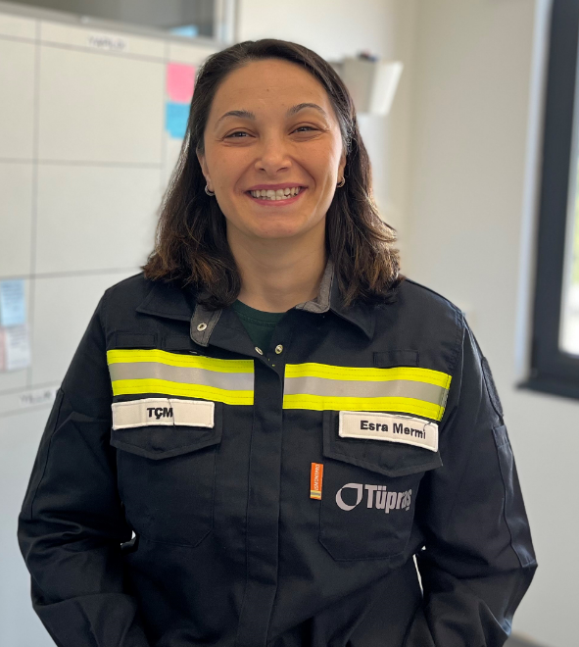
ABOUT ME
Education
Middle East Technical University Chemical Engineering (2006-2021)
Experience
Energy Management Engineer- Tupras Kirikkale Refinery (2011-2012)
Process Engineer (Power Plant) - Tupras Kirikkale Refinery (2012-2013)
Process Chief Engineer (HYC/HYP/Hydrogen) - Tupras Kirikkale Refinery (2013-2017)
Process Safety Shief Engineer - Tupras Kirikkale Refinery (2017-2018)
Process Safety Superintendent- Tupras Kirikkale Refinery (2018- ~)
Certification
Nebosh HSE Certification in PSM
Functional Safety Engineer (TÜV Rheinland)
Contact
Esra.akin@tupras.com.tr
Notes:
Thank you for your interest. You can see information about me. You can use my e-mail address to contact me for further information about my paper.

Slide 20
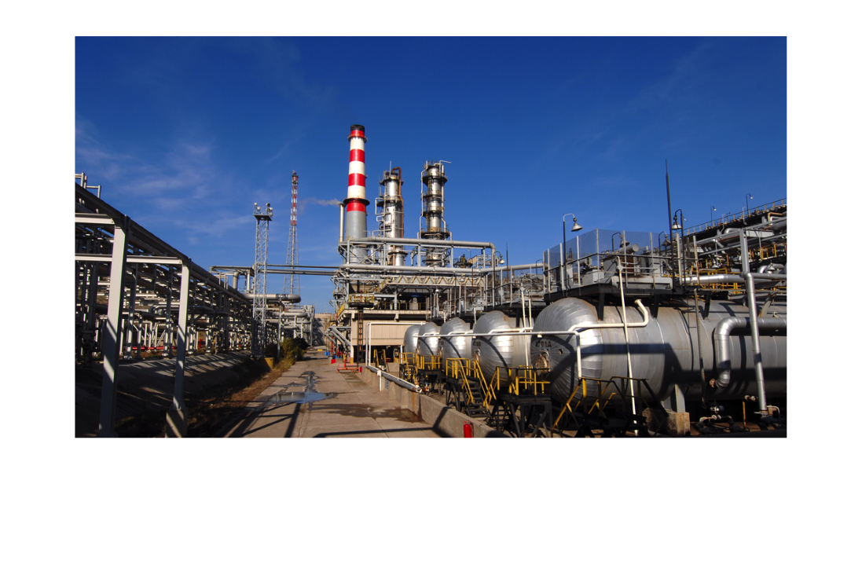
Thank you!
Notes:
Thank you very much.

