Slide 1
SIF Testing It’s more complicated than you think
Andy Brazier – AB Risk Limited
Nick Wise – SSE Hornsea Limited
Harvey Dearden – Time Domain Solutions Ltd.
Notes:
Hello
Three of us have prepared this paper. I volunteered to present it.

Slide 2
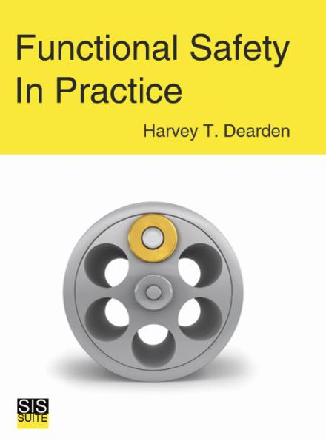
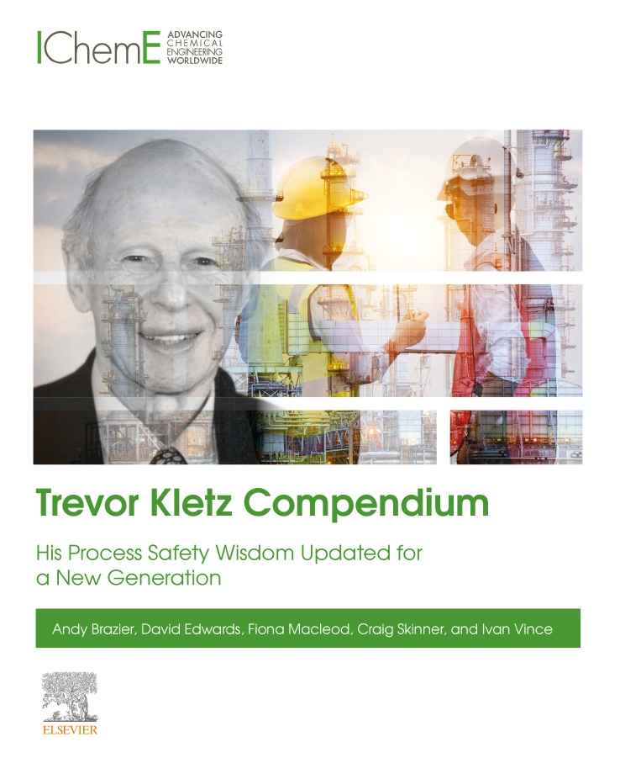
Author Collaboration
Harvey – Functional Safety
Nick – Operational support
Andy – Human Factors
Notes:
By way of background.
Harvey is an expert on functional safety. You may have seen his papers in The Chemical Engineer
Nick has worked at SSE’s Gas storage sites for a number of years, overseeing process safety and COMAH amongst other things.
I am just the human factors consultant. I know Nick professionally. Harvey lives very near me and we usually meet in a local pub.
Like all good chat show guests, we have a couple of books to publicise. Harvey’s book provides an excellent overview of all aspects of functional safety. For my part I was lead author of the Trevor Kletz compendium, which I hope you are all aware of.

Slide 3
Safety Instrumented Function (SIF)
Logic
Sensor
SIF
Control
Final element
Notes:
I am sure you know what a Safety Instrument Function is. It is often our last line of defence when our control of a process is lost. A SIF is made up of a Sensors that senses the process. Some logic that and decides if the process is outside of where we want it. And a final elements that take action to protect people, the environment and assets by avoiding a hazard being realised.
We don’t want to rely on SIF but if we get to the point where they are needed we really want them to work.

Slide 4
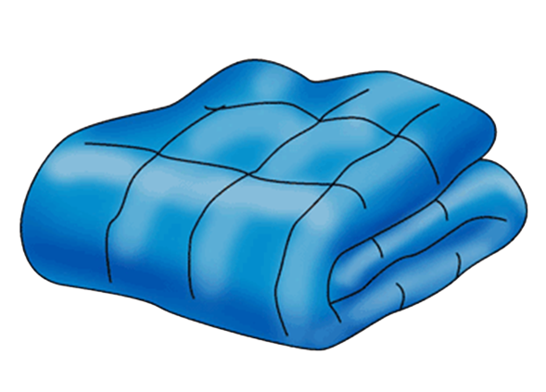
Testing SIFs for reassurance
Is the SIF working?
Will it work when we need it?
Is its reliability consistent with assumptions made when we decided our risks are ALARP?
Notes:
The reasons for testing SIF may seem obvious but we often see it a bit too simply.
Knowing the SIF works when we test it is reassuring like comfort blanket but is not really enough.
What we want to know is that it will work when we need it. But of course nothing is ever 100% reliable. What we really need to know is that our SIFs reliability is at least as good as we assumed it would be when we did our original safety study. In the UK our regulations require us to confirm that risks are As Low As Reasonably Practicable or ALARP.

Slide 5
Challenges when testing
Even the simplest SIF has multiple components
Each can have multiple failure mechanisms
Working today does not predict the future
Testing methods have many similarities but the differences can be the most critical parts.
Notes:
As you have gathered from the title of this presentation SIF testing is not simple. The very simplest SIF includes a sensor, logic solver and final element. When you consider the cables that connect them the number of components is already significant.
Most components can fail in a number of different ways. Even a cable can fail open or closed circuit. A partial failure may increase its resistance, that could affect the way a SIF operated.
Because we are testing for future performance it is not good enough to just test function. Visual checks are particularly critical but reliant on the competence of the technician. How do you train someone to carry out a visual check and make a reliable decision about whether everything is good enough?
When you look at testing procedures you do tend to see many similarities. That can be helpful but often it is the differences that are most critical. It is easy these to be overlooked.

Slide 6
Obvious failures are obvious!
Failures that are easy to overlook
Less common
Obscure
Hidden
Valve operation is obvious
Tubing blockage??
Notes:
SIF testing is very reliant on human performance. It is hard to foresee a situation where that is not going to be the case. This is because people have abilities that have proven impossible to replicate with technology. But we also have limitations.
Carrying out an effective test of a SIF require a high level of vigilance or situational awareness. One thing with people is that we have limited ability to pay attention to multiple things at the same time. Once our attention has been grabbed by something it is difficult for us to see beyond it.
So for a SIF if the valve has closed as expected we may be reassured that the system is healthy. Noticing evidence of a potential blockage in some instrument tubing takes a very close attention to detail, that may not come naturally.

Slide 7
Look for the hard to find
A proof test is more than a function test
Focus on unrevealed hazardous failures
No technical reason to exclude all failures from the test
But …
Devil is in the detail – recognising the most important parts of the test
Testing fatigue – alert to obscure or unexpected.
Notes:
The fact that a SIF appears to work correctly when we test it may be enough for a function test but not for a proof test.
We need to be very clear that our requirements are to look for unrevealed and hazardous failures. If a failure would be visible during normal operation it would be revealed not unrevealed. If it will always result in the system moving to a safe status it would not be hazardous.
There is no real reason why we cannot cover all types of failure in our testing. But from a practical and human factors perspective this makes procedure longer and can distract technicians from looking for the failures that proof testing should be focussing on.
It is a case of less is more when we are planning proof testing – as long as we focus on what is important.

Slide 8
SIF
Control
2 valves 2 solenoids
SIF valve will not operate routinely
SIF
Control
1 valve and 2 solenoids
Valve will operate routinely
Valve is proved but is the solenoid?
Notes:
Valves are very frequently our final element. To achieve a high degree of independence it is common to have a valve used only for SIF. The problem can be that the valve will not operate during normal operations and so we can have unrevealed failures such as the valve sticking. When we come to test the valve we need to be vigilant for this.
An alternative arrangement is to use a single valve with dual purpose. This may be achieved by having two solenoids to the valve. One is used for normal control and the other for the SIF. Because the valve is operated routinely it becoming stuck would be a revealed failure but that does not prove the SIF will function. And when we come to test we need to make sure it is the SIF solenoid that operated. Often a tidy up function of a SIF is to send a closed signal to the control system. The fact the valve closes in our test does not prove that the SIF solenoid is working, unless we inhibit the control one.
We cannot say that one of these is better than the other. We just need to be aware of the issues with both.

Slide 9
End to end fallacy
100% test coverage is very difficult
Redundant channels
Plant operating conditions
Complexity = risk
Be realistic
The requirement is ALARP
Notes:
I have heard it many times that proof testing has to be “end to end.” This means every component making up the SIF is tested from sensor to final element. But whilst it may seem to be a good target to aim for the reality is it is very difficult to achieve.
For example, as soon as you introduce some redundancy you see an end to end test has not covered everything. And even if you repeat the same test using each item it is rarely sensible or safe to conduct a test under real life plant conditions. So it still cannot be claimed as truly representative.
Fixating on end to end testing is time consuming and distraction and usually not necessary. Simpler tests focussed on hazardous unrevealed failures is far more effective.
Remember we don’t expect to ever reduce risks to zero. We only have to do what is reasonably practicable.

Slide 10
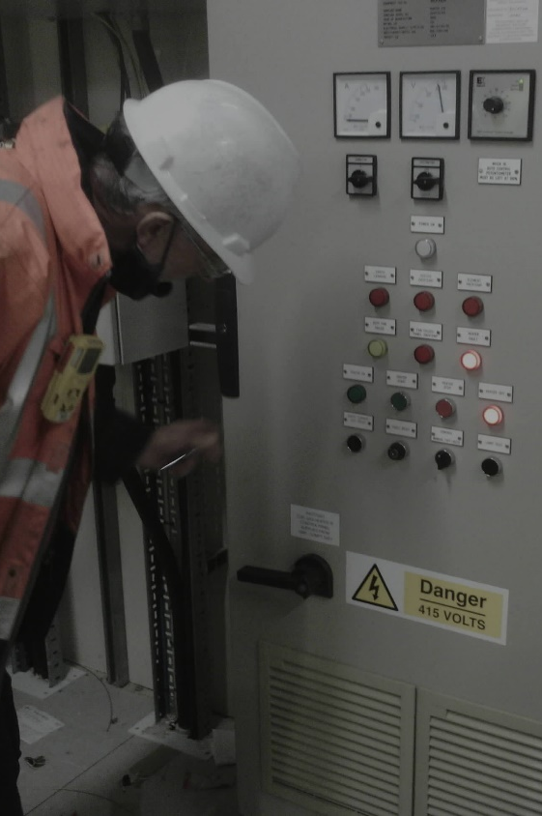
The Human Factor
Performed by Instrument Technicians
They have the correct skills
Understand function vs proof test
Most of their day is reactive maintenance
We need data from testing – before, during and after
SIF visual inspection is critical but hard to control
Notes:
SIF testing is fully reliant on people. Usually it is assigned to the instrument Technicians. This makes sense because they have the correct skills and will be familiar with SIF components. This does not mean they automatically understand SIFs and what is important when testing. They can certainly perform a function test without any guidance but as discussed already a proof test requires a lot more consideration.
One of the challenges for Instrument Technicians is that they can spend a lot of their time fixing things. They get called by the operations department when an instrument has failed and they are encouraged to rectify the faults as quickly as possible to avoid any disruption to production. In these circumstances, as long as they act safely we don’t really care too much about how they perform their tasks. This is not good enough for SIF testing. Yes, we do want the SIF to be working after the test but we also need data to support our evaluation of reliability and hence risk reduction. For this it is vital to collect data about the state of the SIF before testing – as found. What is observed during testing and the condition of the system afterwards. It may be working but for how long.
One particular challenge is the visual inspection of SIF components. This is one of the most important aspects of the proof test but highly subjective. How do you train people to do it and how do you assess their competence? It is worth noting that finding faults means extra work for the technician. This may not always be an incentive to be so particular about the visual inspections.

Slide 11
Human error
Impossible to eliminate
Competent people make mistakes
Less likely if people follow a procedure
If correct
If useful
Keep it simple
Do you consider testing when designing a SIF?
Operations vs maintenance errors.
Notes:
SIF testing is a critical task because human errors can mean the SIF will not work when we need it – which will always be a critical situation.
If would be great if we could eliminate human error but that is impossible. But that does not mean we can’t reduce the risk. That can be by either reducing the likelihood or consequence of errors that occur.
Having competent people perform testing is one way of controlling some risks of human error but it is important to recognise that even the most competent person makes mistakes.
A good procedure can reduce the likelihood of error or increase the likelihood of recovery from the error by including critical checks along the way. But only if the procedure is technically correct and useful to the person doing the task. The procedure has to be used in practice if to have any effect.
Keeping testing as simple as possible will help people to understand what they are doing and why. This allows them to use their competence to focus on what is important and be vigilant to any weak signals.
Simplicity of testing can only really be addressed effectively if it is considered when designing a SIF. Do you consider test methods during design and do you consider the potential for human error?
It is worth noting that we often install SIFs in response to a risk initiated by an operator error. We often congratulate ourselves for reducing or even eliminating the potential for human error. But really all we do is transfer the risk to maintenance instead of operational error.

Slide 12
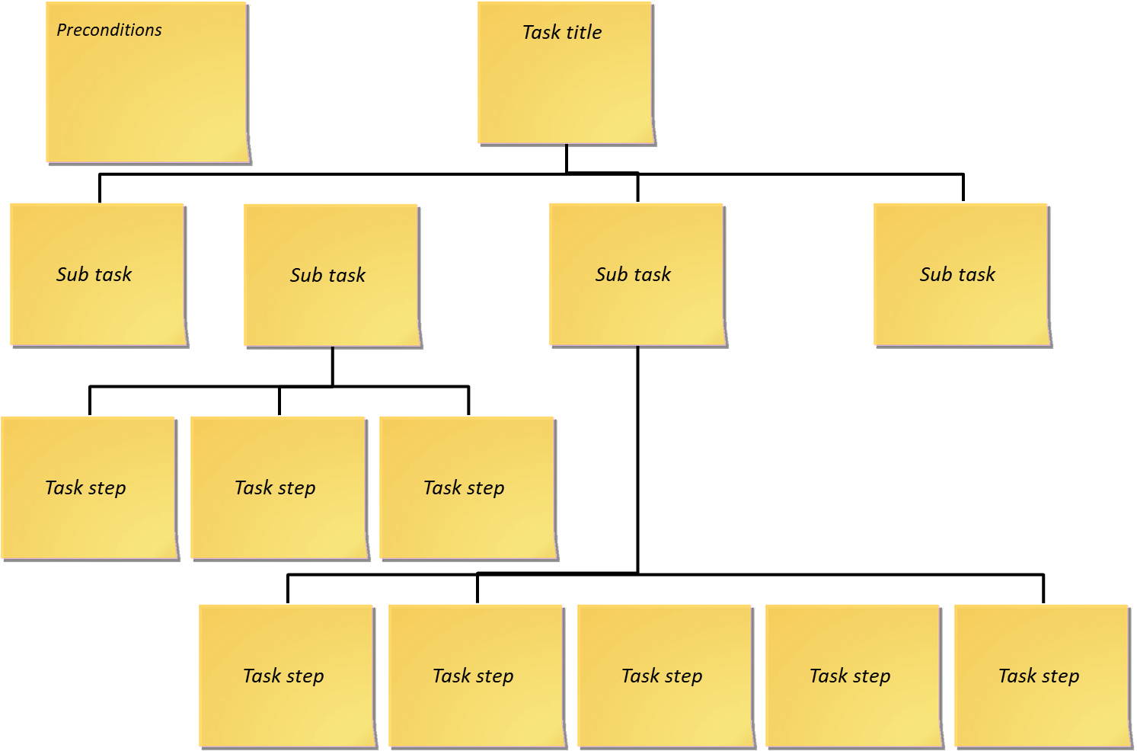
Task and human error analysis
Tried and tested technique
Every proof test is unique
Overarching approach emerges
Based on numerous analyses
Common error potential
Effective controls
Notes:
Having identified the vulnerability to human error the question remains what we can do about it. We know that the potential cannot be eliminated but the risk can be controlled.
We have tried and tested methods of identifying and understanding human factors. Task and human error analysis is particularly effective and applicable to SIF testing. We have used it to analyses a selection of proof test methods. Taking existing procedures and actively involving technicians in discussions about practical application.
We find that every proof test is unique. It depends on the nature of the process, the conceptual design of the SIF and specific component selection. It is tempting to look for similarities and say that the same style of SIF using the same technology requires the same test method. That is correct but identifying the specific components is a very important part of the test and so we have to be careful to account for even the very minor differences.
Having said that an overarching approach does emerge and there are definitely some benefits in defining this. Based on multiple analyses we do find that there is a raft of common types of error that can occur. We also start to understand what risk controls work in practice.

Slide 13
Overarching method
Preconditions
1. Identify components
2. Visually inspect components
3. Prepare to activate
4. Activate
5. If test is successful – return to operating status
6. If unsuccessful – develop a plan
7. Update and review the SIF data file
https://www.abrisk.co.uk/sifprooftesting
Notes:
Here is a quick overview of the main activities. The first is the preconditions. These typically involve having approval for any inhibits and overrides that may be required, Arranging access and having test equipment available.
I should say the full task and human error analysis is available to download at the link shown.

Slide 14
Main actions – part 1
Sub-task | Comments
1. Identify system components | Ensures the correct SIF is tested and all components are inspected.
2. Visually inspect the SIF components | Labelling, supports, cabling, process connections, electrical (Ex). Also, other items relevant to SIF reliability (e.g. insulation, trace heating). There is a high degree of subjectivity at this stage, which should be captured through competence management.
3. Prepare to activate the SIF/SIF section | The method for this subtask depends on the type of SIF (e.g. initiation by electronic simulation, pressure source, level bridle, exposing the sensor to a controlled condition).
Notes:
The first activity is one you may not always explicitly state in a procedure. Identifying the correct components is clearly an obvious requirement but when you do the human error analysis you start to realise what can go wrong. One possibility is that the wrong SIF is activated during the test. That never goes down well with the operators. Another is that components are overlooked in testing. As a one off that may not be too significant but over time the implications of only testing part of the system become apparent.
I have already mentions the importance of the visual inspection. In some ways this is almost more important than the actual test because it gives you an indication of how the SIF will perform in the future and not how works on the day it is tested.
Preparation to activate depends very much on the circumstances. The main process needs to be in a suitable condition as well as the SIF components themselves.

Slide 15
Main actions – part 2
Sub-task | Comments
4. Activate the SIF/SIF section | Adjust a simulated condition to activate the SIF or expose the sensor to a controlled condition that will activate the SIF. Monitor final elements to confirm operation. Record findings.
5. If successful, return SIF to operating status | The method for this subtask depends on the type of SIF (as above). An independent inspection of installation should be included after reinstatement wherever the physical arrangement was disturbed.
6. If test is unsuccessful, develop an appropriate plan | Deciding the operational strategy whilst waiting for repair. An Operational Risk Assessment (ORA) or similar may allow operations to continue but must be carried out by people with a thorough understanding of what the risks and how the SIF (when operational) contributes..
7. Update and review SIF data file | Collecting data for future analysis and demonstration. Who looks at this data and how do they identify systemic issues?
Notes:
Action 4 is the actual test. Already we can see that the overarching methods is far more than attaching a simulator and seeing if a valve closes.
Continuing we have a number of potential actions after the test. Reinstatement after a successful test is actually very critical. There are a number of potential human errors that can mean a SIF that is proven to be functional is not actually left in an operational state, Failing to remove inhibits and overrides is an obvious example, Leaving sensors physically isolated from the process is another and although similar to inhibits and overrides, is often far less obvious from the control room of equipment room.
From our analyses we have concluded that an independent inspection of the SIF component status is required. Achieving independence is not as easy as it sounds, especially with a small workforce. In most cases testing involves at least one person on plant and another in the control room or equipment room. Requiring them to swap locations at this stage is one way we can have some degree of independence.
Responding to a failed test is equally important. This is largely an operations concern but the instruments department can provide a useful input. The instinct of operators is to keep the plant running and to just take more care whilst the SIF is out of action. That may be more acceptable for normal trips but for SIFs that have a Safety Integrity Level or SIL defined that needs far more thinking about.
The final stage is largely administrative but very important. The first requirement is to record the data that tells you how well your SIF is working. But that data also needs to be looked at. That may be beyond the scope of the test but it is critical for the overall system management.

Slide 16
Potential errors during testing
Activating too early
Not confirming the status of the final element before the test
Not looking to the future
Overlooking critical items beyond the SIF
Instrument to process connection
Insulation
Trace heating
Wrong test fluid
Insufficient data collected.
Notes:
We have identified a number of potential human error that can occur during testing that can compromise the value of doing the test. Some are obvious and others less so,
The first one is not always a concern, but for a final element that is not routinely operated we need confirmation that it will operate, on demand within the necessary time. It is not unheard of for technicians to predict that a valve may stick so they exercise it a few times so that it will pass the test OK. This is often a learnt behaviour from a previous test where the time seemed a bit long so they repeated it and found the problem cleared.
The status of the final element for the test is another. The technician may notice that the final element is already in its tripped position and conclude that it is OK because we know it is working. Unfortunately they won’t necessarily know what tripped it, so it may have not been the SIF. Technicians are sometimes conditioned to think like this because they are told to carry out the test but then told by operations that a valve cannot be opened for them.
Insulation and trace heating of instrument lines is something that is very easily overlooked, especially if testing is carried out in the summer. But a blocked line can prevent a SIF activating when required and it is actually very difficult to design a test that will cover these effectively,.
Using the wrong test fluid, particularly for a level activated SIF, can be significant. It may not be calibrated for the instrument. Again, it can lead to blockages if water is used and not drained effectively afterwards.

Slide 17
Re-instatement errors
Inhibits or overrides left on
Sensors isolated
Cables reconnected incorrectly
Not restoring in-service intelligent devices
Not sense checking status
Switch type sensors??
Analogues usually at zero/ambient??
Notes:
Controlling the risks of human error during the main test can be relatively easy. But human factors tells us that actions that we don’t directly associate with the task are more tricky.
I am sure we have all experienced it over the last couple of years. You make a very intelligent and witty comment on a Teams call and wonder why no one responds. You then get the well known chorus “you’re on mute.” Not only do you feel like a fool, you have missed the moment to impress the crowd.
Errors during reinstatement fall into a similar category. It is very easy for the technician to mentally tick the task off, satisfied that everything is working. In their head they working starting the next task in their busy schedule.
The ability to sense check the SIF status is really useful in this case. That works really well if we the SIF uses an analogue sensor and other analogue devices are installed at a similar part of the process. But there are soe cases where this is not available.
Switch type sensors that are on or off are a well known example. You really have no indication that it is actually lined-up and ready to activate the SIF. Even with analogue sensors similar issues apply if the process is usually at zero or ambient. For example, a SIF activated by high level in a flare knock-out drum.

Slide 18
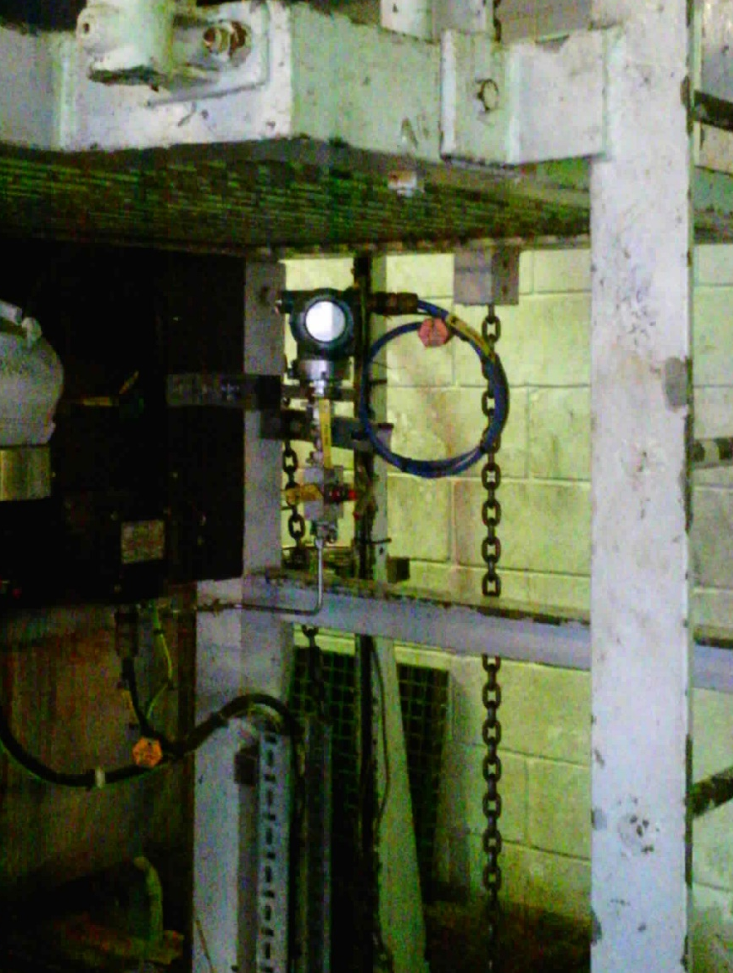
Performance Influencing Factors
Conditions that make testing errors more or less likely
Signs and labels
System interfaces
Routine task
Time available
Tools
Communication
Access and visibility
Notes:
The final part of our task and human error analysis involves looking at the performance influencing factors or PIFs that affect the likelihood of human error – good or bad. This highlights that it is not just the test method that we need to be aware of. Also, the importance of watching or walking through tasks to decide whether risks are really ALARP.
Here are some examples of factors that apply to SIF testing and reliability.
I have already talked about identifying component so labelling is clearly important.
The system interfaces determine how data can be obtained to confirm a successful test but also the opportunity to detect faults at other times.
Whether the task is routine or not to the technician can be significant. Doing it infrequently can lead to errors due to lack of familiarity. Frequently leads to complacency.
Time available may not affect the main physical test but can easily affect the effort put into visual inspections and vigilance during reinstatement.
The last one is particularly important. We have found quite a few instances where a test procedure requires a visual inspection of something that cannot be seen due to poor access, lighting or lagging.

Slide 19
Avoiding analysis paralysis
Each test is unique
Analysing every one is rarely practical
A generic overarching assessment is useful
Compare each specific to identify the differences
Perfect on paper that is no use in practice
Walk-through talk-through
HSE, OG-00054 Appendix 4
Diminishing returns
Counter productive
Productive
Notes:
We have found task and human error analysis to be an effective tool to better understand the risks associated with SIF testing and how they can be controlled. And whilst we have had a fairly strong steer from the HSE about continuing these analyses it is clear that it is not sensible to assess every SIF, unless you have a very small number to start with.
Whilst you cannot rely on a generic assessment it has proven useful to have an overarching analysis that covers most of the issues. The main benefit is that it allows you to identify what is different about specific SIF. This is very important for technician training and procedures. It is very easy to overlook the subtle differences if everything looks the same.
Whilst we have generally identified the main issues in a workshop there are always local issues to take into account. There is no real short cut to going out and having a look at every SIF and considering how it will be tested.
One resource we found useful when performing our analysis was OG-00054 from the HSE which is free to download from their website.

Slide 20
Conclusions
SIF testing is more complicated than you think
Testing must be carried out by competent technicians working to specific and detailed procedures.
Sorry!!
Our analysis has emphasised the need to consider inherent safety and passive engineered solutions
And to consider testing when design SIFs
https://www.abrisk.co.uk/sifprooftesting
Notes:
So my final slide reiterates the title of the paper. Don’t think that testing SIFs is simple.
Testing must be carried out by competent technicians, and they have to actively use fully detailed and specific procedures. I would like it was different but there really is no other way of making sure a proof test does what it needs to.
This leads me to Trevor Kletz’s words from the 1980’s. Have we really done enough about inherent safety and passive engineering? Ironically, in the last few decades we have really done the opposite and SIFs have proliferated.
Of course there is a place for SIFs and always will be. At least if we thought about testing during their design life would be a little simpler and possibly safer.
I have repeated the link to download our overarching task and human error analysis.

