Slide 1

Is the time right to digitalise the HAZOP?
Dr. Paul W Seccombe (Sales Director UK/EU)
Angel Casal (Product Manager)
HAZ32_055
Harrogate, UK - October 18-20 2022

Slide 2
Agenda
Kairos & Vysus – who are we?
HAZOP – A brief history in time & challenges
The ‘Digital HAZOP’ Approach
Functional modelling (MFM)
Building blocks & libraries
Key features
Case Studies
Conclusions
© Kairos Technology

Slide 3








Kairos Technology - Background
Our Customers define our Portfolio…
Established 2014
  22 employees
  6 PhD´s
Technology
  Multilevel Flow Modelling theory from DTU
  Developed in JIP with Harbour, TotalEnergies and Danish Hydrocarbon Research and Technology Centre (with funding from Research Council of Norway)
Notes:
This is a short 15-20 min intro of kairos
The Challenge we address
Short of our technology
One overall business case
What would you like to see next ?

Slide 4
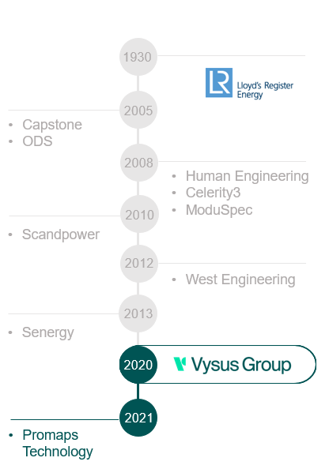
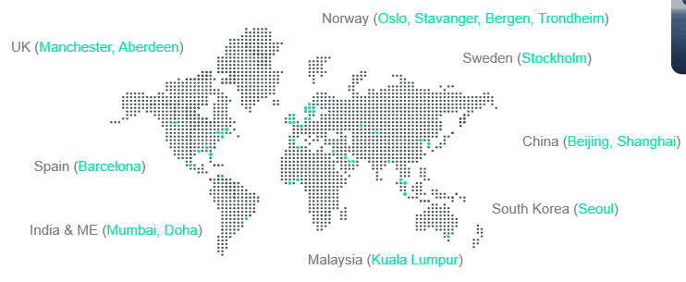
Vysus Group - Background
Leading independent provider engineering and technical consultancy expertise
Established 2 years ago from a carve-out from LR
  80 years of history, 600 employees, > 20 countries
Risk Management Consultancy
  150 employees, Tech Safety, QRA
  Dozens of HAZOPs / LOPAs / FMEAs every year

Slide 5
The ‘Traditional HAZOP’ - 1
Set the context
  Hazard – Source of harm
    Deviations from ‘Ops’ or Design may cause harm
  Harm – consequence of Hazard
    Damage to people, infrastructure or environment
    Risks
  Risk – Combination of probability of Harm & Severity
Form a Team of Subject Matter Experts (SMEs)
  Operations
  Maintenance
  Control & Instrumentation
  Process / Mechanical Engineering / Design
  Other SMEs - as needed
Notes:
Early 60s - ‘started’ by Trevor Kletz & team in ICI
‘Operability study’ Phenol process
3days a week, 4 months
1974, IChemE offered a 1 week course at Teesside Poly
Shortly after ‘Flixborough disaster’
Fully booked!
1977 ‘Chemical Industries Assoc.’ published a guide
1983 HAZOP term first used by Kletz essentially using the course notes from the IChemE course!

Slide 6
The ‘Traditional HAZOP’ - 2
Define Scope, Objectives & Responsibilities
  Boundaries, Interfaces & Assumptions
Identify Elements & Objectives
  Team availability
  An ‘end goal’ date
Identify Parameters and Guidewords
  No, More, Less, Other than, Early, Late,
  As well as, Part of, Reverse, Before, After…
‘Do the HAZOP’
  ‘The Hard / Long Part’ !
Document
Approval
Focus
Effort
1
2
3
4
5
6
7
8
Time

Slide 7
’Traditional HAZOP’ problems – From experience
Human-based
  ‘Expert’ judgments – no guarantee completeness or consistency
  Many factors affecting “human cognition”
Size of the Node matters
  Large nodes are complex, people will struggle
Risk ranking and prioritization very hard…
  Inconsistent process for assessing existing risk, and
  Making recommendations for new controls
Time consuming & costly
  Medium offshore greenfield project >1,000 manhours per stage (FEED / EPC)
  Re-HAZOP 30-40% of initial cost (every 5th year)
  Documentation ‘heavy’
© Kairos Technology

Slide 8
The ’Digital HAZOP’
KAIROS & Vysus team to market the HAZOP Assistant:
  Is a cloud-based SW that helps designers & operators systematically analyse safety threats and operability problems via a simple-to-build digital twin
  Combines XAI with unique functional modelling to run fast, repeatable and in-depth analyses better and in less time and cost than humans
Although it still is early days, we have:
  Tested the tool in a JIP and various case studies / proof of concepts
  Performed 3 real projects (2 ongoing)
  Coverage of hazards has been measured to be greater than >79 % (traditional HAZOP scored 40% only)
  Reduction in costs for our clients… and the models are faster to build each time!
  We don´t want to substitute HAZOPs, but to improve them !

Slide 9
HAZOP Assistant goal
Provide a structured and systematic approach for operational engineering
Increase the quality of HAZOPs and design reviews
Deterministic approach based on functional models
Reduce cost of the HAZOP and design reviews
Less people involved
Capture and reuse the design information, able to learn
Through design phase
Operation
Automation of analysis

Slide 10




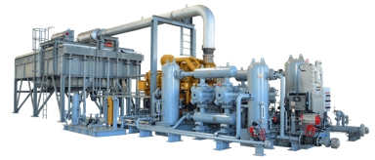
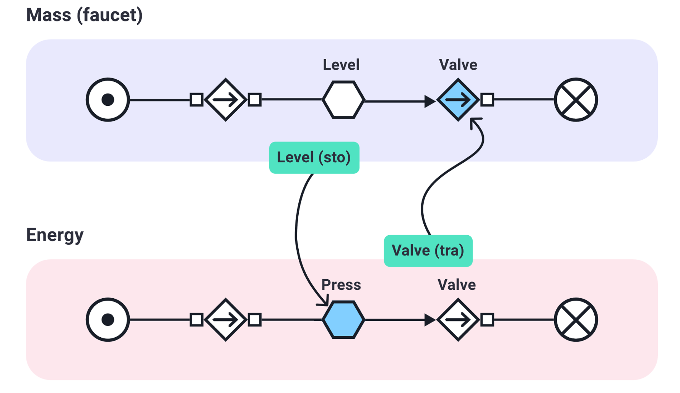



Explainable functional models
Kairos models
based on plant design & physical laws…
…utilising simple functional modelling…
…to provide
sound real-time actionable advice …
1
2
3
DESIGN
OPERATE
IMPROVE
HAZOP assistant
Control Room Assistant
Emissions
Radar

Slide 11
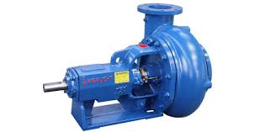
How can functional models help?
Reason how a failure propagates in a plant to become a consequence
Covering
  Operation mode (Start-up, SD, etc)
  Sensors and gauges
  Actuators and valves
  Manual operation
  Automatic action
PUMP
(example)
Objectives
Maintain flow
Function
Feed Cooling unit
Define relevant failure modes
  Design (FMECA)
  Experience (ISO14224, OREDA)
  RCAs
Failure Modes
Cavitation
…..

Slide 12
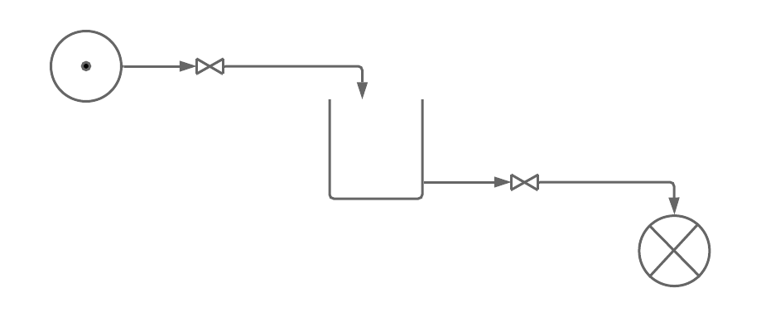
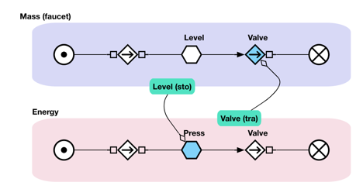
Basic concept of a Functional Model
Model based on:
Meeting intended goals of the systems from design (P&IDs, etc)
Functional behaviour & failure modes
Maintaining mass and energy balances
Capture and use client´s engineering expertise
Capture and use client operational knowhow
Deterministic:
Easy to understand
Super fast response
Patterns (footprint) of all sensors
Forward looking
Always same results on same issue/process state

Slide 13
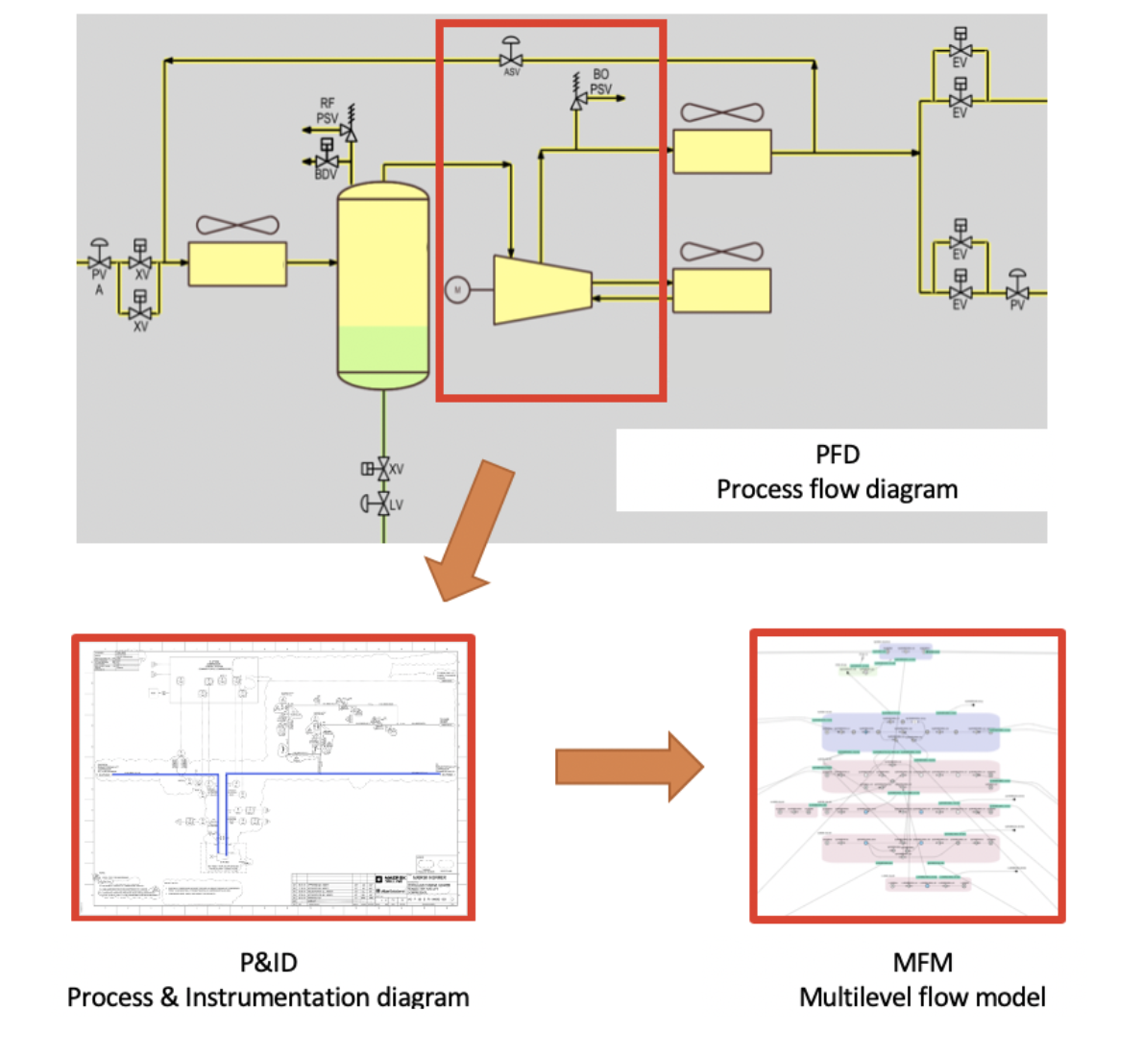
The steps to build a model
Start with PFD and P&ID
Goals and Functions
Re-use library of components
Add structure

Slide 14
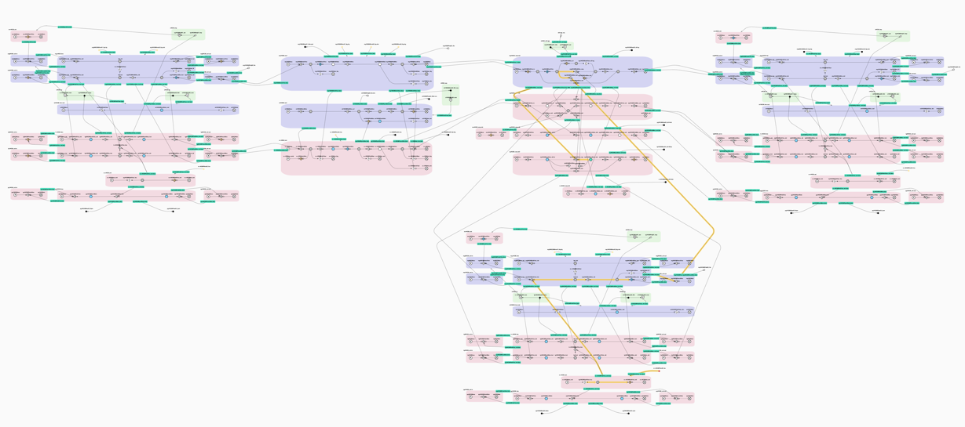
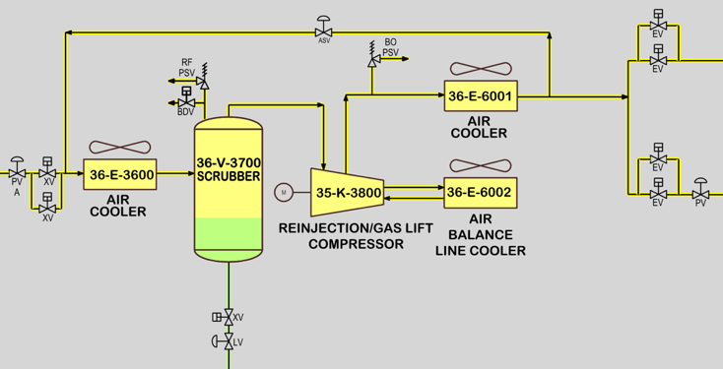
Library Approach
Scrubber
Compressor
Cooler
Cooler
© Kairos Technology
– Mass Balance
– Energy Balance
– Fault Propagation
Library Components
Cooler

Slide 15
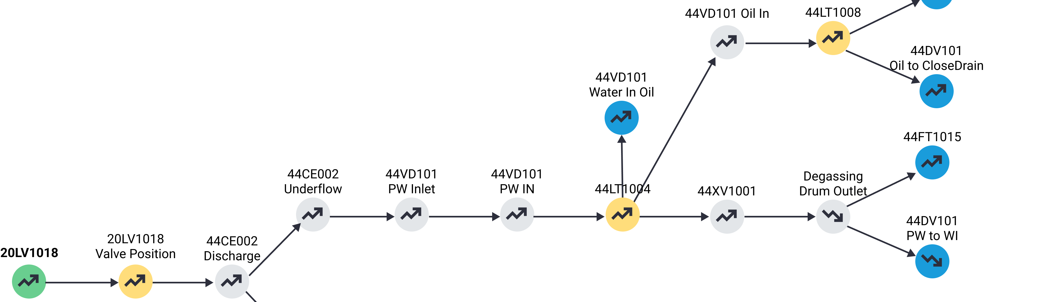
HAZOP Assistant “Tree view”
Evaluate missing Detection, Controls / Actuators
Manual steps required (operator verification)
Update Operational Procedures
Investigate how to mitigate consequences
Cause to consequence

Slide 16
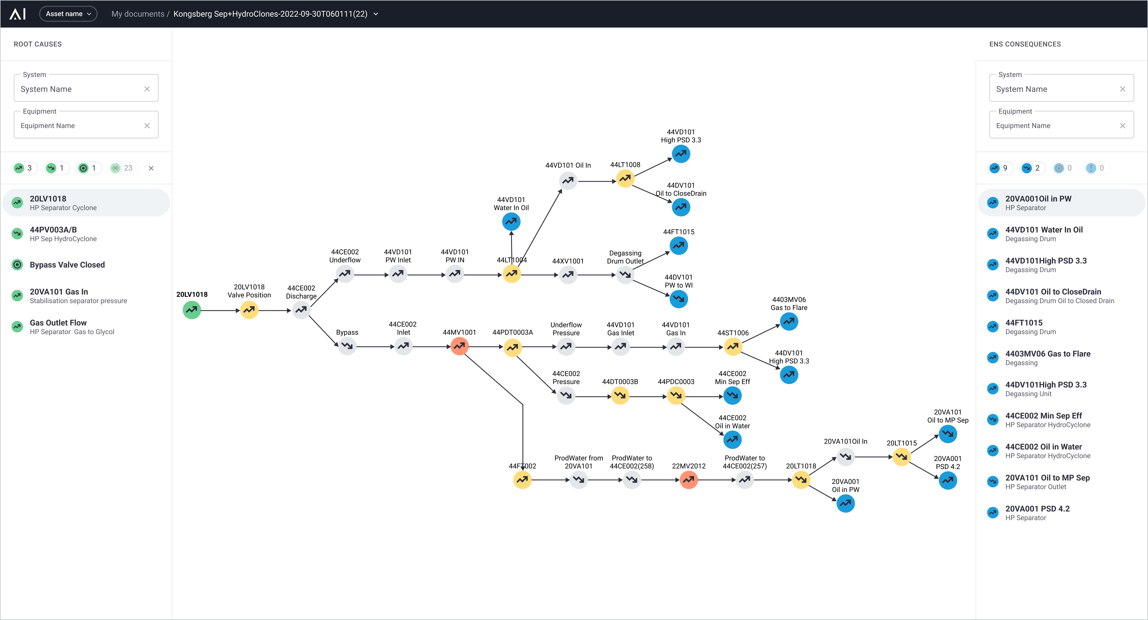
Tree view
Selected cause
Possible mitigations
Possible consequences
Opportunities to add instruments or inspection points
Transmitter detects deviation

Slide 17
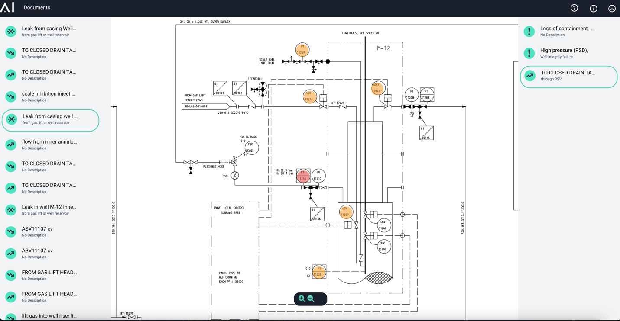
HAZOP Assistant “P&ID view”
Complete overview of Causes (Initiating Events) and Consequences across all nodes
With Sensors and Safeguards
Identified on P&IDs
Selected cause and its consequence
Transmitter detect increasing value
Transmitter detect decreasing value
Transmitter will not react to root cause
Notes:
The HAZOP Assistant consist of a toolbox to support the operability and design.:
Fault Detectability (Fault detectability from sensors, inspections etg )
Fault Ranking Strength (Distinguish between two or more error modes, identify need for inspections )
Fault Scenario Graph (Support counteraction standard operational procedures)
P&ID View (Superimpose the Fault scenario on a P&ID)
Tabular view (Spreadsheet like view with export to excel capabilities)

Slide 18
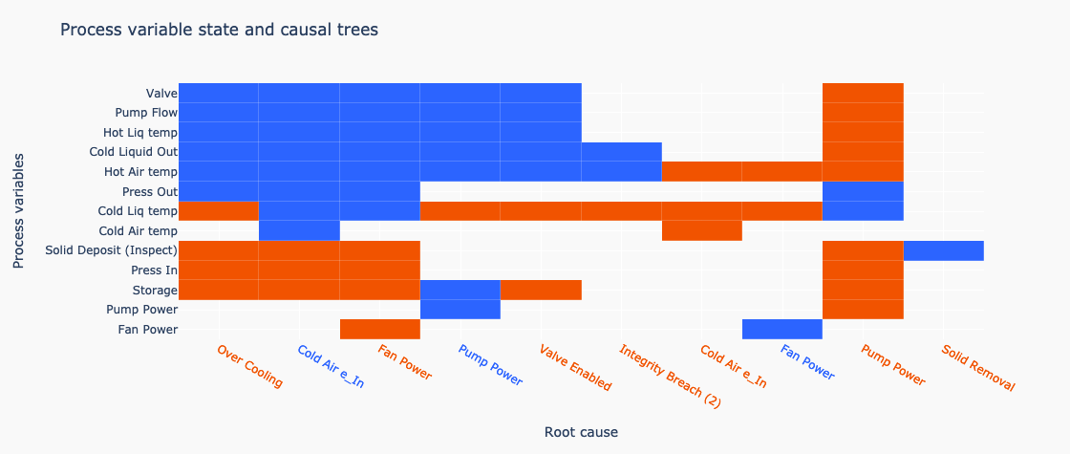
HAZOP Assistant “sensor coverage view”
Provides systematic evaluation of the instrumentation coverage
Missing sensors?
Too many sensors?
Manual verification steps required by field operator?
Transmitter detect increase
Transmitter detect decrease

Slide 19
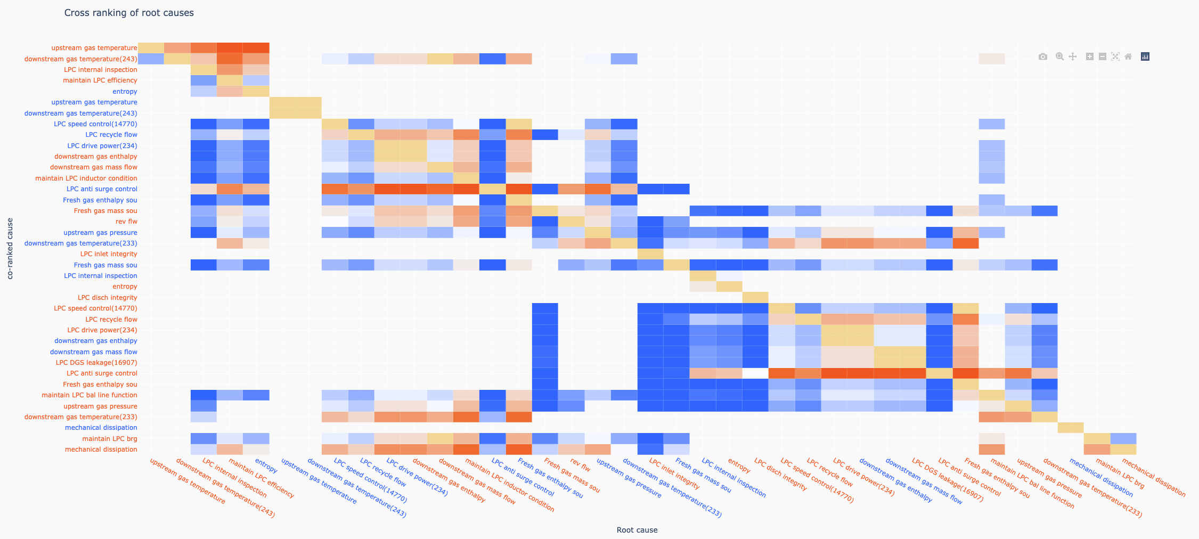
HAZOP Assistant “sensor coverage precision view”
Instrumentation cannot
detect uniquely
Ambiguous detection
Unique detection

Slide 20
Example from one project
HAZOP study (JIP)
20

Slide 21
HAZOP study (JIP)
A JIP between an NCS Operator, Kairos and Vysus in 2021
  Establish a MFM model for slurry, produced water and flowlines
  Deterministically identify initiating events and predict consequences
  Validate the tool, suggest improvements.
The HAZOP Assistant run the analysis for the said systems
2 HAZOP sessions were held, set of agreed guidewords only
The HAZOP Assistant consistently delivered better results
  Average hit rate for 87% HAZOP Assistant
  Average hit rate for 38% for normal HAZOP
Notes:
for a set of agreed guideword
full recording

Slide 22
HAZOP study (JIP)
The HAZOP Assistant missed 8 and 30 failure modes respectively because the lack of functionality to handle misdirected and reverse flow.
Notes:
for a set of agreed guideword
full recording

Slide 23
Example from one project
D2O study
23

Slide 24
Improved HAZOP approach
Updated design
PFD / P&ID
Update Library Components or model
Short Expert sessions
FMEA update
Improvements, Risks & Mitigations
Traditional HAZOP
Pre HAZOP or Operability Workshop Analysis
Analysis of propagation across total plant

Slide 25
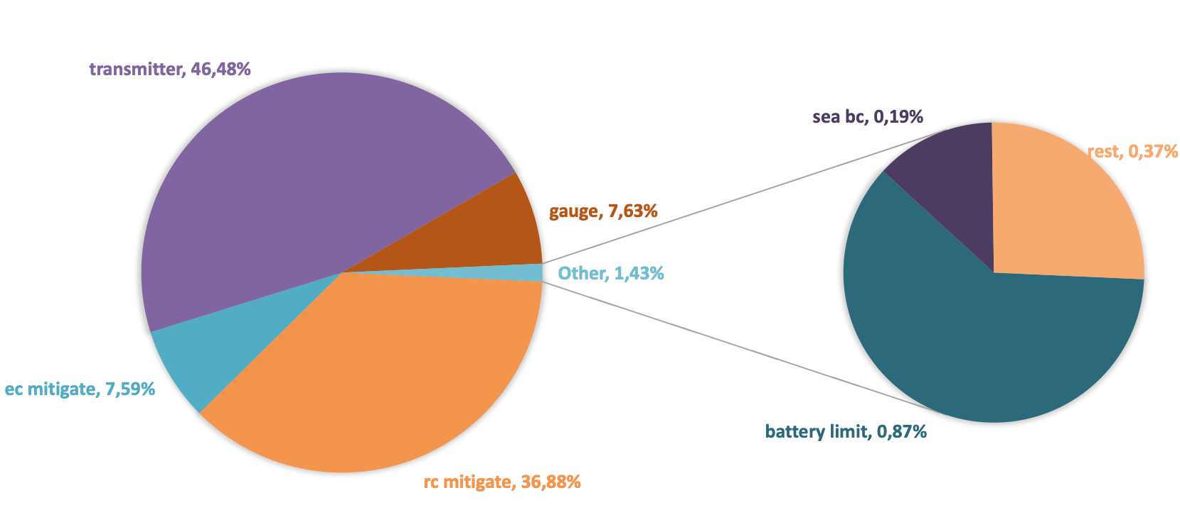
Pre HAZOP summary example – one system
Hazards with no mitigations
Consequences mitigated
Causes mitigated

Slide 26
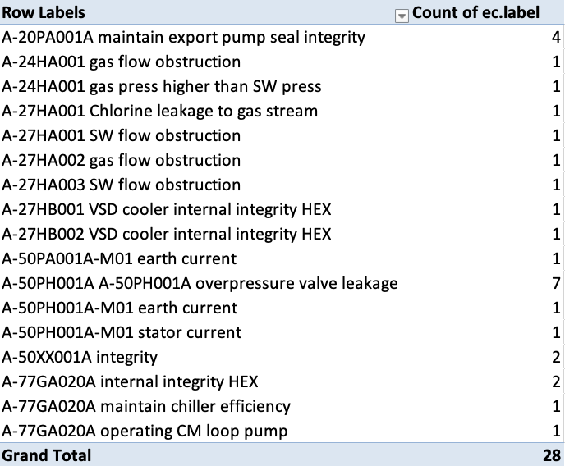
Pre HAZOP identified risks
Items of interest
Causes / failure modes w/out mitigation
Consequence w/out mitigation
No detection
Investigate
List of design mitigations required
Implicit human barriers

Slide 27
Typical content of study
Establish functional digital twin
Based on library functions and operational experience
Functional Twin
Optimize level of instrumentation
Fault detectability and ranking
Fault scenario graph
Document design mitigations
Design verification
Unmitigated risks
Detectability, precision
Implicit human barriers

Slide 28
Conclusions
The HAZOP Assistant has been tested in real projects and has yielded levels of performance that are twice those from traditional HAZOPs.
Due to the XAI nature, models will improve continuously achieving rates exceeding the 87% (JIP 2021), >95% will be achieved soon.
Very rapid reasoning and documentation.
Significant reduction in SME time and cost.
The info deployed in digital HAZOP can be made available to operators when the facility moves into the operation phase.
  Excellent platform for maintaining alive and updated Process Safety Information which is a PSM core requirement (continuous improvement).
  MOC HAZOPs and Re-HAZOP – executed very rapidly.
Models can learn from different plants and operators
© Kairos Technology

Slide 29
Angel Casal
Product Manager
Tel: +34 658 208080
angel.casal@vysusgroup.com
Paul W Seccombe
Sales Director UK/EU
Tel: +44 7860 454769
paul.seccombe@kairostech.no

