Slide 1
E-Hazop: A fresh approach to reviewing electrical systems
HAZARDS 32 – OCTOBER 19, 2022
Rob Fogg, Process Safety Consultant, ABB Energy Industries
Notes:
Hello
I’m Rob Fogg and I’m a Process Safety Consultant with ABB.
In this presentation I’ll be talking about safety reviews of electrical supply systems and the development of a new E-Hazop methodology.
There is also a conference paper on this topic which expands on this presentation.

Slide 2
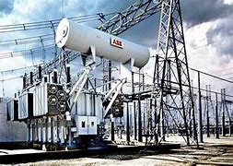
E-Hazop: A fresh approach to reviewing electrical systems
Now is the time for an improved approach
For New Facilities and Existing Facilities
Beyond just an audit
Digitized into a common tool
Notes:
Electrical safety and operability have never been more important,
with energy transition investments moving at a pace
and the need to maximise availability and reliability with rising energy costs,
electrical system readiness is fast becoming an operational priority.
I’ve approached this topic from a background in Process Safety and have drawn upon the specialist electrical knowledge of my colleagues throughout ABB.
In so doing, I have sought to bring fresh clarity, robustness and integration.
It’s clear that there are significant hazards and operability issues associated with electrical systems.
But how can we best identify and manage these hazards?
For both New and Existing Facilities
going beyond the standard “tick box” approach of a compliance audit.
And making use of new developments in recording and integrating information on digitized platforms.

Slide 3
E-Hazop: A fresh approach to reviewing electrical hazards
Presentation Overview
Electrical Hazards
Reviewing Electrical Hazards
Opportunities to Improve
A fresh approach to reviewing electrical hazards
Notes:
In this presentation I’ll talk about Electrical Hazards,
Issues observed with how Electrical Hazards are reviewed
I’ll move on to look at opportunities to improve these reviews
And finish by describing the new E-Hazop methodology we have developed

Slide 4
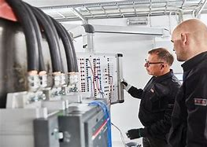
Electrical Hazards
Simple electrical hazards can be managed by basic universal measures
More complex electrical hazards, with potential to cause significant harm, require a more complex, multi-layered means of managing them.
An appropriately focussed and structured approach is therefore required to identify and analyse such hazards and the systems managing them.
Notes:
First of all, let’s be clear what we are focusing on here.
There are a full range of electrical hazards around us.
Simple electrical hazards can be managed by simple measures. You keep it in good condition and check it periodically. And if something fails, you fix it and get it working again before any harm is done.
Complex electrical hazards, with potential to cause significant harm, require a complex, multi-layered means of managing them as the hazards are not obvious and many people may be involved.

Slide 5
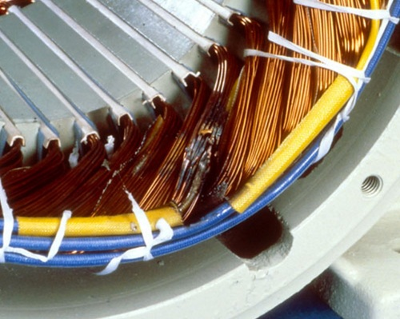
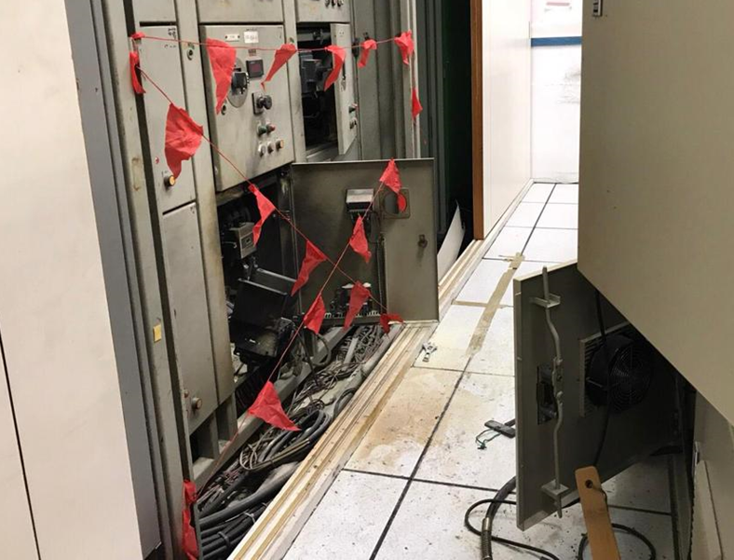
Electrical Hazards
Major electrical hazards and incidents
Generation
Transmission
Distribution
Example:
Winding damage due to voltage surge, short or overload
Example:
Transformer fire
Example:
Switchgear short circuit and arc flash events
Notes:
We tend to find major electrical hazards in the sectors of Generation, Transmission and Distribution.
These may be on electrical generating sites, chemical and manufacturing sites and are also present on many smaller sites.
We’re predominantly looking at High and Medium voltage systems along with their associated back-up and protective systems.
Although electrical incidents rarely make the headlines, we often hear of issues being raised at hazard studies and during incident investigations.
These have included transformer explosions, switchroom fires, electrical supply to parts of the network being turned off in error and in extreme cases electrocution.
But it’s not only the infrequent big events. There are far more small events occurring all the time.
Harm to People – such as an Electric shock or even near misses
Harm to the Environment – from Oil leaks and fire water run-off and increased energy usage, due to reduced efficiency.
Damage to Equipment – such as Reduced equipment life due to insulation breakdown
Disruption to Operation – due to an increased maintenance workload, and maintenance issues taking operational focus.
And Reputational Damage – due to facilities having less than 100% availability, and a perception of poor organizational culture developing

Slide 6
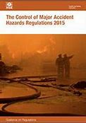
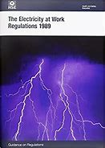
Electrical Hazards
Good Practice:
COMAH
IEC 61882
Health and safety at work act
Electricity at work regulations – absolute, must prevent harm (NFPA70E in US)
Machinery Directive
PUWER
Notes:
There is a range of Good Practice legislation and guidance aimed at the safety of electrical systems
Some of this is prescriptive in defining specific requirements.
And some is goal setting including statement like “all measures necessary” and “suitable and sufficient”.

Slide 7
Reviewing Electrical Hazards
Typical Issues
Over reliance on simple audits
Older plants may never have been reviewed
Lack of operational learning from incidents and near misses
Poor records (inability to demonstrate safe operation
Common Weaknesses
Changes to design and operations compromise the system
Fit and forget mentality.
People lose sight of expected life of systems
Lack of focus on foreseeable human error
Ageing and obsolescent plant
Loss of corporate memory through staff turnover
Electrical hazards often managed by perceived compliance and not viewed as complex hazards
Tightening standards
Notes:
Industry’s approach to electrical system hazards has been variable with sites often just following good practice and others also using a range of review techniques usually just once when it is built.
We see a number of common weaknesses.
Over reliance on simple compliance audits.
Lack of learning from incidents and near misses that have occurred at the facility under review or in wider industry.
Lack of focus on foreseeable human error.
We also see general issues,
There tends to be poor visibility of electrical assessments across organisations with operators and maintenance staff often being unclear of electrical hazards and the systems in place to manage them.
Known hazards are often well managed but there is often no process for identifying other hazards present in the original design or which arise over time.
……But these issues are due to electrical supply hazards being complex hazards.

Slide 8
Reviewing Electrical Hazards
Historic approaches
HAZOP (Hazard and Operability Study)
Based on P&IDs so miss electrical systems (which are shown on a single line diagram)
Lack of understanding of electrical issues within study team
Incomplete coverage of hazards due to guidewords not developed to assess electrical systems robustly
FMEA (Failure Mode and Effect Analysis)
Misses foreseeable “real life” scenarios as focus is on single defined failures
Complex and time consuming
Unclear boundary with HAZOP resulting in duplication and inconsistency
SAFOP (Electrical Systems Safe Operability Review)
Review includes SAFAN (Safety Analysis), SYSOP (System Security and Operability Analysis), OPTAN (Operator Task Analysis)
Unclear boundary with HAZOP resulting in duplication and inconsistency
Time consuming
Difficult for a non-specialist to engage with
Notes:
A range of techniques are available to review complex electrical hazards, but each has its limitations.
HAZOP has been used with specific electrical guidewords.
But with P&IDs being used as the basis, electrical issues often get missed.
The HAZOP team often have limited understanding of electrical issues and are not presented with sufficient information of the electrical aspects of the system being studied.
SAFOP is an approach used to analyse various aspects of electrical safety.
It has an unclear boundary with HAZOP resulting in duplication and inconsistency on sites with both process and electrical hazards.
It tends to be quite time consuming
And is often difficult for a non-specialist to engage with.
FMEA is a detailed technique analysing individual failures of defined components and as such can miss foreseeable “real life” scenarios particularly those involving people and processes.
Like SAFOP, FMEA is complex and time consuming and has an unclear boundary with HAZOP and other studies.

Slide 9
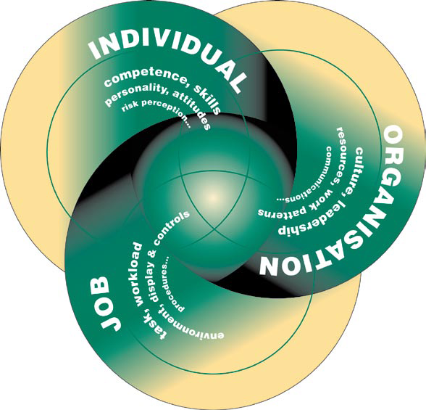
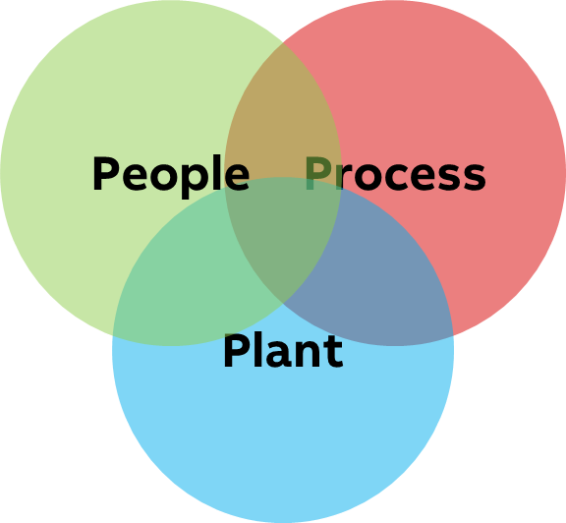
Opportunities to Improve
Learning from assessment of other Complex Hazards
Do we understand what can go wrong?
Do we know what our systems are to prevent this happening?
Do we have information to assure us they are working effectively?
Tell a clear and simple story:
Human Error: Identify foreseeable human error with significant consequences within each of the guidewords
Human Error is the consequence
of influencing factors
ALARP: Identify what more could be done to reduce risk and improve operability (best practice)
HSG48
Notes:
To learn from the assessment of other complex hazards we can look at improvements that have been made to HAZOP in reviewing Process Safety hazards.
ICI developed HAZOP in the sixties, it was adopted by industry in the 70s and variations were developed the 80s to better suit assessment of existing facilities. The development of HAZOP has continued and although the basis of HAZOP has remained unchanged, a good HAZOP now looks very different to earlier versions, even those from 10 to 15 years ago.
We’ve moved on from using stunted one or two word entries to describe hazards, causes and consequences as these told us nothing of the true scenario.
We now have a longer discussion and use more words to tell a clear and simple story. We follow the challenge set out by the HSE following the Buncefield trial, to answer the 3 questions and describe what can go wrong (step by step, through to the ultimate harm), what the systems are that prevent the hazardous event and describe the measures (such as periodic testing, inspection and maintenance) that assure us they will work effectively when called upon.
Human Factors is a key aspect with electrical safety and deserves a special mention.
There are lots of things that people can do incorrectly, but to usefully identify issues we need to understand the influencing factors and the opportunities for recovery.
There may be parts of the system that could be mixed up with other parts resulting in people working on live equipment.
They may take the same approach as they did elsewhere as they thought it was a similar situation.
They may perceive some deviations from procedure as “the right thing” as it’s the only way to get the job done.
HAZOP has moved on from tagging Human Error on to a list of guidewords for it to be considered as an isolated cause as this does not provide much insight.
To effectively include human factors in an assessment, we need to tell the story of how hazardous events may arise and within the story for any of the guidewords there may be human error. To do this, we need the people who work on these electrical systems in the study, fully engaged with it, and willing to talk openly.
The aim is to identify foreseeable error with significant consequences and put measures in place to make it less likely.
Similarly, HAZOP studies now understand that each hazard scenario tends to involve aspects of Plant (physical equipment), Process (the systems by which we use the physical equipment) and People (those who implement the systems). It’s not an inevitable, random event when something fails - we can make the operation more robust by having good processes carried out by competent people.
And expectations are now to not only identify Actions that will be carried out but also measures for further improvement which could be carried out along with justification of measures not being implemented.
This demonstrates that risks have been reduced to As Low As Reasonably Practicable.
There is the opportunity to make these improvements with the review of electrical hazards.

Slide 10
Opportunities to Improve
Opportunity to identify Inherent Safer approaches
Learn from incidents elsewhere to avoid repeating them
Opportunity for more sustainable design
Benefits of Improved Review
Make cost-effective design improvements
Good records from the start
Check that relevant Good Practice will be met
Opportunity to implement Best Practices
Identify Safety Critical Tasks for better design and operating procedures
Notes:
Improvements in electrical safety reviews provide an opportunity benefit existing facilities and new plant design.
An early review gives opportunity for more inherently safer approaches to be identified and implemented.
There is also opportunity to identify and implement Best Practices from across industry.
Safety critical operational and maintenance tasks can be identified so they can be given more focus to result in better design and operating procedures.

Slide 11
Opportunities to Improve
Like a HAZOP
Complementary to HAZOP without overlapping
Robust Record
Identifies Good and Best Practices
Remote and On-Site Delivery
Effective technique for analysing complex hazards
Build on 50 years of development and improvements to Hazop approach
Robust and focused guidewords
Considers Human Factors for each Hazardous Event
Can be used as an extension to Hazop
Does not confuse and contradict other site hazard assessments
Part of common approach to complex hazards
Risk Ranking on same matrix as Hazop
Goes beyond an audit
Identifies good practice and gaps to it
Identifies potential further improvements utilising industry expertise
Prioritised recommendations
Eliminates the requirement to travel
Flexible timing minimises disruption of site operation
Minimise cost
Promote consistency by enabling common team members across studies of multiple sites
Demonstration of pro-active approach and existing hazard management
Clear communication of hazards and safeguards to workforce
Reference for MOCs
Common digital platform
Notes:
From all of these opportunities for improvement we put together a Wish List of what we would ideally want from a new electrical hazard review.
As I’ve just described, HAZOP works extremely well for Process Hazards.
And it would make sense to apply the HAZOP approach and developments to Electrical Safety.
We wanted to be able to assess electrical hazards in more detail as an extension of a HAZOP without repetition or contradiction.
We wanted to go beyond identifying gaps to good practice and also identify potential further improvements utilising industry expertise. These would form an ALARP review and suitable measures could be implemented.
Over the past few years we have seen many benefits in carrying out studies remotely and such an approach is more sustainable.
We wanted to develop something with remote delivery in mind from the start.
We also wanted the study to result in a robust record that could be built upon by future studies and revisions.
Using a common digital platform for complex safety and operability reviews would enable this and allow a live suite of studies to be maintained and communicated.
We then took this wish list and set about developing a new E-Hazop approach.

Slide 12
A fresh approach to reviewing electrical hazards
ABB E-Hazop Guidewords – Example of Detailed Guidance
Guideword (Deviation from intent) | Definition of guideword | Aspects to consider | Sub Aspects | Examples
Over current | Current higher than design | Overload | Using more than the design power | Total system power (total from the load list) exceeds equipment rating e.g. feeder breaker
 |  |  |  | Simultaneous start of high-power equipment
 |  |  | Generator | Supplying more than the design rate of power (voltage/current/power factor)
 |  |  |  | Voltage control fault including, Controller fault Operator error - entering incorrect setpoint value
 |  | Short circuit | Bridging across live equipment | Deterioration of equipment, including insulation e.g. loose connection on a power supply terminal
 |  |  |  | Water ingress
 |  |  |  | Tools, cladding, materials and other items bridging across live equipment
 |  |  | Internal phase fault | Phase conductor touching another phase conductor due to insulation failure
 |  |  | External phase fault | Supply phase imbalance
Notes:
The approach we have developed starts in a similar way to conventional HAZOP by defining the scope and splitting into nodes.
The difference is that this is marked up on a single line diagram alongside a site layout diagram, instead of on a P&ID.
We didn’t want a long list of vague guidewords.
So we have developed a concise list of guidewords with a clearly defined structure behind them.
This is an example of the guidance structure for Over Current.

Slide 13
A fresh approach to reviewing electrical hazards
Good and Best Practice
Hazardous Event | Good Practice | Best Practice
High-Voltage Insipient insulation failure | Periodic Insulation resistance checks | On-line (continuous) partial discharge tests. This would provide early warning of any potential insulation failures as the equipment ages.
Power Transformer fire | Mineral oil with Dissolved Gas Analysis | Fire safe oil
Switchroom fire | Heat and smoke detection | High speed smoke detection
Overheating of terminal connections | Periodic visual inspection | Install infra-red viewing windows at vulnerable connections.
Notes:
For each Hazardous Event any Good Practice in place is recorded along with recommendations to address any gaps.
Any Best Practice in place is also recorded along with recommendations for further improvement.
Many of the best practices are viewed by insurance companies as risk reducing measures and their implementation may therefore result in lower insurance premiums.

Slide 14
A fresh approach to reviewing electrical hazards
Hazard
Ref
Cause
Safeguard
Immediate
Consequence
Ultimate
Consequence
2.14
Loss of electrical power
Boiler Feed Water Pump stops
Low Boiler level trip etc.
Boiler runs dry and overheats
Explosive overpressure on reintroduction of water.
Harm to people etc.
Hazop
5.21
Overheating of terminal connections
Visual inspection
Gradual breakdown of insulation leading to arc flash
Loss of electrical power to boiler Feed Water Pump.
Initiating cause for Hazop Hazard Ref 2.14
E-Hazop
Notes:
Where electrical system hazards are identified as leading to hazardous events already identified in a HAZOP, a linking reference is made. So, the full sequence of events is recorded, and the same hazardous event is not recorded multiple times.
Where electrical system issues (such as loss of power) are identified as causes of significant events in a Process Safety HAZOP, this can prompt an E-HAZOP to review the electrical system in more detail and link to the original HAZOP.

Slide 15
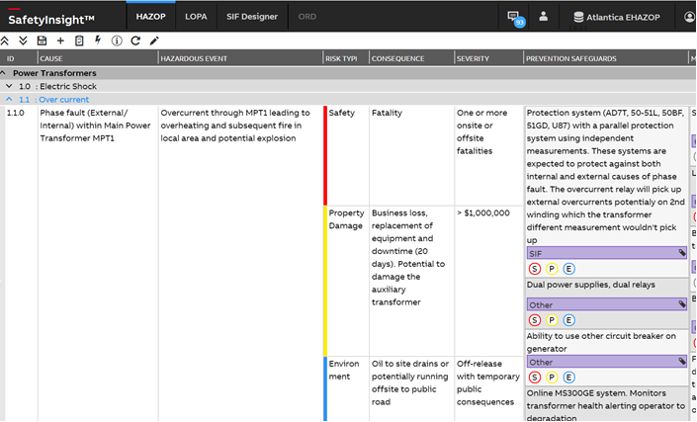
A fresh approach to reviewing electrical hazards
Notes:
The E-Hazop is recorded on ABB’s digital platform SafetyInsight
This is a common platform for all complex hazard studies including HAZOP and LOPA.
It plots hazardous events on a common risk matrix to produce a site risk profile
We feel that the new ABB EHazop addresses many of the drawbacks and weaknesses of other approaches
and is an easily achievable way to make big improvements over compliance audits alone.
The initial studies using this methodology have been well received
And there is particular interest from the energy transition sector.

Slide 16
Closing Thoughts
Improving Electrical Safety and Operability across industry will require:
A focus on electrical systems across a more diverse range of industry sectors
Inclusion of electrical systems into an integrated hazard review suite:
Tell a simple and clear story
Provides a demonstration of pro-active hazard management
Can be referenced as an information source for regulatory compliance e.g. COMAH, EAWA, etc.
Digitized platform to allow “Evergreen” reviews to be communicated, maintained and built upon
Notes:
Now, Going forward we see that in order to Improving Electrical Safety and Operability across industry we will need to
Focus on electrical systems across a more diverse range of industry sectors
We need to tell clear stories of what can go wrong with electrical systems and what we need to do to manage that
And we need to integrate the review of electrical systems into a hazard review suite to maintain consistency and provide a solid foundation on which future review studies can build.

Slide 17
E-Hazop: A fresh approach to reviewing electrical systems
Contact ABB
Rob Fogg
Safety Consultant
robert.fogg@gb.abb.com
Notes:
Thank you for your attention.
I hope you found this presentation interesting.

