Slide 1
Hazards 32 - Harrogate
Gas transmission network conversion to Hydrogen: impact on explosive atmosphere sizing

Slide 2

Summary
01
HYDROGEN – A GROWING PERSPECTIVE FOR GRTgaz
INTERNAL GUIDELINES FOR HAZARDOUS AREA CLASSIFICATION
PERSEE+ AND DISPERSION MODEL VALIDATION FOR H₂
DIMENSIONING HAZARDOUS AREA FOR H2: Main assumptions
COMPARISONS WITH NATURAL GAS
CONCLUSION
02
03
04
05
06

Slide 3
Hazards 32
01 - HYDROGEN : A GROWING PERSPECTIVE FOR GRTgaz

Slide 4
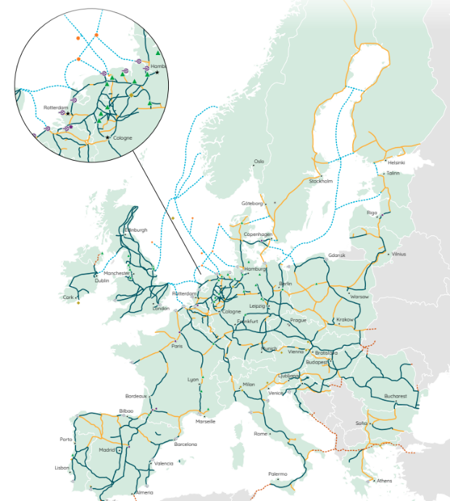
Hydrogen – a growing perspective for GRTgaz
Hydrogen to decarbonise energy sector
  A challenge for the gas industry to answer to climate change and rarefaction
  New strategies and roadmaps defined by national governments and the
  EU for the development of hydrogen technologies
A common goal for TSOs
  31 european energy infrastructure operators
  are creating the European Hydrogen Backbone (EHB)
  Roadmap up to 2040
  53,000 km based on using 60% of repurposed
  natural gas pipelines and 40% new pipelines
  Investments from 80 to 140 billions € (70 to 125 b£)
European Hydrogen Backbone (2022)

Slide 5
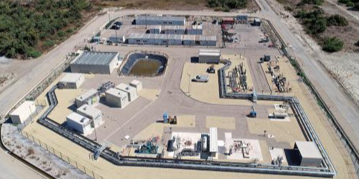
Hydrogen – a growing perspective for GRTgaz
GRTgaz: leading member of the Jupiter 1000 project
  Power-to-gas demonstrator: 1 MWe for green hydrogen
  production and methanation
  Electrical supply is 100% renewable energy
  Methanation with captured CO2 from on a
  nearby industrial site (25 m³/h)
  Hydrogen used for blending in natural gas for
  industrial customers (200 m³/h)
  Tests on two different electrolysis technologies:
  PEM and alkaline electrolysis
  Demonstrate feasibility to impulse investment in
  Power-to-Gas solutions whose deposit in France
  is estimated at 30 TWh of gas produced each year
European Hydrogen Backbone (2022)

Slide 6
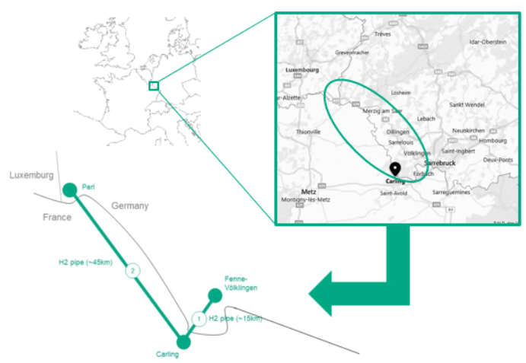
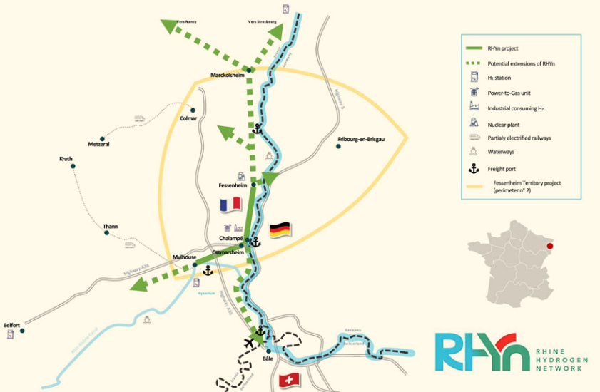
Hydrogen – a growing perspective for GRTgaz
GRTgaz: EHB projects are coming
  MoSaHyc project
    Collaboration between GRTgaz and CREOS
    Convert two existing gas pipelines to 100% hydrogen transport
    Interconnection of Völklingen, Perl (Saarland), Bouzonville and Carling (Moselle)
    70km long network for a capacity up o 20,000m³/h
  RHyn project
    Promote the Upper Rhine hydrogen ecosystem and
    answer to industrial and mobility needs
    100km pipeline with 60km of natural gas repurposed pipeline
    125,000 tonnes of hydrogen per year
Technical challenges are numerous
  To support these projects, GRTgaz must review its guidelines
  and good practices for both repurposed and new pipelines

Slide 7
Hazards 32
02 - INTERNAL GUIDELINES FOR HAZARDOUS AREA CLASSIFICATION

Slide 8
INTERNAL GUIDELINES FOR ATEX CLASSIFICATION
ATEX classification guidelines at GRTgaz
  Hazardous area classification is compulsary for all GRTgaz operating facilities
    26 compressor stations
    11 320 delivery and sectionning stations
    Easy-to-use guidelines are necessary for such numerous facilities
  Guidelines based on recognised standards
    EN-IEC 60079-10-1: Classification of areas - Explosive gas atmospheres, 2021
    IGEM SR 25: Hazardous Area Classification of Natural Gas Installations, 2013
    EI Part 15: Area classification for installations handling flammable fluids, 2015
  Guidelines description
    Overview of legislation requirements
    38 technical forms with area classification and sizes for the different equipments and locations
    Helpful information to choose ATEX equipments and verify conformity

Slide 9
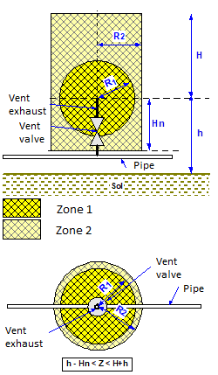
INTERNAL GUIDELINES FOR ATEX CLASSIFICATION
Technical form
Contents of each form
  Characteristics of the release associated with the
  equipment (based on standards and feedback)
  Method used to size the hazardous area (assumptions,
  standard reference, etc.)
  Shape of the area and classification (sphere, cylinder, etc.)
  Extents of the area depending on
    Flowrate
    Pressure
    Diameter
    Wind speed
    or any other relevant parameter
Update of these forms are necessary for H₂
Example of the area classification for a vent release

Slide 10
Hazards 32
03 - PERSEE+ AND DISPERSION MODEL VALIDATION FOR H₂

Slide 11
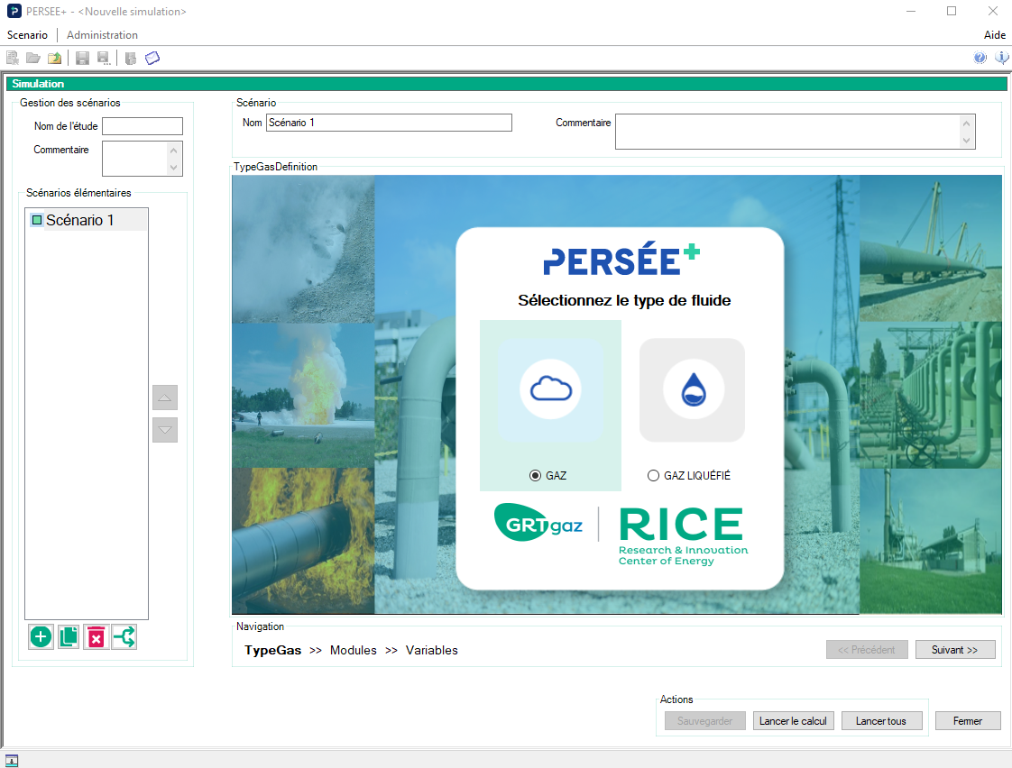
PERSEE+ SOFTWARE DEVELOPMENT
PERSEE+ in a nut shell
  Developed to simulate natural gas and LNG accidental releases
    Release rate calculations
    Gas dispersion
    Jet fire and pool fire
    Explosion (UVCE, jet)
    Pipeline burst
    Pipeline fire resistance under fire
  Widely used in France:
    Users : Terega, Storengy, EDF, RGDS, Elengy and GRTgaz
    Risk assessment studies for local authorities
Development for H₂ releases since 2016
  Models’ adaptation to consider H₂ and blends (NG-H₂) characteristics
  Validation work to estimate accuracy

Slide 12
PERSEE+ SOFTWARE DEVELOPMENT
Main differences between H₂ and NG about dispersion
  Density is 8 times lower for H₂
    Already use of light gas models considering buoyancy effect : no modification but comparison with experiments
    Impact of air entrainment : modification of air entrainment coefficient in the dispersion model
  Flammability range in air is larger
    4 to 75% for hydrogen against 5 to 15% for natural gas
    Limited effect on model accuracy for LIE
  Reverse Joule-Thomson effect
    Adaptation of pseudo-source model for underexpanded jet (sonic)

Slide 13
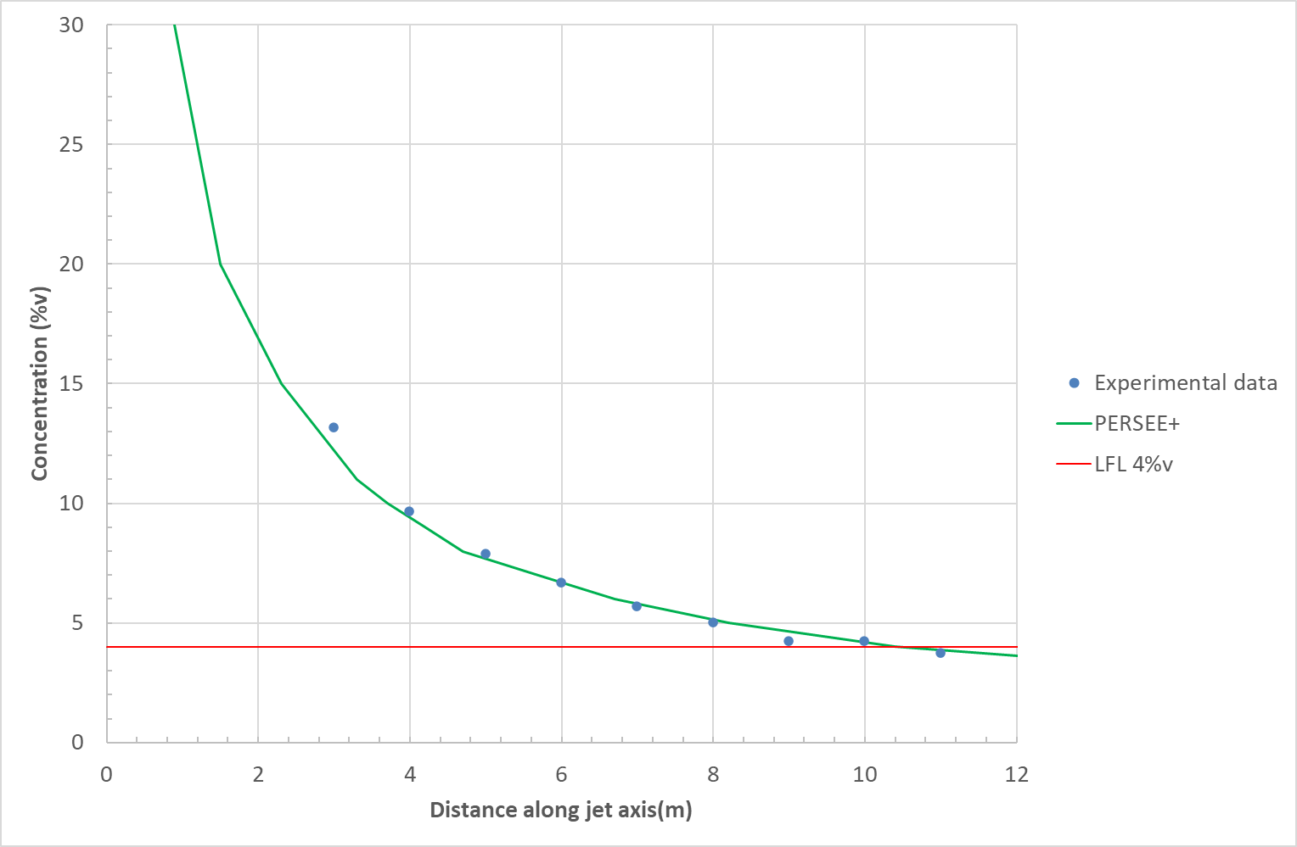
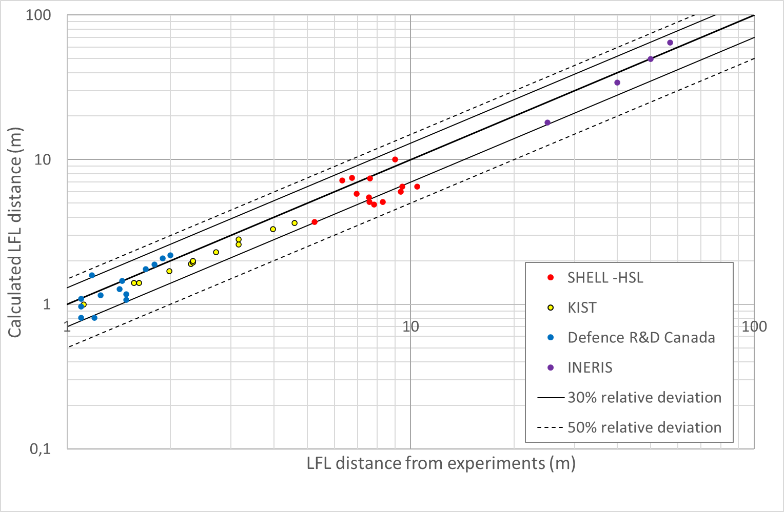
DISPERSION MODEL VALIDATION FOR H₂
Comparison with dispersion experiments
  4 main data sources with various pressures and release diameters
  Comparison of simulations with experiments
    Concentration decay in jet axisInterpolated LFL distance based on measurement
    Accuracy for H₂ is similar to accuracy for NG (about +/- 30%) → Acceptable
    for ATEX guidelines
  Next steps: generate additional to increase validation range
Trials | Pressure (bar) | Release diameter (mm)
SHELL - HSL | 25 to 140 | 3, 4 and 12
KIST | 100, 200, 300 and 400 | 0.5, 0.7 and 1
INERIS | 35 and 40 | 12, 25, 50, 75 and 100
Defence R&D Canada | 6.6 and 16.3 | 0.79 and 1.6 mm
Comparison of calculated and measured concentration for test 9 of the Shell-HSL trials
Comparisons of LFL distances interpolated from concentration measurements and calculated LFL distance

Slide 14
Hazards 32
04 - DIMENSIONING HAZARDOUS AREA FOR H₂: MAIN ASSUMPTIONS

Slide 15
DIMENSIONING HAZARDOUS AREA FOR H₂
Main assumptions
  Release diameter
    Flanges, screwed connections, etc.:
      0.25 mm² for normal conditions
      2.5 mm² for harsh donditions: high flow velocities, vibrations, irregular flow rates, pressure fluctuations
    Vent, relief valves, etc.: full diameter release (normal release) and similar to flange (unexpected leak)
  Maximal operating pressure
    For vertical venting: from MOP to ambient pressure to consider passive dispersion
  Release direction
    Vent, relief valves, etc.: exhaust direction (mostly vertical)
    Flanges, screwed connections, etc.: most conservative direction → use of CFD to consider impinging release

Slide 16
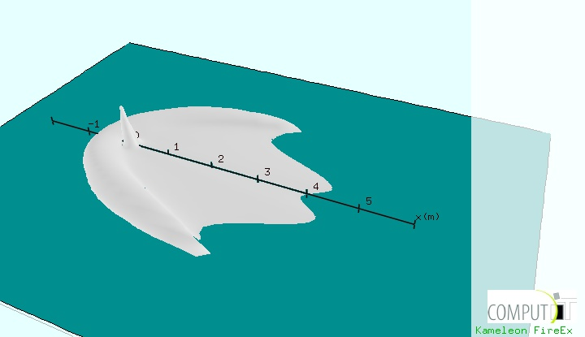
DIMENSIONING HAZARDOUS AREA FOR H₂
Main assumptions
  Release direction: CFD modeling
    CFD modeling with KFX (DNV)
    Normal conditions (0.25mm²) and harsh conditions releases (2.5mm²)
    Low pressure (5bar) and high pressure releases (250bar)
    Low (0.5m/s) and high (15 m/s) wind speed
    Release direction: -60° and -90°
    LFL distance for impinging releases always shorter
    than LFL distance for horizontal releases
  ATEX region shape and wind speed
    Two main types or region: cylinder or sphere
    Sphere: Horizontal extend (R1) 6, 10, 15m/s depending on wind conditions in the location
    Cylinder:
      Vertical extend (H): 0.5 m/s
      Horizontal extend (R2): 6, 10, 15m/s depending on wind conditions in location
3D view of the flammable cloud for a downward H₂ release

Slide 17
Hazards 32
05 - COMPARISONS WITH NATURAL GAS

Slide 18
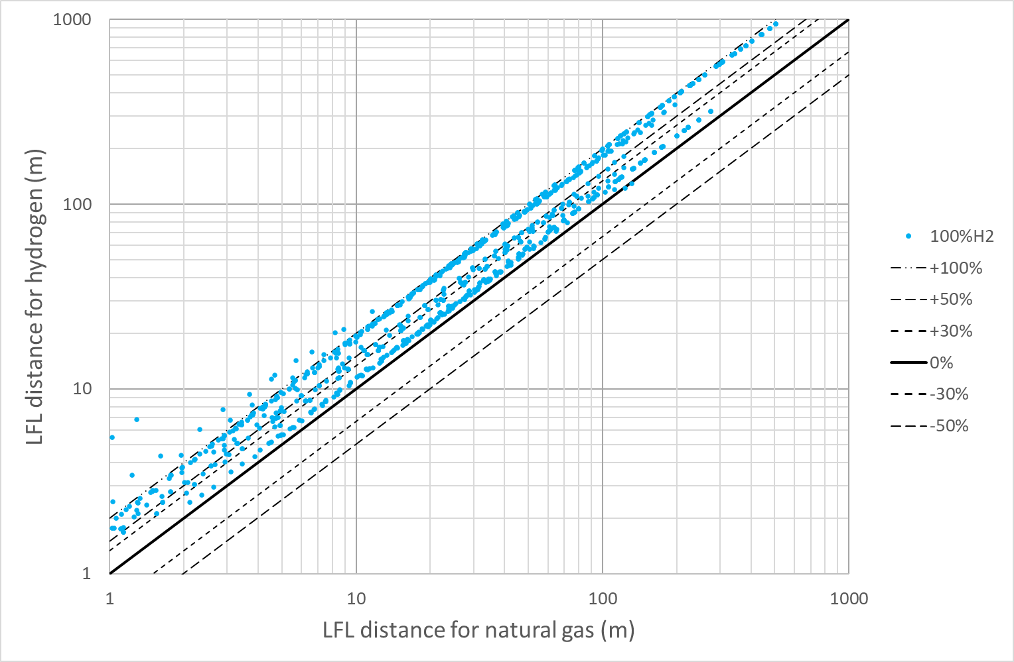
Comparisons with Natural gas
Significant increase of ATEX region
  Comparison for about 1000 scenarios
    Comparison at similar operating conditions
    Horizontal and vertical extents increases
  From about +10 to +100%
    Important variability: not possible
    to apply a conversion factor
    GRTgaz duplicated the 38 technical forms in
    updating LFL distance

Slide 19
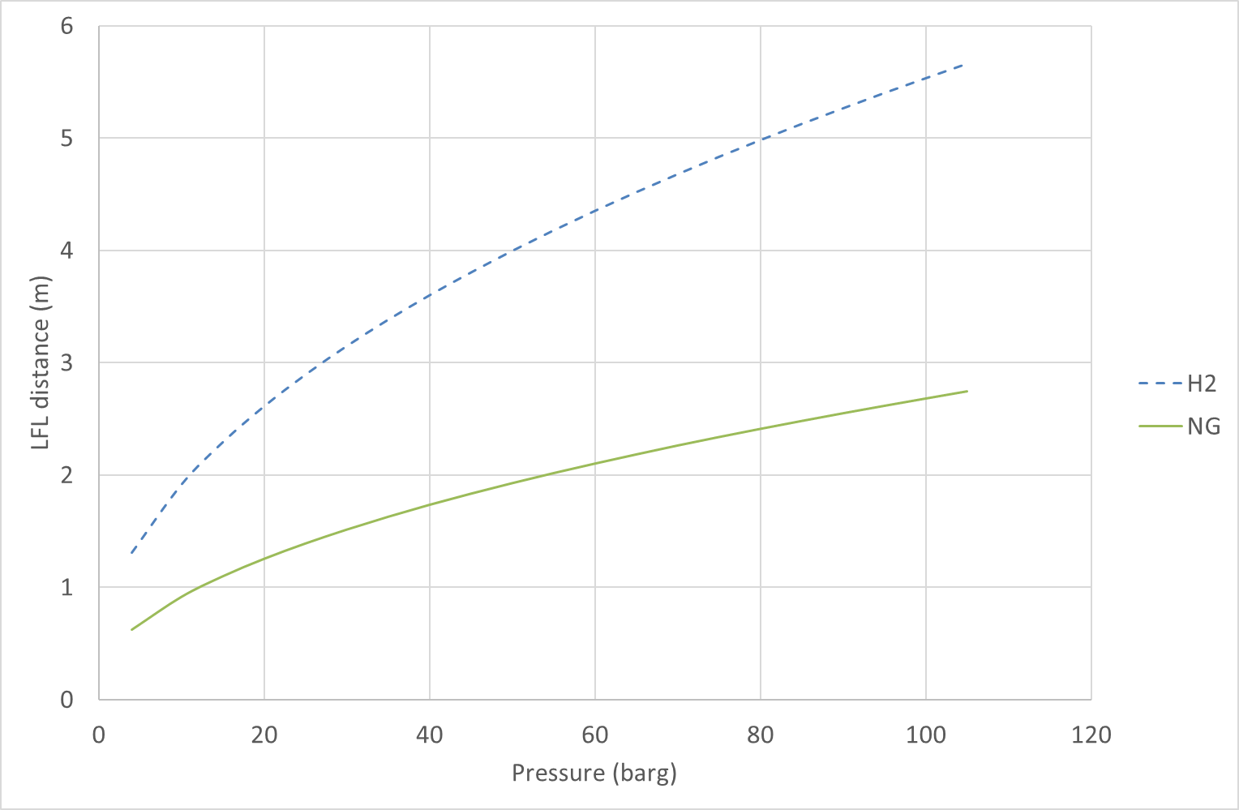
Comparisons with Natural gas
Impact for repurposed facilities
  H₂ ATEX region could:
    ATEX region outside fences: extend the site ? Possible ?
    Non-ATEX equipment enters in ATEX region: replace the equipment ?
  Alternative solution: decrease operating pressure
    Solution also investigated to maintain steel integrity
    Pressure decrease depends on equipment
  Example 1 : Flange leak
    Harsh conditions (2.5 mm²) at 100bars
    For natural gas: Rmax = 2.6m
    To get the same size with H₂, initial pressure should
    be reduced at 20bars
Comparison of LFL distance (R_{max}) for a flange leak in hard conditions

Slide 20
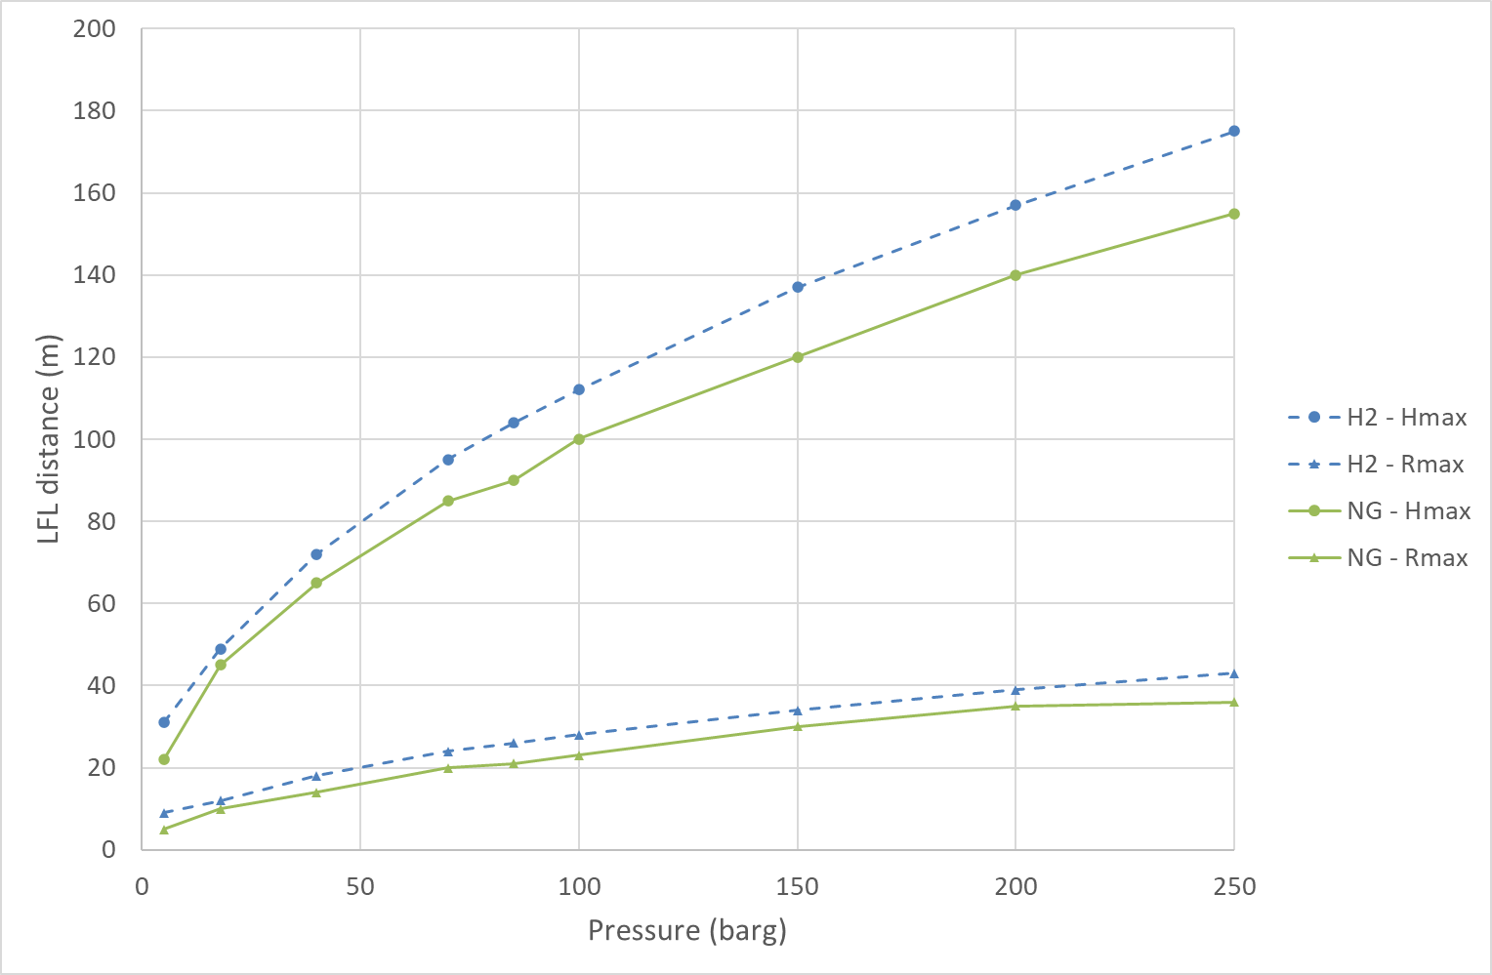
Comparisons with Natural gas
Impact for repurposed facilities
  Example 2 : Driven relief valve
    100mm diameter and opening pressure of 100bars
    For natural gas: Hmax = 100m and Rmax = 23m
    To get the same sizes with H₂, initial pressure should
    be reduced to 77 bars for Hmax and 60 bars for Rmax
  Reduce operating pressure:
    To investigate case by case
    Not always sufficient
  Compatibility of ATEX equipment must be verified
    Hydrogen is much more reactive than NG
    ATEX equipment must respect the requirements for the gas group
      IIC for H₂
      IIA for natural gas
Comparison of LFL distances (H_{max} and R_{max}) for a driven relief valve at 100 bar

Slide 21
Hazards 32
06 – CONCLUSION

Slide 22
Conclusion
  For H₂ facilities : new best practices to design, maintain and operate are necessary
  H₂ properties of hydrogen justify to review risk assessment, safety distances and hazardous area classification
  Since 2016, GRTgaz is developing a new version of PERSEE+ to model H2 releases with a sufficient level of accuracy. New tests with horizontal releases at medium pressure (about 40 bars) and release in gas cabinet at low pressure (< 4 bar) will be performed for continuous improvements
  Thanks to this new version, GRTgaz updated its internal guidelines for hazardous area classification
  For H₂, ATEX region are much larger than for natural gas
  For new facilities: more difficulties regarding facility siting
  For existing facilities: lower operating pressure and/or equipment upgrade after detailed compliance reviews
  Internal guidelines is helpful in completion of these studies in reasonable time and efforts

Slide 23
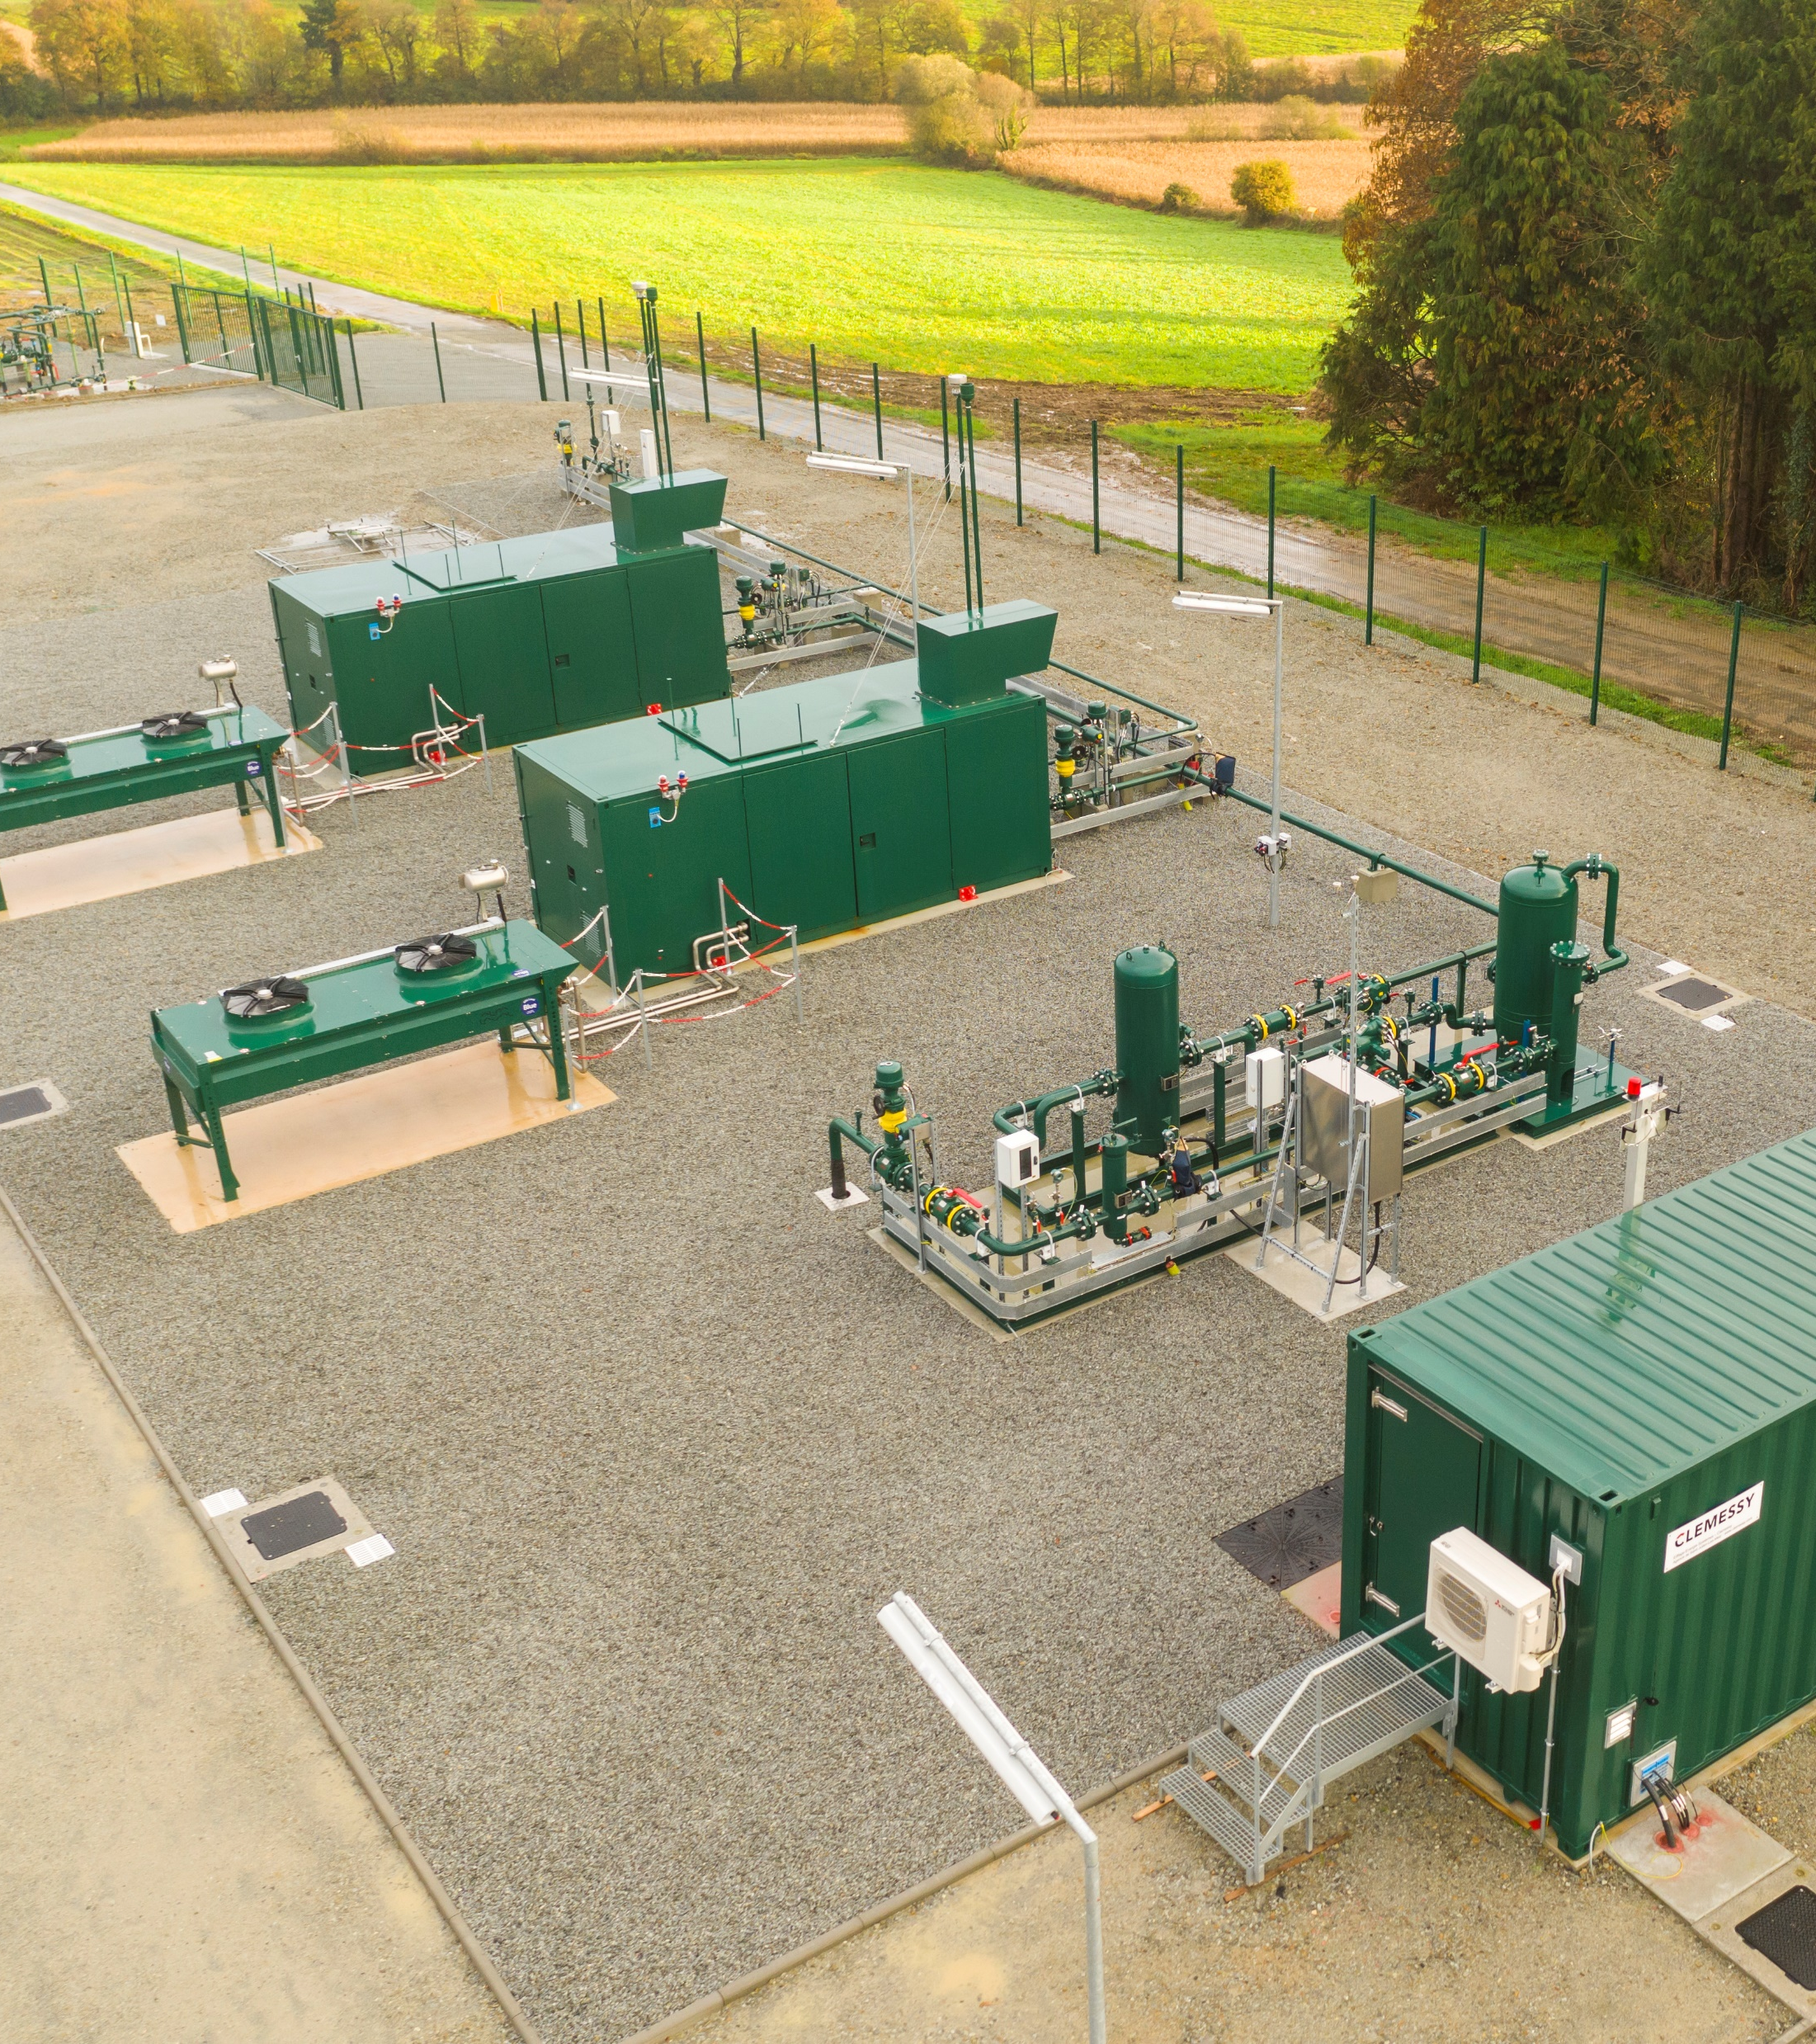
Any questions ?

