Slide 1
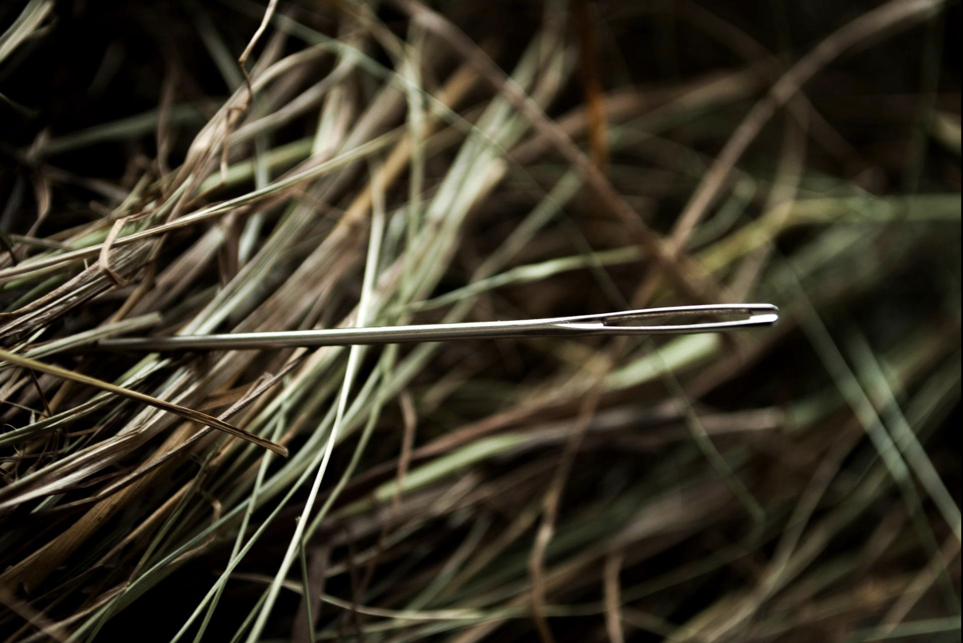
How I Became a Better
Safety Engineer

Slide 2
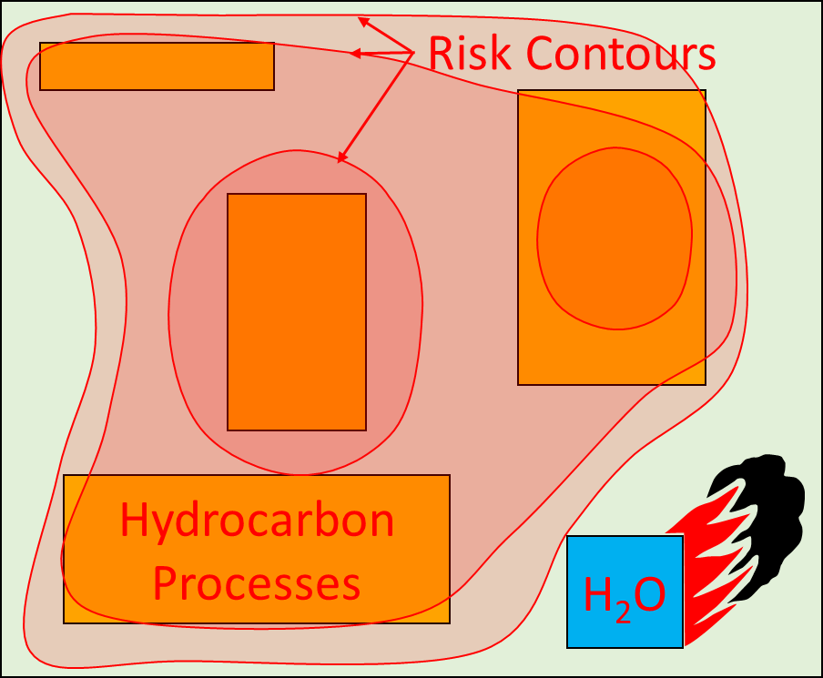
The Event That Changed My Thinking
Hydrocarbon Processing Plant
Explosion risk was clearly
not Broadly Acceptable
Predicted high risk areas
were obvious
QRA was a root cause
of the accident
A random number
generator would have
been better.

Slide 3

Fukushima
Guadalajara
Longford
Macondo
Mumbai High
Pasadena
Seveso
Texas City
3 Mile Island
Would QRA
have
benefited?
Bhopal
Buncefield
Chernobyl
Feyzin
Flixborough

Slide 4
What is Risk?
Measurement
Prediction
Knowledge
Based Risk
Statistics
(Frequent,
representative,
random and
ergodic)
Ignorance
Based Risk

Slide 5

Knowledge Based Risk (KBR)
What is the risk
the patient has
disease X?
Doctor #1
Doctor #2
Doctor #3
Knowledge | Population Statistic
Risk | 1/1,000
Family History
1/10
Test Results
9/10
Which level of knowledge is reasonably practicable?

Slide 6
Pierre-Simon Laplace
“Probability is a mark of our ignorance.”

Slide 7
Knowledge vs. Ignorance Based Risk
Risk
Ignorance Based
Risk (IBR)
QRA and
risk matrices
Real risk
Knowledge Based
Risk (KBR)
Pre-analysis
Realisation
Post-analysis

Slide 8
A Real Plant?
?
IBR
Real risk
?
QRA
KBR

Slide 9
Conjunction Fallacy
Nobel Laureate Daniel Kahneman
 | Probability? | Probability?
Seveso
Poisonous cloud
affecting 100,000
people
Routine weekly shutdown drops load
on turbine, which increases the steam
temperature above exothermic
1/1,000 – 1/1,000,000
1 – 1/10?
KBR
IBR – the real risk

Slide 10
The Risk Prediction Paradox:
Without knowing the reasons for failure, risk can be dangerously underpredicted.
But, if those reasons are understood, there is no reason for prediction.

Slide 11
A Truism:
“Accidents only happen because someone thinks the risk is low.”

Slide 12
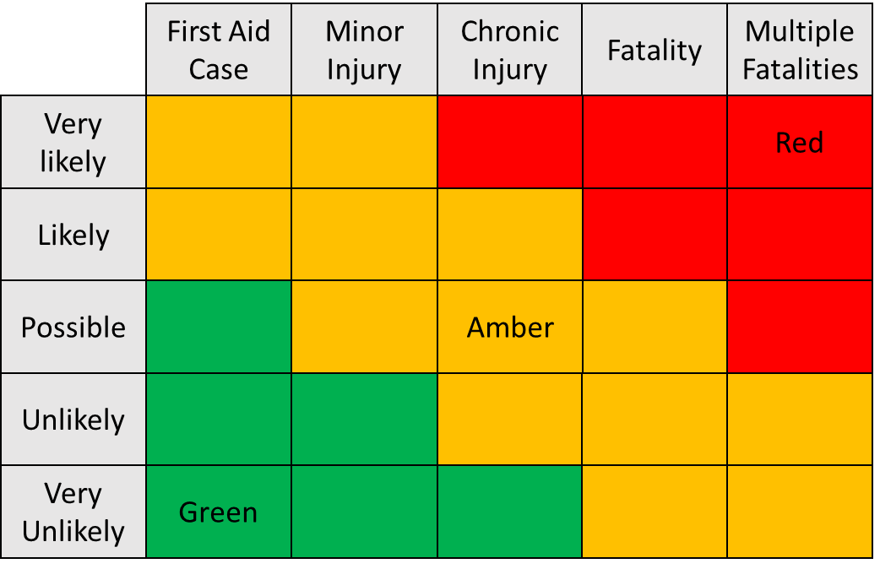
Risk
Matrices
High or
Knowledge
Based?
Low or Ignorance
Based?
Notes:
Gamechanger when understood

Slide 13
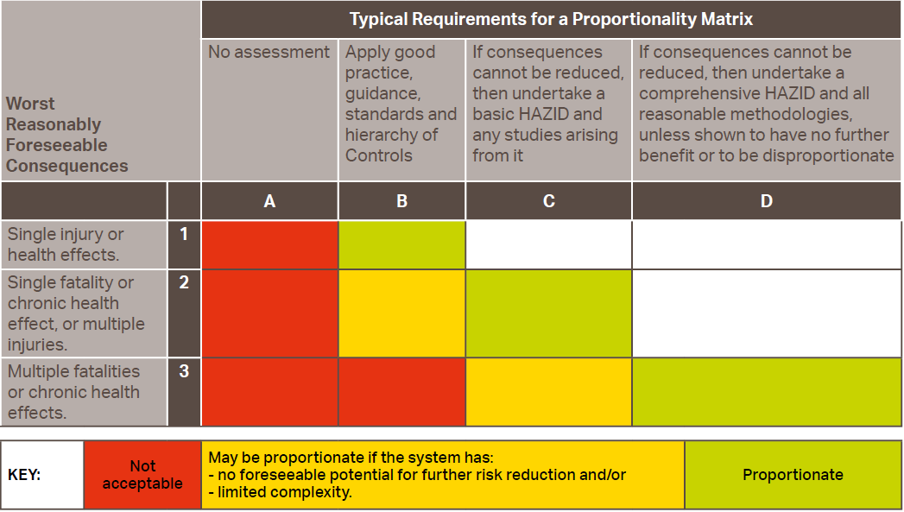
The Proportionality Matrix

Slide 14
Business Risk Assessment &
Reliability Methods
Identify
variables
Collect data or
make estimates
Establish
independence
or relationships
Produce
model
Variable #1
Data #1
Model
Variable #2
Data #2
Variable #3
Data #3
Variable #4
Data #4
Variable #5
Data #5
Variable #6
Data #6

Slide 15
QRA & Internet Advertising Methods
Available
data
Data
mining
Produce
model
Data
Variable #1
Model
Chance Correlation #2
Chance Correlation #3

Slide 16
What causes
major accidents?
What does not cause
major accidents?
System Complexity
Management Systems
Operating Environment
Activities
Procedures
Human Error/Factors
= Functions!
Equipment Categories
Bhopal, Feyzin, Seveso, Texas City
Buncefield, Pasadena
Flixborough, Guadalajara, Macondo
Piper Alpha
Mumbai High, Longford
These are critical variables
but they are ignored in QRA!
QRA equipment categories
are chance correlations!
Notes:
Cf WRA

Slide 17
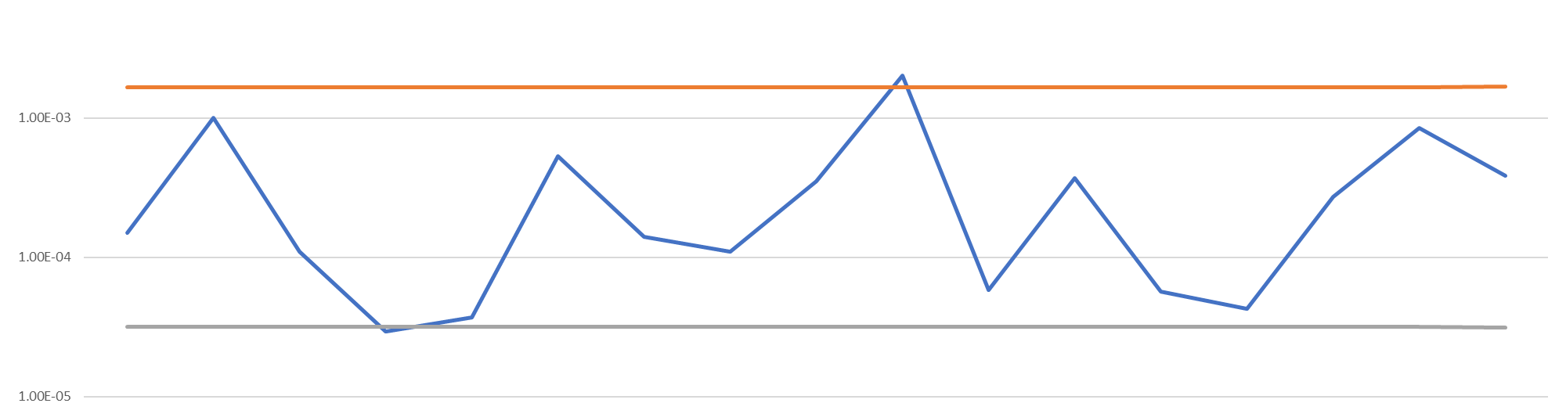
Randomness in Equipment Categories
Poisson Confidence Intervals for DNV Leak Frequency Data
95% Confidence Level Upper Bound
1E-3
1E-4
Lower Bound
1E-5
Filters
Flanges
Pig Trap
Piping
Vessels
Tanks
Shell Exch.
Tube Exch.
Average
Plate Exch.
Act. Valves
Compressors
Fin Fan Exch.
Recip. Pump
Man. Valves
Recip. Comps
Centrifugal Pump
Chance Correlations

Slide 18
‘Risk calculation’
‘Risk estimation’
‘Risk expert’
Oxymorons
Risk quantification = measurement
= statistics
= an average
Notes:
So busy - Cant see wood for trees
Without verification there are no controls

Slide 19
Well Reasoned Argument (WRA)
A qualitative demonstration, possibly supported by robust quantitative data, that proportionate, systematic and scientific processes have been used to identify and understand any foreseeable hazards, and all reasonable measures have been employed to prevent or mitigate their causes and effects.
Notes:
Ignorance reduction

Slide 20
Defence Failure Guidewords
Design Envelope of System
Capability/Scope of RRM
Reliability/Life Expectancy
Diversity
Redundancy/Common Mode Failure
Availability/Overrides
Failure to Safety
Self-Revealing Failures
Overruling/Camouflaging
Survivability in Hazard Conditions
Calibration/Set-up Error
Control/Software Error
Human Error
Decision Criteria & Feedback Loops
Secondary Risks
Deterioration/Creeping Change

Slide 21
Risk Management:
“Is it just chance alone?”

Slide 22

The time has come for change!

