Slide 1
IChemE Major Hazards Management Priorities
October 2022
Dr Steven Flynn
Major Hazards Lead, IChemE

Slide 2
IChemE Priority Topics to 2024
Led by members, we develop knowledge, generate meaning and deliver influence

Slide 3
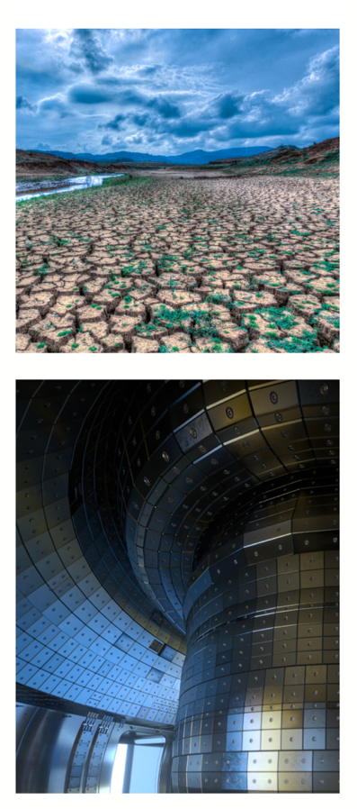
IChemE Priority Topics Progress
Responsible Production
COVID-19 pandemic response support
Climate Change Position Statement, November 2020
Climate Change Action Plans for IChemE groups 2021
IChemE at COP 26
Carbon Capture Science & Technology journal August 2021
‘Sustainability Hub’ for online training launched February 2022
Policy related activities UK, Australia and New Zealand
Future focus - climate change, circular economy, life-cycle analysis & energy transition
Digitalisation
Digitalisation Technical Advisory Group established
Articles in The Chemical Engineer magazine
IChemE accredited chemical engineering degrees - systems thinking, artificial intelligence, security, and ethical leadership
Digital Chemical Engineering journal launched
Advances in the Digitalisation of the Process Industries virtual conference 2021
Future focus – collaboration on awareness building, training and education

Slide 4
IChemE Major Hazards Committee
IChemE Safety Centre
Safety & Loss Prevention SIG
Learned
Society
IChemE Hazards Conference
IChemE Journals – LPB & PSEP

Slide 5
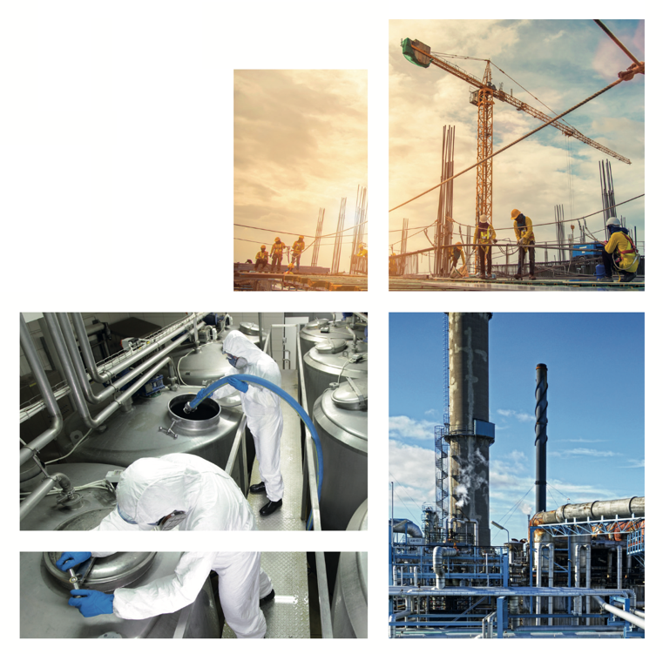
Major Hazards Management
“Advancing understanding & application of major hazards management techniques, and contributing worldwide for the benefit of society”
People
Through-career professional & technical competence
Leadership, culture & human factors
Practices
Establishing / applying tools & good practices
Promoting sharing & learning for continual improvement
Emerging challenges
Evolving technology, industry & society
Adapting & developing knowledge, skills & tools
Working with others

Slide 6
Major Hazards Management - People
Education, course accreditation, professional qualifications and continuing professional development core to IChemE
University Students:
Student Process Safety Diary to capture practical experience (ISC)
University process safety workshops (S&LP SIG)
IChemE Safety Centre - training programme, including Leadership and Culture workshops
IChemE professional qualification processes - being revised & Professional Process Safety Engineer registration will reopen when complete
Through-career process safety competencies - project to be completed by 2023

Slide 7
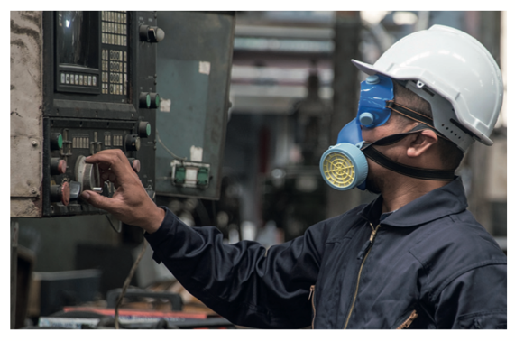
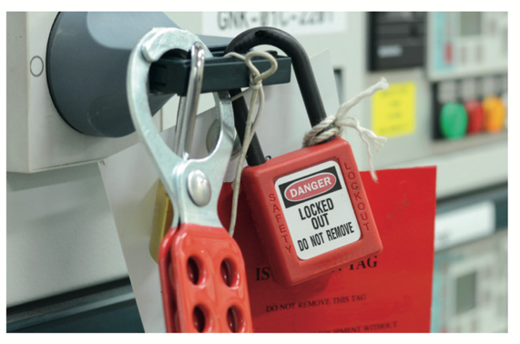
Major Hazards Management - Practices
Helping make good practice, common practice
IChemE Safety Centre Guidance – recent new additions include application of process safety indicators & enhancements to HAZOP
IChemE Loss Prevention Bulletin - now available to members free of charge to promote learning from incidents
E-Book of major incident 1-page summaries published in electronic format with links to reports
Enhancing application of learning from incidents – project in progress

Slide 8
Major Hazards Management – Emerging Challenges
Working with members, governments and other institutions for a safe and just transition, as the world responds to climate change and delivers the Sustainable Development Goals
Knowledge & Skills
Webinars on energy transition & emerging technology hazards and the energy transition webinars
New training; eg hydrogen safety
Cross Sector Collaboration
UK Hazards Forum - joint projects on natural hazards, new technologies and consistent application of good practices
Participating in IMechE projects on human factors and process safety practices
National Engineering Policy Centre support

Slide 9
IChemE Major Hazards Management - Summary
IChemE Priority Topics
Responsible Production
Major Hazard Management
Digitalisation
Major Hazards Management
People
Through-career professional & technical competence
Leadership, culture & human factors
Practices
Establishing / applying tools & good practices
Promoting sharing & learning for continual improvement
Emerging challenges
Evolving technology, industry & society
Adapting & developing knowledge, skills & tools
Working with others

