Slide 1


hazard.
Battery Warehouses
Pat Swords – Principal Process and EH&S Consultant

Slide 2
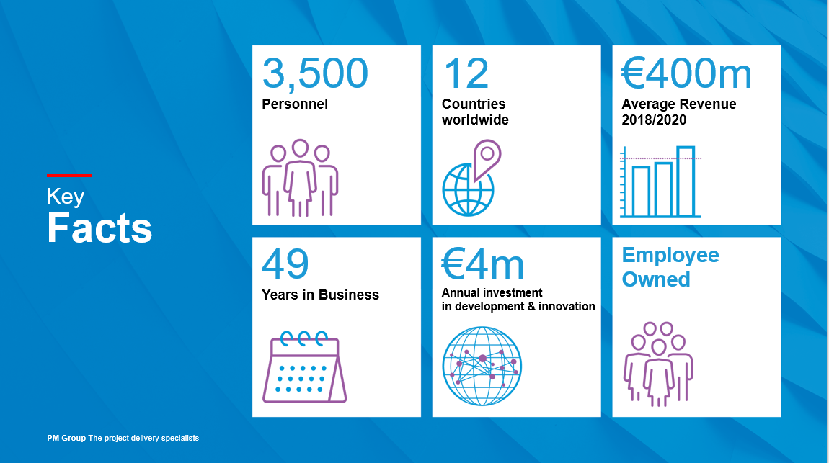

Slide 3


Slide 4

Contents of Presentation
Battery Warehouses – Large scale storage of lithium ion batteries, e.g. logistics, in Battery Energy Systems or even being transported in maritime shipments.
Potential for major accident scenario.
Relationship with COMAH legislation.
Control measures – Fire triangle.
Passive and active fire protection.
Environmental protection

Slide 5
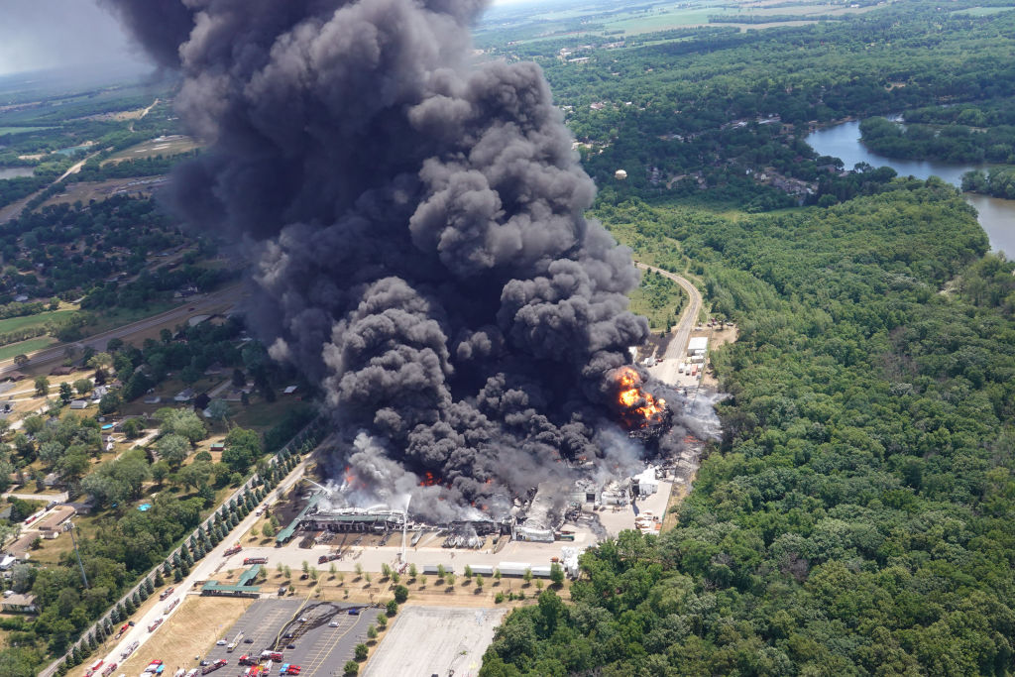
Lithium Ion Batteries
Combine high energy density with relatively low weight, in increasing use ranging from cell phones to vehicles, but;
Electrolytes are flammable and in a fire scenario release toxic gases.
Self ignition from internal short circuit, causes are termed ‘abuse’:
  Physical abuse occurs from penetration or mechanical impact;
  Electrical abuse from such as overcharging or manufacturing defects;
  While thermal abuse from external overheating or similar leads also to an exothermic runaway reaction.
Scientific literature reports failure rates of ranging from 1 in 10 million to 1 in 40 million for lithium ion battery cells;
  While a large 100 kWh battery for an electric vehicle can comprise over 8,000 cells.
Bus goes on fire in Paris street:
https://www.youtube.com/watch?v=5r-yN8SugWM
Warehouse of waste batteries on fire in Morris, ILL, USA (latinpost.com).

Slide 6


Potential for Hydrogen Fluoride Release
Thermal release from a Lithium Ion battery fire can be six to ten times electrical energy:
Copious amounts of extinguishing water are required and batteries can reignite several hours or days later.
Degree of toxic fumes released depends on battery chemistry, but Swedish measurements show large amounts of hydrogen fluoride (HF) may be generated, ranging between 20 and 200 mg/Wh of nominal battery energy capacity.
Hydrogen Fluoride is fatal if swallowed, is fatal in contact with skin, is fatal if inhaled and causes severe skin burns and eye damage (ECHA).
Additional quantities of other airborne toxic chemicals and contaminated firewater.
GHS symbols for Hydrogen Fluoride

Slide 7

Control of Major Accident Hazards (COMAH) Legislation
The original Seveso incident related to a loss of control where dioxins were generated and released to the environment.
COMAH Directive 2012/18/EU therefore defines:
  ‘presence of dangerous substances’ means the actual or anticipated presence of dangerous substances in the establishment, or of dangerous substances which it is reasonable to foresee may be generated during loss of control of the processes, including storage activities, in any installation within the establishment, in quantities equal to or exceeding the qualifying quantities (…).
Potential exists for a major accident scenario at a battery warehouse, as a failure in one battery cell will quickly propagate to other cells and adjacent batteries.
Based on previous Swedish figures, 17 MWh of battery storage in a fire situation could produce a health hazard falling under the terms of the Seveso III Directive.

Slide 8

Scope of COMAH is Broadly Defined
Batteries can be classified as ‘articles’ under the Classification, Labelling and Packaging (CLP) Regulation, where;
‘article’ means an object which during production is given a special shape, surface or design which determines its function to a greater degree than does its chemical composition.
However, COMAH includes explosive articles and specifically states:
  In the case of dangerous substances which are not covered by Regulation (EC) No 1272/2008 [CLP], including waste, but which nevertheless are present, or are likely to be present, in an establishment and which possess or are likely to possess, under the conditions found at the establishment, equivalent properties in terms of major-accident potential, these shall be provisionally assigned to the most analogous category or named dangerous substance falling within the scope of this Directive.
While Seveso III Directive dates to 2012 and the widespread usage of large lithium ion batteries, the legislator clearly didn’t intent for it to be circumvented.

Slide 9

Reasonable to Foresee may be Generated during Loss of Control
A battery is cycled with reversible chemical reactions.
German ‘Seveso’ Commission (KAS) guidance on loss of control of processes:
“Whether or not it is reasonably foreseeable that a hazardous substance may be produced in an out-of-control process may also depend, inter alia, on measures to prevent or limit accidents”.
“(…) in the presence of at least two independent engineered protective measures or one inherently safe engineered protective measure, it may be concluded that the generation of hazardous substances in out-of-control processes is not reasonably foreseeable”.
A battery warehouse does not fulfill the criteria above ➔ a loss of control process is foreseeable which could develop into a Major Accident Scenario if measures are not implemented to prevent propagation.
Kommission für Anlagensicherheit (KAS)

Slide 10
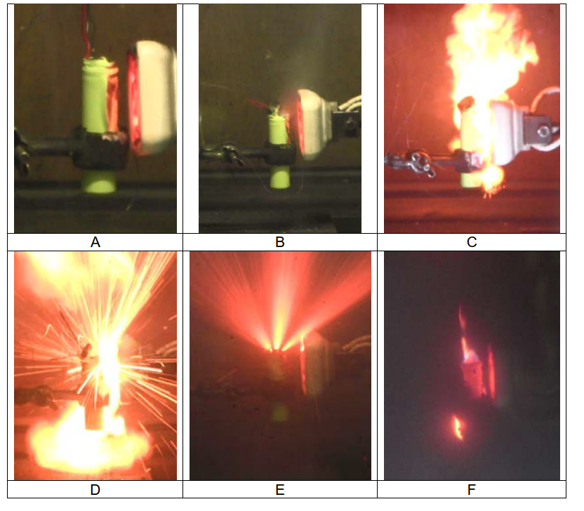
Available Control Measures – Fire Triangle?
Self ignition is inherent to the battery, as is fuel ➔ Can oxygen be excluded?
Warehouses for fire protection can be operated as low as 13% oxygen, while ignition limits for flammable liquids lie between 11% and 14.7% oxygen.
However, Karlsruhe Institute Technology (KIT) Research Centre for Fire Protection Technology investigated the experimental fire testing of small lithium batteries with nitrogen reduced atmospheres down to 8% and for argon down to 7%.
While combustion by-products were affected by the lower oxygen levels, it did not stop the thermal runaway reaction, a contributing factor being the reaction developing its own oxygen.
Furthermore, the reduced oxygen atmosphere did not prevent the spraying of sparks or the explosive energy releases associated with such battery fires.
KIT Report 192. Example of a small lithium ion battery heated (A, B), which then self ignites (C) and burns intensively with spraying of sparks (D, E). .

Slide 11
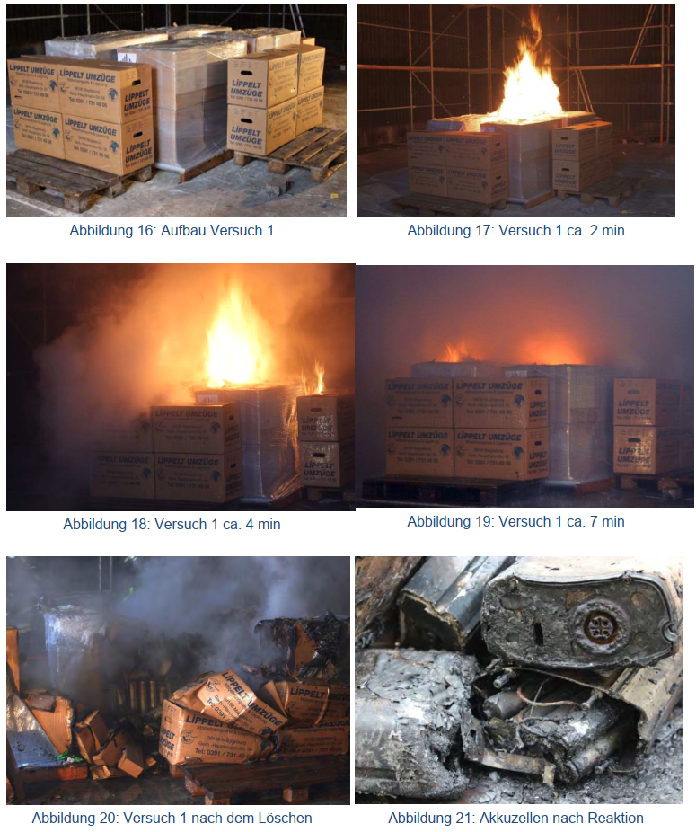
Passive Fire Protection
Passive fire protection includes fire compartmentalisation, fire resistant structures, etc.:
VKF (Swiss Cantonal Fire Authorities) recommend fire resistance structure EI 60 and where batteries exceed 500 kWh per section, separate storage in small fire compartments (max 600 m²), plus effective sprinklers.
German insurance association VdS 3103en Lithium Batteries:
At the moment we do not have reliable information about adequate safeguards for batteries of high capacity.
Possible measures are e.g.:
  Separation and limitation of quantity.
  Storage in areas with fire resistant manner or safe distances (Spatial separation of 5 m).
  Automatic extinguishing systems.
VdS: Sprinkler concepts for warehouses with lithium ion batteries

Slide 12
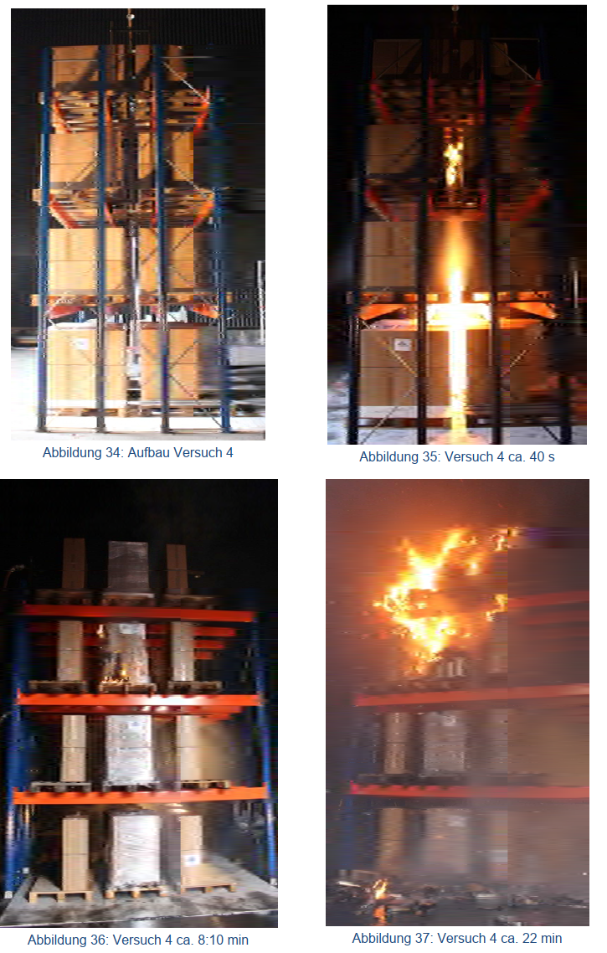
Active Fire Protection
Active fire protection includes detection and automatic extinguishing systems, the literature (M Ghiji, 2020) stating:
“To be effective the foam must fully encapsulate the cell which is a challenging task as LiBs [lithium ion batteries] are considered to have multi-stage jet fires, presenting high-velocity flammable gas venting”.
“Water is identified as an efficient cooling and suppressing agent and water mist is considered the most promising technique to extinguish LiB fires”.
VDS: Sprinkler concepts for warehouses with lithium ion batteries

Slide 13
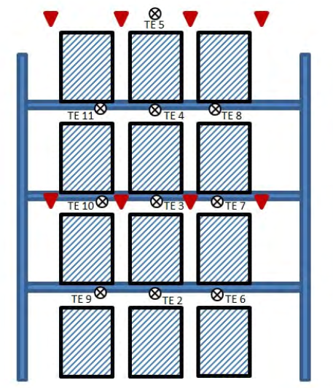
Research completed on Battery Fires
FM Global / NFPA in USA and VdS in Germany continue to research this area:
Batteries utilized are generally for bicycle size rather than vehicle size, so results are not directly applicable to larger batteries.
These results also depend on battery chemistry. Lithium iron phosphate batteries have lower energy density, but fire testing has demonstrated that autothermal ignition of a cell does not propagate to adjoining cells and the battery as a whole ➔ such battery chemistry is inherently safe.
However, conventional lithium ion batteries burn with intense flame and heat, in conjunction with jet fires as pressure within battery is relieved.
Hence the recommendation for an individual design for battery warehouses in each particular case, as to date there is insufficient design information available for standard designs to code.
Although, in principle lithium ion batteries should be installed at low level in racked warehouses.
Warehouse containing Li batteries with sprinkler heads (red) and thermal measurement.

Slide 14
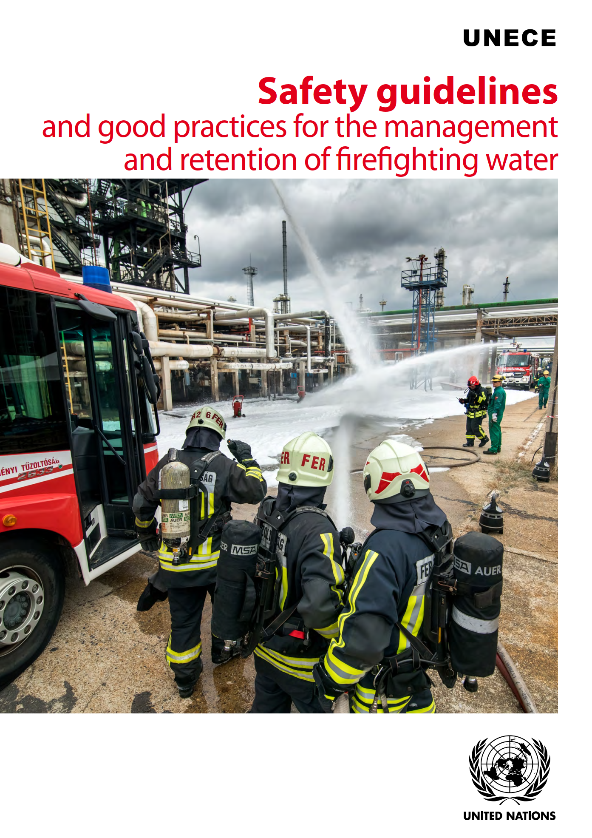
Environmental Protection
Fire fighting has potential to lead to copious quantities of contaminated firewater.
Oxides of heavy metals, etc., from the combustion of batteries and the large volumes of extinguishing water required for a battery warehouses result in a necessity to consider firewater retention.
VdS 3103en Lithium Batteries:
  Test carried out by insurers, manufacturers and fire services showed that rapid and targeted firefighting with water can contribute to controls the effects of the fires under the participation of lithium ion batteries.
  If efficient fighting of an initial fire succeeds in the first few minutes, there is a great chance to get control of the fire.
For example, by utilizing UNECE guidelines on firewater retention

Slide 15
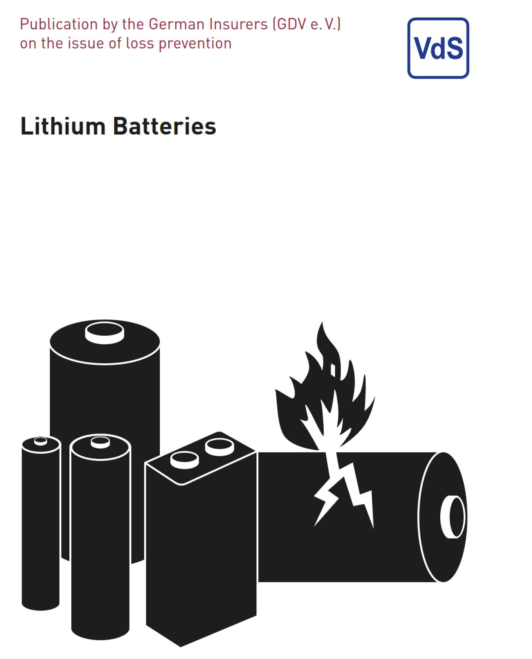
Conclusion
The intense fire from combustion of lithium ion batteries requires particular passive and active fire protection.
As VdS 3103en Lithium Batteries concludes:
  As there is a multitude of different battery types and there is rapid development in this field, it is impossible for the time being to make general statements regarding appropriate concepts.
  There are reasons why an effective protection concept always requires the analysis of the particular case and an agreement with the insurer.

Slide 16

Questions?

