Slide 1
Evaluating electrolyzer hazards in production of green hydrogen and ammonia
Murtaza Gandhi, BakerRisk

Slide 2
Overview
Introduction to electrolyzers
Hazard assessment and it’s importance
Green hydrogen and ammonia processes
Description of key hazards
Conclusion

Slide 3
Introduction to Electrolyzers

Slide 4
Introduction to electrolyzers
Electrolyzers are key to produce green hydrogen and ammonia
Produces “on demand” energy generation
Supports non-deterministic power source
Three key types of electrolyzers:
  Polymer Electrolyte Membrane (PEM)
  Alkaline Electrolyzer (AEL)
  Solid Oxide
  This presentation focuses on PEM and AEL technologies

Slide 5
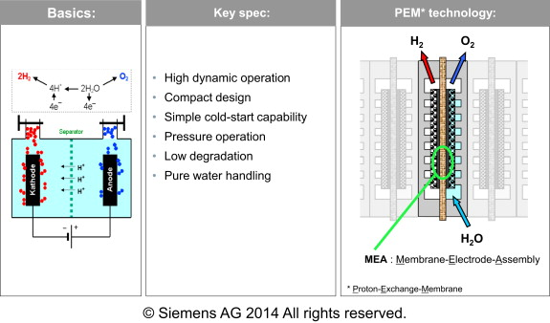
Polymer Electrolyte Membrane (PEM)
Membrane separates reaction compartments for hydrogen and oxygen
Membrane also provides ionic contact between the electrodes
Production of gas takes place at the surface of electrodes

Slide 6
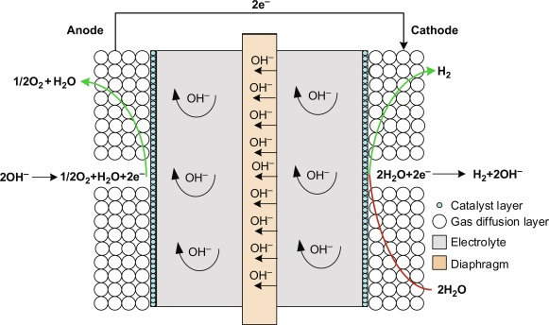
Alkaline Electrolyzer
Contains caustic water solution and 25%-30% of KOH, NaOH and NaCl
Liquid electrolyte allows ions to be transported between electrodes
Ions are not consumed in the chemical reaction
Needs periodic replenishment of electrolyte solution

Slide 7
Electrolyzer technology comparison
PEM Advantages
Ability to operate at high current densities
PEM Disadvantages
High manufacturing cost due to expensive materials and components
Sensitive to imperfections and dust infiltration
Ability to operate with dynamic energy sources like wind and solar
Ability to operate at high pressures with low ohmic losses
High gas purity allows usage in fuel cell applications
AEL Advantages
Mature technology
AEL Disadvantages
Inability to effectively support dynamic energy sources like wind and solar
High corrosive effects of the electrolytes at high temperatures
Longer lifetime (tens of thousands of hours of operation)
Ability to operate at current densities of 100-400 mA/cm²

Slide 8
Hazard Assessment and it’s importance

Slide 9
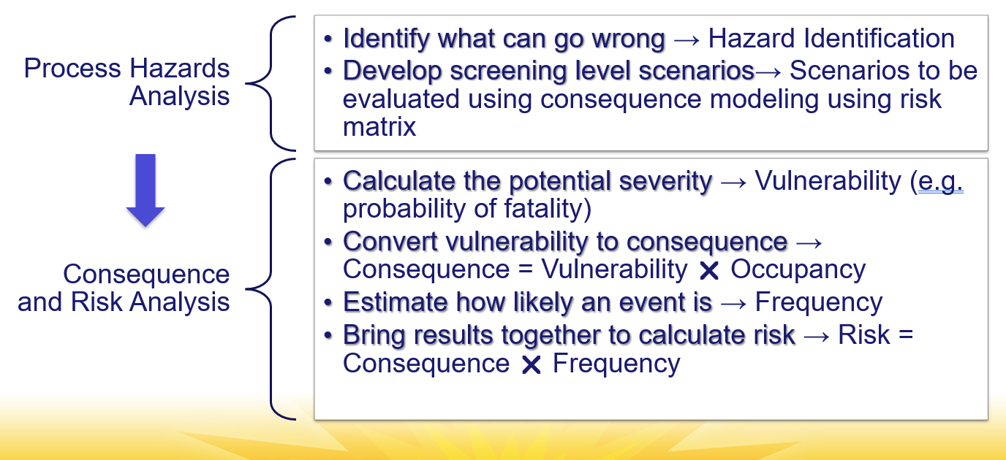
Importance of hazard assessment
Key safety concerns with hydrogen and ammonia
  Previous industry incidents related to these sources have the global community looking at it more closely
Growth of the new energy economy
  Increased production pressure
  Increased pressure to bring new technologies to market sooner
  Increased pressure to reduce costs of such technologies

Slide 10
Green Hydrogen and Ammonia processes

Slide 11
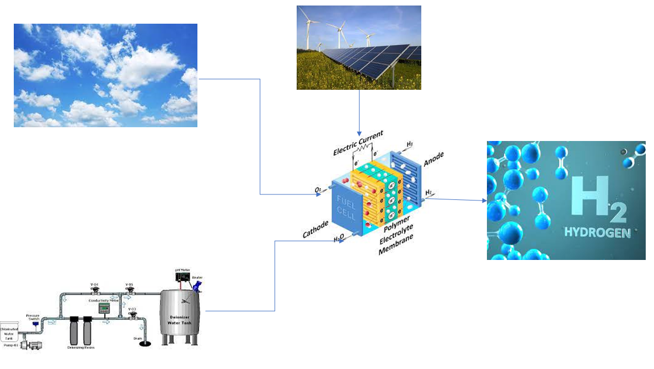
Green Hydrogen fuel cell process
Green hydrogen being used in various modes of transportation
Designs ongoing to use in large vehicle applications
Needs engine manufacturers to build and retrofit test facilities from diesel, gasoline and other engines
Hydrogen being added to confined spaces
Transition from fire hazards to explosion hazards

Slide 12
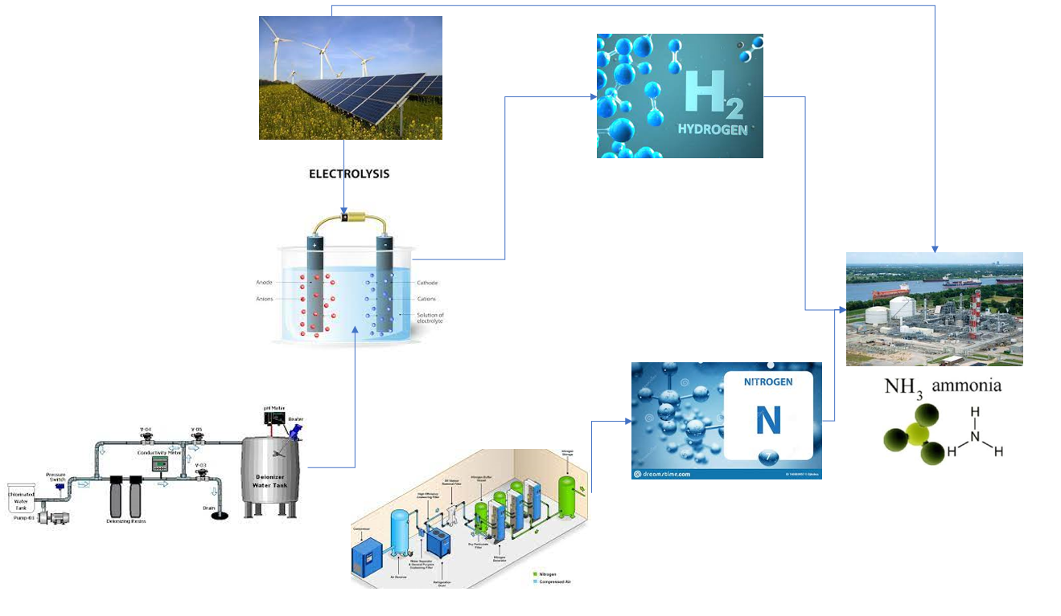
Green Ammonia process
Ammonia touted as a fuel of choice by International Maritime Organization (IMO)
Strategy focuses on reduction of CO2 emissions consistent with Paris climate accord
Fertilizer manufacturers shifting focus to energy production
Hydrogen was used as input before, now is being generated onsite

Slide 13
Description of key hazards

Slide 14
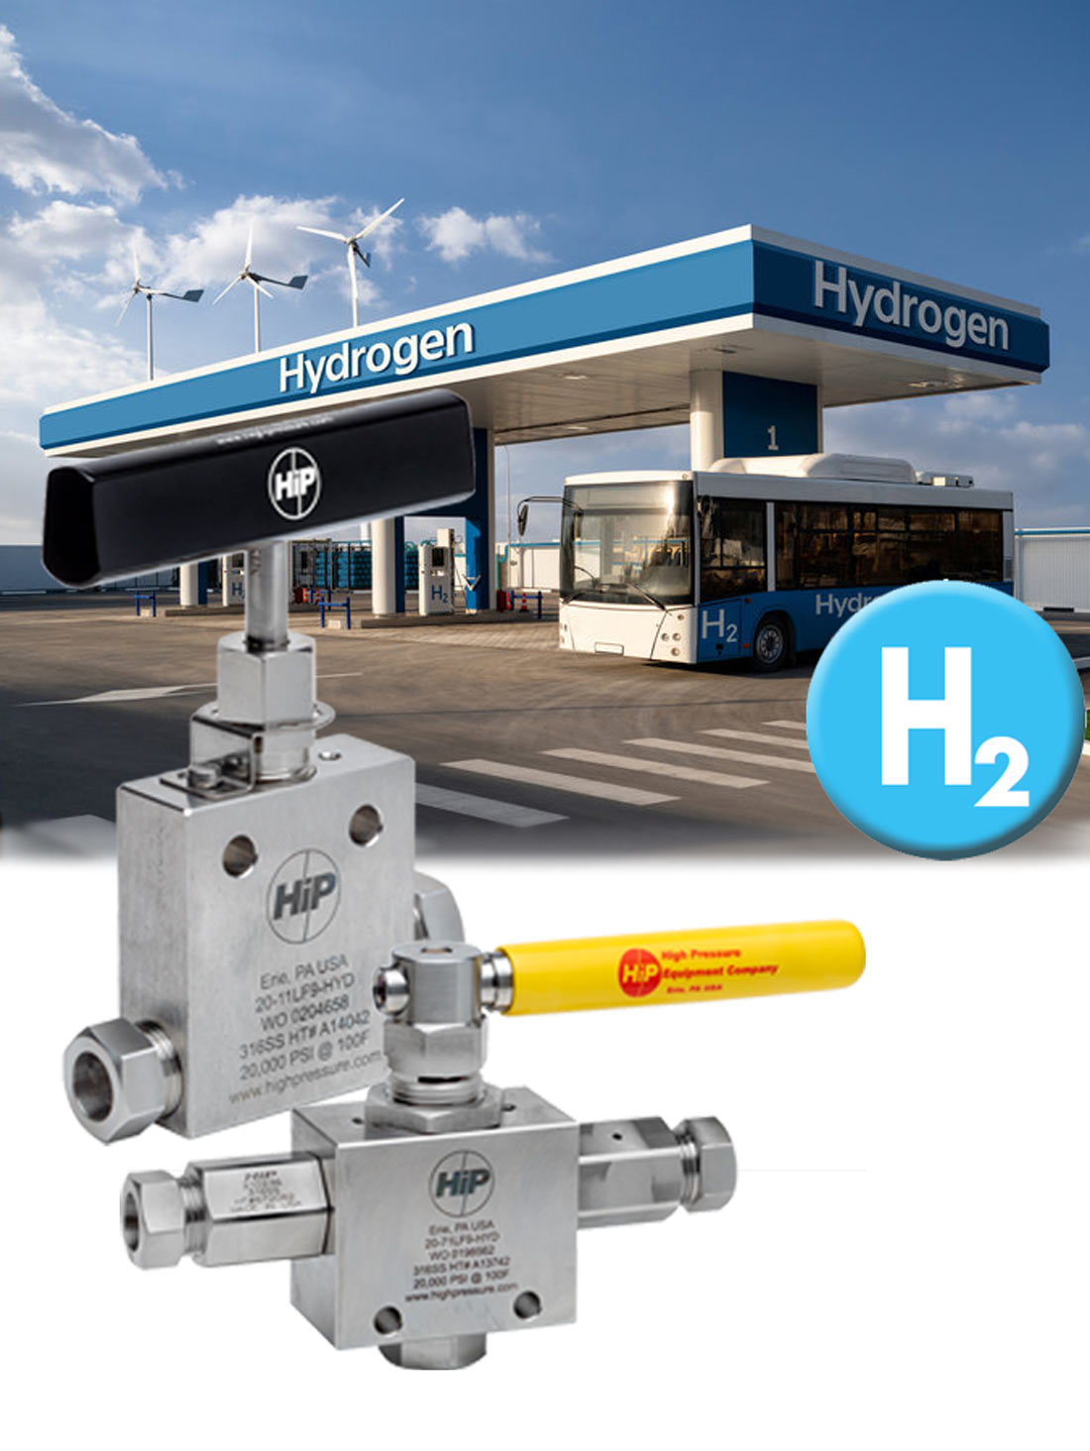
Key hazards – 1 of 7
High hydrogen pressure
  Cause: blocked outlet or vent
  Consequence:
    Fuel cell application
      Congested space
      Possibility of stoichiometric volume forming quickly
      Significant deflagration or deflagration to detonation transition (DDT)
    Ammonia production
      Significant number of electrolyzers required creating large volume
      Consequence depends on the location of failure
  Mitigation
    Gas detection with increased HVAC flow
    Relief valves vented to safe location
    Vented deflagration panels
Courtesy: HiP

Slide 15
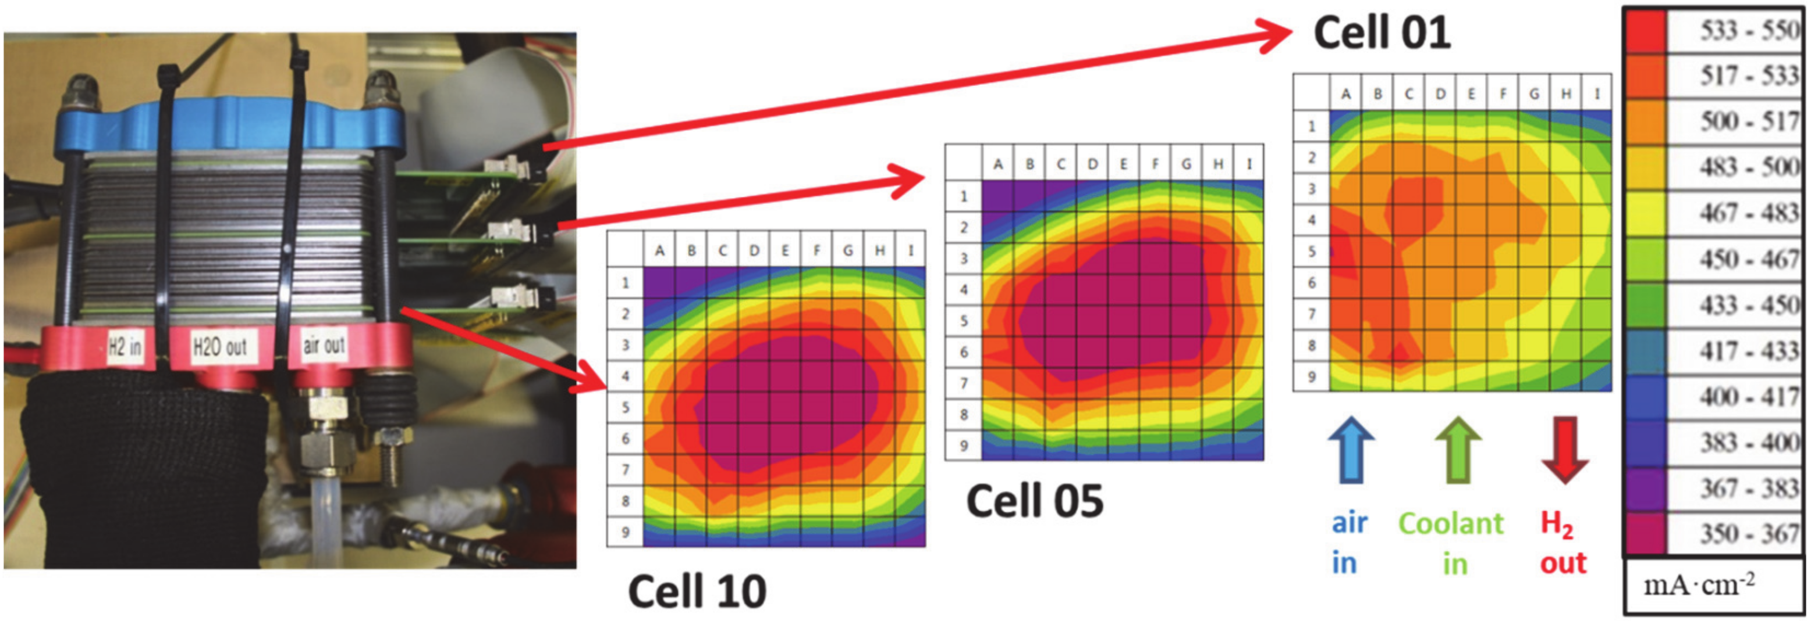
Key hazards – 2 of 7
Overheating of the cell stack
  Cause: Loss of DI water or chilled water supply
  Consequence:
    Fuel cell application
      DI water is a key raw material and chilled water provides cooling
      Overheating of the cell stack with piping failure and release of hydrogen
  Mitigation
    Gas detection with increased HVAC flow
    Temperature monitoring at the cell stack
    Flame monitoring with shutdown
Courtesy:
“Advancement of Segmented Cell Technology in Low Temperature Hydrogen Technologies” by Biswas et al, Energies 2020

Slide 16
Key hazards – 3 of 7
High oxygen pressure
  Cause: Pressure control failure or blocked flow
  Consequence:
    Fuel cell application
      Possibility of higher pressure oxygen releases (around 200 psig (14 barg))
      Increased flammability inside the room
      If there is a hydrogen leak, can cause a fire/explosion very quickly
  Mitigation
    Oxygen gas detection with shutdown

Slide 17
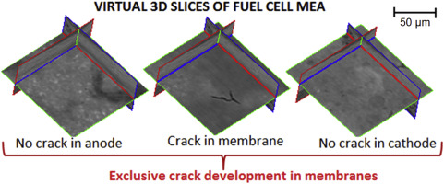
Key hazards – 4 of 7
Mixing of hydrogen and oxygen
  Cause: Membrane failure or diffusion
  Consequence:
    PEM electrolyzer
      Hydrogen going to oxygen side with possibility to ignite and explode
      Likelihood of diffusion is high with not a significant consequence
      Likelihood of membrane failure is low, consequence can be catastrophic
  Mitigation
    dP measurement across the membranes
    Gas analyzer measurement with shutdown of electrolyzer
Courtesy:
“3D visualization of membrane failures in fuel cells” by Singh et al, Journal of Power Sources, 2017

Slide 18
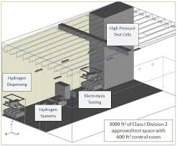
Key hazards – 5 of 7
Overpressure of hydrogen vent lines
  Cause: Water carryover to the vent
  Consequence:
    Both applications:
      Overpressure in the hydrogen lines when needing to vent
      Possible failure and release of hydrogen inside the room, consequence similar to the #1
  Mitigation
    NFPA and CGA as well as other design guidelines for the vent
    Operations and maintenance ensuring water is drained regularly
Courtesy:
“High Pressure Hydrogen Pressure Relief Devices : Accelerated Life Testing and Application Best Practices” by Burgess et al, NREL

Slide 19
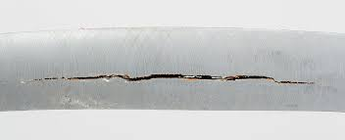
Key hazards – 6 of 7
Piping failure
  Cause: Hydrogen embrittlement
  Consequence:
    Both applications
      Sudden catastrophic failure of piping
      Possible release of hydrogen in the room with explosion
  Mitigation
    Appropriate design considering hydrogen embrittlement
    Regular mechanical integrity checks
    Temperature monitoring at locations where temperature drops are possible
Courtesy: Wikipedia

Slide 20
Key hazards – 7 of 7
Higher diffusion between hydrogen and oxygen side
  Cause: Loss of cooling to anolyte/catholyte cooler or high cell voltage
  Consequence:
    AEL electrolyzer
      Increased temperature and hence increased voltage at the cell stack
      Damage to the cell, possible release of hydrogen to the building or area
      Consequence mostly applies to large scale applications like green ammonia manufacturing
  Mitigation
    Adequate monitoring of the cooling water supply

Slide 21
Conclusion

Slide 22
Key takeaways
Important to recognize the hazards with the new energy field (electrolyzers)
Important to consider the layouts of the electrolyzer with adequate emphasis on locations of leak, gas detection and HVAC flow
Mitigations will be different depending on the type and scale of the hazard, risk based approach is very helpful
Use the hydrogen and ammonia industry’s experience to make the new technologies safer and reliable

Slide 23
Thanks
Murtaza Gandhi
MGandhi@BakerRisk.com
+1-281-822-3100

