Slide 1

Cryogenic Storage of Anhydrous Ammonia
Adrian Wright, M.I.ChemE, C.Eng. TGE Gas Engineering

Slide 2
Agenda
Introduction to TGE
Business Case for Green Ammonia as a Fuel and Energy Vector
Challenges of Ammonia Storage & Handling
Ammonia Storage Tank Process Safety Design Improvements
Ammonia Storage Terminal Design
Process Safety Considerations
Conclusions
Notes:
This talk will cover the following topics:
I will give a brief introduction to TGE and what it does
I’ll outline the Business Case for Green Ammonia as a Fuel and Energy Vector
I’ll pinpoint the main Challenges of bulk Ammonia Storage & Handling
We will look at Design Improvements in Ammonia Storage Tank s over the last 100 years
I’ll point out the features of a typical Design for an Ammonia Storage Terminal
And I’ll discuss two Process Safety Considerations

Slide 3
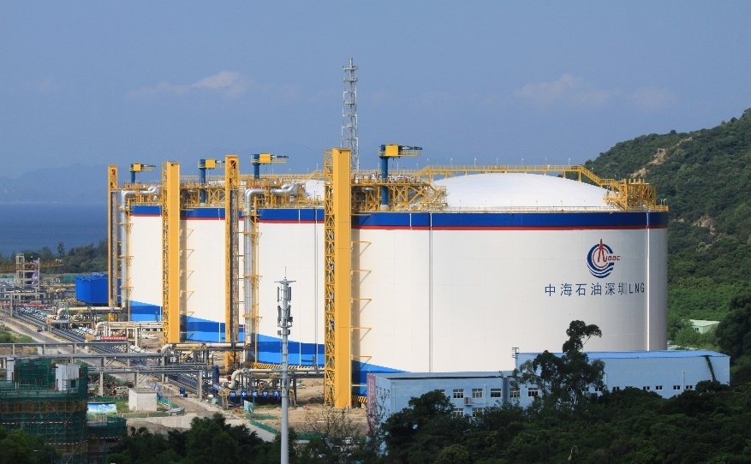
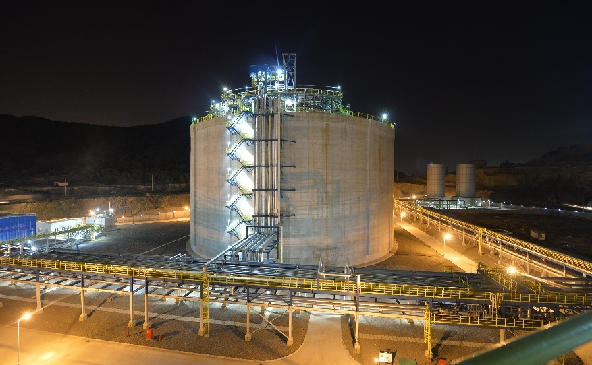
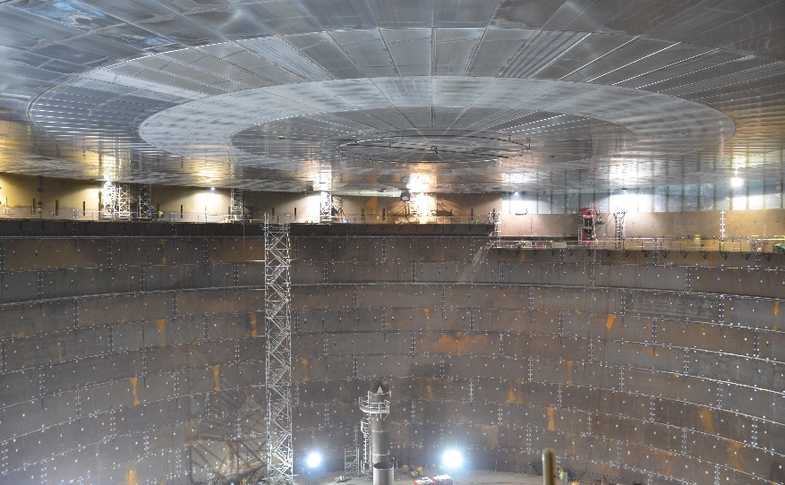
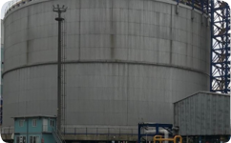
TGE – New EPC Plants
Terminals Storage & Distribution for Cryogenic Liquified Gases
Cryogenic Liquified Gases Design Experts
Plant Conversion & Optimisation
Process Safety Assurance
Cryogenic storage for import, export, buffer or distribution
Import / export terminals
Liquefaction plants
Tank sizes up to 250,000 m³
All relevant infrastructure like ship, truck, container loading / unloading
Plant design solutions with a high level of standardization
Fast-track & cost-effective delivery
Suitable for remote locations
Product change services
Activities to increase capacity
Debottlenecking
In-tank pump modernization
Creation of new revenue streams
All facilities are designed to International Standards
HAZOP, LOPA assurance
ATEX electrical equipment
Active and Passive Fire Protection
Emission minimisation
Notes:
TGE Gas Engineering’s cryogenic storage facilities ensure the highest level of process efficiency, energy integration and safety.
We work with our customers to find the optimal solution for their specific needs – and have created storage solutions for many liquefied gases, including Ammonia, LNG, LPG, Ethane, and Ethylene,. Although this talk focusses on ammonia, a lot of the information on storage tank design also applies to other cryogenic liquids.

Slide 4
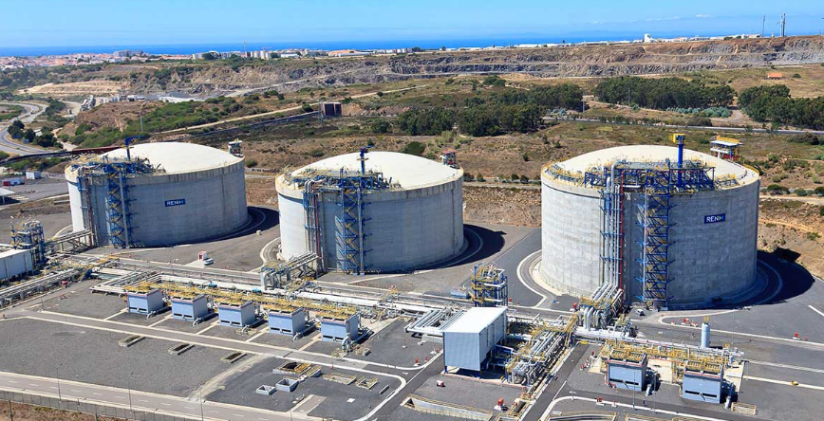
TGE in Numbers
7,000,000
189
Storage Capacity Built (m³)
Tanks Installed
1,200 – 180,000
1,200 – 250,000
Tanks Built (m³)
Tanks Designed (m³)
>40
>350
Years Expertise
Engineers & Specialists Worldwide
22
All
Countries Working Expertise
Relevant Design Codes
Notes:
In the last 40 years TGE Gas Engineering have built more than 189 liquefied gas storage tanks with a combined capacity of over 7 million cubic metres.
Tank sizes range from 1200 m3 to half a million m3.
TGE is headquartered in Bonn, Germany and has over 350 employees,, with working experience in 22 countries.
TGE has a Process and Process Safety design office in Manchester, which is where I am based.

Slide 5

Our Customers
Notes:
These are some of the many customers that TGE has installed tanks for over the last 40 years.

Slide 6
Business Case for Green Ammonia as a Fuel and Energy Vector
Notes:
Lets look at the Business Case for Green Ammonia as a Fuel and Energy Vector

Slide 7
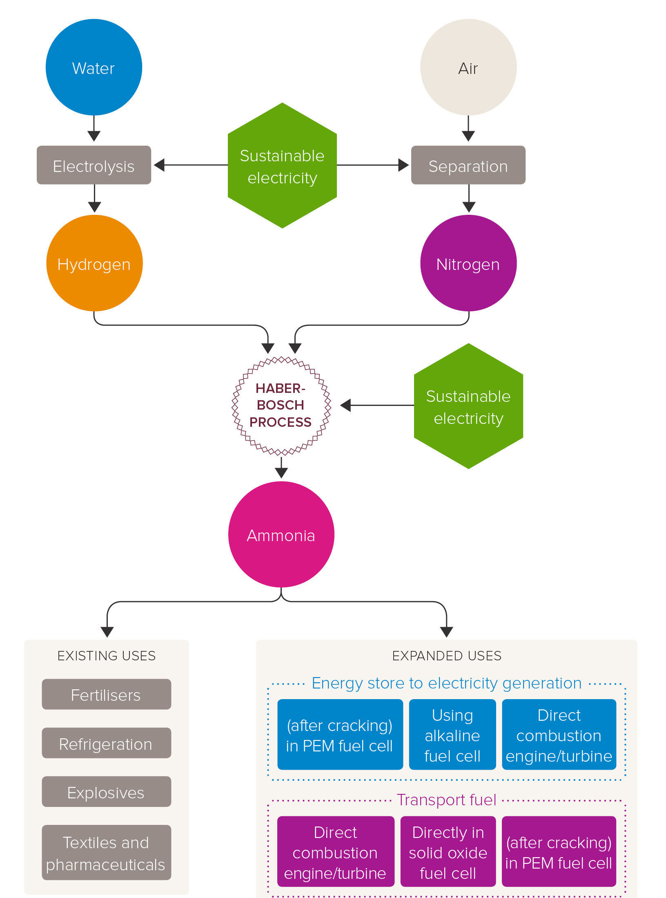
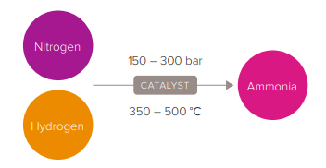
“Brown Ammonia” – Current Status
The Haber-Bosch Process
  N₂ + 3H₂ → 2NH₃ (catalyst, high temp, high pressure)
Hydro-
carbon
CO₂
Reform
Nonrenewable
energy
Hydrogen
Nonrenewable
energy
Ammonia
Hydrogen produced from Steam reforming of hydrocarbons
CH₄ + 2H₂O → 3H₂ + CO (800 ºC, catalyst, highly endothermic)
Water-gas shift reaction
CO + H₂O → H₂ + CO₂ (slightly exothermic)
MTPA = million tonnes per annum
Statistics and image from “Ammonia: zero-carbon fertiliser, fuel and energy store”, The Royal Society, 2020
Notes:
Current commercial ammonia production is predominately based around the Haber-Bosch process.
This reaction involves the catalytic reaction of hydrogen and nitrogen at high pressures, between 150 and 300 bar and high temperature, between 350 and 500 Celsius, over an iron catalyst .
Most of the energy consumption and around 90% of the carbon emissions in ammonia production come from the production of hydrogen.
The hydrogen has traditionally been produced from steam–methane reforming.
The nitrogen is obtained from compressed air or from an air separation unit.
An alternative to steam reforming is the electrolysis of water, to separate hydrogen and oxygen. Unfortunately, this is very energy-intensive.
1 kg of hydrogen (which has a specific energy of 143 MJ/kg) requires (180–200 MJ) of electricity

Slide 8
How Green is my Ammonia?
Ammonia colour same as hydrogen colour:
  Brown ( or grey) ammonia (natural gas steam reforming), CO₂ release to atm
  Blue ammonia (natural gas steam reforming), CO₂ captured & stored (CCS)
  Green ammonia (water electrolysis renewable electricity), no CO₂ emission
In numbers:
  Global production 176 MTPA (mostly brown), was increasing by around 3 MTPA each year
  Over 80% of ammonia production is currently utilized in agricultural fertilizers
  Brown ammonia production consumes 1.8% of all global energy output,
  Brown ammonia production emits 500 MTPA CO₂ (This is 1.8% of all global CO₂ emissions)
  1.6 tonnes CO2 are produced per tonne of ammonia
  90% of these CO₂ emissions are from the production of hydrogen from fossil fuels.
Notes:
Brown ammonia production, where fossil fuels are used to produce the hydrogen, is very energy intensive, consuming 8 MWh of energy per tonne of ammonia
The Haber-Bosch Steam reforming of natural gas is 65–75% efficient and produces 1.6 tonnes CO2 per tonne of ammonia. If other fossil fuels are used, the CO2 figure increases substantially.
Global production of ammonia is around 176 MTPA This is mostly brown, and was increasing by 3 MTPA each year, but many ammonia plants are now being shut down as uneconomic due to high energy costs..
Over 80% of this production currently utilized in agricultural fertilizers
Brown ammonia production consumes 1.8% global energy output, and emits 500 MTPA CO2, which is 1.8% of all global CO2 emissions)
If carbon capture technology and storage is used, then up to 90% of the CO2 could be captured.
This can now claim to be “blue”. Ammonia.
However, carbon capture requires using more methane upstream, which reduces the overall efficiency to around 60-85%.
The developing alternative is to produce Green ammonia.

Slide 9
Green Ammonia – Outlook
Renewable
electricity
Hydrogen from water, zero carbon emissions
Expanded use as a decarbonized fuel and energy carrier
  Electrical storage “round-trip efficiency” up to 39% in fuel cells
  Ammonia-based ship propulsion engines close to market
  Major shipping companies planning ammonia fuel transition
  Potential for ammonia to be used in aeroplane fuel cells
Green ammonia production and cracking facilities in development across the globe, backed by authorities
Significant increase in ammonia storage, import and export terminals is planned
Hydrogen
Hydrogen
Renewable
electricity
Ammonia
Statistics and image from “Ammonia: zero-carbon fertiliser, fuel and energy store”, The Royal Society, 2020
Notes:
Green ammonia is made from electrolysis of water, so there is no CO2 bi-product.
However, only locations with an abundance of cheap renewable energy make electrolysis currently viable.
work is ongoing to reduce the energy demand in the Haber-Bosch process by reducing the temperature and pressure.
Ammonia can be used as a medium to store and transport chemical energy, with the energy being released either directly or by the full or partial decomposition of ammonia to release hydrogen.
The hydrogen or ammonia-hydrogen mixture is then reacted with oxygen in the air to release energy.
Ammonia can be used as a transport fuel either by direct combustion in an engine or by chemical reaction with oxygen in a fuel cell.
Today, the maritime industry accounts for 3-4% of the global human-caused CO2 emissions, which can be greatly reduced if ammonia is used as a long distance propulsion fuel.
There is also development work on storing anhydrous ammonia in aeroplane wings, which would feed a fuel cell which would create hydrogen to power the aircraft,
All this has resulted in a significant interest in bulk storage of anhydrous ammonia, particularly at ports or airports.

Slide 10
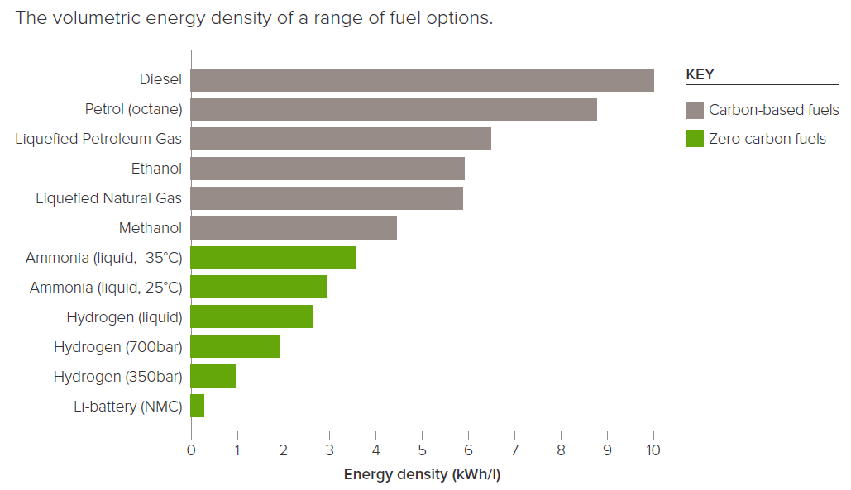
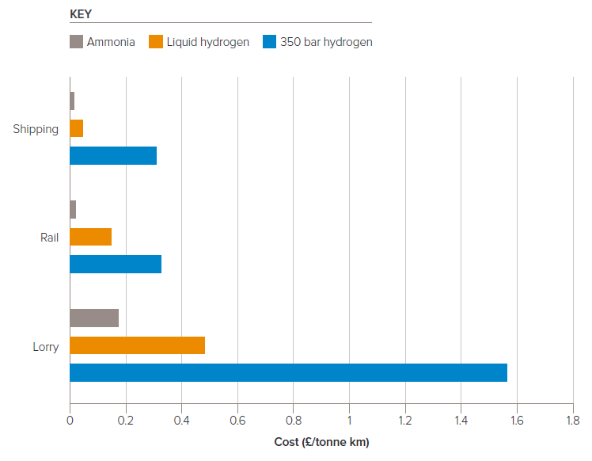
Ammonia Suitability as a Fuel / Hydrogen Carrier
Respectable energy density vs carbon-based alternatives
Considerably cheaper transport costs vs hydrogen
Volumetric energy density of various fuels
Transport cost of hydrogen and ammonia by lorry, rail and ship
Graphs from “Ammonia: zero-carbon fertiliser, fuel and energy store”, The Royal Society, 2020
Notes:
The energy density of liquified ammonia compares well with carbon based fuels.
Its liquid density is around 3 kWh/litre, which is less than but comparable with fossil fuels.
The relative ease of storing liquid ammonia in either compressed or refrigerated form, particularly compared with hydrogen, makes ammonia a much more competitive option for storing zero-carbon energy and transporting it by pipeline, road, rail or ship.

Slide 11
Challenges of Ammonia Storage & Handling
Notes:
So what are the main challenges of Ammonia Storage & Handling?

Slide 12
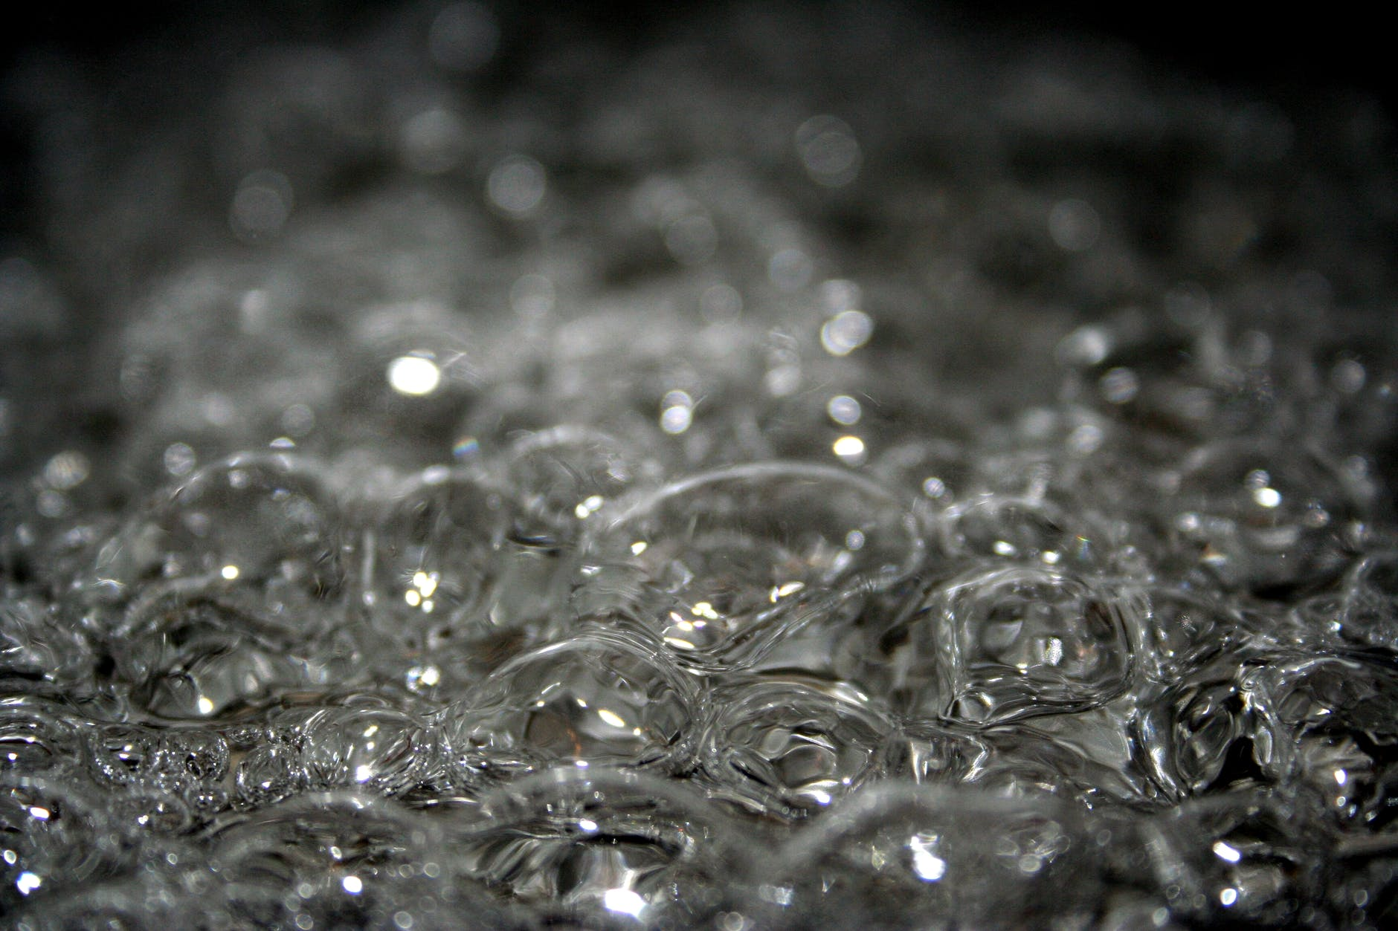

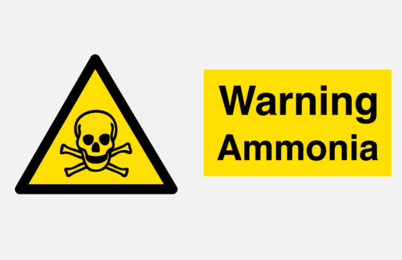


Challenges of Ammonia Storage & Handling
Physical Properties
Flammability
Toxicity
Stress Corrosion Cracking
Electrical Conductivity
Atmospheric boiling point -33°C
Vapour pressure 9 barg (25°C)
Liquid density 682 kg/m³
High latent heat of vaporisation (1369 KJ/kg)
Flammable, but combustion is unsustainable
High flammability concentration (16 – 25 mol%)
High minimum ignition energy (680 mJ)
High autoignition temp (610°C)
Low flame temp (1800°C)
Vapour reacts with moisture in skin, eyes and lungs causing caustic burns
  Pungent odour 5 ppm
  STEL (15 mins) = 35 ppm
  IDLH = 300 ppm
Liquid miscible with water, increasing pH and becoming toxic to aquatic life
A progressive fracturing of metals in stressed and corrosive environment
Effect is less prominent in refrigerated low pressure systems
Slowed by increasing water content (>1000 ppm) and use of lower strength steels
Worsened by increasing O₂ content (target <100 ppm)
High electrical conductivity due to the addition of water to avoid SCC
This prevented the use of in-tank pumps until early 2000s
STEL (Short Term Exposure Limit): Airborne concentration acceptable for 15 minutes without incurring health, safety or work-efficacy risks
IDLH (Immediately Dangerous to Life or Health): Airbourne concentration likely to cause death, permanent adverse health effects or prevent escape from such an environment
Notes:
Physical Properties of Anhydrous ammonia .
Anhydrous ammonia has an atmospheric boiling point of -33°C
Its vapour pressure at 25°C is 9 barg
Anhydrous ammonia gas is lighter than air, with a specific gravity of 0.6 but it is hygroscopic and reacts with water vapour to form Ammonium Hydroxide, which is heavier than air and corrosive
Liquid density of Anhydrous ammonia is 682 kg/m³
It has a high latent heat of vaporisation (1369 KJ/kg) which is more than double that of hydrogen (461 KJ/kg) and methane (511 KJ/kg) )
Flammability of Anhydrous ammonia
Anhydrous ammonia is flammable, but combustion is unsustainable due to its high flammability and very high minimum ignition energy (680mJ) compared to Methane, ethane and propane, (0.2-0.3 mJ) and hydrogen gas which requires just (0.02 mJ.)
Anhydrous ammonia also has a high autoignition temp (610°C) and reasonably Low flame temp (1800°C) which is marginally lower than methane and hydrogen. (methane 1,957 °C, hydrogen 2045°C)
Anhydrous ammonia has a far lower flame speed of 10cm/s so a deflagration of confined gas will occur, rather than a detonation.
Toxicity of Anhydrous ammonia
Ammonia is toxic to humans and the environment.
When anhydrous ammonia gas or liquid comes in contact with the human body three types of injuries may result:
Dehydration, as the result of ammonia's great attraction for water. Anhydrous ammonia will extract water from body tissue.
Caustic burning due to the strong base formed when ammonia combines with water from body tissue.
Freezing. As liquid ammonia vaporizes it pulls heat away from body tissue causing frostbite in an instant ammonia irritates and burns the skin, eyes, and If inhaled, respiratory tract
Fortunately, you can detect a Pungent odour 5 ppm.
The short term exposure limit, over 15 minutes is 35 ppm
The NIOSH IDLH is 300 ppm. This is the concentration where a worker can escape from a given contaminated environment in the event of failure of their respiratory protection.
Anhydrous ammonia is miscible with water, increasing pH and becoming toxic to aquatic life.
Stress Corrosion Cracking
SCC is a progressive fracturing of metals in stressed and corrosive environment.
The effect is less prominent in refrigerated low pressure systems using lower strength steels
SCC is slowed by increasing water content to over1000 ppm, but worsened by increasing the O₂ content.
During start-up the tank should be purged so that the oxygen content is much lower than 100 ppm.
SCC has been a known degradation method for ammonia storage since 1950s.
Following the development of inspection technologies in 1970s, the industry has shifted to low pressure refrigerated storage with Post Welded Heat Treatment (PWHT) and a Risk Based Inspection (RBI) approach.
Pure anhydrous ammonia is non-conductive but the requirement for addition of water to avoid SCC the electrical conductivity of stored ammonia is high.
This electrical conductivity of stored anhydrous ammonia prevented the use of in-tank pumps until early 2000s. I’ll talk more about this later on.

Slide 13
Ammonia Storage Tank Process Safety Design Improvements
Notes:
We are now going to look at the timeline of Process Safety Design Improvements made in Ammonia bulk storage

Slide 14
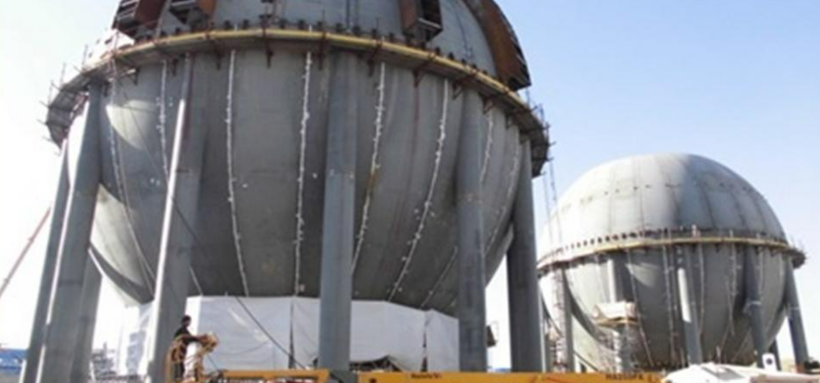
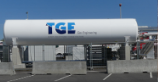
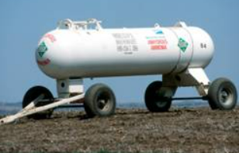
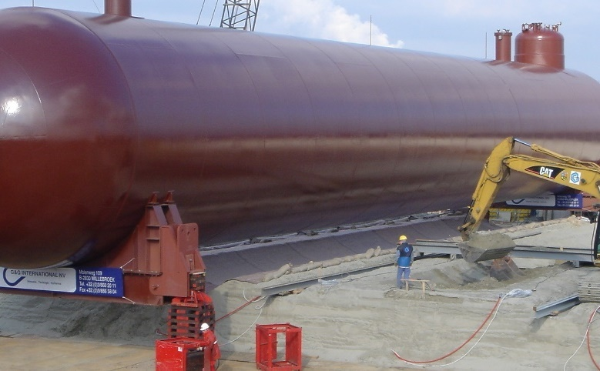
Development of Ammonia Storage Tank Designs
Pre - 1970s
Single containment Pressure Vessels
Ammonia is stored at atmospheric pressure in Pressurised vessels (spheres or bullets)
Bottom penetration surrounded by low bund wall
Failure of vessel leads to total loss of inventory, with huge flashing vapour cloud released to atmosphere
Capacity limitations (spheres 2,000 Te) and expensive to build.
Bullets still used as intermediate vessels for road tanker filling.
Images from TGE Archive
Notes:
Before the 1970s, ammonia was only stored at atmospheric pressure in pressurised vessels (spheres or bullets)
These had bottom penetrations and had to be surrounded by a low bund wall as failure of vessel or bottom outlet would lead to total loss of the tank inventory, with a huge flashing vapour cloud released to atmosphere
There were also capacity limitations ( for instance, sphere volumes rarely exceed 2,000 Te) and the pressure vessels were quite expensive to build.
As we have discussed earlier, Pressurised storage is also more susceptible to SCC.
However, pressure vessels, often covered with earth, can be used as intermediate storage vessels for pressurized road tanker loading or unloading.
Much smaller pressure vessels are also used for point of use pressurized ammonia storage, particularly in the farming industry.

Slide 15
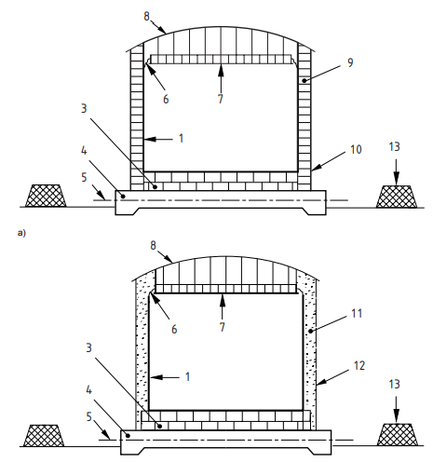

Development of Ammonia Storage Tank Designs
1970s
Single Containment Refrigerated Tanks
Refrigerated tanks were developed so that ammonia could be stored closer to atmospheric pressure at -33ºC
Bottom penetration surrounded by low bund wall
Tank base heated to avoid frost heave
Failure of vessel leads to total loss of inventory, with vapour cloud released to atmosphere
Images from EN 14620-1:2006
Notes:
In the 1970s, Refrigerated tanks were developed so that ammonia could be stored closer to atmospheric pressure at -33ºC
These still had Bottom penetrations, so needed to be surrounded by low bund wall as Failure of vessel could lead to total loss of inventory, with a large pool of evaporating ammonia releasing a toxic vapour cloud atmosphere
Although externally insulated to prevent heat ingress the tank required base heating in order to avoid frost heave in the ground below the tank

Slide 16
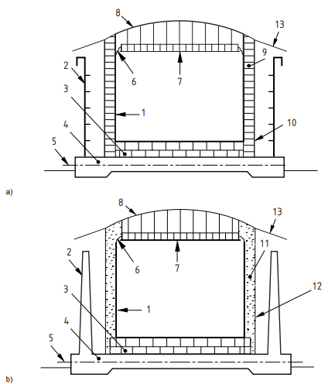
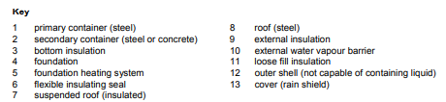
Development of Ammonia Storage Tank Designs
1980s
Double containment Refrigerated Tanks
Refrigerated tanks with bottom penetration and concrete outer bund wall
Outer tank does not contain vapour. Failure of inner tank will release a vapour cloud to atmosphere
Inner tank has a suspended roof, which is insulated to reduce heat ingress into the inner tank
External insulation on the outer shell and roof
Images from EN 14620-1:2006
Notes:
Double containment Refrigerated Tanks came into use in the 1980s
The concrete outer tank acts as a bund to retain the ammonia if the inner tank leaked.
However the outer tank is not designed to contain vapour, so failure of inner tank will still release a vapour cloud to atmosphere, but the cloud is smaller and not at ground level, so may be able to disperse safely.
Another innovation is that the Inner tank is designed with a suspended roof, which is insulated to reduce heat ingress into the inner tank
The tank base still requires heating to avoid frost heave and there is external insulation on the inner tank’s outer shell and roof.

Slide 17
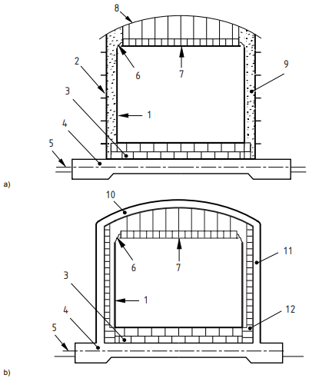
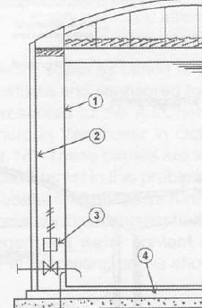
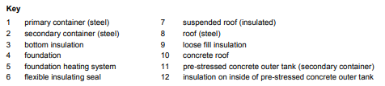
Development of Ammonia Storage Tank Designs
1990s
Full containment Refrigerated Tank
Refrigerated tanks with vapour-tight outer tank
Bottom penetration, but often with actuated valves between tanks or welded to tank outlet flange for isolation
Failure of inner tank entirely contained
Images from EN 14620-1:2006
Notes:
During the 1990s Full containment Refrigerated Tank were introduced with vapour-tight outer tanks.
Failure of inner tank now entirely contained.
The tank still has Bottom penetration, but often with actuated ESD valve located between tanks or welded to tank outlet flange for isolation
The inner tank is either insulated on its outside or the annulus is filled with loose fill insulation such as perlite
Once again the inner tank’s base is insulated and its base slab is heated to avoid frost heave

Slide 18
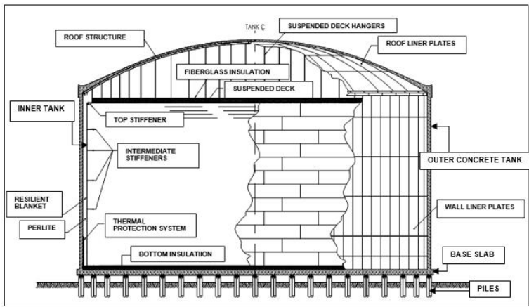
Development of Ammonia Storage Tank Designs
2000s
Full Containment Storage Tank (Roof Penetrations Only).
Consist of a Primary and Secondary Container, together forming an integrated tank
Example Steel/Steel FC Tank
suspended deck with mineral wool insulation
Example Steel/Concrete FC Tank
outer steel tank + PUF insulation + cladding (weather protection)
inner tank wall
bottom insulation
(cellular glass)
vapor containment
insulation
foundation with heating system*
* or elevated foundation,
depending on soil conditions
2nd bottom insulation layer
foundation ring for inner tank
Images from TGE Archive
Notes:
The inherently safer Full Containment Storage Tank became possible earlier this century due to the development of in-tank pumps for ammonia use to overcome the high conductivity of ammonia.
In-Tank pumps allow the only penetrations in the tank to be in the roof, minimizing the potential for large loss of containment.
Any leak downstream of the pump can be detected, and an ESD will stop the pumps.
Another design improvement, if the soil is suitable, is to place the tank on concrete piles to create an air gap in order to prevent ground heave due to freezing of the ground below the tank. ,
This removes the operational expense of base heating.
Full Containment Storage consists of a Primary and Secondary Container, together forming an integrated tank
The Steel Primary Container, can be either open at top, so not vapour tight, or with a roof that contains vapours
A Steel or concrete Secondary Container then surrounds the primary container and its roof contains ammonia vapours. Failure of inner tank is thus entirely contained.
While a steel/steel tank is easier to construct and inspect, and has a smaller footprint, a concrete/steel tank is often preferred as the concrete shell has better insulation and is more resistant to external fire and blasts.

Slide 19
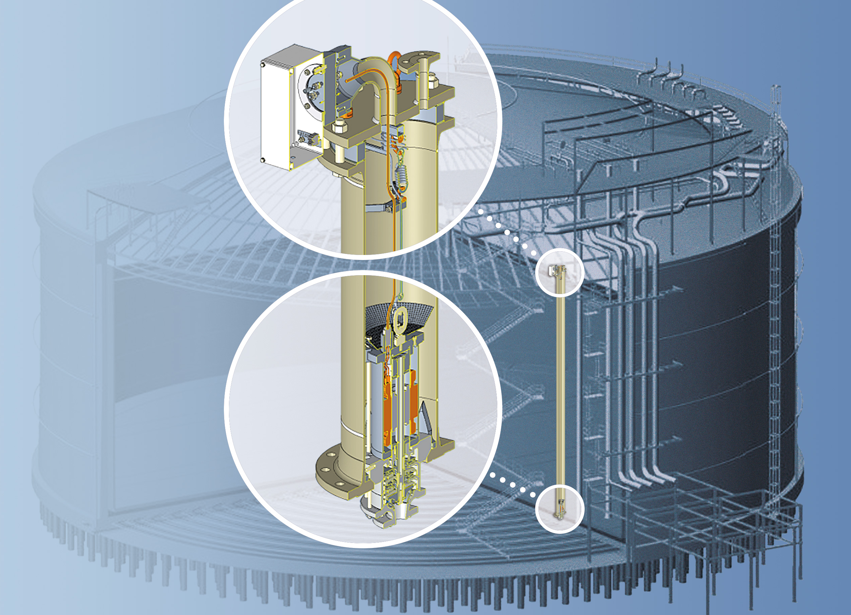
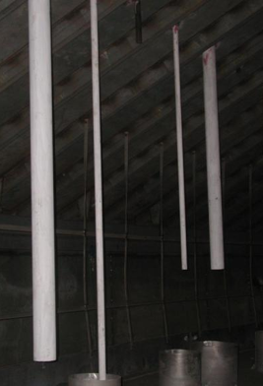
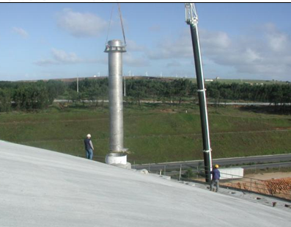
Full Containment Storage Tank (Roof Penetrations)
Use of in-tank pump installed in pump column eliminates bottom penetration
Pumps are contained inside columns inside the tank and cooled by the liquid in the tank
Foot valve creates a vapour seal allowing pumps to be extracted (by crane or hoist) or maintained without having to remove the contents of the tank
In-Tank Pump
Images from TGE archive
Notes:
Some more about the In-Tank Pump:
The export pump is installed inside a storage tank in a vertical pump column with a foot valve located at the bottom of the column which can be closed and sealed to allow the pump to be extracted after purging the column with nitrogen.
The column acts as a guide to seat the pump during installation and also performs as the discharge pipe from the pump to the top of the tank.
Each pump is fitted with an axial flow impeller located at the lowest possible level of the tank to maximise the net capacity of the tank

Slide 20
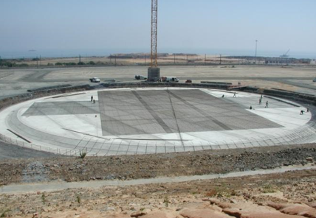
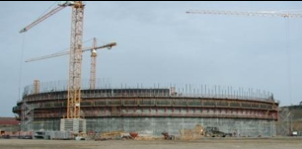
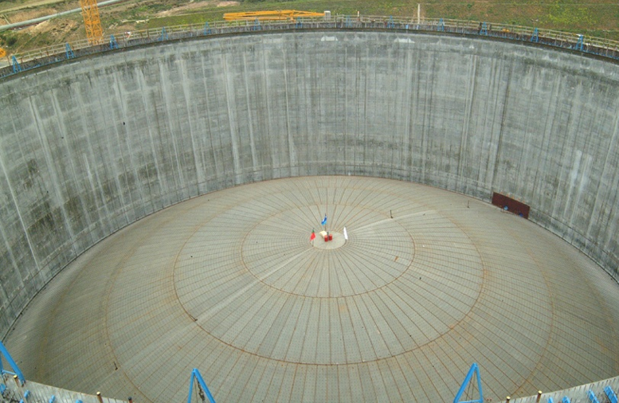
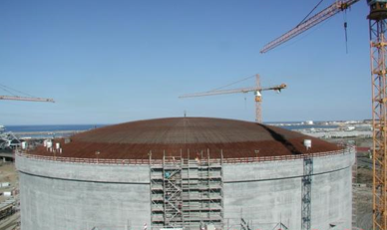
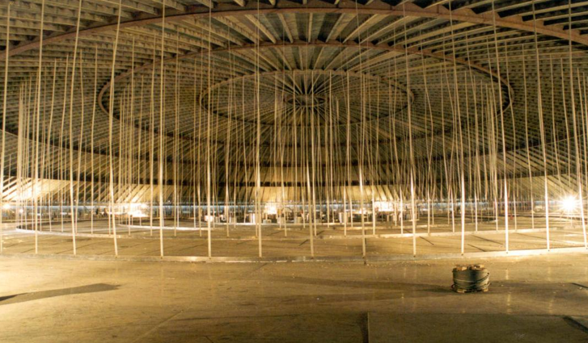
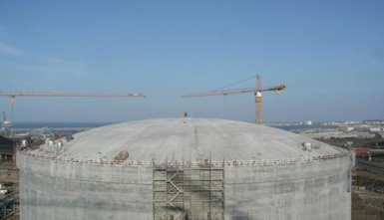
Construction of a Cryogenic Storage Tank
Concrete foundations
Construction of the outer wall
Preparing to air lift the roof
Roof now in place
Suspended deck
Concrete covers the raised roof
Images from TGE Archive
Notes:
Construction of a cryogenic storage tank is a major project that requires a lot of labour, materials and logistical coordination.
Greatly simplifying a long and complicated process:
The ground has first to be prepared and levelled before the concrete base can be cast.
Tank walls are constructed from the ground up over a period of weeks, which requires a huge amount of re-enforcement formwork, and raising the crane heights as the tank wall heights increase.
Often the roof is constructed inside the tank and raised to its required height by pressirising the inside of the tank with compressed air.
Once the roof is welded in place a suspended deck is created for the inner tank.
In the case of a concrete tank, the final concrete is poured onto the roof and then the roof penetrations are created..

Slide 21
Ammonia Storage Terminal Design

Slide 22
Typical Ammonia Storage Terminal
Emergency Disposal System (Flare)
BOG Compressor
Boil-off Gas (BOG)
BOG Condenser
Condensate
Receiver
Chilling Return Line
Refrigerated Ammonia
(100 mbarg, -31.5C)
Ship Import / Export
Downstream Plant
Truck Loading
Full Containment Tank
In-Tank Pump
Sendout Heater
Notes:
A modern ammonia terminal is likely to contain the following features:
Ships unload at jetties, via unloading arms into a full containment storage tank using their on-board pumps.
Pressure in the tank is controlled by boil-off gas compressors, which condense vapour and send it back to the tank.
In-tank pumps send the ammonia to downstream plans or trucks via a sendout heater.
The process can also be reversed so that the send-out pumps can load ships.
In either direction, the transfer line between the ship and the tank has to be cooled down before transfer to avoid flashing of liquid in the unloading line or tank.

Slide 23
Process Safety Considerations

Slide 24
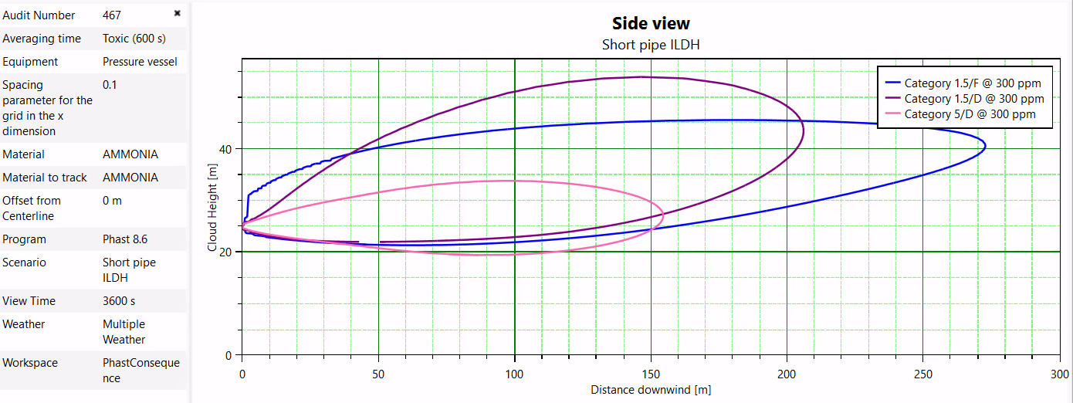
Modelling Ammonia Releases - The Theory
Predicted release from a PSV on an anhydrous ammonia tank from 25 m height – IDLH 300 ppm contour:
PHAST 8.6 model of ammonia release from 25m height
Notes:
This is a model of a typical tank top release from an ammonia tank relief valve. The PSV discharges 25m above grade. The model, for three weather conditions shows he 300 ppm ILDH contour which shows dispersion well above ground level. Obviously contours from lower concentrations will spread further downstream and closer to the ground, so we can conclude that although this may be uncomfortable to people working at grade, it is not life threatening. And people should be able to escape.

Slide 25
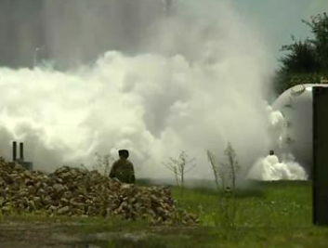
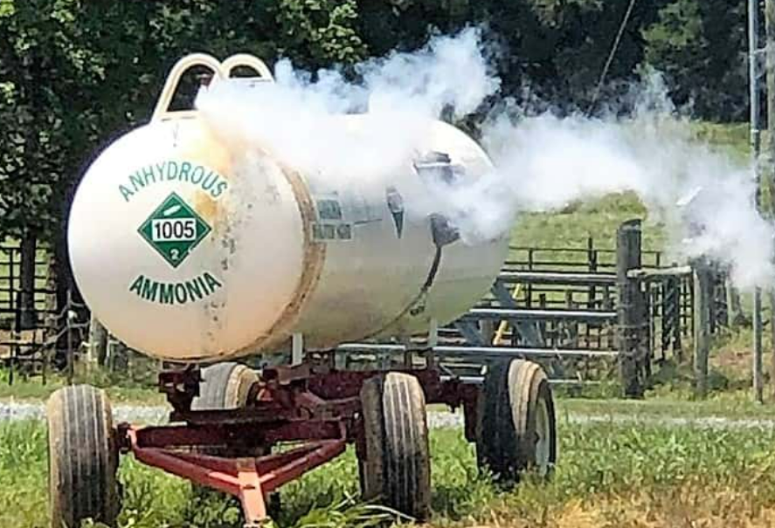
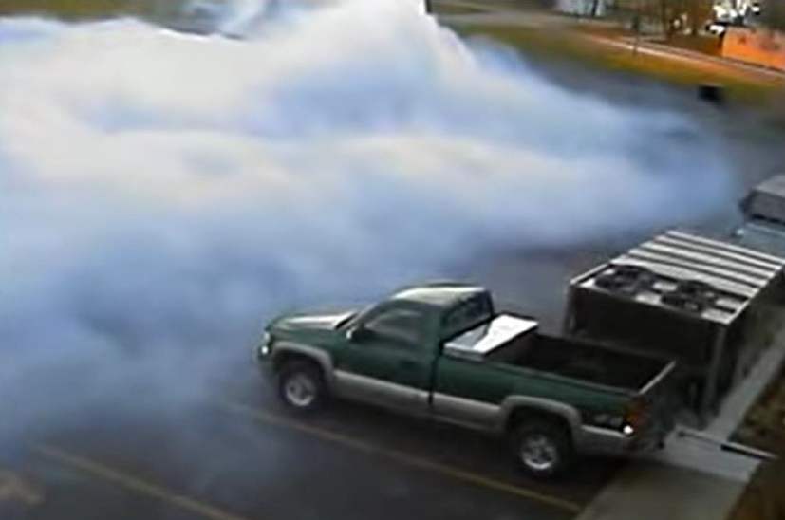
Modelling Ammonia Releases - Reality
Anhydrous ammonia is hygroscopic and will react with moisture in the air.
Ammonium hydroxide vapour clouds can travel along the ground for significant distances
An ammonium hydroxide vapour cloud is heavier than air
Images from internet
Notes:
However, please be aware that modelling of this complex scenario where anhydrous ammonia is released and then reacts with water before and during dispersion is not possible using commercially available software such as PHAST and FRED
As I mentioned earlier, this means that a white ammonium hydroxide cloud forms, which is heavier than air and falls to the ground, where it can travel along the ground for significant distances.
I’m not saying that the modelling is incorrect but it may not give the complete picture.

Slide 26
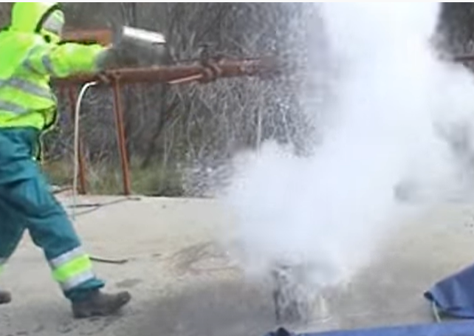
Emergency Response
Never direct water onto an ammonia spill as it reacts violently
Instead, focus on:
Preventing the vapour from reaching populated areas. Consider water curtains.
Protecting or evacuating personnel in populated areas.
Providing windsocks to aid evacuation
Providing SCBA for rescue teams
Training personnel in the use of escape breathing apparatus
Images from internet
Notes:
Finally, a word on Emergency Response.
Never direct water onto an ammonia spill as it reacts violently.
The only reason for a water deluge on an ammonia tank is to protect it from an external fire, but t is inherently safer to apply appropriate separation distances from potential sources of pool and jet fires.
Instead, the operator would be better to focus on:
Preventing the vapour from reaching populated areas. Consider water curtains to contain ammonia clouds.
Protecting or evacuating personnel in populated areas.
Providing windsocks to aid evacuation
Providing SCBA for rescue teams
Training personnel in the use of escape breathing apparatus

Slide 27
Conclusion

Slide 28
Design of Bulk Storage Ammonia Tanks
Due to global decarbonisation policies, demands for “green ammonia” to act as a feedstock for production of hydrogen for aviation fuel, or as a propulsion fuel for long distance shipping, will increase, leading to more cryogenic anhydrous ammonia bulk storage tanks at ports and airports.
Green ammonia usage as a medium to store and transport chemical energy is also expanding.
Although anhydrous ammonia has a serious toxicity hazard, anhydrous ammonia can be safely and economically cryogenically stored in bulk.
The best practice design is a full containment tank with roof-mounted in-tank pump(s) as this effectively eliminates the hazard of a large loss of containment.
Ground heave due to freezing can be eliminated by heating the base of the tank or by placing the tank on piles, creating an air gap.
Stress corrosion cracking can be avoided by storing the ammonia at low temperature and atmospheric pressure and by maintaining a water content of 0.1 to 0.2% in the anhydrous ammonia.
Oxygen should be removed by purging the storage tank with nitrogen before filling.
Care should be taken when modelling ammonia releases due to the hydroscopic nature of the vapour released.
Notes:
So to conclude:
Due to global decarbonisation policies, demands for “green ammonia” to act as a feedstock for production of hydrogen for aviation fuel, or as a propulsion fuel for long distance shipping, will increase, leading to more cryogenic anhydrous ammonia bulk storage tanks at ports and airports.
Green ammonia usage as a medium to store and transport chemical energy is also expanding.
Although anhydrous ammonia has a serious toxicity hazard, anhydrous ammonia can be safely and economically cryogenically stored in bulk.
The best practice design is a full containment tank with roof-mounted in-tank pump(s) as this effectively eliminates the hazard of a large loss of containment.
Ground heave due to freezing can be eliminated by heating the base of the tank or by placing the tank on piles, creating an air gap.
Stress corrosion cracking can be avoided by storing the ammonia at low temperature and atmospheric pressure and by maintaining a water content of 0.1 to 0.2% in the anhydrous ammonia.
Oxygen should be removed by purging the storage tank with nitrogen before filling.
Care should be taken when modelling ammonia releases due to the hydroscopic nature of the vapour released.

