Slide 1
MAJOR COMMON ISSUES ARISING FROM PROCESS SAFETY MANAGEMENT AUDITS
RDC PRIOR
SHEXELLENCE CC, SOUTH AFRICA
OCTOBER 2022
HAZARDS 32

Slide 2
OUTLINE OF PRESENTATION
INTRODUCTION
PSM AUDIT PROTOCOL
LEGISLATION IN SOUTH AFRICA
10 COMMON ISSUES IDENTIFIED IN RECENT PSM AUDITS
CONCLUSIONS

Slide 3
INTRODUCTION
HAVE CARRIED OUT PSM AUDITS FOR PAST 12 YEARS
AUDIT BASED ON THE PSM STRUCTURE AS OUTLINED IN THE ICHEME “FUNDAMENTALS OF PROCESS SAFETY “ COURSE
SOME 40 – 50 AUDITS COMPLETED
AUDIT OVER 2 DAYS
SYSTEM REVIEW (PAPERWORK) – 1 DAY
PHYSICAL REVIEW & INTERVIEWS – 1 DAY
REPORT INCLUDING RECOMMENDATIONS
WIDE VARIETY OF INDUSTRIES INCLUDING ORGANIC CHEMS, EXPLOSIVES, OIL & GAS, PLATINUM PROCESSES
TYPICAL AUDIT CHECKLIST FOLLOWS

Slide 4
SAMPLE PSM AUDIT SHEET

Slide 5
PSM AUDIT SCORESHEET BY ELEMENT
ELEMENT | MAXIMUM SCORE
PSM Strategy, plans, resources | 14
Inherent safety | 12
Process Safety and documentation | 17
Design procedures / capital projects | 20
PHA / Risk Assessment | 17
Emergency planning & response | 28
Management of Change | 17
Process and equipment integrity | 28
Permit to Work | 25
Human Factors and safety culture | 50
Training and performance | 17
Operating/maintenance procedures | 30
PSSR | 14
Contractors | 24
Incident investigation and learning | 22
Audits and corrective action | 14
Legal, standards and codes | 13
Performance measures | 15
Total | 377

Slide 6
LOCAL LEGISLATION AND OTHER INFLUENCES
SOUTH AFRICA HAS A FRAGMENTED SET OF LAWS IN THE PSM FIELD
THE OVERARCHING ACT IS THE OSHACT (1993) WHICH GOVERNS REGULATIONS IN FIELDS LIKE PRESSURE SYSTEMS, MAJOR HAZARD INSTALLATIONS AND EXPLOSIVES
MANY OTHER KEY ASPECTS OF PSM, LIKE ACCIDENT INVESTIGATION, PTW, RISK ASSESMENT ARE TUCKED AWAY IN OTHER LAWS
NO COMPREHENSIVE SET OF PSM REGULATIONS
MAJOR HAZARD REGULATIONS RECENTLY REVISED – TAKEN THE LEAD FROM THE UK COMAH REGULATIONS
NO LEGAL REQUIREMENT OR GUIDANCE FOR PSM AUDITING
FOLLOW GOOD PRACTICE FROM UK / USA
CHEMICAL ASSOCIATION (CAIA) HAS ITS OWN AUDIT PROTOCOL

Slide 7
COMMON ISSUES SEEN IN RECENT AUDITS
ABSENCE OF PROPER SIL RATED TRIP SYSTEMS AND UNCERTAINTY ABOUT THE STATUS OF EXISTING SYSTEMS
NO ROLE FOR INHERENT SAFETY PHILOSOPHY / PRACTICES
INADEQUATE TANK BUNDING
LACK OF AGREED RISK TOLERANCE CRITERIA FOR THE ENTITY
INCOMPLETE PRE-START UP SAFETY REVIEW (PSSR) PROCEDURES
NO INTERNAL PSM AUDITS
LACK OF PSM SYSTEM / STRATEGY
LACK OF LEADING PERFORMANCE INDICATORS
POOR STORAGE OF CHEMICALS AND INCOMPATIBILITY
LACK OF DEVELOPED ASSET STRATEGY / LACK OF SAFETY CRITICAL ELEMENTS (SCEs)

Slide 8
MAJOR COMMON ISSUES ARISING FROM PSM AUDITS
MY THIRD PARTY AUDITS HAVE REVEALED A NUMBER OF RECURRING ISSUES WHCH OCCUR IN MORE THAN ONE COMPANY
THE ISSUES ARE RANDOM IN NATURE BUT REFLECT THE “GAPS” IN PROCESS SAFETY MANGEMENT FOR PLANTS THAT ARE 30 – 60 YEARS OLD.
SOME ISSUES REFLECT LOCAL SITUATIONS BUT OTHERS MAY REFLECT SIMILAR ISSUES INTERNATIONALLY
IT IS HOPED THAT UNDERSTANDING OF THE ISSUES AND METHODS USED TO DEAL WITH THEM WILL BE OF VALUE TO MANY PEOPLE
10 ISSUES HAVE BEEN CHOSEN TO REFLECT THE SITUATION

Slide 9
ABSENCE OF PROPER RATED SIL TRIP SYSTEMS & EXISTING SYSTEM STATUS UNCERTAINTY
TRIP SYSTEMS INSTALLED 10-15 YEARS AGO
KNOWLEDGE OF LOPA/SIL POOR AT THIS TIME
AT BEST SYSTEMS WERE SIL 1
SUPPLIERS WERE EQUALLY UNINFORMED
RELIABILITY OF SYSTEM COULD ACTUALLY BE VERY POOR
TRIP TESTING OVER THIS PERIOD GAVE AN INDICATION OF RELIABILITY
TRIP TEST INTERVALS WERE SET LARGELY AS A MATTER OF CONVENIENCE
AS THE “TRIP” IS OFTEN THE LAST LINE OF DEFENCE AGAINST A MAJOR INCIDENT, MORE IN-DEPTH KNOWLEDGE AND CONTROL OF THESE SYSTEMS IS NEEDED

Slide 10
ABSENCE OF PROPER RATED SIL TRIP SYSTEMS & EXISTING SYSTEM STATUS UNCERTAINTY
SITE OWNERS CONCERNED ABOUT PLANT SAFETY AND THEIR PROTECTION
SITE OWNERS OFTEN DID NOT KNOW THE REQUIRED LEVEL OF RELIABILITY FOR THEIR WORST-CASE SCENARIOS
COULD BE FLAMMABLE/EXPLOSIVE/ TOXIC EVENTS WITH LARGE VOLUMES OF ORGANICS
IEC61611 LARGELY UNKNOWN
AS AN AUDIT FOLLOW-UP, LOPA / SIL STUDIES REQUESTED
SOME LOPA / SIL STUDIES CARRIED OUT BY MYSELF & PLANT TEAMS TO ESTABLISH REQUIRED PROTECTION LEVELS
RATHER LARGE RISK GAPS WERE DISCOVERED
SAMPLE WORKSHEET ILLUSTRATES THE PROCESS

Slide 11
LOPA/SIL WORKSHEET

Slide 12
LACK OF INHERENT SAFETY PHILOSOPHY / PRACTICES
AUDITS INCLUDED TESTING WHETHER THE CONCEPT OF INHERENT SAFETY WAS UNDERSTOOD AND WHETHER ANY APPLICATIONS WERE IN PLACE.
KNOWLEDGE OF THE TOPIC WAS SCANTY AND VIRTUALLY ALL PEOPLE WHO HAD KNOWLEDGE HAD GAINED IT FROM THE ICHEME “FUNDAMENTALS OF PROCESS SAFETY” COURSE
A FEW APPLICATIONS WERE FOUND BUT THESE WERE ALSO DRIVEN BY OTHER FACTORS SUCH AS ECONOMICS OR PERCEIVED HIGH RISK
THERE WAS NO EVIDENCE OF THE CONCEPT AND METHODOLOGIES ANYWHERE IN MODIFICATIONS

Slide 13
LACK OF INHERENT SAFETY PHILOSOPHY AND PRACTICES
SOME EXAMPLES SEEN ON AUDITS:
  A PESTICIDE COMPANY USING INHERENT SAFETY QUESTIONS EARLY IN ITS R&D PHASE
  AN EXPLOSIVES COMPANY REPLACING AMMONIA WITH SODA ASH
ONE MAJOR COMPANY HAD INHERENT SAFETY QUESTIONS EARLY IN ITS CAPITAL PROJECT PROCEDURE
SOME COMPANIES HAVE NO PROJECT PROCEDURE AT ALL
THERE ARE BOTH SYSTEMS ISSUES AND RESISTANCE TO CHANGE HERE
CONCEPT IS UNDERSTOOD INTERLECTUALLY BUT NOT APPLIED
PROJECT ENGINEERS HAVE ENGRAINED SYSTEMS OF WORKING
MANAGEMENT CHANGE TECHNIQUES NEED TO BE USED HERE
INHERENT SAFETY NEEDS TO BE FORMALISED IN PROCEDURES

Slide 14
INADEQUATE TANK BUNDING
SURPRISE FINDING ON NUMBER OF SITES (MAINLY 35-50 YEARS OLD)
AT THE TIME THERE WAS NO LEGAL REQUIREMENT FOR BUNDS
NOW THE SA LAW REQUIRES TANKS CONTAINING HYDROCARBONS TO BE BUNDED
NO BUNDS, BUNDS WITH PORTIONS MISSING, TOTALLY UNDERSIZED BUNDS WERE SEEN.
ONE TANK SEEN WITH ESD VALVES & PIPING WELL BELOW THE LEVEL OF A POSSIBLE ACID TANK OVERFLOW

Slide 15
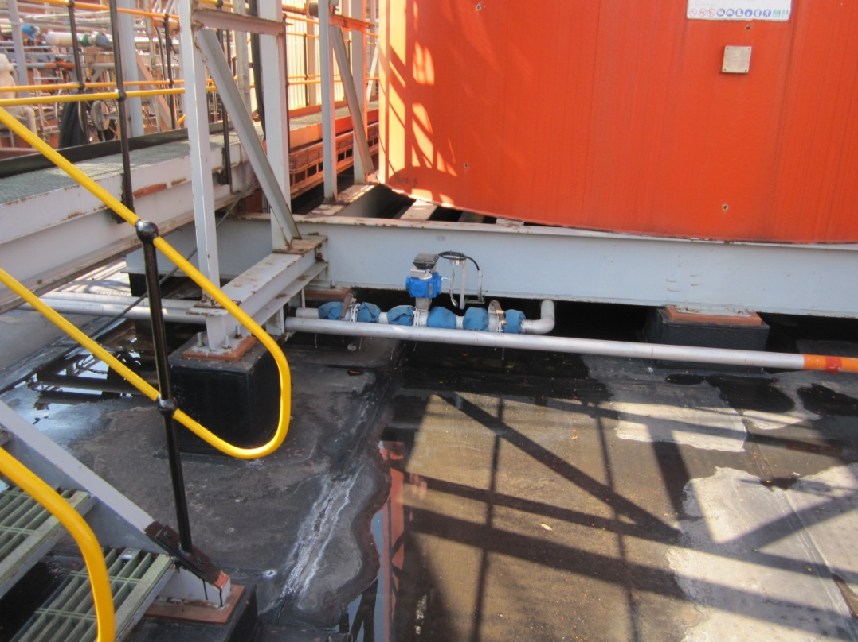
CRITICAL EQUIPMENT LOCATED BELOW THE BUND WALL LEVEL

Slide 16
INADEQUATE TANK BUNDING
NO SYSTEMATIC HAZARD STUDIES DONE ON THE CONSEQUENCES OF NOT HAVING APPROPRIATE BUNDS
RISK OF TANKS OVERFLOWING IGNORED OR UNDERESTIMATED. NO APPRECIATION OF BUNCEFIELD AND TEXAS CITY
MANAGEMENT SEEM RELAXED WITH THE LACK OF BUNDING
MORE MODERN AND SOPHISTICATED COMPANIES HAVE PUT IN SOPHISTICATED TRIP SYSTEMS TO COPE WITH OVERFILLING
MOST COMPANIES ARE AWARE OF THE GLOBAL STANDARD OF 110%
IN SOME OLD SITES THERE IS NO SPACE TO RETROFIT BUND WALLS
THERE SEEMS RESISTANCE FROM SOME MANAGERS TO SPEND MONEY IN THIS AREA.

Slide 17
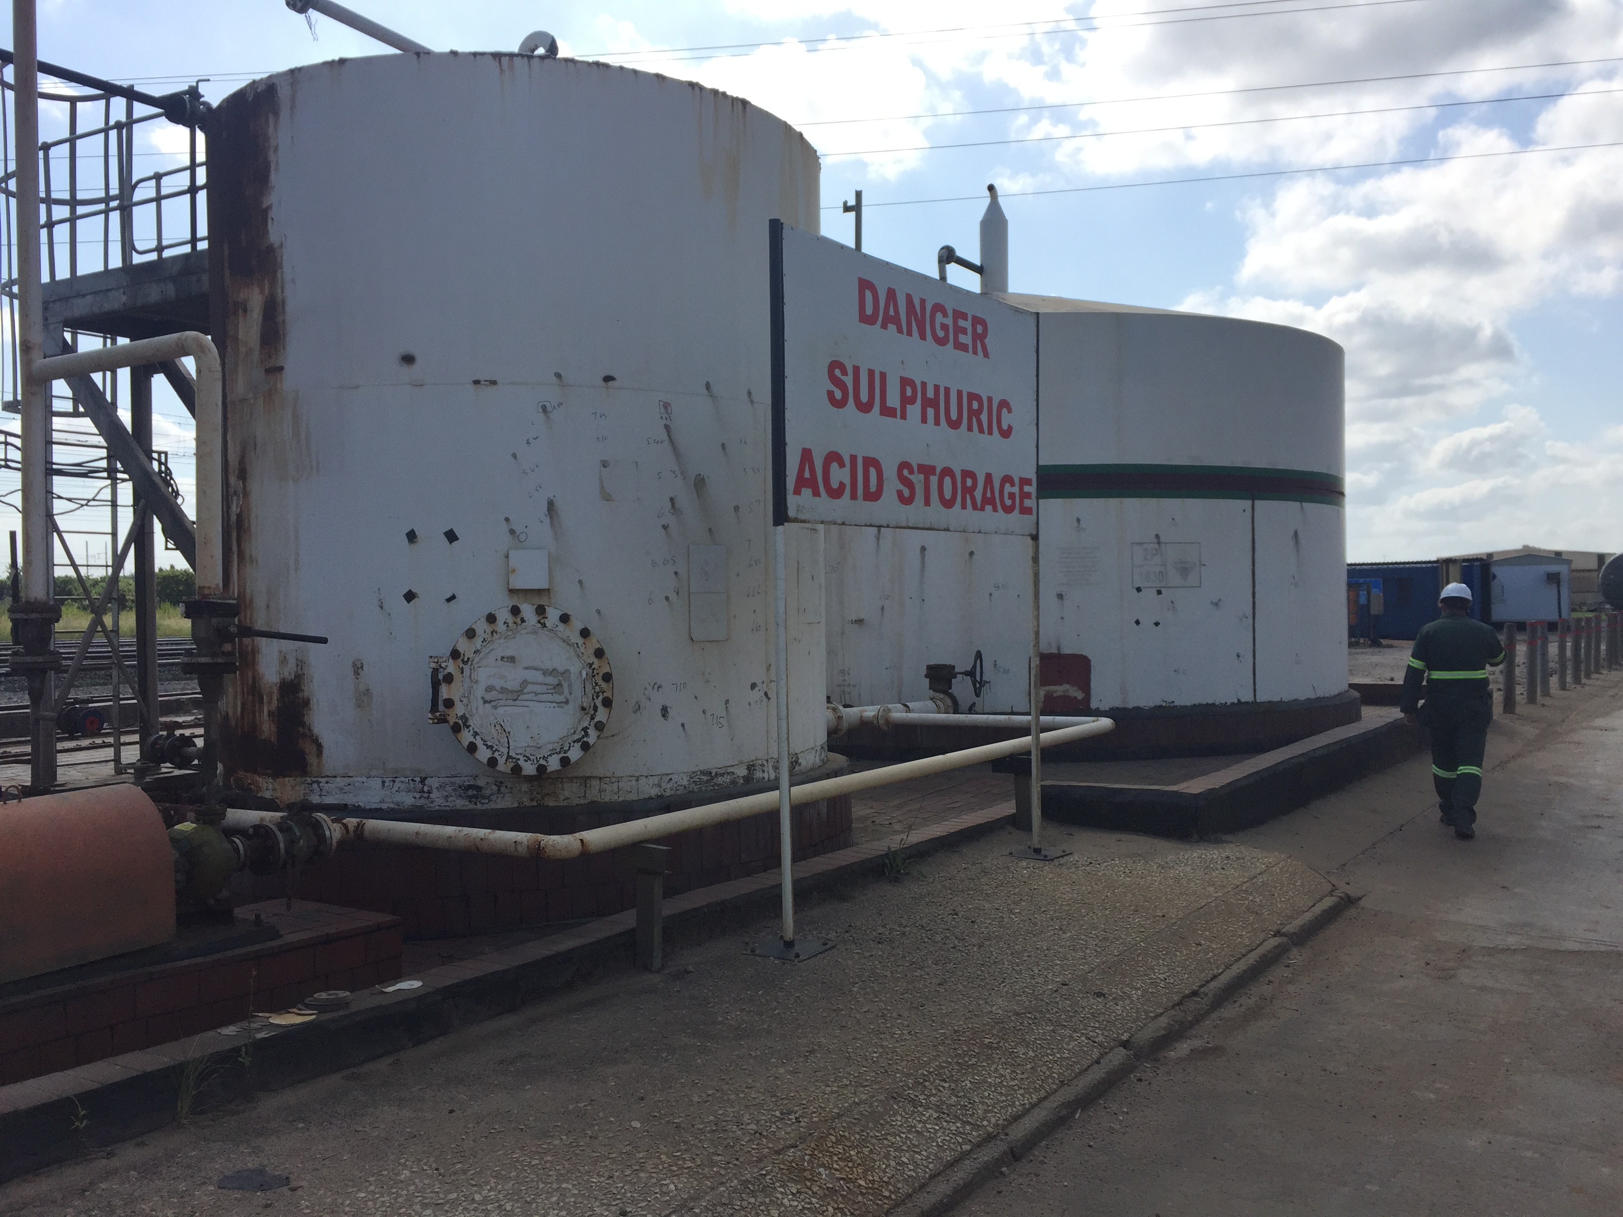
LACK OF BUNDING FOR TANKS

Slide 18
LACK OF AGREED RISK TOLERANCE CRITERIA
REQUIRED FOR A VARIETY OF RISK RELATED DECISIONS
MOST IMPORTANT NEED IS AS A KEY COMPONENT IN LOPA METHODOLOGY AS THE STANDARD FOR INJURIES, ENVIRONMENTAL DAMAGE AND FINANCIAL LOSS RISK EVALUATIONS
SHOULD BE THE ULTIMATE REFERENCE FOR RISK ASSESSMENT
LINKED TO COMPANY RISK MATRIXES
VERY FEW SMALL / MEDIUM SIZED COMPANIES HAD CRITERIA
LARGE INTERNATIONAL COMPANIES HAD RISK TOLERANCE CRITERIA
MOST COMPANIES HAD RISK MATRIXES BUT OFTEN NO IDEA OF THEIR ORIGIN. MANY ANOMALIES SEEN IN THE MATRIXES.
MATRIXES, ON THEIR OWN, CAN GIVE AN IDEA OF TOLERABLE RISK

Slide 19
LACK OF AGREED RISK TOLERANCE CRITERIA
WITHOUT RISK TOLERANCE FIGURES FEW RISK CALCULATIONS DONE
RELUCTANCE FOR SENIOR MANAGEMENT TO DISCUSS THE FIGURES
CONCERN IS ABOUT THE FATALITIES TOLERANCE WHICH MAY APPEAR, SUPERFICIALLY, TO CONTRADICT “ZERO HARM” CAMPAIGNS
ALSO SHOWS THE VALUE OF A HUMAN LIFE
SOUTH AFRICA GENERALLY USES THE UK FIGURES. SA AUTHORITIES HAVE BEEN ACCEPTING THEM FOR YEARS. The AIAs WHO DO THE QRAs FOR COMPANIES ALL USE THESE FIGURES
NOT IN SA LEGISLATION
MAY HAVE TO BE TESTED IN COURT IN THE FUTURE

Slide 20
INCOMPLETE PSSR PROCEDURES
FEW COMPANIES AUDITED HAD COMPLETE PSSR PROCEDURES
ONE EXPLOSIVES PLANT APPLIED PSSR TO ALL NEW EQUIPMENT AND MODIFICATIONS. ALSO ALL PLANT THAT HAD BEEN STANDING FOR A WHILE – CANNIBALISATION OF PARTS!
SOME PSSR QUESTIONS IN START-UP PROCEDURES
FOLLOWING PSSR QUESTIONS COULD BE ADDED
  HAS EQUIPMENT / PLANT BEEN CONSTRUCTED TO SPECIFICATION
  ALL TYPES OF PROCEDURES IN PLACE
  HAZOP COMPLETE & ACTIONS CLOSED OUT
  TRAINING COMPLETE
  EQUIPMENT CHECKED
COMPANIES DO NOT UNDERSTAND THE DIFFERENCE BETWEEN PSSR & A START-UP CHECKLIST
PSSR PROCEDURES ARE PLANT SPECIFIC
MUST HAVE A PHYSICAL CHECK AND A CHECKLIST

Slide 21
ABSENCE OF INTERNAL PSM AUDITS
MOST SMALL / MEDIUM SIZED COMPANIES DO NOT SELF-AUDIT
TOGETHER WITH NO LEADING KPIs – NO REAL IDEA OF PSM STATUS & MAJOR WEAKNESSES
TOTAL RELIANCE ON 3RD PARTY AUDITS
THESE ONLY DONE EVERY 2/3 YEARS SO PSM CONDITION IS NOT WELL UNDERSTOOD
AUDIT PROTOCOLS SUCH AS USED BY THE AUTHOR ARE TOO LENGTHY FOR INTERNAL COMPANY USE. SOME QUESTIONS ARE OF A STRATEGIC NATURE – DIFFICULT TO ANSWER INTERNALLY
COMPANIES HAVE REQUESTED TARGETED AUDITS WHICH THEIR OWN PROCESS ENGINEERS COULD EXECUTE
SOME AUDITING TRAINING NEEDED
THE DIFFERENCE BETWEEN AUDITING AND INSPECTING NOT ALWAYS KNOWN

Slide 22
LACK OF PSM SYSTEM / STRATEGY
A PSM SYSTEM IS NORMALLY A STAND ALONE DOCUMENT WHICH CAPTURES ALL ASPECTS OF PROCESS SAFETY
MANY COMPANIES DO NOT HAVE THIS BUT HAVE DOCUMENTS COVERING ELEMENTS OR SUBSYSTEMS LIKE PTW, MOC, RISK ASSESSMENT, HELD TOGTHER IN A PIECEMEAL FASHION
THESE ELEMENTS HAVE BEEN AQUIRED OVER TIME, SOME FROM OTHER COMPANIES
THERE IS OFTEN NO OVERALL PICTURE OF WHAT PSM IS AIMED AT AND NO GLUE TO HOLD THE ELEMENTS TOGETHER
PARTS OF A SYSTEM RELATE TO EACH OTHER. IN PSM THIS IS NOT ALWAYS SO OBVIOUS
FOR EXAMPLE RISK ASSESSMENTS DEPEND ON PROPER HAZARD IDENTIFICATION

Slide 23
LACK OF PSM SYSTEM / STRATEGY
A GOOD SYSTEM FRAMEWORK FOLLOWS THE HSE MODEL OF PLAN – DO – CHECK – EVALUATE
THE PSM SYSTEM DEFINITION STATES THE SYSTEMATIC NATURE OF PSM
“A systematic framework for managing the integrity of hazardous processes and which uses a blend of engineering and management skills focused on preventing major accidents, particularly explosions, fires, and toxic releases”
WITHOUT A PSM SYSTEM, A PROPER PSM AUDIT IS DIFFICULT TO EXECUTE
NOT THE SAME AS AUDITING A RANDOM GROUP OF PSM ELEMENTS
SOME COMPANIES “BURY” PSM IN OTHER SYSTEMS LIKE THE QUALITY MANAGEMENT SYSTEM. THESE OTHER SYSTEMS HAVE OTHER OBJECTIVES
IT IS SOMETIMES DIFFICULT TO GET COMPANIES TO BUY INTO A SEPARATE PSM SYSTEM
RELATED TO SYSTEM ASPECTS, SOME COMPANIES DO NOT HAVE A STRATEGY TO ADVANCE THE STATE OF PSM. AT BEST THEY HAVE SHORT TERM (12 MONTH) GOALS. THEY DON’T WANT TO PLAN FOR A 5-YEAR PERIOD. THEY ARE UNSURE WHAT TARGETS TO AIM FOR IN THIS PERIOD.

Slide 24
INADEQUATE LEADING KEY PERFORMANCE INDICATORS
GOOD, RELEVANT AND USEFUL LEADING KEY PERFORMANCE INDICATORS (KPIs) WERE NOT OFTEN FOUND IN AUDITS
MORE LAGGING PERFORMANCE INDICATORS – EASIER TO DO
NOT SEEN AS A PRIORITY ACTIVITY FOR PSM IMPROVEMENT
LACK OF PLANNED APPROACH TO IMPLEMENTING LEADING KPIs
SOME COMPANIES IMPLEMENTED FAR TOO MANY KPIs AND HAD TO DITCH SOME THAT GAVE NO VALUE
SOME EXCELLENT EXAMPLES OF COMPANIES MONITORING APECTS LIKE CRITICAL TANK LEVELS

Slide 25
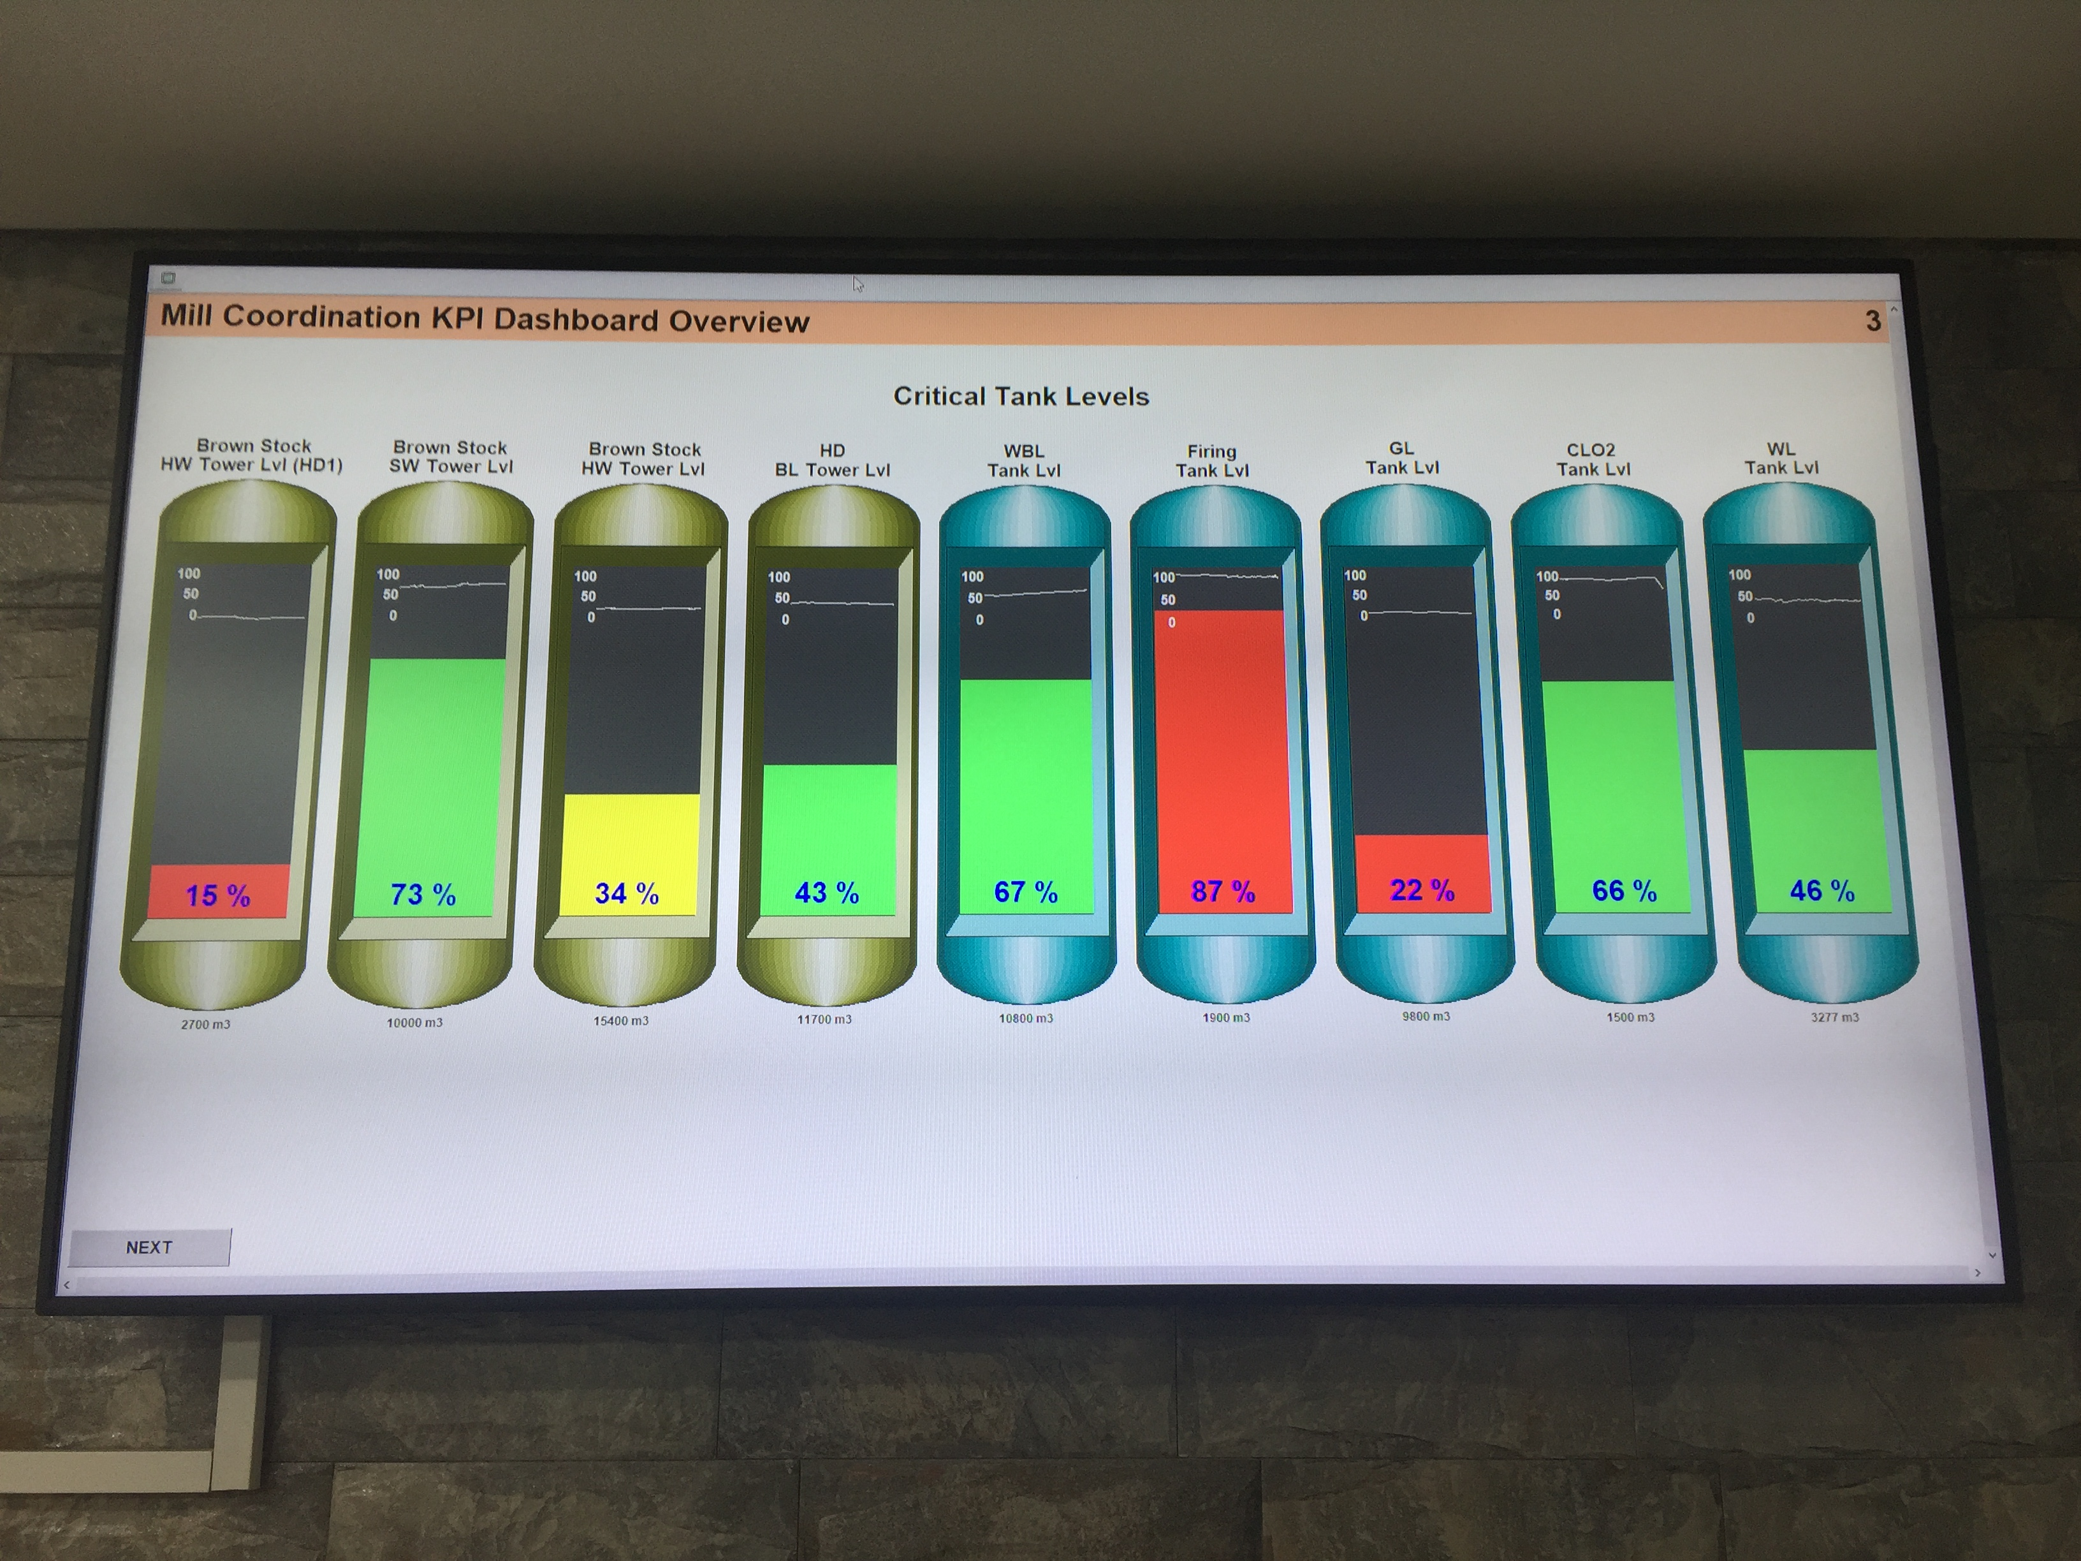
MONITORING CRITICAL TANK LEVELS IN REAL TIME

Slide 26
INADEQUATE LEADING PERFORMANCE INDICATORS
ADVICE WAS GENERALLY GIVEN IN THE FORM OF:
  STICK TO A FEW KPIs TO START WITH (SAY 2-4)
  BASE THESE ON THE CRITICAL PREVENTATIVE BARRIER PERFORMANCE
  SOME TYPICAL KPIs SUGGESTED:
    ADHERENCE TO SCHEDULED MAINTENANCE TARGETS
    TRIP AND ALARM TESTING PERFORMANCE
    TANK BUND STATUS
    PLANNED TASK OBSERVATIONS THAT ARE 100% CORRECT
  THE USE OF THE HSE AND CCPS GUIDES TO MEASUREMENT WAS USUALLY ADVOCATED TO ASSIST IN THE FIRST FEW STEPS AND A PLAN FOR THE FUTURE.

Slide 27
POOR CHEMICAL STORAGE AND INCOMPATIBILITY
MANY SURPRISING EXAMPLES OF POOR CHEMICAL STORAGE
SITES HAD BEEN OPERATING FOR YEARS AND HAD MSDSs/SDSs
SOME EXAMPLES
  FLAMMABLE LIQUIDS IN GENERAL STORES
  DRUMS AND BAGS WITH UNIDENTIFIED MATERIALS
  25% AMMONIA STORED IN FLAMMABLE STORE
  USE OF WOODEN PALLETS WITH FLAMMABLES
  INCOMPATIBLE SUBSTANCES STORED TOGETHER
  STACKS COLLAPSING
  AMMONIUM NITRATE SWEEPINGS PUT IN NPK FERTLISER BAGS
  COMBUSTIBLE PACKAGING STORED WITH FLAMMABLE SOLIDS (HEXAMINE)

Slide 28
POOR CHEMICAL STORAGE AND INCOMPATIBILITY
SOME OF THE REASONS FOR POOR STORAGE INCLUDED:
  PULP & PAPER MILL NOT REGARDING CHEMICALS AS MAIN BUSINESS
  CHEMICAL STORES OUT OF SIGHT / OUT OF MIND
  NO AUDITING / VISITS BY SENIOR MANAGEMENT
  CONTROL SYSTEMS LOOK FINE ON PAPER BUT IN PRACTICE NOT SO
  LACK OF KNOWLEDGE ON COMPATIBILITY & MATERIAL PROPERTIES
SOME GOOD STORAGE PRACTICES ALSO SEEN
  ORGANIC PEROXIDES IN BUNKER – AWAY FROM ORGANICS USED ON SITE
ADVICE WAS GIVEN ON PRINCIPLES OF GOOD STORAGE
HSE GUIDELINES USED AND GIVEN TO MANAGEMENT
ESPECIALLY DANGEROUS SITUATIONS DEALT WITH IMMEDIATELY

Slide 29
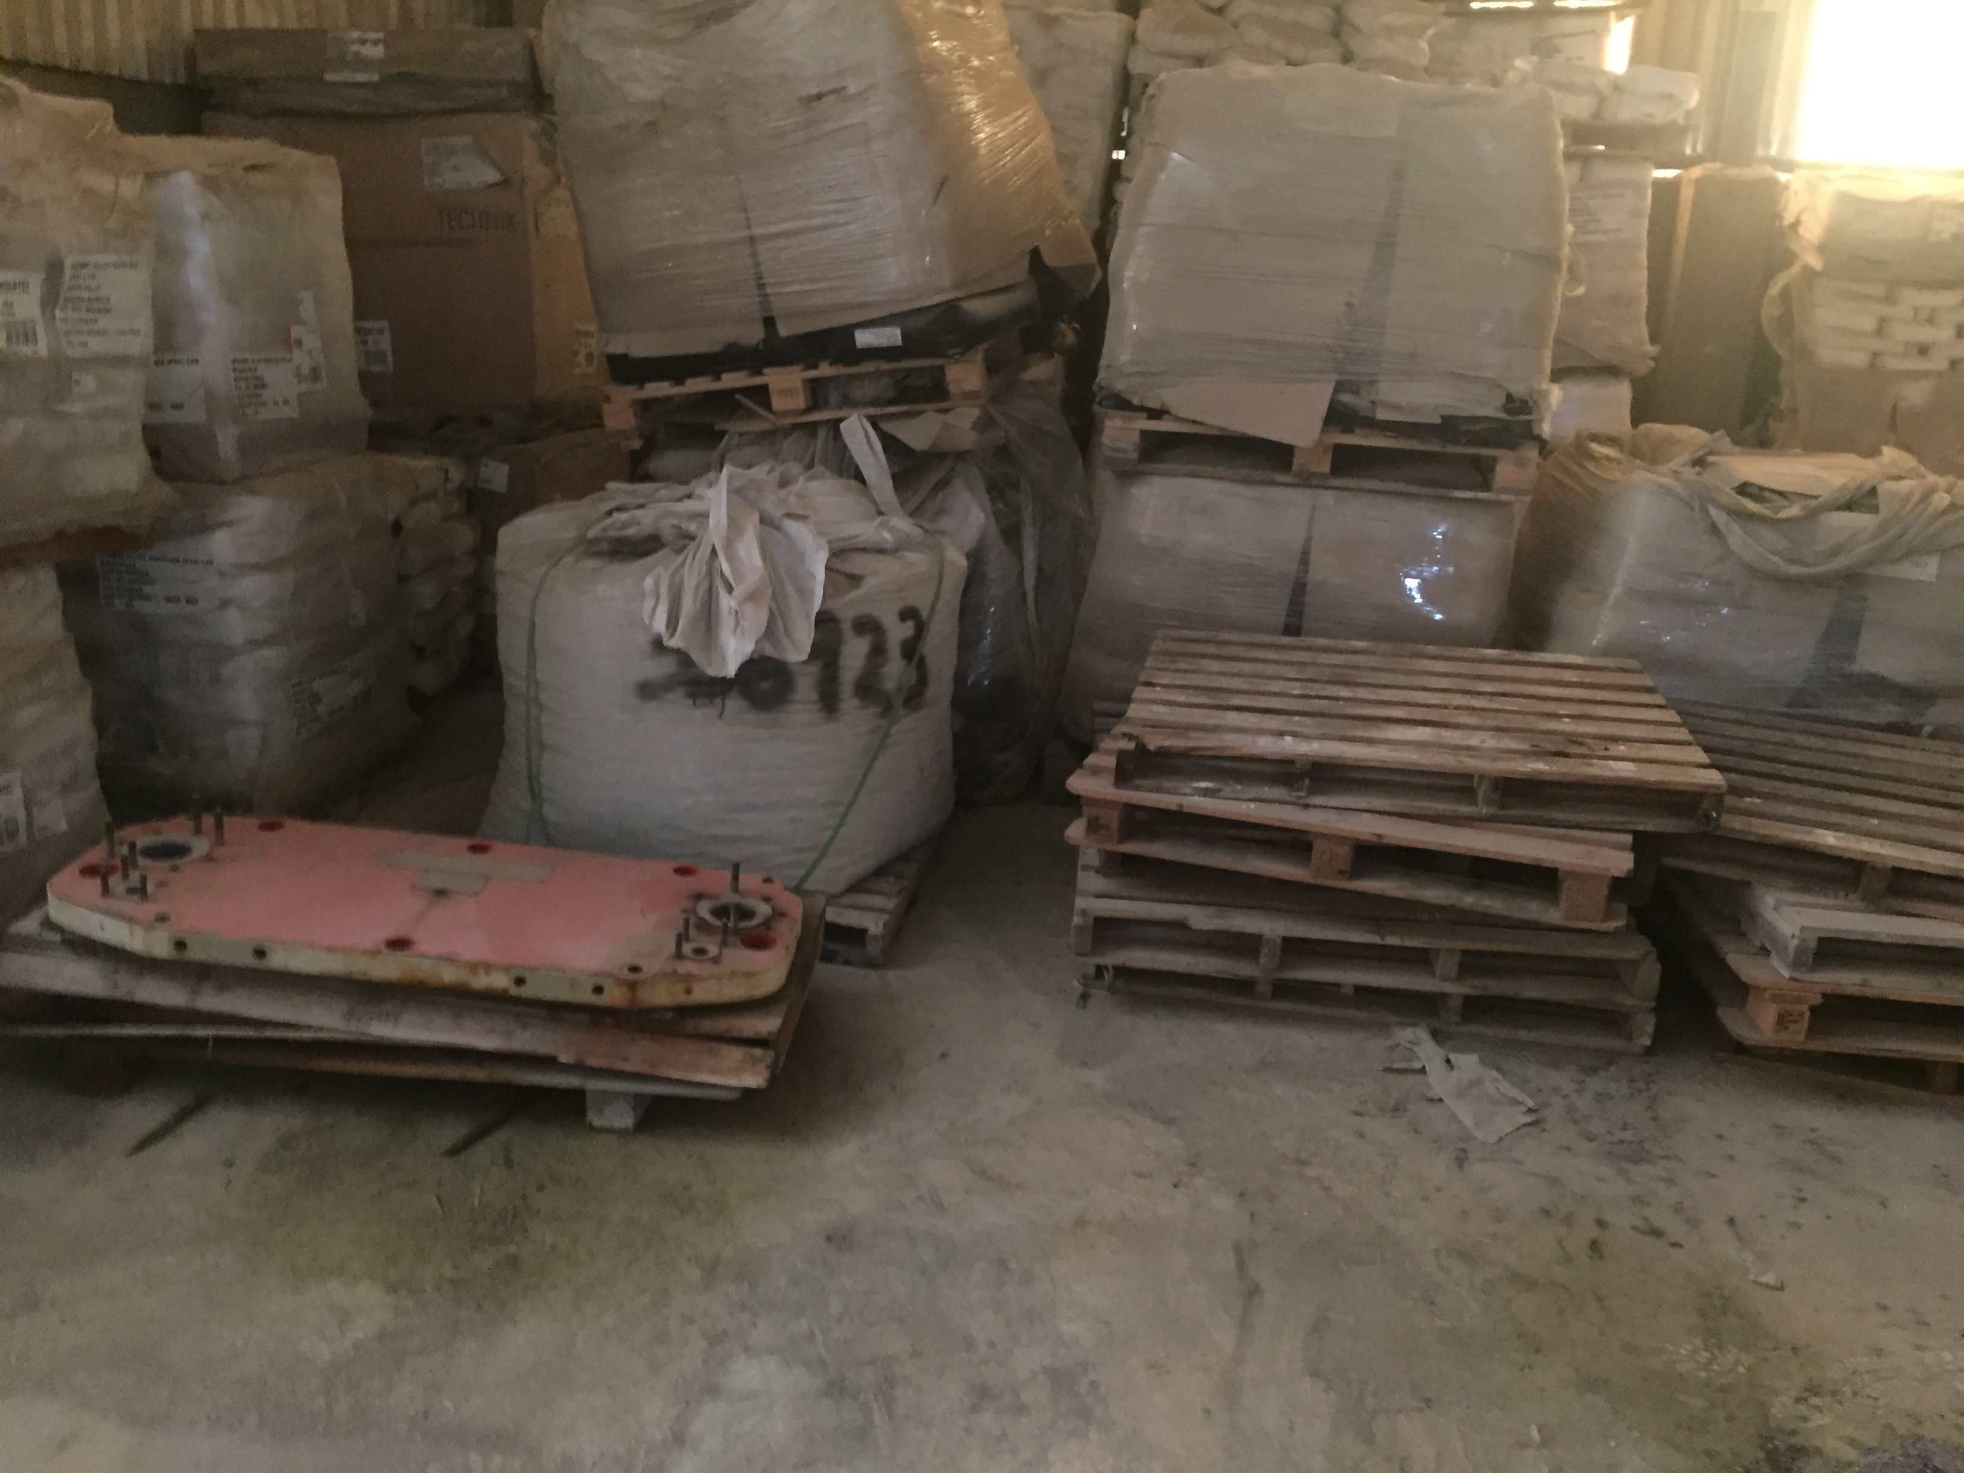
DANGEROUS STORAGE OF CHEMICALS

Slide 30
LACK OF COMPREHENSIVE ASSET STRATEGY / SCES
MOST COMPANIES HAD SCHEDULED MAINTENANCE SYSTEMS
SOME HAD PREVENTATIVE MAINTENANCE SYSTEMS
  THICKNESS TESTING, OIL LUBRICANT ANALYSIS
VERY FEW APPLICATIONS SUCH AS RBI
MANY SOPHISTICATED SYSTEMS LIKE SAP BUT UNDERUTILISED
CAPITAL PROGRAMS STAND ALONE
NO OVERALL ASSET STRATEGY
SCE PERFORMANCE VERY VARIED. ONE OIL REFINERY USED THE CONCEPT VERY WELL AND ENSURED HIGH RELIABILITY FOR SCES
MOST COMPANIES BACKED OFF THIS PART OF PSM
ADVICE OFTEN GIVEN ON CHOOSING SCEs (PREVENTATIVE BARRIERS FOR MAJOR HAZARDS). SOME COMPANIES WENT AHEAD

Slide 31
CONCLUSIONS
THE COMMON ISSUE THEMES SHOW PROBLEMS IN SEVERAL AREAS OF PROCESS SAFETY ACROSS MANY INDUSTRIES
SA LEGISLATION DOES NOT CALL FOR MANY REQUIREMENTS IN PROCESS SAFETY
THE PSM AUDITS WERE BASED ON INTERNATIONAL BEST PRACTICE
BROAD RANGE OF ISSUES FROM COMPLEX (TRIP SYSTEMS) TO SIMPLE (CHEMICAL STORAGE AND BUNDING)
MUCH INERTIA SEEN IN MAKING IMPROVEMENTS – NOT HIGH PRIORITY
ADVICE FROM 3RD PARTY MORE READILY TAKEN THAN FROM INHOUSE
HOPEFULLY THE ICHEME AUDIENCE CAN BENEFIT FROM SOME OF THE EXPERIENCES

