Slide 1
Shipping and Storing Polymerizable Substances: A styrene incident, complex new legislation and how to do it right
Stephen Rowe
Adelia Moraleja Perez
Kamran Rohan Arif
DEKRA UK Ltd
Contents
Polymerisable substance thermal risks
Styrene incident in shipping (2019)
Changes in shipping regulations
Experimental studies on effect of monomer aging
Recommended testing protocols
Conclusion

Slide 2
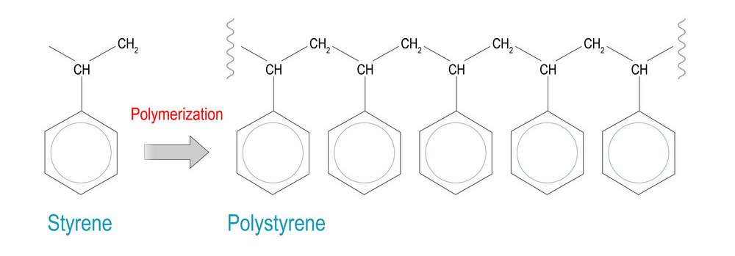
Polymerisable Substance Thermal Risks
Unsaturated carbon-carbon bonds prone to polymerisation by thermal, free-radical or REDOX initiation.
Almost all addition polymerisations are EXOTHERMIC (evolve heat). Polymerisation was responsible for 48% of UK runaway reactions reported to HSE between 1962 and 1987.
Reactions are complex, hard to model and susceptible to small quantities of impurities. Materials usually shipped with inhibitor / retarder (p-tert-butyl catechol (TBC) most common in styrene).

Slide 3
Styrene Incident in Shipping
Stolt Groenland, docked at Port of Ulsan, 28/09/2019. 37 cargo tanks in use, 3 contained styrene monomer. Diagonally adjacent tanks required heating (40-50°C) and caused overheating of styrene tanks.
Lack of temperature monitoring and active management of inhibitor concentration. Inhibitor depleted, self-polymerisation commenced and caused overpressure of the tank. 17 Injuries (zero fatalities).
Identical situation occurred on Stolt Focus vessel weeks earlier but was intercepted / water quenched.
Heated Styrene Empty Other cargo

Slide 4

Styrene incident in shipping

Slide 5
Changes in Shipping Regulations
“Polymerisable substances shall not be accepted for carriage unless the necessary steps have been taken to prevent their dangerous decomposition or polymerisation during carriage”
Pre-2015, only UN guidance was brief and generic. No specific test methods or protocols.
19th Edition of UN transport recommendations included new class “self-polymerizable substances” with a Special Provision (386) and a specific testing regime to determine SAPT (self-accelerating polymerisation temperature).
For sea shipment, SP386 does not apply but a “Certificate of Protection” is required to ensure that the level of stabilization is sufficient for the conditions and duration of the journey.
SP386: “When chemical stabilisation is employed, the person offering the packaging, IBC or tank for transport shall ensure that the level of stabilisation is sufficient to prevent the substance in the packaging, IBC or tank from dangerous polymerisation at a bulk mean temperature of 50°C, or, in the case of a portable tank, 45°C. Where chemical stabilisation becomes ineffective at lower temperatures within the anticipated duration of transport, temperature control is required”.

Slide 6

Changes in Shipping Regulations
Extensive guidance exists for styrene (see paper) but:
  All shipments are different (no standard test)
  Initial inhibitor levels vary (lab supplier concentrations varied from 220 ppm TBC to 5 ppm TBC)
  History / inhibitor depletion unknown on receipt.
There is no simple safe temperature.
How do you classify less common / new monomers?

Slide 7
Effect of Monomer Aging on Inhibitor Concentration
Example: Styrene / TBC at 40°C
TBC analysed weekly by GC/MS
Storage Temperature (°C) | TBC Depletion (days per ppm) | Shelf Life (Assured Days)
25 | 11 | 55
30 | 7 | 35
40 | 1.5 | 7
40* | 1.9* | -
Data from Styrene Monomer Safe Handling Guide 2022 (Styrene Producers Association).
* Data from current study

Slide 8
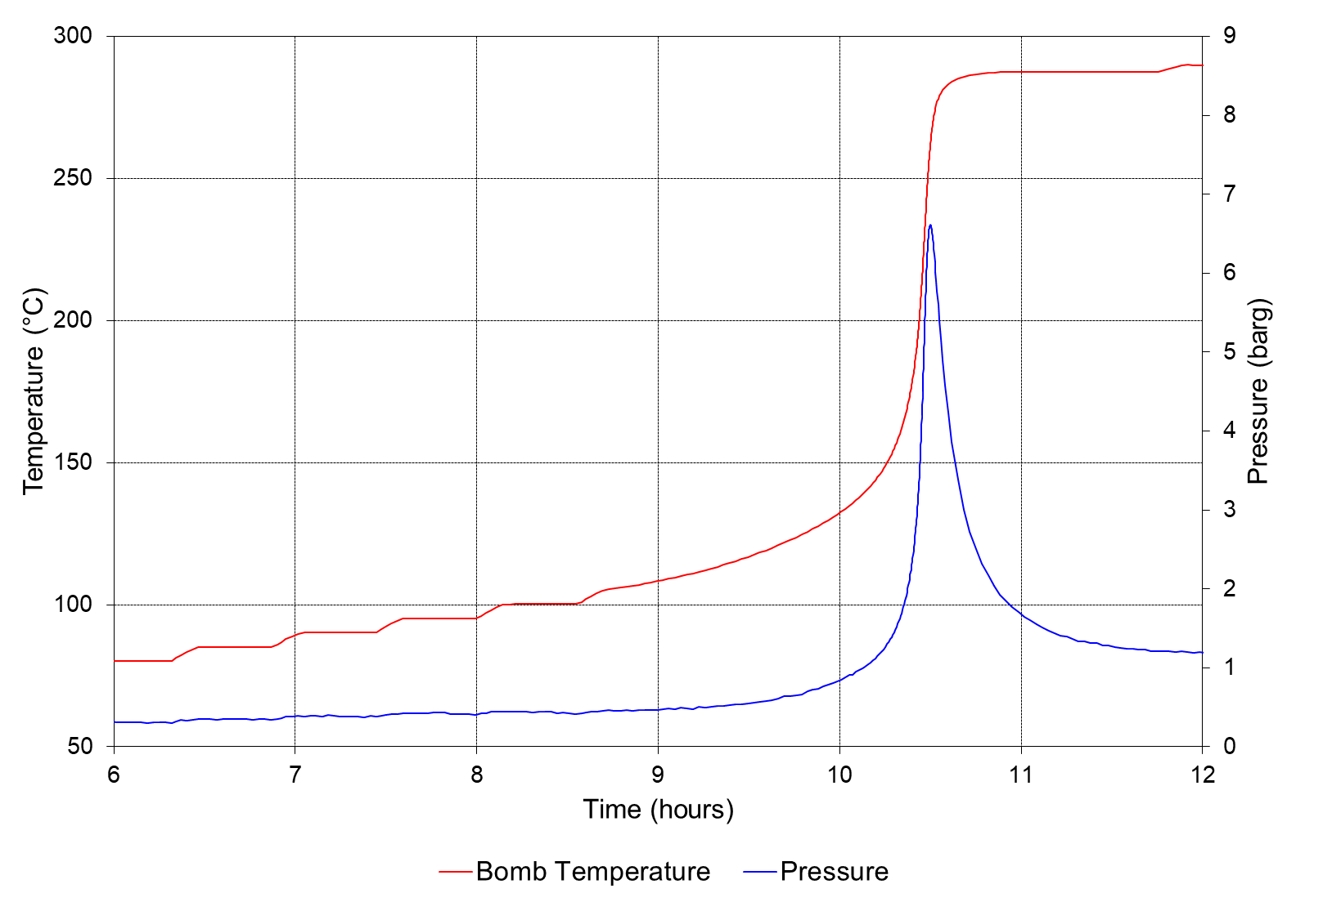
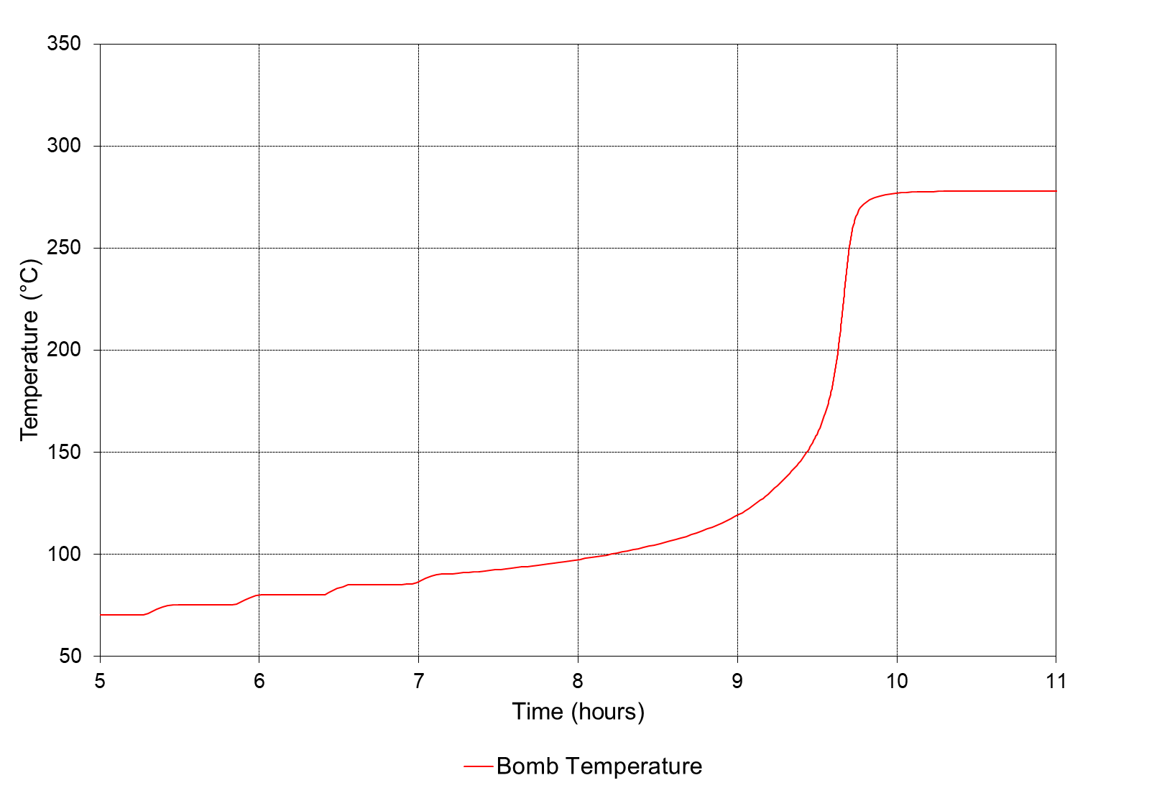
Effect of Monomer Aging on Thermal Stability
Adiabatic Calorimetry using ARC (Accelerating Rate Calorimetry)
(Low phi Titanium cell, 5 K heat steps, 0.02 K/min sensitivity)
Week 0 Styrene (12 ppm TBC)
Week 8 Styrene (0 ppm TBC)
Crude onset
105°C
Crude onset
90°C

Slide 9
Effect of Monomer Aging on Thermal Stability
ARC (Accelerating Rate Calorimetry) – Phi Factor Corrected
Week | Inhibitor Concentration (ppm) | TD₂₄ (°C) | TMR from 40°C (Days) | TMR from 30°C (Days) | TMR from 25°C (Days)
0 | 12.6 | 58 | 3.87 | 8.83 | 13.61
1 | 8.9 | 54 | 2.81 | 6.09 | 9.15
2 | 6.5 | 51 | 2.21 | 4.71 | 7.01
4 | 3.2 | 48 | 1.73 | 3.54 | 5.15
5 | 2.3 | 48 | 1.67 | 3.39 | 4.92
6 | 1.6 | 46 | 1.45 | 2.91 | 4.20
7 | 1.0 | 46 | 1.49 | 3.00 | 4.33
8 | 0 | 41 | 1.06 | 2.05 | 2.90
(Stolt Groenland styrene held at between 35 and 40°C prior to incident)

Slide 10
Recommended Testing protocol
Evaluate worst case transport conditions:
transport duration (max)
initial inhibitor concentration (min)
transport temperature (max)
Perform precise thermal analysis of conditions using adiabatic calorimetry (e.g. UN Test H.2).
Is inhibitor / temperature data available?
No reaction
No
Apply data and controls
Yes
Reaction
Apply data and controls
Modify conditions and repeat analysis (or seek alternative shipping method).
No reaction
Reaction

Slide 11
Monitoring and Control Strategy
Monitoring
Temperature
  Do not store monomers adjacent to any heated container or other heat source. Consider ships engines/services and solar radiation.
Inhibitor and Polymer Analysis
  Many container ships would not have the facility to perform such analysis but it may be possible to book analysis at planned port stops along the route.
Headspace oxygen analysis
  Oxygen is required to activate many inhibitors and hence the oxygen level should be maintained above 3% v/v but below the limiting oxygen concentration for combustion (LOC).
Control
Maintain inhibitor concentration by topping up as required (ensuring mixing strategy effective).
If the temperature starts to rise or other checkpoint deviation occurs, positive temperature control or quenching can be deployed as first line mitigation strategies.
If polymerisation has started / temperature starts to rise add a free radical scavenger (Short Stop).

Slide 12
Conclusion
Polymerisable substances are challenging. Basic kinetic representation is not possible due to the mechanism, effect of impurities and other variables.
There is no simple safe temperature.
Specifying safe handling, shipping and storage conditions requires:
  Understanding of inhibitor depletion rate
  Accurate (or pessimistic) specification of temperature and duration
  Corrected thermodynamic data scaled to heat losses of the specific vessel
  Monitoring and control strategy

Slide 13
THANK YOU!
Contact information
Stephen Rowe
 +(0)23 8076 0722
 stephen.rowe@dekra.com
MISSION
SAFETY
Special thanks to Kamran, Adelia and Trevor Bee at DEKRA for diligently constructing and performing the test programme on which results herein are based.

