Slide 1
The Good, Bad and the Ugly – Pandemic-Driven Acceleration in Audit Technology
Dave Einolf, Managing Director, Endeavour EHS Nick Ashley, Ph.D., P.E. Global Director, Process Safety, W. R. Grace & Co. Lu Menghini, CPSA, Senior Audit Manager, Operations, Internal Audit, bp

Slide 2
AGENDA
Introduction – COVID-19 and Operational Audits
Collaborative Audit Tools
Data Analytics for Operational Audits
Remote Access and Observation
Summary

Slide 3
COVID-19 and operational audits
Process Safety Audits traditionally follow a 3-year audit pattern established by US regulation [29 CFR 1910.119(o)]
March 2020 saw a halt to on-site auditing – ranging from 3 months to 2 years
We urgently surveyed existing technology and new tools to provide access and “auditability” in this new world

Slide 4
Collaborative audit tools
Need for a flexible, interactive platform which could address three critical needs:
1. Face-to-face interview capability
2. Real-time screen sharing
3. Mobile accessibility to allow for field use

Slide 5
Face-to-face interview capability / Real-time screen sharing
While most had cameras in conference rooms and laptops – they were infrequently used. March 2020 was the great unmasking
A limited number of products existed and were scalable as of March 2020
Many products had only a fraction of the functionality needed, such as ZOOM, WebEx and GoTo Meeting

Slide 6
Microsoft® Teams and Google Meet
Most organizations appear to have moved to either the Teams or Google Meet platforms
Teams user base exploded:
March 12, 2020 – 32 MM
April 29, 2020 – 75 MM
January 31, 2022 – 270 MM

Slide 7
Virtues of collaborative platforms
Both platforms allow for the development of secure spaces for sharing data and real-time screen access
Provide face-to-face interview capability
Provide team connectivity with drop-in video call access for active team members
Documents can be co-produced and simultaneously edited
Planning elements can be addressed within the platforms

Slide 8
The advent of the shared screen
Early “webinar” style platforms allowed for screen sharing but required steps such as “passing the ball” or specific permission requests
Collaborative platforms allow any member to share securely within the workspace during a team discussion
Documents within the team workspace can be updated in real-time by a scribe without active control of the viewing screen
Shared screens are valuable for external SMEs who may not have access to internal systems

Slide 9
Added benefits of remote collaboration
As the pandemic has wound down, we have retained many of the elements of remote audits developed over the past two years
Remote collaboration required the development of detailed audit schedules to ensure participation
Existence of remote tools allows for the addition of SME (such as project engineers or instrumentation professionals) for short periods of time during reviews of areas such as PHA or Mechanical Integrity

Slide 10
Data analytics for operational audits
What is “Data Analytics”
Data Lakes and Data Aggregation
Examples of the Use of Analytical Tools to Enhance Audit

Slide 11
What is data analytics?
The science and art of discovering and analyzing patterns, identifying anomalies, and extracting other useful information in data underlying or related to subject matter of an audit through analysis, modelling, and visualization for planning and performing the audit. [AICPA Guide to Data Analytics]
Data analysis allows auditors to reduce search times and augment “judgment” or “auditor’s luck”
Data analytics allows auditors to expand sample sizes moving from the AD Little “table” to 100% in some cases

Slide 12
Fishing in The data lake
With organizations increasing reliance on software products to replace manual systems (e.g., Computerized Maintenance Management Systems (CMMS) or MOC management software), the amount of data available for review has increased exponentially
The ease of review has also increased with use of these tools – let’s look at two examples with increasing sophistication

Slide 13
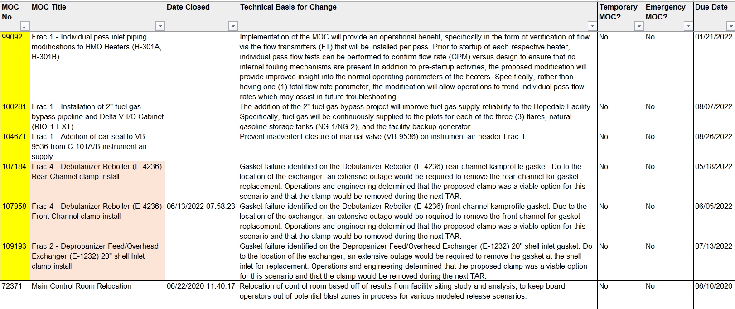
Review of moc/pssr actions using intelex

Slide 14
Review of moc/pssr actions using intelex
Intelex (a multi-functional EHS management web-based software program) has a sophisticated MOC/PSSR module
MOC records may be exported to an Excel spreadsheet and data may be filtered
As an example, finding the prior 3-years of Temporary MOC records takes only a single filter
100% sampling of MOC closure/return to service is a simple task

Slide 15
Evaluation of deferred maintenance using power BI

Slide 16
Evaluation of deferred maintenance using Power BI
Generating dashboards of operational data
Used to provide pictures of the health of various operational activities:
operating limit and design limit excursions
overdue inspection and maintenance activities
training deficiencies
Integrating audit tools with operational health indicators

Slide 17
Considerations in developing data analytics
Incorporating data analytics (DA) in operational audits requires a rigorous and well thought out approach, including consideration of the following items:
Define the questions to be answered with analytics
Understand what data exists, the ‘format’ of the data, and what controls need to be overcome in order to access the data
Getting access to the data early is key
Bring the data analyst into the audit preparation activities as soon as possible
Trial the analytics to see if the results are right

Slide 18
Data analytics – examples of successes
100% sampling of relief valve preventive maintenance data
Using DA to confirm that operating limit and design limit excursions were accurately flagged in software systems – cross-check the results against operations logs and excursion investigation data to confirm that appropriate actions were being taken to track and address limit exceedances
Assess operator overtime rates and compare against API suggested rates

Slide 19
Remote access and observation
Race to improve the technology of observation
From cellphones to VR Goggles
Developing a hybrid model with on-site SMEs
Extending pre-read periods and limiting on-site

Slide 20
Race to improve the technology of observation
March 2020 left auditors both blind and “out in the cold”
Challenges of facilitated remote inspections using devices which were not intrinsically safe
Expansion of availability of iPhone and Android cases
Use of VR headsets connected to Google Glass and similar devices

Slide 21
Rise of the hybrid audit model
Eventual thaw in travel restrictions led to expansion of a hybrid model of 1-2 audit team members on-site addressing the needs of the remainder of the team
Worked well for needed audits in travel-restricted countries
Success of this method was largely a combination of the SME’s understanding of the operational aspects of the business and the comfort level of operational personnel in the field

Slide 22
Extended remote pre-read and shortened on-site periods
Increased comfort of auditors (and auditees) with remote tools has given rise to audits with extended pre-read periods followed by a shortened on-site period
Particularly effective for pre-review of MI documentation as well as MOC/PSSR (where that has been automated)
Greater availability of documentation in electronic form
Auditors need to be aware of the time constraints of site personnel to assure all data is electronically available

Slide 23
conclusion
The COVID-19 Pandemic presented challenges but resulted in a quantum improvement in audit technologies
Improvements have allowed for reduced on-site time, smaller audit teams, and increased audit effectiveness

