Slide 1
Safety Critical Task Analysis
Killing 2 birds with 1 stone
Jonathan Parsons Process Control & Functional Safety Manager Engineering Refinish UK, PPG
Clive de Salis Principal Process Safety Engineer, DEKRA

Slide 2
Overfill Barrier Diagram showing Barriers & Safeguards
We will be the
global partner
for a
safe, secure
and
sustainable
world
Notes:
Text: Horizontal 36,3; Vertikal 11,8

Slide 3
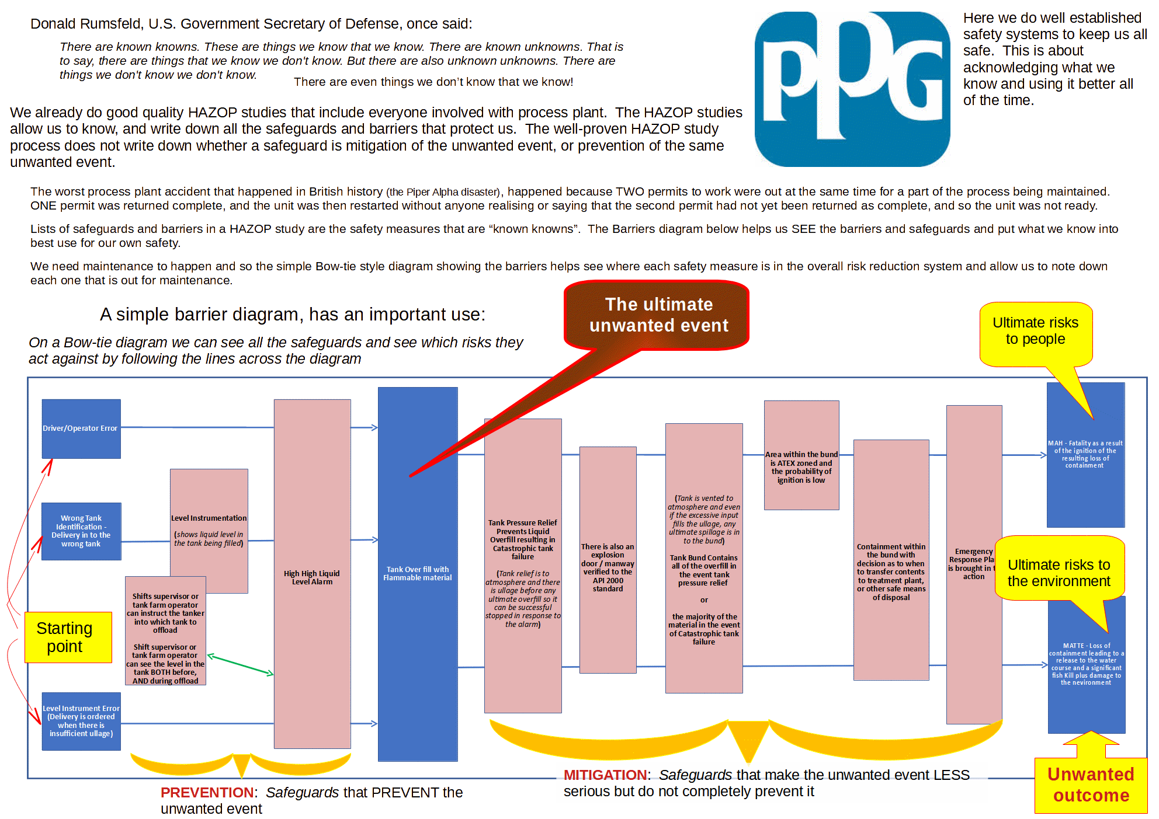
Barrier Diagram
We will be the
global partner
for a
safe, secure
and
sustainable
world
Notes:
Text: Horizontal 36,3; Vertikal 11,8

Slide 4
Thank you,
for taking care of
SAFETY

