Slide 1
Brain-Centred Performance:
The Final Frontier in Workplace Safety
Mark Walker
DEKRA UK Ltd
Contents
Brain Centred Hazards
USS Fitzgerald Case Study: Human Factors Collision Course
Fast Brain / Slow Brain
The way we “see” things
Stress & urgency impact on decision making
Conclusion

Slide 2
Human Performance Reliability
Accomplishment of job tasks in accordance with agreed-upon standards of accuracy, completeness and efficiency

Slide 3
Humans Make Mistakes…

Slide 4
We see with our brains, not our eyes…
Most people won’t see the the mistake in this sentence

Slide 5
We see with our brains, not our eyes…
Most people won’t see the the mistake in this sentence

Slide 6
USS Fitzgerald – a Human Factors Collision Course

Slide 7
Case Study: USS Fitzgerald Collision Course
The $1.8bn, 8,261-tonne Navy Destroyer USS Fitzgerald is on a secret mission near Japan…it’s 1:30am on 27th June 2017, when 35 of the crew find themselves under water while in bed.
The 30,000-tonne MV ACX Crystal cargo ship collides with the Fitzgerald and gouged a hole bigger than a container lorry, in the starboard side of the destroyer.
7 Sailors Dead and many more injured. Navy’s worst accident at sea in 40yrs

Slide 8
Case Study: US Fitzgerald Collision Course

Slide 9
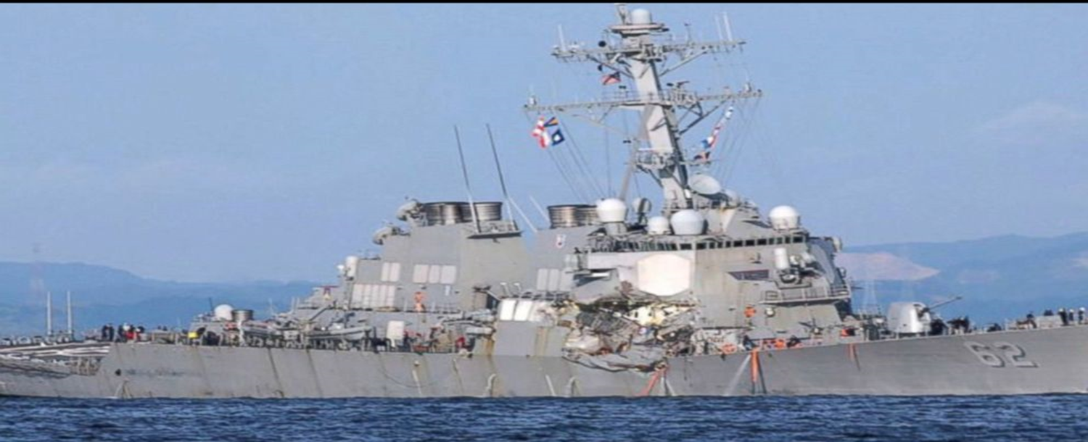
Case Study: US Fitzgerald Collision Course
Two months later, a second destroyer, the USS John S. McCain, collided with another cargo vessel, leaving 10 more sailors dead.
Both destroyers are part of the 7th Fleet, the most powerful naval armada on earth responsible for protecting against nuclear aggression toward the USA.
How could two state of the art navy destroyers, protected by one of the most advanced defence systems on the planet, fail to detect on-coming cargo ships, which broadcast their location worldwide?

Slide 10
Cited Causes and Contributors to USS Fitzgerald Collision
There were a series of near misses in the weeks before the crash.
The Fitzgerald had passed only 7 of 22 required certification tests of seaworthiness.
The crew were exhausted and undertrained – with a bruising mission tempo.
A fire caused the electrical system to fail and a ship-wide blackout one week before.
17yr old ship navigation software…and two separate systems.
The Captain selected an untested team to steer the ship at night.
The crew were ordered to speed through shipping lanes filled with cargo ships and fishing vessels.
The Officer of the deck, 22 hours into her shift, had navigated the route only once before in daylight. She ordered the Fitzgerald to turn directly into the path of the Crystal.

Slide 11
How could this happen?
Fatigue & Stress: Confusion, indecision, panic…
Visual recognition: Wrongly configured radar & only one ‘watch’
Breakdown in Relationships: Personal mistrust between Bridge and Combat Control Room and leaders inexplicably missing…
Systems & equipment not fit for purpose…
Cancelled maintenance programmes & ‘asset stripping’…
Heroism and sacrifice…

Slide 12
Are we are good or lucky?
Most of us are fortunate that our
mistakes are unremarkable.

Slide 13
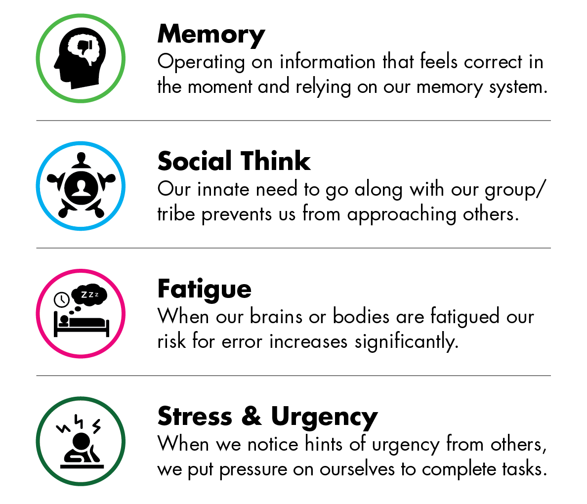
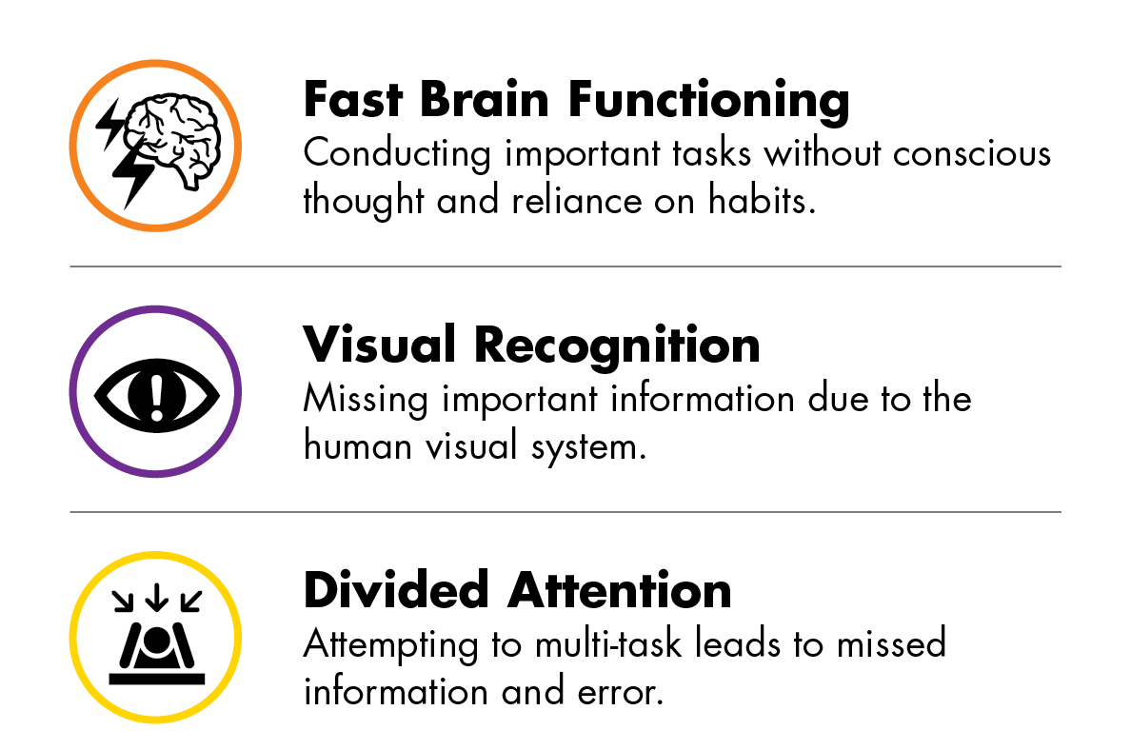
The 7 Brain-Centered Hazards™

Slide 14
Fast Brain/Slow Brain
Fast
Slow
Automatic
Unconscious
Effortless
Routine
Intuitive/Habit-driven
Emotional/reactive responses
Deliberate
Conscious
Effortful/Draining
New/complex
Analytical
Impaired by fatigue, illness, or stress
We’re in Fast Brain mode as much as 50% of the time

Slide 15
We see with our brains, not our eyes…
Ca y u rea t is?
Y u a e n t r ading th s.
W at ar ou re d in ?

Slide 16
Human Vision System & Exposure Identification
We see with our brain, not our eyes
Additional skill required to notice broadly and deeply using the full capacity of our visual system
Looking missions to upgrade Safety and Gemba Walks and trigger our slow brains….

Slide 17
Approach for Enhancing Situational Awareness
B
Breathe
E
Energize
G
Gaze Around
I
Intensify Focus
N
Notice Broadly and Deeply
Notes:
Module 4 – Pressures and Pauses

Slide 18
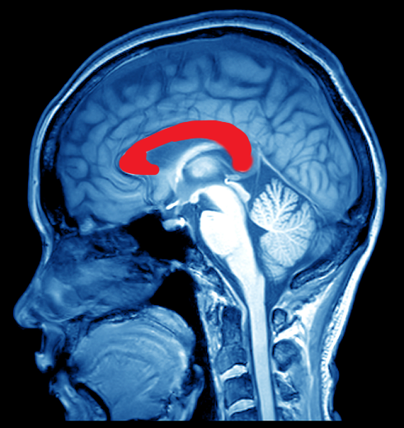
Stress & Urgency Impairs Thinking
The Anterior Cingulate Cortex – ACC – blocks cognition under stress.

Slide 19
Leadership Messaging Has Power
The power of leadership messaging
Leader messages to “hurry up,” create an Urgency Culture…
This will prime employees for Fast Brain performance…
This results in reactive, pre-conscious, thoughtless, emotion-based behaviors and correlated errors.
Notes:
Say: So, knowing that the messages you send as leaders directly influence the behaviors of your workforce and can in fact block the employees’ Thinking Brain, … [Click]

Slide 20
Combating the Stress & Urgency Hazard
Teach leaders about urgency messaging and what to do instead
Take a moment to create a moment with others to drive safety engagement
Emails, conference calls, live meetings, site visits, townhalls, stand downs, videos all offer opportunities to create moments of safety transformation

Slide 21
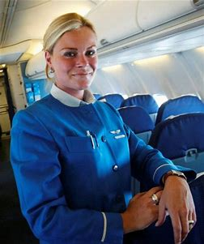
Breaking the Pattern…. Engaging Slow Brain
…and be curious….

Slide 22
The Power of Questions…
Why are we not we seeing more ships…?

Slide 23
Take Aways
Some insight into brain hazards
We see with our brains not our eyes
Activating the slow brain
How do you currently enable this?
How do you break the pattern?

Slide 24
THANK YOU!
Contact information
Sebastian BLAIR
 +44 7960 942929
 sebastian.blair@dekra.com
MISSION
SAFETY

