Slide 1
IChemE HAZARDS 32 Guidance on Vulnerability of Safety and Environmental Critical equipment at AST sites (in press) Ian Herbert – Process Safety Consultant (VHM) John Evans – Principal Consultant (TT)

Slide 2
Overview – SECe Vulnerability at AST farms
New Guide – In press by EI. To cover the following:
Why a new guide
Critical equipment
Vulnerability
AST escalation stages
Hazard ranges
Acceptance or not
Notes:
This presentation will cover an overview of a new guide from the Energy Institute which is in press. This presentation will cover the following topics from the new guide. Obviously if you want full in depth details keep a look out for the publication of this guide in the near future.

Slide 3
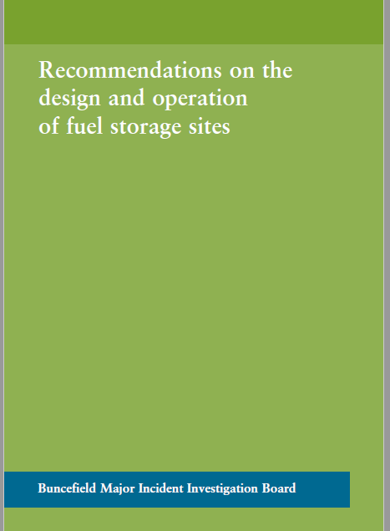
Why a new guide ?
Containment Systems Working Group Of the EI Project
This technical project to identify options on how to reduce risks identified in an assessment to meet the requirements of Buncefield Major Incident Investigation Board (BMIIB) Final report Recommendation 12.
Some guidance previously available in appendix 6 of PLSG
Notes:
This was an EI CSWG (Containment systems work group) identified project to look at means for meeting the requirements of the BMIIB recommendation 12. Some guidance on the means to address this recommendation had previously been provided in the likes of appendix 6 to the Process Safety Leadership Group report on safety and environmental standards for fuel storage sites, however it was felt that this guidance could be improved upon as we shall see.
This is to diff

Slide 4
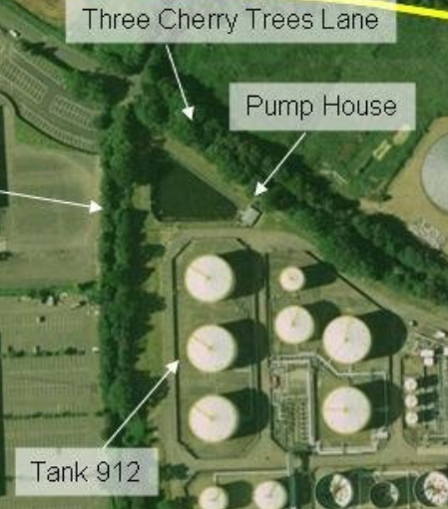
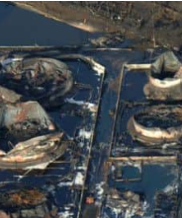
Siting of critical equipment
Survivability of critical equipment?
Destruction of the Fire water pump house at Buncefield
But also ignition location?
Notes:
Recommendation 12 was generated as a result of damage caused to emergency response equipment seen in the likes of the Buncefield incident. The images show the pump house before and after. Obviously if equipment is required in order to respond to an incident it need to survive the initial stages of that incident, hence need to locate such that it is not affected by adverse conditions in the early stages of an incident such as overpressure and thermal flux.
But it should also be noted that the pump house is believed to be source of the initial ignition and this may also be a factor in the location of this critical equipment in relation to loss of containment. The Guide picks up on this and reviews other siting factors in addition to overpressure and thermal exposure.

Slide 5
Two part project
First part determination of critical equipment
Included survey of CSWG members on equipment.
Generated list of typical ‘Emergency response’ equipment - in guide
Equipment – not just the list of fire fighting measures e.g. Fire water sources, pumps , hydrants etc., but also process system equipment such as:
Bund design
Passive protection
Tank overpressure protection (thermal exposure)
Etc
Notes:
It has been a two stage project. Stage 1 identified typical critical equipment required for the control of escalation risks associated with large atmospaheric tank storage ites and operations. which inc;luded a survey of CSWG - the results of which are listed in the guide and which may be a useful tool to duty holders at AST sites on its own as a means of reviewing their emergency response equipment and operations.

Slide 6
Second part of project
Second part of project to determine a methodology
Originally the aim was to have a series of ‘if then’ type flow charts
However, the following precluded this
Need for scenario specific determinations for emergency response
material specific differences
Tank and layout specific differences
Site e.g. access, adjacent process operations differences
Differences in emergency response inc third party capability and availabilities
End result - guidance document that goes into more detail than the PLSG and provides a structure methodology for review and assessment using a scenario determination as a basis
Notes:
After generation of the typical emergency response equipment listings the second pat of the project was to develop a methodology to support duty holders address Recommendation 12 on siting. The original intent was to define possible if – then logic flow charts on options related to critical equipment siting. If then flow charts are those that ask the use logic question such as ‘IF x is exposed to y kW/m2 , THEN you should – relocate. However, when looking at this it became clear that the range of differences in AST site layout and operations – as listed, would mean that a ‘universal’ ‘IF Then’ flow chart would not be applicable. The General approach to emergency planning based on incident scenarios was instead taken. This is in line with other type post incident determinations as seen in appendix 6 of the PLSG guidance and even that for occupied building risk assessments (CIA guidance) which has similar exposure and survivability considerations. The guide builds on and develops this scenario basic approach as shall be seen.

Slide 7
Safety and Environmental Critical equipment
Original scope called for review of Elements in line with offshore SECEs, however systems were determined to be too big – e.g. fire systems – need to break down into critical equipment such as hydrants, fire pumps, lagoons, Etc.
Equipment critical in mitigating escalation
Standard fire equipment
Other equipment – bunds, detection, access, exposed tank protection (overpressure, fire spread)
Human interactions for operation
This is more commonly considered as emergency response equipment
Not covered are:
Initial incident - losses of primary containment. But from LOPC onwards e.g. Unignited LOPC and then Ignited LOPC scenarios
Pressurized storage, LNG/LPG, Process operations, Bitumen and lubricants
Notes:
This is to differentiate with SECE (Safety and Environmentally Critical Elements). As this is looking at elements which is too big i.e. fire water supply can cover sources (tanks/lagoon) pumps , mains and hydrants not all may be affected at the same time. Hence guide has focused on Safety and environment Critical equipment – lower case e.
Critical equipment – Think of as part of emergency response.
Not just equipment but an important factor is the human interaction element it is no good equipment, such as hydrants surviving, if they can not be accessed by ERT members. The scope of the guide only covers larger AST sites and excluded the following listed operations : However, the methodology may be applied to these locations – subject to determination of applicable scenarios.

Slide 8
Vulnerability of SECes
Main aim of Recommendation 12 aimed at siting due to damage and failure caused by Fire (thermal) and explosion (over pressure).
However, it was clear that these siting failures were only one failure mode – That of survivability.
Critical equipment also fails because it wasn’t designed for the scenario, or because of other operational performance failures.
Use of FARSI as potential failure modes – Or Vulnerabilities
Function
Availability
Reliability
Survivability, and
Interaction
Notes:
Although the project set out to review the survivability of SECe, during development of the guide it became increasingly difficult to separate this from other vulnerability factors such as poor design or operation. For those familiar with offshore safety these other vulnerability factors are part of the recommended model for developing Safety Critical Element Performance Standards, based on Functionality, Availability, Reliability, Survivability and Interaction (FARSI).
Detail what is in each

Slide 9
Vulnerability of SECes – 2
The FARSI vulnerabilities were separated into
Performance vulnerabilities, - Function, Availability, Reliability and Interaction, and
Survivability,
In addition to physical equipment failure – Human interaction vulnerabilities should also be considered.
Function – training, PPE equipment, knowledge of emergency plans
Availability – numbers present and time to mobilise
Reliability – sickness, injury and thermal exhaustion
Survivability – not just to thermal and overpressure, but smoke and gases
Interaction – comms between groups, compatibility of equipment to fixed systems etc
Notes:
In addition to physical equipment failures, the review of vulnerabilities to SECes in the guide also covers vulnerabilities associated with Human interactions required for the operation of SECes. Human vulnerability in operating SECe is often the major potential failure mechanism in correct SECe operation. This can cover similar FARSI type vulnerabilities – Function (failure in knowledge, training or equipment (PPE), availability (not present), Reliability (sickness or thermal exhaustion), Survivability (thermal and overpressure exposure plus smoke/gas and runoff), interaction (comms, compatibility of equipment etc)

Slide 10
Different requirements at different stages
Scenario basis requirement for ideal coverage – based on existing assessments.
The HSE focus and guidance is aimed at worst case – such as the large multiple tank fires following OFCE as seen at Buncefield (and others)
However, this is worst case. Need to consider emergency response to earlier stages
single tank, bund fire, bund and tank fire, etc.
AST fires can and have burnt for hours if not days with different escalation paths over this time. Multiple tank fires can be generated due escalation from individual tank fire as well as large OFCE case.
Other cases may be presented by the stored material e.g. Boil over
Or tank design – Fixed roof vs floating roof
Notes:
As for all good Fire and Explosion Hazard Management, as outlined in the likes of the EI 19 guide, the determination of measures required for risk management of AST fire and explosion hazards should be scenario based. The vulnerability guide uses existing assessments to define the risk management measures and hence the SECe required for fire and explosion risk management. The HSE PSLG Final report [2] also states that scenario-based determination should be used in evaluating survivability of SECe. However, the PLSG guidance refers to the use of credible worst cases scenarios for the determination of critical equipment. One factor that can differentiate AST fire and explosion incidents from other process plant incidents is the duration of such incidents and that fires and explosions can go through different escalation stages. The guide highlights that it is as important to review vulnerabilities of SECes at all stages from initial incident through to potential worst case.

Slide 11
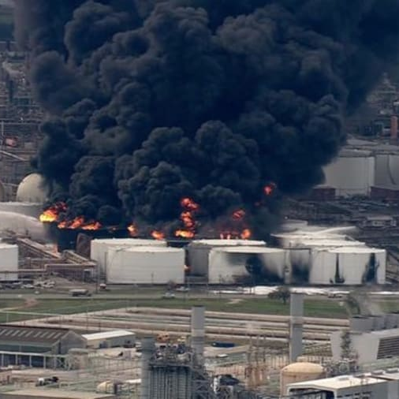
Escalation tank fire cases
Case examples of small fire incidents that escalated to multiple tank cases
Singapore – naptha tanks
ITC Deer park
Notes:
Examples from large AST incidents such as the one that occurred at Deer Park, Texas (a manifold release into the bund escalated to a multi tank fire) and Singapore (the fire spread from an initial floating roof tank to adjacent tanks) highlights that there may be smaller fire stages which if not successfully managed can allow escalation to larger scale events.

Slide 12
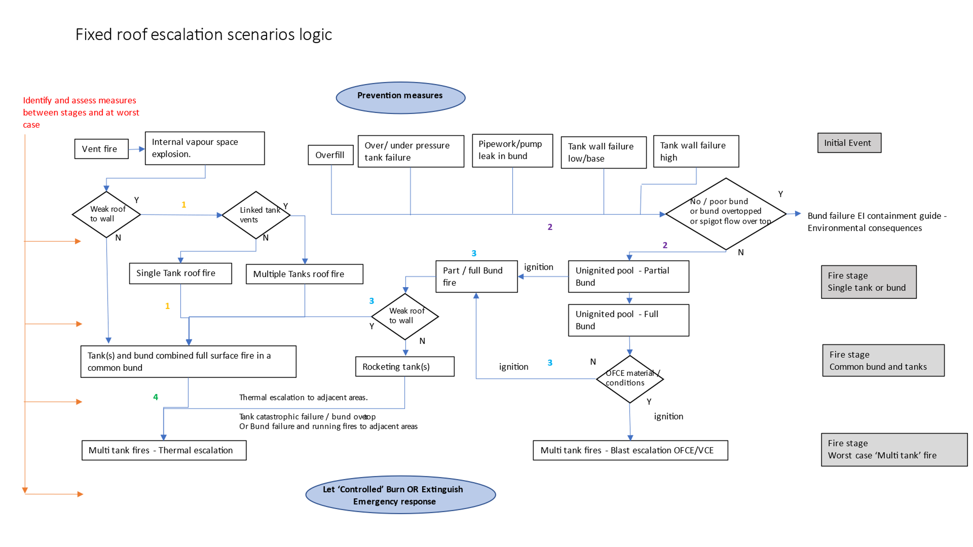
Different scenario cases
For AST sites there are a number of potential stable Fire stage scenarios over the incident time line.
Equipment for earlier hopefully smaller scenarios needs to be onsite, where as equipment for later larger cases is typically held off site and may be part of third party/mutual aid arrangements
Guidance methodology to identify different applicable fire stages and review equipment for that stage
Notes:
Hence it is as important to review the vulnerabilities of SECe for these smaller fire stages as well as for worst case ‘multi tank’ events. This is both to prevent escalation from smaller incident stages but also because equipment required for response to earlier smaller fire stages is more likely to be required closer to hand either as installed equipment or held on site. SECe required for later and larger fire stages is likely to include that held by offsite emergency response resources, such as emergency services and mutual aid groups. The guide and SECe review methodology breaks down AST incidents into a number of credible ‘stable’ incident stages. These should be developed from a review of any FEHM assessment already undertaken for the Specific AST location and operation. Stable incident stages are those where the AST fire remains basically the same size, before escalation to a larger fire size. Examples include rim seal fire before escalation to full surface fire, single tank fire (full roof fire) before tank failure and escalation to tank and bund fire, fire escalation one tank to adjacent tanks (Singapore incident) and bund fire before escalation to engulfed tanks in the bund (Deer park incident). In order to assist in this identification of applicable fire stages, and escalation events between fire stages, the guide has generated two example logic flow charts for Fixed and Floating roof ASTs. The example for fixed roof tank scenarios is shown in Figure 1

Slide 13
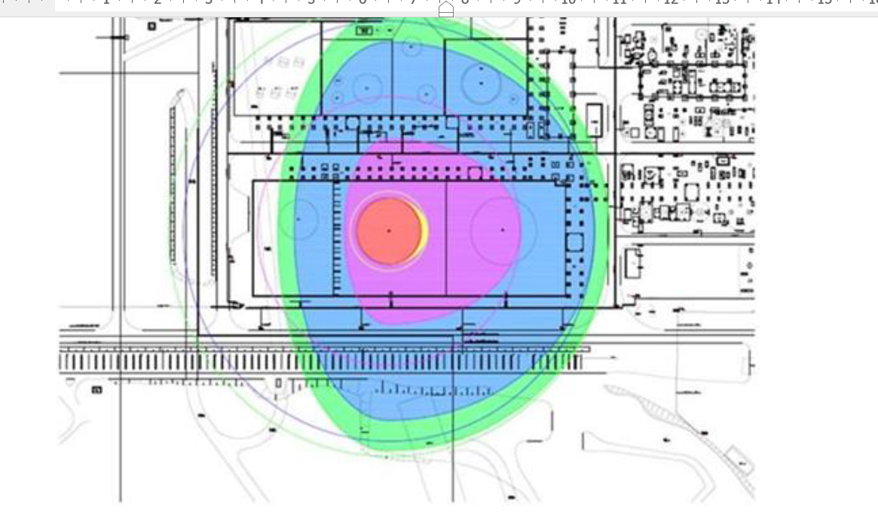
Escalation and survivability hazard ranges
For survivability – failure can result from exposure to the consequences from preceding fire stages.
The effects of fires and explosions has potential for both direct escalation and the failure of SECes within effective ranges
Escalation potential (confirm escalation targets and functional requirement)
Survivability
Hazard ranges – four categories
Unignited liquid and vapour
Smoke / Toxic
Overpressure and missiles
Thermal levels
Notes:
Hazard ranges are required to:
understand and confirm potential escalation targets (whether separation is sufficient), and as such to confirm equipment operational requirements in escalation management (functional requirements), and
determine survivability of SECe and human interactions from adverse exposure.
Four types of hazard range should be determined for their effects on SECes. These include:
Unignited liquid and vapour cloud releases
The spread of unignited material from credible accident conditions can be greater than ‘normal’ hazardous area classification distances.
Smoke and/or toxic vapours
This exposure can significantly affect related human interactions,
Overpressures and missile impacts
The effects of explosion from vessel failures if at pressure, deflagration (VCE), or from large Open Flammable Cloud Explosions (OFCE or Buncefield type events), and
Thermal levels
Pool fires and boil over events. As the scope is for ASTs, pressurised ignited jet releases are not covered in detail, but pump discharge type are mentioned.

Slide 14
Vulnerability
Failure to function when and where required
Performance failures
Survival failure
Performance failures
Operational
Time
Survivability
Consideration against hazard ranges
NaTech considerations as well as Hazard ranges exposure
Notes:
performance failures, through incorrect function or low availability/reliability, and/or failure of interdependent equipment, or failure to survive the adverse conditions present at particular fire stages.
Performance failures comprise direct design and operational elements, but also include time as a vulnerability factor. For example, is there sufficient time and/or speed of response during a fire stage in which to set up and correctly operate the required SECe, such as emergency response setting up portable fire and foam monitors etc.
Survivability vulnerability, that is vulnerability due to failure to survive an event, covers physical equipment survivability and human interaction survivability where these are within hazard ranges.
Survivability also includes resistance to severe environmental factors/events also known as NaTech events (Natural Hazard Triggering Technological Disasters). With climate change NaTech events will play an increasing role in exacerbating future AST incidents. For an example, a fire water lagoon used as a fire water source during the Buncefield event was reported to occasionally dry out or at least have low water levels during summer months. Questions should be asked, such as can events like site flooding, extreme wind, rain and storms affect AST incidents both to increase event likelihood but also lead to failure of emergency response? Other examples of NaTech survivability include delays in offsite resources arriving at the site (failure to meet required time in order to respond to smaller earlier stages in an AST incident), physical conditions on ERT members reducing their response ability, ability to control runoff to environmentally sensitive targets (larger runoff inventories or lack of capacity in drainage and containment systems), etc

Slide 15
Vulnerability acceptance or Additional measures
Emergency response – risk assessment (frequency assessment) not normally applied
Acceptability against RGP and emergency response plans developed through FEHM
For identified vulnerabilities at particular fire stages, then:
Performance failures – can these be resolved
Survivability - can relocate or protect
If not then determined:
If critical ( equipment has low chance of preventing escalation
Alternative equipment and/or plans available
If none of the above then determine Additional measures – hierarchy of measures – up to and including let burn
Notes:
Risk assessment in the use of SECe, as part of emergency response, is not normally undertaken. This is due to difficulty in defining both the ability of such equipment to effectively mitigating the escalation (uncertainty in effectiveness), and in defining the failure probabilities for the equipment. The selection and operational requirement of SECe, as part of emergency response, is typically made against Recognised Good Practices and should, through good FEHM, be developed into emergency plans. The failure, through a realised vulnerability, can lead to the overall failure of emergency response.
If vulnerabilities are identified, then the assessment treats this as a failure of that particular SECe. If the SECe cannot be modified or protected against the vulnerability, i.e., relocate the equipment, then the failure criticality should be determined for its acceptability. Acceptability of a SECe can be because the equipment is not critical in preventing escalation at the fire stage under review, or that other SECes are available as alternatives. The vulnerability review assesses the acceptability of the failure and if the failure is critical and there are no other acceptable alternatives, then additional measures should be determined.
The determination of additional measures applies the risk management hierarchy as an aid in the identification of such measures. This is: Inherent (elimination, separation, moderation), Passive (design and PFP), Active, through to Procedural. As mentioned previously significant vulnerabilities and a lack of feasible alternatives can lead to a planned ‘controlled burn’ emergency plan.

Slide 16
Assessment methodology
Similar to that in Appendix 6 of PSLG report, But
Performance considerations in addition to survivability
All potential ‘stable’ fire stages from unignited releases through to multiple tank fires (inc OFCE and boil overs)
Survivability also inc Human interactions and NaTech
Tabular recording approach
Familiar to HAZID
One for each potential fire stage
Examples provided in the guide
Notes:
not cover requirements for SECes at different stages in an AST incident, it also does not fully cover the performance requirements with the focus on survivability. The new EI guide applies a tabular approach, similar to in style to those familiar with HAZID. This tabular review table is broken down to individual tables reflecting each of the different fire stages that are applicable to the site-specific AST. The assessment record tables can be used to record summary details on hazard ranges at the fire stage, potential escalation targets and for each SECe, columns for the review of performance, survivability, contingency measures (alternative SECes), acceptability /addition measure and comments.

Slide 17
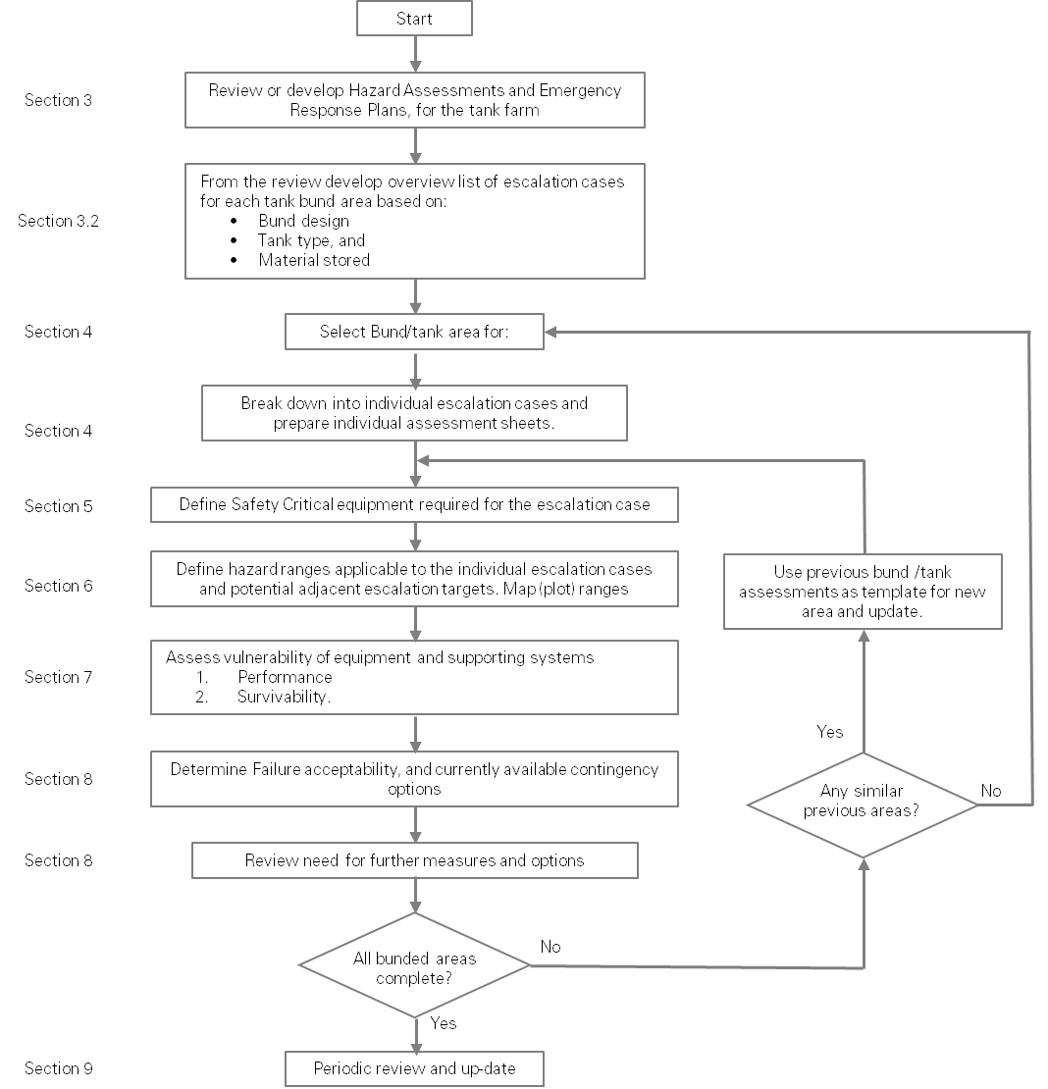
Assessment methodology
Notes:
The overall vulnerability review and assessment process is shown in a sequence flowchart within the guide.
Run though the flowchart

Slide 18
Summary
Listing of SECe for emergency response
Need for more in depth methodology for review and assessment of SECes
Performance in addition to Survivability
Various different fire stages in possible AST incidents
Human interactions
Hazard Ranges for survivability
Unignited gas, Smoke/toxic vapours in addition to thermal and overpressure/missile
Consideration of NaTech in survivability
Means for vulnerability acceptance – or additional measures
Some example tabular assessment templates
Notes:
Highlight of the key contents of the guide.
Think Performance standards (for those with offshore experience) merging with Occupied buildings risk assessments

Slide 19
www.ThorntonTomasetti.com
Notes:
Thank you – and questions

