Slide 1
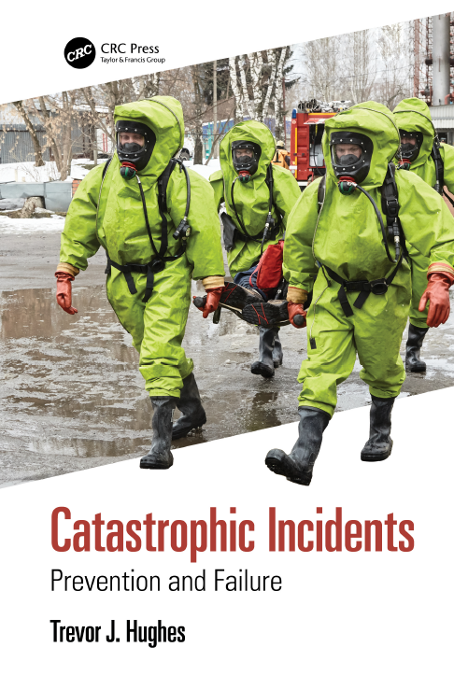
Catastrophic Incidents :
Prevention and Failure
Trevor J. Hughes
Research for the book
For HAZARDS 33 2023

Slide 2
About the presenter..
Trevor J. Hughes
Chemical Engineer
28 years in manufacturing : process engineer, design engineer, production manager , site manager in high hazards chemical manufacture
14 years in management consultancy, primarily in safety, in UK offshore, Kazakhstan, Russia, Ukraine and Saudi Arabia.
This work led to a question…

Slide 3
Objective of Research
… are safety improvement projects durable?
For last 8+years as an insurance risk engineer I surveyed over 100 oil,gas and petrochemical sites.
What works well ?
And what is not working well?
In process safety improvement .
I started by examining over 80 incidents

Slide 4

Agenda
Incidents and Experiences
Spill – Foyle
Fukushima Daiichi
Variations in Safety Culture: Influence of National Characteristics
Outcome of the Analysis
Influencing the Manager’s Moral Compass
Potential Solutions
Tertiary Education
Risk Disclosure
Industries Considered:
Oil and Gas
Chemicals
Mining and Mine Waste
Air Transport
Nuclear Power
Utilities
Agriculture
Process Industry Infrastructure
Metallurgical
Civil Infrastructure (hospitals etc)
Military and Defence Establishiments
Emerging Technologies

Slide 5
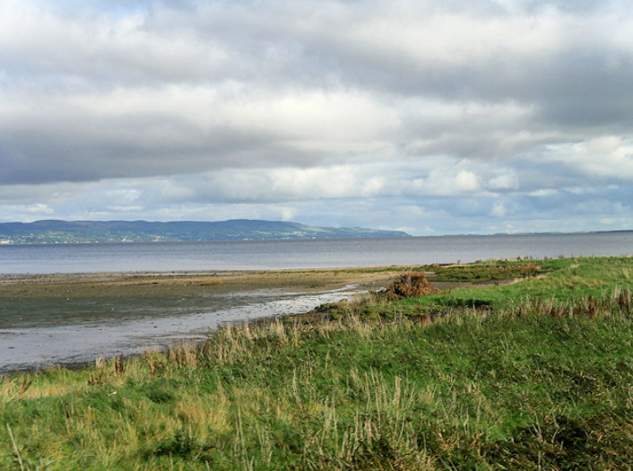
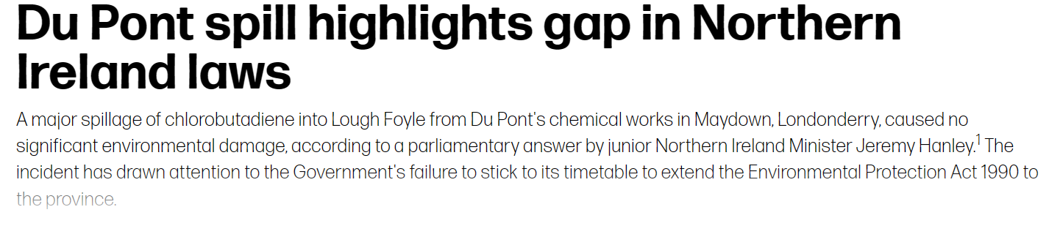
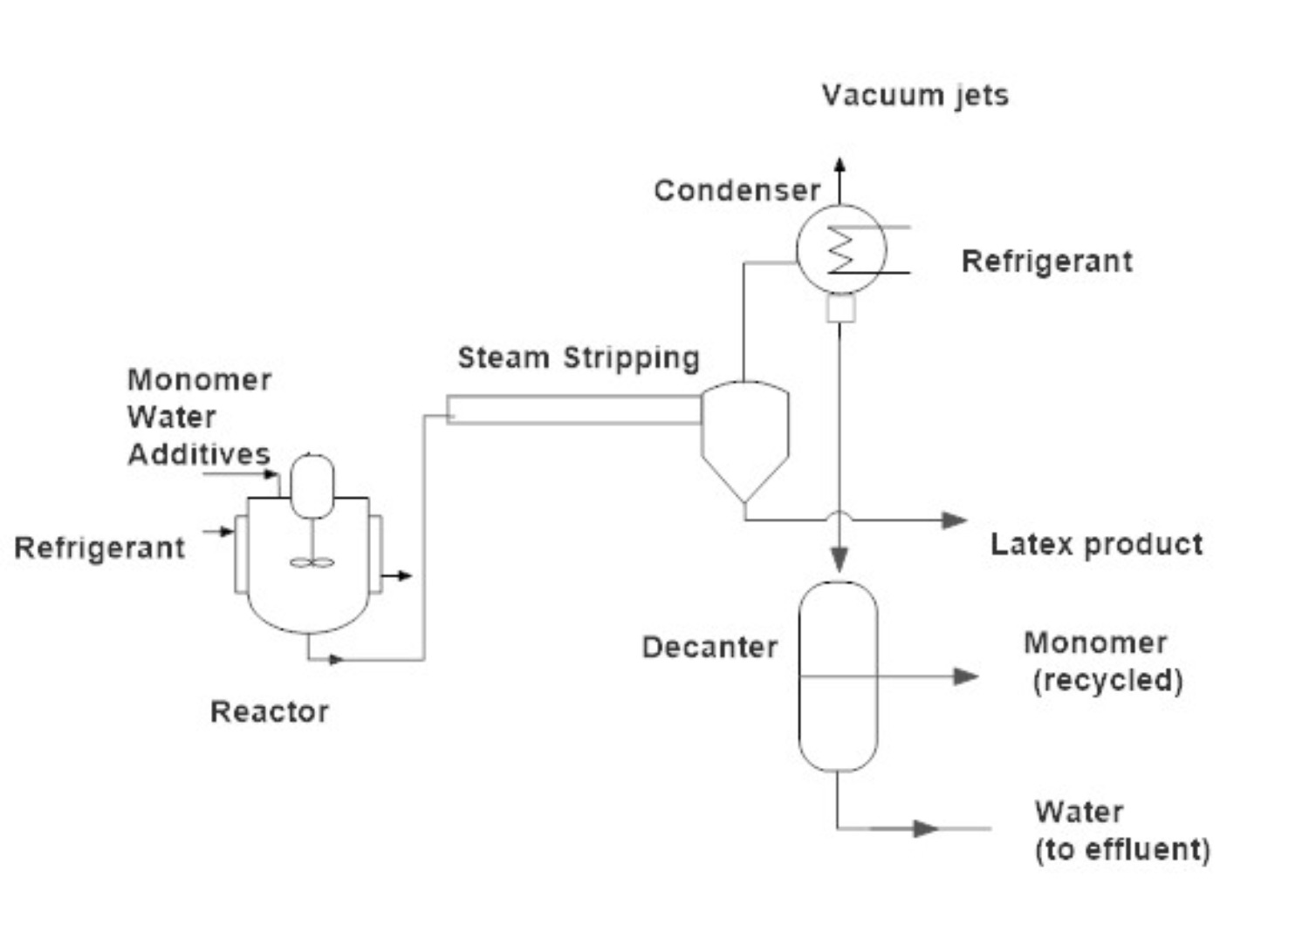
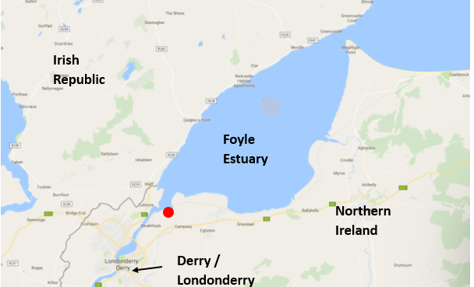
Example Analysis - Spill - 1992

Slide 6
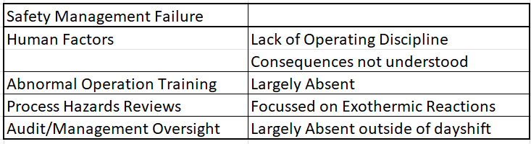
Spill – Analysis
Emphasis in previous Yield work was on Normal Operation
A ‘Convenient’ alternative was chosen by Nightshift for De-Icing the Condensers on the Roof
Consequences:
Scrutiny from divergent political parties and media
Reputational damage

Slide 7
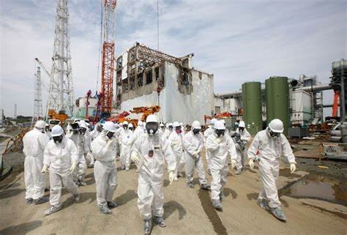
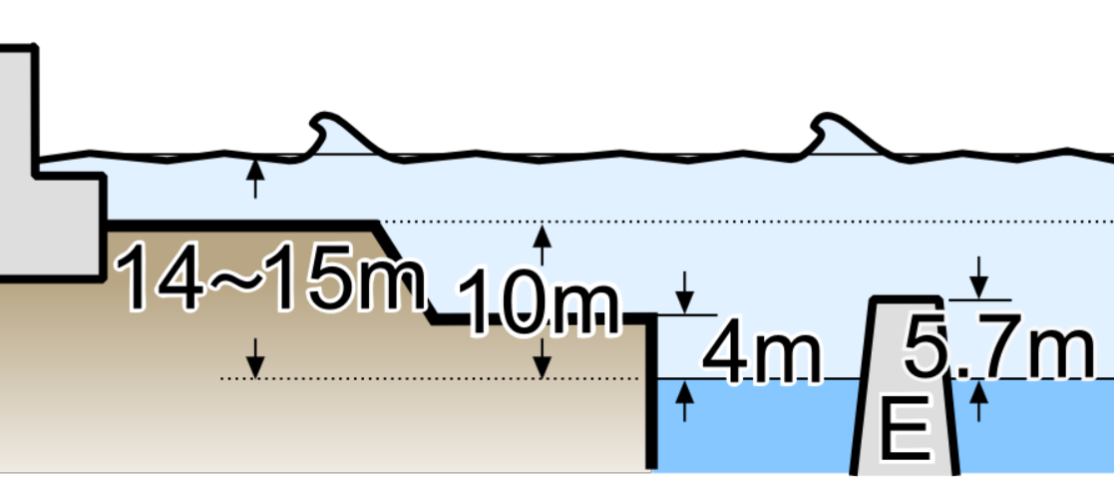
Example Analysis - Fukushima Daiichi 2011
Earthquake caused widespread power outage and reactor SCRAM
Subsequent tsunami overcame existing tsunami wall
Water knocked out both emergency diesel generators
Reactor cooling lost
High temperatures caused hydrogen emissions resulting in explosions

Slide 8
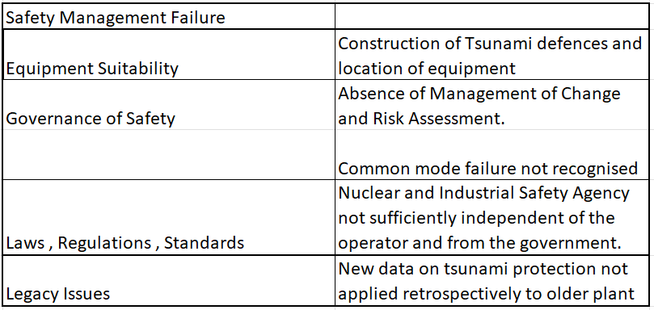
Fukushima Daiichi 2011- Analysis
Atomic Energy Society of Japan: “Nobody had considered that measures against the loss of all AC and all DC power were actually required. Reactor personnel had never received the relevant education and never received hands-on training. Emergency manuals had been premised on the assumption that at least DC power was available".
Consequences:
Extensive property damage
Large radiation release
Long term displacement of residents
Carnegie Endowment for International Peace “most Japanese safety rules follow from deterministic assessments. Regulations do not require probabilistic safety assessments to demonstrate that plants are protected against the threat of severe external events”

Slide 9
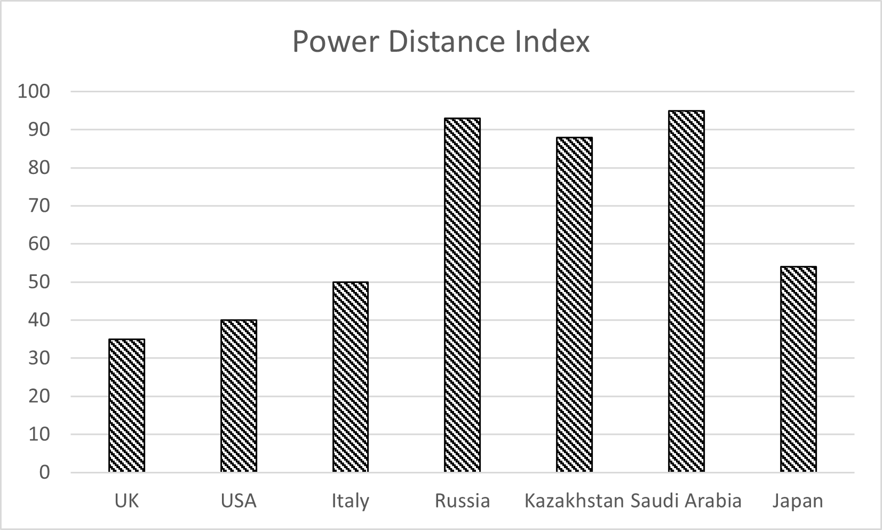
Variations in Safety Culture influenced by Natiaonal Characteristics?
By courtesy of (C)Hofstede Insights, Itim International Oy

Slide 10
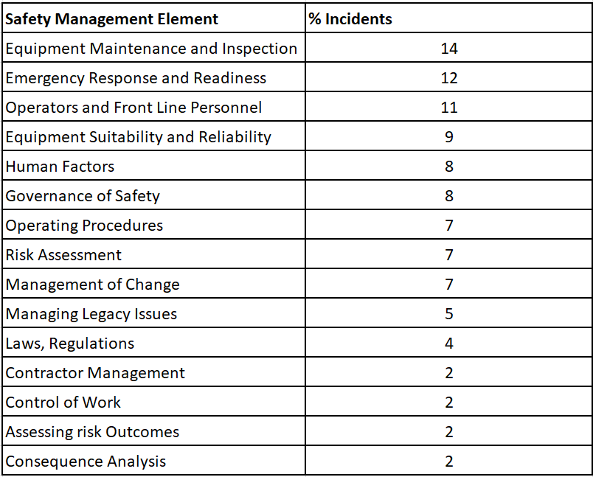
Safety Management Element Failures
– Which has most importance?
Frequency and Importance do not equate

Slide 11
Solutions ?
–
The Manager / Company won’t change on his/her own!
The Influencers of the Manager / Company can change Management / Organisations
What guides a person’s Moral Compass

Slide 12
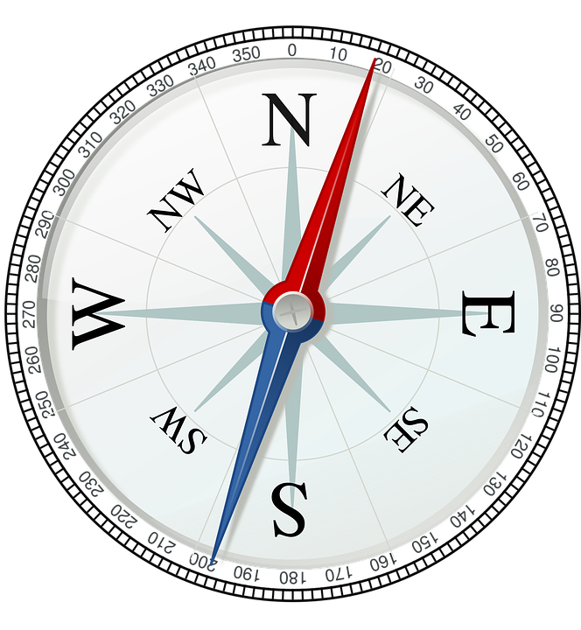
What Guides the Moral Compass of a Manager – (or Each One of Us?)

Slide 13

Solutions ?
– Significant but pragmatic changes
Further Improvements in Risk Management Methodology
Changes to Leadership Mindset, and Qualifications
Changes to Government and Legal Structures
Education: primary, secondary , tertiary
High Reliability Organisations – concept implementation
Public Disclosure of Risk

Slide 14
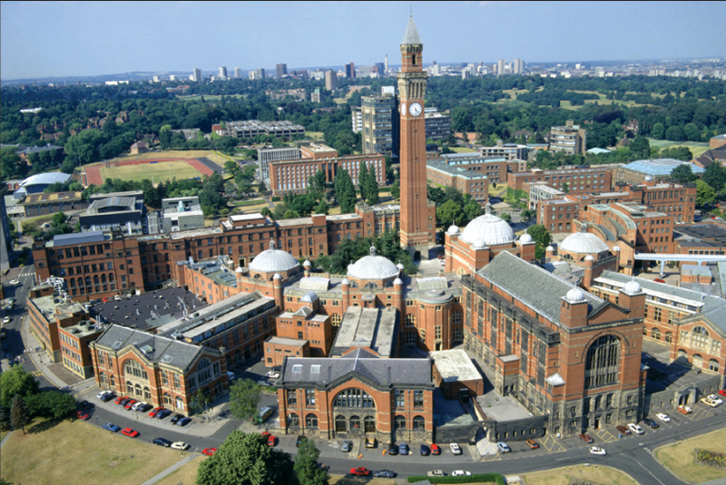
Influencing the Moral Compass -Tertiary Education
Of approx. 30 Chemical Engineering undergraduate courses in the UK, 30% do not have module explicitly called Process Safety or similar.
Where there are modules on Process Safety they amount to less than 15 credits, or less than 5% of the available credits for that year.
Mechanical Engineering courses rarely include Process Safety or Loss Prevention, but also strangely seldom mention Inspection or Mechanical Integrity.
A Major Reason:
Teaching Interests and Research Interests are very much aligned, so the lecturing staff don’t have the background to teach in Process Safety and Loss Prevention

Slide 15

How you can influence:
Contact your local university and/or Alma Mater and discuss this question:
Chem Eng: How much time is dedicated to Process Safety education?
Mech Eng: How much time is dedicated to Asset Integrity / Inspection?

Slide 16

Influencing the Moral Compass Public Disclosure of Risk
But there are good examples:
Expectations not met:
Annual Financial Report
Sustainability Report
10-K and 20-F Filings (US)
My Proposal:
Safety Case – public access
Safety Case – expand coverage
Separate Global Reporting Initiative Standard declaring Catastrophic Risks

Slide 17
Public Disclosure of Risk –
Global Reporting Initiative (GRI)
International Independent Standards Organisation intended to help businesses communicate their impacts on issues such as:
Economic performance
Market Presence
Indirect Economic Impacts
Procurement Practices
Anti-Corruption
Tax
Energy
Effluents and Waste (Past spills are required to be reported)
Supplier Environmental Assessment
Employment
Labour/Management Relations
Diversity and Equal Opportunity
Training and Education
Child Labour
Security Practices
And … Occupational Safety and Health
Something Missing?

Slide 18
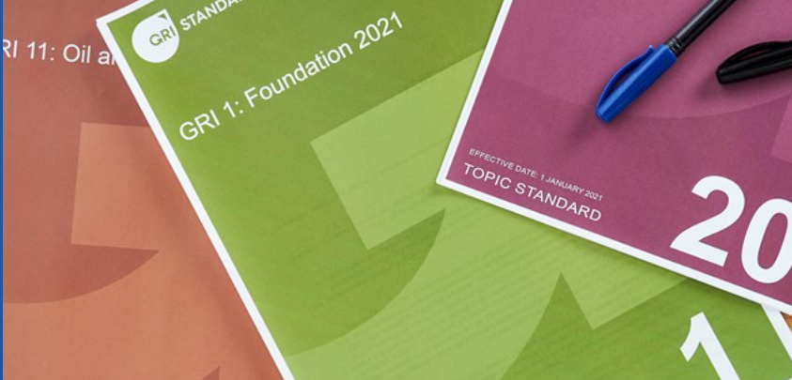
A GRI Standard on Catastrophe Prevention
“
GRI Reporting Proposals resulting from my research include the declaration of:
Tier 1 and Tier 2 Incidents
Inventories of hazardous materials per Seveso standard
Current Residual Risks
Planned Risk Reduction Activities
Identified Legacy Issues relating to Catastrophic Risk
Audit Status : Internal and External

Slide 19
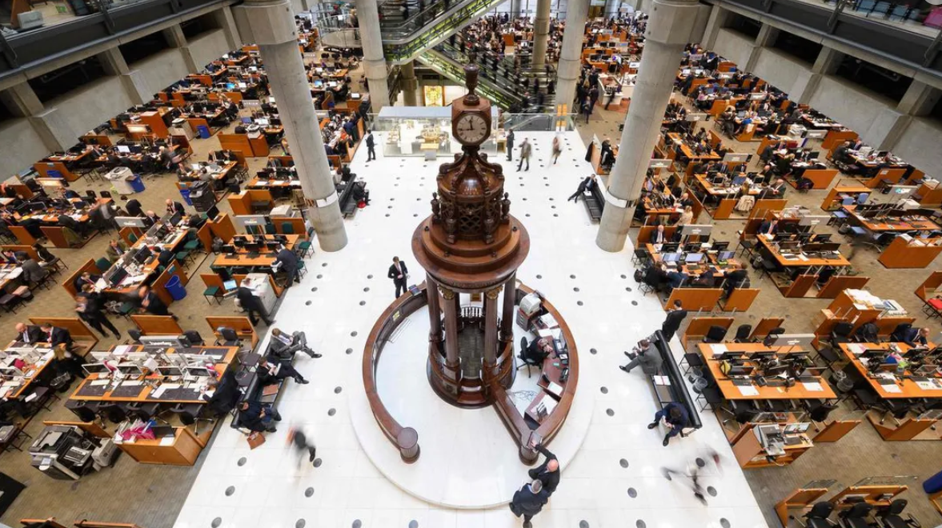
Closing Remarks:
A plant monthly report to Management on Performance versus
Insurance Recommendation Completeness: before survey
Insurance survey assessment – NONE of the recommendations were complete
The plant monthly report after survey
A principle of HROs – High Reliability Organisations
‘Embrace the Red’

Slide 20

Trevor J Hughes
trevor@trevorhughes.co.uk
www.trevorhughes.co.uk
Open for business through 2024!

