Slide 1
Lessons Leaned from Past Incidents:
WestJet Flight 2652
Abbie Harvey – UK Civil Aviation Authority
Notes:
Welcome – mention the nature of the presentation, references and disclamer

Slide 2
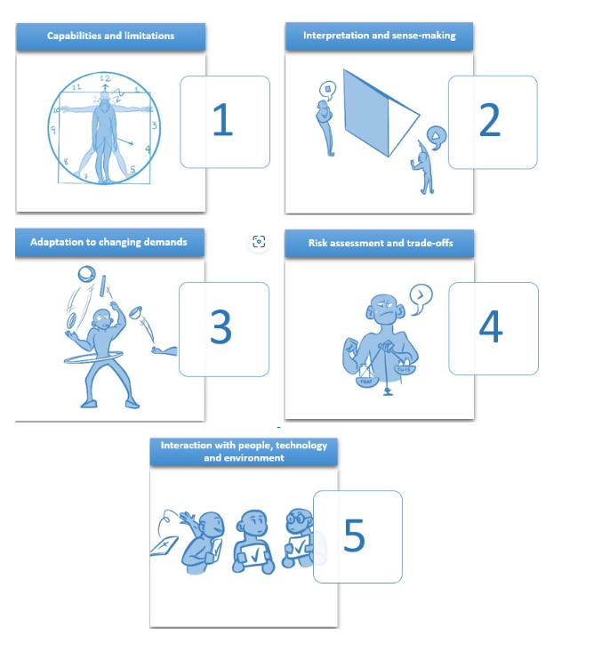
ICAO 5 Principles of Human Performance
Principle 1: People's performance is shaped by their capabilities and limitations
Principle 2: People interpret situations differently and perform in ways that make sense to them
Principle 3: People adapt to meet the demands of a complex and dynamic work environment
Principle 4: People assess risks and make trade-offs
Principle 5: People's performance is influenced by working with other people, technology, and the environment

Slide 3
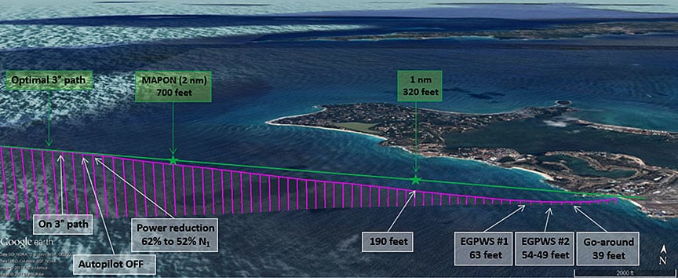
Overview of the Incident
On 07 March 2017, a WestJet Boeing 737-800 aircraft (registration C-GWSV), operating as flight 2652, was conducting a scheduled instrument flight rules (IFR) flight from Toronto International Airport, Ontario, to Princess Juliana International Airport, Sint Maarten.
During the approach to Runway 10, the aircraft deviated from the normal descent path. When the aircraft was 0.30 nautical miles from the runway threshold it had descended to an altitude of 40 feet above the water.
The crew then initiated a missed approach.
Notes:
Given that visibility was below the limits for conducting a second approach, the flight was cleared to hold until conditions had improved. After visibility improved, the crew conducted a second approach and landed at 1618 AST without further incident.

Slide 4
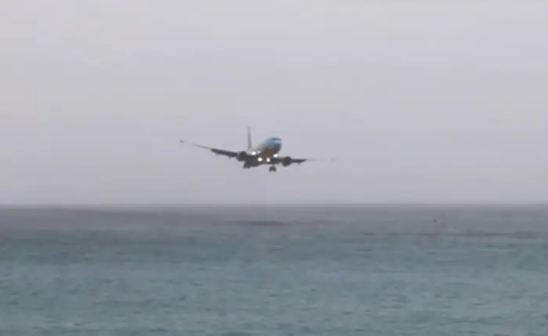
Principle 1: People's performance is shaped by their capabilities and limitations
A person has a range of capabilities may be physical or mental. These capabilities apply to people’s daily work and keep the system functioning safely, effectively, and efficiently. However, the same capabilities that make people so critical to safety, system resilience and operational success may also make them susceptible to errors and to unwanted behaviour.
Principle 1 in this incident:
Very experienced crew, meaning they could be more comfortable in low visibility conditions.
This may have made them less likely to go around initially, as they may have been confident in their abilities to land the aircraft in these conditions.

Slide 5
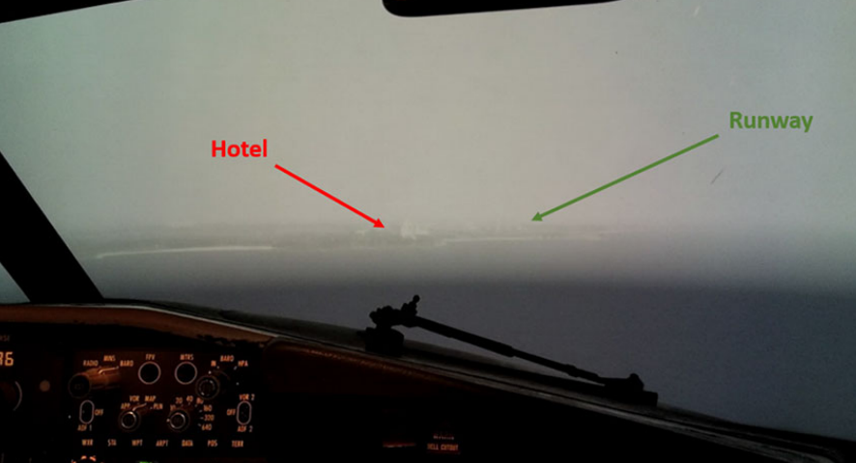
Principle 2: People interpret situations differently and perform in ways that make sense to them
People are always trying to make sense of the world around them. They look for patterns and predictability. However, we all interpret situations differently. People do not go to work with the intention of making an error. Generally, people behave and make conscious decisions in ways that make sense to them, and that they think will achieve a good outcome.
Principle 2 in this incident:
Due to poor visibility, it was difficult to see the runway. A hotel just north of the runway appeared very similar to how the pilots expected the runway to look, causing them to aim for this instead of the actual runway.
As they were focused on the hotel, they descended too low, thinking the runway was closer than it was.
No visual reference to hight was available to the crew, due to poor visibility and flying over water.

Slide 6
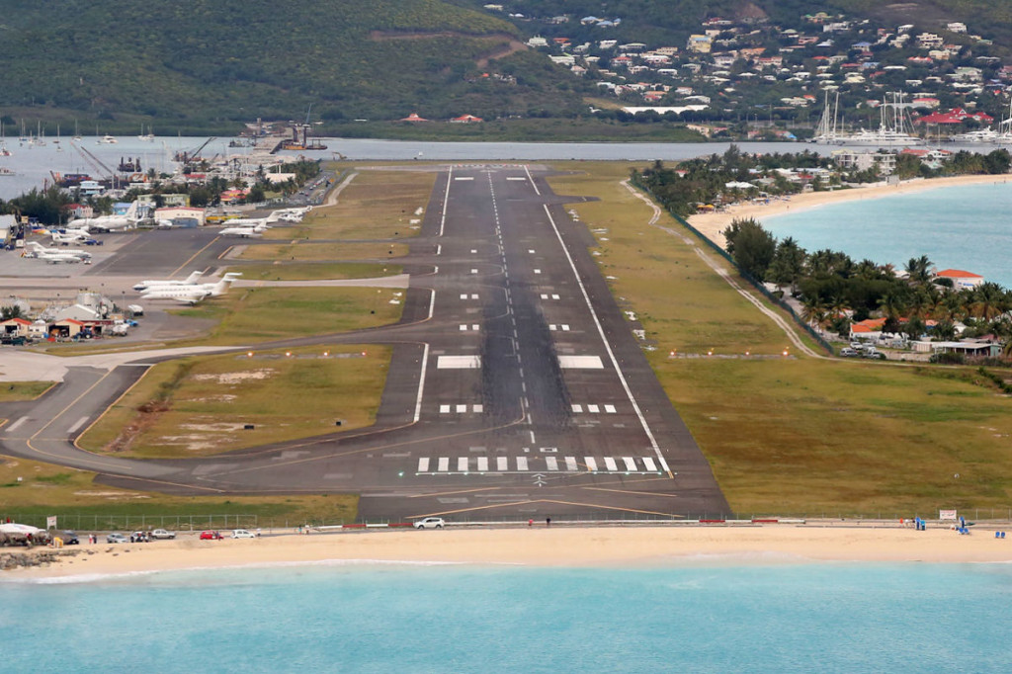
Principle 3: People adapt to meet the demands of a complex and dynamic work environment
People are key to any system, creating resilience by constantly adjusting and adapting to unexpected situations. To address emerging and changing demands, rules and standard operating procedures should be reviewed and updated regularly to meet the demands of a complex and dynamic work environment.
Principle 3 in this incident:
Complex terrain surrounding the airport – close to beach on approach and steep terrain surrounding the go around airspace
Unexpected poor visibility occurred, and the crew were not informed of this by air traffic control (ATC).
No Instrument Landing System (ILS) guidance available at the airport – therefore a slightly more complex approach needed to be used.

Slide 7
Principle 4: People assess risks and make trade-offs
The aviation work environment presents people with conflicting goals. Any activity in aviation must balance safety objectives and other organizational objectives, such as on-time performance, cost savings and environmental protection. For individuals, these conflicting goals can sometimes translate into difficult operational trade-offs: efficiency vs. thoroughness, speed vs. accuracy, cost vs. benefit, short term vs. longer term benefits, and personal vs. organizational goals.
Principle 4 in this incident:
Crew may have become too focused on making the landing, due to poor visibility, complex terrain on go around and high workload.
Crew may have deemed the risk of going around higher than the risk of completing the landing.

Slide 8
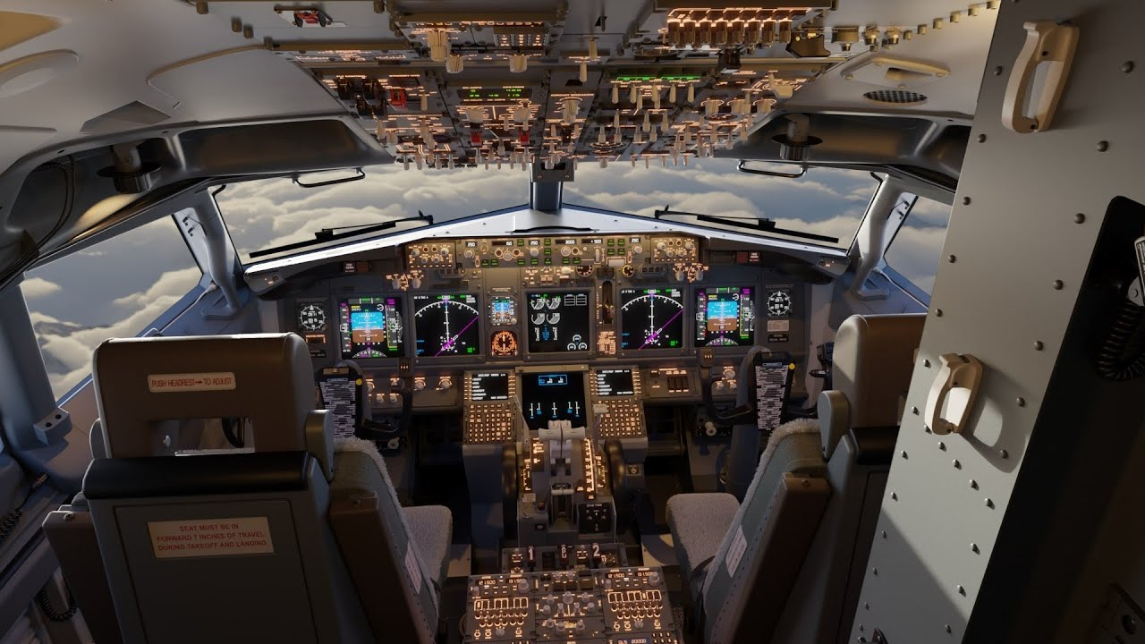
Principle 5: People's performance is influenced by working with other people, technology, and the environment
Human performance can be positively or negatively affected by interacting with other people and with all elements of the socio-technical system. People's performance is also influenced by the technology used and by the environment in which they perform.
Principle 5 in this incident:
Bad weather created a higher workload, making decision making more difficult and error more likely.
Difficult terrain around the airport increased perceived workload.
Due to high workloads, the pilots didn’t get a further weather briefing after the one they got just before the approach started, meaning they were unaware of the worsening weather and visibility.
Crew responded to the automated ‘Too Low, Terrain’ warning as per the company’s standard operating procedure
Notes:
The enhanced ground proximity warning system (EGPWS) alert response procedures of the operator differ from those in the guidance material of the EGPWS manufacturer - crew responded to the automated ‘Too Low, Terrain’ warning as per the company’s standard operating procedure

Slide 9
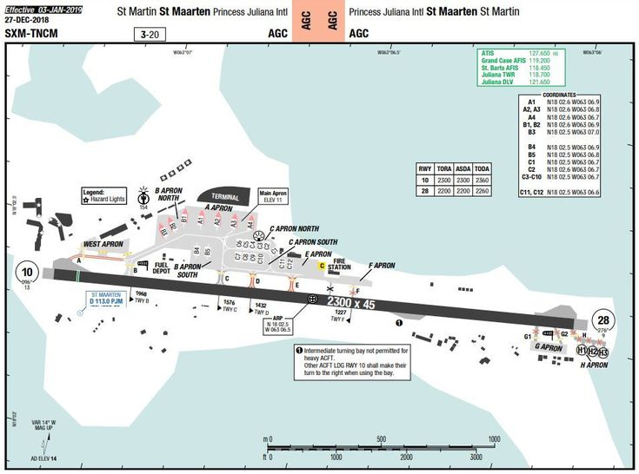
Lessons Learned
Following the occurrence, WestJet conducted a company investigation and developed a corrective action plan.
A safety communication letter was sent to all pilots, explaining the incident and providing information regarding possible challenges and threats at the Princess Juliana International Airport
Revision of the route and aerodrome qualification document for the airport
Provision of a flight safety briefing on the incident to all crews at the annual ground school
Design of a new instrument approach at the airport .

Slide 10
How can this be applied to other industries?
The ICAO 5 Principles of Human Performance can be applied to any industry, as these principles reflect how people work and perform within any system, not just aviation.
Understanding the principles of human performance can be vital to creating a safe, successful, and efficient working environment, no matter what industry staff are involved with. This is due to the fact; safety is all about the management of risk. Human performance considerations should be central to a thorough risk assessment (ICAO, 2021)
By considering the human performance element of safety, we can set employees up for success. Each of the ICAO 5 Principles of Human Performance can help industries to understand how individuals perform, based on their surrounding environment and the information available to them at the time.

Slide 11
Thank you!
Please feel free to contact me at abbie.Harvey@caa.co.uk if you would like to discuss the ICAO 5 Principles of Human Performance – or any other HF topic!

