Slide 1
The Platypus Philosophy
Trish Kerin

Slide 3
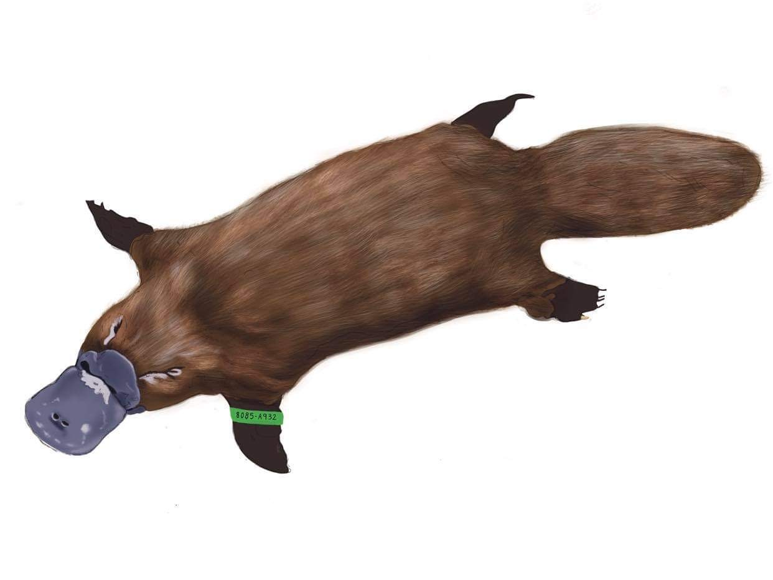
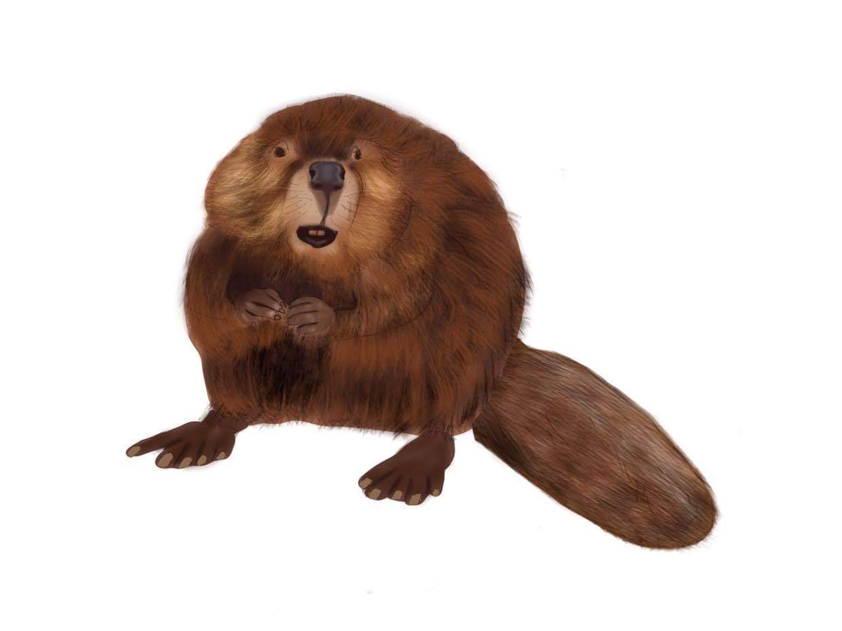
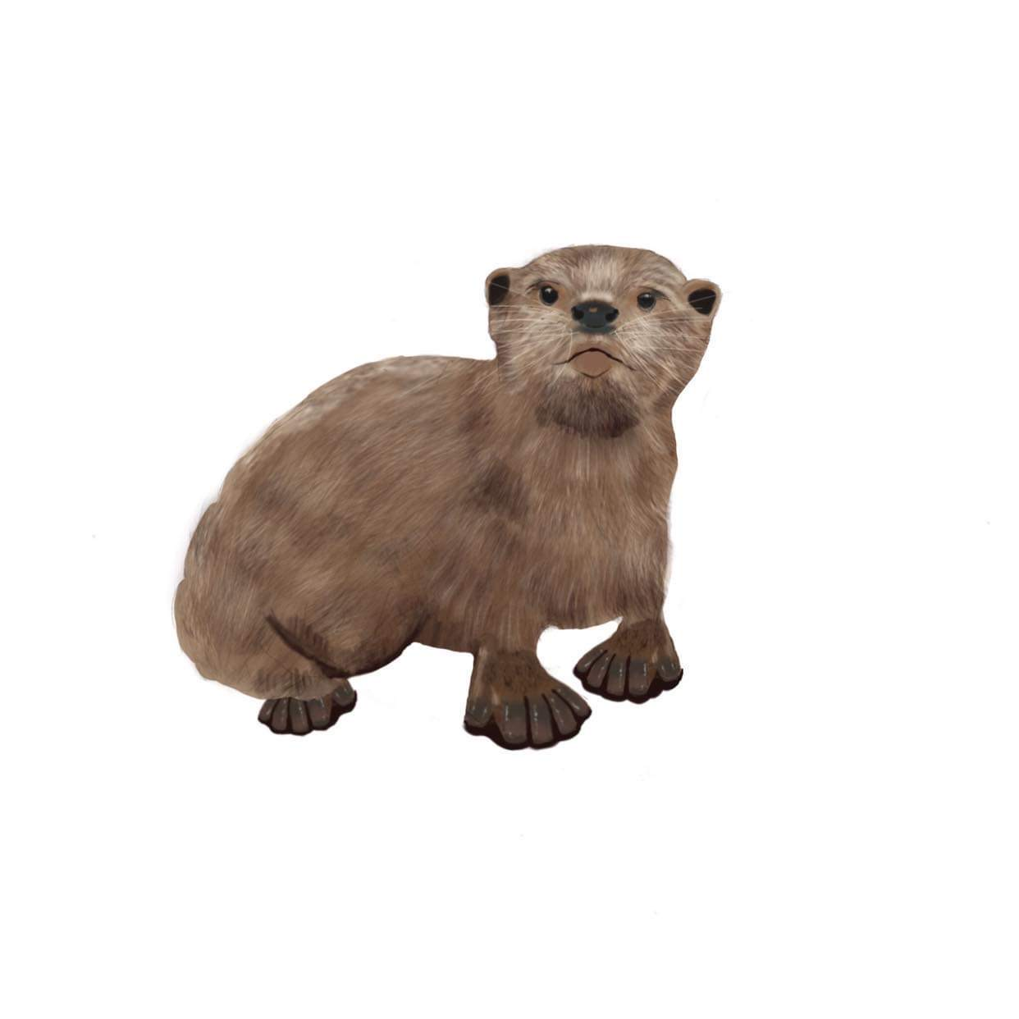
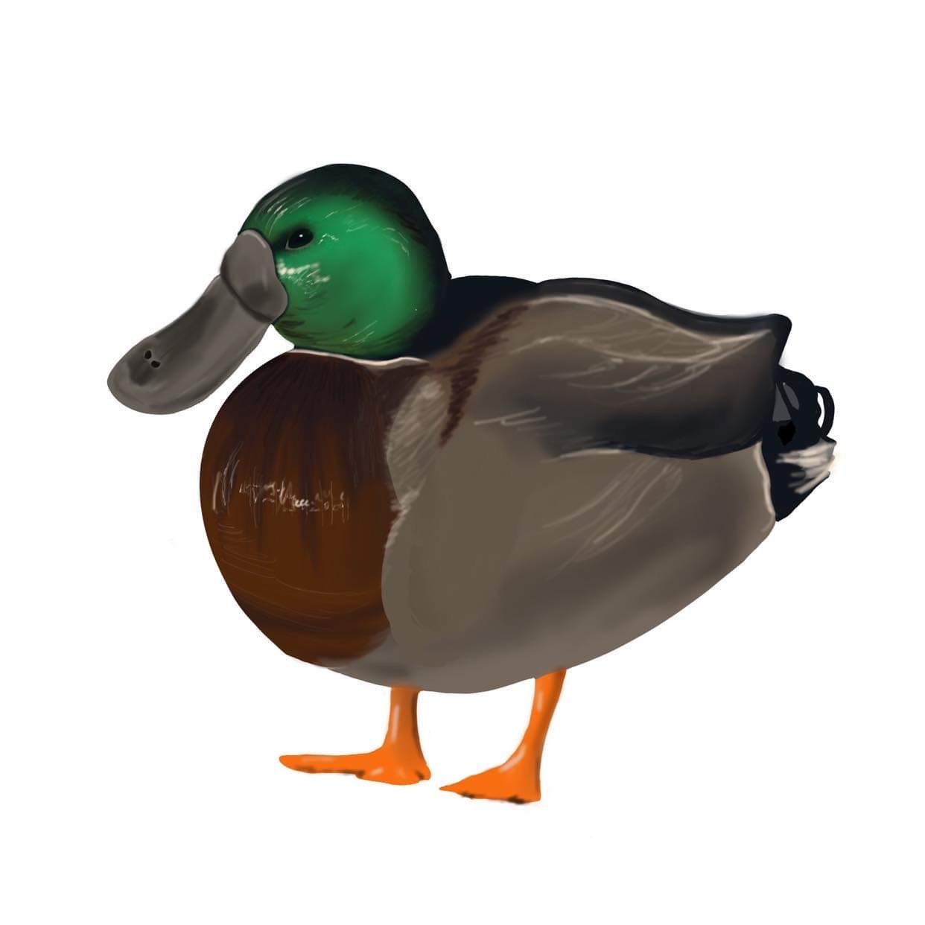

Slide 4
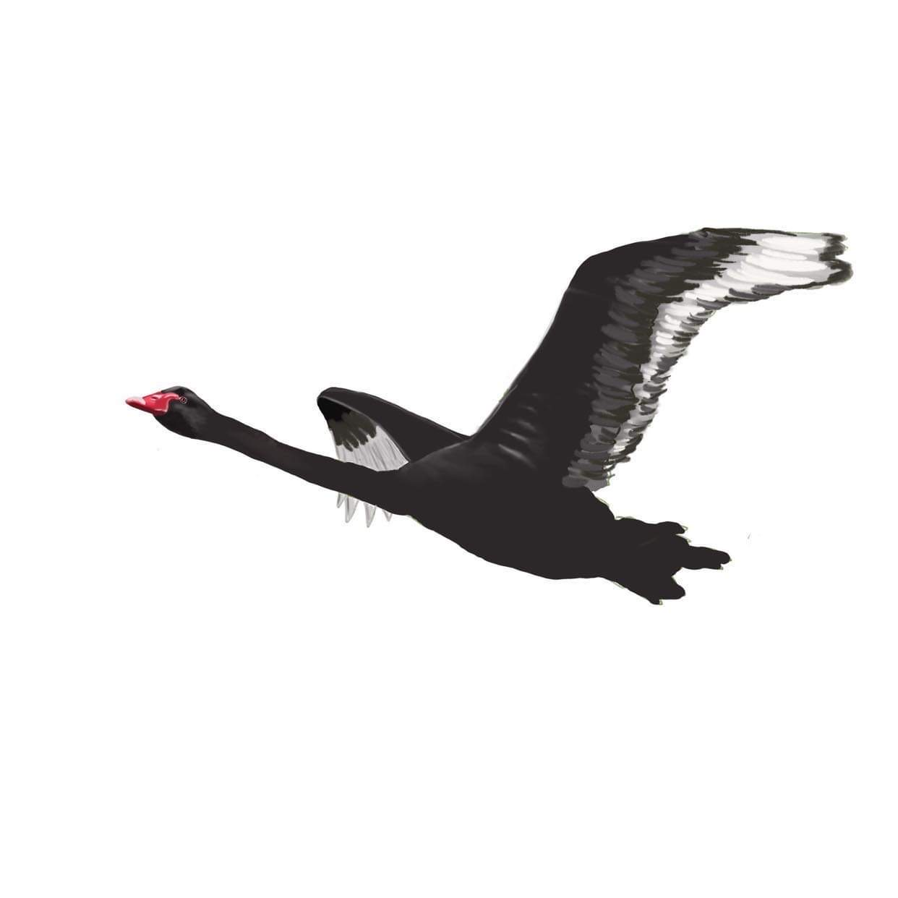

Slide 6
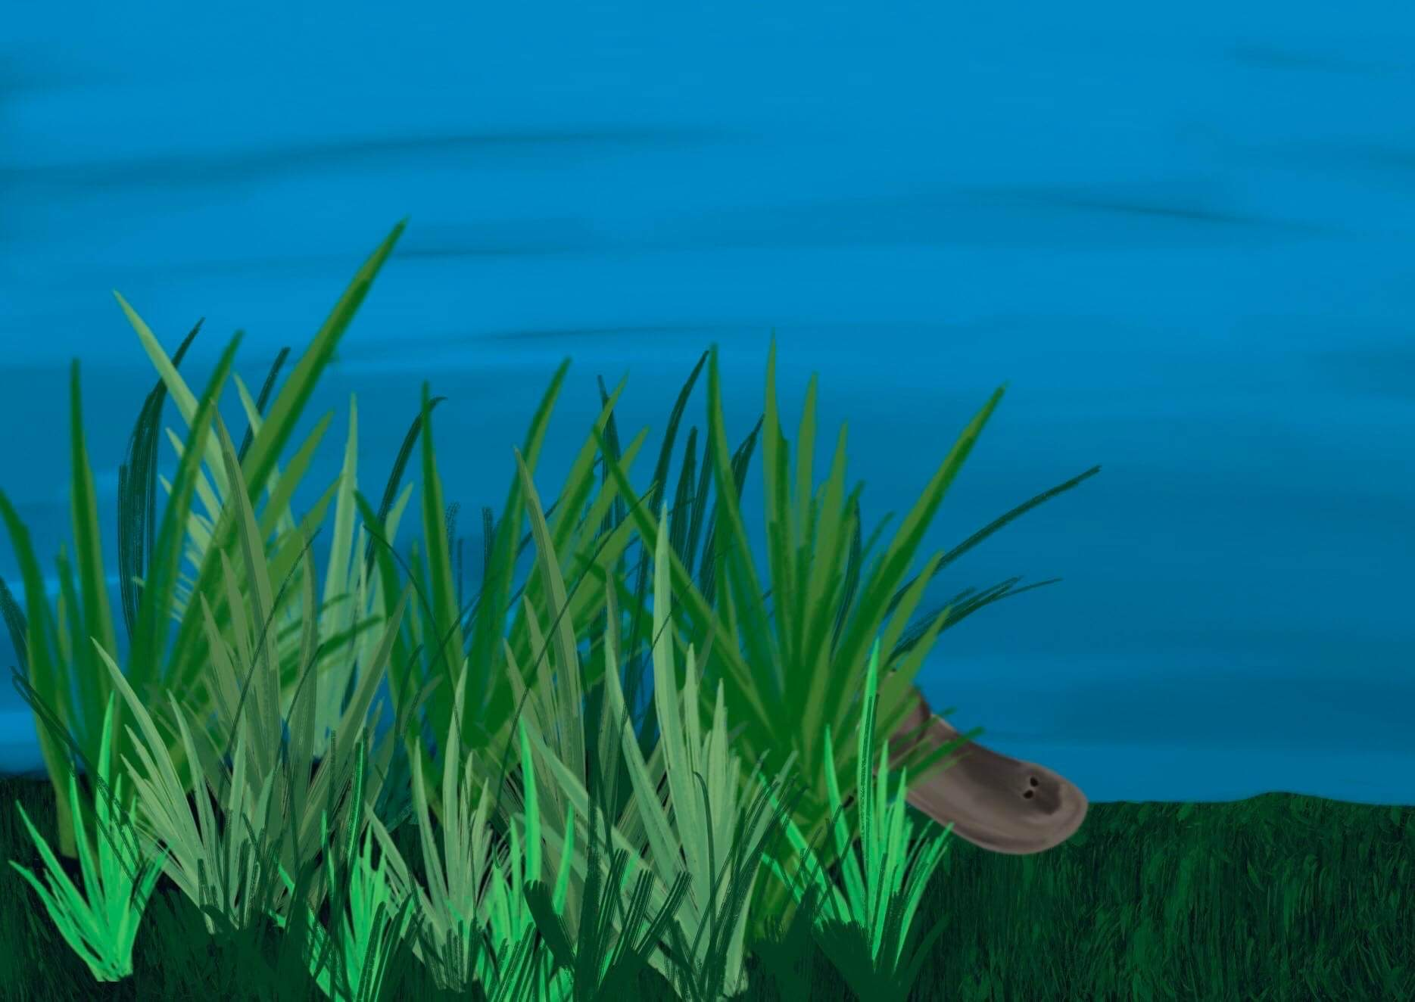

Slide 7
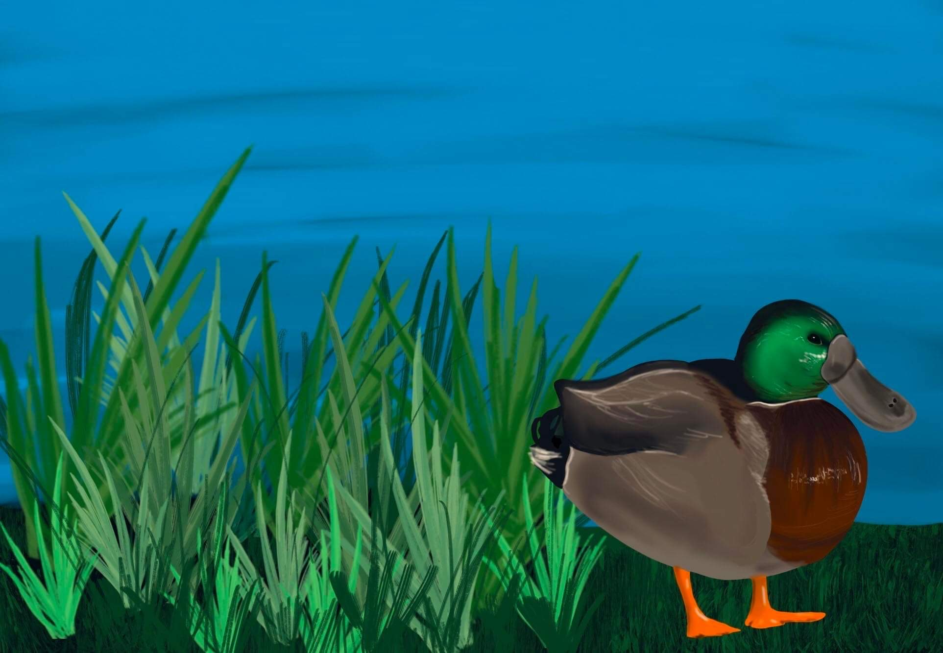

Slide 8
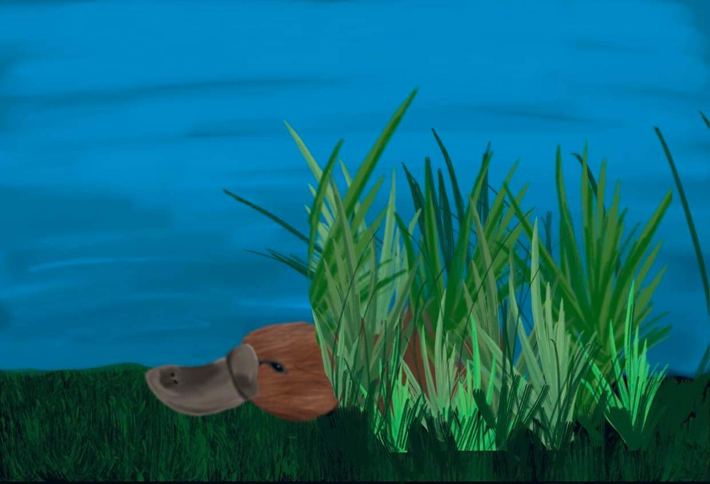

Slide 9
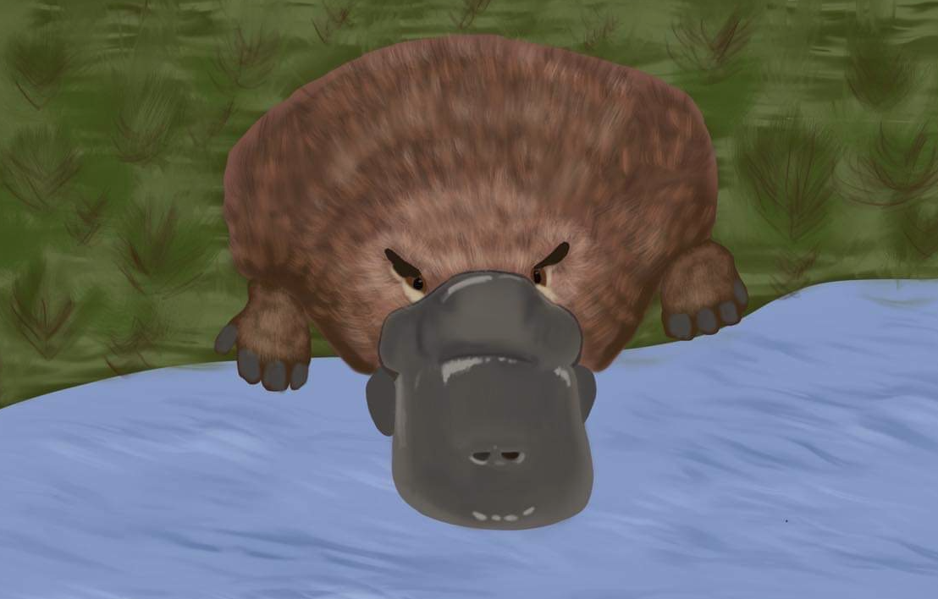

Slide 11
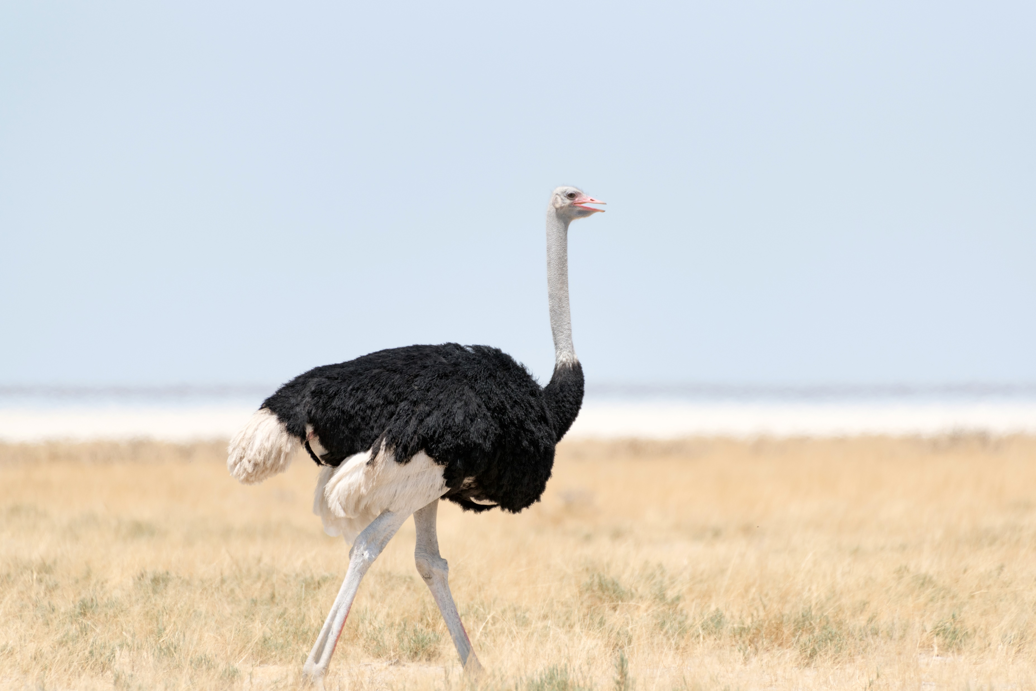
“I don’t want to find a platypus here – if I did I would have to do something about it”
Ostrich Effect

Slide 12
“We don’t have any platypuses here, only beavers, I see their tails all the time”
WYLFIWYF
Confirmation Bias

Slide 13
“Platypuses only exist in other places, they are never here”
Anchoring

Slide 14
“If we do have a platypus it is nothing to worry about, they are so cute, what harm could they do”
Framing

Slide 15
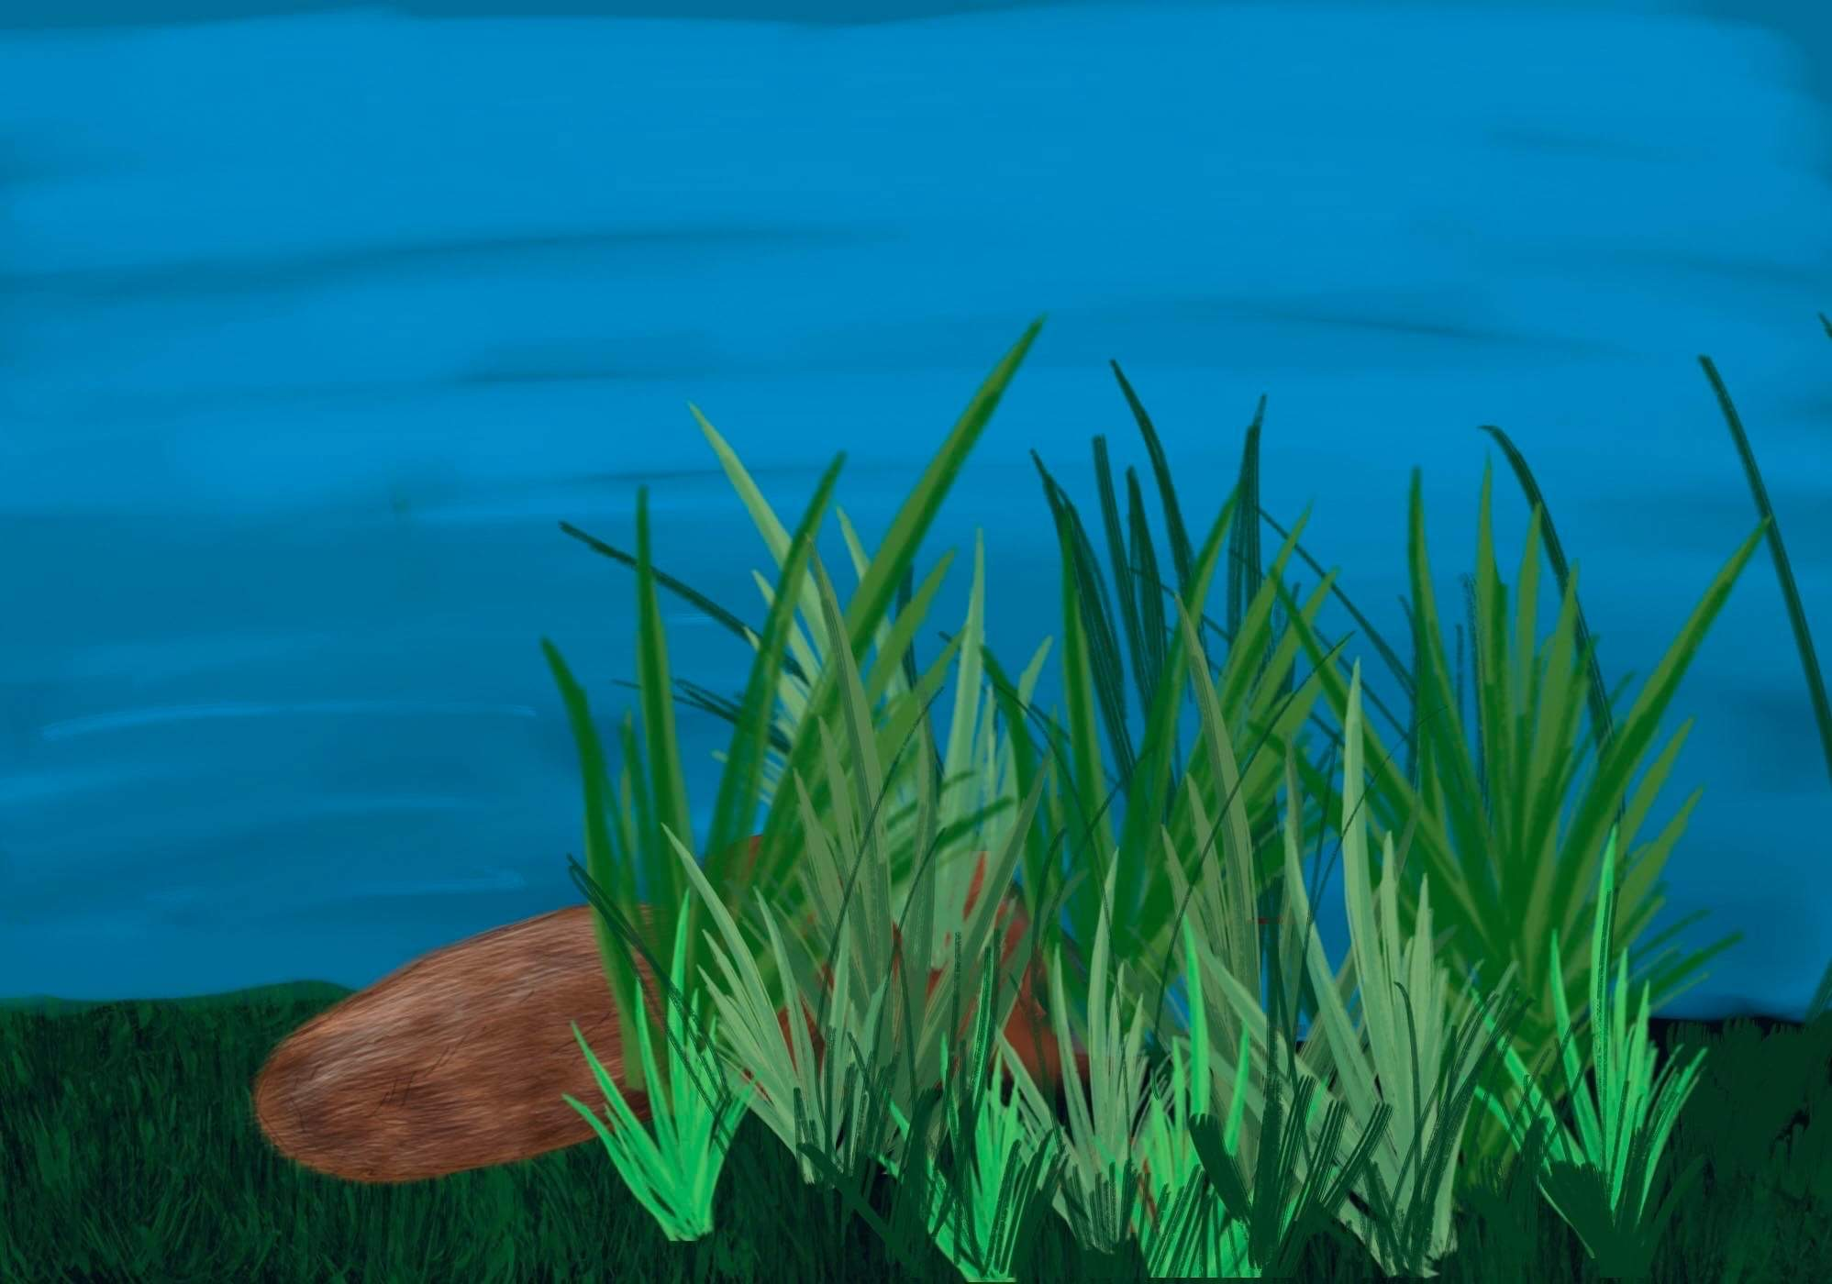
Illusory truth effect
“We see signs of a platypus all the time, but never a whole one, so they are nothing to worry about”

Slide 16
“Everyone here knows about the platypuses and how to manage them”
Curse of knowledge

Slide 17
“I have seen some signs of a platypus, but it looks more like a duck to me”
Pareidolia
;-P

Slide 18
“I have never seen a platypus so I don’t believe they actually exist”
Anecdotal fallacy

Slide 19
“Platypus are very rare so it is not likely we have any here”
Neglect of probability
%

Slide 20
“I keep looking for them in the desert but can’t find any, so we don’t have them”
Information bias

Slide 21
“Even if we have platypuses here, we can manage them”
Illusion of control

Slide 22
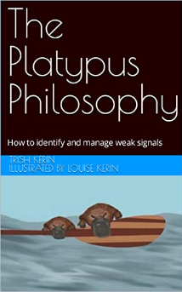
The Platypus Philosophy
The input
The analysis

Slide 23
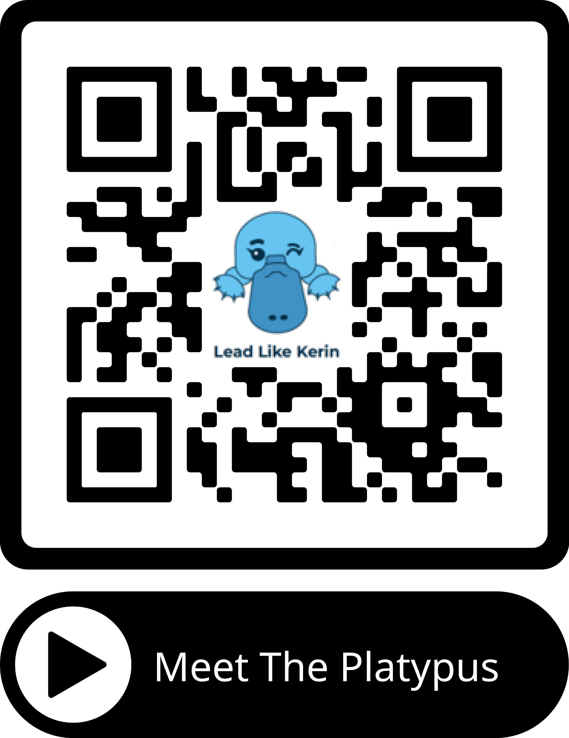
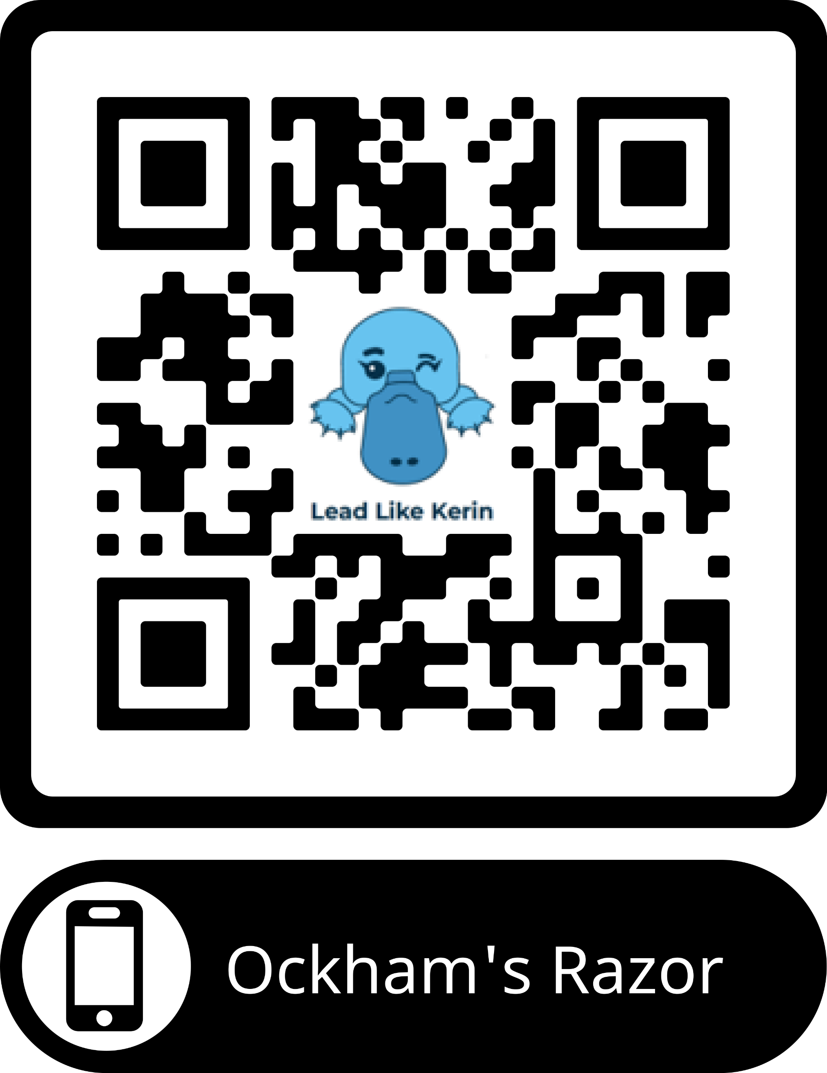

Slide 24
What is the IChemE Safety Centre?
Current Operating and Industry Partners

Slide 25
Current supporting partners and collaborators

Slide 26
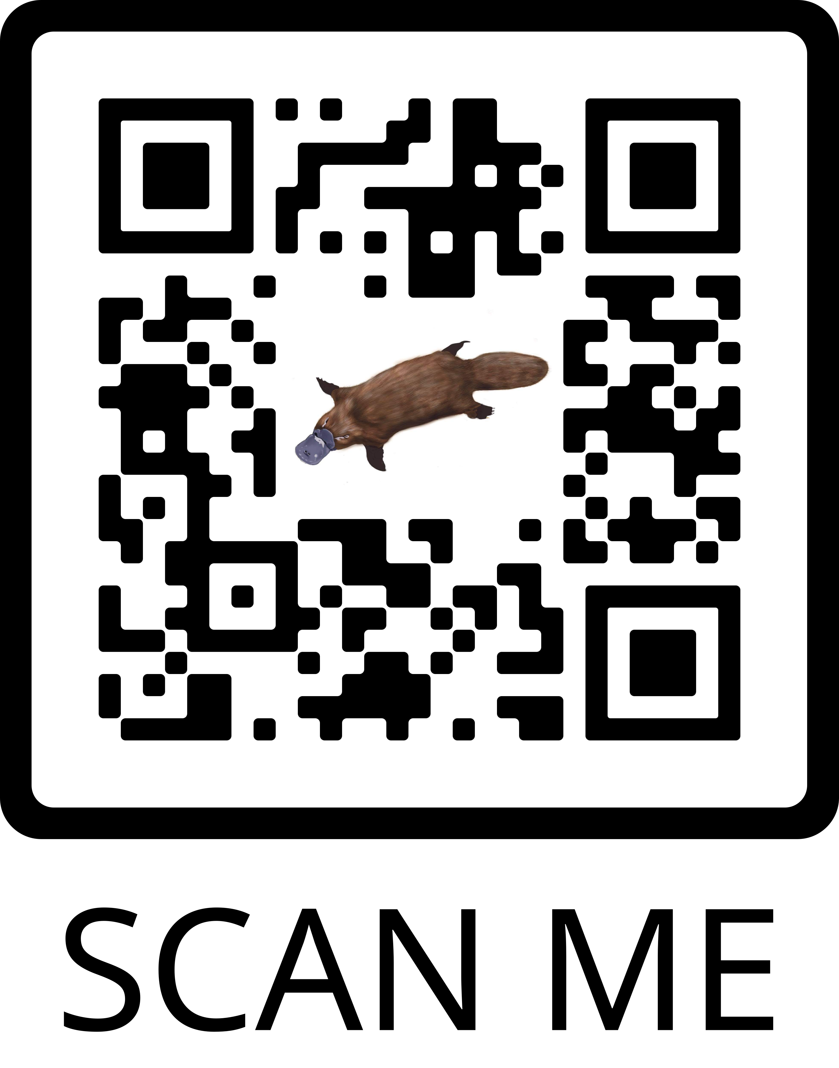
Questions/Contact
Trish Kerin, CEng, FIChemE, FIEAust
Professional Process Safety Engineer, MLdrshp
Superstar of STEM 2023/24
Director IChemE Safety Centre
Email: tkerin@icheme.org, leadlikekerin@gmail.com
Phone: +61 408 925 536
Web: www.ichemesafetycentre.org
www.leadlikekerin.com
@SafetyIChemE​​ | IChemE Safety Centre​​ | @safetyicheme​​ | SafetyIChemE​ | IChemE Safety Centre​
@leadlikekerin | Trish Kerin | @leadlikekerin | trish.kerin.9 | ​

