Slide 1



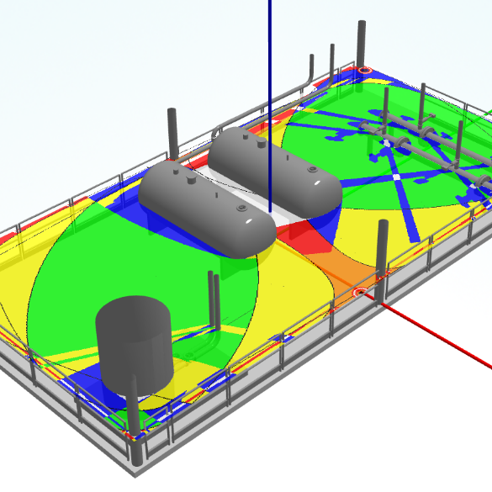
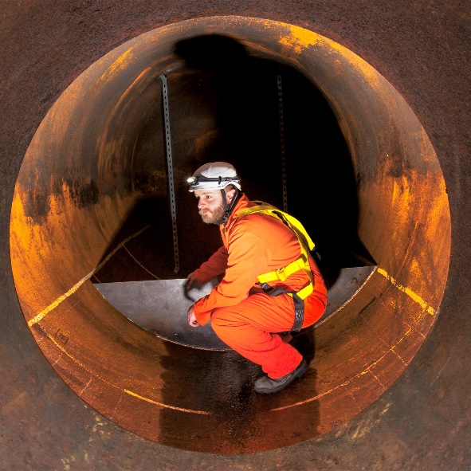
Assessment techniques for supporting ALARP demonstration for energy transition projects
Materials Engineering
Space and Vacuum
Tribology
Industrial Tribology and
Richard Tiffin
Good Practice
Safety & Risk
Management
Non-Destructive Testing
7th November 2023
Notes:
Hello, I am Richard Tiffin, and I am a Principal Consultant with ESR Technology. My presentation is on ways in which tried and tested risk assessment techniques used in high hazard industries, can be applied to new low carbon energy technology projects. These safety assurance processes will facilitate planning approval, and assure stakeholders, regulators, and investors that the design is managing the risks to As Low As Reasonably Practicable, or ALARP.

Slide 2
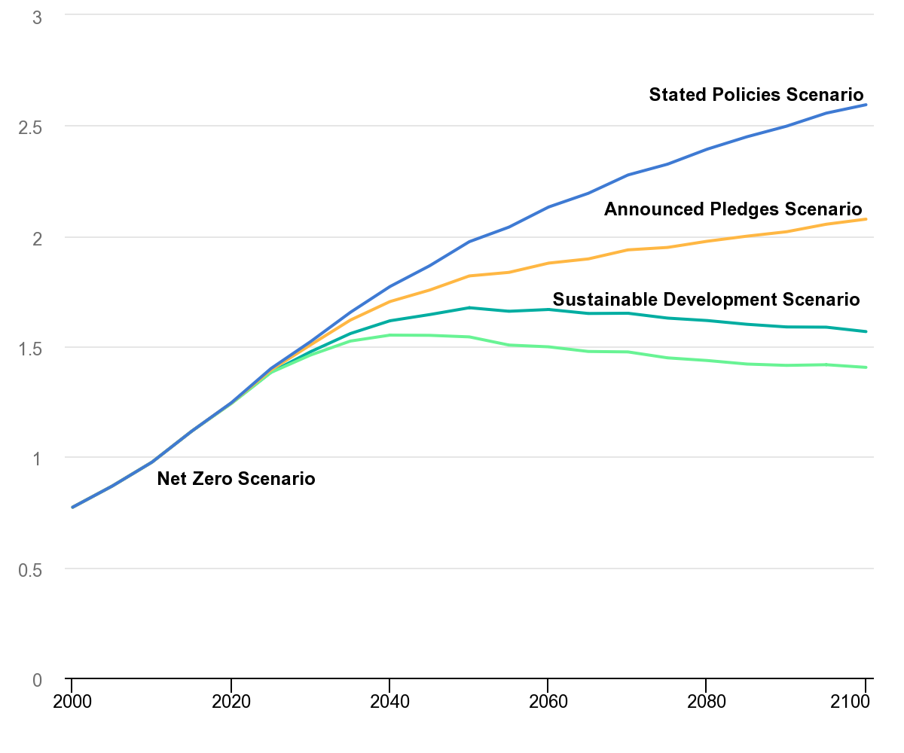
Energy Transition
Global emissions of CO₂ are at all-time highs of around 35Gt.
IEA temperature increase predictions for policy scenarios show 2050 Net Zero scenario keeps to below 1.5°C by 2100 (World Energy Outlook 2021).
Energy transition is essential to reduce CO₂ emissions, and other gases such as methane, to slow climate change.
IEA, Global median surface temperature rise in the WEO-2021 scenarios, 2000-2010, IEA, Paris.
Notes:
Emissions of carbon dioxide are now at all-time highs of around 35 billion tonnes per year, which is pushing atmospheric temperatures higher.
The International Energy Agency predicts that for temperature rises to be slowed and reversed, and stay below the critical 1.5 degree increase, global emissions need to be reduced to net zero by 2050. This is shown on the graph as the bottom line in green. The orange and blue lines above represent outcomes based on current pledges and policies and are predicted to result in temperature increases above 2 degrees by the end of the century.
Power generation is a key area where big reductions in carbon dioxide emissions can be made. New technologies will be required on a large scale, along with the right economic framework and infrastructure to support them.
Transitioning to less carbon intensive energy technology is essential to achieve net zero and keep temperature rises as low as possible.

Slide 3
Some Examples Of Energy Transition Technologies
Renewables; offshore/onshore wind, solar, tidal, wave.
Hydrogen/ammonia production (electrolysis, NG reformation), transport, storage and end use.
Carbon dioxide capture, transport and storage; compression, pipeline, ship, geological storage.
Energy storage/grid balancing; Battery Energy Storage System (BESS), cold liquefied air / hot molten salt.
Biofuel / bioethanol / Recovery of fuel from waste.
Nuclear; modular / molten salt.
Notes:
Some examples of low carbon energy transition technologies that are being developed include;
renewables like wind, solar, hydro, tidal and geothermal.
hydrogen or ammonia production from electrolysis or reformation of natural gas with carbon dioxide capture and storage.
energy storage solutions like battery energy storage systems, liquefied air and hot molten salts.
biofuel.
and nuclear energy.

Slide 4
Challenges Facing Energy Transition Projects
Scaling up to increase capacity.
New technology – new problems.
Planning process to meet climate targets.
Regulatory regime.
Safety concerns could challenge and delay projects.
Environmental impacts need to be considered.
Notes:
The scale of carbon reductions required is huge. For example the new SSE Seagreen offshore windfarm is one of the largest built. It has an installed capacity of 1,075 MW which can power 1.6 million homes, and displaces about 2 million tonnes of carbon dioxide from electricity generated by fossil fuels every year. However many such projects will need to be built in order to reduce carbon emissions from current levels.
Large projects involve multiple work packages and Clients should ideally have a view of the risks across them, and ensure consistent systems for managing them.
New technologies will present new problems and safety challenges. These unknowns need to be understood and will require appropriate solutions to manage them.
To successfully pass the tests of the planning and safety regimes, projects will need to demonstrate that the risks are being reduced to As Low As Reasonably Practicable. Committing to a suitable safety assurance process will be the best way of achieving this.
The risk management process will also help in communicating the risks to the public and other stakeholders and avoid objections and delays.
Managing between safety, technical and environmental risks can sometimes require trade-offs. These need to be understood by decision makers, so that whatever approach is ultimately adopted can be justified and communicated to future operators and duty holders.

Slide 5
Groups of Risk & Proportionality
Significant Accident Hazards
Major Accident Hazards
Marine / Shipping Hazards
COSHH
Electrical
Pressure
Flamm-able
Toxic
Reactive
Collision
Cargo
Jetty Ops
Rotating Equipm’t
Lifting
Work at Height
Explo-sive
Environm-ent
MA Pipeline
Boat Landing
Notes:
A range of ‘significant’ hazards may be present. These include conventional hazards such as working at height, electricity, and substances harmful to health. These are often covered by topic-specific regulations. Projects can group together “significant hazards”, which his helps to identify potential threats and manage them consistently across the project.
Major Accident Hazards, as defined in the Control of Major Accident Hazards regulations, or COMAH, are present where dangerous substances exceed defined quantities, and for the Pipelines Safety Regulations where “dangerous fluids” are transported.
Where substances are transported by ship the risks associated with marine transport will need to be identified and managed in accordance with relevant legislation.

Slide 6

Groups of Risk & Proportionality
High Risk Residential Buildings
Energy
Escape
Struct-ural
Fire
Smoke
Security
Notes:
After the Grenfell Tower disaster, the Building Safety Act has been introduced. These are intended to ensure that risks to people living in high rise buildings are managed to a higher standard by those responsible for them throughout their lifetime.

Slide 7
Groups of Risk & Proportionality
Significant Accident Hazards
Major Accident Hazards
Marine / Shipping Hazards
COSHH
Electrical
Pressure
Flamm-able
Toxic
Reactive
Collision
Cargo
Jetty Ops
Explosive
Environm-ent
MA Pipeline
Rotating Equipm’t
Lifting
Work at Height
Boat Landing
High Risk Residential Buildings
Energy
Smoke
Structural
Fire
Escape
Security
Notes:
Projects of any kind need to identify potential sources of hazards and manage the risks proportionately.

Slide 8
Building A Safer Future
‘A robust Golden Thread of information should be passed across to future building owners to underpin more effective safety management throughout the building lifecycle.’
Dame Judith Hackitt
Notes:
In the 2018 review of building and fire safety regulations, Dame Judith Hackitt highlights the need for a golden thread of information to ensure safety is at the heart of decision making throughout the lifetime of the building. A portfolio of safety critical information is assembled during design and construction and passed on to building owners and managers. This principle is akin to the Safety Report required under the COMAH regulations with its focus on lower frequency but potentially high consequence events.

Slide 9
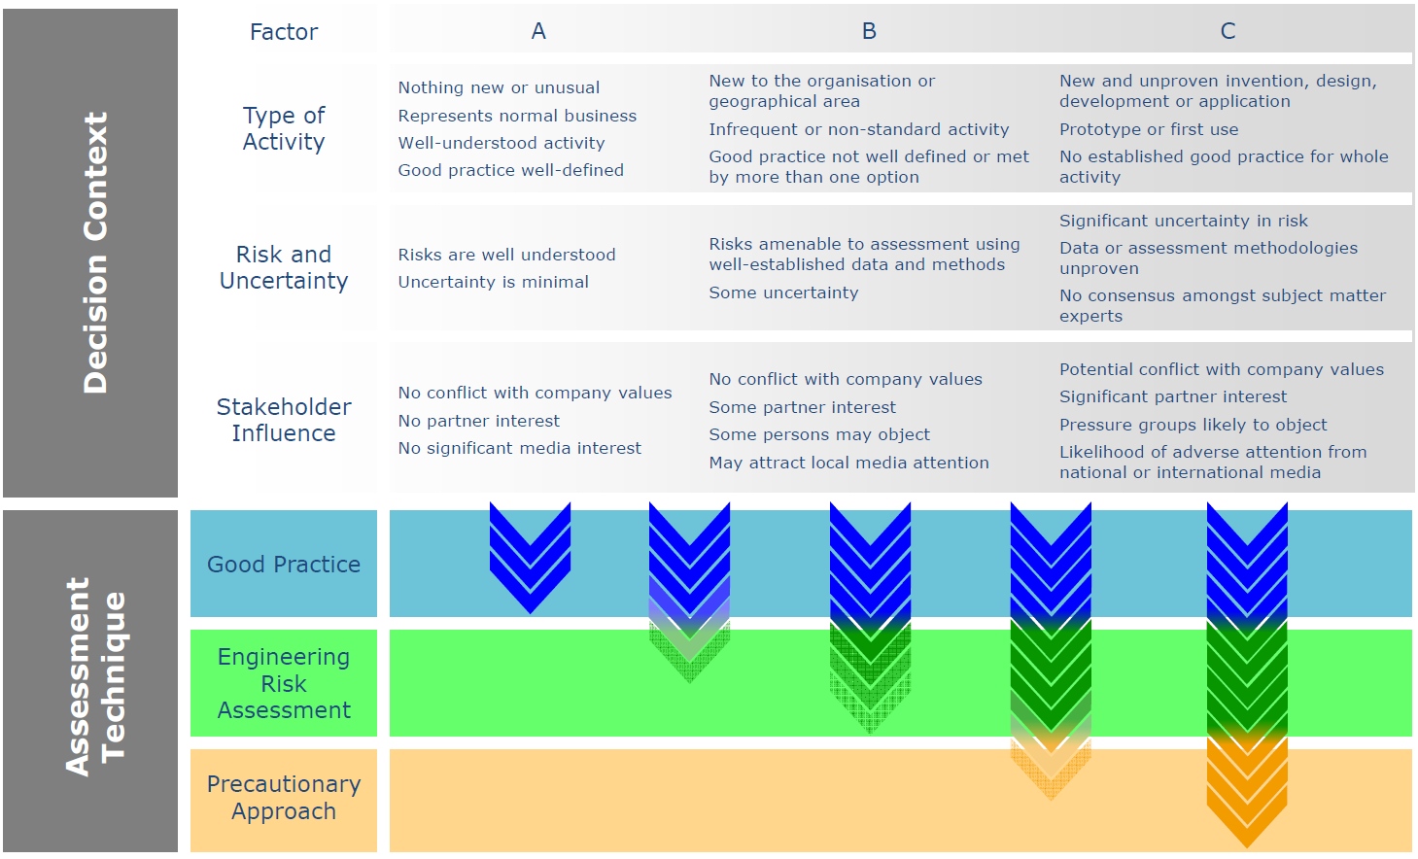
Risk Related Decision Making Framework (OGUK, 2014, Guidance on Risk Related Decision Making, Issue2)
Increasing Level of Risk
Increased level of assessment.
Credit: OGUK (now OEUK)
Notes:
The guidance on risk related decision making published by the Oil and Gas UK sets out a framework for categorising decisions as low, medium or high risk – A to C at the top - based on criteria for three factors. “Activity type”, “risk and uncertainty” and “stakeholder influence”, each ranging from well understood with well-defined good practice, at the lower end up to first use of technology with no established good practice for the whole activity at the higher end of the risk spectrum.
Guidance is given on what assessment techniques to use in proportion to the level of risk, which range from application of good practice through engineering risk assessments to a precautionary approach to be applied for decisions with the highest degree of risk and uncertainty.

Slide 10
Risk Management
Hazard Identification:
  Major Accident Hazards.
  Significant Accident Hazards.
Risk Tolerability:
  Individual, societal or other measure for risk.
Relevant Good Practice
Hierarchy of risk reduction measures:
  Elimination / Prevention / Detection and Control / Mitigation of consequences / EER
  Eliminate / Reduce / Isolate / Control / PPE / Discipline (ERIC-PD)
Notes:
The risk management process would typically comprise;
- Hazard identification
- Criteria for risk tolerability
- Application of relevant good practice and a suitable hierarchy of risk reduction, such as; eliminate, prevent, detect, control and mitigate.
And the level of risk will determine what depth and level of assessment is proportionate.

Slide 11
Documented ALARP Demonstration
Documented ALARP Demonstration
Golden thread of information
Gap Analysis:
- Implementation of good practice.
- Justification of gap / alternative.
Bowtie Analysis:
- Safety & Environmental Critical Barriers
Qualitative / Quantitative Assessments:
- LOPA
- QRA
- FMEA
Key Decision Documents:
- Definition
- Logic/argument
- Assessment
- Decision
Notes:
A range of studies and techniques can be used to develop the documented ALARP demonstration:
- Gap Analysis is a good way of checking that good practice has been applied. A gap or alternative approach to the recommended good practice should be justified.
- Bowtie analysis is a tool which enables the identification of safety and environmental critical barriers. It also illustrates their position in the risk reduction hierarchy.
- Quantitative assessments, require more time and resources to complete but provide a more detailed understanding of the risk level and its tolerability.
- A Key Decision Document can be developed at any stage of the project whenever a significant issue arises. It presents factual information and a range of alternative design approaches, with logical arguments and supporting evidence about each. The document helps the relevant parties to reach a decision by consensus, and future project stakeholders to understand the basis of that decision.
The key information contained in the project documentation can be compiled into an ALARP demonstration document. [Click]
This can then be handed over, in an accessible format, to subsequent stages of the project and to the operations management team, to ensure that the basis for safety for people and the environment is readily available when it is needed in the future.

Slide 12
Deep Water Offshore Wind
Project used a process safety assurance process to demonstrate ALARP, including ‘Key Decision Sheets’ to present factual information and record the decision basis.
First offshore wind foundations for deep water (30m – 50m). 4-legged jacket with boat landing at 7degree incline. Industry norm was monopile with a vertical boat landing.
Significant challenge to the design by operations teams on grounds of safety and operability compared to a vertical design.
An approved design was required for the boat landing for FEED deadline. Key Decision Sheet provided the framework for the decision.
Notes:
In this first example this project safety assurance process was applied to a particular significant accident hazard - The design of the boat landing which was the primary means of access for maintenance technicians transferring from vessels to the wind turbines.
The issue was that an inclined boat landing was proposed whereas most wind turbines at the time had a monopile foundation with a vertical boat landing. The greater water depths of this development required a 4 legged foundation with an angle of about 7 degrees.
A significant challenge to the inclined boat landing design came from operations because of the uncertainty about safety and operability.
This led to the development of a key decision sheet to help support the decision between the two designs.

Slide 13
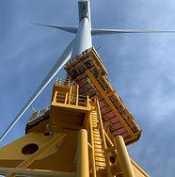
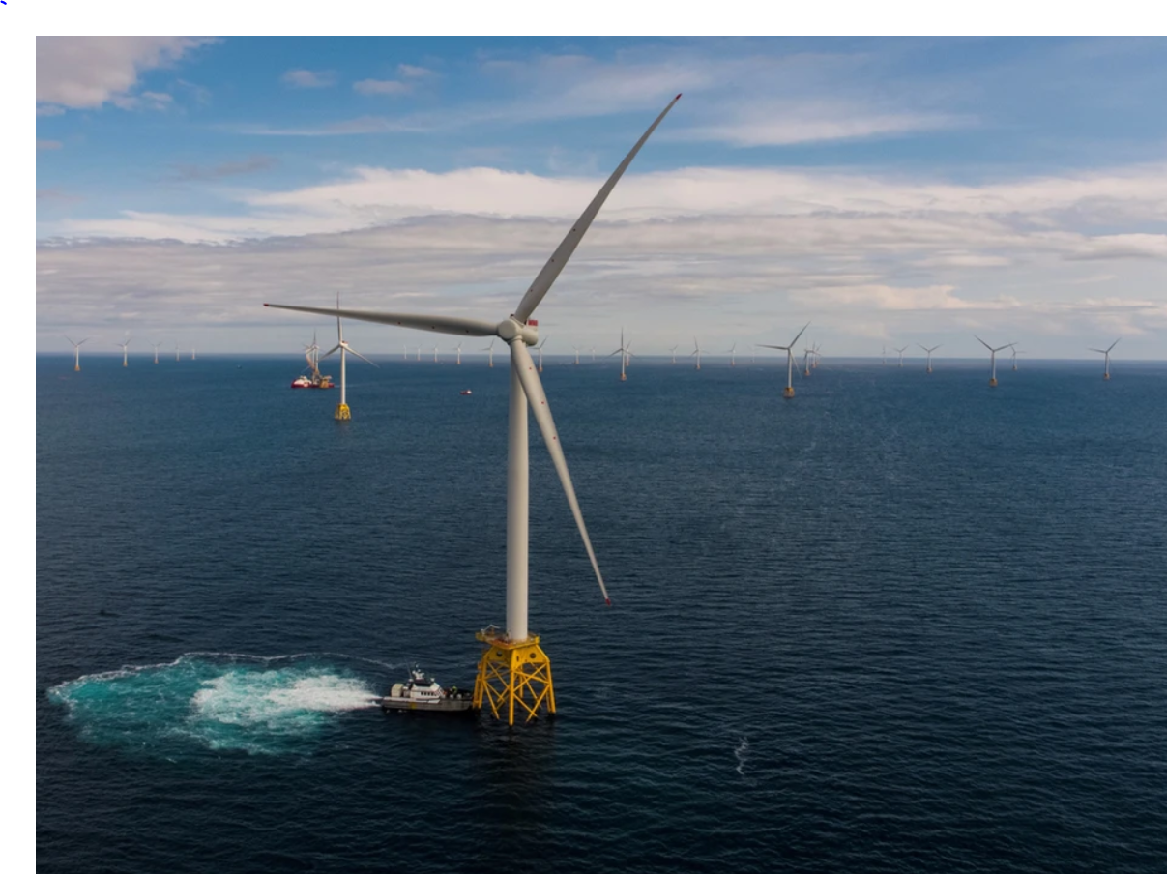
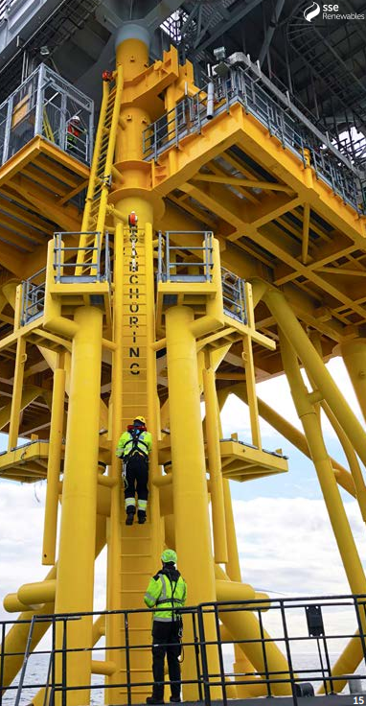
Boat Landing Significant Hazards
Lifting
Operations
Boat Landings
Work at Height
Emergency
Evacuation
Down
Marine
Operations
Ergonomics
Ref: www.beatricewind.com/copy-of-library
(Credit Beatrice Offshore Windfarm Ltd.)
Notes:
Each wind turbine has one boat landing which is the primary means of access, with walk to work system working deck being the secondary means. The picture shows the size and scale of the windfarm, which is why safe and reliable access is so vital for operations.
In the middle photograph a Crew Transfer Vessel can be seen pushing onto the boat landing creating a stable platform for personnel to transfer to or from the ladder.
The right hand photograph shows a technician descending the ladder of an offshore substation between the boat bumpers and a boat hand waiting to receive them on the front fender of the vessel with their work restraint lanyard attached and safety barrier in place.
Boat landings are a complex interface with a range of significant hazards which need to be managed to ALARP.
A key decision document was developed comparing vertical and inclined boat landing performance across a range of issues. These include:
- A review of scientific literature on the ergonomics of ladder climbing concluded that the likelihood of falls was somewhat reduced for inclined ladders. The upper boat landing ladders also inclined to ensure consistency.
- An ergonomic assessment of the step over from crew transfer vessel to an inclined ladder found no significant difference.
- The functioning of fall arrest systems on an inclined ladder was confirmed with manufacturers.
- Rescue techniques for a casualty suspended on or behind an inclined ladder was demonstrated.
- Vessel stability pushing onto inclined boat landing was confirmed by vessel captains and crew.
- Lifting operations using the davit crane over the full height the boat landing was demonstrated, as was lowering a casualty on a stretcher using rescue devices and equipment.
The boat landing key decision sheet was developed based on information from workshops, and evidence from literature reviews, technical studies, suppliers and research. The conclusion reached was that the inclined boat landing was the ALARP solution when fitted to an inclined foundation.

Slide 14
Major Accident Hazards
- Project Evaluation
- Concept
- FEED
- Detailed Design
- Construction
- Commissioning
- Detailed Design
- Construction
- Commissioning
- Handover
- Operation
- MOC
- Handover
- Operation
- MOC
Dialogue with Regulators and Key Stakeholders
COMAH/HSC Qualification:
- Identify ‘Dangerous’ / ‘Controlled’ Substances.
- Compare quantities with thresholds.
Planning Application EIA:
- Major Accidents & Disasters (MAD) – ALARP
COMAH Safety Report & 5-Yearly Update:
- As-built/modified.
- Safety Management System
- Operation and Maintenance
- Management of Change
- Incident learning
- ALARP Review
COMAH Pre-Operational SR:
- Commissioning & Operation
- ALARP Demonstration
- Emergency Response
EIA Scoping:
- Major Accidents & Disasters
ALARP
COMAH Pre-Construction Safety Report (PCSR):
- HSE / Environment (CA)
- Process / Location / Layout
- Consequence based assessment.
Hazardous Substances Consent:
- Planning Authority
Notes:
Projects involving major accident hazards have additional requirements to demonstrate ALARP as the project moves through early design development, detailed design, construction, commissioning and operation.
At an early stage in the project it is important to understand whether the project will qualify as an establishment under the Control of Major Accident Hazards Regulations. This is done by identifying COMAH dangerous substances that will be present and estimating the maximum quantities that could be held.
At this stage an EIA scoping and screening studies would be carried out to determine whether the EIA regulations apply. This would also decide whether a chapter on major accidents and disasters would be required.
Projects that come under COMAH will need to notify the COMAH regulator before the start of construction. Following notification a pre-construction safety report would be submitted. The PCSR would present the options considered and the basis for the selection of process technology, the location and layout of the plant. The COMAH regulator would assess whether the report demonstrates ALARP or partially demonstrates ALARP. The PCSR assessment would normally be completed in 3 months.
The planning application would be submitted for approval at the point during detailed design when the layout is fixed. For COMAH sites a chapter on major accidents and disasters will be a requirement, and for other energy projects it is likely to be screened in.
The COMAH pre-operational safety report will cover the ALARP demonstration for the operational design of the plant and should also be assessed within 3 months. An application for hazardous substances consent will need to be made to the relevant planning authority in time to allow dangerous substances at the site. These will both be required before the COMAH dangerous substances are introduced to the site.
Once the site is operational, the COMAH safety report and ALARP demonstration must be reviewed and updated every 5 years, or whenever a significant change is made.
Dialogue with regulators and key stakeholders is essential to developing consensus on the ALARP demonstration and provide assurance that project deadlines will be met.

Slide 15
Blue H₂ & CCS Project
Innovative project for H₂ fuelled power generation with CCS commenced 2003.
EIA covered MAH criteria in evaluation of location options.
COMAH Pre-construction Safety Report (PCSR) was produced for FEED.
Issues addressed included:
  Rationale for the project.
  Selection of a location from alternatives nationally and locally.
  Selection of the process technology (auto-thermal reformer) and layout.
  Site-wide HAZID, and identification of representative scenarios.
  Hazard from CO₂ included in ALARP assessment despite not being a COMAH DS.
  Conservative worst case consequences of representative scenarios.
  Major Accident Prevention Policy (MAPP) and Safety Management System for design.
Notes:
This second example goes back 20 years to a proposed hydrogen fuelled power plant, with carbon dioxide capture and export. The carbon dioxide was to be re-injected from an existing North Sea platform into a depleted hydrocarbon reservoir.
The project determined that the power plant would be a COMAH site, and an appropriate project safety assurance process was developed based on the combined corporate standards of the Joint Venture partners. A Project Major Accident Prevention Policy and Safety Management System was endorsed by senior management and included in the COMAH pre-construction safety report.
Issues addressed in the early stages of the design included:
- The rationale for the project.
- The selection of a location from alternatives, nationally and locally.
- The selection of the process technology. In this case an auto-thermal reformer and air separation unit, carbon dioxide separation and compression, and a hydrogen fuelled combined cycle gas turbine.
- Layout of the plant.
A risk analysis, based on a site-wide hazard identification, was carried out and a representative scenario set identified. The analysis of the representative scenarios for the pre-construction safety report focused on the consequences of worst case scenarios.
Carbon dioxide was identified at an early stage as a potentially significant accident hazard, despite it not being a COMAH dangerous substance. A precautionary approach to the assessment of carbon dioxide hazards was adopted because of the level of uncertainty at the time over carbon dioxide gas dispersion and the consequences exposure.

Slide 16
Blue H₂ & CCS Project
Cross-country pipeline for CO₂ export. Repurposed NG import pipeline to CO₂ export.
Concurrent study of modification to offshore platform for CO₂ receipt and well injection.
FEED COMAH PCSR submitted in 2005.
COMAH CA assessment concluded there were no serious deficiencies in the ALARP demonstration for FEED, and ALARP demonstration for detailed design would be submitted in the POSR.
All regulatory compliance boxes had been ticked that would have enabled the project to move to the next phase of detailed design.
Notes:
Other significant elements of the project included:
Change in use of the cross-country pipeline from natural gas import duty to carbon dioxide export. The pipeline export facility at a coastal location, and a sub-sea pipeline to the offshore platform for gas injection.
Updates to the major accident pipeline document and offshore platform safety case were required.
The project was ultimately shut down before it could be built, because of delays in the government competition for selection and funding of carbon capture projects.
However, before the decision to close the project was taken, it had received planning permission, and the conclusion of the COMAH preconstruction safety report assessment with a suitable ALARP demonstration for the FEED design,

Slide 17
Conclusions
A range of energy transition technologies are required to reduce global carbon emissions and mitigate the effects of climate change.
Project process safety assurance frameworks develop ALARP arguments that allow consensus, support planning processes and regulatory compliance.
Two examples have been given that show ways that safety assurance has supported decision making. Key factors include:
  Identifies and manages key issues early, including Significant Accident Hazards (conventional safety) and Major Accident Hazards (COMAH dangerous substances).
  Gains consensus on ALARP with key stakeholders e.g. designer, installer and operator.
  Allows projects to proceed through design and construction phases with agreed ALARP demonstrations e.g. for the technology, location and layout.
  Provides safety information that facilitates planning approval.
  Facilitates due diligence, corporate approval and funding.
Notes:
This talk is a response to the urgent need to implement a range of energy transition technologies, on a large scale, to reduce global carbon emissions.
The focus has been on how projects can be supported by a suitable and proportionate project safety assurance process that is underpinned by a toolkit of assessment techniques, which can show that significant and major accident hazards are being managed.
The process facilitates identification and ranking of hazards, consensus on key design decisions, supports the planning process, supports the financial decision stages for large capital projects, and ensures compliance with safety and environmental regulations.

Slide 18
Conclusions
The safety assurance process delivers a documented ALARP argument which, together with other relevant documentation, provides a
‘Golden Thread Of Information’ which can be maintained throughout the lifetime of the project.
This gives the duty holders, at any given time, a line of sight between the hazards identified and the critical measures that have been put in place to ensure that the risks, to the safety of people and to the environment, are being managed to As Low As Reasonably Practicable.
Notes:
The safety assurance process delivers a documented ALARP argument which, together with other relevant documentation, provides a
‘Golden Thread Of Information’ which can be maintained throughout the lifetime of the project.
This gives the duty holders, at any given time, a line of sight between the hazards identified and the critical measures that have been put in place to ensure that the risks, to the safety of people and to the environment, are being managed to As Low As Reasonably Practicable.

Slide 19
Questions
Thank you.
Are there any comments or questions?

