Slide 1

Guidance for UK Hydrogen Safety Case Development Onshore and Offshore
IChemE HAZARDS 33
Sean Baker
Nikhil Hardy

Slide 2
Agenda
Introductions
Background
Phase 1 – Legislation Review
Phase 2 – Guidance for Operators

Slide 3
Introductions
Sean Baker
Principal Consultant, ERM London
Nikhil Hardy
Managing Consultant, ERM Bristol

Slide 4
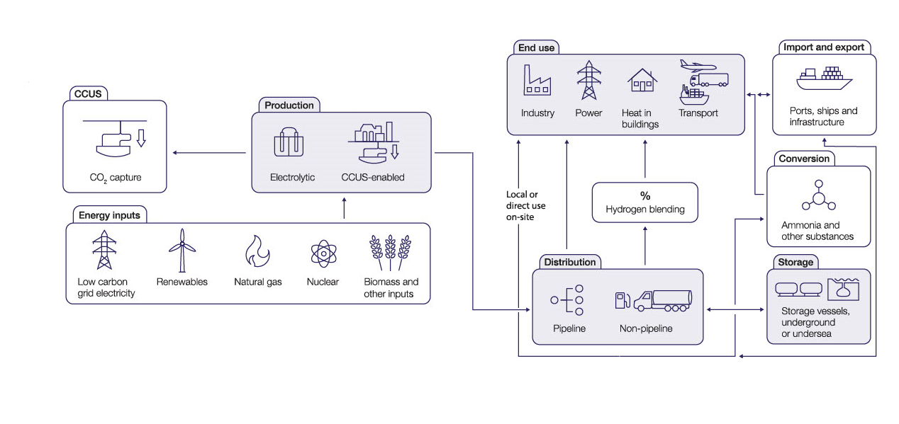
Background
Source: UK Hydrogen Strategy, BEIS, 2021

Slide 5


Project Overview
Comprehensive, high-level review of key UK safety regulations applicable to the hydrogen lifecycle.
Phase 1: Identification and high-level review of UK legislation
Phase 2: Development of industry guidance

Slide 6
Focus Areas
Safety Case
Design and Asset Integrity
Pipelines
Transportation
Gas Safety
Emergency Response
Environmental Permitting
DESIGN – OPERATION – MAINTENANCE - DECOMMISSIONING

Slide 7
Hydrogen Application Focus Areas

Slide 8
Hydrogen Application Focus Areas
Onshore Production
New Build Sites
Offshore Production
Greenfield
Bulk Transport
Offshore Pipelines
Onshore Storage
Salt Cavern
Existing COMAH Sites
Brownfield
HP Onshore Pipelines
LP Distribution Pipelines
Bulk Road Transportation
LOHC, Ammonia, Liquid Hydrogen
LOHC, Ammonia, Liquid Hydrogen
HP Hydrogen (200bar)

Slide 9
Phase 1
Gap Identification

Slide 10
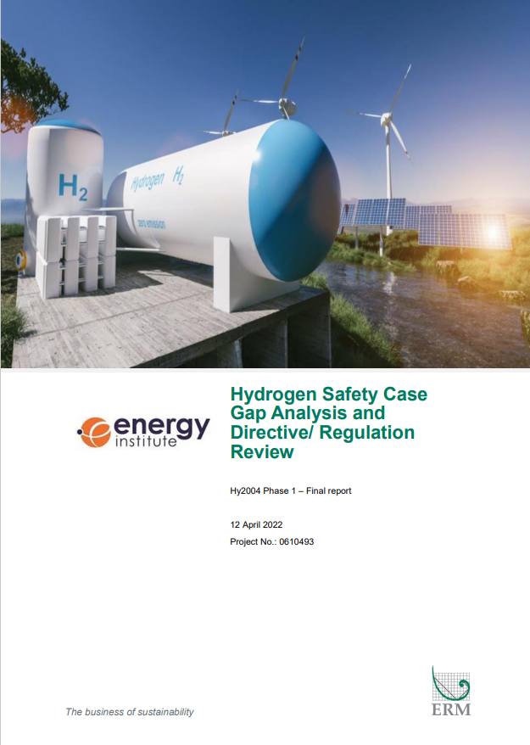
Scope
Legislative Review
Current / Future Requirements
Available Guidance
Stakeholder Engagement
Interviews
Questionnaires
Findings
Identification of Key Issues
Next Steps
Gap Analysis

Slide 11

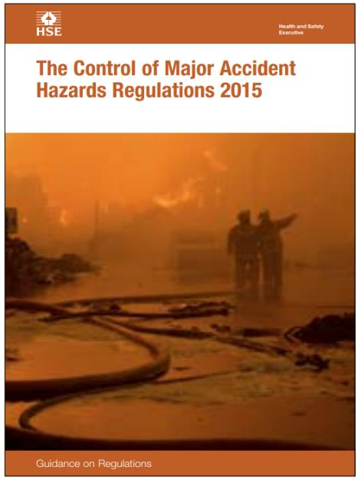
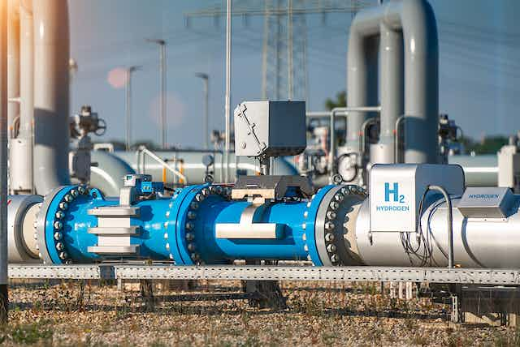

Phase 1 Recap
Safety Case Legislation
Standalone offshore hydrogen production not covered by OCSD
Design And Asset Integrity
Hydrogen covered as a dangerous substance
Pipelines
Hydrogen covered by PSR
Transportation
Hydrogen covered as dangerous goods

Slide 12



Phase 1 Recap
Gas Safety
GS(M)R does not cover majority H2 or blends >0.1% H2 (without an exemption)
GS(IU)R does not cover commercial premises supplied with majority H2
Emergency Response
Hydrogen covered as a hazardous substance
Environmental Permitting
Hydrogen production is a listed activity

Slide 13
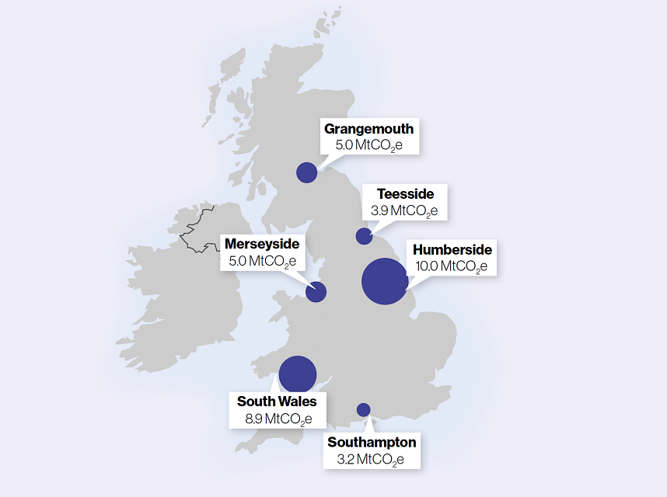
Stakeholder Engagement
Liaison with stakeholder organisations across the six UK industrial clusters
Understanding of organisations’ experience and confidence with Safety Case framework
Common themes :
    Use of existing frameworks for developing a basis of safety for hydrogen
    Application of ALARP principles
    Guidance sets a generic framework supported by hydrogen-specific gas standards
    Framework of natural gas to hydrogen conversion
    Change management integral to basis of safety
Source: GOV.UK (www.gov.uk)

Slide 14
Phase 1 Conclusions
Some gaps identified in coverage for hydrogen applications.
Need for an overarching guidance document to provide clarity for demonstrating the safe development of hydrogen projects

Slide 15
Phase 2
Guidance

Slide 16
Scope
Properties of hydrogen
Physical and other Hazards
Guidance on legislation
Purpose, Scope, Owner, Authority, Duties
Codes and standards
Purpose
Case Studies
Hydrogen Storage
Comparison to Other Fuels
Applicability for Hydrogen
Guidance for Compliance
Scope
Requirements
Stakeholder Engagement
Gaps Identified

Slide 17

Hydrogen Properties
Physiological and Personnel Safety
Fire and Explosion
Hydrogen Embrittlement
High Temperature Hydrogen Attack
Low Temperature Embrittlement
Source: DNV

Slide 18

Safety Case
COMAH legislation applies to hydrogen (and associated substances, e.g. LOHC)
Offshore Safety Directive SCR 2015 does not cover offshore hydrogen production but can be followed as a general framework for managing hazardous fluids

Slide 19

Design and Asset Integrity
Hydrogen covered by legislation but need to consider the specific properties of hydrogen when specifying and designing equipment.
Requirements relating to pressure, flammability and explosivity
Hydrogen specific standards can be used to demonstrate good practice

Slide 20

Gas Safety
GS(M)R applies to gas networks containing less than 50% hydrogen but limits content to 0.1%
    Exemptions from the 0.1% rule would be required (e.g. HyDeploy).
    Not applicable to 100% hydrogen trials, however provides a framework for safety cases.
GS(I&U)R applies to hydrogen in domestic premises
    Applies in non-domestic premises where it is not the main constituent
    For commercial settings, should be used as a framework to comply with broader HSWA duties

Slide 21
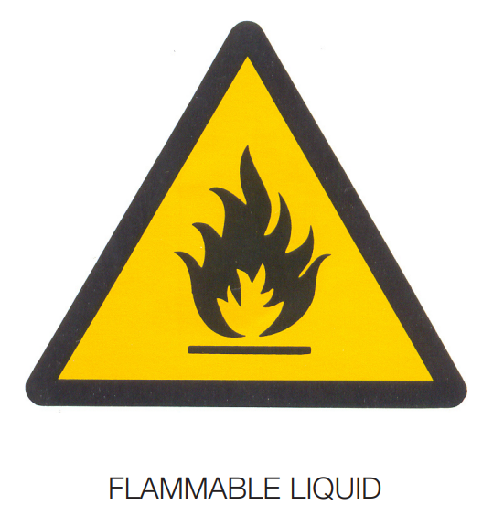
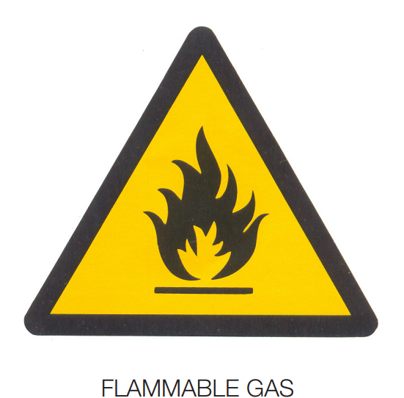

Emergency Response
Emergencies likely to be similar in nature to Natural Gas but need to consider the unique properties of hydrogen
Maintain good communication with local authorities and emergency response services
Notify the authorities when significant quantities of hydrogen are stored on site and provide signage to warn first responders

Slide 22

Environmental Permitting
Production of hydrogen and associated activities (e.g. CCS) require an Environmental Permit
Other associated activities may need to be included on the same permit (e.g. combustion)
Activities need to demonstrate that they meet best available techniques (BAT) and operate in accordance with BAT conclusions

Slide 23
Case Studies
Onshore Production & Storage
Hydrogen to Humber (H2H)
Offshore Production & Transport
Dolphyn
Gas Network
Refuelling Station

Slide 24
Onshore Hydrogen Production & Storage
Hydrogen to Humber (H2H) and Aldbrough Hydrogen Storage
Aldbrough Hydrogen Storage
Cavern storage of hydrogen
H2H Saltend
‘Blue’ hydrogen production
(NG reforming with CCS)
Source: GOV.UK (www.gov.uk)

Slide 25
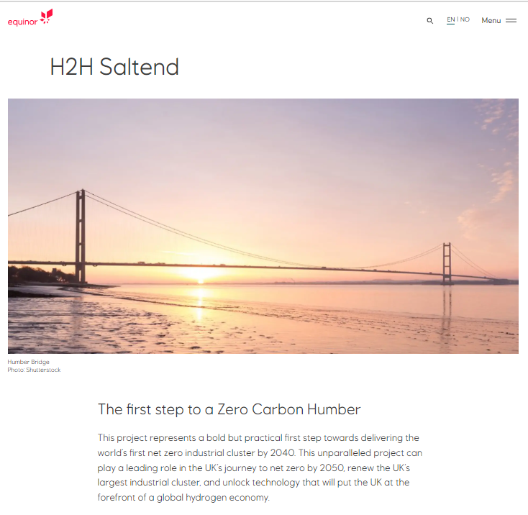
Onshore Hydrogen Production & Storage
Hydrogen to Humber (H2H) and Aldbrough Hydrogen Storage
Regulatory Framework
COMAH
Key Findings
Lack of single published BAT for CCS when carried out via SMR
General Health and Safety legislation
Environmental permit for regulated activities
Lack of accepted method for modelling risk from Carbon Dioxide created during the process

Slide 26
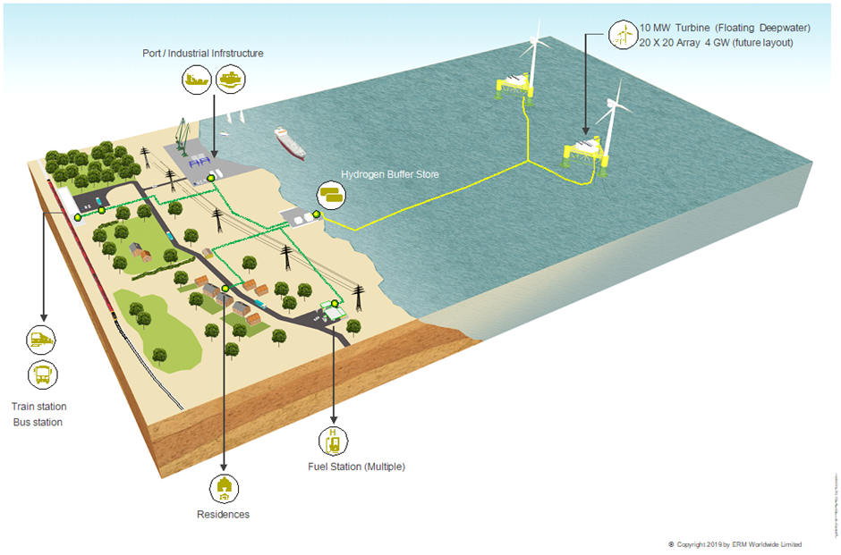
Offshore Hydrogen Production & Transport
Dolphyn Hydrogen
Dolphyn Hydrogen
‘Green’ hydrogen production
(Electrolysis of seawater using wind power)
Subsea Pipeline
Onshore Facilities
Storage, Compression & Metering

Slide 27

Offshore Hydrogen Production & Transport
Dolphyn Hydrogen
Regulatory Framework
Lack of regulatory framework for the offshore production of hydrogen
Onshore facilities unlikely to exceed COMAH thresholds
General H&S legislation (HSWA)
Key Findings
Not covered by safety case regulations, but broad adherence is being undertaken as representative of good practice.
Design notification / safety case
Requirements to ensure identification and assessment of all potential hazards, consequences and adequacy of controls (ALARP)

Slide 28
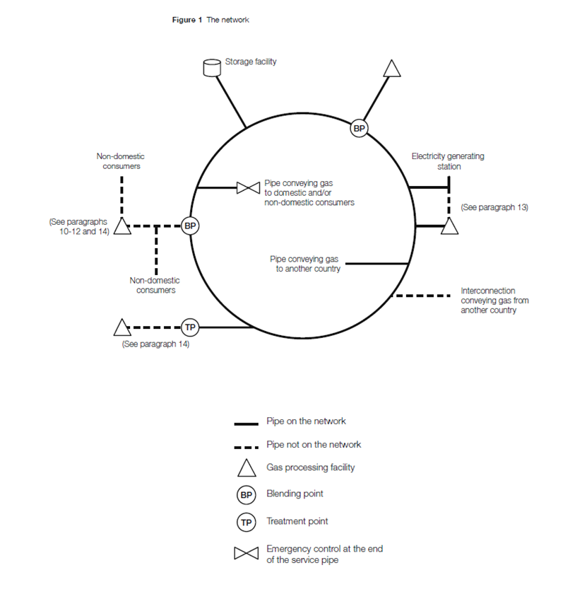
Hydrogen Network
Hydrogen Production Facility
HP Transmission Pipeline
Offtake to Storage Site
Offtake to LP Distribution Network
Offtake to Industrial Users
Source: Guide to the GS(M)R Figure 1

Slide 29
Hydrogen Network
Regulatory Framework
Blended hydrogen networks (less than 50%) can apply for an exemption under the GS(M)R
Key Findings
GS(M)R exemption for time-bound trials not an efficient means of wider roll out of hydrogen blending
GS(M)R does not cover 100% and majority hydrogen gas networks

Slide 30

Hydrogen Refuelling Stations
Regulatory Framework
DSEAR and PSSR
Below threshold for COMAH and Hazardous Substances Planning
“A1:low impact permit” for certain types of hydrogen production via electrolysis e.g. Octopus Energy/ HORIBA
Key Findings
Transposition of the EU to UK regs is incomplete
Limited availability of some components
UK test facilities not ready
UK MOT does not currently cover hydrogen

Slide 31
Conclusions
Generally well developed from a hydrogen perspective
Hydrogen often regulated under existing legislation, same as other hazardous fluids
Relatively few blockers to project development
However, some key issues identified:
Application of the OSC Regulations to hydrogen
GSMR Regulations require an exemption for blending (>0.1%)
GSMR Regulations only applicable when conveying “predominantly methane”

Slide 32

Download the Full Report Here:
https://publishing.energyinst.org/topics/hydrogen/guidance-for-uk-hydrogen-safety-case-development-onshore-and-offshore

