Slide 1
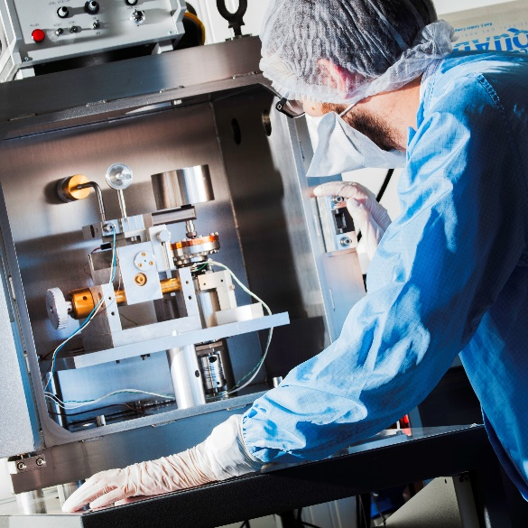
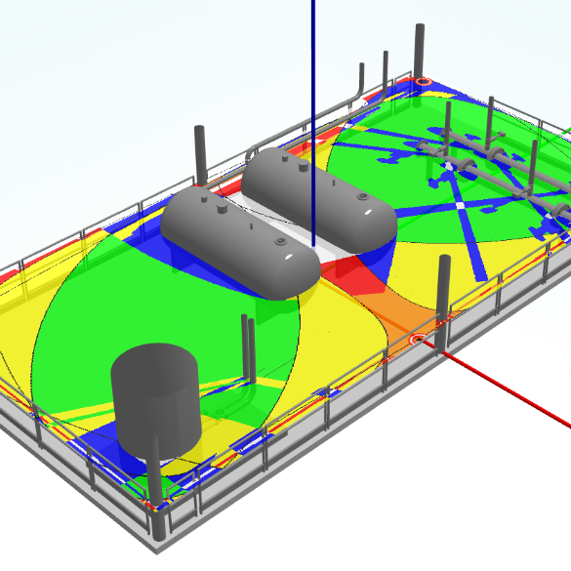
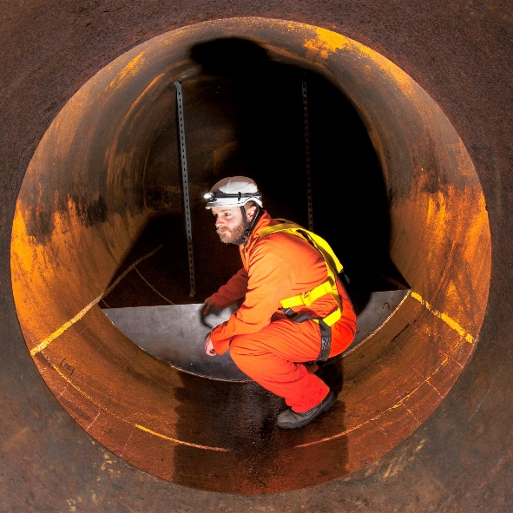
Future of hydrogen in industry: Technical and Safety Challenges
Materials Engineering
Space and Vacuum
Tribology
Industrial Tribology and
Good Practice
Safety & Risk
Luke Butcher – ESR Technology
Graeme Cook – AECOM
Management
Non-Destructive Testing
7th November 2023

Slide 2
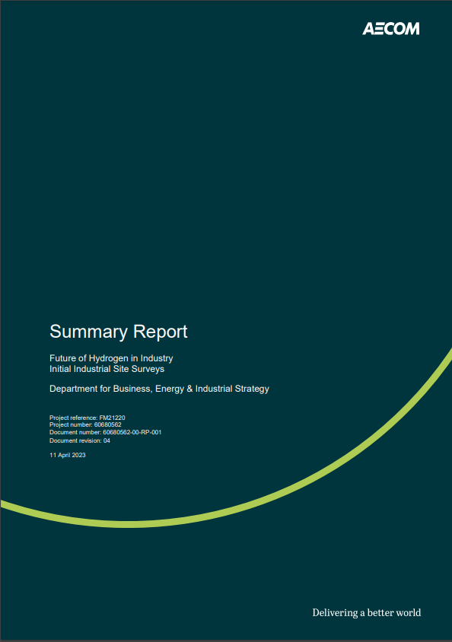
Background
The Department for Energy Security and Net Zero (formerly BEIS) is working with industry and regulators to deliver R&D projects assessing the feasibility, costs and benefits of using 100% hydrogen for heat
Future of hydrogen in industry: BEIS commissioned AECOM and ESR Technology to survey 7 industrial sites outside clusters
Scope: Assess the technical feasibility, economics and safety implications of switching from Natural Gas (NG) to 100% Hydrogen (H2)
For each site an overall engineering business case and Safety report was prepared
Summary Report is available online:
https://www.gov.uk/government/publications/future-of-hydrogen-in-industry-initial-industrial-site-surveys

Slide 3
Sites Surveyed
Organisation | Industry Sector | Type of Gas Use | Annual Gas Use | Annual Total Energy Use
Site 1 – Other Industry 1 | Primary Plastics | Industrial steam boilers, ovens, water heaters, space heaters, flare pilot & ignition packages | 83,000 MWh | 143,000 MWh
Site 2 – Food & Drink 1 | Food & Drink | Industrial ovens, fryers, air handling units, water heaters | 18,000 MWh | 20,000 MWh
Site 3 – Metals 1 | Non-ferrous metals | Furnaces, gas torches, burners, water heaters and space heaters | 28,000 MWh | 32,000 MWh
Site 4 – Vehicles 1 | Vehicle Manufacturing | Industrial ovens, air handling units, recuperative thermal oxidisers, water heaters and space heaters | Limited site extent: 29,000 MWh Whole site: 246,000 MWh | Limited site extent: 29,000 MWh (gas only) Whole site: 364,000 MWh
Site 5 – Minerals 1 | Non-metallic minerals | Aggregate dryer | 35,000 MWh | 35,000 MWh
Site 6 – Metals 2 | Metal Packaging | Industrial ovens, recuperative thermal oxidisers, water heaters and space heaters | 6,000 MWh | 9,000 MWh
Site 7 – Food & Drink 2 | Food & Drink | Germination kilning vessels, roasters, grain dryers, thermal fluid heaters, water heaters, space heaters | 42,000 MWh | 50,000 MWh
Notes:
A number of sites were selected across the UK covering a range of gas consuming sectors. Sites expressed their interest in participating. Wide selection of sites but not comprehensive
The sites selected contain a high proportion of direct fired equipment where the flame / combustion products come into contact with the product. For the sites studied over 90% of the installed gas equipment was used for process heat.
Because the site selection process largely prioritised direct fired applications there are potentially fewer examples of indirect applications than would be typical in a larger sample of industrial sites.
Graeme with technical challenges

Slide 4
Technical Challenges
The study considers site readiness for grid hydrogen at site connection point, the potential impacts , options and mitigations available. The key common technical challenges identified are :
Cost
Equipment availability
Line Size adequacy
ATEX rating of instrumentation
Emissions
These challenges require a range of solutions ranging from market or technical development to ‘simple engineering’ modification
Notes:
Basis of study assumed full site conversion based upon a hydrogen supply available at site connection point.
Cost - For the surveyed sites the 100% hydrogen solution is typically significantly cheaper on CAPEX than the best alternative (non-hydrogen) solution, which is most often electrification, due to the ability to retrofit and by avoidance of new or reinforced electrical infrastructure. A hybrid hydrogen solution may offer a lower CAPEX option in some cases. For the surveyed sites the 100% hydrogen solution is typically less expensive on OPEX than the best alternative (non-hydrogen) solution, which is most often electrification, but there are exceptions. The hybrid hydrogen solution may have a higher OPEX option than 100% hydrogen in most cases, but again with exceptions. For the surveyed sites the 100% hydrogen solution lifecycle cost is very site dependent and so is the difference to the best alternative (non-hydrogen) solution, which is most often electrification. Use of electrification results in high lifecycle costs due to a combination of Capital and Operating costs along with the level of CO2 emissions per kWh of electricity on the long term marginal basis consumed during the projected 2025-2045 period. This results in lower CO2 emission savings relative to the baseline when compared to the hydrogen alternatives leading to a higher cost per tonne of CO2 abated. The hybrid hydrogen solution is generally shown to be more expensive than the 100% hydrogen option in most cases. Averaged across the sites investigated for hydrogen conversion, indirect costs account for approximately 52% of the CAPEX with approximately 43% on end user conversion and 5% on site infrastructure modifications.
Availability of Hydrogen Ready equipment / burners - Within the scope of the study, current technical feasibility and equipment availability varies across applications. There are commercially available hydrogen equivalents for a number of end users such as various types of burner suitable for installation as part of boilers, furnaces, ovens, dryers, water heaters, and thermal fluid heater packages. Complete boiler (steam generator) packages are also available. However there are very few reference plants operating with 100% hydrogen gas. A number of common modifications were observed as being necessary for both direct and indirect applications. Replacement of inlet piping to burners for capacity reasons and removal of threaded fixtures are expected, as are modifications to Programmable Logic Controller and Burner Management System. Flame-eye re-tuning will also be required, and it is likely that the replacement of existing flame-eye or additional flame-eyes specifically calibrated for hydrogen flames will be required. Some bespoke projects and commercial development for hydrogen equivalents have been in the field of large steam generators and small ‘domestic’ type water heaters along with industrial roasters, ovens and fryers. These are not commercially available ‘off the shelf’ hydrogen equivalents and have limited reference projects. For certain applications such as speciality ovens, large air handling units, direct fired space heaters, gas fired torches, complete furnace packages, complete dryer packages, and complete thermal fluid heater packages there appeared to be no commercially available hydrogen equivalents
Line size adequacy - The line capacity of existing natural gas lines is often insufficient for the hydrogen flow required to maintain the same energy flow to the end users. In the majority of sites studied approximately 50% or more of the pipework would need to be replaced because it is undersized for hydrogen service.
Increased ATEX ratings - Equipment such as regulators, fan motors and other electrical equipment present in hazardous areas will be required to be ATEX certified as IIC-T1 for hydrogen, compared to the less stringent (and cheaper) IIA-T1 required for natural gas, due to hydrogen's greater flammability compared to natural gas. In many instances, it may be possible to introduce additional ventilation, or change pipe routings or component locations to mitigate the potentially increased zoning requirements as opposed to upgrading or replacing affected equipment
Emissions - For the surveyed sites the 100% hydrogen solution typically gives a greater reduction in CO2e emissions than the best alternative (non-hydrogen) solution, which is most often electrification. The hybrid hydrogen solution is generally shown to be similar to 100% hydrogen in most cases. Burner OEMs consulted indicated that for both retro-fits and new builds further work is required to understand and predict achievable NOx values. There is a risk that any early NOx guarantees offered are potentially more conservative than required and indicate a need for Flue Gas Recirculation (FGR) or Selective Catalytic Reduction (SCR) being specified when not necessary, increasing the capital and operating cost.

Slide 5
Technical Challenges - Market Development
Equipment Availability
The study highlighted challenges around the availability of Hydrogen Ready equipment / burners depending on application.
Commercially available hydrogen equivalents for various burners suitable as part of boilers, furnaces, ovens, dryers, water heaters and thermal fluid heater packages. Few reference plants operating with 100% hydrogen gas.
Common modifications include replacement of inlet piping, mods to PLC / BMS and flame-eye re-tuning or replacement for hydrogen flames.
Bespoke projects and commercial development for hydrogen equivalents for large steam generators and industrial roasters, ovens and fryers. Not currently ‘off the shelf’ and have limited reference projects.
Speciality ovens, large air handling units, direct fired space heaters, complete furnace packages, complete dryer packages, and complete thermal fluid heater packages appeared to have no or few commercially available hydrogen equivalents.
Notes:
GTC to add – check top 5 from summary report – Table 2 align to report
Basis of study assumed full site conversion based upon a hydrogen supply available at site connection point.
Check balance of OPEX vs CAPEX
Expand notes and add photos
Life cycle cost strongly influenced by assumptions of projected utility unit costs and carbon emissions ‘value’ for the sites surveys and will be different for specific sites.
CAPEX – for the sites surveys hydrogen solution is typically cheaper on CAPEX than best alternative (non-hydrogen) solution due equipment retrofit and avoidance of new or reinforced electrical infrastructure. A hybrid hydrogen/ electric solution is cheaper in some cases
OPEX - for the surveyed sites hydrogen solution is typically less expensive on OPEX than electrification, but there are exceptions. A hybrid hydrogen/ electric solution may have a higher OPEX
Whole Life - for surveyed sites hydrogen solution lifecycle cost is very site dependent and so is the difference to the best alternative (non-hydrogen) solution. Capital and Operating costs and the level of CO2 emissions for electricity during the projected 2025-2045 period results in high lifecycle costs for electrification resulting from lower CO2 emission savings and higher cost per tonne of CO2 abated relative to hydrogen alternatives
Carbon ‘value’ is a monetary value that society places for assessing impacts of policy interventions and differ from carbon prices, which represent the observed prices in a relevant market (such as the UK Emissions Trading Scheme).
The study highlighted challenges around the availability of Hydrogen Ready equipment / burners depending on application.
Commercially available hydrogen equivalents for various types of burner suitable for installation as part of boilers, furnaces, ovens, dryers, water heaters, and thermal fluid heater packages.
Complete boiler (steam generator) packages are available.
Very few reference plants operating with 100% hydrogen gas.
Common modifications necessary
Replacement of inlet piping to burners for capacity reasons and removal of threaded fixtures are expected
Modifications to Programmable Logic Controller and Burner Management System.
Flame-eye re-tuning or replacement of existing flame-eye or additional flame-eyes specifically calibrated for hydrogen flames.
Bespoke projects and commercial development for hydrogen equivalents for large steam generators, small ‘domestic’ type water heaters and industrial roasters, ovens and fryers. Not currently available ‘off the shelf’ and have limited reference projects.
Speciality ovens, large air handling units, direct fired space heaters, gas fired torches, complete furnace packages, complete dryer packages, and complete thermal fluid heater packages appeared to have no or few commercially available hydrogen equivalents

Slide 6
Technical Challenges – Engineering
Line Size adequacy
The line capacity of existing natural gas lines is often insufficient for the hydrogen flow required to maintain the same energy flow to the end users.
Approximately 50% or more of the pipework would need to be replaced because it is undersized for hydrogen service.
Some sites had ‘over capacity’ due to historic reduction in output
Unknown material or unknown fittings made replacement a suitable risk mitigation in certain instances
ATEX Rating
Equipment such as regulators, fan motors and other electrical equipment may be required to be ATEX certified as IIC-T1 for hydrogen, compared to the less stringent (and cheaper) IIA-T1 required for natural gas
Additional ventilation, or changed pipe routings or component locations can mitigate increased zoning requirements as opposed to upgrading or replacing affected equipment
Notes:
GTC to add – check top 5 from summary report – Table 2 align to report
Basis of study assumed full site conversion based upon a hydrogen supply available at site connection point.
Check balance of OPEX vs CAPEX
Expand notes and add photos
Line size adequacy - The line capacity of existing natural gas lines is often insufficient for the hydrogen flow required to maintain the same energy flow to the end users. In the majority of sites studied approximately 50% or more of the pipework would need to be replaced because it is undersized for hydrogen service.

Slide 7
Technical Challenges- Technical Development
Emissions
The 100% hydrogen solution typically gives a greater reduction in CO2e emissions than the best alternative (non-hydrogen) solution, which is most often electrification.
Burner OEMs consulted indicated that for both retro-fits and new builds further work is required to understand and predict achievable NOx values.
Early NOx guarantees offered are potentially more conservative than required and may indicate a need for Flue Gas Recirculation (FGR) or Selective Catalytic Reduction (SCR) when not necessary
Notes:
GTC to add – check top 5 from summary report – Table 2 align to report
Basis of study assumed full site conversion based upon a hydrogen supply available at site connection point.
Check balance of OPEX vs CAPEX
Expand notes and add photos
Emissions - For the surveyed sites the 100% hydrogen solution typically gives a greater reduction in CO2e emissions than the best alternative (non-hydrogen) solution, which is most often electrification.
The hybrid hydrogen solution is generally shown to be similar CO2e emissions to 100% hydrogen in most cases.
Burner OEMs consulted indicated that for both retro-fits and new builds further work is required to understand and predict achievable NOx values. There is a risk that any early NOx guarantees offered are potentially more conservative than required and indicate a need for Flue Gas Recirculation (FGR) or Selective Catalytic Reduction (SCR) being specified when not necessary, increasing the capital and operating cost.

Slide 8
Comparison of H2 to NG
Increased Risk due to H₂ Fires and Explosions
Lower Ignition Energy
Wider Flammable Limits
Higher flamespeeds leading to more severe explosion effects
Increased likelihood of detonation causing catastrophic explosion effects
Decreased flame visibility
Increased volumetric flowrates leading to larger gas clouds
Increased buyoancy which can lead to gas accumulation at elevated positions in buildings
Notes:
Overview of differences between H2 and NG
Sites using hydrogen need to evaluate and implement additional safeguards and controls to ensure that the risk level is comparable to that of natural gas and that the risks are reduced to As Low As Reasonably Practicable (ALARP) in accordance with UK legislation.
To assess the new or increased risks associated with hydrogen use, we conducted a preliminary Hazard Identification (HAZID) study, a hazardous area classification exercise and a high-level Consequence Assessment for each of the seven sites surveyed. For hazardous area classification we followed draft IGEM guidance for hydrogen installations, which supplements IGEM/SR/25 [2] for natural gas installations and was under development at the time of the study. The draft hydrogen guidance has since been updated and published as IGEM/SR/25 Hydrogen Supplement 1 and is available for use by sites.

Slide 9
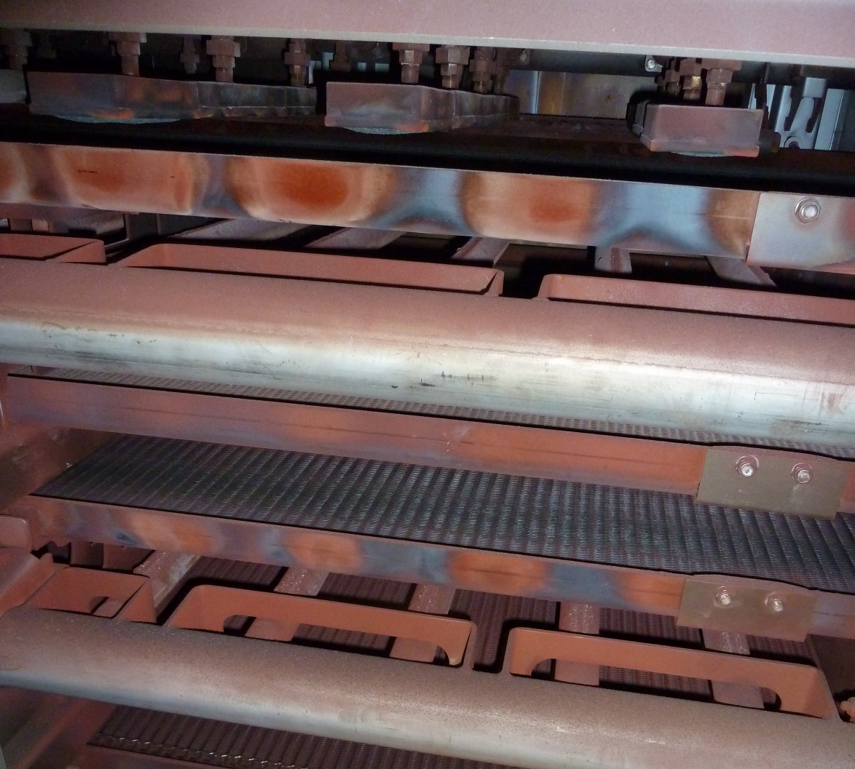
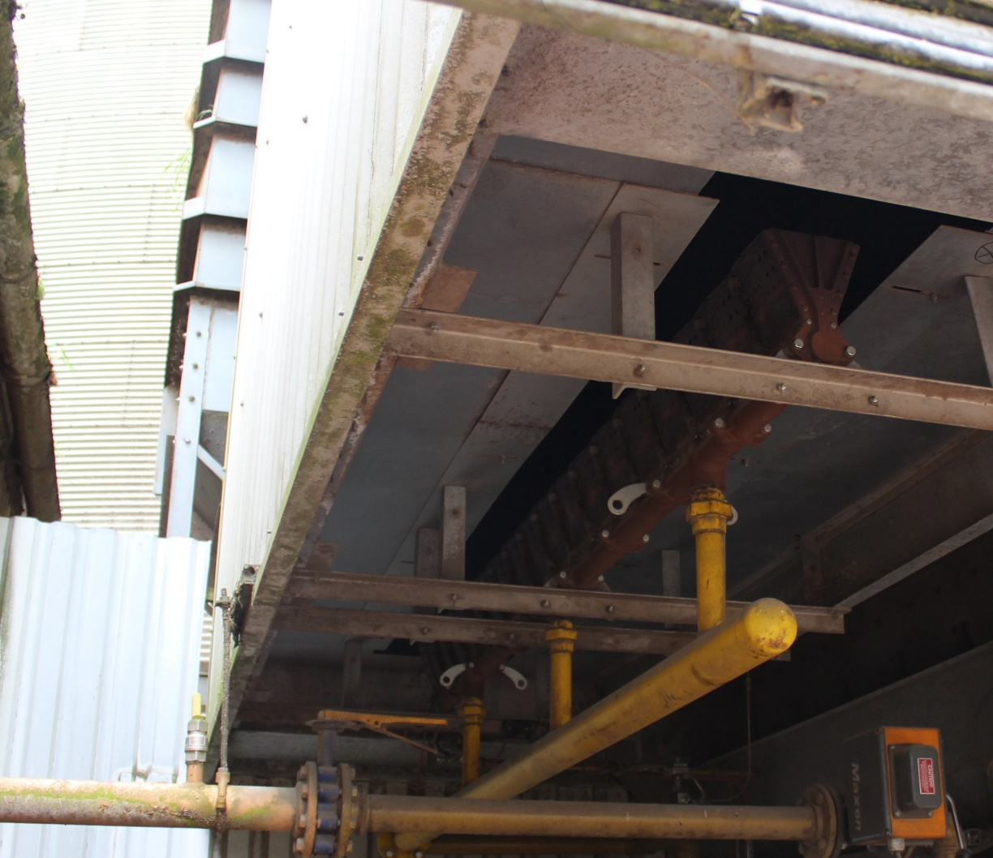
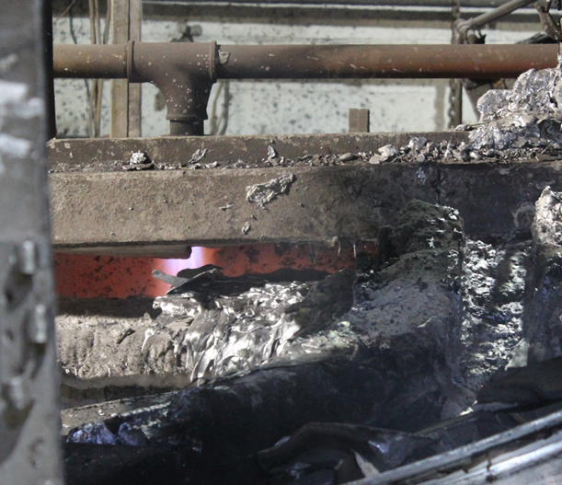
Safety Challenge 1 – Risk of gas equipment explosions
Adequacy of Burner Management Systems (BMS) for hydrogen – flame detection, purge duration, SIL Rating
Pre-mixed burners and/or hand lit burners could pose a significant risk
Existing explosion relief is unlikely to be sufficient for H₂ operation
Notes:
One of the main issues that emerged from the surveys is the suitability of the current safety systems on combustion devices to avoid internal hydrogen explosions. Before switching to 100% hydrogen, it will be necessary to verify and upgrade / replace gas combustion devices and related burner management systems (BMS) with the supplier. The BMS reliability should be high enough to ensure that the risks are as low as reasonably practicable (ALARP) given the increased severity of internal hydrogen explosions. (see left/middle)
Some of the sites surveyed had pre-mixed burners, where air and gas are mixed before reaching the burner. These configurations may need significant modifications or complete replacement to prevent damaging internal explosions in the pipework, because hydrogen has a higher flame speed and a much wider flammable range than natural gas. (see pic right)
For any equipment with explosion venting (or explosion suppression) equipment, the design will need to be reviewed and major changes may be required due to the higher flame speeds of hydrogen. In some cases, it may not be feasible to provide adequate explosion relief for equipment.

Slide 10
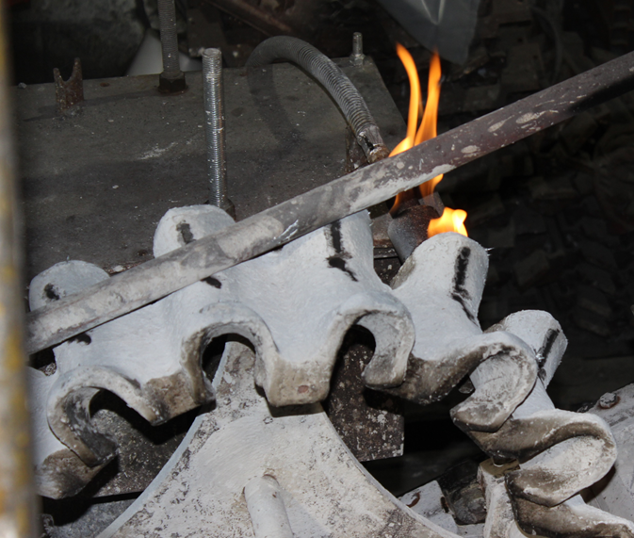
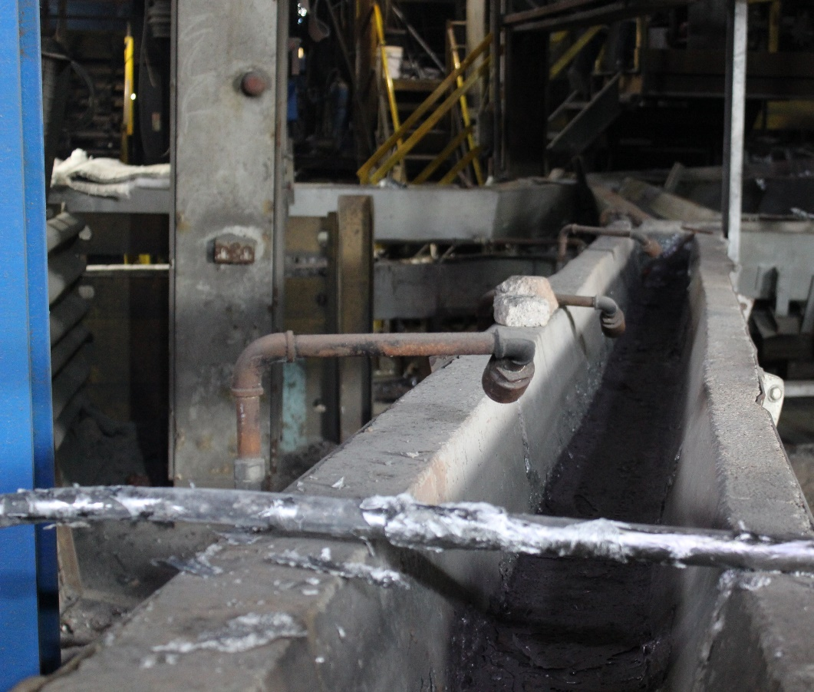
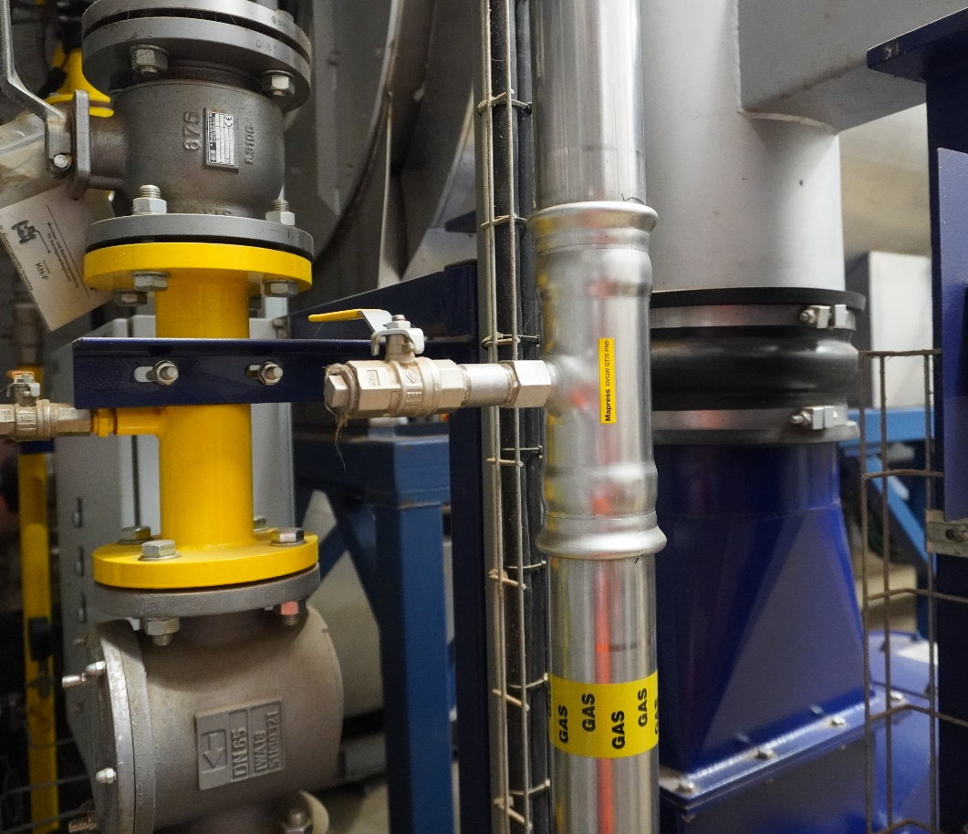
Safety Challenge 2 – Equipment Compatibility for H2
Safety measures for legacy equipment will require appraising from scratch for hydrogen operation - could be challenging for older equipment
Small amounts of air ingress into gas systems is a greater concern with H2
Leak tightness and material compatibility needs to be confirmed for H2 (e.g. compression fittings)
Hand-held gas torches fed from gas headers of particular concern due to low H2 flame visibility
Notes:
The gas equipment in industrial sites may have been installed for a long time and may not comply with the current standards
The safety measures for legacy equipment will need to be assessed from scratch when switching to hydrogen operation, as this may affect the original design basis and compromise the effectiveness of any existing safety measures.
Gas equipment also needs to be verified as safe for hydrogen operation, taking into account factors such as: material compatibility, leak tightness, higher flame temperatures, lower energy density, higher volumetric flows (leading to vibration).
Hydrogen embrittlement is a well-established phenomenon. It affects high strength steels in particular. The effects of hydrogen on elastomers/polymers and other materials is still under investigation. More research is needed to assess the material compatibility of existing systems. For older sites, where the identification of all materials in the gas distribution system may be challenging, replacement may be a better option.
The leak tightness and material compatibility of screw and compression jointing techniques for hydrogen service also need to be evaluated (see picture right)
The low visibility flame of hydrogen fires could result in accidental burns to workers, unintended ignition of flammable or combustible materials and increase difficulty in determining if a gas torch is ignited with the potential for accidental gas releases (see left/middle pic)

Slide 11
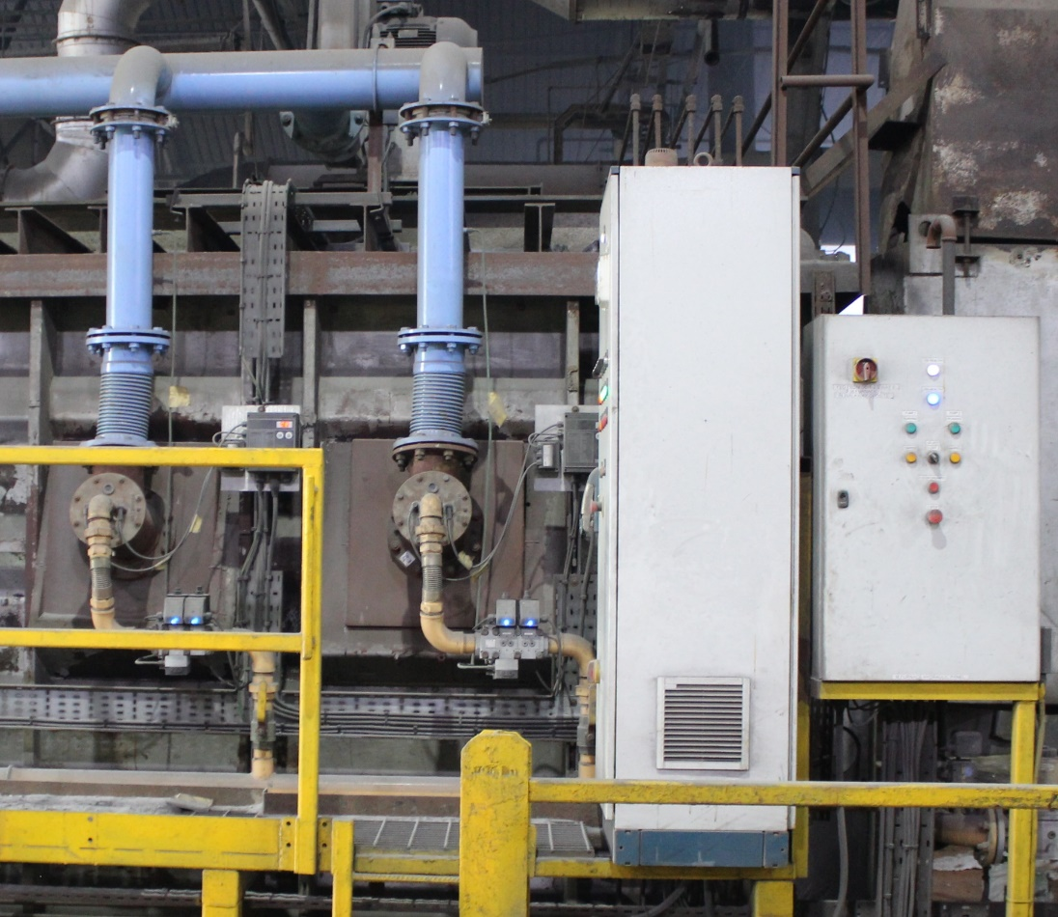
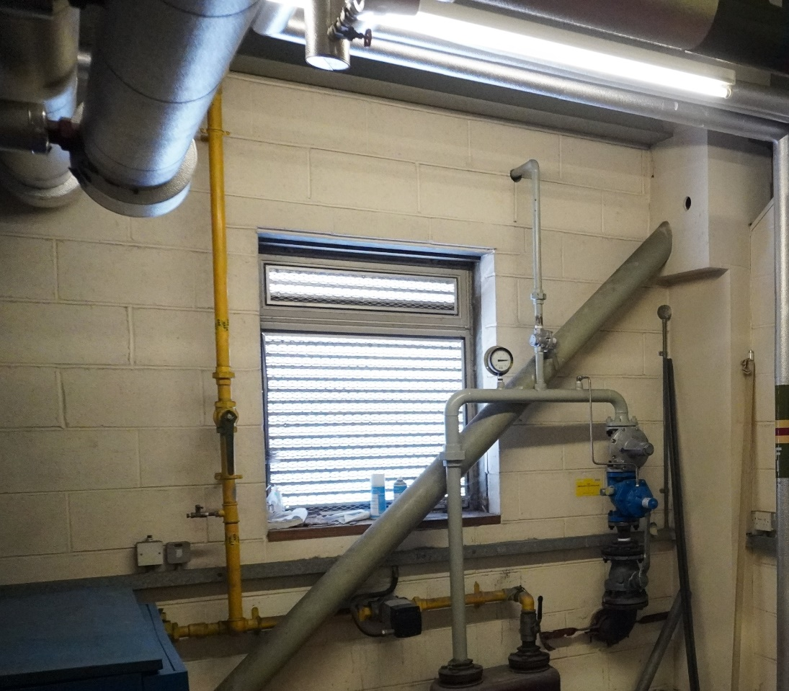
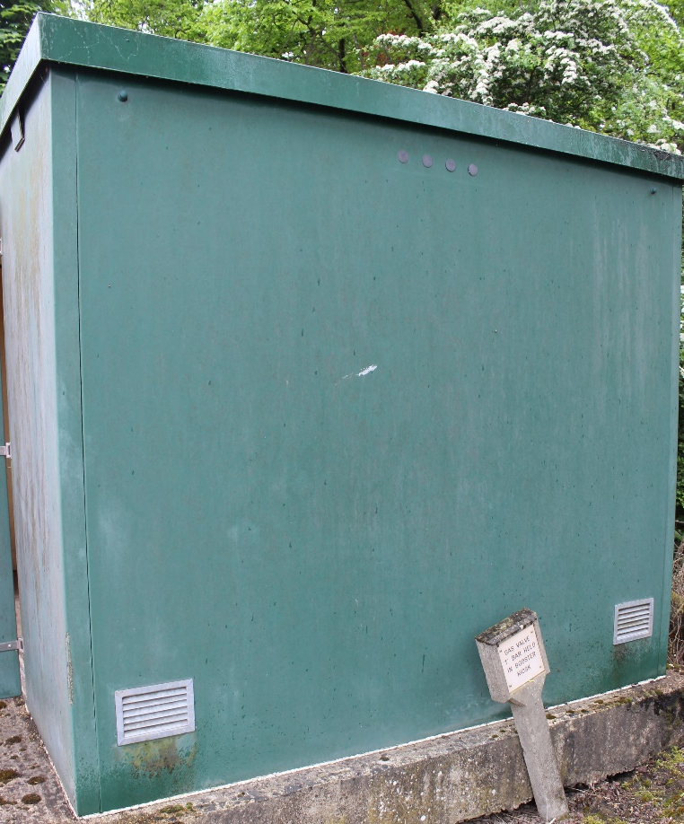
Safety Challenge 3 – Enclosure Ventilation and HAC
Most enclosure had inadequate ventilation to maintain current HAC zones, including most meter houses! High level ventilation was rarely present but could be easily retrofitted.
Where new Zone 2 HACs are predicted this would encompass unrated electrical installations – expensive to remedy.
Where Hazardous Areas are unavoidable, tighter ignition control will be required with IIC-T1 ATEX required versus IIA-T1 for NG.
Notes:
Outdoor gas supply pipework tends to result in a Zone 2 of Negligible Extent (NE) for the operating pressures commonly found – not a major issue.
For gas pipework and equipment inside enclosures it was commonly found that existing ventilation arrangements would be inadequate for hydrogen to maintain current zones. Result was typically a Zone 2 for the enclosure. Can encompass unrated electrical and mechanical equipment (see middle/right pic)
Ventilation was often absent at high level, as hydrogen is highly buoyant and could collect at roof level. Nearly all meter houses surveyed required increased ventilation area, especially at high level, to maintain the current zone classification when operating in hydrogen service (see left pic)
Where practicable, gas supply systems inside enclosures and buildings should aim to operate below 100 mbarg. Doing so leads to zone 2 NE as long as ventilation can be demonstrated to exceed 1.5 air changes per hour (ACPH).

Slide 12
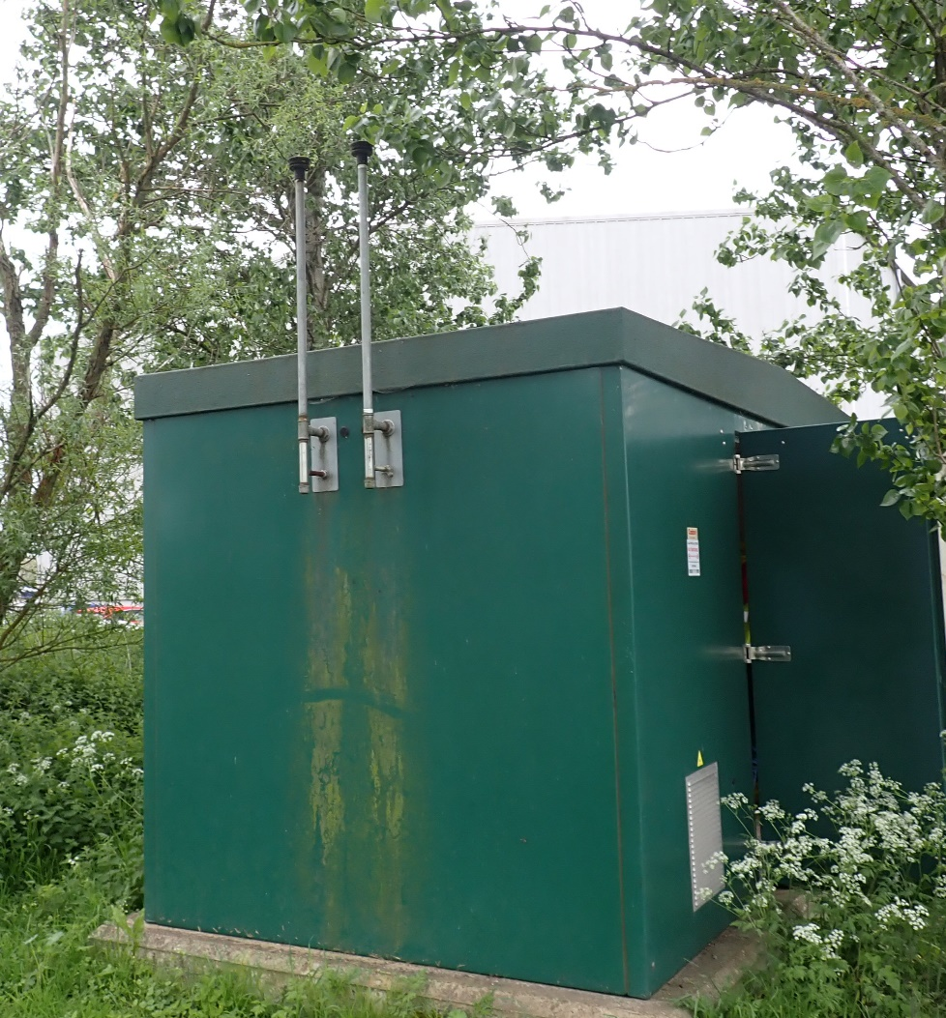
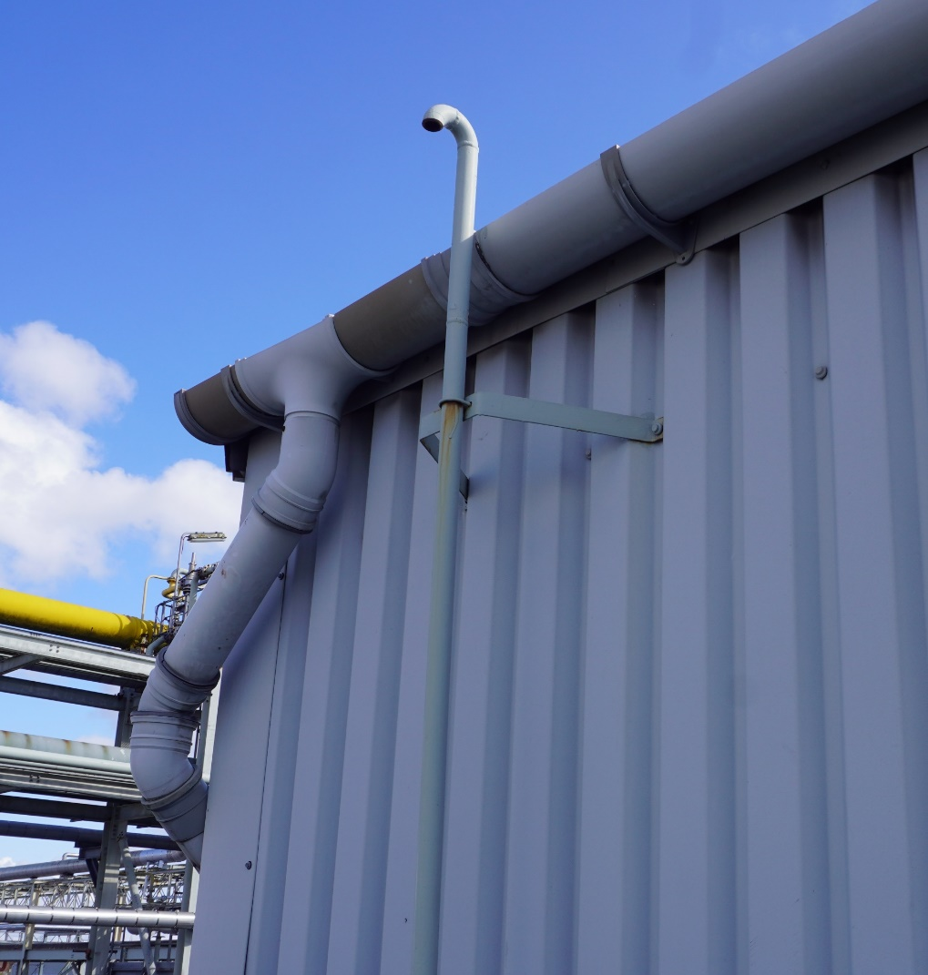
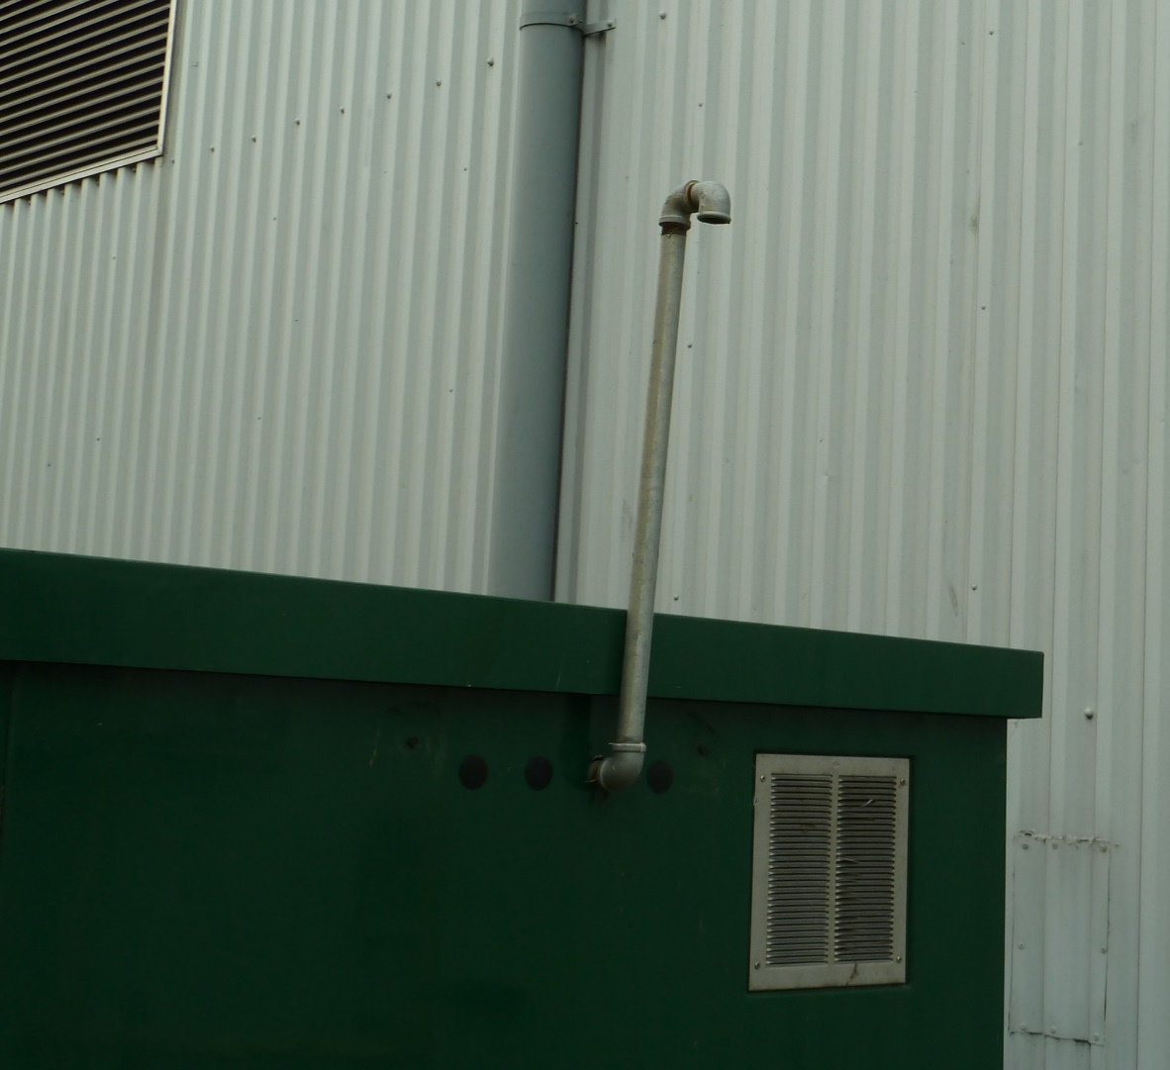
Safety Challenge 4 – Pressure Relief Vents
IGEM guidance for calculating HAC extents around vent tips increase significantly with H2
Could result in additional requirements for ATEX rated equipment versus NG.
Vents with non-ideal vent tip configurations (e.g. downwards or impeded) had the most significant implications
Notes:
Applying the draft IGEM guidance for calculating hydrogen hazardous areas [1], Hazardous Area Classification (HAC) extents around vent tips would increase significantly with hydrogen and, depending on vent location and configuration, this could result in additional requirements for ATEX rated equipment versus natural gas
Vents with non-ideal vent tip configurations (e.g. downwards or impeded) have the most significant implications for some sites with hazardous area radii increasing to encompass non-rated ground level equipment. (see all pics)
Design of pressure relief (e.g. sizing) needs to be validated under new H2 operating conditions. Concerns around vegetation leading to explosions (left pic)

Slide 13
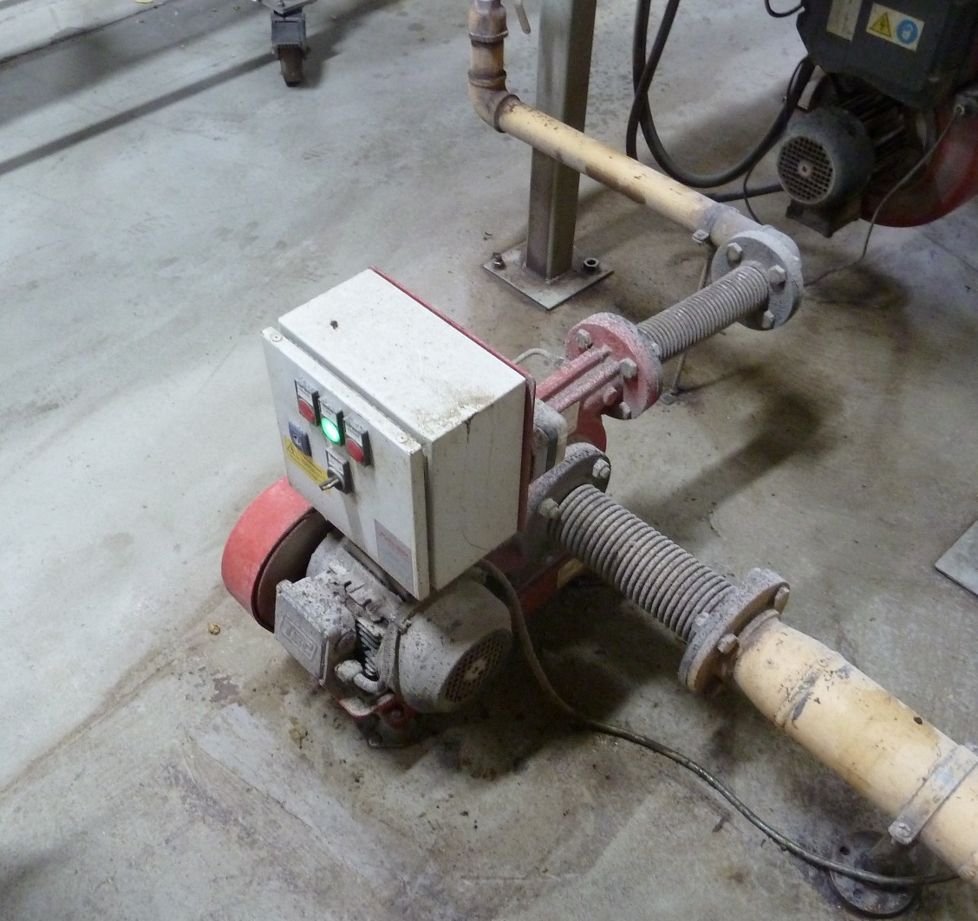
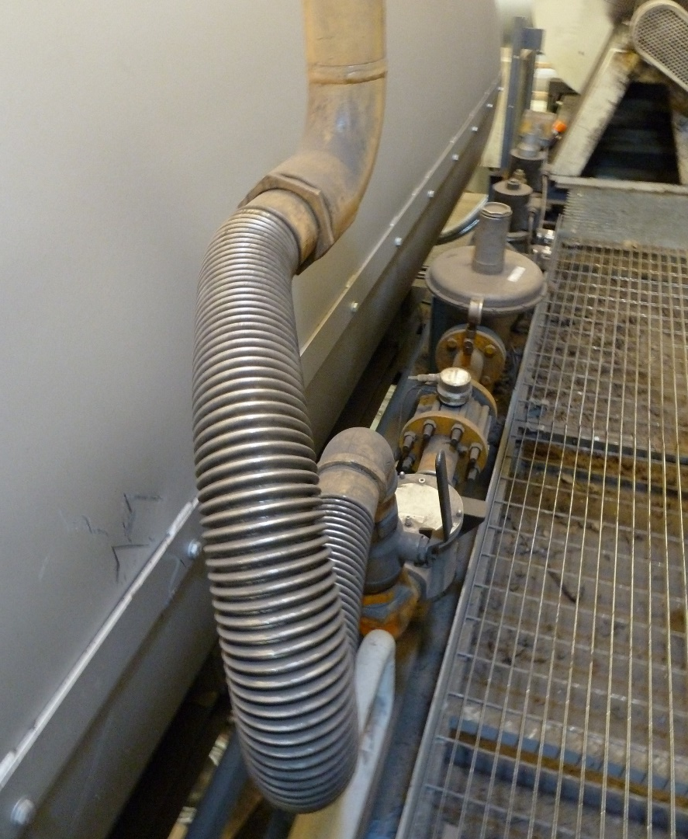
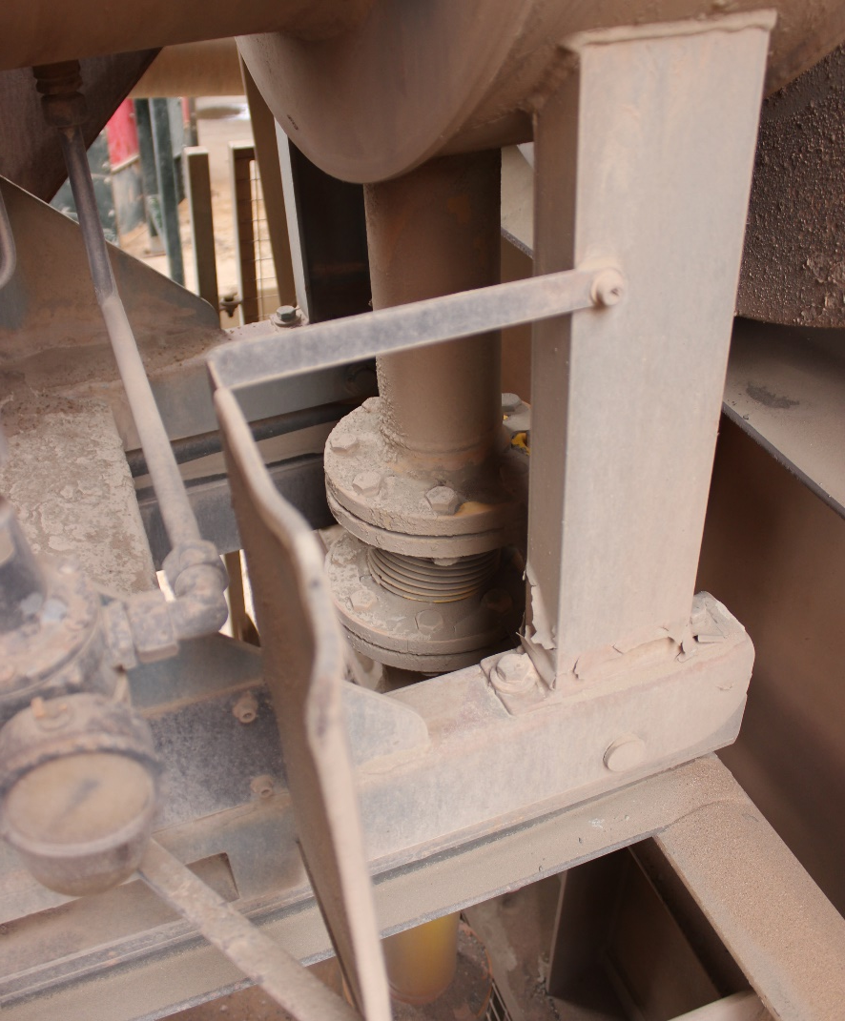
Safety Challenge 5 – Adverse Conditions
The most common source of adverse conditions (as defined in IGEM/SR/25) was associated with flexible hoses and rotating equipment (vibration source). This result in much larger hazardous areas for hydrogen than for natural gas and can encompass previously non-ATEX rated equipment
Gas boosters are commonly used to meet operating pressures of equipment (e.g. ovens) and are unlikely to be adequate for hydrogen and were found to result in HAC Zone 2 extents of several meters
No coastal sites were visited as part of this work but these sites would also require significantly increased hazardous areas.
Notes:
Gas boosters are commonly used where there was a need to boost low pressure gas to the operating pressure of gas burners (e.g. industrial ovens). The integrity of existing gas boosters is unlikely to be adequate for hydrogen and were found in the DSEAR review to result in HAC Zone 2 extents of several meters. (see right pic)
Vibration (see middle pic)

Slide 14
Technical Recommendations
OEM engagement with their clients to understand whole system installation, operational impacts and the extent of modifications required
OEM development of commercial hydrogen versions of their equipment ranges
OEM development of hydrogen ready boosters/compressors for low pressure applications
Develop understanding of higher moisture content effects from hydrogen combustion on product and process in direct combustion applications
Develop site information on materials and fittings inventory of gas systems
Develop fiscal meters for hydrogen applications
Supply chain engagement to identify changes for bespoke end-user equipment at the rate required for decarbonisation
Notes:
Add from table 4
T1. Additional engagement is required from OEMs to better understand the extent of modifications required, NOx guarantees, and impacts on operation (e.g. temperature profiles, efficiencies, thermal rating, control system changes, material suitability, equipment durability) of switching equipment to hydrogen as a fuel. OEMs should consider the implications of recent BEIS work on Hydrogen Ready Industrial Boilers
T2. Further work is required by OEMs, particularly those providing complete packages, to develop commercial hydrogen versions of their equipment ranges. Availability of funding to support their development could encourage OEMs who are hesitant to invest prior to major hydrogen uptake or switchover. An assessment will have to be made by government as to the extent to which existing programmes like Industrial Energy Transformation Fund, Industrial Hydrogen Accelerator, Industrial Fuel Switching 1 & 2, and the Industrial Clusters programme provide sufficient imperative to manufacturers to create Hydrogen Ready solutions.
T3. Further work is required for OEMs to develop Hydrogen Ready boosters/compressors for low pressure applications.
T4. Further work and study are required to understand the impact of the higher moisture content from hydrogen combustion on processes such as ovens and dryers, and if this will have an impact on air flow rates, product flow rates, quality, and fuel consumption. Some potentially complex cases were identified involving combustion products which will require further research at food manufacturers.
T5. Industrial sites will be required to positively identify all materials within a site’s natural gas infrastructure if it is to be repurposed for hydrogen, in particular valve trims and non-metallic components at joints and valves. Whilst hydrogen embrittlement is a known issue, particularly for high strength steels, hydrogen effects on elastomers/polymers and other materials is an area of ongoing research. Further study is required to determine the material compatibility of the existing system. It is also recognised that the positive identification of all materials used in a gas distribution system may be a difficult task on older sites. It may therefore be more cost/time efficient to construct parallel replacement piping; this may be mandated based on the line capacity and size of the pipework required for hydrogen versus natural gas.
T6. Though flowmeters suitable for hydrogen flow measurement exist, a recognised fiscal hydrogen flowmeter is still an area requiring further development. The possibility to modify existing fiscal natural gas flowmeters to work for hydrogen also requires further investigation.
T7. Further work is required to understand the potential demands on the supply chain in assessing the changes required for bespoke end-user equipment, and the ability to provide equipment at the rate required for potential conversion or retrofitting

Slide 15
Safety Recommendations
Site risk assessments, HACs and operating procedures (e.g. SSOW) should be revised for H2.
Review enclosure ventilation to determine if it is adequate. In particular, the presence of ventilation at roof level
Evaluate suitability of current gas equipment for operating with hydrogen and replace or upgrade if found not to be suitable.
Burners and burner management systems (BMS) should be reviewed and updated, to consider revised combustion air flows, purge cycles, flame detection, gas isolation systems, risk of air ingress and explosion relief adequacy. Pre-mixed burners are of particular concern.
A more thorough approach to prevent air ingress into gas pipework (e.g. reverse flow, purging procedures) will be required due to the wider flammable limits of H2.
HAC zones around pressure relief vents need to be checked and is a particular issue for “non-ideal” vent configurations (e.g. goose neck vents).
Sites should ensure that all electrical and mechanical equipment located within HAC zones are suitably ATEX rated for H2 (e.g. IIC-T1 rating).
Existing Relevant Good Practice (RGP) for gas installations (e.g. BS EN 161 and BS EN 746) require revision to ensure they are appropriate for H2. Many small industrial sites rely on RGP compliance to help manage their risks to ALARP.

Slide 16
Acknowledgments
The Department for Energy Security and Net Zero (DESNZ)
The seven participating sites
The project teams at ESR Technology and AECOM

