Slide 1
Performing a Technical Audit with examples of some of the Findings
Presented by Eur. Ing. R T Canaway, B.Sc. FIChemE., MIMarE.
Suregrove Limited

Slide 2
PURPOSE of TECHNICAL AUDITING
Bench Marking – To confirm the Facilities are compliant with International Codes & Standards, have proper (working) safety systems, and are competently operated and maintained
Risk Management – To confirm that Risks have been identified and are being/have been addressed to minimise loss exposures.
Corrective Measures – Provide feedback from the audit and calculations in the form of unambiguous recommendations which are prioritised for action by the owner

Slide 3
AUDITING FREQUENCY/TEAM SCOPE RESULT
Every 5-10 years or whenever a significant change has been made (software or hardware)
Independent Third-Party Team of qualified engineers/scientists
Plant Data Collection & technical familiarization by Audit Team
Plant Survey of all areas, taking of photographs, recording of findings
Feedback, Report Preparation, Submission, Owner Response, Issue

Slide 4
DATA REQUIREMENTS TO BE STUDIED ONE MONTH in ADVANCE OF AUDIT DATE KNOW YOUR SITE BEFORE YOU AUDIT IT! ADVANCE)
Process & Utility Flow Diagrams
Piping and Instrumentation Diagrams
Plot Plans, Structural Drawings, General Arrangements
Selected Isometrics (for major inventory calculations)
Corrosion Circuit Diagrams
Single Line Diagrams
Tagged items Data Sheets (Equipment List)
Piping Specification
Design Philosophies, Specifications, Design Codes
Marine Data
Fire/Explosion Protection Details
Research natural perils exposure – earthquake, cyclone, flooding …
Business Continuity and Incident Response Plans
Hazid/Hazop Results and subsequent actions taken
Safety Case Reports
Loss Records for 10 years
Management of Change Records
All Department Procedures, Work Instructions and Permits
Security Arrangements
Emergency Response Plans for all types of Incidents

Slide 5
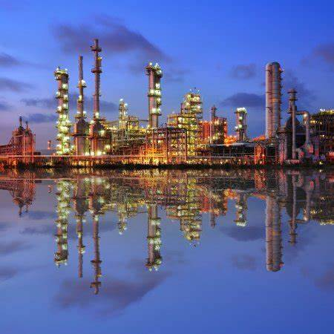
SITE SURVEY (DEMIODAL)
Decide on a programme with the Owner/Operator
2-3 days per major process unit,
1-2 days for utility areas,
2 days for tank farms,
1 day for jetties,
2-3 days for interviews of departments
Explain your task to site personnel, gain their confidence that the audit has the objective of improving their safety as well as that of the site
Make comprehensive notes on each walk through, taking photographs of any deficiencies, anomalies
Identify Key Areas for Possible Loss of Containment, Significant Fire, Explosion, Toxic Release and so on
Observe risk to your site and also to/from neighbouring sites
Determine the adequacy of the facilities to start-up, operate and shutdown safely
Assess the competency of the workforce from the shop floor upwards to management, the standards which are being deployed and identify any problem areas such as manning levels, inexperience, attitude to risk taking.
List main findings and agree with management/senior staff before leaving the site

Slide 6
KEY AREAS FOR THE SITE WORK
Physical Parameters
Layout of Site – compactness, spacing (meets recommended criteria?) – vulnerability of the Control Room
Assess any terracing – can leakage flood over the site
Construction – assess standard, look for deficiencies (need for a structural expert)
Condition – appearance, bolting completion, painting, housekeeping, rust, passive fireproofing status, evidence of water ingress, pooling, oil/chemical spillage, out of service equipment and instrumentation
Identify Major inventories – such as accumulators, towers, tanks, pipelines
Identify all ESD valves in the site, their function, the risk of these being lost in a fire
Study Drainage – open and closed routing, capacity and sophistication
Study Relief Systems – to Vents Stacks, Closed Flare (drums, piping, relief valve discharges)
Map all incoming pipelines and exiting pipelines – isolations
Loading/Unloading Systems – review road, rail, pipeline, ship, barge delivery and send-out – how are these shutdown in an emergency
Identify exposures from natural perils to the site (earthquake, tsunami, lightning, flood, storm)
Visit all buildings – assess blast resistance, gas ingress, pressurisation, internal fire risk & protections
Visit the fire station and assess the vulnerability due to its location, collect all information concerning fire water & foam systems plus any fire suppression systems
Identify the fire fighting routes for vehicles and mobile equipment and check the reach limitations
Look out for hot work being done close to the site, temporary equipment being used in Classified Areas, redundant equipment being left in the site

Slide 7
Key
The facility must be able to shutdown in a safe manner
Control & Safety
The systems deployed
Whether they are fully functional
Alarm Management (number per station in 10-minute period)
Assess Fire and Gas Detection Effectiveness
Location of ESD buttons
Cause & Effects Logic
Isolation, Depressurisation, Blowdown
Fire Zones
Time required to meet codes
Review the Flare & Vent Design Basis
Are there any problematic cases

Slide 8
Ranking of the Risk (Example) Rate the risk (e.g. 1 to 5) 5 - Excellent 4 - Good 3 - Average 2 - Substandard (recommendation to improve) 1 – Poor (recommendation to correct – mandatory)
1 Plant Layout (Safety Distance) - meets code?
2. Equipment, Tanks, Spheres
3. Pipelines, Piping & Valves
4. Electrical & Instrumentation
5. Storage and Handling of Chemicals
6. Utility Systems
7. Loading & Unloading stations
7. Fire & Gas Protection & Detection Systems
9 . Buildings
10. Security Systems

Slide 9
Assembling the Audit Team
The key auditors must be fully qualified and suitably experienced to conduct the audit – there can be no learning curve for the team except for the support staff (who should be trainees).
Many audits may be overseas and require travel and assignment of several weeks – thus suitable staff must be selected. In order to avoid misunderstandings, the team should include personnel who can converse in any foreign languages used at the site location.
The main goals are to review the company’s facilities, safeguards and method of working to achieve their business objectives.

Slide 10
Consider an Ethylene Cracker
Explosion Model
Key Facts
Spheres (inside red boxes) are very close to the process units – separation distance meets code but only just!
If a 50t release of propylene occurs and is detonated the spheres are at risk (particularly the front row).
The most likely damage would be a line rupture on the outlet line from a sphere(s) – resulting in a massive release.
How do we mitigate the exposure?

Slide 11
Typical Technical Audit
Plant Layout (Safety Distance)
International plant designed by a reputable contractor? will probably meet the recommended practice, a check on the actual spacing between units, equipment, tanks, roads and accessways, and any surrounding exposures should be carried out particularly when expansions have been inserted in a congested plot
Equipment, Tanks, Spheres
Design codes/certification procedures should be reviewed against international standards. The inspection routines for all items need to be analyzed for deferrals, unchecked data and any concerns.
Include fired heaters where the fire box integrity should be checked (pressure profile).
The position and number of fire safe Emergency Block Valves in the plant should be observed.
Overspeed protection for rotating equipment.

Slide 12
Selection of the appropriate materials for services in a plant is made in accordance with the piping specifications. Inspection data will reveal whether the material of construction is suitable and recommendations for any upgrades should be made for short lifetime components (mainly corrosion/erosion). Also pipe stress calculations should be looked into when vibration is occurring on the plant or buckling/deformation is noted.
The pressure rating for upstream and downstream systems (for deadheaded pumps, maximum compressor pressure cases) should be checked.
Any derated systems should be reviewed where the operator has had to reduce the working pressure/temperature due metal thinning, loss of wall thickness and so on.
Pipelines, Piping & Valves
Electrical and Instrumentation
The starting point will be the Hazardous Area Classification documentation. Cross check with the electrical ratings (basically the requirement for intrinsically safe items in a particular zone). Cable tray location and protection (e.g. potential fire and the impact on cables running in the areas). Inspect the substations, switchgear, MCCs - are they gas tight, fire protected (basements and overhead entry), transformer condition -suitable inspection regime ? include cathodic protection, static electricity, groundings/bonding/lightning protection system. Plant instrumentation can be observed in the control room/P&IDs. Check for alarm flooding - numbers will reveal whether the plant has adequate control, and the number of shutdowns is excessive. Are the Safety Instrumented Systems adequate?

Slide 13
Loss of containment of flammable liquids such as Liquefied Petroleum Gas, hydrocarbons, unstable reactive chemicals. The need for inert atmospheres and their reliability. Are the dikes adequate for tankage? Confined space entry. Reactive chemicals stored in a properly segregated area? All storage tanks should be inspected within the recommended time frames and there should be internal photographic evidence of the findings
Storage and Handling of Chemicals
Utilities
One of the most important areas which is often overlooked is the utilities – which should be checked for reliability (power source and back-up), cooling water, heating media, relief, blowdown and depressurization, air, nitrogen, water decontamination, run off, and so on.
Loading/Unloading Stations
Most common areas for potential loss of containment are where disconnection and reconnection occurs such jetty loading arms, hoses, railcar, truck systems. How these are controlled to prevent overfilling, accidental spillage, and whether the shutoff systems are suitably designed. The procedures for unloading/loading of ships and barges/rail wagons and trucks need to be reviewed for completeness.

Slide 14
Checked for faults such as ‘out of service’ fire/gas detectors, panels, and also the plant coverage.
Fire water systems - best systems usually have a combination of fire pump drivers (electrical and diesel fuel).
The criteria for assessment - one fire pump is out of service.
Similarly, the foam system should be checked for capacity (enough to meet the code guidelines).
A useful exercise is to run a wet test and note the response time for wet and dry pipe sprinkler systems, the effectiveness of deluge systems, fluid curtains, inert gas systems. Correct use of water, foam, dry chemical and gases such as carbon dioxide, Inergen, FM-200 in areas of the site should be verified. The physical status of the fireproofing and insulation for Fire Protection should be examined as well as the extent to which it has been applied
Fire & Gas Protection and Detection
List the location of occupied buildings subject to Process Hazards and then their robustness examined. Is the Control Room blast resistant? (does it have windows, is it positively pressurized to prevent gas ingress). An explosion prediction model should be used to calculate the damage radius when volatile flammable material is released.
Security Systems
Often overlooked but important to site integrity. CCTV is now sophisticated so that roving cameras can be used to patrol the entire site. Gate access, fencing, motion detectors are key parameters but also access to the site by third parties should be controlled.
Buildings

Slide 15
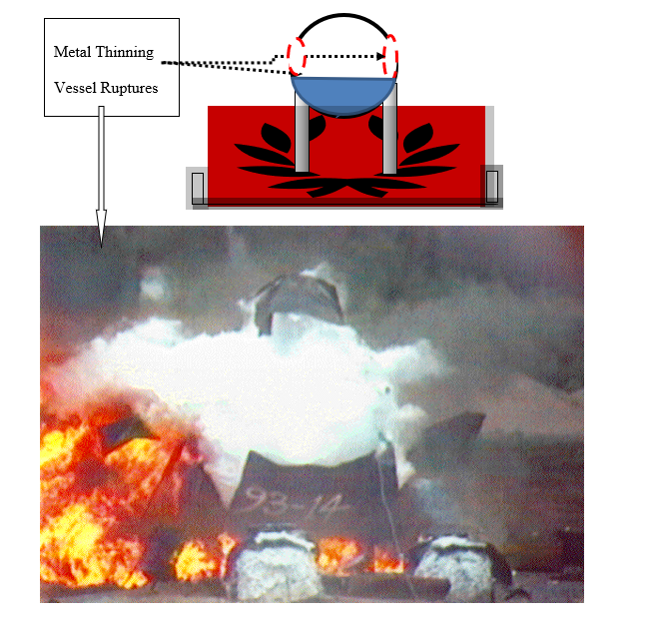
Sphere BLEVE

Slide 16
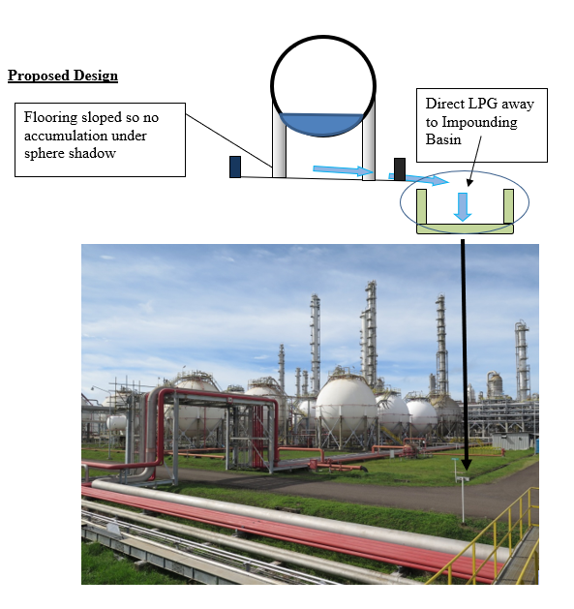
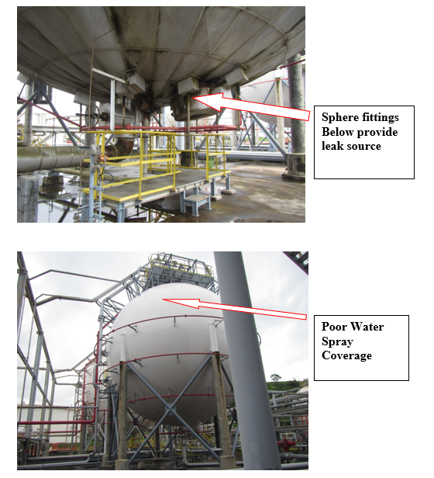
Slope ground under sphere to direct LPG away from sphere shadow

Slide 17
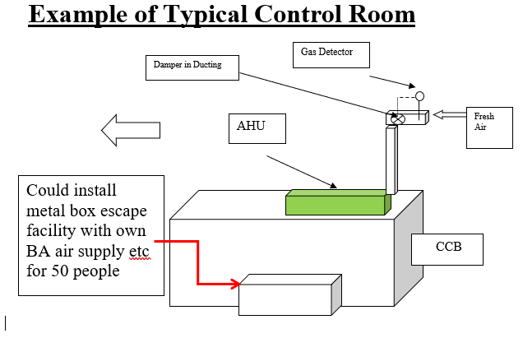
Control Rooms - Findings
The Double Airlock prevents gas ingress
Some control rooms are found to be close to the Process Area and have no blast resistance or no positive pressurisation

Slide 18
KEY PERFORMANCE INDICATORS (AUDIT KPIs)
Frequency of Turnaround Maintenance, Backlog of Work (deferrals)
Trending of Equipment & Instrumentation Failure Data
Inspection Thickness Data, Breather Valve, Relief Valve & ESD Valve Testing
Positive Material Identification, Rejection Data
Process Safety Management Programme, Elements Fully Implemented
Loss Record (last 10 years) – any repetitive losses?
Near Miss Reporting and Corrective Action List
Site Status – housekeeping, short bolting, electrical system integrity
Power failures (last 5 years), Other Key Utilities Reliability
Any Thermal Cycling Issues ? This ages the plant !
Isolation of Equipment, Bypass Management, Impairment of Fire Protection Systems
Work Permit Control (Effectiveness)

Slide 19
KPIs - Continued
GAPs in Standard and Emergency Operating Procedures
GAPs in Maintenance and Inspection Procedures
Structural Criteria for Plant, Jetties, Buildings (Piling, Soil Data)
Earthquake, Wind, Storm, Cyclone, Typhoon, Tsunami Design
Fire Pump Testing - with copy of the standard form used
Fire & Gas Detection (coverage), Manual Call Points (accessibility)
Firewater and Foam Coverage (Fixed Monitor, Mobile Units, Hydrants)
Fire Suppression (inert gas), Powder, Portable Extinguishers
Fire Brigade onsite, external, National Support, Emergency Response
Security, Traffic Control, Training including Emergency Response

Slide 20
Facility Workforce
Assess the capability of each department:
Experience, Blend of Recruitment and Longterm Employees
Review current status and what will happen in next 2-5 years (expertise handover)
Problem solving (ability testing)
Attitude and Stress Level (working hours)
Manning Level, Shift Handover
Keyman Cover (sickness)

Slide 21
Some Notable Audit Findings
Control Room is not pressurized, has openings permitting gas ingress, cable transits are sealed with polyurethane foam (flammable!) – doors often left open
Emergency Shutdown System does not fully function (never fully tested)
Not enough Fire pumps, Fireproofing inadequate
Plant maintenance – incomplete bolting, gasket leaks, external corrosion, CUI
Plant Inspection – Lack of data for thickness trending, RBI used well beyond its limitations (particularly rotating standby machines – never run-up)
No Positive Material Identification (unknown materials)
Safety Procedures – cannot control Lockout, poor PTW, inadequate isolation
PSSR not conducted before re-commencing Operations
Too much work being carried out with fully operational plant (SIMOPs)
Turnaround frequency is too long

Slide 22
Continued
Personnel overstressed (hours too long)
Documents out of date – negating any PHA (HAZOPs)
No refresher training
Disconnection between Senior Management & Workforce (unable to report)
Operating significantly outside design envelope of plant
Too many plant bypasses on executive instrumentation
Passive fireproofing in poor condition
Double Block and Bleed missing, blind flanges not at same pressure rating as flange
Stacking of products in warehouse too high, unprotected stacks outside shadow of firewater deluge
Warehouses too dusty – health hazard and explosion risk
Contamination issues

Slide 23
Continued
Non-essential vehicles parked close to plant and non-essential staff in Control Room
Poor scaffolding without tag certificate
Insufficient fence height around the perimeter and open access to site via jetty
Inadequate security measures at entrance – no barrier gate or security check
Poor tank bunding (capacity does not meet code), earth mounds have asphalt coverage deteriorating in sunshine, blocked bund drains, piperacks supported on bund wall (lifting damage), pipework penetrations are not sealed at bund wall
Piping routed through bund (also pumps inside bund)
Pipework continuously vibrating, inadequately supported

Slide 24
Continued
Lack of kerbing in loading areas to contain spillage, Fire Boxes located inside kerb (sitting in potential hydrocarbon area)
Fixed firewater monitors too close to plant for use by fireman
No plans, documents or procedures in ECC
Limited CCTV coverage of site
No transformer firewalls, or too low so all lost in a fire case
Open drainage blocked by silt, weeds, debris
Closed drains drum is atmospheric tank and could be pressurized
Liquid carryover in KO drums, flare drums
Hydrate formation, Wax formation, No-winterisation

Slide 25
Continued
Equipment foundations – inadequate piling causing pipe stress, subsidence
Welding failures – incorrect welding materials used (Delayed Hydrogen Cracking)
Bolts/nuts materials mismatch causing corrosion
No internal pipeline inspection (not pigged)
Underground, Buried lines and equipment never inspected
Flare tip damaged by previous significant relief cases
Thermal cycling has significantly aged the plant (usually due to power failures, control system instability, poor operating experience)
Security inadequate – risk of intruders causing damage to site and/or being injured/killed

Slide 26
FIRE PROTECTIONS
Firewater
Determine the maximum firewater load case and number of pumps required plus the power source (diesel/electric) - assume one pump may be out for repair and one does not start
Run a firewater test to observe a tank/sphere/major vessel deluge assess the wettage
Check the delivery pressure at the furthest hydrant from the pumphouse (jetty end?)
Review the access to all plant areas for deluge (e.g. inside a bund, reach, roadway access, check diameter of deluge rings and delivery rate against code)
Look for leaks in the system, if the jockey pump is running this may be because the firemain is leaking.

Slide 27
Continued
Foam
Inert gas
PFEs
Fire Brigade
Calculate the delivery volume for the worst case (usually a tank fire), review distribution system
Examine building which has fire suppressant for openings, pressurization, calculate volume required, activation method, evacuation plan
Determine number per code, condition, access, type of extinguishant is correct for service?
Capability - trucks, trailers, mobile units, telescopic units, back up from outside.

Slide 28
Continued
Passive Fire Protection
Determine the Class Rating in hours
Assess the extent by considering the nearest pool fire exposure
Assess the condition (is it deteriorating?)
Locate heavy weights in piperacks above and also the supporting structures
Study the cabling routing for power and control – is it subject to fire damage – this could be a minor physical damage loss but major interruption to business continuity

Slide 29
KEY DOCUMENTS
Safety Aspect
Document
Fire
Work Permit
ERP
Firepump Test Records
Hit and Miss Register
Fire Pre-plans should be available for each area
For Naked flame, Cold work, CSE, Excavation, Vehicle, Isolation, Radiation
Review adequacy, clarity, emergency response team, Location
Check Performance at 3 points, duty point, zero flow and 150% flow
Look for Repetitive Occurrence, Corrective actions applied ?
Frequency of reporting (should be 10000 HSE Cards/year plus for large installation). The serious incidents should be elevated to Management Level so that they are immediately corrected

Slide 30
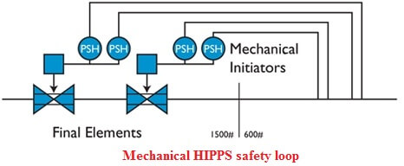
Safety Systems
System
Remark
Fire and Gas System
ESD Valves
Duplicity of PSVs
Interlocks
LOTO System
Check Functionality – identify faults, check Field Location
Check position on screen and in field
- Review need for HIPPS
- Voting Systems (such as 2oo4 etc.)
- Review SIL Studies
Any additional? Will one valve removal stop process?
Study the Cause & Effects – all events covered?
Isolation in field, electrical substation, control of work – can the system be bypassed (shortcut will invalidate safety)

Slide 31
SECURITY
Check manning level in security & Integrity
Physical Barriers such as warehouse entry, CCTV
Fencing, Gates, Personnel Recruitment and Background Checks
Necessary? Fit for Purpose? Drug & Alcohol Testing
Identify the Risk in the particular global region
Do not layoff contractors inside the site boundary
Investigate vulnerability to outside & inside attack
Simple Theft
Sophisticated Fraud
Intrusion Prevention
Vehicle Access
Terrorism & Sabotage Risk
Civil Unrest, Malicious Damage
Cyber Exposure

Slide 32
Offshore Platforms
Typical Complex
Important Aspects
Safe Refuge & Escape, Gas and Smoke Ingress
Structural Integrity, Member Flooding & Undersea Fouling
Shipping Collision Risk
Layout of Decks, Dropped Objects, Aviation
Spillage Dissipation from Topsides (Drains!)
Connection to Wells, Isolation, Depressurisation
Isolation of Pipelines from platforms
SIMOPS – check the controls in place as the platforms will continue to operate

Slide 33
REPORT WRITING
Topic
Remark
Introduction
Summary
Description of Facilities
Plant Safety Criteria
Site Location – Safety Criteria
Appendices
Photographs
Site Plan
QRA Results
Supplementary Safety & Loss Prevention Guidelines
Scope, Location, Attendees
Key Findings, Illustrated, Action List (prioritized) by system, plant, area
A very brief description of the plant with key parameters
Subsection for each topic selected (e.g. layout & construction….)
Exposure to all perils (e.g. fire and explosion, natural peril…)
Provide photo-evidence of findings, deficiencies…
Detailed scaled layout of site
Failure frequencies analysis
Advise/list any topics not addressed by owner

Slide 34
KEY POINTS (Positives or Negatives)
Does the site appear well managed ? Is it clean & tidy, properly bolted?
Are there proper written procedures, work instructions – are they enforced?
Review Control Room Vulnerability to Fire/Explosion, Gas Ingress, Natural Peril
Check for indications of subsidence and collapse
Assess Maintenance/Inspection – scope and budget, look at Turnaround Findings
Sample the inspection records (where you would expect deterioration might occur)
Are there any critical items which are ‘Bad Actors’ ? Why have they not been replaced?
Examine failure data for all equipment, piping and structures (Mean Time Between)
How is corrosion being handled both externally and internally?
Check Isolations in field for pipework, valves, electrical and so on
How are safety systems being tested (frequency and scope of test)
Assess capability of fire and gas detection, protections and responses plans

Slide 35
Continued
Examine Recruitment & Training adequacy
Carry out a review of the Emergency Response Plans, ECC and practice frequency – are they satisfactory?
Determine the status of the PSM system? Is it complete and is it working?
Review the management of Change System (how many outstanding and how will these be closed out)?
Any Third-Party exposures?
Are Documents up to date ?
Are refresher HAZOPs carried out every 5 years?
Spares – any difficulty with obtaining spares, obsoleteness, what is kept in stock?

Slide 36
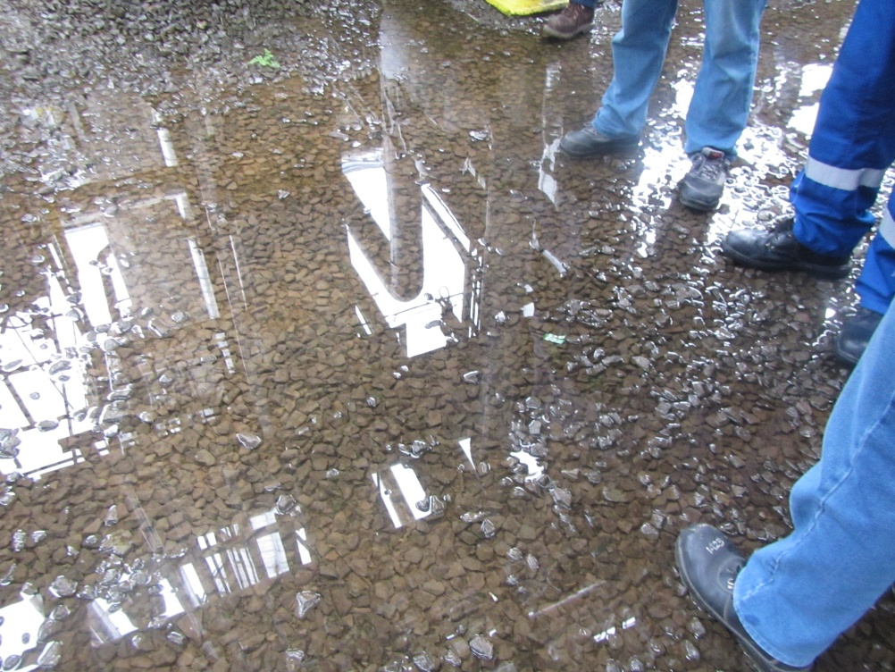
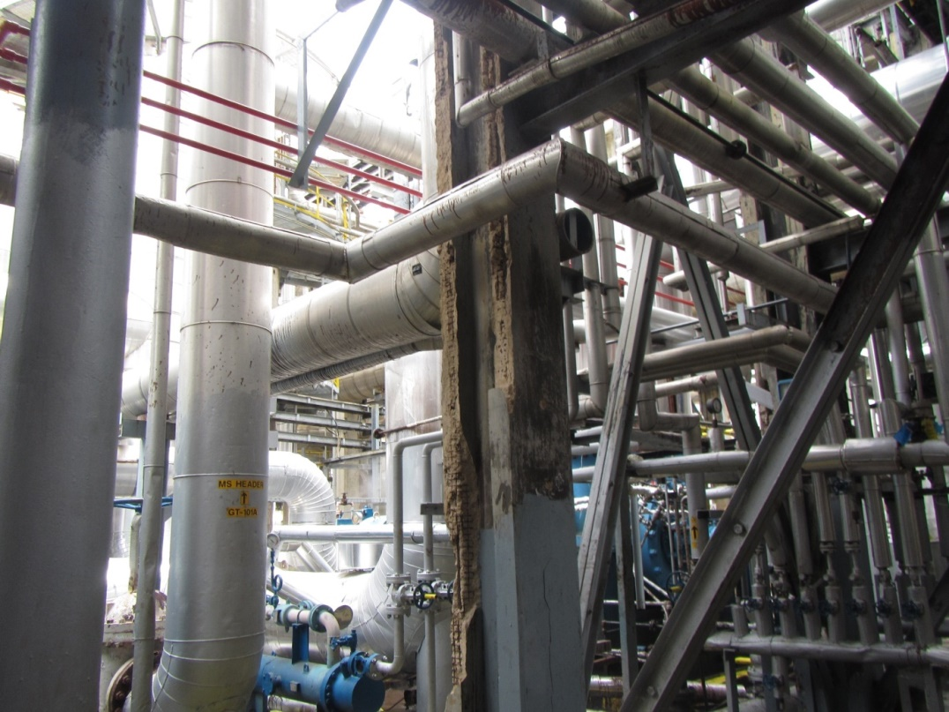
Some Typical Audit Findings
The Fire pumps are located within a process area so a relatively minor explosion could result in no firewater – relocate to safer area or install second set.
Deluge sprays do not actually cover pump seals (they are directed over the pump/motor)
Tank, Sphere, Vessels sprays are blocked, with paint, rust or face the wrong way
Fireproofing is peeling off structure beams
Inadequate (blocked) drainage causes flooding and transfers hydrocarbon leak across the site usually the result of open drainage piping being
too small in diameter

Slide 37
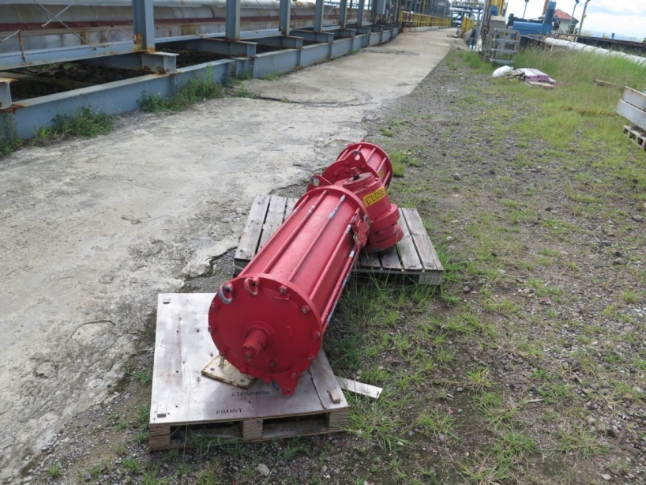
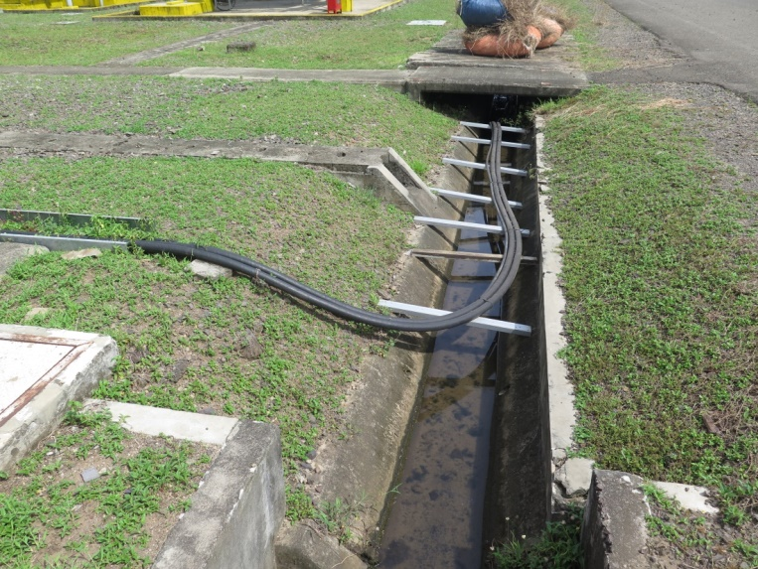
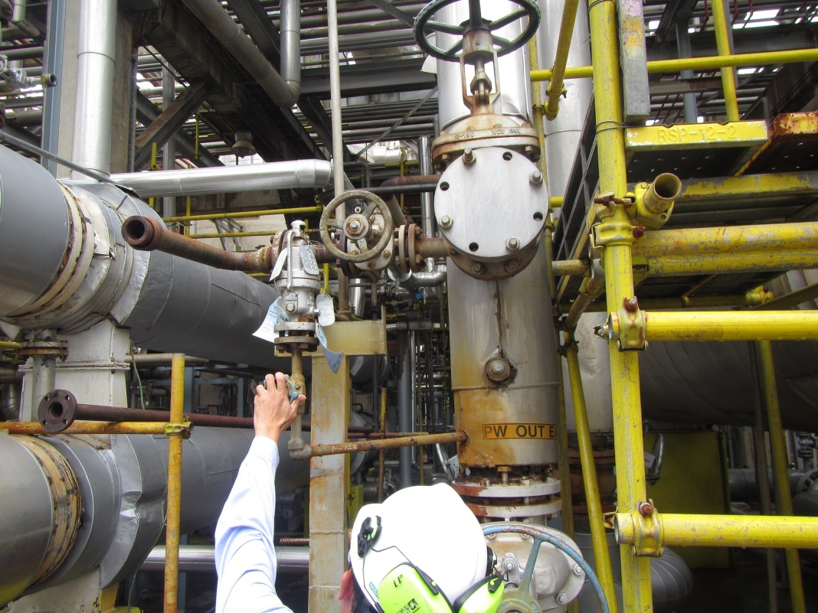
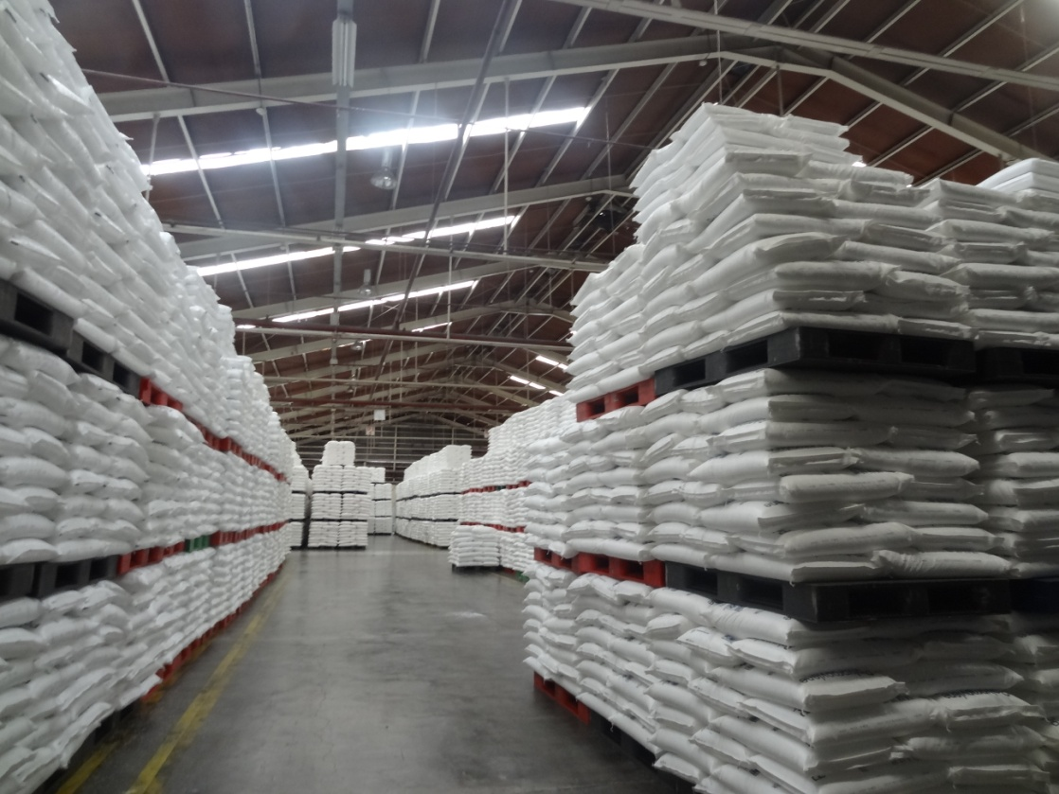
Power lines appear to be
run down an open drainage gulley supported by unfixed metal poles
Missing shutdown valves – this valve actuator failed so the valve was removed from the jetty import line and a spool was inserted (not possible to isolate Jetty from ship unloading pumps)
Only 4 bolts – 4 missing
Dangerous Stacking

Slide 38
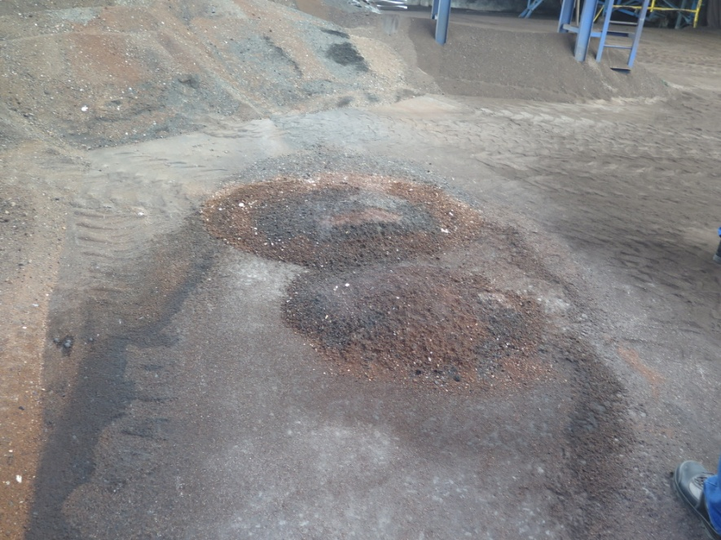
More findings
Redundant Reactor – blocking plant entrance
Vessel empty and flanged with blank plates
Not able to drive a fire engine into plant
Hot embers from a coal boiler dumped in coal storage shed
Potential fire risk

Slide 39
REPORT CONCLUSIONS
Prioritise the Corrective Actions
High (Major issue - as soon as practically possible)
Medium (Moderate issue - at next shutdown)
Low (Considered minor issue - for correction/consideration)
Rank the site under topics given above
Suggest solutions to gaps and provide back-up references or supplementary practices
Identify the top five loss scenarios, estimate the exposure in terms of plant damage, business interruption and financial loss.
Calculate the expected frequency of each loss and decide whether it is within tolerable limits
Appendices
Photographic illustrations
Site Plans
QRA Calculations, Output
Any other submissions

Slide 40
Output for the Report - Ratings
Topic | EP
1. Plant Layout (Safety Distances) – against code guidelines
– Surrounding Exposures | 4
– Road and Accessways | 3
– Drainage Systems, Sewer and Sumps | 1
2. Void | -
3. Electrical
– Hazardous Locations | 4
– Cable Tray Location & Protection | 3
– Substations, Switchgear, MCC, Electrical Room, and Electrical Equipment | 3
– Transformers | 3
– Static Electricity Grounding and Bonding | 4
– Lightning Protection System | 3
4. Equipment – protections installed – improvements, adequacy
– Tanks and Vessels | 3
– Cathodic Protection | 3
– Heat Exchangers | 3
– Pumps & Compressors | 3
– Metals, Alloys and Non Metallic Materials of Construction | 3
– Glass and Transparent Devices | 2

Slide 41
Table 1 Potential Major Source Inventories for VCE Cases
Source Tower/Drum Considered for VCE | Inventory Released | Total Loss to Site | Units damaged (% of Unit Lost)
DA-406 | 41 | 39.3% | Butadiene 40%, Boilers 29%,Cracker 69%, MCR 38%, Tankage 8%, Spheres 16%, Substations 31%, Power Units 26%
FA-404 | 32 | 36.5% | Butadiene 40%, Boilers 17%,Cracker 65%, MCR 39%, Tankage 4%, Spheres 13%, Substations 23%, Power Units 21%
FA-424 | 27 | 36.5% | Butadiene 39%, Boilers 3%,Cracker 61%, MCR 19%, Tankage 4%, Spheres 12%, Substations 40%, Power Units 14%
FA-427 | 34 | 40.9% | BD 40%, Boilers 33%, Cracker 71%, MCR 39%, Tankage 10%, Spheres 18%, Substations 36%, Power Units 30%
FA-654 | 32 | 40.2% | BD 40%, Boilers 30%, Cracker 71%, MCR 39%, Tankage 17%, Spheres 16%, Substations 30%, Power Units 30%
The rebuild time for any of the above scenarios is 28-36 months based on delivery times, re-engineering a, procurement and construction to start-up.

Slide 42
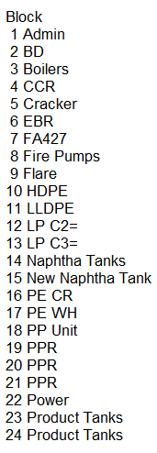
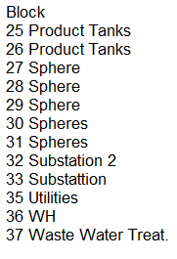
Typical VCE Model

Slide 43
Fire & VCE Cases – Expected Frequency
Case Considered |  | Probability of a Full-Bore line failure (Zone 5-8 Earthquake Area) | Probability of a Catastrophic Vessel Failure | Worst Case Total | Failure Once in Years | Remark
Quench Tower Failure |  | 12 x 10⁻⁴ | 10⁻⁵ | 12.1 x 10⁻⁴ | 826 | LP vessel, Low Leakage Rate – consider Pool Fire Only
Fireball in EP (one of 18 vessels) |  | 18x2.52 x 10⁻³ | 10⁻⁵ | 45.36 x 10⁻³ | 22 | Some Unit Damage 5-7% of Total Value – investigate damage potential
Distillation or Accumulator Failure |  | 18x12.6 x 10⁻⁴ | 10⁻⁵ | 226.8x10⁻⁴ | 44.1 | Many units - composite Probability VCE case (up to 40% of Total Value) – CONTROLLING EXPOSURE
Non-Destructive Fire in EP (assume 18 vessels) |  | 18 x 25.2 x 10⁻³ | 10⁻⁵ | 453.61x10⁻³ | 2.2 | Minimum Damage assumed -
Tank Failure (4 Naphtha Tanks) |  | 4 x 4 x 10⁻⁴ | 10⁻⁶ | 16.01x10⁻⁴ | 624 | Major Fire - tanks lost
The probability of line failure is significant in a high earthquake area – check the design basis for line movement – all of the plant should be designed for the appropriate acceleration rates and accept movement.

Slide 44
Why we should audit ! Sphere containing 2000 cu.m of liquid Propane usually pumped out by a pump directly below the sphere
Single LPG Pump
Butane pumped to LPG bottling Plant

Slide 45
Sphere containing 2000 cu.m of liquid Butane
Pump removed (not working)
Paint (Air) compressor
Installed to move out Butane
Butane to LPG bottling Plant

Slide 46
We did not have time to write the report on this one
Stopped all operations
Direct visit to the Management to obtain the parts to repair the pump
Requested any future ‘ideas’ were subject to Management of Change
Put in a request to audit all their facilities
Corrective Actions
THANK YOU - THE END

