Slide 1
"Statistical-Based Maintenance for Aboveground Gas Risers in Domestic High-Rise Buildings“
Hazards 33, IChemE
7–9 November 2023, Birmingham, UK
Simon Au Managing Consultant ERM Hong Kong
Pasindu Samaranayake Consultant ERM Hong Kong

Slide 2
Typical Maintenance Strategies
Issues:
Maintenance strategy not optimal
Unnecessary Maintenance
Waste of manpower
R2F
Run To Failure
Carried out on a premeditated schedule to anticipate failures
Corrective maintenance
Simplest Maintenance technique
Preventive Maintenance( (PvM) (Scheduled or Time-Based Maintenance)
Issues :
High equipment downtime
High risk of secondary faults
Supply disruptions
PvM
2

Slide 3
Predictive Maintenance
Where are we moving towards for better maintenance?
Application of Machine Learning Models (e.g., Neural Nets) on collected machine monitoring and sensor data to identify patterns and outliers which lead to losses.
Usually built on a foundation of Condition Based Maintenance
Condition Based Maintenance
Based on Continuous monitoring of
equipment and their process health.
Maintenance action carried out when
conditions of degradation of process are observed

Slide 4
Obstacles for Implementing Predictive Maintenance
While Predictive maintenance presents significant opportunity in;
Minimizing equipment failures
Reducing maintenance costs
Forecasting of incipient issues leading to disastrous failures
Significantly implementation challenges exist
Requirement of real time monitoring IoT sensing systems resulting in high overhead costs
Security concerns with respect to data theft
Implementation difficulties in Public Utility systems with no
online condition monitoring
High dependence on operational data and doesn’t sufficiently consider geographical data

Slide 5
A statistical approach to the problem
Instead of full-fledged Machine Learning models which implement real time IoT sensing systems, offline solutions based on historical failure present a convenient solution
Uses Survival Analysis to incorporate the time to failure of equipment into the predictive model
“
“
Advantage of using Survival Analysis
Drawbacks of
Survival Analysis
Easily implemented using conventional software packages
Provides failure probability curves to assess when to carry out maintenance
Requires large amounts of historical data to have a reasonably accurate model
NOT robust to adapt to scenarios which are not in the modelling dataset
”
”

Slide 6
An Ideal Solution
Statistical Approach using Survival Analysis
Easily accessible static data as input for user
Accounts for Operational and Environmental/
Geographical factors
Combining the Best of Both Worlds
Robust, Accessible and Affordable Predictive Maintenance solution
Easily implemented in production
Accounts for time varying factors in equipment life
Robust Machine Learning models
Accessible with minimal overhead costs

Slide 7
Our
Solution
Users can easily prepare input dataset using MS Excel
Output: User Interface embedded with a trained machine learning model to be used locally by operators
Historical equipment failure data
Convenient deployment in local notebooks
Maintenance Records of equipment
Input :
A multilayered dataset
Trained Machine Learning model
Typical data of equipment (e.g., Temperature, Pressure, Diameter of piping etc.)
Statistical Approach using Survival Analysis
Robustness of Machine Learning models
Training Machine Learning Models using features identified from EDA
Special features of equipment (e.g., Material handled, Contains corrosion protection? )
Random Survival Forests
Operational Data
Weather Records (e.g., Relative Humidity etc.)
Environmental, climatological and geographical Data
Features affecting failure rate
Statistical Techniques (e.g., ANOVA Tests, Chi² Correlation Tests)
Distance from Coastline
Exploratory Data Analysis (EDA) :
Extract and Identify Features causing higher failure rates in equipment
Machine Learning Algorithms (e.g., DBSCAN, Time Series Clustering)
Pollutant Levels
Using Public Domains to obtain geographical features (e.g., Satellite Imagery)

Slide 8
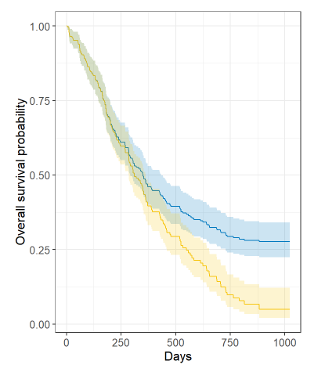
Technicalities : Survival Analysis
A branch of statistics which allows to predict the occurrence of an event along with its probability using historical event data
Operators typically have historical records of when an asset failed (i.e., date or time of failure)
With survival analysis we can fit such data to survival models
Survival models can be;
Non-Parametric (e.g., Kaplan Meier Estimator, Nelson Aalen Estimator)
Semi-Parametric (e.g., Cox Proportional Hazards Model)
Parametric (e.g., Weibull Models)
A key advantage of survival analysis is the use of both failed and “censored”(i.e., assets which have not failed) asset in the analysis.
Survival Curves can be plotted for different groups of different characteristics for their failure data
A typical Survival curve resulting from survival analysis
Allows operators to understand when to carry out maintenance of asset
Allows the prioritization of different groups of asset for maintenance

Slide 9
Technicalities:
Random Survival Forests
An extension of the well-known machine learning model known as Random Forest to incorporate Survival Analysis
Split using Information Gain
Uses an Ensemble of multiple Decision Trees
Robust model that generalizes well and captures complex interactions of data
Random Forests
Randomly selects subsets of the dataset to be applied for each Decision Tree
Traditional Random Forests split nodes using Information Gain criteria
Use Log Rank Split Tests to split nodes of the tree instead of Information Gain
Split using Log Rank Split Test
Iteratively uses log rank split test on features at every node
Fits a Kaplan Meier Estimator and Nelson Aalen Estimator to the data at each leaf node
Random Survival Forests
Fits Survival Models on the data at each leaf node
Assets with similar survival distributions will be grouped in leaf nodes of tree
Survival Probability modelled using Kaplan Meier Estimator.
Cumulative Hazard (Risk Score) modelled using Nelson Aalen Estimator
Provides a Risk Score and Survival Probability for each asset

Slide 10
Asset
Users can understand influential factors that could not be accounted for previously, in typical operational settings
Providing an overall picture of how different factors affects Asset performance instead of using only operational data and experience
Allows users to strategize and prioritize maintenance of assets
People
Procedures
Environment/Climate
Value addition to operators using our solution
Lower overhead and deployment costs than a fully fledged Predictive Maintenance system. Attractive for users with budgetary constraints.
Convenient deployment in operators' local notebooks and familiar data input formats (MS Excel)
A Scalable solution that is adaptable to any users' data availability
Impact due to aging of assets are inherently identified in the model.

Slide 11
A Case study on Gas Risers of High-Rise Buildings

Slide 12
Dataset Description
Item | Parameter
1 | Number of gas consumers in Building
2 | Gas riser installation year
3 | Regular Safety Inspection within 5 years
4 | Building Category
5 | Riser Condition
6 | Number of Gas Risers in the Building
7 | Installation pipe to consumer concealed in bathroom ceiling
8 | Location of Installation Pipe
9 | Installation pipe to consumer protected by concrete
10 | Riser Pipe Diameter
11 | Flowrate/Consumption Rate
12 | Number of valve/joints
13 | Lateral Pipe Diameter
14 | Riser Coating material
Provided by governmental body
16,421 High Rise Buildings
Data was collected from 2016 to 2022
3,193 Buildings with one or more gas riser failures
Failure date of each incident was available in the dataset
13,228 are censored data points (without gas-riser failures)
19,668 Data Instances
Total Dataset
6,440 gas-riser failures across 3,193 buildings

Slide 13
Geographical and Climatological Factors
External factors which could affect the performance of gas risers were extracted using public domains
Item | Parameter
1 | Relative Humidity Levels
2 | Distance from Coastline
3 | Latitude of the studied building
4 | Longitude of the studied building
5 | SO₂ Levels
6 | NO₂ Levels
7 | NO_{x} Levels
8 | O₃ Levels
9 | FSP Levels
10 | RSP Levels
Techniques used for collection of External Factors
Distance to Coast
Relative Humidity and Pollutant Levels
Latitude and Longitude
Government Weather Observatory and Environmental Protection Departments API
Satellite Imagery for Water Bodies
Make API Requests to Google Places API
Apply algorithms to isolate coastline based on pixel intensity
Use Time Series Clustering Algorithms
Latitude and Longitude of each Building Address
Assign each building to relevant clusters
Find minimum distance to coast for each gas building

Slide 14
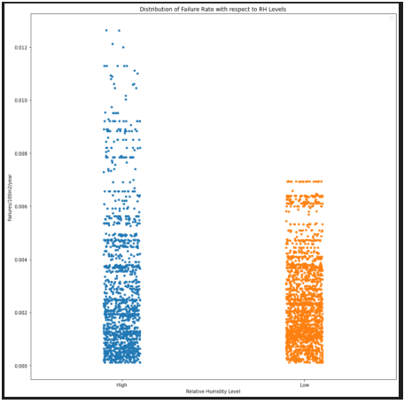
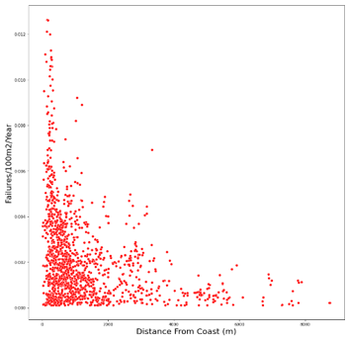
Insights and patterns seen in data
High Relative Humidity causing higher failure rates
Effect of Relative Humidity Levels on pipe failure rate
An extensive Extrapolatory Data Analysis (EDA) was carried out on all available features
Features which show significant impact on the performance of gas risers include but not limited to;
Latitude and Longitude of Gas Risers
Relative Humidity Levels
Distance from Coastline
Piping Condition
Pipe Diameter
Building Category (Public or Private Housing)
Due to sensitivity of data of some factors, detailed EDA results are not presented
Higher Failure rates seen when closer to the coast
Effect of distance to coastline against failure rate
Through this analysis we help Operators to understand influential factors that could not be accounted for previously, in typical operational settings.

Slide 15
Training the Random Survival Forest (RSF) model
We use Machine Learning models with Survival Analysis to leverage on the insight and correlations observed between features in the EDA phase.
The metric used for assessing the performance of the model is the Concordance Index
Parameters used for tuning include;
Number of Estimators in RSF
Depth of each tree in the RSF
Minimum number of samples for splitting a node
Cross Validation and Hyperparameter tuning
20%
Testing Dataset
Entire Dataset of gas risers
Risk Scores provided for each Gas Riser
Training Dataset
Trained RSF model
80%
81.2% Validation Accuracy on test set
Hyperparameter tuning with 5-Fold Cross validation
to get the best parameters for the model
Tuned model is trained on the entire training dataset

Slide 16
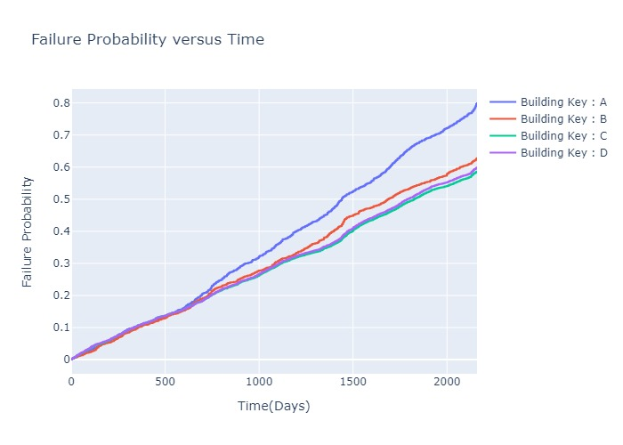
Results of the Model
Results for four unique Buildings after application on the Random Survival Forest model
Building Name | Building Category | SO2 Level | RH Level | Location of installation pipe | Riser Condition | Distance to Coast Line (m) | Lateral Diameter size (mm)
A | Public | L | H | Outdoor | Old | 707 | 20
B | Public | L | H | Outdoor | Old | 2680 | 20
C | Private | H | L | Indoor | New | 1378 | 25
D | Private | H | H | Indoor | New | 1374 | 25
Trained RSF model
Prioritize Building A for maintenance after ~700 days
Building Name | Risk Score
A | 1027
B | 785
D | 736
C | 720
Failure probability curves for the 4 buildings over time
Using the Curves, gas suppliers can select which building needs priority maintenance combined with the features identified to be impactful towards failures in the EDA
Risk Scores for each building

Slide 17
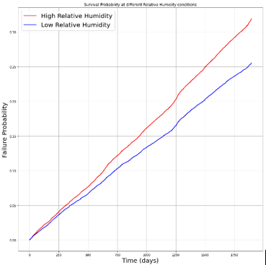
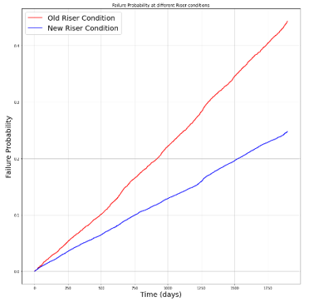
Results of the Model
Failure Probability graphs for Buildings grouped on;
Relative Humidity Levels
Riser Condition
Model successfully learns that high relative humidity levels cause increased failure probabilities
Model successfully learns that having old risers cause increased failure probabilities

Slide 18
Validation of the Model
The model was validated against on field maintenance data from the gas suppliers
126 High Priority Buildings identified by on field experience
An Accuracy of 80% when validated with on field experience
101 buildings out of the 126 identified as High Priority by Our Model

Slide 19
Conclusion
A robust and easily accessible machine learning model incorporating statistical approaches.
An overall picture of how your equipment depends on Asset, People Procedures and Environment!
Ability for operators to optimize their maintenance strategies without the cost of deploying a full-fledged Predictive Maintenance System
A way for users to understand how factors which previously weren’t accounted for, influence asset performance
A deployed and working case study of our solution was also presented showing its flexibility of application

