Slide 1
Engaging leadership:
Getting better insights from incident investigations
Stuart King | Energy Institute
IChemE Hazards 33| 7-9 November 2023

Slide 2
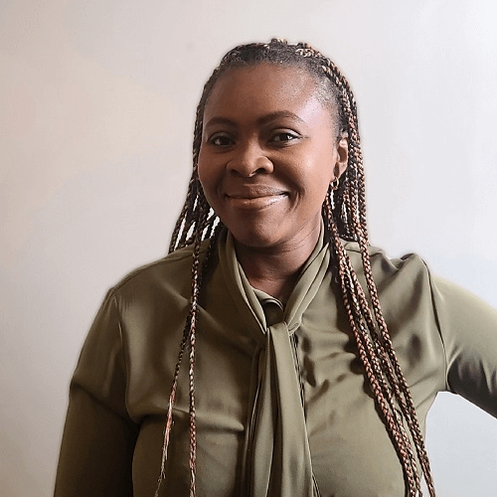
The Energy Institute
Chartered professional membership body for the energy sector – CEng, Cenv, Ieng, EngTech etc.)
Technical institute - $2million annual research fund, publish 50+ industry guidance documents annually
Training provider – providing training on the energy sector itself, risk management, energy management, and more
Registered charity – to disseminate accurate, scientific, knowledge about energy to wider society

Slide 3
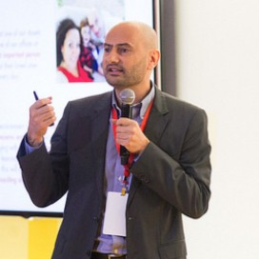
The Stichting Tripod Foundation (STF)
A charity, based in the Netherlands
Setup by Shell in 1998
Worked with the Energy Institute since 2012
Managed by the Tripod Board
The Foundation helps organisations on their journey to become better and safer companies.
This is best achieved by using scientifically proven methods that push organisations forward.
The Foundation provides thought leadership.
The Foundation develops, promotes, and ensures high quality delivery of proven methods to learn from events and sustainably embed learning into your organisation.
Emanuele Cimica | Chair, Stichting Tripod Foundation Board | General Manager, Business Transformation, Shell

Slide 4
What do leaders think?
At International Petroleum Week (now International Energy Week) 2018, we asked leaders on their thoughts on learning from incidents (LFI):
Leaders expressed frustration about repeated incidents and had low confidence in the capacity of investigations to improve LFI.
27-29 FEBRUARY 2024
Problem statement
The Tripod Foundation has identified a need for leaders to be supported in the role that they play in learning from incidents (LFI).
Enabling leadership in LFI is not just limited to leaders themselves, but also involves LFI practitioners who will interact with leadership.

Slide 5
What we developed

Slide 6
What is a leader’s role in LFI?
Leaders’ roles in LFI is important…
… but not well defined.
EI (2016) Guidance on learning from incidents, accidents and events provides a little insight:
Creating a positive culture (e.g. good reaction to bad news)
Review investigation recommendations
Allocate resources to close out actions
Key role to play in implementing broader learning (by encouraging change)
Identify broader learning opportunities by reviewing investigations

Slide 7
Tool 1: A leader’s role
The tool presents an overview of three different skill sets that leaders need to support effective learning.
It outlines the psychological theory behind those skills
A self-assessment questionnaire to help determine shortfalls in any of the three roles
Practical guidance on how a leader can demonstrate the different skillsets

Slide 8
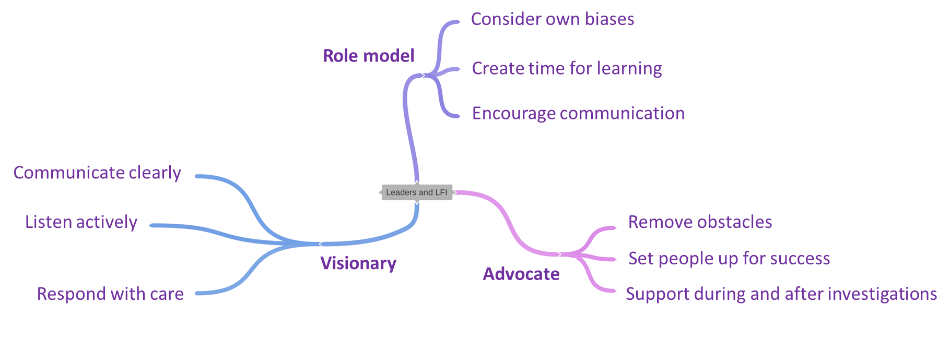
Leadership skillsets in LFI

Slide 9
Leadership skillsets in LFI
Their initial response to an incident, such as showing care for workers.
Ensuring the resources of the incident investigation (including the right people).
Ensuring follow-up of the investigation findings, making sure systemic causes of an incident have been identified and a decision made on what to do about them.
Transformation of the organisation, by removing obstacles to implementation of the investigation findings, and ensuring the project has met its goals.

Slide 10
Tool 2: An investigator’s role
Identifies the key skillsets investigators need to engage leaders and other stakeholders during the investigation
Self assessment questions to show shortfalls in investigators skills
Practical guidance and exercises

Slide 11
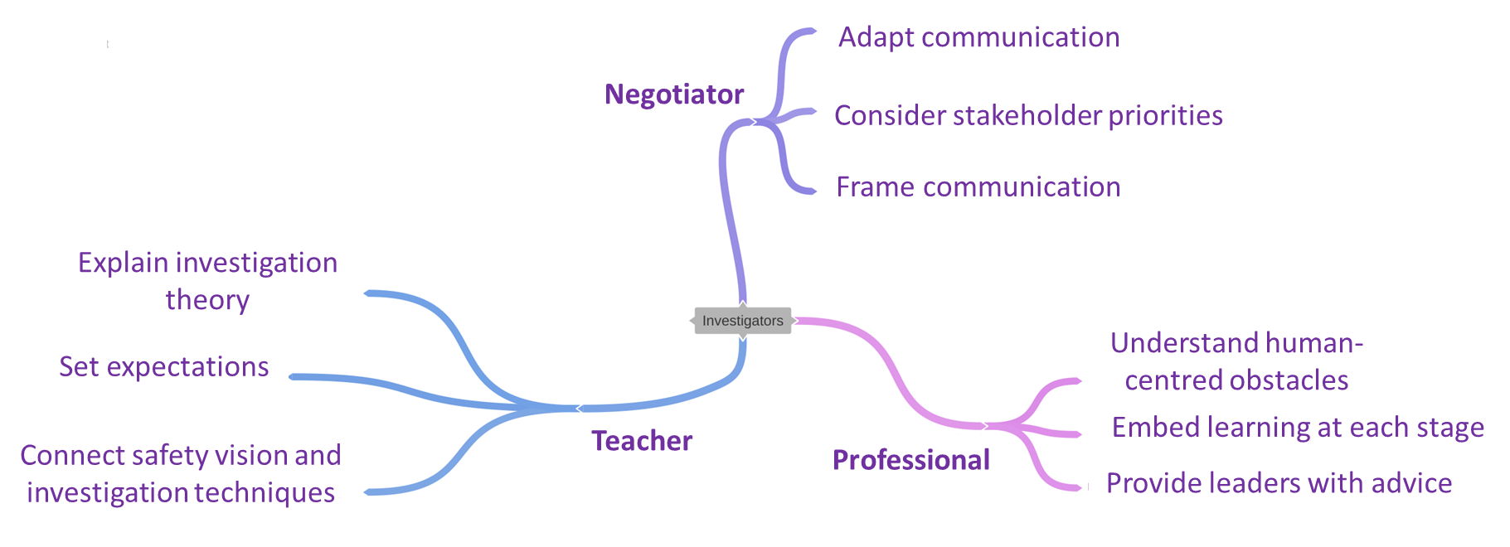
Investigator’s skillsets

Slide 12
Investigator’s skillsets
Before the investigation – set expectations with leaders about how an incident investigation can lead to change
During the investigation – choose your investigation team from a variety of roles and positions, as these will become the ‘ambassadors’ for change after the investigation.
After the investigation – provide advice to help post-investigation learning activities, such as communication activities. The investigator is not best placed to create recommendations, but is the one to have the most complete understanding of the incident.

Slide 13
Tool 3: Better insights workshop
Research by Glasgow Caledonian University highlighted reflective learning as a key, but under-practiced part of learning
Previous work has focused on reflect learning in frontline, but what about leadership?
Tool 3 provides a workshop to be run with leaders periodically
To engage leaders in the investigation findings
To reflect on a recent incident
Understand their role in the incident
Better recommendations

Slide 14
The better insights workshop
1. What happened?
2. Why do I/we think it happened?
3. Was I right? No? Then why did it happen?
4. Hmm. Interesting.
5. Let’s look at the investigation’s recommendations to prevent similar incidents…
7. What could my personal role have been in this incidents, as a leader?
6. Can we improve the recommendations?

Slide 15
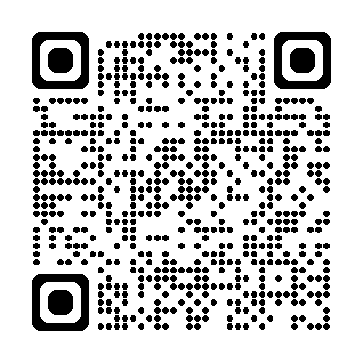
What did leader’s find?
“It helped me reflect on my unconscious biases”
“We discussed further opportunities to improve that maybe weren’t implemented or effective and why that was”
50% of leaders were ‘truly enlightened’
“Let’s continue to run this several times per year”
“I know how to make the company safer”
Pilot results discussed here

Slide 16
Tool 4: Better learning outcomes
Companies often struggle to implement investigation recommendations:
Too many recommendations
Easiest (but least effective) done first
No time for the ‘hard to do’ ones
Tool 4 provides six exercises to help prioritise and implement recommendations
At its heart is the PECE cycle.

Slide 17
The PECE cycle
Listen actively
Prioritise
Avoid working only on the easiest recommendations
Multiple recommendations that would require various resources
Engage
Get buy-in from those who need to make the change
Talk to stakeholders
Make action plans
Communicate clearly
Encourage communication
Create time for learning
Remove obstacles
Evaluate
Gather data and evaluate whether the changes have been made and are effective
Change
Follow change management processes
Set people up for success

Slide 18
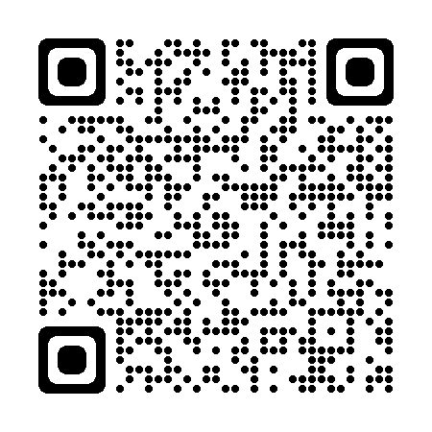
Conclusion
Leaders have several key roles to play in LFI (Advocate, visionary, role model)
These roles come in to play when setting up the investigation, during the investigation, and afterwards
Accident investigators need to engage leaders
Reflective learning is a tried and tested way of engaging leaders after the investigation
We developed a toolkit to help leaders and investigators – available from the QR code

Slide 19
Thank you for listening

