Slide 1
Leadership site visit toolkit ashley.hynds@dnv.com
Ashley Hynds MEng CEng FIChemE PPSE
Hazards 33 Process Safety Conference, 8 November 2023

Slide 2
Macondo Leadership visit
7 hours before the Macondo Oil blowout, 4 Senior Leaders landed on the Deepwater Horizon drilling rig for a ‘Management Visibility Tour.’ They had detailed knowledge of drilling operations (as drilling engineers or rig managers).
A major purpose of the visit was to emphasise the importance of safety, by meeting and talking with workers. Activities included:
congratulating workers on achieving 7 years LTI free
carrying out a rig tour including drilling floor & bridge
sharing learning from a recent injury on another rig
following up an observation on fall arrest harnesses
discussions on hand injuries and dropped objects
Were opportunities missed to prevent the imminent disaster?
What makes an effective leadership visit?
A controlled burn of oil from the Deepwater Horizon Macondo oil spill

Slide 3
Safety Leadership – Success Factors
Cooper (1998) identifies the importance of a balance of ‘caring’ and ‘controlling’ behaviours
Caring | Controlling
Being available | Setting standards
Concern for people’s well-being | Motivating people to follow rules and procedures
Establishing a good rapport with sub-ordinates | Clarifying job roles, expectations, and responsibilities
Cooper, D., Improving Safety Culture – a practical guide, John Wiley & Sons Ltd, London, 1998

Slide 4
Safety Leadership – Success Factors
Kerin (2020) identifies important process safety leadership personality traits and actions
Who we are
Be inspirational | Be trustworthy
Have vision | Be humble
Serve others | Be empathetic
What we do
Set direction | Speak up
Be consistent | Seek information
Be yourself | Look after people
Reflect | Have fun
Kerin, T., The importance of (process safety) leadership, Journal of Loss Prevention in the Process Industries, Vol 66, 104220, July 2020.

Slide 5
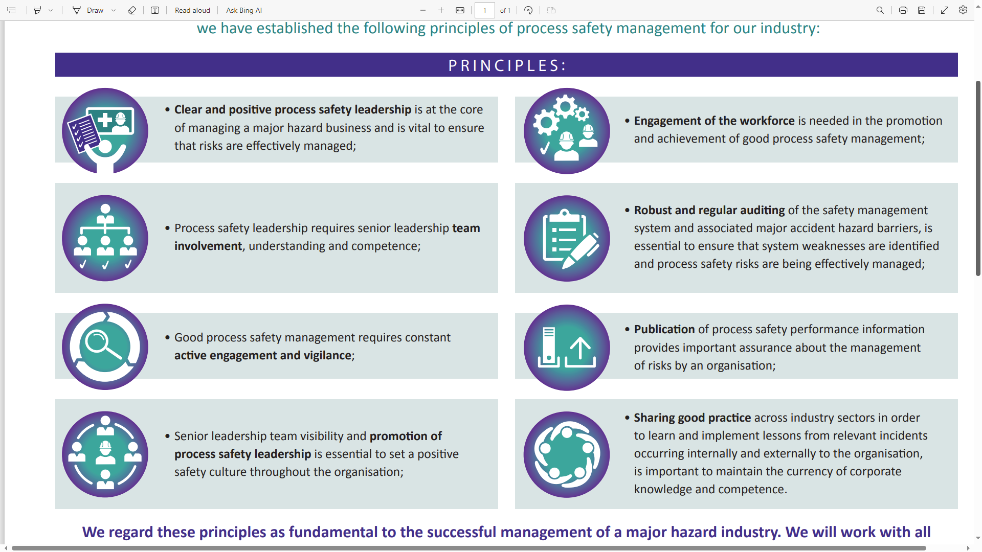
Principles of Process Safety Leadership for the offshore UKCS Energy Industry

Slide 6
Principles of Process Safety Leadership for the offshore UKCS Energy Industry

Slide 7
Hopkins’ analysis of the Macondo leadership visit
Andrew Hopkins analysed the conduct of the Macondo leadership visit. He concluded that the following factors contributed to the outcome:-
an exclusive focus on personal rather than process safety.
a preference to target assessment of conditions (e.g. housekeeping) rather than individuals’ behaviours (actions and decisions) such as adherence to procedures.
avoidance of spending time in areas where there was intense activity, to minimise interference or disruption.
avoidance of direct engagement with junior staff, out of a concern not to undermine site leadership or be seen as challenging individuals’ competence.
Hopkins, A., Management Walk-arounds: Lessons from the Gulf of Mexico oil well blowout, Safety Science, Vol 49, 1421-1425, 2011.

Slide 8
Hopkins’ leadership visit recommendations
Be aware of the major accident events that could occur at a site, prior to attendance.
Understand the controls that should be in place to prevent such events, with a view to verifying that they are in place and working as intended whilst on site.
Be aware of any recent significant process safety incidents that have occurred on other sites which may have relevance to the current site.
Dedicate time to check processes which may be of fundamental importance to process safety.
Be aware of any current operations at the site which might present an opportunity for closer attention, and potentially relate to the higher risk issues identified above
Hopkins, A., Management Walk-arounds: Lessons from the Gulf of Mexico oil well blowout, Safety Science, Vol 49, 1421-1425, 2011.

Slide 9
Leadership site visit toolkit

Slide 10
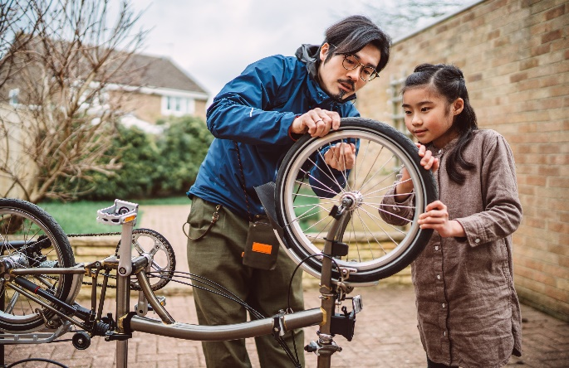
Conduct of visits
Prior notification & planning
Prioritisation of time on safety
Walk the talk
Engagement with safety reps
Listening & challenging
Follow-up of issues arising

Slide 11
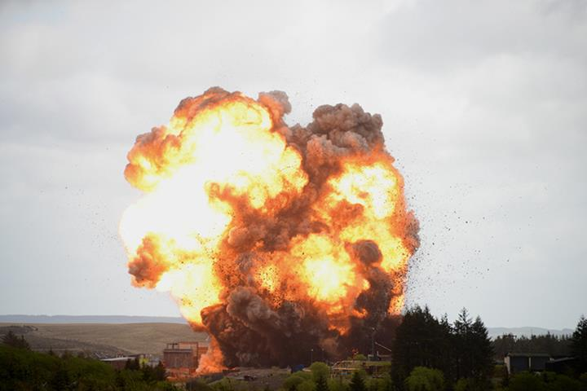
Walk the talk – desirable process safety attributes
High level of awareness of process hazards
Vigilance and curiosity for indications of weakness
Unwillingness to be complacent
Respect for technical expertise

Slide 12
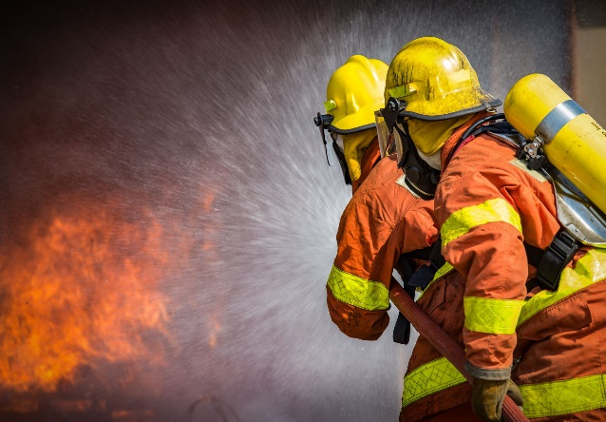
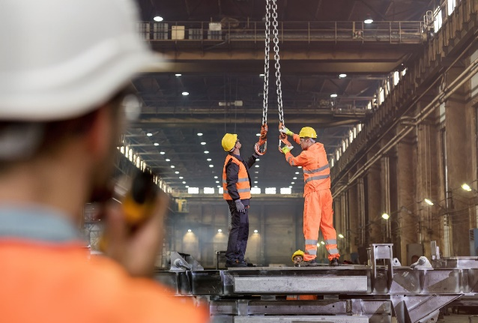
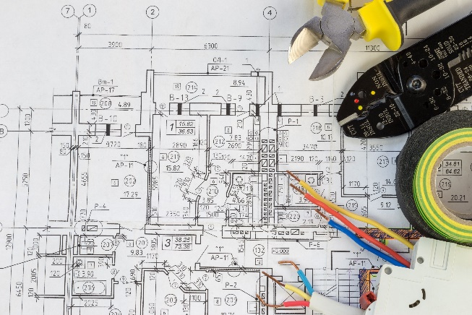
Visit activities
Small group discussion
Incident review
Work shadowing
Improvement planning assessment
Control room visit
Task audit
Safety system audit
Barrier assessment

Slide 13
Small group discussion
Activity (60 minutes)
-Lead a discussion with a small group (4-6) of site staff (different roles/backgrounds)
-Ask how well process safety is managed within the company?
-Listen hard!
Purpose
-Find out what is really going on
-Identify any process safety concerns
-Demonstrate leadership values PSM
Methodology
Establish trust and engagement (introduce each other, share session purpose, ground rules)
Describe why process safety is important to you, with use of any personal experiences
Share details of any occasions where you have made a poor decision or error of judgement as a leader, which may have impacted on safety. It can be helpful to share these to demonstrate humility and willingness to learn.
Ask questions of the group. Examples below (but see toolkit)
If there was going to be a major incident at this site in the coming years, what would it be and why?
What improvements in process safety have there been at the site in recent years?
What is on the improvement plan for process safety this year?
Are any of you involved in any process safety improvement projects?
What would have the biggest impact in terms of reducing the risk of a major incident?
If you had (say) £50k, £500K, or £5M to improve process safety at the site, what would you spend it on?
What frustrates you about your job, and getting work done?
Follow-up
-Thanks participants, personally and publicly. Discuss observations/concerns/suggestions with management. Commit to action

Slide 14
Control room visit
Activity (60 minutes - maximum)
-Spend time in the control room in discussion with operators, reviewing paperwork records, and inspecting equipment and systems
Purpose
-Assess facilities, support systems, level of activity and operating team situational awareness.
Methodology
Agree timing of visit with team supervisor. Be prepared and be conscious of being a distraction.
Introduce yourself and establish trust.
Ask questions of the group. Examples below (but see toolkit)
Follow-up
-Thanks participants, personally and publicly. Discuss observations/concerns/suggestions with management. Commit to action

Slide 15
Next steps
Next steps
-What leadership visits take place at your sites?
-How effective are they?
-How do you know?

Slide 16
Leadership site visit toolkit
Ashley.Hynds@DNV.com

