Slide 1
Safety Culture in an Operating Environment
Hazards 33
Ron Ramshaw

Slide 2
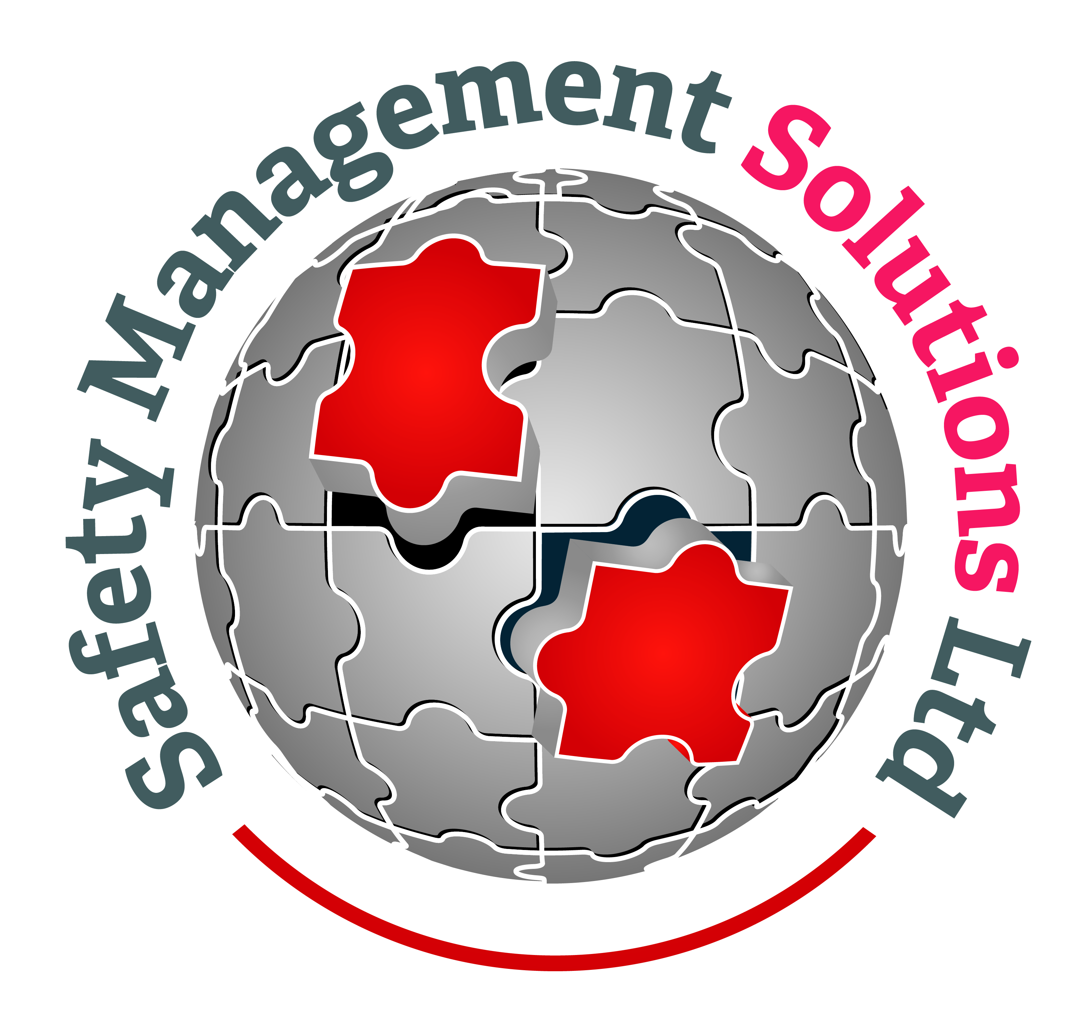
Introduction
40 years in the major hazards arena
4 key questions
People
Leadership
The Operational Asset
4 key thoughts

Slide 3
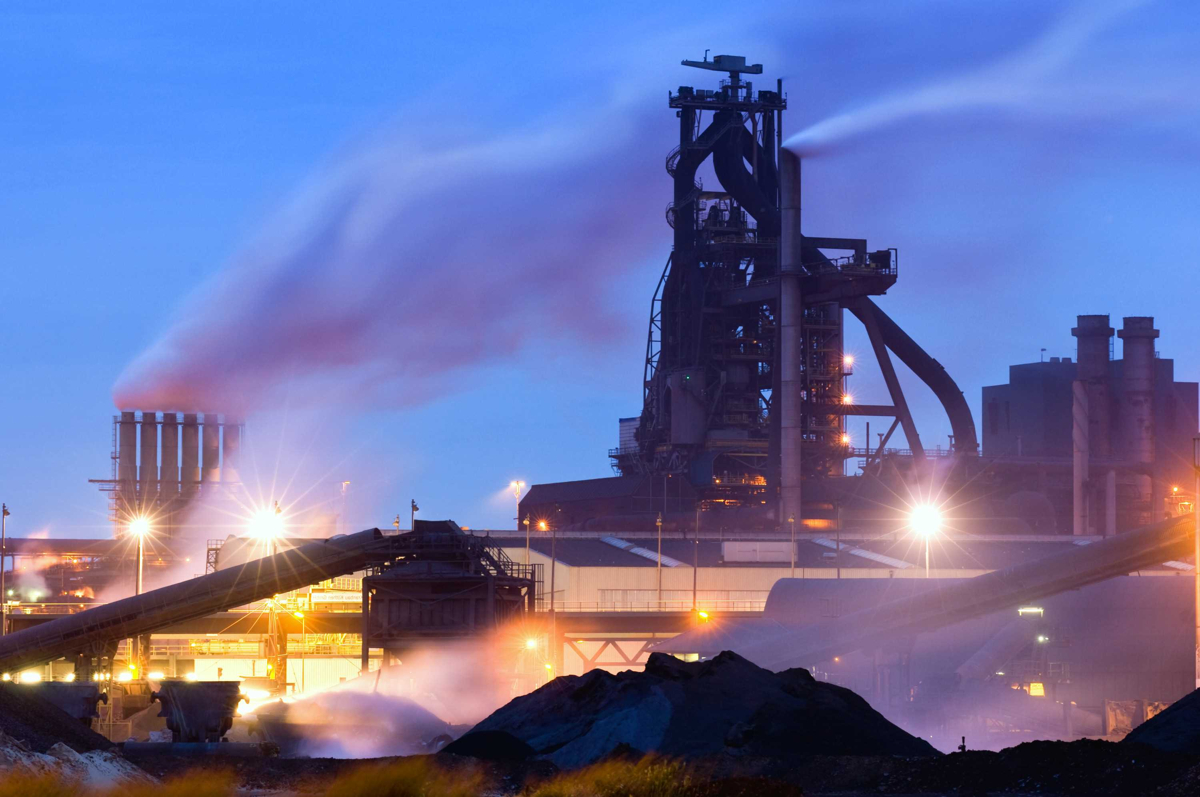
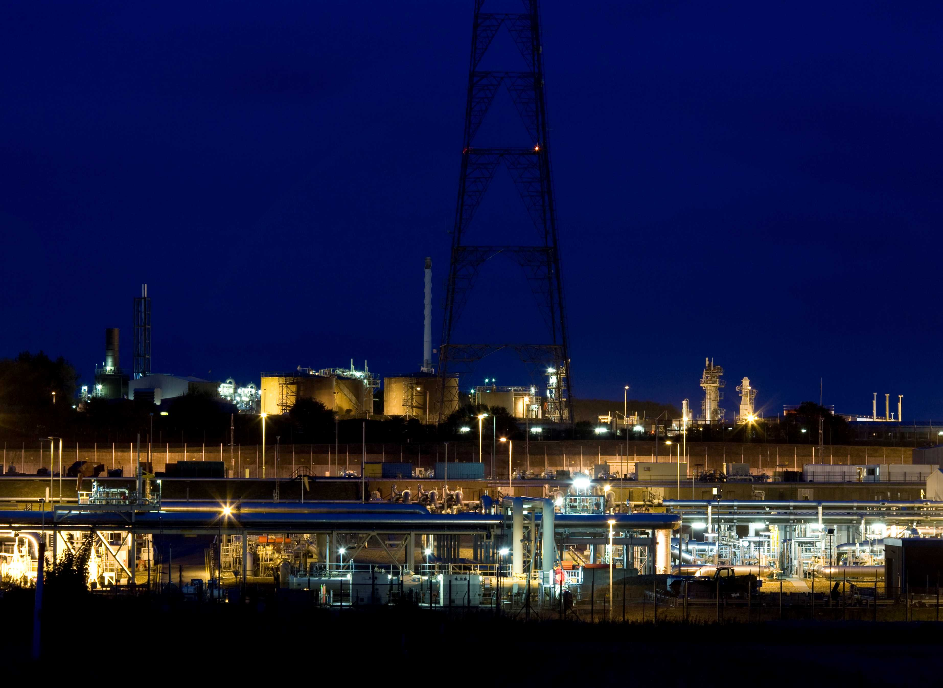
Major Hazards Arena

Slide 4
HSE Management Systems
SIL
QRA
PHR
HAZOP
LOPA
An organisations culture can have as big an influence on safety outcomes as the safety management system (Health and Safety Executive)

Slide 5
Four Key Questions
Are we spending too much of our time focussed on the tangible and relatively well understood hard systems and not enough truly understanding the softer world of safety culture and how that presents and is executed in an operational environment?
Should we be having the same conversation around safety culture and processes and systems that we have been having regarding process safety and occupational safety?
Is improving safety culture to broad and difficult a subject or are engineers and consultants happy to perform within their comfort zone?
Does improving safety culture need to be an academic exercise or can we simplify and, what does improvement look like?

Slide 6
People

Slide 7
The behaviours of people ultimately determine whether a company is successful in safety or not

Slide 8
Leadership
Board / Senior Management
Managers / Supervisors
Company Staff
Promotions
A leader’s minimum standard is the maximum standard you can expect of your subordinates
(DuPont)

Slide 9
Assurance
Safety Critical Procedures
Operating Environment
Procedures
KPI’s
Procedures
Safety Management System
Written Scheme of examination
Inductions
Maintenance Operations & Projects
Documentation
Planned Maintenance
Permit to Work
Breakdown Maintenance
Interventions
Regulator
SAFE OPERATIONS
LOPA
Safety Report / QRA
Legislation
Safety Engineering / Integrity Management
Capability Assessments
Process Hazard Analysis
Contractor Management
MOC
Organisational Capability
SIL
Procurement
HAZOP/HAZID
Competence
Organisational Change
Training

Slide 10
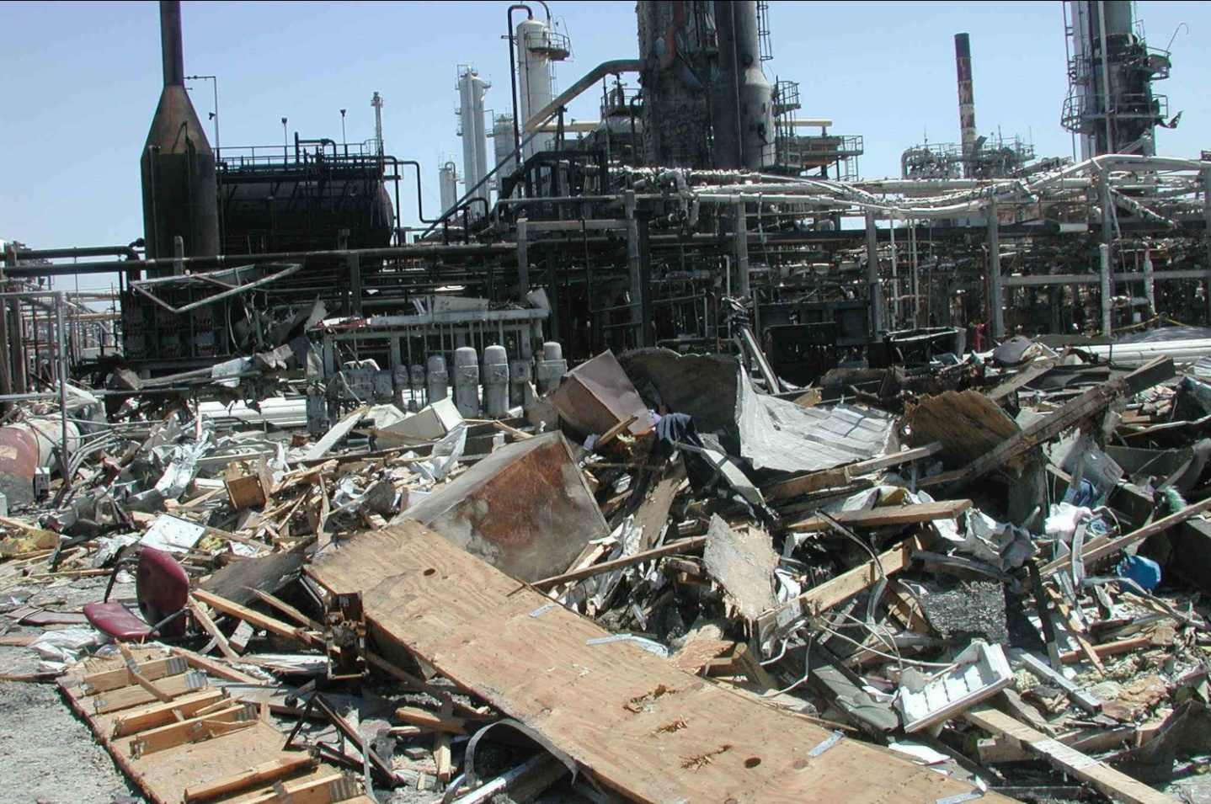
Four Key Questions
Are we spending too much of our time focussed on the tangible and relatively well understood hard systems and not enough truly understanding the softer world of safety culture and how that presents and is executed in an operational environment?
Should we be having the same conversation around safety culture and processes and systems that we have been having regarding process safety and occupational safety?
Is improving safety culture to broad and difficult a subject or are engineers and consultants happy to perform within their comfort zone?
Does improving safety culture need to be an academic exercise or can we simplify?

Slide 11
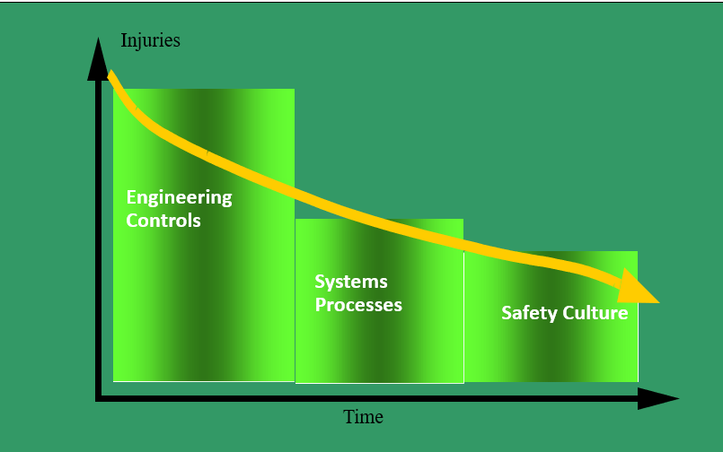
Four Key Thoughts
Are we spending too much of our time focussed on the tangible and relatively well understood hard systems and not enough truly understanding the softer world of safety culture and how that presents and is executed in an operational environment?
The process and chemical industries have achieved significant improvements in the last thirty years largely due to improved engineering and safety management practices. Ultimately these improved engineering and safety management practices will be diluted if there is inadequate attention to organisational safety.
In the authors opinion, yes, we are spending too much time focussed on tangible, hard systems in relation to the time we spend on safety culture.

Slide 12
Four Key Thoughts
Should we be having the same conversation around safety culture and processes and systems that we have been having regarding process safety and occupational safety?
Most definitely, they are two different topics with a different set of tools required to deal with each one in much the same way as Occupational Safety and Process Safety.
The marked difference in relation to Safety Culture and Processes and Systems is that Safety Culture and Processes and Systems are not independent of one another.
A poor safety culture will impact processes and systems significantly.
A good safety culture can overcome flaws in some of the existing processes and systems.

Slide 13
Four Key Thoughts
Is improving safety culture to broad and difficult a subject or are engineers and consultants happy to perform within their comfort zone?
Engineers and consultants like to deal with hard, tangible issues and safety culture can feel at times like pushing jelly up hill.
Selling the product is one thing but it needs to be workable for the organisation, suitable for their available resource and ideally something they can take ownership of.
Consultants need to be careful not to make some of their topic’s academic exercises or too complex for operational staff and hence put a strain on already stretched resource. They should also be conscious of the overall prize, safe operations!
Internally, engineering teams need to have human factors as an integral requirement in all project activity and modifications.
From the authors perspective the engineering world has not embraced safety culture as well as they could have done, and it is not naturally an integral part of the work they deliver.

Slide 14
Four Key Thoughts
Does improving safety culture need to be an academic exercise or can we simplify and, what does improvement look like?
Improving safety culture is about rigour and discipline and striving for excellence in all areas.
Striving for excellence should not be about complexity, we should simplify where possible.
We also need to be conscious we are working in a very dynamic business and organisations change all the time. Personnel come and go. Problems and issues arise and change regularly.
We need to provide a plan, but we need to be agile and able to respond to changing circumstances. The plan needs to be a live document and a rolling commitment. Not a tick box annual exercise.

Slide 15
Summary
Board members and senior leadership need to be seen to be leading this journey.
Safety and safety culture is not managed in offices.
We need to up our game in the pursuit of a great safety culture.
No magic bullets, incredibly hard work.
Demand excellence in the performance of every task.
Clear vision, plan and communication is key to making the journey. Climate surveys and behavioural safety programmes are all well and good but only offer a few pieces to a large jigsaw.
We need to ensure there is balance between hard and soft systems.
Can we afford not to make this journey?

Slide 16
Thank you
ronramshaw@safety-managementsolutions.com
http://www.safety-managementsolutions.com

