Slide 1
How much chronic unease is enough?
Jan Skriver and Mohammad Shafiq
Sandvik Coromant, Sweden

Slide 2
What is chronic unease?
Hazards 33, 7-9 November, 2023, Birmingham, UK
Chronic unease:
Is a state of vigilance (Flin, 2016)
Refers to a mindset where focus consistently is on what can go wrong, how it can be prevented and which mitigating actions are required to minimize potential consequences
Is about changing the mindset on catastrophic incidents and accidents from, It can’t happen here, to How can it happen here?
Implies that organizations always ask the question: Is there anything else we need to do?
Requires a degree of scepticism about what we see and do including not making assumptions about the reliability and safety of systems in place
Too much or too little can be debilitating

Slide 3
Mind traps
Hazards 33, 7-9 November, 2023, Birmingham, UK
Systematic errors in thinking affecting information processing, perceptions and decisions, e.g.
Underestimation of familiar risks
Confirmation bias
Overestimation of the likelihood of success
Sticking to the plan even if circumstances change
Mind traps lead to drifting

Slide 4
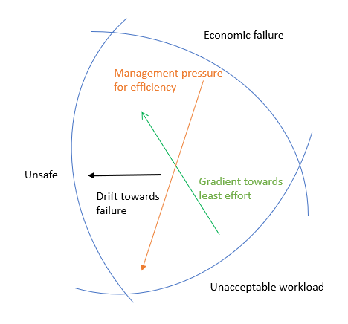
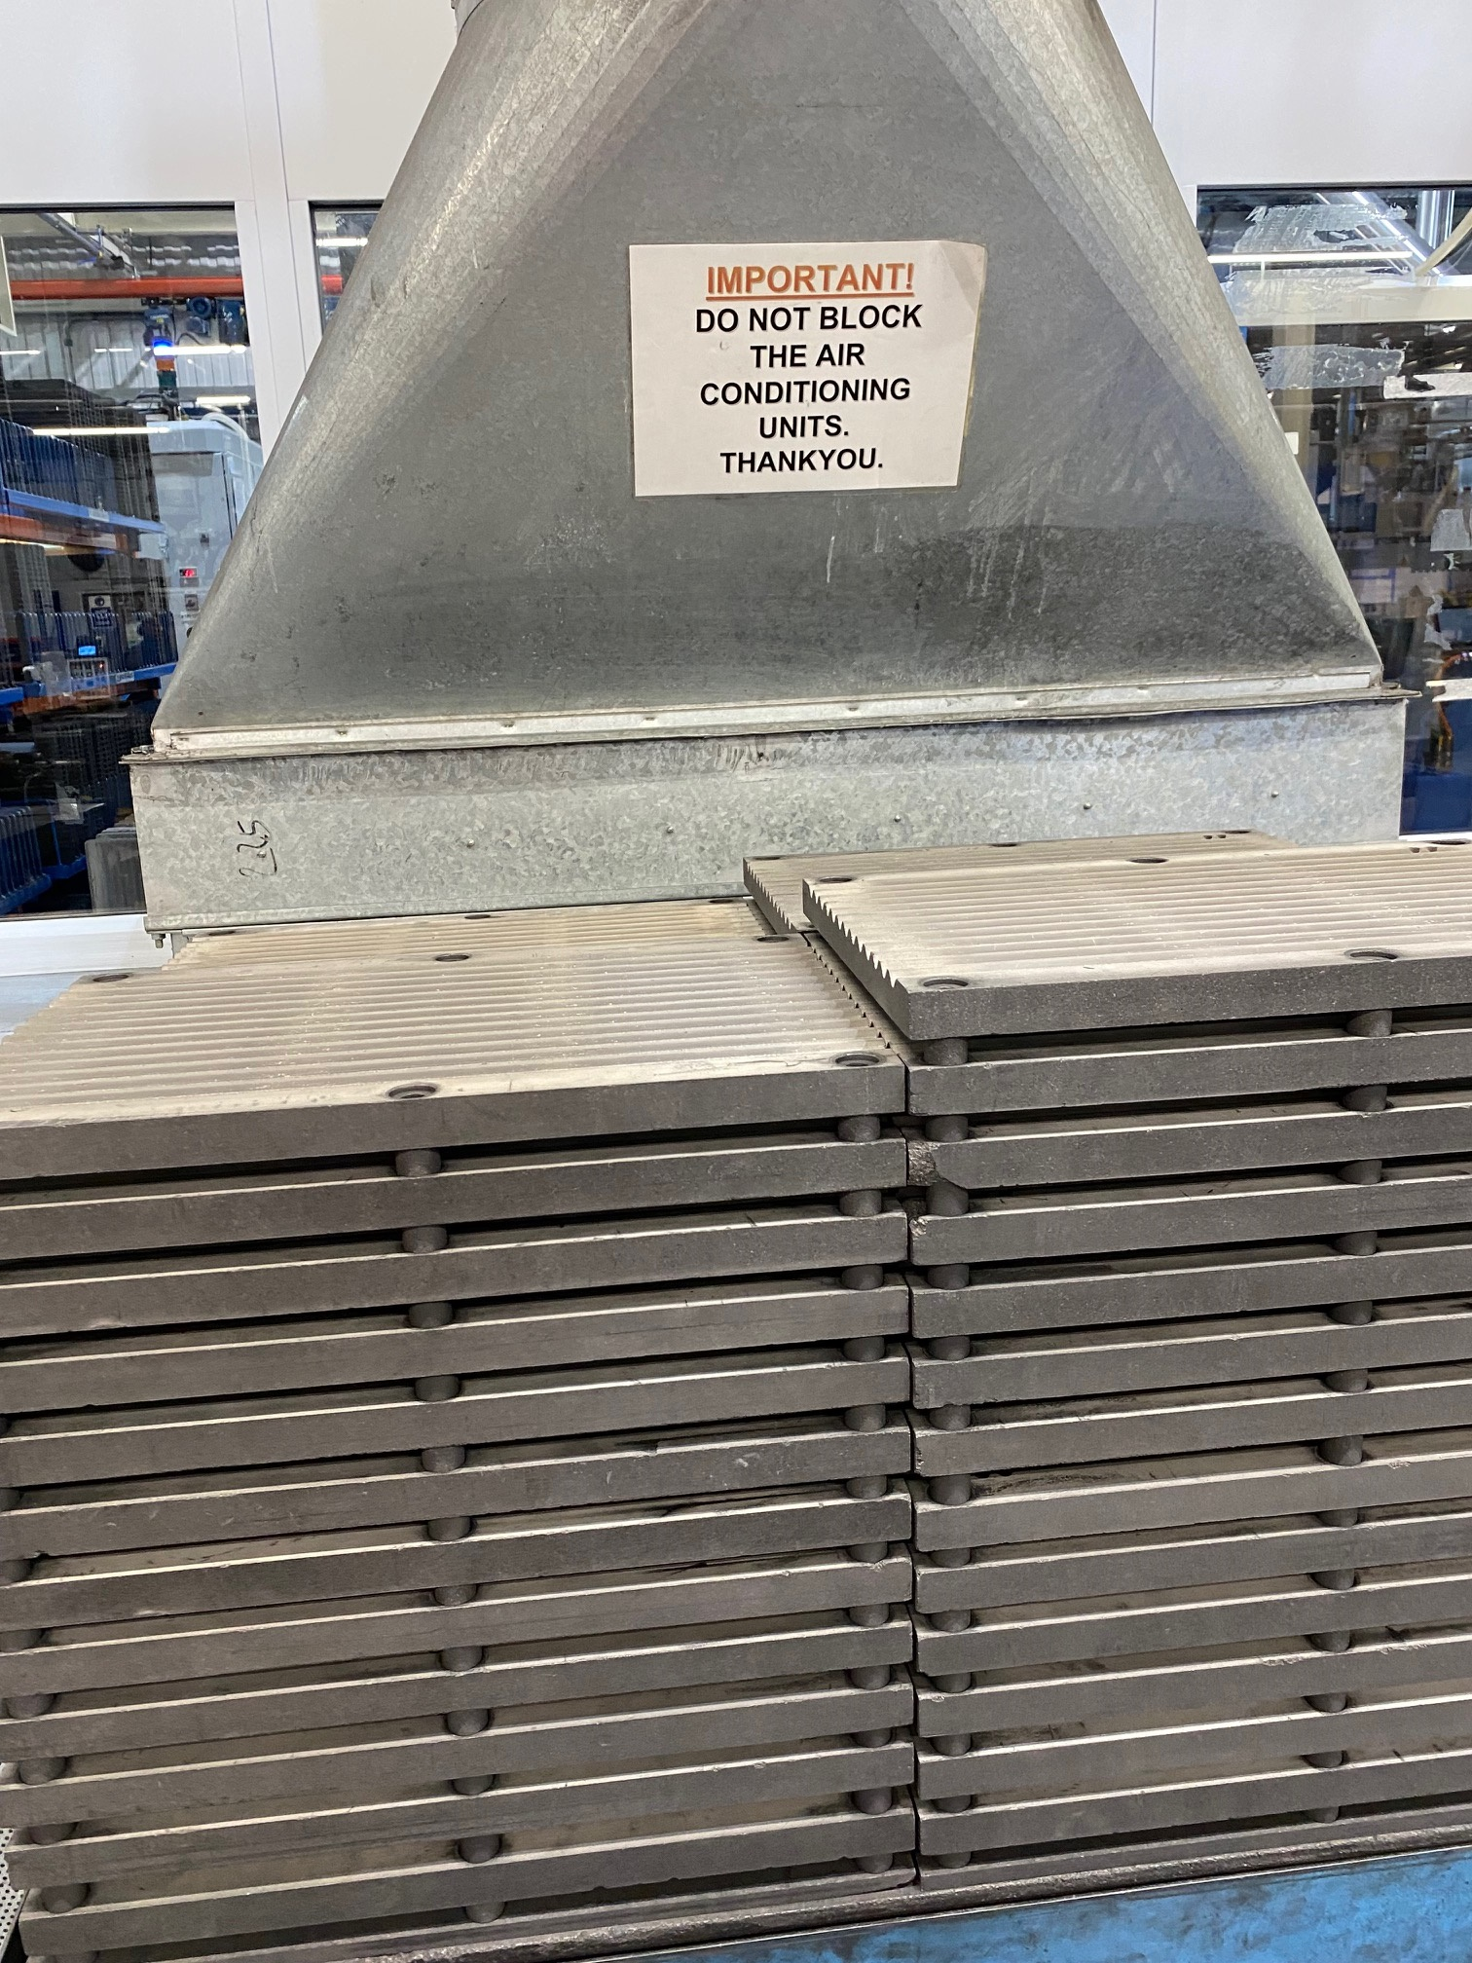
Drifting
Hazards 33, 7-9 November, 2023, Birmingham, UK
Rasmussen, 1997

Slide 5
Weak signals
Hazards 33, 7-9 November, 2023, Birmingham, UK
Are indications or signs that things may not be as they should be, e.g.:
Incorrect or outdated procedures
Unexpected readings, smells, or vibrations
Acceptance of uncompleted paperwork before a task is started
Non-compliance with procedures, rules and regulations
Short term acceptance of non-compliance by management
Management not listening to experts or staff on the ground
Delayed maintenance activities for safety critical equipment
Frequent leaks or alarms

Slide 6
Safety leadership
Hazards 33, 7-9 November, 2023, Birmingham, UK
Snyder & Smith (2021) suggested that as a safety leader with chronic unease, there is a need to focus on:
Asking triggering questions to confirm that signals and incidents are not being missed during periods of low incident reporting
Recognizing that problems are always possible since no system is without gaps
Encouraging the reporting of weak signals or minor abnormalities
Thoroughly investigating variances and anomalies to improve learning and understanding
This implies that safety leadership shall be transparent, questioning and encourage dialogue

Slide 7
Course content
Hazards 33, 7-9 November, 2023, Birmingham, UK
Human behavior in organizational context
Weak signals
Safety leadership
Human performance and mind traps
Drifting and normalization
Work-as-imagined and work-as-done
Description of typical weak signals
Illustrations from own organization
How to encourage chronic unease
The importance of transparency
Humble leadership and building relationships

Slide 8
Results
Hazards 33, 7-9 November, 2023, Birmingham, UK
Increased risk awareness
Increased reporting of weak signals
Dialogue facilitated understanding
Problem solving across departments
Understanding of mind traps
Increased transparency
Increased clarity in safety leadership

Slide 9
Conclusions
Hazards 33, 7-9 November, 2023, Birmingham, UK
To create enough chronic unease:
It is important to facilitate understanding of human behaviour
The type of mind traps we fall into
The risks associated with drifting and missing weak signals
The training should be relevant and makes sense to the audience
It must be targeted to the major accident hazards on-site
Scare tactics or underplaying risk is counterproductive

Slide 10
So how much chronic unease is enough?
Hazards 33, 7-9 November, 2023, Birmingham, UK
It depends on the site risks
When these have been mapped, training should be targeted and be proportionately authentic to achieve the best possible outcomes

Slide 11
Thank you!
Jan Skriver, PhD
jan.skriver@sandvik.com

