Slide 1
Learning from Process Safety Events - A Culture Improvement Journey [Hazard33]
Author: Naseem Qamar Shaikh
Co-author: Syed Aamir Abbas Shah

Slide 2
Background
Challenges faced by MPCL in Process Safety culture and reporting of events
Fear of Reporting
Blame Culture
Lack of Awareness
Initiatives Undertaken
Leadership Buy-in
HSE Culture Survey
HSE Leadership Workshop
Learning from Incident Tool Kit
Revision of Incident Management Process
Objective
Enhance Reporting Process: Encourage employees to report incidents without fear.
Cultivate a Positive Safety Culture: Foster an environment of learning and improvement.
Leadership
Safety Culture
Committment
Accountability

Slide 3
Missed Opportunities of Learning and Improving
Major Challenges of Underreporting:
Underreporting of process safety events at MPCL before 2019.
Undiscovered cause
Wrong practices continue
Missing corrective / preventive actions
Potential for major event/Incident
From Not Reporting to changing : MPCL bridged gaps in management system to ensure open culture for reporting
Journey span over 3 three years from Not Reporting to open reporting culture

Slide 4
Underreporting of Process Safety Events
Major Challenge:
Underreporting of process safety events at MPCL before 2019.
Contributing Factors:
Lack of Awareness: Employees are unaware of incident categorization and classification.
Operational Issues: Incidents often considered routine breakdowns, not reported.
Inadequate Investigations: Little emphasis on learning, communication, and system improvement.
Consequences
Hindered Process Safety Management: Lack of incident data for analysis and improvement.
Missed Learning Opportunities: Inability to prevent recurring incidents.
Potential Safety Risks: Unaddressed issues pose threats to personnel and facilities.

Slide 5
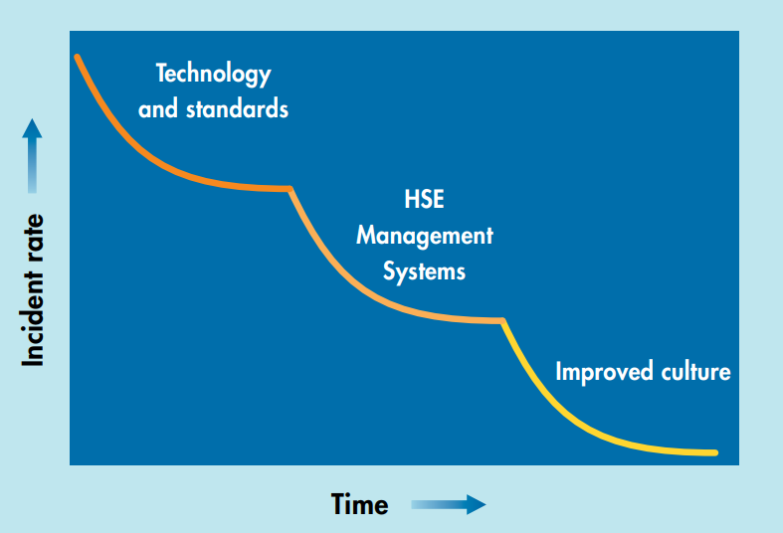
Culture Vs HSE Performance

Slide 6
Managing the Challenge
Culture Improvement Journey
Leadership Buy-In and Commitment
Revision of Incident Management process
Implementing of API RP 754
Training and Persuasion
Learning from Incidents Tool Kit-Culture Improvement Journey
Implementing Actions
Reporting
Step
01
Step
06
Step
Investigation
02
Reflection
Step
05
Step
Step
03
04
Communication
Developing Incident Alerts

Slide 7
Leadership Buy-In and Commitment
HSE Culture Survey
Learning From Incidents (LFI) Toolkit
Setting Specific Targets for Safety Indicators
Organization-Wide HSE Scorecard
Assessed existing safety culture to identify improvement areas.
Gained insights into employee perspectives on process safety.
Equipped leadership with incident learning and prevention tools.
Promoted a proactive approach to enhance process safety.
Introduced process safety goals and targets.
Demonstrated top-level commitment to safety improvement.
Provided visibility of process safety performance to all employees.
Fostered accountability and responsibility for safety.
Brainstorming
HSE Leadership Workshop
Customization of Incident Reporting Module
Proactive Approach
Engaged management in fostering a safety-first mindset.
Demonstrated the importance of process safety for overall performance.
Streamlined incident reporting for efficient data capture.
Ensured user-friendly interface for improved reporting.
Created a culture valuing incident reporting as a learning opportunity.
Encouraged open communication and transparency.

Slide 8
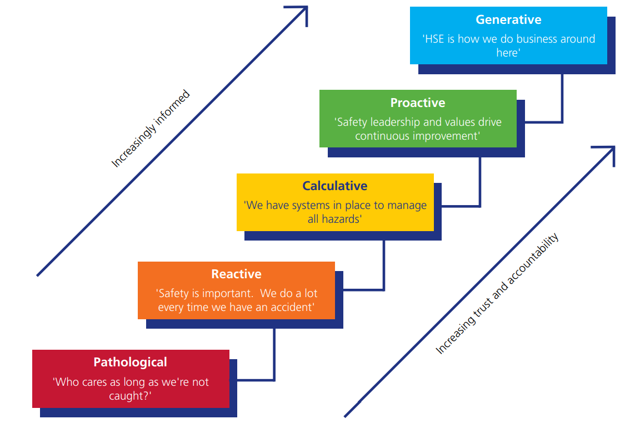
The HSE Culture Ladder
We conducted a safety culture survey in the organization and the results showed that we were at “Reactive Stage”.
We were Here

Slide 9
Process Safety Leading and Lagging Indicators | Implementation of API RP 754
Establish KPIs for Process Safety Lagging Indicators
Initiation of PSE Tier I & II Reporting to Assess Annual Process Safety Performance
Reporting Process Safety Tier III KPIs
PSE Tier III initiated which gives learning opportunities to prevent Tier I & II.
Reporting over the years is illustrated in graph.
Customization of Incident Reporting Module:
Streamlined incident reporting for efficient data capture.
Ensured user-friendly interface for improved reporting.
Reporting Culture
Latest 4 Years
Increase in PSE Tier III Reporting
PSE Tier III reporting was absent during the periods of 2019-2020, subsequently commencing in 2020-2021, and consistently yielding incremental improvements in each successive year until 2022-2023.

Slide 10
PSM Leading Indicators | PSE Tier III
Key Parameters
Impact
LOPC below Tier II
Safety System Demand
Failure of the Safety system on demand
Impaired or bypassed safety systems
Safe Operating limit excursion
Identification of system gaps.
Opportunity to improve weaknesses in the plant operations and process
Trend analysis and failure data availability.
Safety barrier performance check
Effectiveness of management system
PS KPIs
PS Tier III

Slide 11
Process Safety Leading KPIs | Tier IV
Sr. No | KPI Definition | Calculation
1 | Process Safety Action Item Closure Percentage and/or number of past-due process safety actions. This may include items from incident investigations, hazard evaluations, or compliance audits. | Percentage of process safety actions overdue for the defined period,
2 | Training Completed on Schedule The count of required process safety training sessions completed with skills verification and the total count of required process safety training sessions scheduled during the defined period. | Percentage of process safety required training sessions completed with skills verification for the defined period,
3 | Procedures Current and Accurate The count of required process safety operations and maintenance procedures reviewed or revised and the total count of required process safety operations and maintenance procedures scheduled for review or revision during the defined period. | Percentage of required process safety operations and maintenance procedures reviewed or revised for the defined period,
4 | Work Permit Compliance The count of sampled work permits that meet all requirements and the total count of sampled work permits during the defined period. | Percentage of sampled work permits that meet all requirements for the defined period,

Slide 12
Process Safety Leading KPIs | Tier IV
Sr. No | KPI Definition | Calculation
5 | Safety Critical Equipment Inspection The count of safety critical equipment inspections completed on time and the total count of safety critical equipment inspections scheduled during the defined period. This may include pressure vessels, storage tanks, piping systems, pressure relief devices, pumps, instruments, control systems, interlocks and emergency shutdown systems, mitigation systems, and emergency response equipment. | Percentage of safety critical equipment inspections completed on time for the defined period,
6 | Management of Change (MOC) and Pre Start-up Safety Review (PSSR) Compliance The count of MOCs and PSSRs that meet all company requirements and quality standards and the total count of MOCs and PSSRs completed within the defined period. | Percentage of completed MOCs and PSSRs that meet all company requirements and quality standards for the defined period,
7 | Completion of Emergency Response Drills The count of emergency response drills completed and the total count of emergency response drills scheduled within the defined period. | Percentage of emergency response drills completed within the defined period,

Slide 13
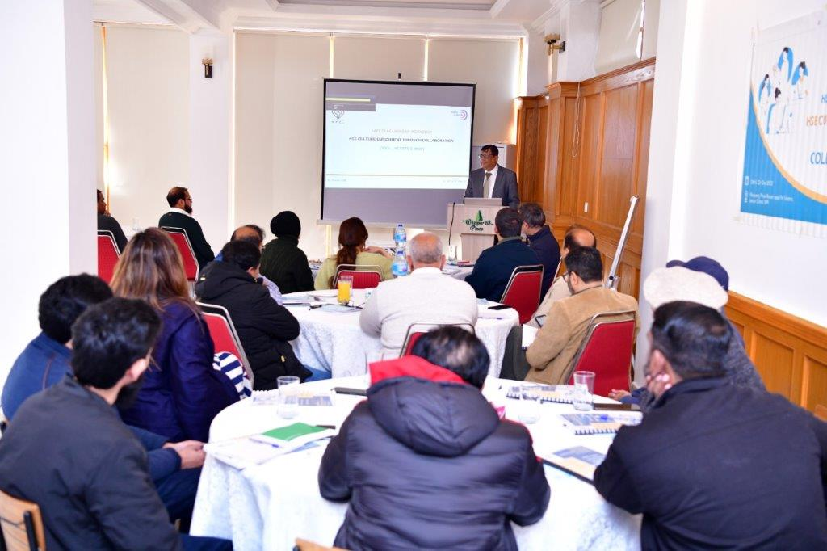
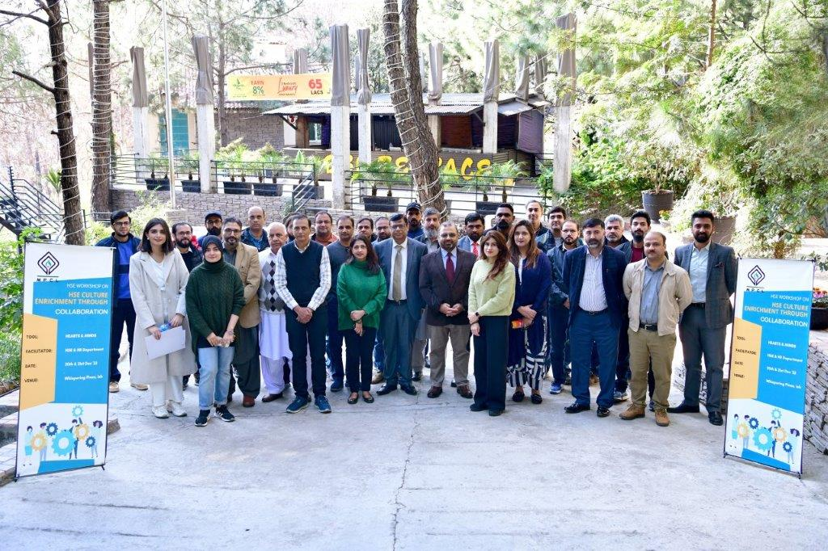
Training and Persuasion
Annual Internal / External HSE Training Plan
Skill Assessment
Certification Level Training
End User Involvement
Process Safety Trainings*
HSE Procedures Awareness
*Tripod Beta RCA, HAZOP Study and LOPA

Slide 14
Phase-I & II Reporting & Investigation | Improving HSE Culture
The pivotal role of effective reporting and investigation in elevating HSE culture cannot be overstated. Previously Excel tools were used for these processes, Now we have embraced digital transformation to further enhance our culture.
Incident Reporting
Investigation Excellence:
We've transitioned to the SAP system, streamlining incident reporting for swifter response and action.
Introducing the Tripod Beta analysis tool for investigations, enabling in-depth analysis and proactive mitigation.
By integrating these digital systems, we're taking a proactive step towards fostering a safer, more informed, and thriving HSE culture at our organization."

Slide 15
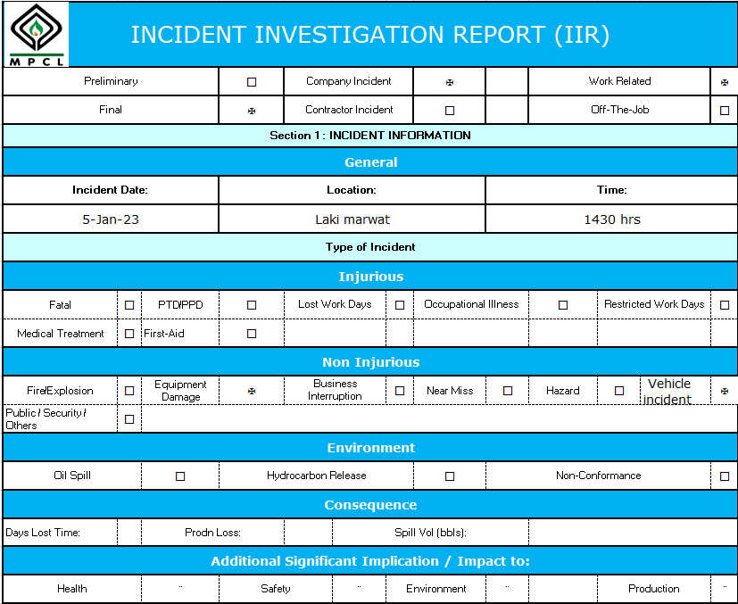
Digitization of HSE Data and Processes
EXCEL BASED MANUAL REPORTING
Manual Reporting to → SAP EHS, Qlik & Share Point
Where we were
Where we are
FY 2020-21
FY 2021-22
FY 2022-23
Excel Based Manual Reporting
Introduction of SAP EHS Module for Incident Investigation
Introduction of Dashboard for Enhancing Data Visualization and Analytics

Slide 16
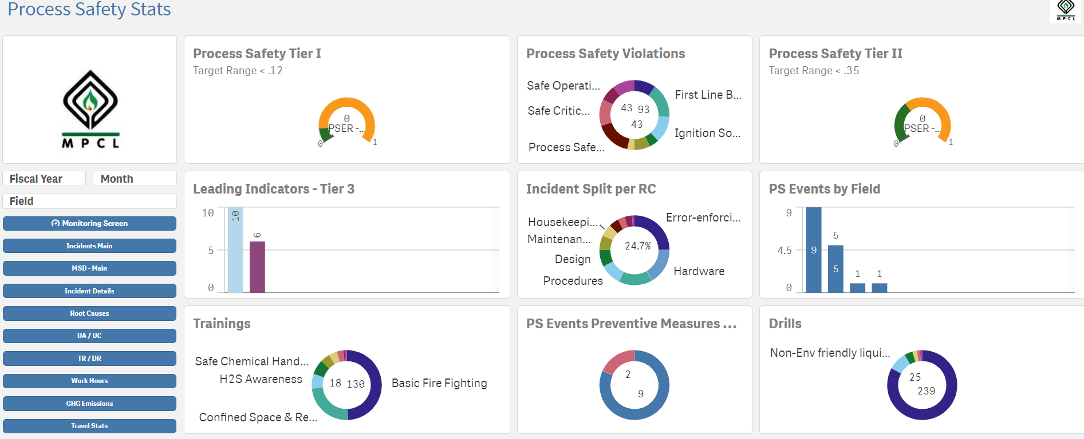
Process Safety Leading KPIs Dashboard

Slide 17
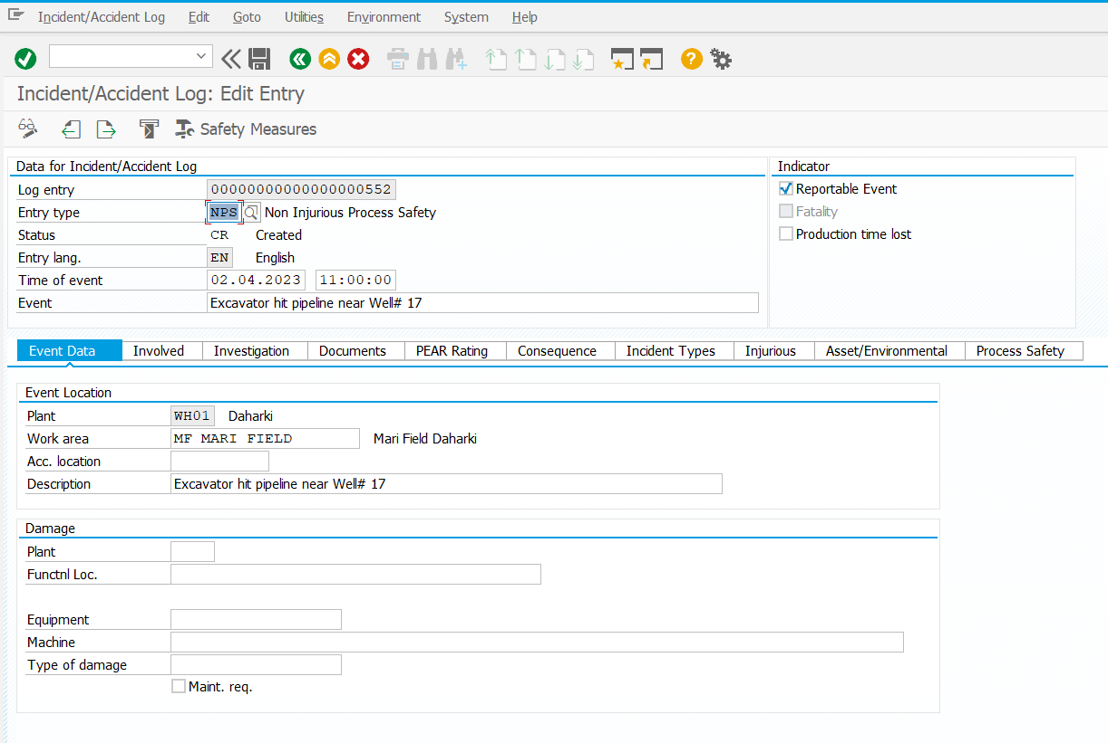
Digitization of HSE Data and Processes
INTRODUCTION OF SAP EHS MODULE
Manual Reporting to → SAP EHS, Qlik & Share Point
Where we were
Where we are
FY 2020-21
FY 2021-22
FY 2022-23
Excel Based Manual Reporting
Introduction of SAP EHS Module for Incident Investigation
Introduction of Dashboard for Enhancing Data Visualization and Analytics

Slide 18
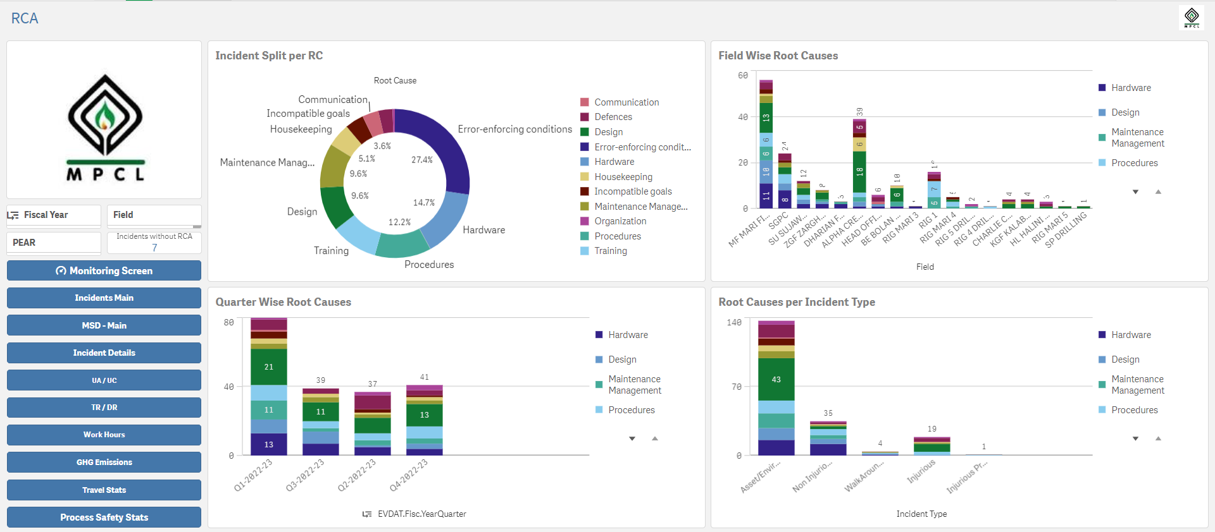
Digitization of HSE Data and Processes
INTRODUCTION OF HSE DASHBOARD
Manual Reporting to → SAP EHS, Qlik & Share Point
Where we were
Where we are
FY 2020-21
FY 2021-22
FY 2022-23
Excel Based Manual Reporting
Introduction of SAP EHS Module for Incident Investigation
Introduction of Dashboard for Enhancing Data Visualization and Analytics

Slide 19
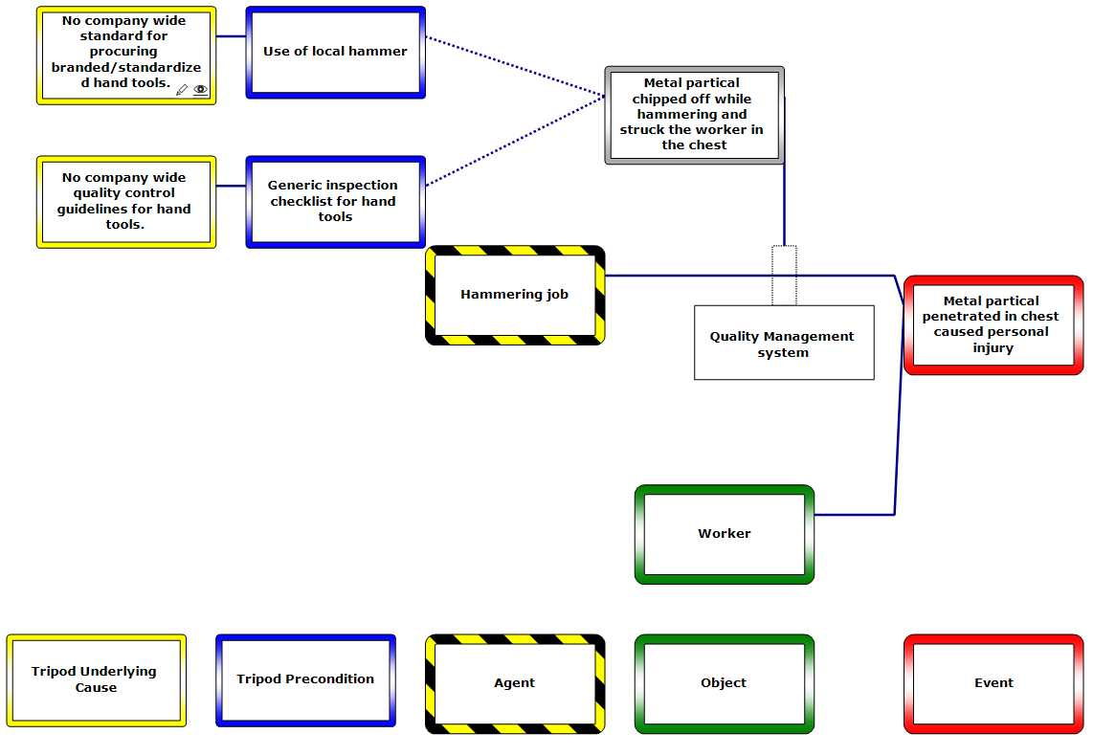
Introduction of Incident Investigation and Tripod Beta Analysis
Where we were
Where we are
FY 2021-22
FY 2022-23
No standard Methodology / Technique
Manual Reporting and follow-up
Action points remained open
RCA Reporting on SAP
Tri-Pod Beta Analysis
Notification Creation
Target dates are being assigned
System Follow-up
Purchased License for SGPC

Slide 20
Phase-III & IV: Alerts and Communication
Phase-III & IV Developing and Communicating Incident Alerts|Improving HSE Culture
Approach: Regular distribution of Incident Lesson Learned Alerts to all employees via email.
Significance:
Shared Knowledge: Disseminating insights from incidents fosters a culture of awareness and knowledge-sharing.
Preventive Action: Alerts provide actionable steps to prevent similar incidents, promoting proactive measures.
Collective Learning: Encourages employees to learn from incidents, contributing to our collective growth.
Implementation:
Incident Analysis: Thorough analysis of incidents to extract valuable insights and lessons.
Alert Creation: Compiling concise alerts outlining key takeaways and recommendations.
Email Distribution: Alerts sent directly to all employees, ensuring organization-wide access.
Impact:
Empowers employees to make safer decisions and take preventive actions.
Strengthens our commitment to a culture of continuous improvement.
Reinforces that HSE is a shared responsibility.
Conclusion:
Incident Lesson Learned Alerts reinforce our dedication to fostering a robust HSE culture.
Together, we create a safer workplace and contribute to the well-being of all employees.

Slide 21
Phase-V Reflecting | Improving HSE Culture
In our journey to mirror and strengthen our HSE culture, we undertook two impactful initiatives:
Cultural Survey: We engaged the entire organization, capturing invaluable insights that mirror our existing HSE culture. This comprehensive understanding forms the bedrock for positive change.
Hearts & Minds Tool: An essential workshop that involved every member, encouraging open dialogue and shared responsibility. This tool amplifies our commitment to a robust HSE culture.
These endeavors collectively drive us towards a safer, more aligned, and thriving HSE culture, underscoring our dedication to continual improvement."

Slide 22
Phase-VI Implementing Actions | Improving HSE Culture
Notification Creation: Streamlining Incident Action Implementation through SAP Notifications
Implementation Process:
Incident Identification: Incident triggers the need for corrective or preventive actions.
Customized Actions: Create specific actions tailored to each incident's requirements.
Assigned Accountability: Assign actions to responsible individuals for clear ownership.
Deadline Management: Set deadlines to ensure timely completion.
Real-time Monitoring: Track action progress within the SAP system.
Impact:
SAP Notifications offer a robust framework for efficient incident action management.
By assigning actions and deadlines, we ensure a proactive and accountable response.
Together, we elevate our incident management capabilities and enhance overall field operations.
Safety Measures Notification Status

Slide 23
Results - Tangible Improvement
HSE Culture Improvement
Near Misses
Reporting Culture Improved
PSE Tier - III
Reporting Culture Improved
LTI Free Year
Performance Improved
A Comparative Graph over Four Years
Four-Year Trend Analysis
Safe Million Man-Hours Achieved
HSE Cultural Survey Conducted
Reflecting Vigilance and Reporting Culture
Unveiling Learning Opportunities for Enhanced Safety
LTI-Free Year Milestone
MPCL at Calculative Phase
Tangible Improvement
Tangible Improvement
Tangible Improvement
Tangible Improvement
Tangible Improvement

Slide 24
Implementation of Contractor HSE Management System
51 FY 2021-22
SOW Preparation – HSE Prequalification and HSE Terms & Conditions
01
Bidding and Award Stage
02
BEFORE
03
Premobilization Stage - Bridging of Contractors
Implementation of Contractor HSE Management System
Mobilization Stage – Inspections of Contractor’s equipment and Audits
AFTER
04
36 FY 2022-23
05
Work Execution Stage
Close-out Stage – Post Project Evaluation
06
29.4% Decrease in Incidents

Slide 25
The HSE Culture Ladder
We conducted a safety culture survey in the organization and the results showed we are at the stage of transformation from “Calculative” to “Proactive”.
We are Here

Slide 26
Reporting Culture on Near misses and Tier-3
Latest 4 Years
Near Miss Reporting
Increase in Near miss reporting observed for years 2019-2022 accompanied by a marginal reduction observed in the preceding year.
Increase in PSE Tier III Reporting
PSE Tier III reporting was absent during the periods of 2019-2020, subsequently commencing in 2020-2021, and consistently yielding incremental improvements in each successive year until 2022-2023.

Slide 27
HSE Performance over FOUR years (2019-23)
38% enhanced performance
33% enhanced performance
50% enhanced performance

Slide 28
HSE Performance over FOUR years (2019-23)
Performance Reduced
Enhanced performance
Zero LTI Reported

Slide 29
Thank You

