Slide 1

Caldbeck Process Safety Inc.
Kick Starting Process Safety
in the Pulp and Paper Industry in Western Canada
John M Riddick, President & Director, Caldbeck Process Safety Inc., Calgary, AB, Canada
& Francesca Apruzzese, Technical Director, Canfor Pulp, Prince George, BC, Canada
.
© 2023 Caldbeck Process Safety Inc.

Slide 2
Presentation overview
Why PSM needs to be applied in the pulp and paper industry
Process Safety Hazards and Risks in the industry
An outline of pulp and paper production
Four PSM tools
PDCA 4-step approach to PSM
An example in case – chlorine dioxide
Next steps - challenges
Notes:
John:
There has been some very serious and significant process safety incidents that have occurred in the pulp and paper industry
Culture of the industry in western Canada is quite conservative and does not look outside the industry
Assets are ageing with some facilities 50+ years old
Limited / Minimal upgrading, maintenance and improvement since commissioning in some cases
Pulp and paper industry store and use or generate a range of hazardous materials, e.g., H₂SO₄, H₂O₂, ClO₂, SO₂, etc.
This presentation will illustrate some of these process safety hazards, describe how a simple 4-step model based on the Walton, Deming and Shewhart Plan-Do-Check-Act quality improvement cycle
The latter part of the presentation will focus on ClO2 as a case study to show how the process has been applied
In addition, the next steps for ongoing work and challenges facing the industry in the future

Slide 3
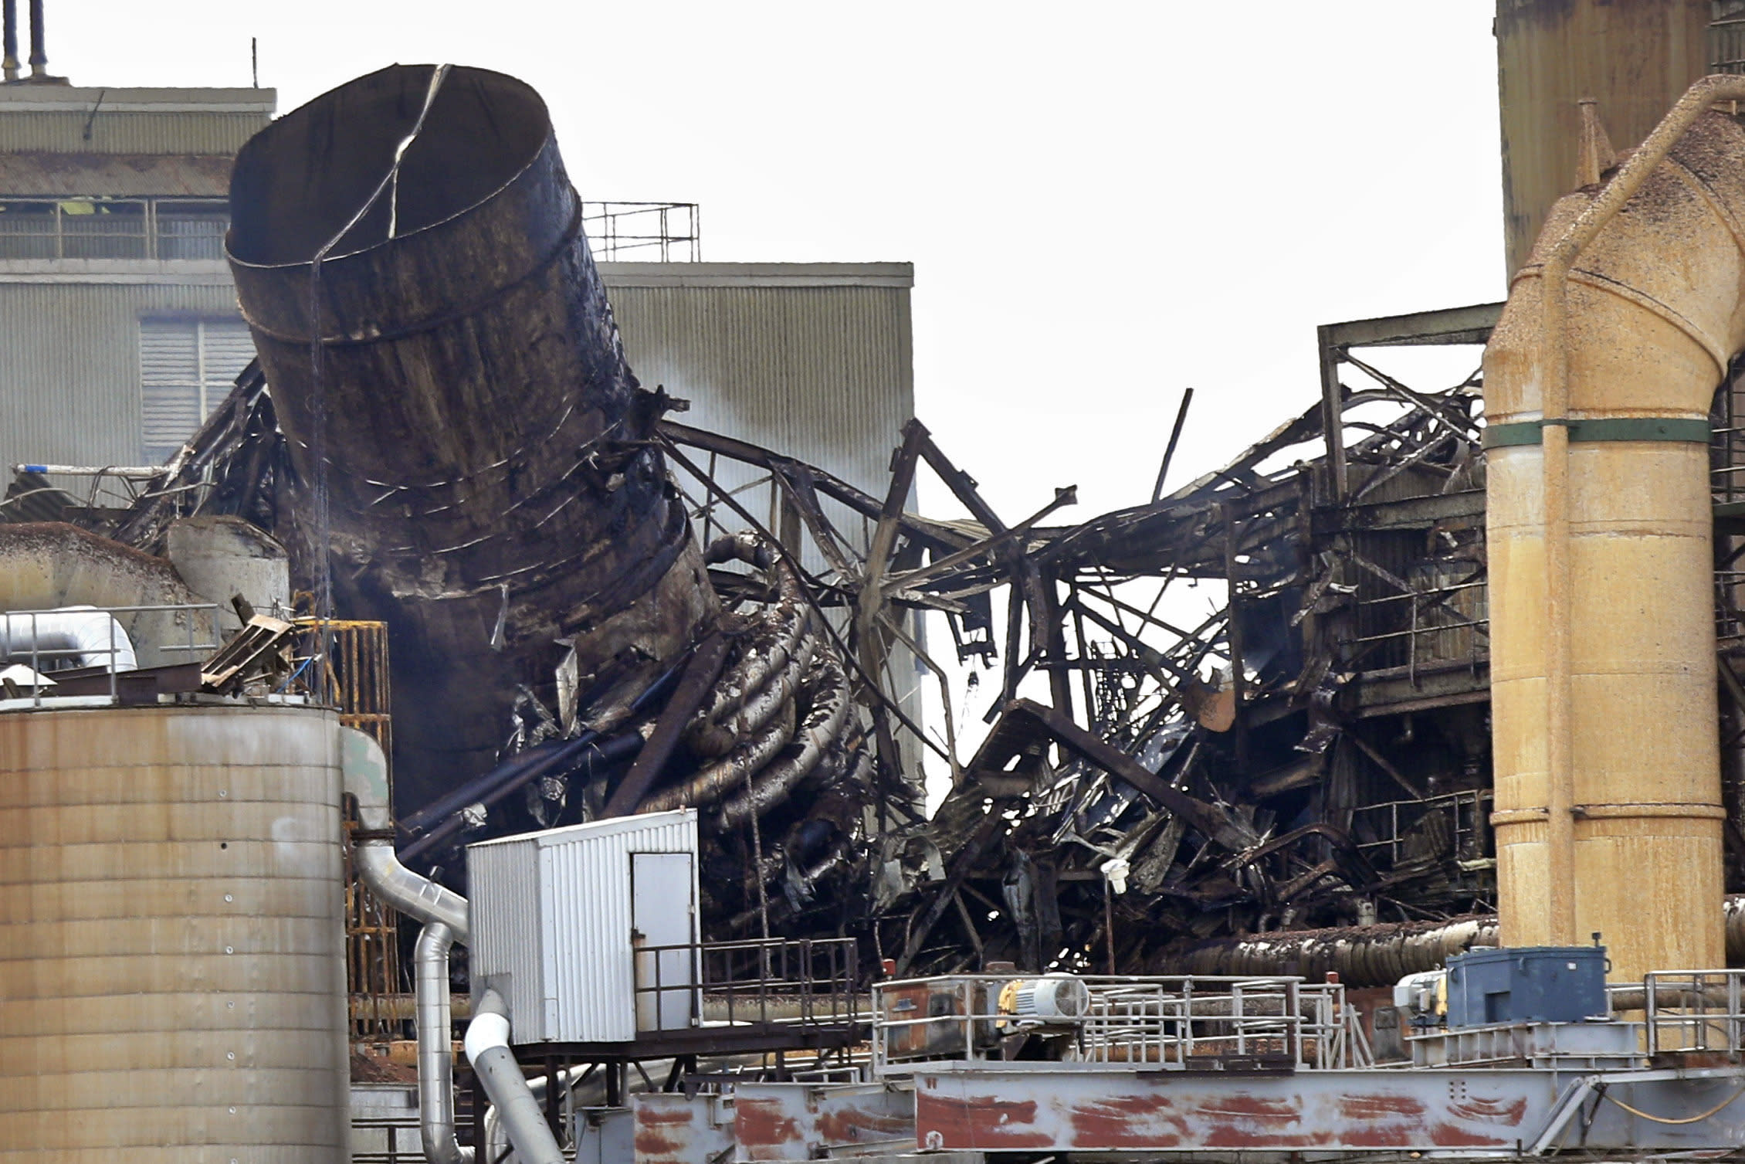
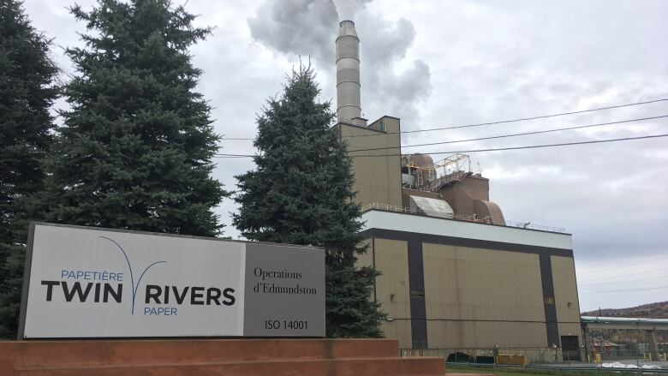
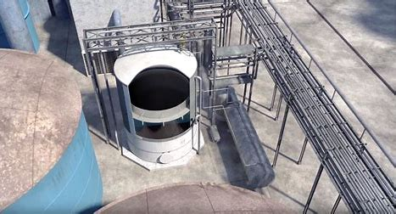
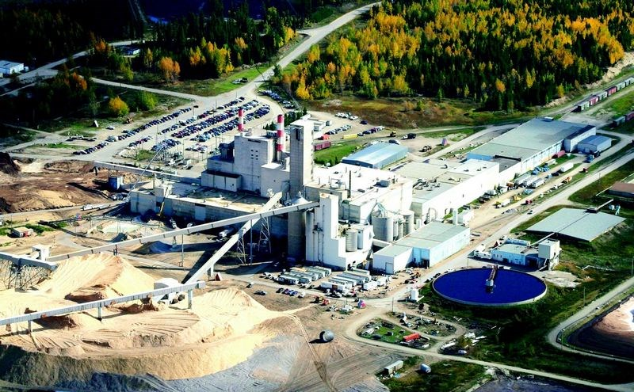
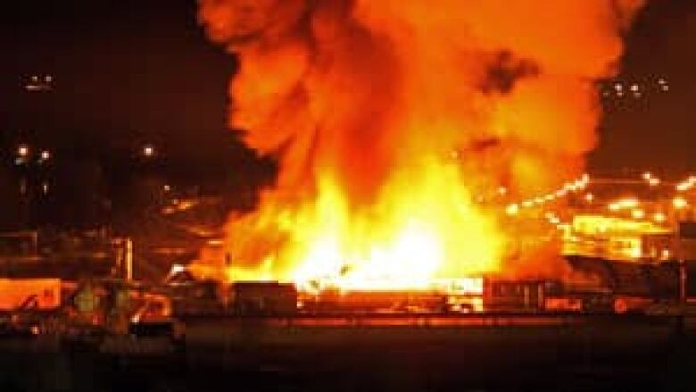
PSM is needed in pulp and industry…..
Androscoggin Mill, Jay, Maine, US - April 2020, Digestor - OP
0 deaths
Twin Rivers Mill, New Brunswick, Canada - 2016,
5 x ClO₂ LOC
0 deaths
DeRidder Mill, Louisiana , US - February 2017,
Condensate Tank - LOC
3 deaths & 7 injured
Mackenzie Mill, BC, Canada - February 2009,
ClO₂ - LOC
0 deaths
Lakeland sawmill, Prince George, BC, Canada - April 2012,
Dust explosion
2 deaths & 24 injured
Notes:
Francesca:

Slide 4
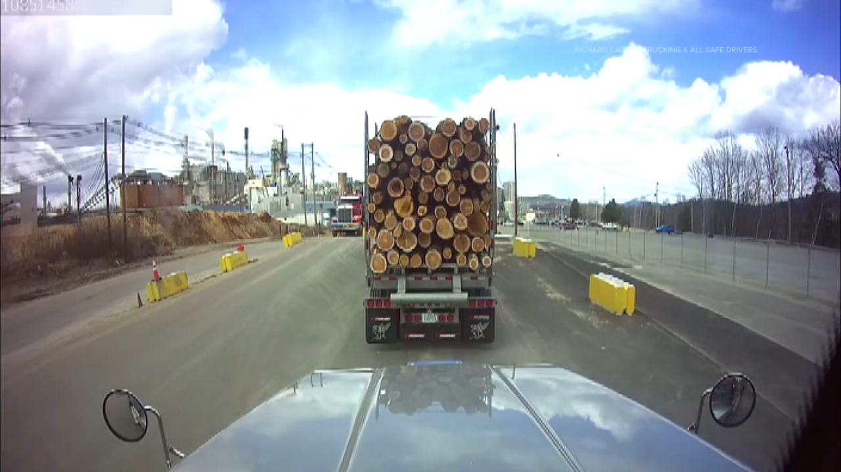
Androscoggin Mill, Pixelle Speciality Solutions,
Jay, Maine, US - 15 April 2020
Notes:
Francesca:
This the overpressure event that had domino effects leading to a catastrophic onsite incident
Pixelle ceased to operate 2 years after the incident
Incident was an overpressure LOC in the one of the digesters which toppled over and lead to a domino effects causing further adjacent LOCs

Slide 5
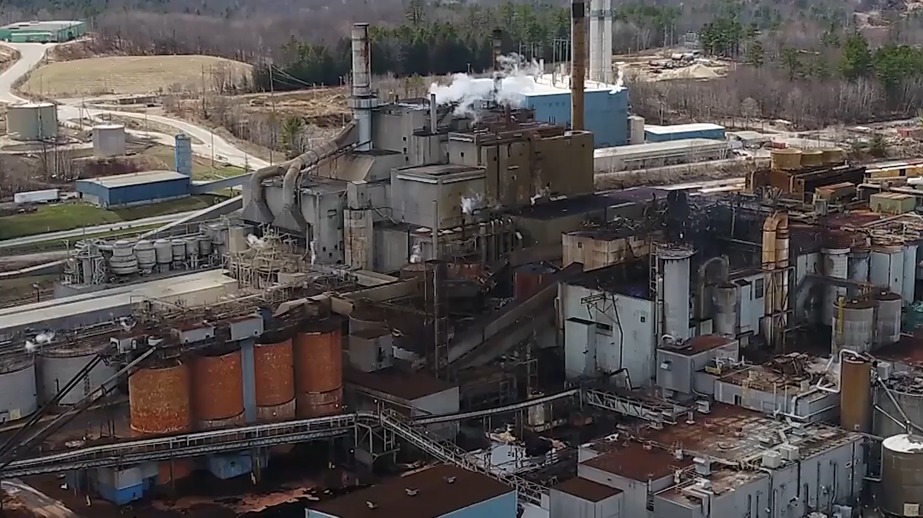
Androscoggin Mill, Pixelle Speciality Solutions,
Jay, Maine, US - 15 April 2020
Notes:
Francesca:
This the aftermath

Slide 6
What is the Pulp and Paper production process?
Notes:
Francesca:
Pulp manufacturing and Bio energy
Inputs
Processing
Outputs

Slide 7
Substance MAHs in the Pulp and Paper industry
Major Accident Hazard | Use / Source | Principal Hazards
Methanol (pure) | Chlorine dioxide generation | Flammable & Toxic
Sulfuric acid (>93%) | Chlorine dioxide generation | Corrosive & Exothermic reaction with water
Hydrogen peroxide (>50%) | Bleaching process | Oxidising agent & Corrosive
Sodium chlorate (pure or solution) | Chlorine dioxide generation | Oxidising agent
Methane (natural gas) | Heating & Steam generation | Flammable (Explosive)
Calcium oxide (quicklime) (pure) | Process chemistry | Corrosive & Exothermic reaction with water
Smelt | Process chemistry | Exothermic reaction with water
Green liquor (containing sodium carbonate, sodium sulfide, etc.) | Process chemistry | Corrosive & Toxic gas on acidification
Black liquor (containing lignin residues, hemicellulose, various inorganic chemicals, etc.) | Process chemistry | Flammable
White liquor (containing sodium hydroxide, sodium sulfide, etc.) | Process chemistry | Corrosive & Toxic gas on acidification
Steam (up to 600lb) | Process heating | Thermal burns & Overpressure
Sodium hydroxide (50% solution) |  | Corrosive
Sodium sulfide |  | Toxic gas on acidification
Sodium sulfite (pure) |  | Corrosive & Toxic gas on acidification
Hydrogen sulfide including total reduced sulfur gases (TRS) | Process chemistry | Toxic & Flammable (explosive)
Sulfur dioxide (pure) | Bleaching | Toxic & Corrosive
Chlorine dioxide (solution) | Bleaching | Toxic & Corrosive
Turpentine (pure) | Process chemistry | Irritant, Harmful & Flammable
Non-condensable gases (NCG) (mixture) | Process chemistry | Irritant, Harmful & Flammable
Tall Oil (liquid rosin) | Process chemistry | Irritant & Flammable
Mineral oil (transformers) | Electrical system | Flammable
Combustible dusts (e.g., sawdust, process fluff, etc.) | Process chemistry | Explosive

Slide 8
Other MAHs and process safety hazards / risks
PSM concerns include also but not limited to;
  Dropped objects
  Structural integrity
  Black site
  Wildfire
  Traffic movement (collisions) including rail car, tankers, vehicles, etc.
  Seismic activity (tsunami, landslides, etc.)
  Flooding
  Ambient temperature (-40 ºC to +40 ºC)
  Cybersecurity
  Security
  Human Factors
  Railcar unloading, switch and car movement on site
  Boilers: Biomass handling, Natural gas
  Power generation: steam turbines
  High Voltage Transformers

Slide 9
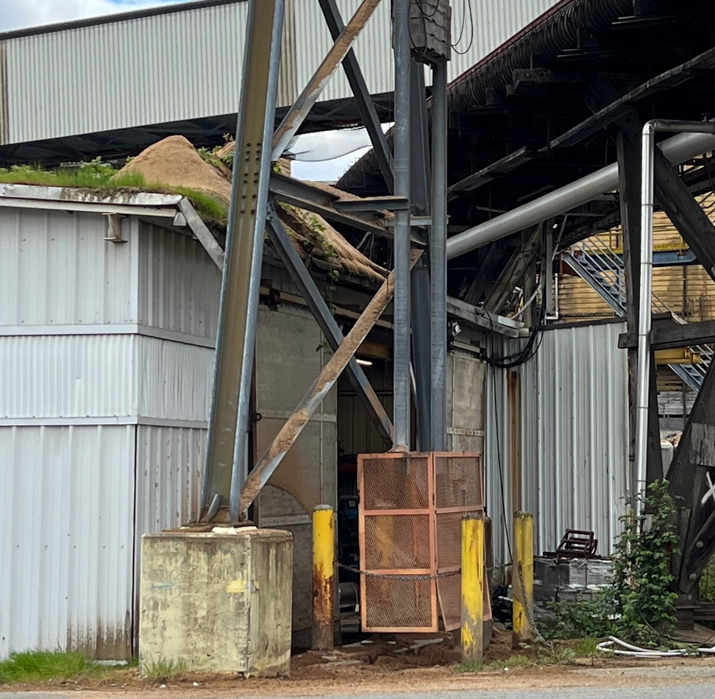
Poor risk management
Aging assets: structural Integrity, lack of inspection, poor housekeeping, etc.

Slide 10
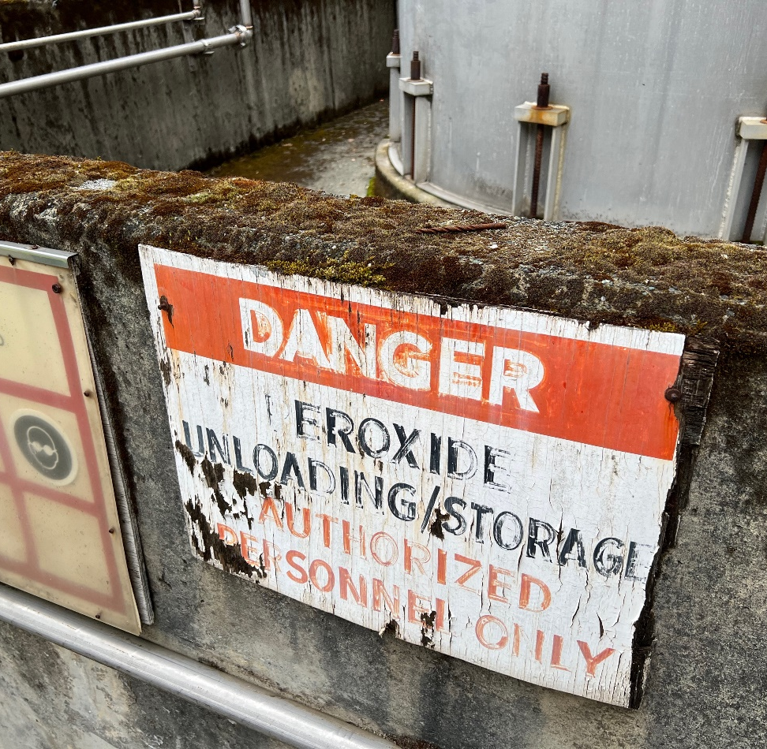
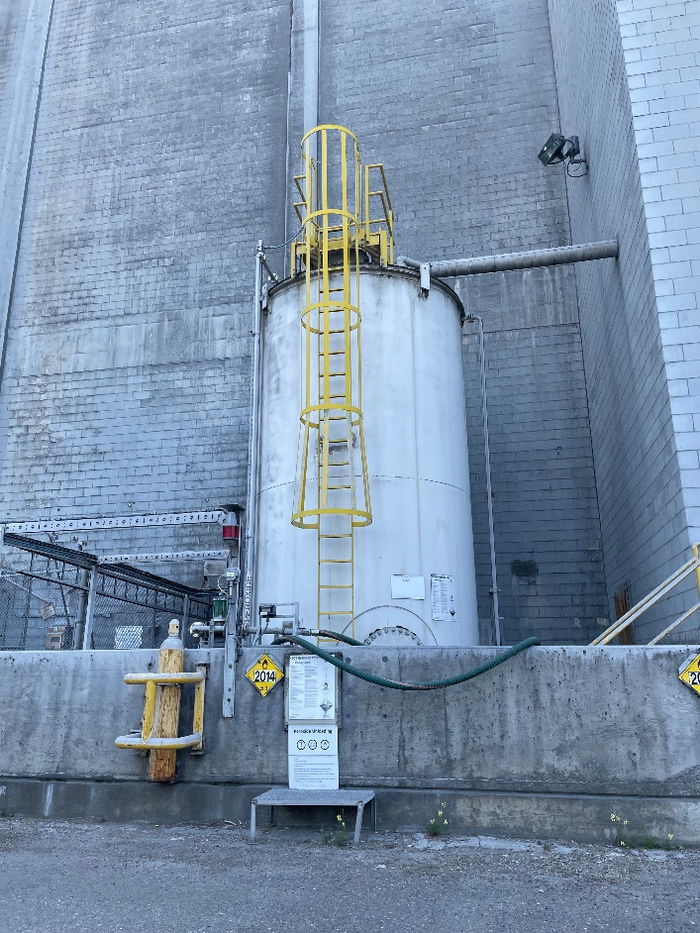
Hydrogen peroxide storage
Some modern maintained assets
Poor signage, lack of inspection and maintenance, etc.

Slide 11
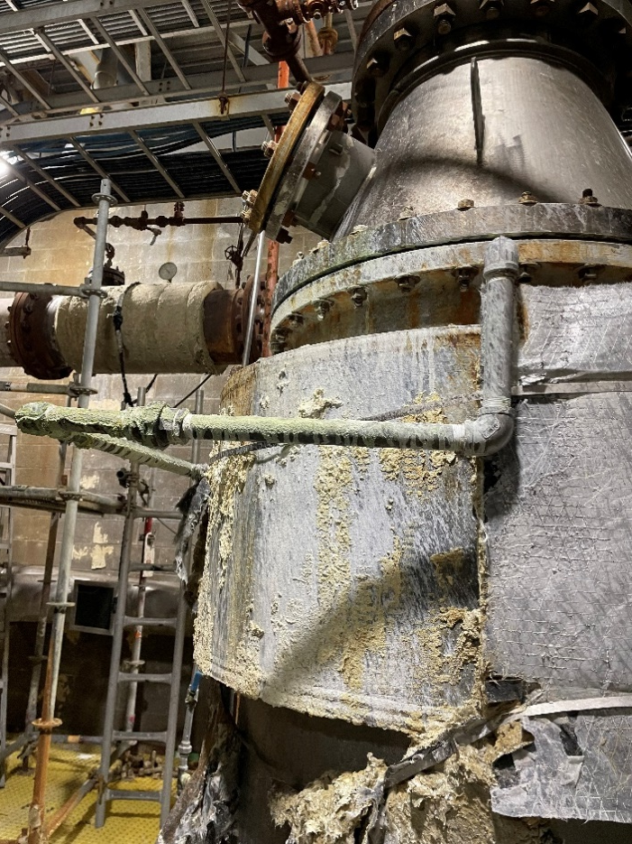
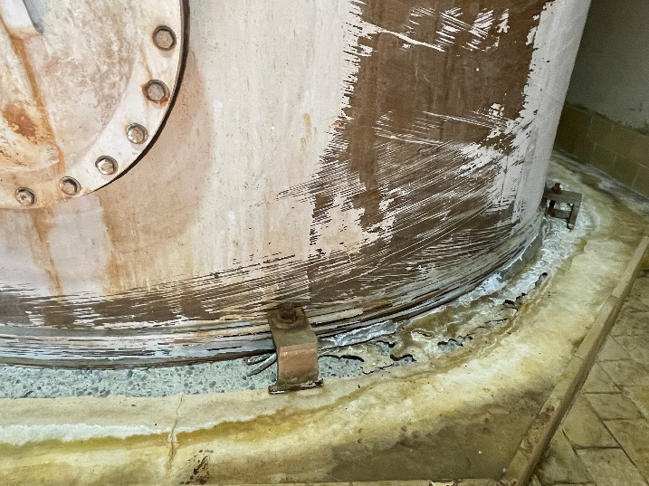
Chlorine dioxide generation and storage
Highly corrosive environment: sodium sesquisulphate

Slide 12
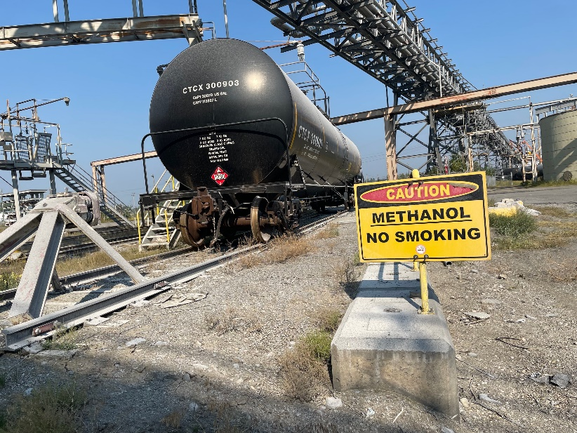
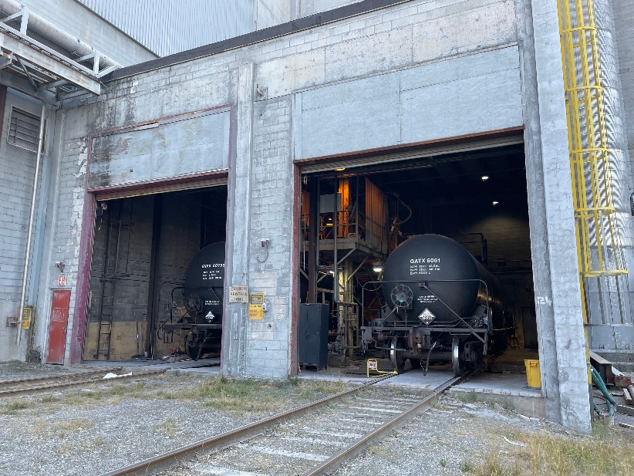
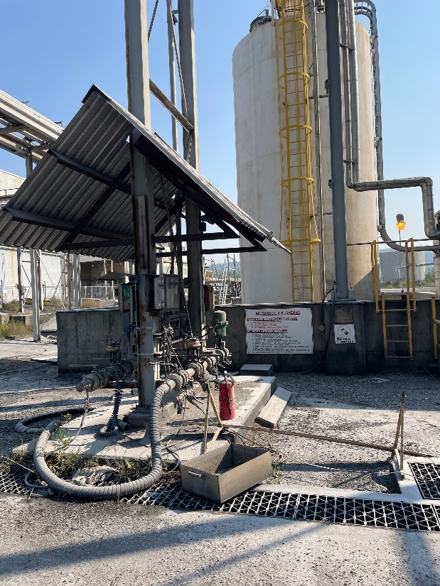
Chemical unloading and Storage – high frequency

Slide 13

Preparation – setting the scene for PSM
Language/Definitions/Terminology:
    MAH – MATTE – MAE
    Highly hazardous chemicals (HHCs)
    PSM
    Safety Criticality, ……. etc.
Training – differentiated
Policy – aims, expectations, priorities, etc.
Framework – 4-step (PDCA) PSM Model
Road Map – Strategic journey for next 3-4 years
3 Year Plan – detailed 3-year operational plan, with targets etc.
PSM Standards – HAZOP, HAZID, BowTie, What-If, etc.
Notes:
John:
Key challenges – push-backs included “what is PSM, why do we need it, what resources do we need & what will it bring in benefits?”
Different than OHS but had some commonality with the companies EMS and Engineering
PSM model must integrate into existing management system – did not want complexity, another agenda, etc.
PSM model had to be subtle, risk based and simple!
Need a new nomenclature – personnel had to learn and speak a new language quickly and fluently, i.e., PSM
Training – differentiated for each level within the organization, e.g., senior leaders – several 1 sessions (strategic resource and objective focused) GM – ½ day (business focused), Key operational staff - 4-day (foundational & technical), operators – short focus sessions “what are the process safety hazards and risks in my job and what needs to be done”, contractors and visitors to the mills will use a video supported by JSA and tool-box talks, etc.
To gain traction for the PSM agenda the following documents were developed and implemented
Policy - statement of intent for the aims, expectation, priorities for PSM
PSM Framework document, essentially the risk management of process safety using the PDCA 4-step model
A high-level road map that can displayed and used describe strategically the PSM journey
A comprehensive 3-year plan using the PDCA structure, supported by PSM pillars to progress the implementation of PSM. This was shared with the regulators to show commitment, transparency, develop partnership, etc.
In addition, ongoing development of PSM standards for What-if, HAZOP, HAZID, BowTie, Competency, ALARP and Risk Reduction, etc.

Slide 14
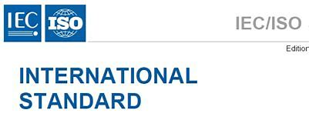
Selection of key PSM tools for process hazards and risk analysis
Tools and techniques | Risk assessment process
 | Risk Identification | Consequences | Probability | Level of risk | Risk evaluation
Brainstorming
Structured or semi-structured interviews
Delphi
Check-lists (HAZID) (Ext)
Primary hazard analysis
Hazard & Operability studies (HAZOP) (Ext)
Hazard Analysis and Critical Control Points
Environmental risk assessment
Structure « What if? » (SWIFT) (Int)
Scenario analysis
Business impact analysis
Root cause analysis
Failure mode effect analysis
Fault tree analysis
Event tree analysis
Cause and consequence analysis
Cause-and-effect analysis
Layer protection analysis (LOPA)
Decision tree
Human reliability analysis
Bow Tie analysis (Int)
Reliability centred maintenance
Sneak circuit analysis
Markov analysis
Monte Carlo simulation
Bayesian statistics and Bayes Nets
FN curves
Risk indices
Consequence/probability matrix
Cost/benefit analysis
Multi-criteria decision analysis (MCDA)
Key
Strongly Applicable
Applicable
Not Applicable
Ref. IEC/ISO 31010 Risk management – Risk assessment techniques
Notes:
John:
This table taken from IEC/ISO 31010 illustrates just some of the PSM / Risk Management tools and techniques that can be deployed
Companies were overwhelmed with the wide range of techniques available, 5-Ws: Who – What – When – Where – Why
A key objective to support clarity and understanding was to simplify this a few easy-deployable yet covering as much the risk assessment process as possible, i.e., simplistically utilise a small number of easy-to-use techniques covering as much as the risk assessment process as practicable - trying to achieve green (strongly applicable)!
Two key tools were selected using external facilitation – Check-lists (HAZID) and Hazard & Operability (HAZOP) studies
Two key tools were selected using internal facilitation – BowTie analysis and What-If (SWIFT)
Needless to say, other techniques other the 4-core tools described, can and are used as needed, Layer of Protection Analysis (LOPA), Consequence / Physical Effects Modelling, formal ALARP demonstrations, etc.

Slide 15
4-steps - The PDCA Pulp and Paper PSM model
STEP 4 - Assurance and Verification
Assurance Activities
STEP 1 - Process Safety Hazard Identification & Risk Assessment
Identification (HAZID) of MAEs (MAHs & MATTEs) & process safety hazards
STEP 2 - Development Safety Critical Safeguarding Manual
Safeguards must priortize and focus on high risks and safety crticality
STEP 3 - Implementation of Safety Critial Safeguarding Manual
Safety Critical Safeguarding Standards Gap Analysis
Risk Analysis (Bow-Tie analysis) defining safety criticality
Risk Reduction Measures - ALARP demonstration
Maintenance Management
Management of Change incorporating - safety critical barriers Impairment or Deferment
Verification Scheme
Measuring, Monitoring & Review - Process Safety Safeguarding Indicators (KPIs)
Hazard and Operability (HAZOPS)
Notes:
John:
Step 1 covers Planning – in essence, the preparatory work previously described coupled with the identification and risk risk assessment of process safety hazards on site, achieved in part with a HAZID study, BowTie analysis and other techniques such as HAZOP, etc.
Step 2 addresses Do or implementation, here a safeguarding manual was formulated with roll-out at each operating asset. This document is key to PSM in that it describes process safety hazards and risks, safety critical barriers and expectations which is simplified but akin to oil and gas performance standards following FARSI expectations (functionality, availability, reliability, survivability and independence).
Step 3 refers specifically to Checking PSM progress against safety critical barriers as identified in the PHAs and described in the safeguarding manual. These safety critical barriers are managed via the mill’s computerised maintenance management system (CMMS), e.g., Maximo, SAP, etc.
Completing the cycle is Step 4 which is Act involving reviewing progress, against dashboard, KPIs, etc.
Now the philosophy of continuous improvement in its forms has been comprehensively adopted globally across a wide industries
Considering the cultural changes necessary to implement PSM, limited resources, existing management systems available within the pulp and paper industry as well as the familiarity with the continuous improvement methodology, the 4-step model based on the Walton, Deming and Shewhart Plan-Do-Check-Act quality improvement cycle was chosen to progress PSM with several of the pulp and paper manufacturers in western Canada

Slide 16
PSM workflow
Preparatory work
STEP 1 - Process Safety hazard identification & risk assessment - HAZID
BOWTIE
HAZOP
Other PHAs (as required)
STEP 4 - Review via dash boards, KPIs, periodic reviews and audit
STEP 2 - Safeguarding Manual (safety critical barriers)
STEP 3 - FARSI SCBs in CMMS
Sustainability - future legislation?
Start
3
5/6
Time/years
Notes:
John:
The high-level objectives include: integration into existing management system, proactive and timely risk identification, assessment and mitigation of process safety risks, sustainability, scalability and flexibility should new changes future occur in relation to technology, legislation, etc.
Here we can see that the journey to sustainability will take typically around 6 years
Note: This timeframe assume ongoing investment and no significant changes take place within the company or the industry, etc.
COVID and significant re-organisations have impacted on this timeframe and adjustments have taken place accordingly

Slide 17

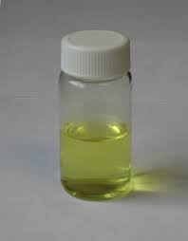
PSM workflow for chlorine dioxide
Use of chlorine dioxide (ClO₂)
Properties of ClO₂
Generation and storage of ClO₂
12NaCIO₃ + 3CH₃OH + 8H₂SO₄ →12ClO₂ + 4Na₃H(SO₄)₂ + 3HCOOH + 9H₂O
ClO₂ identified in the HAZID as a high-risk MAH
Notes:
Francesca:
ClO₂ main bleaching agent
Very unstable produced as gas and stored in solution at 9 -11 g/l
Violently decompose in chlorine and oxygen

Slide 18
Risk Assessment Matrix (RAM)
The HAZID studies identified ClO₂ as being a high risk MAH.
Notes:
John:

Slide 19
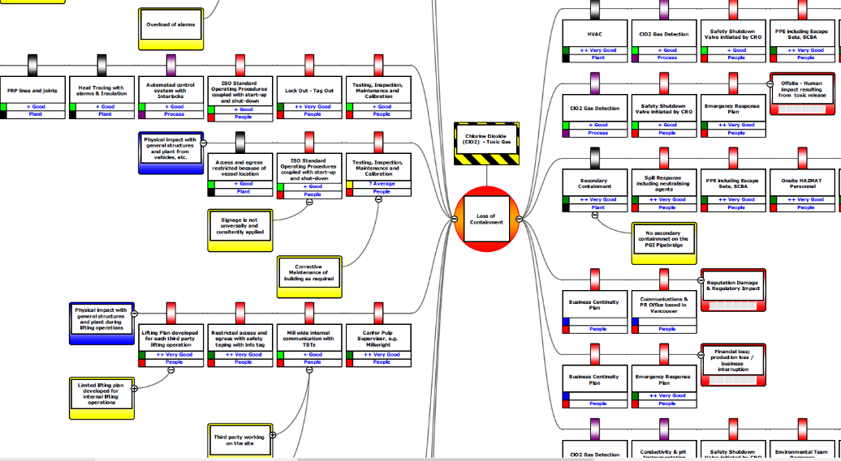
BowTie analysis and HAZOP studies
Two x Bow Tie diagrams
Decomposition &
LOC – Toxic dispersion
Qualitative!
HAZOP
Cause & Consequences
Still qualitative!
Requirement for physical effects modelling to better understand a ClO2 LOC
(quantitative) – O/P & Dispersion
Notes:
John:

Slide 20
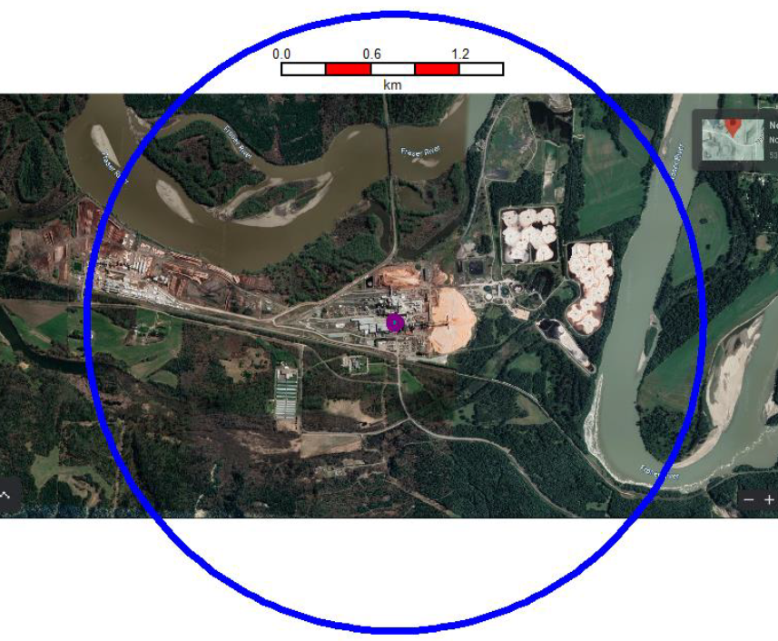
Consequence Modelling
15 ClO₂ scenarios were modelled for each mill using DNV PHAST
New learning - extent of dispersion footprint!
More objective, providing greater understanding of the magnitude of a decomposition (overpressure) & toxic gas dispersion.
Leading to:
Revisit Bow Tie diagrams & HAZOP findings – review of safety critical barriers
Safeguarding Manual update as required
Training and SOPs
Emergency Response Plan (ERP)
Local community communication?
Notes:
John:

Slide 21
Next steps – challenges
Sustainability of PSM – show ongoing progress, success and
KPIs – local and corporate
Review and Audit
Ongoing review RAM, PHAs and new PHASs (QRAs?)
Revise Framework and Plans
Capital Projects + Operations + Asset Integrity = Comprehensive PSM
Human Factors
Resources / Cost savings / Energy / Environmental / Profitability
Horizon scanning - new legislation, standards, codes & practices, insurers, pressure groups, business demands, etc.
Potential scalability of the 4 step model based upon future demands, etc
Notes:
Francesca:
KPIs – local and corporate
Review and Audit
Capital Projects + Operations + Asset Integrity = Comprehensive PSM
John:
Human Factors
Horizon scanning - new legislation, standards, codes & practices, insurers, pressure groups, business demands, etc.
Potential scalability of the 4 step model based upon future demands, etc.

