Slide 1
Operational Risk Assessment: Sharing Good Practice for the Control of Major Accident Risk
IChemE Hazards 33 Conference, Birmingham
Tom Downie, Process Safety Engineer, INEOS FPS
November 2023

Slide 2
Introduction
Overview of INEOS FPS
Why is Operational Risk Assessment (ORA) required and what is it?
Identifying changes
Risk assessment
Managing risks
Summary of key factors for success

Slide 3
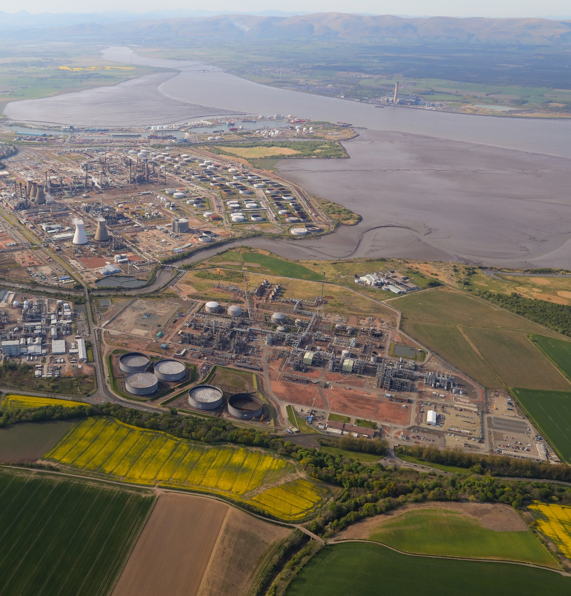
INEOS FPS
INEOS FPS is an integrated oil and gas liquid transportation system operating in the Central North Sea
The FPS 36” subsea pipeline extends from the Forties Charlie platform via the Forties Unity platform to a landfall at Cruden Bay on the North East Coast of Scotland - a distance of 169 kilometres
The 36” FPS landline travels 209 kilometres south to the Kinneil Terminal at Grangemouth. The Kinneil Terminal processes the liquids into saleable gas, LPG and crude oil products for export or use at the Grangemouth Complex.
Notes:
Key additi

Slide 4
Why and what

Slide 5
Why is Operational Risk Assessment Required?
During the design of high hazard processes, relevant good practice and risk assessments are used to define the measures necessary to manage safety and environmental risks to a tolerable level
During the lifetime of the process, abnormal conditions, defects, impairments and external factors may change the major accident risk
Failure to identify and manage such changes as they emerge is a cause of serious incidents in high hazard industries

Slide 6
Challenges
Challenge | Major Incident Example | Impact
Change identification | Buncefield Terminal, 2005 [1], UK. Major explosion and fire due to tank overfill. Critical factors included failure to identify and manage throughout changes at the facility and known defects with level monitoring systems | Major Accident to Environment, Catastrophic asset damage
Understanding the significance of changes | Watson Grinding incident, 2020 [2], Texas. Major explosion due a propylene release inside a factory building. A critical factor was a failure to manage faults with a gas detection and shut-off system. | 2 fatalities, 2 injuries, Catastrophic asset damage
Managing known changes | Southern Water, 2019 [3], UK. Long term failure to manage equipment and monitoring equipment faults at the company’s sewage treatment works leading to unpermitted sewage release into the environment | Prolonged and extensive environmental harm Fines and reparation >£200m
Notes:
1. U.S. Chemical Safety and Hazard Investigation Board, 24th Jan 2020, Fatal Release and Explosion and Watson Grinding, No, 2020-03-I-TX.
2. Board The Buncefield Incident ,11 December 2005, The final report of the Major Incident Investigation Board Volume 1, HSE Books 2008 ISBN 978 0 7176 6270 8.
3. Ofwat, 10 October 2019, Ofwat’s final decision to impose a financial penalty on Southern Water Services Limited, Ofwat’s-final-decision-to-impose-a-financial-penalty-on-Southern-Water-S....pdf
Record £90m fine for Southern Water following EA prosecution - GOV.UK (www.gov.uk)

Slide 7
What is Operational Risk Assessment?
It’s a structured process for
identifying,
risk assessing and
managing unplanned changes in major accident risk
Goal is to normalise the discussion of change in major accident risk, and provide a simple process that can used to support asset operations
ORA is common term in the oil and gas industry, but comparable process exist in other hazardous industries

Slide 8
Scope of the ORA Process
At INEOS FPS the ORA process is primarily applied to unplanned changes in safety and environmental major accident risks – discretion of plant manager to consider business and reputational risks
It is not used to manage acute immediate safety or environmental concerns – INEOS Process Safety principles apply first and foremost
INEOS Process Safety principle 9 - When in doubt the asset must always be taken to its safest state
Planned changes are managed through a separate Management of Change Process
Category
Operation of equipment outside of normal operating envelope
Degradation of layers of protection, such as control systems, trip systems, alarms and relief systems
Reduced equipment integrity
Impaired mitigation systems
Any other system which is not meeting it’s performance standard with potential safety or environment

Slide 9
Interaction with complementary processes
Process | Description
Operational Risk Assessment | Emerging unplanned changes to major accident risk
Management of Change | All changes (permanent or temporary) to plant and people
Risk Management Process | Complex long term risks with potential safety, environment, asset and reputations impacts
Management of Change (MoC)
Operational Risk Assessment (ORA)
Risk Management Process (RMP)

Slide 10
Identifying Changes

Slide 11
How are changed identified?
Structured inspection, testing and maintenance activities
Revealed failures – i.e. plant stops working
Technical oversight & review
Monitoring of operating performance and long term trends
Review of near misses and incidents
Routine hazard study revalidations and other technical assessments
There is no one solution to identifying change because the types of changes and the people who identify the change are highly variable

Slide 12
Foundational Elements for Change Identification
Accountability and responsibility for safe operation of the asset is clearly defined 24/7
This ensures there is a clear reporting route when abnormal conditions become apparent
Fosters culture where ORAs are demanded rather than pushed on the people operating the asset
Adequate process safety information
Strong culture of safety observation and near miss reporting

Slide 13
Opportunities to Escalate Change
Multiple opportunities are provided to catch potential changes
 | Activity | Strengths
Primary – direct report to Site Authority | Site Authority is responsible for safe operation of the asset at all times and is responsible for identifying the needs for ORAs | Simple and clear procedure when an obvious issue is identified any time of night or day
Secondary – Daily Operations and Maintenance Reviews | All near misses, safety observations, work orders, operating envelopes and operational issues are reviewed daily and discussed as a team | Provides an opportunity for a wider team to consider the impact of issues on major accident risk
Tertiary – Weekly and Monthly Process Safety Meetings | All safety observations, near misses and emerging issues are reviewed weekly All near misses and KPIs are reviewed monthly Both meetings sponsored and attended by relevant leadership team personnel | Weekly meeting provides an open forum to discuss changes and a parking lot is maintained of issues to monitor

Slide 14
Risk Assessment

Slide 15
Initial Assessment
Initial assessment – completed quickly and records an initial qualitative analysis of the risk and a decision on continued operation.
If initial risk assessment shows risk is low priority it may be stopped at this stage or progressed to a full ORA with a more formal and detailed risk assessment
The urgency of the ORA is agreed with the Site Manager (dependent on risk & complexity) and resource made available to support
ORA risk assessment are supported by trained facilitators – requires experience in a broad range of hazard study techniques and good knowledge of site process safety information

Slide 16
Detailed Risk Assessment
Normal risk
The team consider the hazard severity and likelihood for the system if it was operating as it was intended
This may make use of existing hazard studies (HAZOPs, LOPA, Fire Hazard Analyses etc.)
Abnormal Risk
The team document what has changed and how it impacts the severity and / or likelihood
The impact of any existing ORAs is considered
Mitigated Risk
The team considers “what else could we do”, applying the hierarchy of control
Additional measures are documented with an owner and details of how it will be applied
The Abnormal Risk is re-evaluated with any credible mitigations in place (if any)
Basis for Continued Operation
The team consider “why are we not shutting down?” and describe the basis for continued operation, if any. The activities to remove the ORA are documented along with an expected duration.
Facilitator determines appropriate risk assessment method – typically semi qualitative “LOPA” but may be less or more detailed depending on the risk under consideration

Slide 17
Risk endorsement
Senior managers visibly support the ORA process and are experienced in its application
Endorsement level by mitigated risk priority from 8x8 matrix which is imbedded in the FPS management system
Significant changes to major accident risk typically require Operations Director endorsement
Permanent record of risk assessments and endorsements retained in the asset control of work software which includes an ORA module
Endorsed ORAs are communicated to operations and maintenance teams and remain accessible and visible at any time
Risk Priority | Endorsement
PURPLE | CEO
BLUE | Operations Director
TURQUOISE | Asset Manager
WHITE | Plant Manager

Slide 18
Continuous review

Slide 19
Continuous review
It is important to ensure that existing ORAs:
Remain valid (i.e. the risk level remains correct)
Are removed by the expected completion date (i.e. actions are resourced and completed)
All existing ORAs receive a intensive ongoing review and monitoring
This is both a strength and challenge with any ORA process

Slide 20
Continuous review
Frequency | Activities
Daily | Shift operations team review all ORAs in place and review and sign any new ORAs as part of handover and daily meetings
Weekly | Site Authority has to formally review and resign all existing ORAs ORAs and action plans reviewed as part of weekly process safety meeting
Monthly | All ORA are reviewed with Asset Manager
90 Days | ORAs require formal re-review and endorsement

Slide 21
Summary

Slide 22
Summary
Historical incidents show that unplanned change to major accident risk needs to be well managed, but that change takes a variety of forms. Indenting changes requires multi-layered and highly disciplined approach.
ORAs are resource intensive to develop and manage. They must be applied strategically to major accident risks. Alternative change management tools must also be in place. Rapid initial risk assessments are an effective triage tool.
ORA risk assessments require a normal, abnormal and mitigated risks to be defined. The focus must be on determining what more could be done to reduce the risk and ensure continued operation is not the default.
Endorsement and engagement of senior leaders and the wider management team is crucial for success – at INEOS FPS the there is strong pull from risk owners to use this process.
ORAs require intensive review and management to ensure they remain valid and are resolved promptly.

