Slide 1

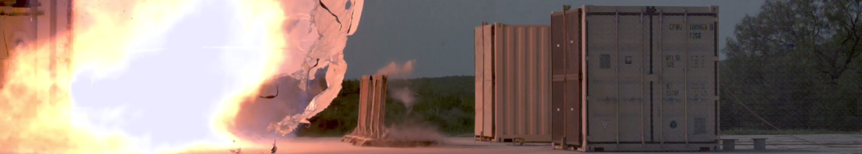

CONSORTIUM
Guidelines for Managing Abnormal Situations
Roger Stokes
Notes:
Hello everyone, my name is Roger Stokes and many thanks to the IChemE for the opportunity to present here at Hazards 33
I hope you find what I have to say interesting and helpful.
This talk is based on some work we did for the CCPS that involved writing a book. It was carried out by a team at BakerRisk with the involvement of the Abnormal Situation Management Consortium (ASM) and is entitled Guidelines for Managing Abnormal Situations

Slide 2
Speaker Bio
Roger Stokes – Principal Engineer CEng FIChemE
12 Years in Chemical Industry
          Chlor-alkali / solvents resins / VCM / PVC
      Design, process troubleshooting, plant management
23 Years in Insurance Industry
      Investigating incidents and accidents in refineries, petrochemical / chemical
8 Years with BakerRisk
      Incident Investigation
        2019 update to CCPS Book – Guidelines for Investigating Process Safety Incidents
      Insurance Risk Engineering
      PSM systems and audits
      PHAs (Process Hazard Analysis), FHAs (Fire Hazard Analysis)
    IChemE Loss Prevention Bulletin Panel
      Sharing learning from incidents
Notes:
..

Slide 3

About CCPS
Center for Chemical Process Safety
March 1985, in response to Bhopal, AIChE formed CCPS with seventeen charter member companies.
A collaborative effort to eliminate catastrophic process incidents by advancing state of the art technology and management practices, serving as the premier resource for information on process safety, supporting process safety in engineering, and promoting process safety as a key industry value
About 260 member companies including most of the world’s leading chemical, petroleum, pharmaceutical, and related manufacturing companies.
Over 100 books and products
Notes:
CCPS part of the American Institute of Chemical Engineers
Unfortunately, they can’t spell Center, but we don’t hold that against them
A collaborative effort between about 260 companies and it has produced over 100 books and products in relation to Process Safety.
Baker Risk has written at least seven books

Slide 4
Acknowledgements – CCPS & Subcommittee
Brian Farrell– CCPS Staff Consultant
Tony Downes | Honeywell International, Inc.
Todd Aukerman | Lanxess
Felix Azenwi Fru | National Grid
Susan Behr | Braskem
Michelle Brown | FMC
Eddie Dalton | BASF
Seshu Dharmavaram | Air Products
SP Garg | GAIL (India) Ltd
Paul Gathright | Ascend Perf Materials
Amy Gay | Oxy
Nirupama Gopalaswami | Honeywell International, Inc.
Ghaffar Keshavarz | NOVA Chemicals
Alan Kobar | Dow
Rebecca Lipp | Marathon Petroleum
April Lovingood | Eastman
Marcus Miller | TapRoot
Assem Saleh | Petro Rabigh
Nicholas Sands | DuPont
Bryant Sartor | AdvanSix
Bruce Spencer | Marathon Petroleum
Todd Stauffer | Exida
Andrew Trenchard | Honeywell (ASM Consortium representative)
Matthew Walters | Exponent
Stephanie Wardle | Cenovus Energy
Notes:
Some of you may have been involved in writing books or standards using a committee.
It’s quite a complex process– trying to satisfy the (sometimes) different views of the various parties.
However, you soon realise that there is a vast and varied resource to tap into and I was able to learn a lot from the contributors, much of which was incorporated into the book.
A lot of different companies were involved and are very grateful for their input and direction.

Slide 5
Acknowledgements – Peer Reviewers
Mohd Ibrahim Mohd Ashraf | Petronas
Palaniappan Chidambaram | DuPont Sustainable Solutions
Robert Johnson | Unwin Company
Caitlin Mullan | Ashland
Connor Murray | CNRL
Beverley Perozzo | NOVA Chemicals
Notes:
..

Slide 6

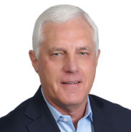



BakerRisk Project Team
Larry Bowler
Mike Broadribb
Mike Moosemiller
Duane Rehmeyer
Roger Stokes
Notes:
The rogue’s gallery
Note: the odd grey hair here and there.
Our team was tasked to write the various chapters based on a general structure provided by the Subcommittee members

Slide 7
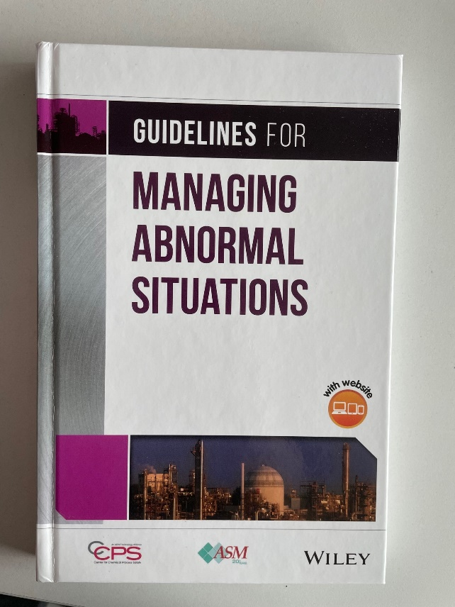
The Book !
What’s Inside?
Seven Chapters
234 pages
35 Embedded Case Studies
3 Detailed Case Studies
5 Interactive on-line Training Modules
Target Audience
Operations Managers
Process Safety Engineers
Plant Engineers
Process Control Engineers
Notes:
The accompanying paper describes the scope of the book in more detail, the development of principles and procedures for managing abnormal situations plus a summary and review of available resources. It provides guidance for management and engineers to develop appropriate training and procedures and demonstrates how to institutionalize these into process operations. Case Studies are included as training aids for frontline operating personnel. Thirty five short Case Studies are embedded throughout the book that complement the concepts discussed followed by 3 more detailed case studies. Five online training modules were developed that can be used to help train operating teams in diagnosing an abnormal situation. The modules allow trainers to step through specific abnormal situations and discuss diagnosis of the abnormal situation, actions to be taken, learnings, and relevance to their own plant operations.

Slide 8
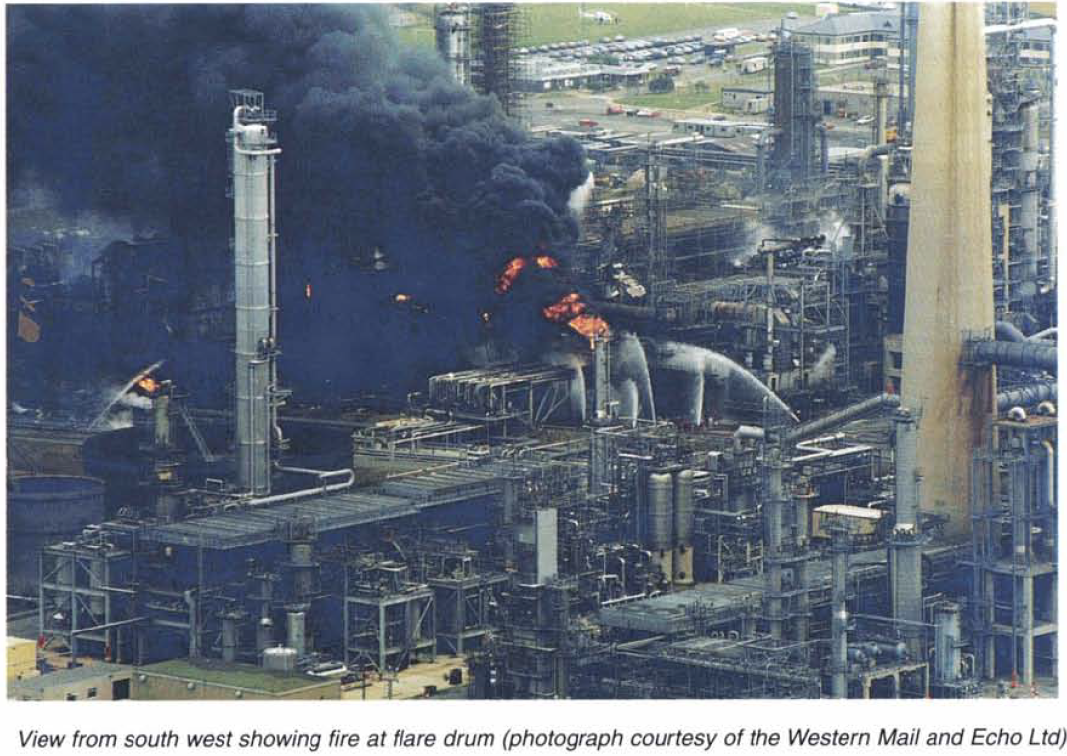
Example - Milford Haven, 1994
Release of ~ 20 tonnes of hydrocarbons
Delayed ignition and explosion – ignition source 100m away
26 minor injuries on site (Sunday afternoon)
Property damage 3km away
Refinery damage ~ £48M
HSE fines £200k
https://www.hse.gov.uk/comah/sragtech/casetexaco94.htm
Notes:
Here is one of the case studies – it was a long time ago and a lot was learnt from this incident, thankfully without any major injuries. It was the relatively early days of DCS systems before alarm management was implemented and is a good example of how a relatively minor incident can develop into a major one, if not handled properly. The HSE report link is shown

Slide 9
Example - Milford Haven, 1994
0720: Thunderstorm ⇒ Small fire (not direct cause of main event)
Electrical disturbances tripped feed to cracker (temporarily)
Operators attempted to re-stablish conditions
  But outlet valve from debutanizer stuck closed (not spotted by operators)
Debutanizer filled up
  Level gauge (DP) showed 79% but was actually >> 100% (calibrated for single fluid density between two specific points)
Other distractions
  Compressor trip, overpressure, manual venting to flare
Flare knockout drum overfilled
1323: Rupture of 30” pipe downstream of KO drum at its
weakest point due to overpressure, explosion, and fires
Notes:
Debutanizer filled up – level gauge issues – very similar to BP Texas City that occurred 11 years later
See the time over which the situation developed – you would have thought there was plenty of time to correct this abnormal situation.
However, there were many factors including alarm overload and lack of prioritization, inability of operators to see an overview of the developing abnormal situation and issues with MOC, identification of safety critical elements – for more information see the HSE report.

Slide 10
Book Chapters
Chapter 1 – Introduction
Chapter 2 – Process Safety and Managing Abnormal Situations
Chapter 3 – Abnormal Situations and Process Plant Operations
Chapter 4 – Education for Managing Abnormal Situations
Chapter 5 – Tools and Methods for Managing Abnormal Situations
Chapter 6 – Continuous Improvement for Managing Abnormal Situations
Chapter 7 – Case Studies
Notes:
Here are the 7 chapters – quickly list them out

Slide 11
Definitions
CCPS: A disturbance in an industrial process with which the basic process control system of the process cannot cope.
ASMC: A disturbance or series of disturbances in a process that cause plant operations to deviate from their normal operating state. Abnormal situations extend, develop, and change over time in the dynamic process control environments increasing the complexity of the intervention requirements.
Notes:
The slide contains two definitions for an Abnormal Situation – one from CCPS and one from the ASMC. It is clear that abnormal situations require human intervention to resolve. Abnormal situations do not provide an opportunity for planning, training, and procedures to be developed to respond to them as they are occurring. Procedures and practices to manage abnormal situations should be established before an abnormal situation occurs. Operating personnel must be able to recognize the occurrence of an abnormal situation, identify its source, and take corrective action quickly and efficiently.

Slide 12
Business Case
Consequences of failing to adequately manage them could range from/ to:
  Minor product quality issue / reduction in process efficiency
  Equipment deterioration
  Loss of containment of hazardous substances due to overpressure or overfilling, and potentially leading to major events such as fire, explosion, toxic release, environmental damage, and fatalities
Cost, fines
Reputational damage (social media)
  Philadelphia Energy Solutions (PES) refinery closure after loss of containment, fire, explosion, June 2019
Notes:
Talk Through

Slide 13
Business Case
Insurance Study (2020) by Jarvis and Goddard
  Examined 137 Incidents from 1996-2019 with losses greater than $50 MM
  42% (57 incidents) due to Operations issues
  39% (22 incidents) due to Abnormal Situations
Notes:
A 2020 insurance study analyzed 137 incidents between 1996 and 2019 that resulted in major losses (> $50 million) in the onshore oil, gas, and petrochemical industries (Jarvis & Goddard 2020). The first pie chart on this slide shows the distribution of cause of loss between mechanical integrity failure, unsafe maintenance, and operations. Operations losses in the study accounted for 42% of the total or 57 losses. The second pie chart shows the classification of the operations losses by operating mode. Abnormal situation accounted for 39% of the operations loss events, or 22 loss events in total.
Think about that – 22 loss events over the span of a 23-year period that each caused more than $50 million dollars of asset damage as the result of abnormal situations.
Abnormal situations if not controlled, can also result in injuries and fatalities, environmental damage, and have a negative impact on company reputation. But it is not only these headline-grabbing incidents that are caused by abnormal situations. They occur every day in operating plants around the world.
The costs from not recognizing and responding to abnormal situations can be significant.

Slide 14


Process Safety Management and Abnormal Situations
Hazard Identification and Risk Analysis
Operating Procedures
Training
Competency
Asset Integrity
Process Safety Culture/Leadership.
ABNORMAL SITUATION MANAGEMENT
PROCESS SAFETY MANAGEMENT
IMPORTANCE
OF TRAINING
FOR ASM
Understanding the Limits
STOP WORK Authority ?
Notes:
Chapter 2 describes how ASM fits within the broader context of Process Safety Management (PSM). There is a clear overlap between the two. The importance of training before an abnormal situation occurs is emphasized, in order to have a positive outcome. And also issues such as STOP WOK authority where operators are faced with a situation that they are having difficulty understanding or controlling.

Slide 15
Operating Limits and Abnormal Situations
EMERGENCY OPERATING PROCEDURES
NORMAL OPERATING PROCEDURES
EMERGENCY OPERATING PROCEDURES
EMERGENCY SHUTDOWN
EMERGENCY OPERATING
LIMITS
NORMAL OPERATING
LIMITS
EMERGENCY OPERATING
LIMITS
EMERGENCY SHUTDOWN
BUFFER ZONE
BUFFER ZONE
PRODUCT QUALITY TARGET
LIMITS ARE IN RANGE
SAFE LOW LIMIT
TROUBLESHOOTING ZONE
(BRING PROCESS BACK WITHIN NORMAL OPERATING LIMITS)
TROUBLESHOOTING ZONE
(BRING PROCESS BACK WITHIN NORMAL OPERATING LIMITS)
SAFE HIGH LIMIT
Notes:
Click through
Emergency operating procedures – these are helpful when the emergency is predicted and has been planned for, but what about when it is not? That is where we need to recognise and understand abnormal situations
Shutdown before Safe Limits are exceeded

Slide 16
Process Plant Operations
Recognising and Managing Abnormal Situations before a major incident
ASM Consortium key research areas:
  Understanding Abnormal Situations
  Organisational Roles, Responsibilities, and Work Processes
  Knowledge and Skill Development
  Communications
  Procedures
  Work Environment
  Process Monitoring Control and Support Applications
Notes:
Key aspects of Process Plant Operations are to recognise and manage AS before a major incident. ASMC has a number of specific areas they focus on as detailed here below …
Work Environment (Control room, workplace / ergonomic design factors that could impede performance of personnel during both normal operation and abnormal situations.
Process Monitoring Control and Support Applications (includes issues such as alarm flooding and the Human Machine Interface (HMI) in abnormal situations)

Slide 17
Process Plant Operations - additional
Instrumentation failures: Faulty valves, sensors, calibration errors, bypassed trips
Energy blackouts: Backup supplies do not always function when required.
Emerging technologies: New technologies can be beneficial but can also cause confusion for operating teams
  Human factors require detailed consideration when new systems are installed, as part of the management of change (MOC) process.
Notes:
In addition to the ASM areas we added some other key ones as shown here
Instruments do go wrong / can be difficult to diagnose
Technology can help or hinder

Slide 18
New/ Emerging Technologies
Advanced Process Control, connected devices, machine learning, and artificial intelligence
  Can add to the safe and reliable operation of a process.
But might also cause confusion for operating teams
  Systems may have inherent, unknown modes and patterns of failure.
Design of the Human Machine Interface (HMI) is crucial
  Ensure that operators maintain Situation (Situational) Awareness during complex deviations from normal operations
Increasingly sophisticated systems
  But operators may lose hands-on experience of managing the process during upsets
  Unless practiced via specific training / process simulator
Notes:
A bit more about New Technologies:
HMI design – key issues at Milford Haven and lack of an available process overview / mass balance trends etc
Process Simulator – scenarios need to be identified but will not cover all scenarios that might be encountered.

Slide 19
Education
Train the trainer – guidance, tools, and techniques
  Toolbox talks, E-learning
  Interactive desktop studies – learning from previous events inside/ outside the site / company / industry
Digital twins / simulators
Crew Resource Management (CRM)
  From the aviation industry (AKA Non-Technical Skills)
  Leadership techniques / effective management of resources plus cognitive skills required to gain and maintain situation awareness, particularly in stressful situations
Don’t forget the design engineers!
  Consider inherently safer design
  HAZID/ HAZOP/ HMI Design
Notes:
Simulators are good as long as they’re set up using “imaginative abnormal situations where things like instruments may not be telling the true story.
Crew Resource Management (CRM) comes from the aviation industry but can apply to process operations on the ground too.
Design – HMI design must make is easy for the operatorsto understand what is going on.

Slide 20
Education
Operating personnel must have the competencies and skills to be able to:
Identify the initiation of an abnormal situation
Apply their mental model of the process
  To understand the situation and formulate a plan to identify the appropriate action(s) that may be required.
Calmly and adequately troubleshoot the cause of the abnormal situation
  Either directly or in association with another member of staff / SME
Understand process safety issues associated with making changes, shutting down, or isolating equipment (e.g., trip overrides)
Restore the situation to normal or make further decisions such as whether to continue operating, reduce production rates, or to shut down the process.

Slide 21
Mental Model and Situation Awareness
Process
State
Operator Mental & Physical Activities
Orienting
Evaluating
Acting
Inputs from Process
(sensors, analyzers, radios, video, instructions, sounds & smells)
(1) Sensing, Perception, and/or Discrimination
(2) Analysis, Interpretation and/or
(3) Projection
Physical and/or Verbal Response
Outputs to Process (SP, OP%, Manual adjustments)
Situation Awareness
Internal Feedback
Assessing
External Feedback
Adaptation of Supervisory Control Activity models of Jens Rasmussen and David Woods - CMA.
Notes:
The diagram that appears here was developed by the gentlemen credited on the bottom right.
For an operator to perform at a high level, they need knowledge, understanding as well as a good information, well presented to them.
This slide is an attempt to show a mental model of what is going on.

Slide 22
Tools and Methods
Traditional tools
  HAZID / HAZOP / LOPA/ FMEA / Bow Ties
  Procedures – Standard, Transient, Emergency
Process Control
  Trend monitoring
  Alarm management
  Instrument condition monitoring, advanced diagnostics
Ergonomics and Other Human Factors
  HMI systems and graphics, ergonomics, non-technical skills (CRM)
Learning from previous Abnormal Situation Incidents
Exercises / drills
Notes:
The Chapter on Tools and methods is outlined here.
HMI – Operator needs good information, well presented to him
Exercises/ drills – unplanned, unexpected events

Slide 23

Continuous Improvement
Measurement and Metrics
Incident Investigation
Auditing
Management Review
Notes:
This is covered in Chapter 6 through the use of familiar concepts derived from RBPS.
Measurement and Metrics: A comprehensive list of leading and lagging metrics related to ASM is provided.
Incident Investigation: The goal when investigating abnormal situations should be to identify the system weaknesses and conditions causing the abnormal situation, and then improve the system to prevent the conditions that could otherwise lead to future abnormal situations.
Audits: Potential audit topics include the adequacy safety systems in a plant to perform during abnormal situations, review of the alarm summary with operators to identify standing/stale alarms, and a review of how well the operators are trained and their level of understanding of their diagnostic capabilities.
Management Review: The management review process provides regular checks so weaknesses and inefficiencies can be identified and corrected before they are revealed through an incident.

Slide 24

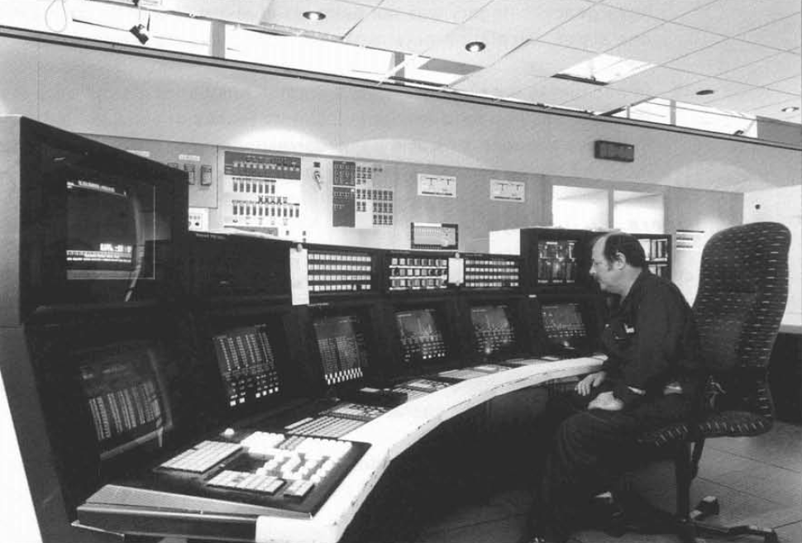
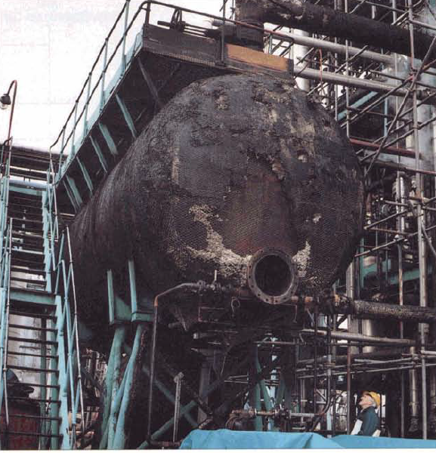
Case Studies – in depth
Air France 447 Crash
Texaco Milford Haven
Fire and Explosion
Hickson and Welch
Fire
Notes:
Chapter 7 presents three detailed Case Studies that discuss how inadequate management of abnormal situations contributed to significant incidents.
The Air France 447 crash (pitot tubes froze, a problem that they were aware of, were planning to change, but hadn’t quite got around to it). Pilots were disorientated and couldn’t work out speed or whether they were going up or down and ended up in a high altitude stall and crashed. CRM and human factors were key to this and many lessons from the aviation industry are directly transferrable to the process industries. Don’t get me started on the 737 MAX!
The Texaco Milford Haven incident is analyzed through the lens of abnormal situation management. The analysis shows there was a lack of recognition that an abnormal situation was developing and so actions to prevent the incident from proceeding were delayed. The contribution of human factors and crew resource management to the development of the abnormal situation are detailed, with recommendations on how to improve in these areas to prevent similar incidents from occurring.
And finally the Hickson and Welch Fire; some of the events that led to this took place many years prior to the actual maintenance event when the incident occurred, one of the causes was associated with process modifications that were made – it wasn’t recognized that these changes led to an accumulation of unstable material that was then raked out by operators in a job that was poorly planned, leading to a horizontal jet flame that took out the control room and ignited the office block, leading to 5 fatalities. There were many other issues including organizational changes and seven Lessons Learned related to the management of abnormal situations are discussed.
Now we are short of time so I will quickly demonstrate one of the five on-line training modules that were included with the book. This shows just one way an abnormal situation management training session could be put together using basic tools.

Slide 25
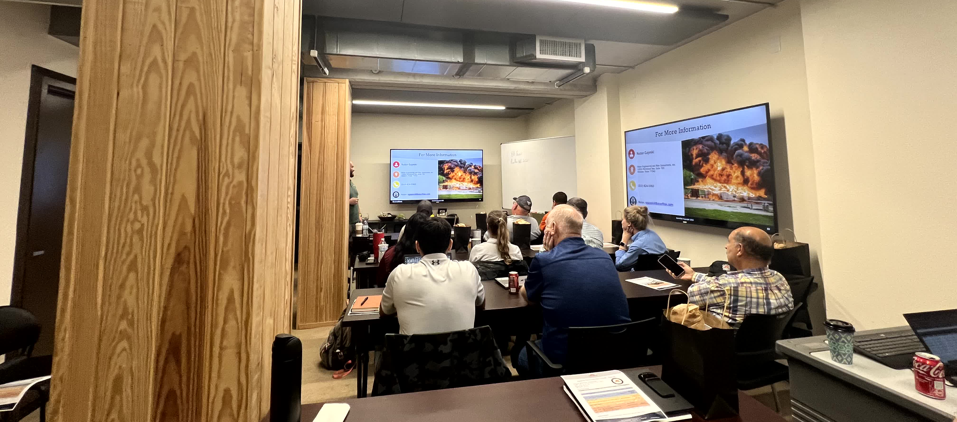
Training Scenario

Slide 26
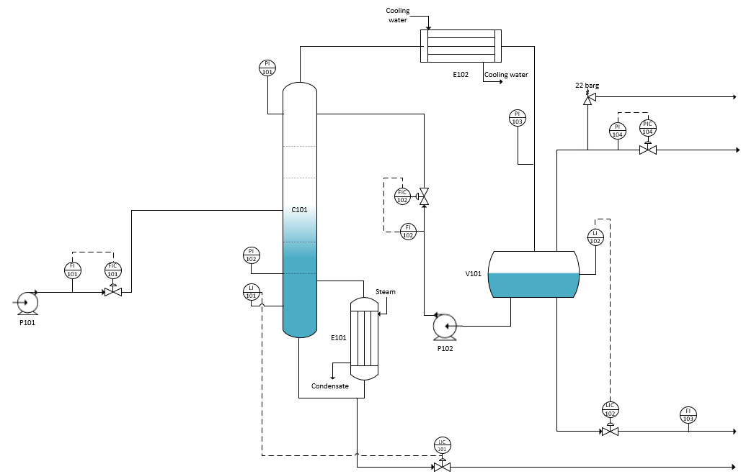
Training Scenario
Process Details – Distillation System
Liquid feed from Pump P101 to distillation column C101 via flow control FIC 101
Reboiler E101 fed with steam
Condenser E102 fed with cooling water
Column sump level control via LIC 101
Reflux drum V101
Reflux pump P102 via FIC 102
Pressure control via PIC 104
Relief valve set at 22 barg
Level of V101 controlled via LIC 102

Slide 27
Scenario
Slowly click through to see trend at bottom
Column level LI101 is somewhat unsteady
Then LI101 rises and becomes constant
Column base pressure PI102 begins to rise
Level LI102 (Reflux drum) begins to rise
Column level LI101 starts to drop
Continued rise in PI102, LI102 and fall in LI101
DISCUSS
Hi

Slide 28
NOTES
Column base pressure increases after slight rise in level
Then level remains constant while pressure still rises
Why is the pressure rising, while level remains constant?
The level reading starts to fall
What else might be going on?
ABNORMAL SITUATION ISSUES
The rise in PI102 may indicate that the column is starting to flood
The column level is “flatlining” on LI101.
LI101 may be at top of range
LI101 appears to be dropping, but is it?
Why is LI102 (reflux drum) going up?

Slide 29
Abnormal Situation Explanation
Notes for Trainer – Discussion with the People Being Trained
The LI101 increase and then “flatlining” might suggest a fault or it might indicate that it has reached full scale.
Discuss what may have caused this – instrument fault / actual rise?
This could be checked by looking at the configuration data, perhaps with an instrument technician.
Column base pressure PI101 rising? No other PI increase, so does this suggest there might be a high differential pressure in the column?
What are the possible causes? Column may be flooding due to high base level LI101 coming above bottom tray.
If the level LI101 is above the full range of the instrument, it would not show a further increasing level.
What could be the cause of the apparent decrease in the column level?
Was this a real level reduction or not?

Slide 30
Abnormal Situation Explanation
Notes for Trainer – Explanation
The column level control valve LIC101 has stuck partially or fully closed causing the column level to rise.
The column starts to flood due to high base level LI101, causing a rise in the base pressure.
The LI101 “flatlining” suggests it has reached its full scale. The instrument calibration data would confirm this.
The actual level continues to rise but this is not shown by LI101 as it is above range.
The rise in the reflux drum on LI102 shows a mass balance problem – accumulation of liquid, carryover of liquid into reflux drum from the column. Eventually the control valve LIC102 opens fully but cannot empty fast enough.
The apparent decrease in the column level is due to a similar situation to BP Texas City. A level device (using differential pressure) was used and the level is above the maximum instrument range. If the base temperature was going up (check the temperature readings) the fluid density would fall, causing the indicated level to drop erroneously. This leads to further confusion.
Other instruments (e.g., temperature measurements) may help diagnose the problem.

Slide 31
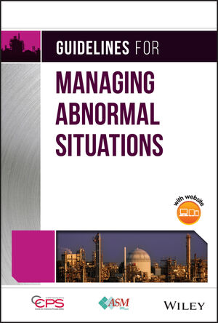

Summary
Guidelines for Managing Abnormal Situations
Collaborative Effort Between CCPS, BakerRisk, and the ASM Consortium
Demonstrates How ASM Connects to PSM and RBPS
Emphasises Case Studies to Learn from Past Incidents
Offers Exclusive and Challenging On-Line Training Modules
CONSORTIUM
Notes:
CCPS, Baker Risk and the Abnormal Situation Management Consortium worked together to develop a new book on managing abnormal situations. The book is now available from Wiley in book form and in an electronic version.
The book provides guidelines and practical advice for companies looking to improve how they respond to abnormal situations. The book explains how ASM fits within the overall process safety management program at a facility or company. The links between abnormal situation management and risk-based process safety are detailed. Training techniques that prepare operators and plant engineers to recognize and respond to abnormal situations are presented. Thirty five short case studies are embedded throughout the book to illustrate how abnormal situation management factored into past incidents, and these case studies can serve as the basis for toolbox talks or other training activities. One of the five online training modules was demonstrated.
In closing, Guidelines for Managing Situations covers new ground and is an exciting addition to the CCPS list of book offerings.

Slide 32
Thank You for Listening
Questions?
Hazards 33 | CCPS Guidelines for Managing Abnormal Situations
32

Slide 33
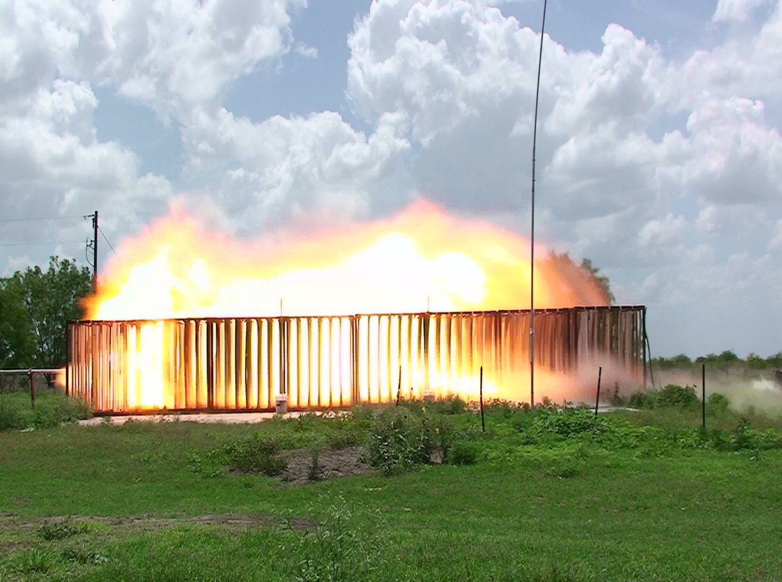
Contact Us
Roger Stokes BSc CEng FIChemE MEI
BakerRisk Europe Ltd.
Regus House, Heronsway
Chester, CH4 9QR
United Kingdom
+44 1244 792040 (UK office)
+44 7725 828928 (Mobile)
RStokes@Bakerrisk.com
Understanding Hazards and Risks

