Slide 1
Pre Start-up Safety Review (PSSR) -
Pitfalls and Insights
Hazards 33, Institute of Chemical Engineers (IChemE)
Birmingham, UK 7th – 9th November 2023

Slide 2
Speaker’s Profile
Mohammad Moonis
Senior Loss Prevention Engineer, Saudi Aramco
MSc Process and Environmental Systems Engineering, University of Surrey
AMIChemE, AMEI, FS Eng (TUV Rheinland)
Mohammad Mulhim
Supervisor Plant and Support Unit, Ras Tanura Area Loss Prevention Department, Saudi Aramco
MSc. Process Safety, University of Sheffield

Slide 3

Who we are
www.aramco.com
We are one of the world's largest integrated energy and chemicals companies, creating value across the hydrocarbon chain, and delivering societal and economic benefits to people and communities around the globe who rely on the vital energy we supply.
  We are committed to playing a leading role in the energy transition.
  For our customers, we are a supplier of choice.
  For our shareholders, we provide long-term value creation.
  For communities around the world, our ambition is to provide reliable, affordable, and more sustainable energy.

Slide 4

Objectives
Available
Guidance
Confusions
& Pitfalls
Aramco
Way
Awareness
Using Examples from Hydrocarbon Industry
For asset owners, PSSR facilitators and the technical safety community.
Insights presented can be applied to a broad spectrum of industries
Notes:
This paper aims to create awareness about the principle and importance of PSSR, citing examples of past incidents in the industry. Another primary objective of this article is to cover common areas of confusion, queries and pitfalls regarding the scope, application and use of PSSR for the general benefit of asset owners and operators, PSSR facilitators and the loss prevention/technical safety community. Insights presented can be applied to a broad spectrum of industries

Slide 5
What is Pre Start-up Safety Review (PSSR)
Final review before bringing a new or modified process or equipment online; or restarting an existing one after a major turnaround or mothballing.
In a project or Management of Change (MOC) lifecycle, PSSR shall be held after the mechanical completion and before commissioning.

Slide 6
Why Is PSSR Important
Start-up is a very critical activity
  UK offshore hydrocarbon release Data are collected by the U.K. HSE
  For the period October 1, 1992, to December 31, 2015, there were 4,656 reported releases in the UK offshore.
  773 (16.6%)
  had 'reinstatement' or 'startup' as the primary or secondary operational mode at the time of the release (Hynds, 2020)
Some Significant incidents in the hydrocarbon Industry were attributed to deficiencies in the start up process
Notes:
Before we go further let us discuss some background [CLICK] about the importance and significance of PSSR [CLICK]. Many process safety incidents have occurred during start-up, so robust and timely PSSR is vital in ensuring plant safety [CLICK]. Some examples of significant process safety incidents, which may be attributed in part or whole to lack of or deficiency in careful startup or restart, are provided.

Slide 7
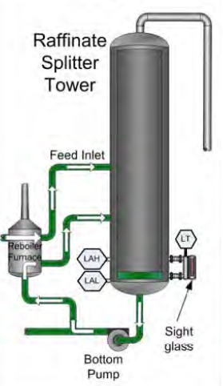
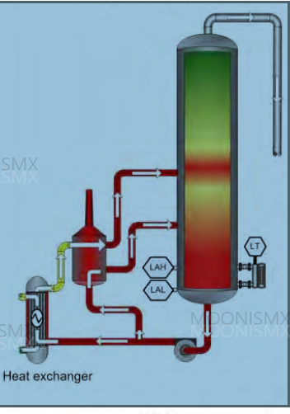
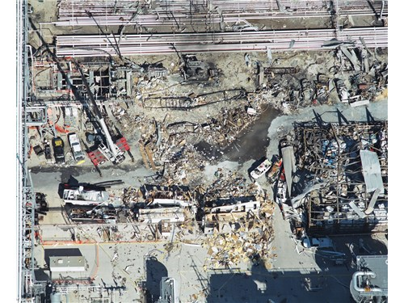
2005, Texas City Refinery Explosion (CSB, 2007)
15 fatalities and 180 injuries
A section of the refinery’s isomerization unit (ISOM) was being restarted after a maintenance turnaround that lasted one month.
The incident happened on the day of the startup of the raffinate splitter section.
The tower got overfilled with hot liquid during this startup.
Notes:
For example let us look at the 2005 Texas City Refinery explosion [CLICK] which led to 15 fatalities and 180 injuries [click]. One of the key factors identified in the incident investigation was that the PSSR was not carried out [click]. On 23 March 2005, an explosion and fires occurred at a refinery in Texas City, Texas. The incident occurred while a section of the refinery’s isomerization unit (ISOM) was being restarted after a maintenance turnaround that lasted one month. The incident happened on the day of the startup of the raffinate splitter section. The tower was overfilled with liquid during this startup which eventually overflowed through the blowdown drum stack, following a series of failures . Flammable liquid was released, vaporized, and ignited, resulting in an explosion and fire

Slide 8
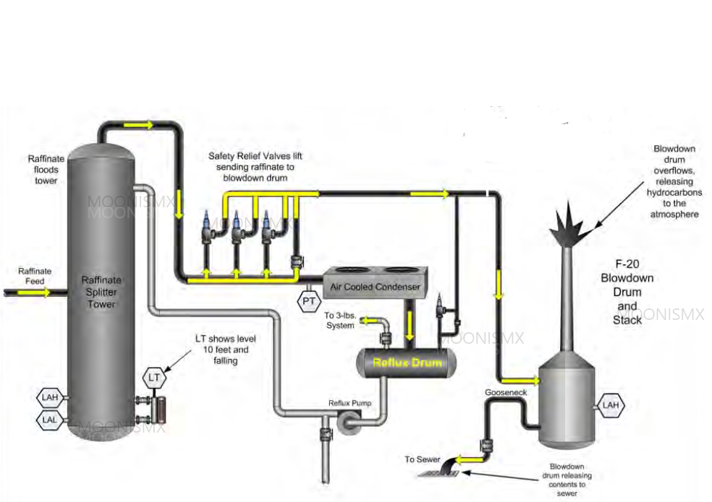
2005, Texas City Refinery Explosion (CSB, 2007)
15 fatalities and 180 injuries
PSSR after Turnaround was missing
  The system eventually overflowed through the blowdown drum stack, following a series of failures
  Flammable liquid was released, vaporized, and ignited, resulting in an explosion and fire
Notes:
For example let us look at the 2005 Texas City Refinery explosion [CLICK] which led to 15 fatalities and 180 injuries [click]. One of the key factors identified in the incident investigation was that the PSSR was not carried out [click]. On 23 March 2005, an explosion and fires occurred at a refinery in Texas City, Texas. The incident occurred while a section of the refinery’s isomerization unit (ISOM) was being restarted after a maintenance turnaround that lasted one month. The incident happened on the day of the startup of the raffinate splitter section. The tower was overfilled with liquid during this startup which eventually overflowed through the blowdown drum stack, following a series of failures . Flammable liquid was released, vaporized, and ignited, resulting in an explosion and fire.

Slide 9
2005, Texas City Refinery Explosion (CSB, 2007)
A rigorous PSSR procedure was in place at the time of the incident. But, the process safety coordinator was unaware of it.
The other key findings were:
Equipment malfunction
Deferring replacement of malfunctioning instruments and equipment without considering any additional controls
Lack of supervisory oversight and trained personnel
Inadequate shift turnover communication
Inadequate training program
Outdated and ineffective procedures
Failure to learn from similar incidents in the facility
Essential Requirements of Any PSSR
An adequate and timely PSSR may have prevented the incident or reduced the severity of the consequences.
Notes:
the operating company had a rigorous PSSR procedure in place at the time of the incident, it was not carried out. The company's PSSR procedure required all startups after turnarounds to go through a PSSR, and in fact, it was applied to unit startups after turnarounds for two years before this incident. However, it was not implemented in this case because the incumbent process safety coordinator was unaware of it. [CLICK] Other Key findings were
Equipment malfunction
Deferring replacement of malfunctioning instruments and equipment without considering any additional controls
Lack of supervisory oversight and trained personnel
Inadequate shift turnover communication
Inadequate training program
Outdated and ineffective procedures
Failure to learn from similar incidents in the facility [CLICK]
All of these factors are essential PSSR requirements. An adequate and timely PSSR may have prevented the incident or reduced the severity of the consequences.

Slide 10
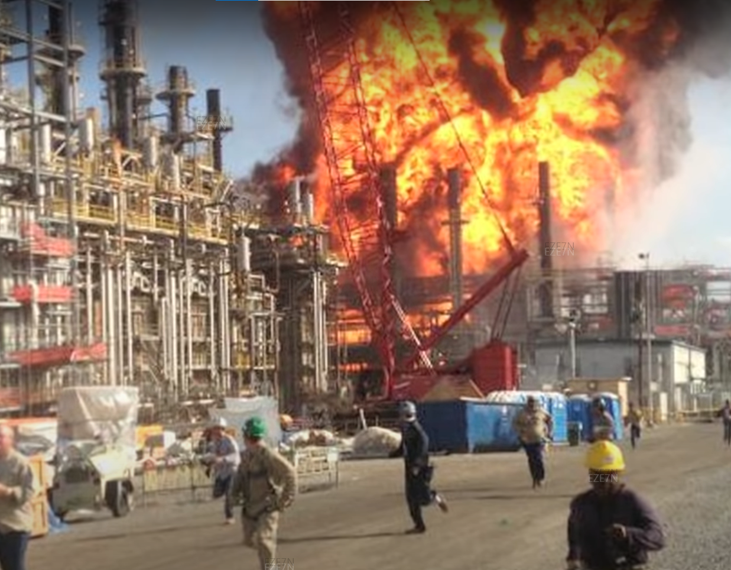
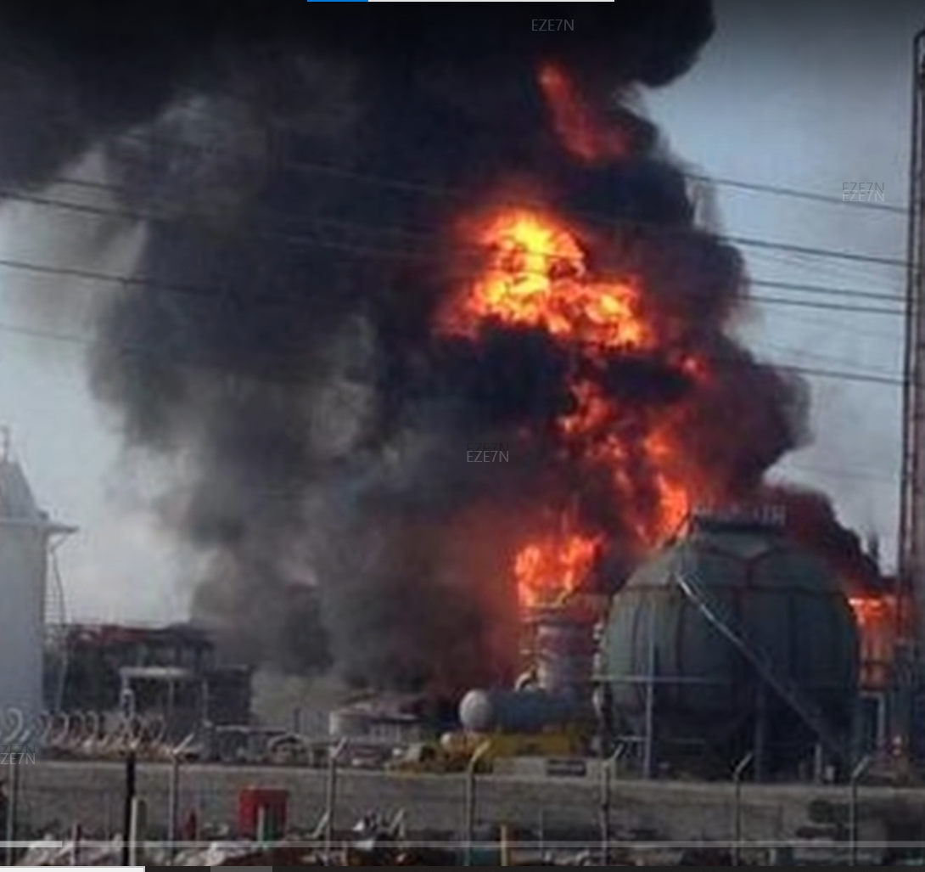
Olefins Plant, Louisiana, Reboiler Rupture and Fire (CSB, 2016)
2 fatalities, 167 injuries - Inadequate PSSR
The plant configuration had two reboilers supplying heat to the fractionation - operating continuously
Continuous Operation implied downtime when maintenance was required.
Design change to allow a duty-stand-by arrangement by installing isolation valves on reboilers
If the new valves were not in the proper position (open or closed) for each operation phase, the reboiler could be isolated from its protective pressure relief valve on top of the propylene fractionator.
At the time of the incident, the stand-by reboiler had been off-duty for about 16 months.

Slide 11
Olefins Plant, Louisiana, Reboiler Rupture and Fire (CSB, 2016)
2 fatalities, 167 injuries - Inadequate PSSR
Propane had accumulated on the shell side of the stand-by reboiler during this time via a mistakenly opened valve, leaking block valve(s), or another unknown mechanism.
Starting the reboiler introduced heat --> Thermal Expansion of propane --> high pressure --> cracked the reboiler shell, leading to: -------------->
Pressurised propane release falling to atmospheric pressure and causing a Boiling Liquid Expanding Vapor Explosion (BLEVE)

Slide 12
Olefins Plant, Louisiana, Reboiler Rupture and Fire (CSB, 2016)
Causes
MOC
Conducted post modification
Inadequate identification of hazards
PHA
Recommendations closed without proper verification
PSSR
Inadequately filled in checklists
PSSR was conducted once post the modification, but in this case the duration of stand-by was 16 months
Field position of valves
Closure of PHA recommendations

Slide 13
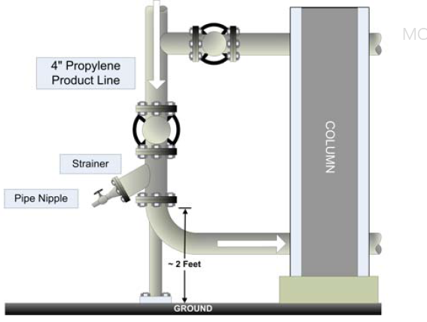
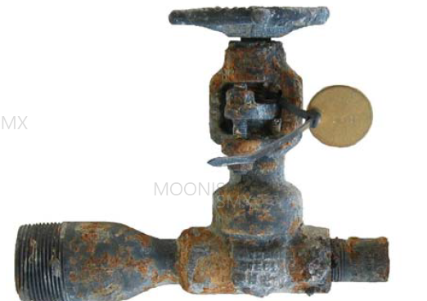
2005, Fire & explosion at olefins production unit, Point Comfort, Texas, (CSB, 2006)
16 injuries
A small drain valve was pulled out of a strainer in a liquid propylene system, snagged by a trailer pulled by a forklift
The escaping propylene rapidly vaporized, ----- large vapor cloud ---- ignition within two minutes
2 burn Injuries, 14 minor injuries
Site wide evacuation
One of the units shut down for 5 months

Slide 14
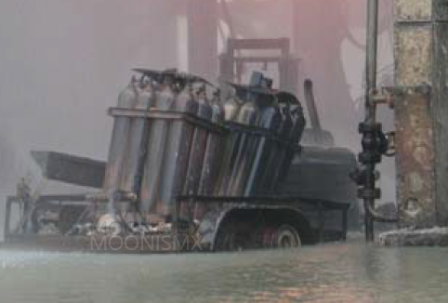
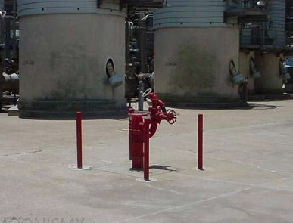
2005, Fire & explosion at olefins production unit, Point Comfort, Texas, (CSB, 2006)
16 injuries
General Layout and traffic protection were missed during PSSR field visit
Facility siting analysis
Considered the vehicular impact on process piping as a very low-frequency event.
    Administrative safeguards were deemed adequate
    Passive engineering controls were not considered
PSSR
Only considered protection of emergency equipment.
The PSSR team verified traffic protection around emergency equipment, BUT
Did not check for any potentially vulnerable locations around specific process piping or equipment.
Notes:
The facility siting analysis did consider the vehicular impact on process piping as a severe consequence event but judged it as a very low-frequency event. Consequently, administrative safeguards were considered adequate without recommending any passive engineering controls. The PSSR carried out before operating the olefins unit, only considered protection of emergency equipment. Consequently, during their field visit, the PSSR team verified traffic protection around emergency equipment but did not check for any potentially vulnerable locations around specific process piping or equipment.
The striking contrast between the physical protection for firefighting equipment and the administrative provisions for process piping and other equipment can be seen in Figure

Slide 15
Regulation, Guidance and Best Practices Regarding PSSR

Slide 16
Regulation, Guidance and Best Practices Regarding PSSR
Ref: (Hynds, 2020)
1. OSHA: Mandated the PSSR via its OSHA 29 CFR (Code of Federal Regulations) 1910.119(I)
2. Insurers: Guidance documents, e.g., the position paper by Marsh Risk Engineering (Marsh, 2016)
3. CCPS: Guidelines for PSSR (CCPS, 2011) provide comprehensive guidance on PSSR methodology
4. UK HSE: Publication HSG253 (HSE 2006) on safe isolation of plant and equipment, also touches upon
reinstatement
5. Energy Institute: Guidance for the PSM framework (Energy Institute, 2016) Element 13
Notes:
Lets look at some available guidance related to PSSR or plant re-instatement. Then [CLICK] until the bullet point #5. [THEN] – As we can see that the number of published guidance is limited, let’s discuss this aspect in a little more detailin the next slide. [CLICK]
The Energy Institute (EI) guidance for the PSM framework (Energy Institute, 2016) also describes controls associated with operational readiness and process startup, within Element 13

Slide 17
Regulation, Guidance and Best Practices Regarding PSSR
Ref: (Hynds, 2020)
However, the information is still limited.
For example:
CCPS guidelines provide comprehensive guidance on PSSR methodology. But does not cover best practices regarding what to check when reversing the isolations, performing line walk, etc., in the same detail.
The HSE publication HSG253 (HSE 2006) also covers safe isolation mainly, but reinstatement steps are discussed at a more generic level.
The lack of published guidance has contributed to different reinstatement practices, approaches or nomenclatures.
A joint industry exercise to develop a consistent methodology will be a welcome step for operators, auditors, insurers, and other industries.
Notes:
[CLICK] The Center for Chemical Process Safety (CCPS) guidelines for PSSR (CCPS, 2011) provide comprehensive guidance on PSSR methodology, which can be applied to any startup-related exercise but does not cover best practices regarding what to check when reversing the isolations, performing line walk, etc., in the same detail. [CLICK]
The HSE publication HSG253 (HSE 2006) also covers safe isolation mainly, and reinstatement steps are discussed at a more generic level.
[CLICK]
The lack of published guidance has contributed to different reinstatement practices, approaches or nomenclatures to startup reviews in different geographical regions within the industry. Many of these practices may be effective and practical, but a joint industry exercise to develop a consistent methodology will be a welcome step for operators, auditors, insurers, and other industries.

Slide 18
The Aramco Way
PSSR in Aramco SMS

Slide 19
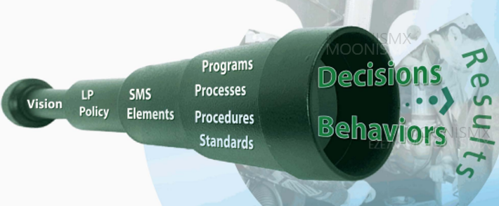
PSSR in ARAMCO SMS
11 Elements
Standards, rules, procedures and subject matter guides
Notes:
ARAMCO SMS has 11 elements, each element has detailed standards, rules (General Instructions), procedures and Subject Matter Guides (SMG) to provide details regarding implementation of the requirements

Slide 20

11 Elements of ARAMCO SMS
Leadership and Accountability
Risk Assessment and Management
Communications
Competency and Training
Asset Integrity
Safe Operations
Contractors, Suppliers and Others
Emergency Preparedness
Incident Reporting & Analysis
Off-the-Job Safety
Continuous Improvement
MOC
e-MOC
PSSR
Notes:
[CLICK] Element 5 of the Saudi Aramco SMS, "Asset Integrity" includes the requirements of a PSSR to manage the risk associated with the startup of new and existing facilities or equipment
A PSSR must be embedded within the change management process to ensure that it is not missed or overlooked.
[CLICK]
The Aramco MOC process, within Element 2, has provisions to highlight or consider requirements to conduct a PSSR within the MOC reviews or project lifecycle

Slide 21
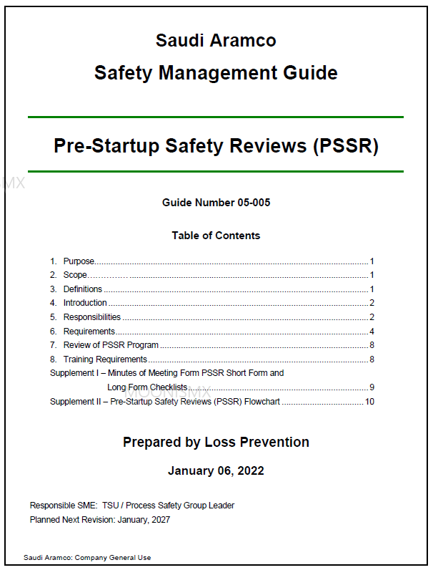
The Aramco PSSR Safety Management Guide
The SMG describes roles, responsibilities, competencies, methodology, and template checklists.
PSSR Triggers
Events or changes that trigger a PSSR in Aramco are classified under the following groups:
• Changes to an existing process or equipment. (Management of change)
• Construction of a new unit or plant or new processes
• Turnaround & Inspection activities where a process will be shutdown (Planned and emergency)
• De-mothballing

Slide 22
Pitfalls, Best Practices and Insights

Slide 23
Common Pitfalls, Best Practices and Insights
Perceiving PSSR as very time-consuming
The scale of PSSR checklists can be scary for the review attendees
Uncertainty and doubts about the value obtained and a half-hearted focus
For instance, there was a reported case where a rupture-disc was installed upside down because of misreading the drawings.
Leading to,
A 4 tonne tank lift-off to 30m away
((Hedlund, 2016; Middle, 2018))
Some Best Practices
Set of screening questions or risk-based criteria to select a shorter or longer form based on the risk or novelty of the change
CCPS guidance (CCPS 2011) provides examples of risk-based criteria.
Where the long form has to be used following the screening, a smaller number of subject-specific and segmented checklists shall be adopted
Notes:
One of the most common pitfall is uncertainty about value obtained by spending time in PSSR. The contractors and duty holders may claim all checks get covered anyway through other provisions.
CLICK
CLICK
CLICK
An example incident. Nobody checked the installation. Consequently, a 90 m3 tank weighing four tons lifted off like a rocket, rose to about 30 m and landed on a van. Fortunately, there were no injuries (Hedlund, 2016; Middle, 2018).
{click] – some best practices in this regard
Click
Click]
Segmented checklists help maintain focus, attention and ability to choose the applicable or relevant ones, makes good value of time.

Slide 24
Common Pitfalls, Best Practices and Insights
Perceiving PSSR as very time-consuming
Aramco Approach
Short-Form and Long-form Formats
Screening questions criteria
Potential effects of the involved material
Novelty of change.
Potential consequences upon failure.
Changes to control systems
New, or modifications to, fire protection systems.
LONG FORM
Very Wide Scope
Stand-alone detailed checklists, can be chosen as applicable
Notes:
Aramco has adopted SHORT-FORM AND LONG-FORM FORMATS [CLICK]
The screening questions, for selecting the short or long form, are based on the following critera.
health, reactivity and flammability effects ----Changes to control systems related to safety systems or processes.-------
Long form scope will range from modifications bigger than the scope of the short form to major projects, which may be well over hundreds of millions of dollars. Therefore, it provides detailed stand alone checklists which can be selected as relevant.
covers modifications bigger than the scope of the short form to major projects, which may be well in billions of dollars. And therefore, consists of detailed stand-alone checklists which cn be selected as applicable.

Slide 25
Common Pitfalls, Best Practices and Insights
Poor PSSR Planning
The Management of Change (MOC) and the PSSR process shall go hand in hand.
In one example, inspection revealed that the flare was insufficient to cope with the worst-case release scenario.
A high-integrity pressure protection system (HIPPS) was later designed for this case (Middle, 2018).
Some Best Practices
Identify PSSR requirements during the MOC reviews
Aramco Approach
MOC form requires identifying PSSR requirements
Drive to digitalization --- e-MOC
Minimises the likelihood of PSSR being missed.
Notes:
As part of extensive digitalization carried out in Aramco, the MOC process is now entirely electronic, further reducing any likelihood of a required PSSR not being carried out unless an adequate justification is provided.

Slide 26
Common Pitfalls, Best Practices and Insights
Understanding the Scope and Limitations of PSSR
    PSSR is not a
    Design review
    PHA
    PSSR is Verification of Design:
    Implementation of PHA or MOC recommendations,
    Competence and organisational management,
    Field verification of plant condition, and
    Review of construction punch lists.
Notes:
Re-evaluating design information during a PSSR review will waste time, possibly leading to frustrations and overlooking critical aspects

Slide 27
Common Pitfalls, Best Practices and Insights
Understanding the Scope and Limitations of PSSR
For example,
A PSSR review shall not
Whether the relief provided is adequate
Basis for the relief valve design.
A PSSR Review should (and must):
Are relief valves provided as per the design;
Are they of the correct specification,
Installed in the field, and
Color coded according to the plant's specifications.
Notes:
After the example,,

Slide 28

Common Pitfalls, Best Practices and Insights
Selection of Team and Review Chairman
As a minimum, the experienced representatives from operations, maintenance, construction, project management and MOC coordinator, Safety Representative
The relevant discipline engineers,, inspection engineers etc, can be optional/on-call.
Experienced Chairman — conflicting decisions, assertive
The push for conducting a PSSR shall come from the organization that will ultimately be running the plant.

Slide 29
Common Pitfalls, Best Practices and Insights
Missing out on the not-so-obvious
    More reliable pressure transmitter — changes in proof-test interval
    preventative maintenance schedules not updated
    A change in safe operating limits* or after installing a new pump in the field and update of the DCS panel
    Awareness/training not provided
    In one incident, equipment manufactured in EU and shipped to the USA had a 50 Hz motor setting
    when used in the USA plant (60Hz), the motor ran slower, leading to high temp and shutdown.
    Operational steps taken while cooling the process led to a propagating fireball explosion
    (Wincek 2018).
    *Generally, PSSR not required if update of safe operating limit is the only change
Notes:
Let’s see some examples, if they sound familiar
[CLICK]
Keep clicking until the end.. All the text is on the slide

Slide 30
Common Pitfalls, Best Practices and Insights
Missing out on the not-so-obvious
    Aramco PSSR Guidelines
    - Checklists
    - Multi-disciplinary field walkthrough
    This ensures, for example:
    - That the systems are laid out as per the process
    - Car-seals are applied,
    - Training records available
    - Control room changes are implemented
    - Safety warnings and CHB/MSDS are attached
Notes:
Let’s see some examples, if they sound familiar
[CLICK]
Keep clicking until the end.. All the text is on the slide

Slide 31

Common Pitfalls, Best Practices and Insights
Extensive Punch List Items
Request to start-up sooner by deferring some activities as construction punch-list items
Carries the risk of some critical steps being deferred.
Some Best Practices
Project leaders or change coordinators shall encourage the construction teams to categorise punch list items according to their criticality
Aramco Approach
Careful review of punch lists submitted by the contractors.
Categorising punch list items

Slide 32
Common Pitfalls, Best Practices and Insights
Effective close-out
Aramco Approach
Pre-Startup Actions: Actions critical to safe start-up
        Must be completed before the start-up.
        Action plan.
Post-Startup Actions: will lead to enhanced safety or ease of operation
        Closed out after the startup.
        Action plan.
Actions
Pre Start-up
Post Start-up
Formal close-out
Authorisation for start-up
Notes:
To further make the PSSR process pragmatic and easier to manage, Aramco has adopted the approach of categorizing the PSSR recommendations into pre and post startup actions.

Slide 33
Common Pitfalls, Best Practices and Insights
Last but not the Least
Retaining and maintaining records
Minutes of meetings;
PSSR forms; and
Associated documentation
Operators’ internal self-assessments
Establishing and monitoring of KPIs
External audits
Aramco PSSR
Plan
Do
Check
Act
Notes:
Last but not the least, Aramco PSSR process is continually monitored and improved. Processes which are in place to ensure continuous improvement include e.g. those for record-keeping, Internal assessments, KPIs and External audits.

Slide 34
CONCLUSION
The importance of Pre-Startup Safety Review cannot be emphasised more as it is the final validation check before energising a system.
There is a strong link between MOC and PSSR processes — PSSRs play a crucial role in verifying the effectiveness of design and construction implementation.
The time spent on a PSSR review does add value.

Slide 35
References
CSB, 2006, Fire at Formosa Plastics Corporation: Evaluating Process Hazards, Report No. 2006-01-I-TX, USA Chemical Safety and Hazard Investigation Board (CSB).
CSB, 2007, Refinery explosion and fire investigation report, Report No. 2005-04-I-TX, USA Chemical Safety and Hazard Investigation Board (CSB).
CSB, 2011, Pesticide chemical runaway reaction pressure vessel explosion investigation report, Report No. 2008-08-I-WV, USA Chemical Safety and Hazard Investigation Board (CSB)
CSB, 2016 Oct, Williams Geismar Olefins Plant Reboiler Rupture and Fire, Report No. 2013-03-I-LA, USA Chemical Safety and Hazard Investigation Board (CSB).
CCPS 2010 Guidelines for risk based process safety, Centre for chemical process safety, J Wiley and Sons, NJ.
CCPS 2011, Guidelines for performing effective pre-startup safety review, Centre for chemical process safety, J Wiley and Sons, NJ.
Energy Institute, 2016, guidelines on meeting expectations of EI Process safety management framework: Element 13 Operational readiness and process start-up, 1st Edition, energy Institute, London.
Hedlund, FH et al., Large steel tanks fails and rockets to a height of 30 metres – rupture disk installed incorrectly, Safety and health at work, 2016
Health & Safety Executive, 2006, The safe isolation of plant and equipment, HSG253, 2nd Edition, HSE books, London, accessible at https://www.hse.gov.uk/pubns/books/hsg253.htm
Hynds, Ashley and Templeton, Scott, 2020, Safe reinstatement of process plant, Learnings from HSE's regulation of the UK offshore oil and gas industry, Hazards 30 conference, paper-58, Institute of Chemical Engineer (IChemE) UK, 2020
Occupational Safety and Health Administration (OSHA), 1992 Standard 1910.119 – Process Safety Management of Highly Hazardous Chemicals.
Marsh, 2016, Pre-startup safety review, risk engineering position paper.
Middle, Keith, 2018, Common pitfalls in designing emergency pressure relief systems, Processing magazine, 25 July 2018.
Wincek, John C., Nov 2018, Perform a proper pre-start-up safety review – 5 steps, Chemical Processing.

Slide 36


